Slide 1
Evidence-Based Decision Making
In Healthcare
Rating Up the Quality of Evidence
Dr Jay K. Varma
https://drjayvarma.com
Dr. Jay K. Varma | https://drjayvarma.com
Notes:
1

Slide 2
GRADE
Summary of evidence and systematic approach to make recommendations
Reviews quality of evidence with the study design
5 reasons to rate down, 3 reasons to rate up
Dr. Jay K. Varma | https://drjayvarma.com

Slide 3
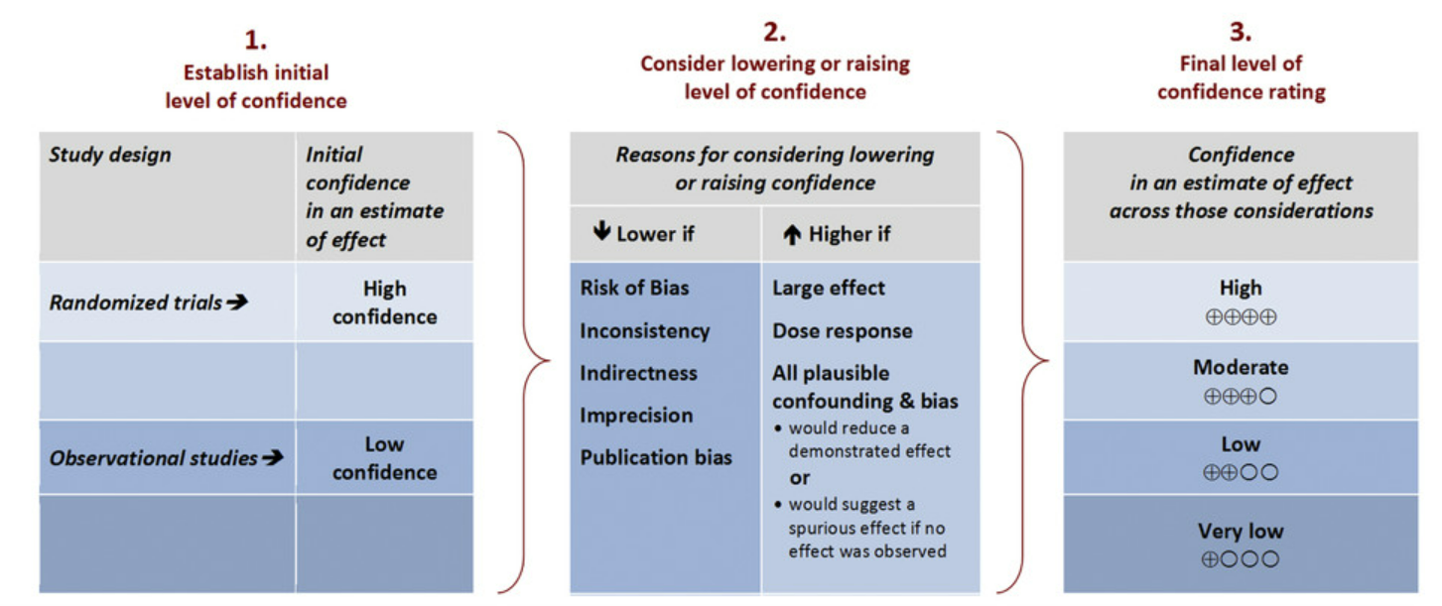
Rating Quality of Evidence
Source: Environment International 2016
Dr. Jay K. Varma | https://drjayvarma.com

Slide 4
Rating Quality of Evidence
Source: Environment International 2016
Dr. Jay K. Varma | https://drjayvarma.com

Slide 5
Grading Quality of Evidence
Grade | Definition
High | We are very confident that the true effect lies close to that of the estimate of the effect
Moderate | We are moderately confident in the effect estimate: the true effect is likely to be close to the estimate of the effect, but there is a possibility that it is substantially different
Low | Our confidence in the effect estimate is limited: the true effect may be substantially different from the estimate of the effect
Very Low | We have very little confidence in the effect estimate: the true effect is likely to be substantially different from the estimate of effect
Dr. Jay K. Varma | https://drjayvarma.com

Slide 6
LARGE EFFECT
Dr. Jay K. Varma | https://drjayvarma.com

Slide 7

What is an Effect Size?
Impact of an intervention
Standardized mean difference
Compare interventions of different size and setting
Not the same as statistical significance
Large effect sizes means the difference is important; small effect sizes mean the difference is unimportant
Dr. Jay K. Varma | https://drjayvarma.com

Slide 8
What is an Effect Size?
Size | Effect size | Example
Small | 0.2 (20%) | Height difference in 15 vs.16 yr old girls in USA
Moderate | 0.5 (50%) | Sleeping on back to reduce SIDS – reduced 50-70%
Large | 0.8 (80%) | Bicycle helmets to reduce injury – 85-88%
Dr. Jay K. Varma | https://drjayvarma.com

Slide 9
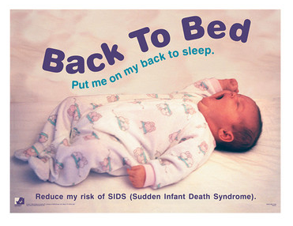
SIDS Example
“Back to sleep”
Sleeping on belly with odds ratio 4.1 (3.1,5.5)
Sleeping on back associated with 50-70% decrease in SIDS in numerous countries
Dr. Jay K. Varma | https://drjayvarma.com

Slide 10
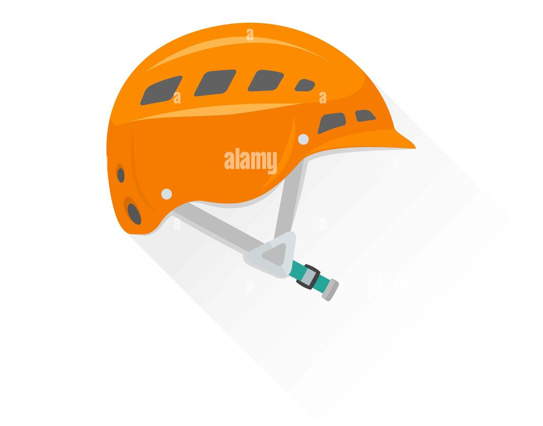
Bicycle Helmets
Systematic review: Fewer head, brain, face injuries
Five published studies, all cas—control, no RCTs
Results – 63-88% reduction in risk of head, brain, and severe brain injury for all ages of bicyclists.
What helped strengthen this review despite the nonexperimental study designs?
Dr. Jay K. Varma | https://drjayvarma.com

Slide 11
Bicycle Helmets
Case-controls studies with low risk of bias
Controls selected from same population as cases
Injuries verified by medical records
Ascertainment of exposure was equivalent for case and control groups
Consistent benefit for head injury in all studies
Large magnitude of effect, precise estimate in all studies: protective effect for head, brain, face 64-88%
Dr. Jay K. Varma | https://drjayvarma.com

Slide 12
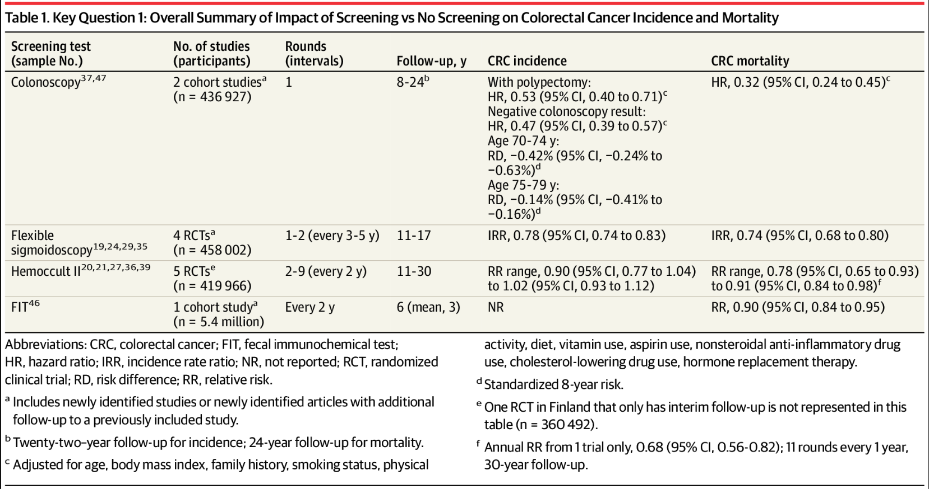
Inference of Strong Association
Reference: JAMA Network
Dr. Jay K. Varma | https://drjayvarma.com
Notes:
Reference: https://jamanetwork.com/journals/jama/fullarticle/2779987

Slide 13
DOSE-RESPONSE EFFECT
Dr. Jay K. Varma | https://drjayvarma.com

Slide 14
Dose-Response Gradient
An important criterion for believing a putative cause- effect relationship
Increases confidence in findings of observational studies
Dr. Jay K. Varma | https://drjayvarma.com

Slide 15
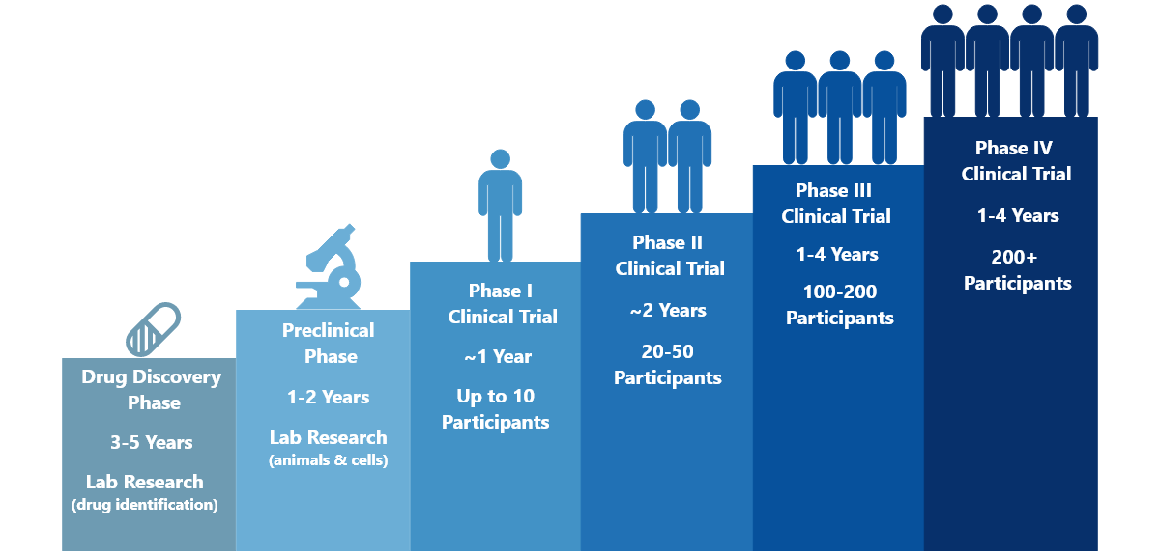
Dose-Response in Drug Development
FDA drug approval
Dr. Jay K. Varma | https://drjayvarma.com

Slide 16
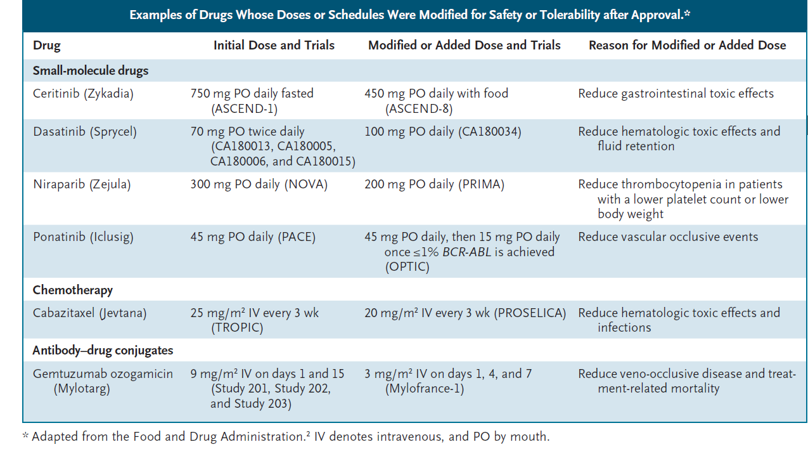
The Drug-Dosing Conundrum in Oncology — When Less Is More
N Engl J Med 2021; 385:1445-1447
Dr. Jay K. Varma | https://drjayvarma.com

Slide 17
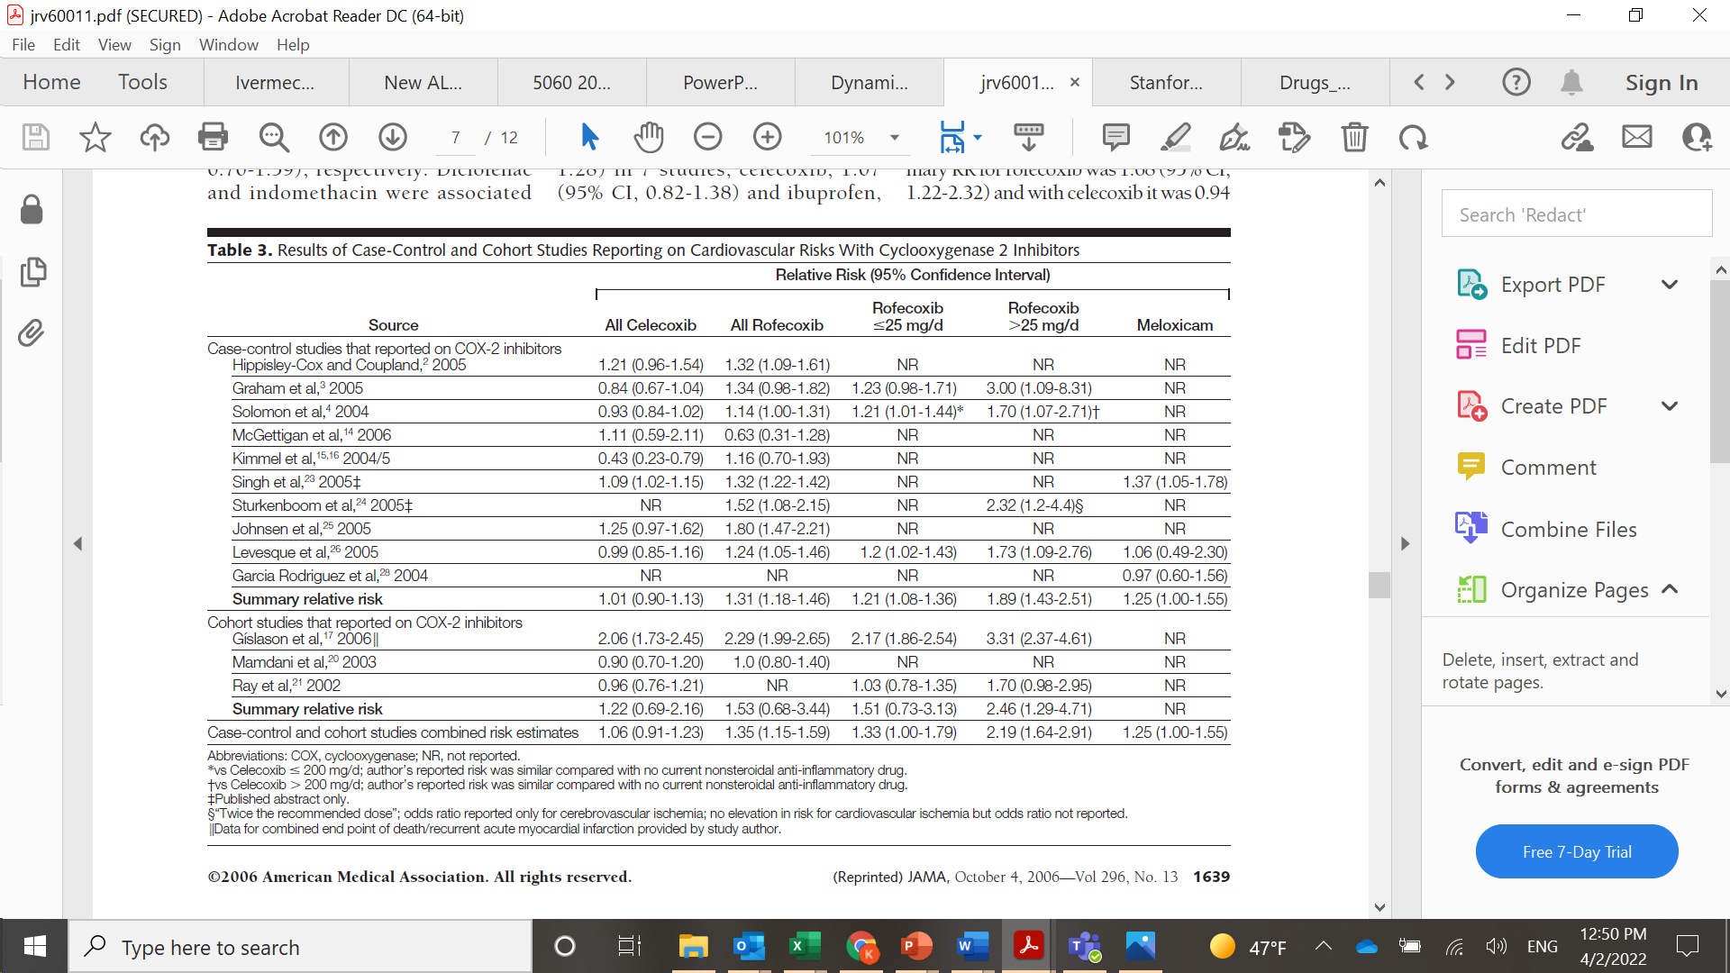
Dose-Response Gradient of Drugs
Dr. Jay K. Varma | https://drjayvarma.com

Slide 18
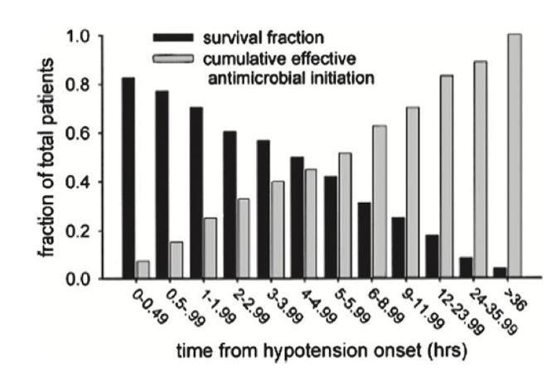
Dose-Response Gradient an Intervention
Observing effect of the intensity of an intervention
Sepsis survival and timeliness of antibiotic administration
Dr. Jay K. Varma | https://drjayvarma.com

Slide 19
Dose-Response in Psychotherapy
Study Data
Dose for clinical improvement: 13-18 sessions
Rate of improvement: 50%
Real-World Data
Median dose of sessions in practice: 3
Rate of improvement: 20%
Reference: https://onlinelibrary-wiley-com.ezproxy.med.cornell.edu/doi/pdf/10.1093/clipsy.9.3.329
Dr. Jay K. Varma | https://drjayvarma.com

Slide 20
PLAUSIBLE RESIDUAL CONFOUNDING
Dr. Jay K. Varma | https://drjayvarma.com

Slide 21
Effect of Plausible Residual Confounding
Distortion of effect of exposure on disease by 3rd factor
Can result in the overestimation or underestimation of the true effect of exposure on disease
Dr. Jay K. Varma | https://drjayvarma.com

Slide 22
Attributes of a Confounder
It is associated with the outcome of interest and;
Associated with exposure and unequally distributed between the exposed and unexposed cohorts
Not just a link in the causal chain between exposure and outcomes
Dr. Jay K. Varma | https://drjayvarma.com

Slide 23
Confounding
Hormone Replacement Therapy
CVD
Not a link in causal chain
+ Association
+ Association
unequally distributed
Smoking
Dr. Jay K. Varma | https://drjayvarma.com

Slide 24
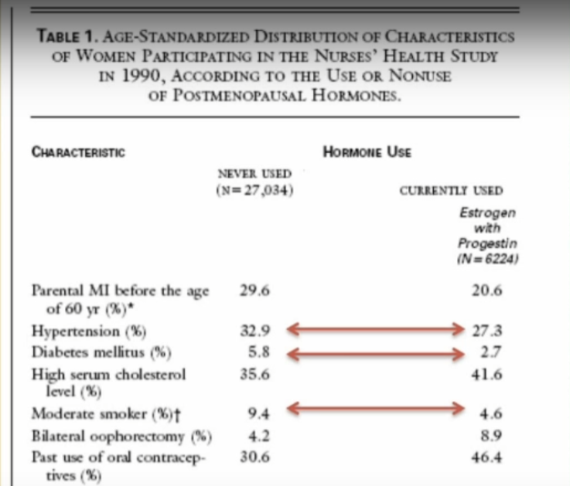
Are These Confounders?
Dr. Jay K. Varma | https://drjayvarma.com

Slide 25
Residual Confounding
Distortion that remains in exposure-outcome association due to incompletely controlling for confounding in the design or analysis of a study
Confounding factors not considered, no attempt to adjust, because data on these factors was not collected.
Control of confounding was not tight enough
Dr. Jay K. Varma | https://drjayvarma.com

Slide 26
Confounding Expected to Reduce Effect
Comparing mortality rates of private for-profit and private not-for-profit hospitals
Systematic review of observational studies including a total of 38M patients
Private for-profit hospitals were associated with an increased risk of death
Relative Risk [RR] 1.020 (1.003-1.038; p = 0.02)
Dr. Jay K. Varma | https://drjayvarma.com

Slide 27
Confounding to Reduce Effect
Are there any potential sources of bias in this study?
Towards which hospital type are the results likely biased?
Dr. Jay K. Varma | https://drjayvarma.com

Slide 28
Confounding Expected to Reduce Effect
Possible source of bias: Disease severity between patients in the two hospital types
Residual confounding: Biases results against non-for-profit hospitals (sicker patients)
As residual confounding reduced the demonstrated effect (higher risk of death at private for-profit hospitals) => UPGRADE
Dr. Jay K. Varma | https://drjayvarma.com

Slide 29
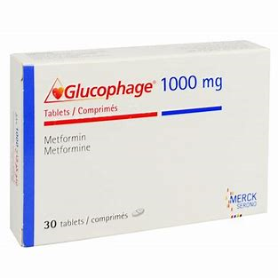
Confounding Expected to Increase Effect, but No Effect Observed
Example: Metformin under suspicion of causing lactic acidosis
Approved by FDA in 1995
First line therapy for newly diagnosed type 2 diabetes
Most commonly prescribed oral antihyperglycemic in the world
Dr. Jay K. Varma | https://drjayvarma.com

Slide 30
Metformin and Lactic Acidosis
Related drug phenformin caused lactic acidosis
Metformin-associated lactic acidosis n extremely rare condition
≤10 events per 100,000 patient-years of exposure
Mortality rates of 30 to 50%
Dr. Jay K. Varma | https://drjayvarma.com

Slide 31
Metformin and Lactic Acidosis
Large observational studies failed to demonstrate
Systematic review with 347 comparative trials and cohort studies found no cases of lactic acidosis, no difference in plasma lactate levels
Case–control study compared lactic acidosis between metformin and sulfonylurea users
In 50,048 patients, no significant difference
Dr. Jay K. Varma | https://drjayvarma.com

Slide 32
Metformin and Lactic Acidosis
Clinicians likely have been more alert to lactic acidosis with metformin due to phenformin
Clinicians likely over-reported occurrence of lactic acidosis with metformin
Upgrade the evidence for no association between metformin and lactic acidosis
Dr. Jay K. Varma | https://drjayvarma.com

Slide 33
Rating Quality of Evidence
Source: Environment International 2016
Dr. Jay K. Varma | https://drjayvarma.com

