Slide 1
Evidence-Based Decision Making
In Healthcare
Preparing an Evidence to Decision Recommendation
Dr Jay K. Varma
https://drjayvarma.com
Dr. Jay K. Varma | https://drjayvarma.com
Notes:
1

Slide 2
Review the Methodology of GRADE
Highly formal – to the point of sometimes being difficult to understand
Will also present slightly less formal approach
Dr. Jay K. Varma | https://drjayvarma.com

Slide 3
Globalize the Evidence and Localize the Recommendation
Summaries of evidence regarding management strategies should ideally very similar
Ratings of confidence in evidence may differ, e.g., [un]desirable outcomes valued differently
Final recommendation for your local entity will vary depending on factors other than scientific evidence
Dr. Jay K. Varma | https://drjayvarma.com

Slide 4
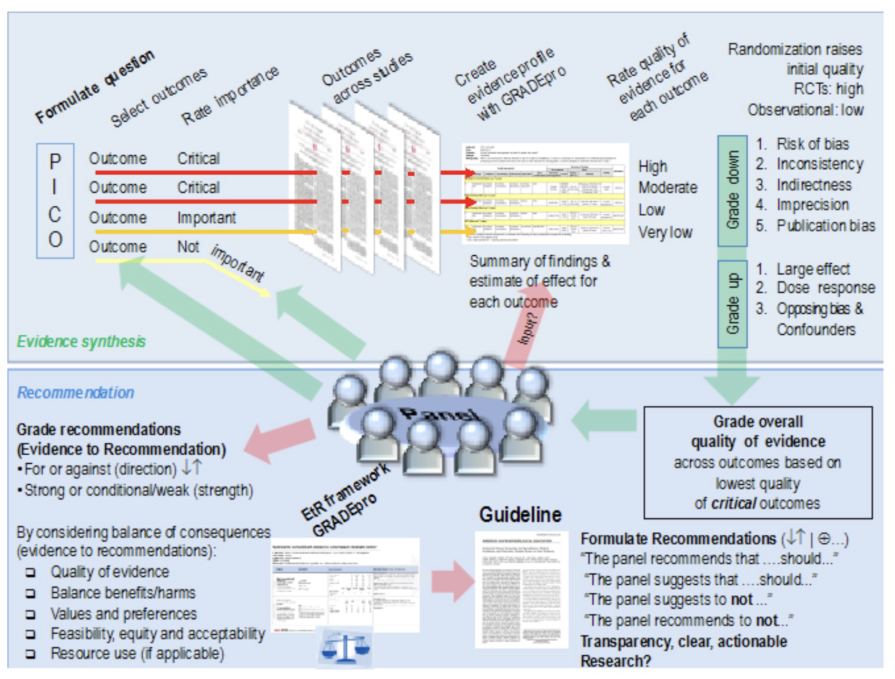
Dr. Jay K. Varma | https://drjayvarma.com

Slide 5
Overview of GRADE Approach
1. Frame a question
2. Choose critical and important outcomes
3. Rate the confidence in effect estimates for each outcome
4. Rate the confidence in effect estimates across all outcomes
Dr. Jay K. Varma | https://drjayvarma.com

Slide 6
Overview of GRADE Approach
5. Create an evidence profile and a summary of findings table
6. Describe other factors – affordability, acceptability, feasibility, ethics, and values
7. Categorize, label, and word health care recommendations based on evidence and other factors
Dr. Jay K. Varma | https://drjayvarma.com

Slide 7
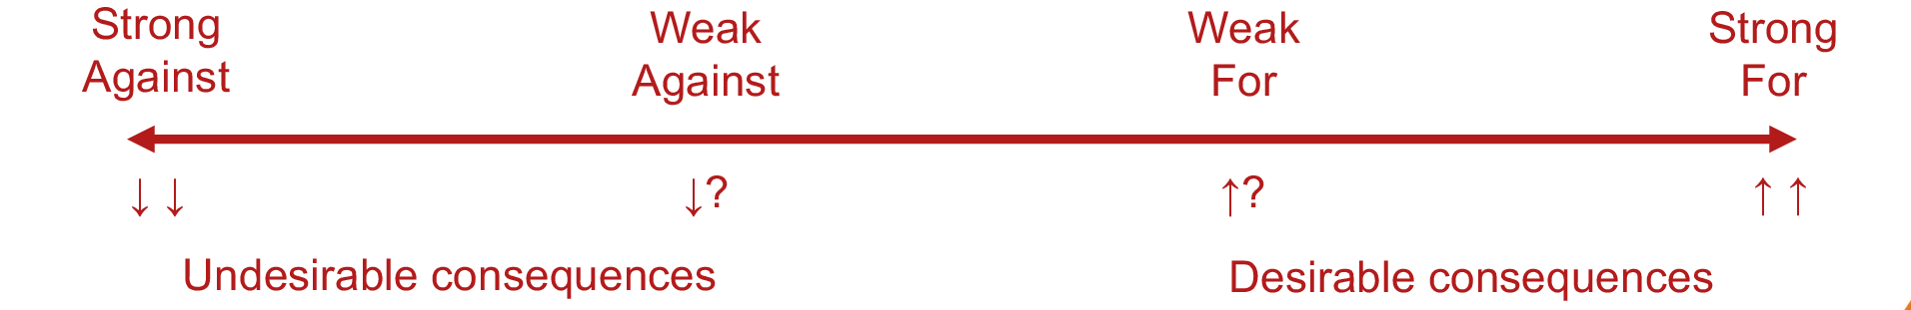
Strength of Recommendation
Confident that desirable consequences of an intervention outweigh its undesirable consequences (net worth)
For vs. against, strong vs. weak
Dr. Jay K. Varma | https://drjayvarma.com
Notes:
o Direction: For vs Against
o Strength: Strong vs Weak (Conditional)

Slide 8
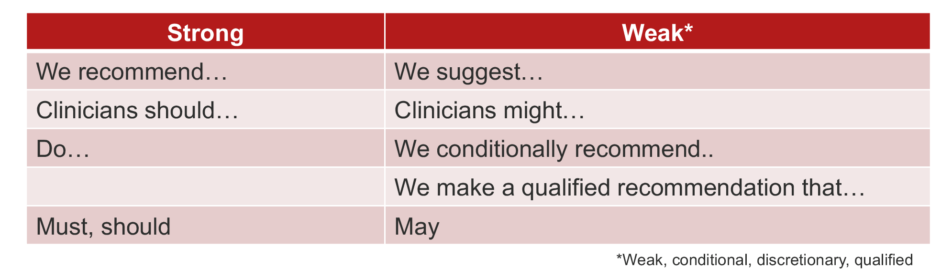
Strength of Recommendation
Dr. Jay K. Varma | https://drjayvarma.com

Slide 9
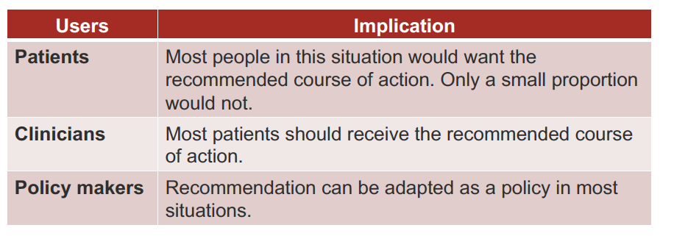
Implication of Strong Recommendation
Dr. Jay K. Varma | https://drjayvarma.com

Slide 10
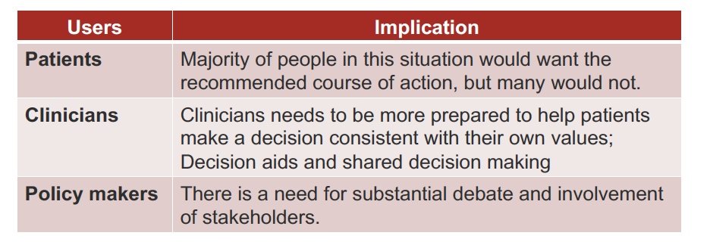
Implication of Weak Recommendation
Dr. Jay K. Varma | https://drjayvarma.com

Slide 11
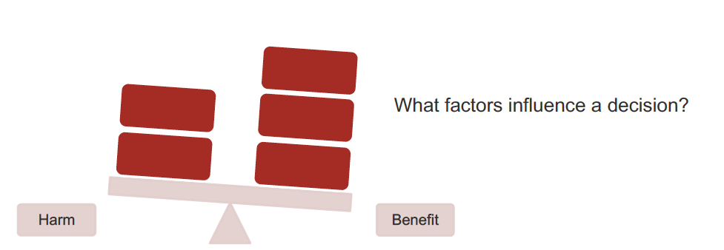
Evidence to Decision
Do health benefits outweigh harms?
Dr. Jay K. Varma | https://drjayvarma.com

Slide 12
Questions to Ask
Is the problem a priority?
Is there important uncertainty about how much people value the outcome?
What is the overall certainty of the evidence of effectiveness?
How substantial are the [un]desirable anticipated effects?
Dr. Jay K. Varma | https://drjayvarma.com

Slide 13
Questions to Ask
Do the desirable effects outweigh undesirable effects?
Is it acceptable to key stakeholders? (acceptability)
Is it feasible to implement? (feasibility)
How large are resource requirements? (affordability)
How large is incremental cost vs. net benefit? (affordability)
What would be the impact on health inequities?How does it align with our values? (ethics and justice)
Dr. Jay K. Varma | https://drjayvarma.com

Slide 14
Many Questions Have No Data
Individuals, organizations, and jurisdictions will disagree about these issues
In government, these become questions for democracy rather than science
Cost can be quantified, but affordability is subjective
Money spent on X cannot be spent on Y
Governor says it affordable, legislature disagrees, and population is divided
Dr. Jay K. Varma | https://drjayvarma.com

Slide 15
Values and Preferences
How we weigh the potential benefits, harms, costs, limitations, and inconvenience of the management options relative to one another
Each of us weighs these differently!
Best recommendations involve being fully transparent about what you value and prefer
Dr. Jay K. Varma | https://drjayvarma.com

Slide 16
Values and Preferences
State foundational assumptions about the values and preferences that underlie recommendations
e.g., freedom from vs. freedom to
Consider recommendations directed to patients who do not share the values and preferences underlying the recommendation
Disclose information on outcomes the panel judged critical, important, and not important
Dr. Jay K. Varma | https://drjayvarma.com

Slide 17
Why Transparency So Important
Allows those impacted to understand the rationale
Makes recommendations credible and acceptable
Manage conflict of interest
Acknowledge that recommendations may be different in other settings
We all agree on the evidence (facts), but we disagree on the policy implications.
Dr. Jay K. Varma | https://drjayvarma.com

Slide 18
Dr. Jay K. Varma | https://drjayvarma.com

