Slide 1
Evidence-Based Decision Making
In Healthcare
Post-Marketing Surveillance
Dr Jay K. Varma
https://drjayvarma.com
Dr. Jay K. Varma | https://drjayvarma.com
Notes:
1

Slide 2
Phase 4 Trials
After drug approved, sold on market
Long-term safety
Adverse events
Drug-drug interactions
Long-term efficacy
Findings can lead to FDA taking action
Dr. Jay K. Varma | https://drjayvarma.com

Slide 3
MedWatch
Not a “trial,” but a system to collect data
Covers
Prescription, over-the-counter, biologic medicines
Medical devices
Special nutritional products, supplements & infant
Cosmetics such as moisturizers, makeup, shampoos
Food, such as beverages and food additives
Dr. Jay K. Varma | https://drjayvarma.com

Slide 4
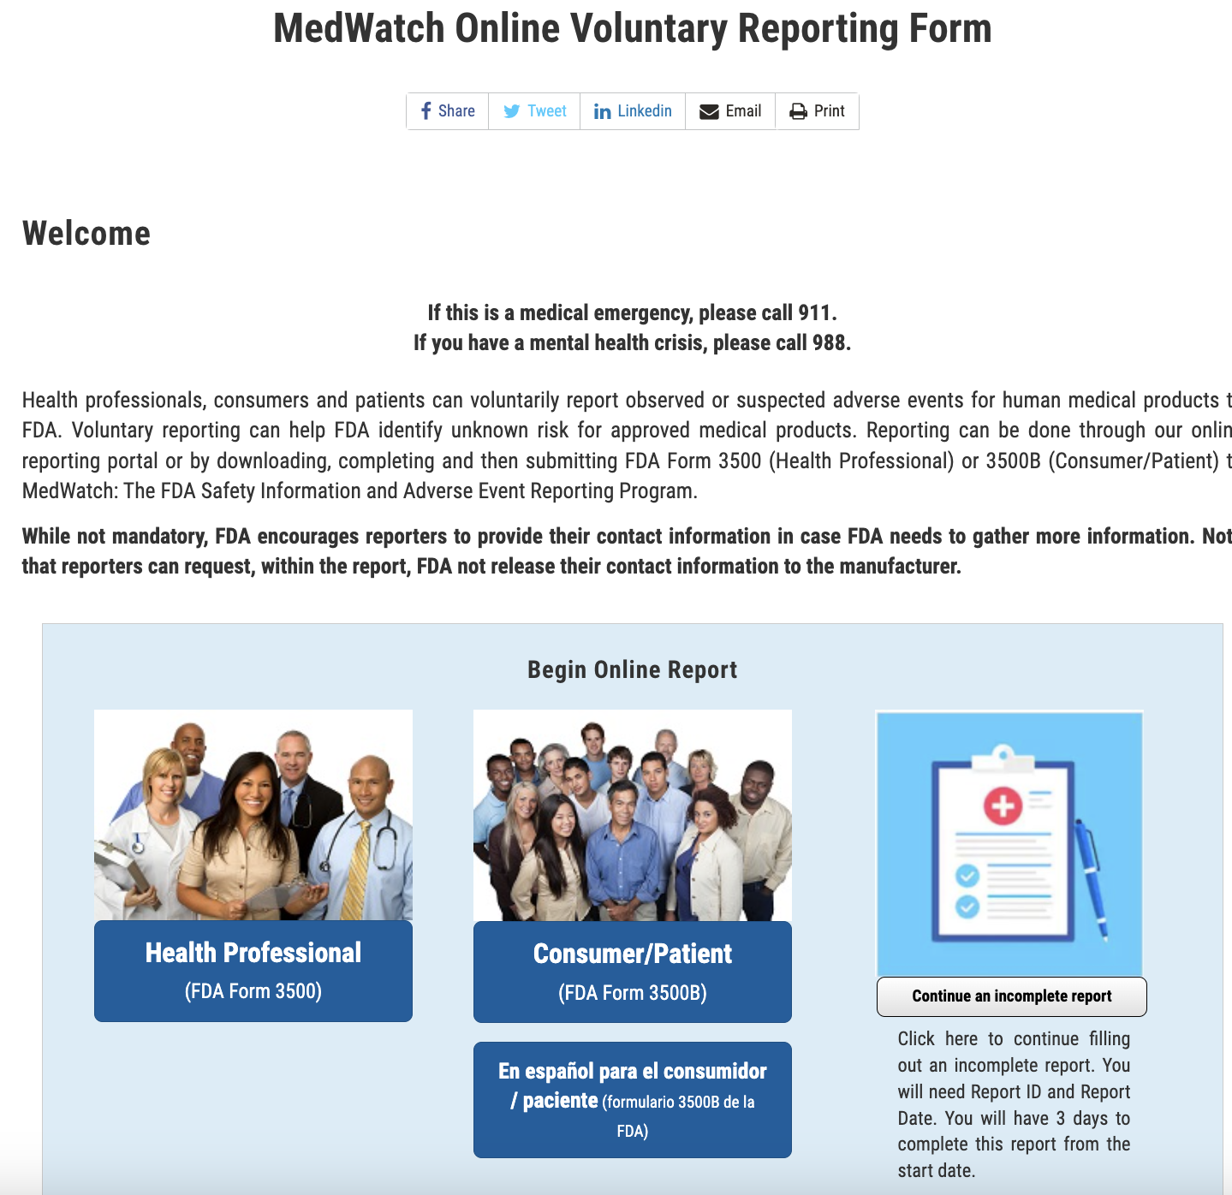
Dr. Jay K. Varma | https://drjayvarma.com

Slide 5
How MedWatch Works
Provider or patient submits Form 3500B
An FDA safety evaluator reviews report and examines database for similar reports
FDA monitors the data for trends and investigates, if appropriate
Dr. Jay K. Varma | https://drjayvarma.com

Slide 6
Potential FDA Actions
Safety alerts with recommendations to monitor a product's use, adjust the way it is used, or stop using it
Updating the product labeling to reflect new warnings
Inspecting the manufacturer
Requesting a change in the product’s design, manufacturing process, packaging, or distribution
Requesting that a company recall a product
Dr. Jay K. Varma | https://drjayvarma.com

Slide 7
Weaknesses
Under-reporting: relies on healthcare providers and patients to report
Reactive: adverse events must occur before action
Expensive to conduct without a strong economic incentive to perform
Dr. Jay K. Varma | https://drjayvarma.com

Slide 8
Potential Improvements
”Big Data” approaches to collecting and analyzing data from pharmacies, electronic health records, patients
Promote public and provider awareness and reporting of need for reporting adverse events
Funding and infrastructure for CDC, FDA, and/or academic centers to conduct post-marketing surveillance and report results in “real-time”
Dr. Jay K. Varma | https://drjayvarma.com

