Slide 1
Evidence-Based Decision Making
In Healthcare
Combating Misinformation and Disinformation
Dr Jay K. Varma
https://drjayvarma.com
Dr. Jay K. Varma | https://drjayvarma.com
Notes:
1

Slide 2
Misinformation and Disinformation
Misinformation = false information that is presented as fact without an intent to deceive or mislead
Disinformation = false information that is presented as fact with an intent to deceive or mislead
For purposes of this topic, will simply refer to it as “misinformation”
Dr. Jay K. Varma | https://drjayvarma.com

Slide 3
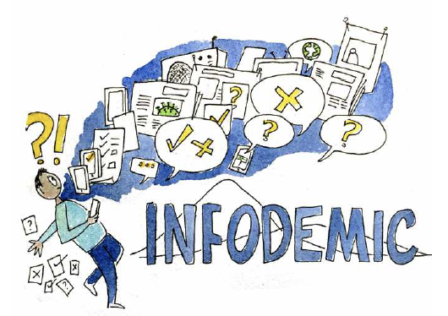
“Infodemic”
Term used by World Health Organization
An overabundance of information—some accurate and some not—that occurs during an epidemic
Spreads via digital & physical systems
Hard for people to find trustworthy sources and reliable guidance
Dr. Jay K. Varma | https://drjayvarma.com
Notes:
sss

Slide 4
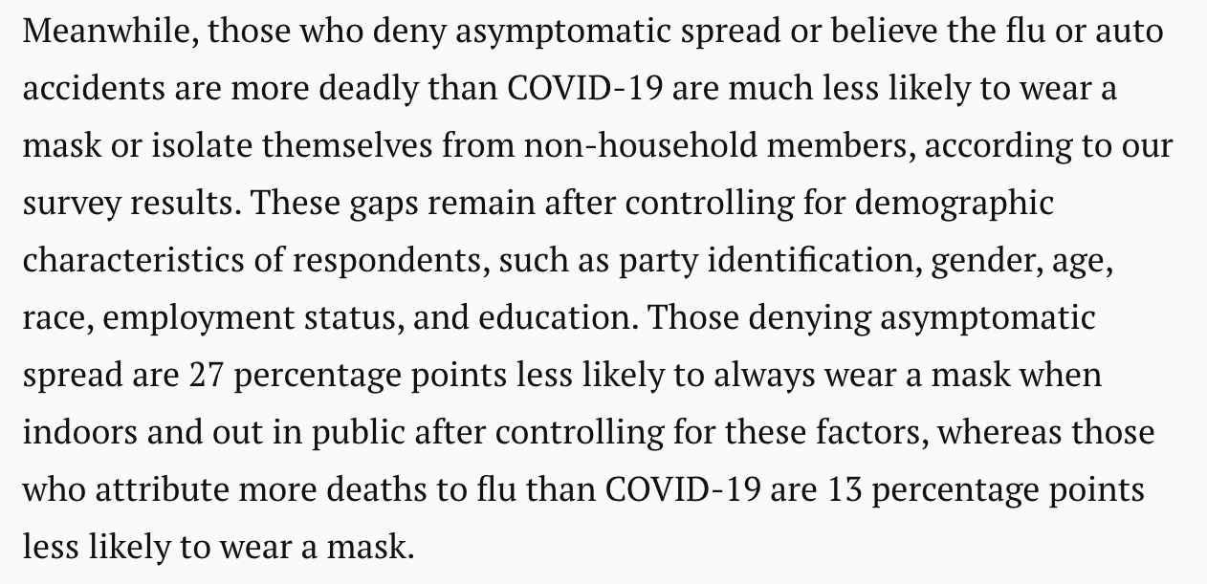
Harms: COVID Protection Measures
Monthly data from 35,000 U.S. adults in Franklin Templeton-Gallup Economics of Recovery Study, December 2020
https://www.brookings.edu/research/how-misinformation-is-distorting-covid-policies-and-behaviors/
Dr. Jay K. Varma | https://drjayvarma.com

Slide 5
Harms: Vaccination
Vaccine misinformation now fueling outbreaks of infectious diseases that were previously considered ‘eliminated’ in the United States
In 2022
Large measles outbreak in Ohio
Paralytic polio in New York
Dr. Jay K. Varma | https://drjayvarma.com
Notes:
sss

Slide 6
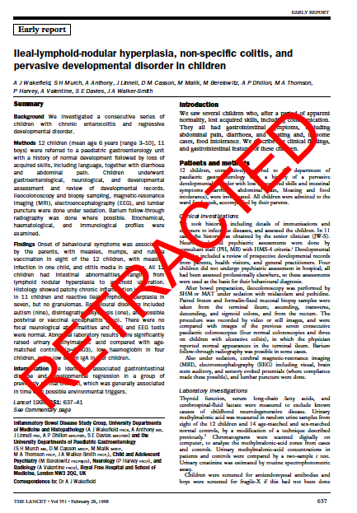
Damage from One Study
Study published in The Lancet in 1998, suggesting that measles, mumps, rubella vaccination is linked to autism and colitis
Led to massive declines in vaccination in UK and Ireland, leading to measles resurgence there and in other countries
Dr. Jay K. Varma | https://drjayvarma.com
Notes:
sss

Slide 7
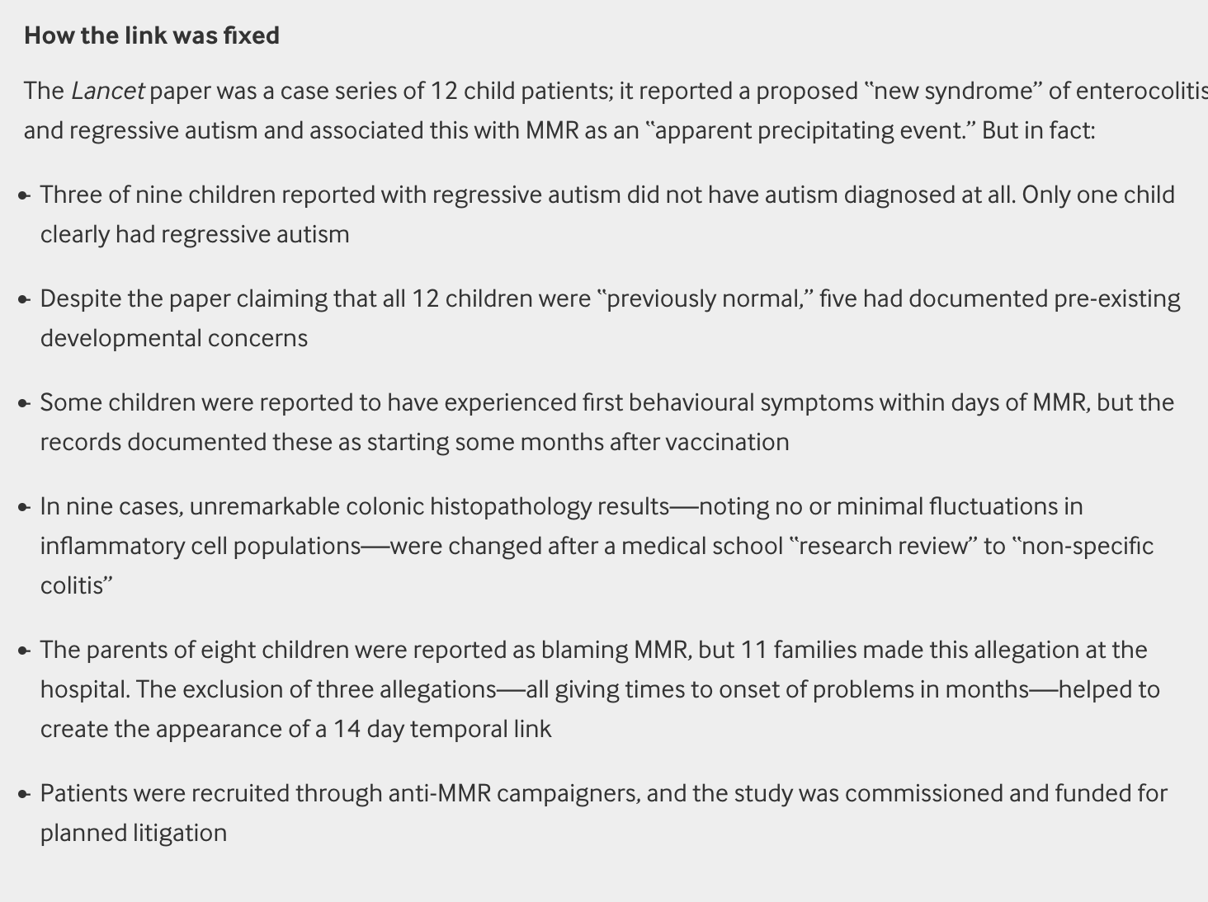
BMJ 2011, 342;c5347
Dr. Jay K. Varma | https://drjayvarma.com
Notes:
BMJ 2011, 342;c5347

Slide 8
Attempts to Debunk Extensive
Wakefield’s license revoked after documentation of fraud, ethical violations, financial conflicts
Massive epidemiologic studies in US, Europe, and elsewhere have shown zero association between MMR and autism
Nevertheless, misinformation ”sticks”
Dr. Jay K. Varma | https://drjayvarma.com
Notes:
sss

Slide 9
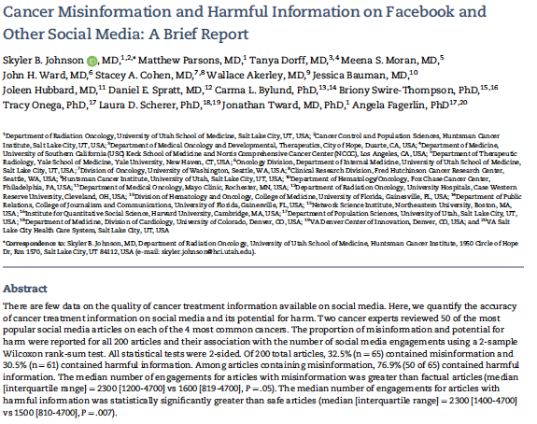
JNCI J Natl Cancer Inst (2022) 114(7): djab141
Dr. Jay K. Varma | https://drjayvarma.com

Slide 10
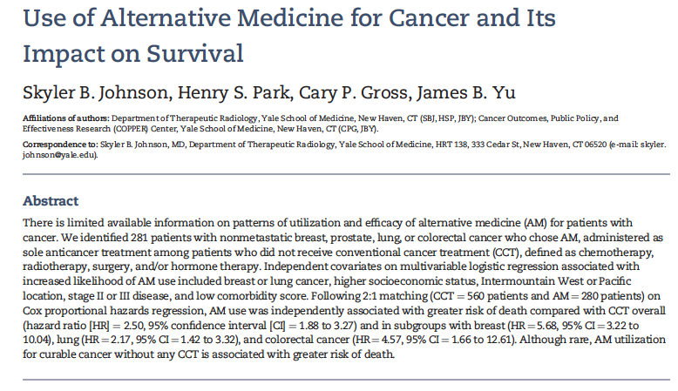
Dr. Jay K. Varma | https://drjayvarma.com

Slide 11
Strategies to Combat Misinformation
None would meet GRADE criteria for high quality
Primarily based on
Observational studies
Expert consensus
A challenge not just for health, but for democracy
Dr. Jay K. Varma | https://drjayvarma.com

Slide 12
Why It’s So Hard to Combat
Defining fact vs. falsehood is imperfect, since some scientific “facts” are later proven “false”
Fact checking does not reach everyone exposed to misinformation
Getting people to believe fact checks is challenging
Effective interventions hard to scale across large, diverse populations
Testing effectiveness complicated
Dr. Jay K. Varma | https://drjayvarma.com

Slide 13
Science-Based Information
Use techniques discussed in previous lecture
Stick to facts, while acknowledging uncertainty
Provide context
Reduce cognitive burden
Use credible messengers
Tell stories to add emotion to facts
Dr. Jay K. Varma | https://drjayvarma.com

Slide 14
“Truth” Sandwich
Coined by linguist George Lakoff
More of a “lie” sandwich with the truth as the bread and the lie as the filling in between
Start with truth. The first frame gets the advantage.
Indicate the lie. Avoid amplifying the specific language if possible.
Return to truth. Always repeat truths more than lies.
Dr. Jay K. Varma | https://drjayvarma.com
Notes:
sss

Slide 15
Health Literacy and Inoculation
Science education
Teach people to recognize misinformation tactics
Excessively emotional language
Incoherence
False dichotomies
Scapegoating
ad hominem attacks
Dr. Jay K. Varma | https://drjayvarma.com

Slide 16
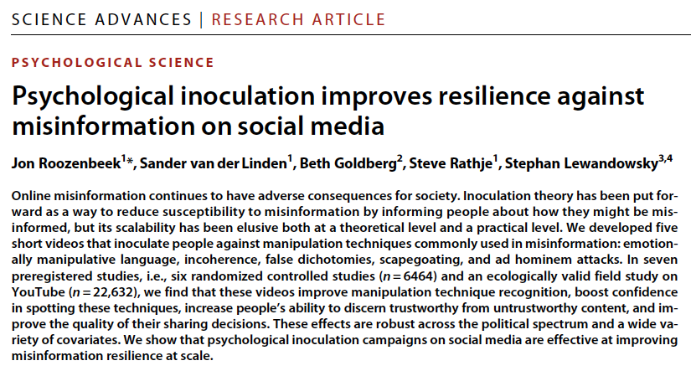
Dr. Jay K. Varma | https://drjayvarma.com
Notes:
sss

Slide 17
Community Engagement
Trusted messengers
Hyperlocal
Identify culturally, linguistically, ethnically
Must have a history with the community, rather than new to them
Dr. Jay K. Varma | https://drjayvarma.com

Slide 18
Counter-Arguments
Is it legal for government to combat misinformation?
Is it ethical for government to combat misinformation?
Dr. Jay K. Varma | https://drjayvarma.com
Notes:
sss

Slide 19
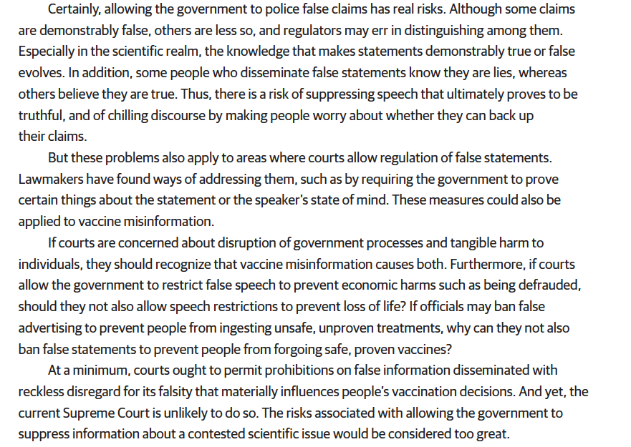
https://jamanetwork.com/journals/jama-health-forum/fullarticle/2790169
Dr. Jay K. Varma | https://drjayvarma.com
Notes:
? https://jamanetwork.com/journals/jama-health-forum/fullarticle/2790169

Slide 20
https://jamanetwork.com/journals/jama-health-forum/fullarticle/2790169
Dr. Jay K. Varma | https://drjayvarma.com
Notes:
? https://jamanetwork.com/journals/jama-health-forum/fullarticle/2790169

Slide 21
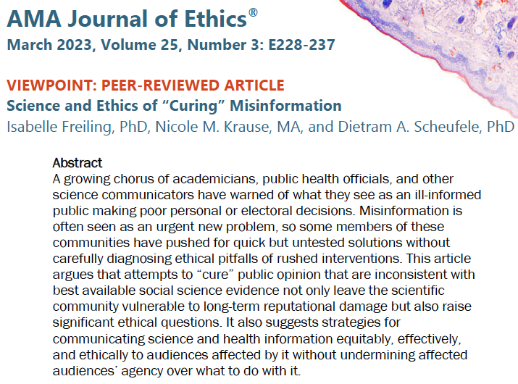
Dr. Jay K. Varma | https://drjayvarma.com

Slide 22
Why Not Combat Misinformation
Complex problem with no high quality studies proving benefit
Scientists cannot just ”stick to the facts,” since the choice of which facts to present involves judgement
Scientists often wade into questions of policy, rather than just technical merit
Dr. Jay K. Varma | https://drjayvarma.com

Slide 23
Why Not Combat Misinformation
“Inoculation” techniques ethically questionable
Derived from wartime propaganda methods
Population has not consented to inoculation
Will undermine credibility of scientists if public believes
It is being manipulated
Scientists are silencing dissenting voices
Dr. Jay K. Varma | https://drjayvarma.com

