Slide 1
Evidence-Based Decision Making
In Healthcare
Randomized Controlled Trials
Jay K. Varma, MD
https://drjayvarma.com
Dr Jay K Varma | https://drjayvarma.com
Notes:
1

Slide 2
All Studies
Descriptive
Analytic
Experimental
Observational
Qualitative
Quantitative
Controlled Trial
Cohort study
Randomized Controlled Trial
Cross-sectional
(Analytic)
Investigator controls which people get exposed
Case-control study
Investigator has no control over which people get exposed
Dr Jay K Varma | https://drjayvarma.com

Slide 3
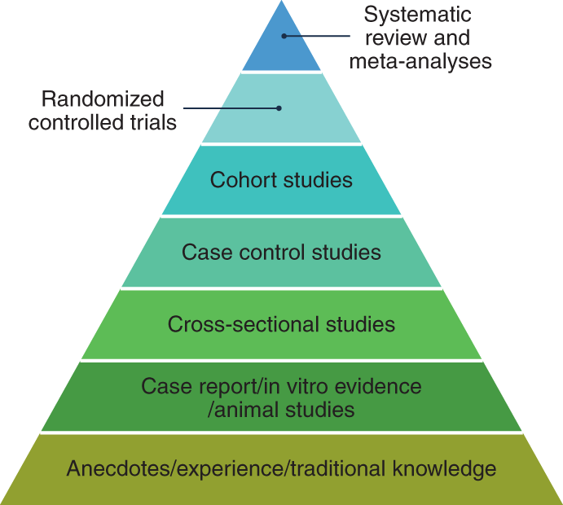
Hierarchy of Evidence
https://www.nature.com/articles/s43016-021-00388-5/figures/1
Dr Jay K Varma | https://drjayvarma.com
Notes:
https://www.nature.com/articles/s43016-021-00388-5/figures/1

Slide 4
Randomized Clinical Trials
Clinically relevant question
Greatest impact if limited information or high variability in care or outcomes
Can be answered by RCT
Feasible to perform at your center
Systematic review
Identify available information
Justify importance of question
Help design study
Dr Jay K Varma | https://drjayvarma.com

Slide 5
Randomized Clinical Trials
Define key elements of study
Population
Intervention
Comparator
Outcome
State primary hypothesis
Expected result for primary outcome in population
Dr Jay K Varma | https://drjayvarma.com

Slide 6
STUDY DESIGN
Dr Jay K Varma | https://drjayvarma.com

Slide 7
Randomization
Generate sequence of allocation
Computer generated random numbers table
Randomize in blocks
Concealed allocation
When obtaining informed consent to enroll a patient, investigator does not know if patient will get new treatment or control
Non-manipulable allocation schedule, e.g. off-site
Dr Jay K Varma | https://drjayvarma.com

Slide 8
Concealed Allocation
RCT comparing new therapy vs. placebo for abdominal pain in irritable bowel syndrome
Investigator interviews eligible patient, who complains of abdominal pain that has not responded to treatment
Next patient to enter trial will get placebo
Dr Jay K Varma | https://drjayvarma.com

Slide 9
Concealed Allocation
Investigator thinks placebo is unlikely to relieve abdominal pain in this patient
Investigator may subconsciously try to convince patient not to enroll in the trial
Patients with severe abdominal pain will not be evenly divided between new therapy and placebo groups
Dr Jay K Varma | https://drjayvarma.com

Slide 10
Stratification
To assure baseline factors that impact study outcome equally distributed in study groups
Especially useful in smaller trials
Choose factors that have greatest impact on primary outcome
Aspirin use in MI study
Separate randomization schedules for patients with and without high blood pressure
Dr Jay K Varma | https://drjayvarma.com

Slide 11
Randomization “Blocks”
Assures equal number in each study arm for every successive block of patients enrolled
Prevents unequal numbers in study arms
Prevents differences in distribution over time
eg, study intervention mostly early, comparator later
Disadvantage
If block size figured out, next allocation may be predictable (unconcealed)
Dr Jay K Varma | https://drjayvarma.com

Slide 12
Blinding
Knowing patient received placebo or drug may alter:
Whether patient gets another therapy that my impact outcome
Assessment of symptoms, signs, outcomes
Blinding means patients, providers, & investigators do not know if patient got placebo or drug
Reduces bias in management decisions and in assessment of outcomes by subject or investigator
Dr Jay K Varma | https://drjayvarma.com

Slide 13
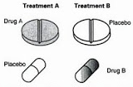
Blinding
Identical appearing therapies, eg, sham surgery
Double-dummy, e.g., receive identical active and control together
Side effect of therapy may unblind
Dr Jay K Varma | https://drjayvarma.com

Slide 14
Patient Population
Will results be generalizable to population that will be treated in real world?
Inclusion and exclusion criteria
Broad: exclude few, more generalizable
Restricted: exclude many, less generalizable
Prospectively screen patients with condition of interest
Skipping patients may introduce bias
Keep log of subjects screened, but not enrolled
Dr Jay K Varma | https://drjayvarma.com

Slide 15
Choosing Control Intervention
Placebo control vs. active control
Placebo best to define efficacy of study therapy
May not be ethical or practical,
For example, because should not withhold standard care if documented effective
Active control if hypothesis is that new therapy is superior or non-inferior (equivalent)
Dr Jay K Varma | https://drjayvarma.com

Slide 16
Primary vs. Additional Endpoints
What is the most important impact you want to achieve with the new intervention?
Trials should be designed to measure a small number of primary endpoints
All others should be considered ”additional”
Dr Jay K Varma | https://drjayvarma.com

Slide 17
Surrogate vs. Clinically Meaningful
Which study endpoint would alter practice?
Lab test (CRP) or clinical outcome (death)
Studies of intermediate/surrogate endpoints may indicate areas for further research, but generally don’t alter patient management
Some surrogate endpoints are accepted as “true” indicators of clinical outcomes
e.g., blood pressure, cholesterol, colon polyps
Dr Jay K Varma | https://drjayvarma.com

Slide 18
Sample Size Based on Endpoints
Primary endpoint result for intervention and comparator
Assumptions based on available data, clinical judgment
Difference should be clinically meaningful, realistic
Power calculation based on:
Type 1 error: Probability of finding difference when does not exist
Type 2 error: Probability of not finding a difference when does exist
Dr Jay K Varma | https://drjayvarma.com

Slide 19
Feasible Sample Size
Review medical records at study center(s) to
Determine number who meet enrollment criteria
Confirm assumptions about outcomes
“Preparatory to research” review does not require IRB approval of protocol
Dr Jay K Varma | https://drjayvarma.com

Slide 20
Non-Inferiority Study
Determine non-inferiority margin
Maximal difference that would be considered clinically non-inferior, i.e., no unacceptably worse than the control
Set a margin of difference less than the upper bound of the confidence interval observed in study
If you observe a difference more than the confidence intervals, then not ”non-inferior”
Dr Jay K Varma | https://drjayvarma.com

Slide 21
Recruitment and Retention
Engagement before and throughout trial
Brochures, ads, social media, phone, text, email
Reminders for study personnel and participants
Benefits of participation for subjects
Reimbursement for time and effort
Identify and minimize barriers to participation
Easy access to study personnel and activities
Participation as non-onerous as possible
Dr Jay K Varma | https://drjayvarma.com

Slide 22
Follow Up of Patients
If numerous patients are lost to follow-up, results of the trial may not be accurate
Predefine method to deal with such patients
Last observation carried forward
Imputation methods
Re-calculate results assuming that patients lost to follow-up in treatment group had bad outcome and patients in control group had good outcome
Dr Jay K Varma | https://drjayvarma.com

Slide 23
STUDY ANALYSIS
Dr Jay K Varma | https://drjayvarma.com

Slide 24
Which Patients to Study?
Intention to treat
Analyze all patients randomized regardless of whether they completed study
Per-protocol
Did not receive sufficient study intervention
Did not return for necessary follow-up visits
Major violations of inclusion or exclusion criteria
Major violations during study
Dr Jay K Varma | https://drjayvarma.com

Slide 25
New Surgery to Stop Gastric Bleeding?
Compare surgery vs. medications and endoscopy
Patient randomized to receive surgery
Dies from bleeding before can be operated on
Do you include them in the study analysis?
Dr Jay K Varma | https://drjayvarma.com

Slide 26
Whom to Include in Analysis?
Choose most conservative analysis
Less likely to favor intervention, be overly optimistic
Dr Jay K Varma | https://drjayvarma.com

Slide 27
Superiority Study
Per-protocol assumes optimal circumstances
Study done perfectly, no one dropped out, everyone took medication as prescribed
Intention-to-treat analysis avoids bias to treatment difference and superiority
Dr Jay K Varma | https://drjayvarma.com

Slide 28
Non-Inferiority Study
ITT can bias to no treatment difference
Bias to “non-inferiority”
e.g., non-adherence, drop-outs, misclassified subjects/endpoints
Per protocol analysis should be included
Dr Jay K Varma | https://drjayvarma.com

Slide 29
Define Analysis Before Enrollment
Predefine presentation of data
Proportions vs. time-to-event curves
Mean vs. median
Predefine statistical analyses
Comparisons for primary, additional outcomes
Subgroup analyses
Sensitivity analyses
Dr Jay K Varma | https://drjayvarma.com

Slide 30
Is Difference Due to Chance?
Null hypothesis means “true” proportion of success w/treatment = “true” proportion of success w/ control
If the null hypothesis correct and treatments are equally effective, p-value indicates
Probability of observing a difference between treatment and control at least this large
Probability that difference at least this large is due to chance
Dr Jay K Varma | https://drjayvarma.com

Slide 31
Is Difference Due to Chance?
A small p-value (< 0.05) means finding a difference at least this large is unlikely if the null hypothesis (treatments equally effective) is true
Reject the null hypothesis
The more comparisons you make, the more likely you will get a result with a p<0.05
Single primary outcome > multiple outcomes
Statistical methods to ‘correct’ for multiple comparisons
Dr Jay K Varma | https://drjayvarma.com

Slide 32
Confidence Intervals
 | Success (Small Study) | Success (Large Study)
Treatment | 13/26 (50%) | 1000/2000 (50%)
Control | 10/26 (38%) | 973/2000 (48.7%)
p-value | 0.40 | 0.40
Difference | 12% | 1.3%
95% CI | -15% to 38% | -1.8% to 4.4%
Interpretation | Large effect size; high uncertainty | Small effect size; low uncertainty
Dr Jay K Varma | https://drjayvarma.com
Connor. AJG 2004;99:1638

Slide 33
Subgroup Analysis
Some groups respond differently
Does drug produce benefit in men but not in women?
Pre-define and justify
Post hoc more risk of bias since results known
Less power than overall analysis
More analyses increases chance of significance occurring by chance
Smaller number in each subgroup
Dr Jay K Varma | https://drjayvarma.com

Slide 34
DATA SAFETY MONITORING BOARD
Dr Jay K Varma | https://drjayvarma.com

Slide 35
Data Safety Monitoring Board
“Ensures that a clinical trial is stopped if the benefit-risk balance for participants or the expected value to society no longer justifies continuing”
Lewis et al. JAMA 2016;316:2359
Dr Jay K Varma | https://drjayvarma.com

Slide 36
Data Safety Monitoring Board
Independent, external experts
Periodic assessments of recruitment, retention, data quality, adverse events, endpoints
Make recommendations to continue, modify, or terminate study
Dr Jay K Varma | https://drjayvarma.com

Slide 37
Interim Analysis
Modify study
Stop study
Futility: no possibility can document benefit
Efficacy: unequivocal benefit in clinically important outcome
Stopping should be based on pre-defined rules
Dr Jay K Varma | https://drjayvarma.com

Slide 38
Stopping Study
Pre-defined rules
Usually very conservative p-value (e.g., 0.001)
Prevents incorrect conclusion (vs. p <0.05)
Usually focused on safety
Stop if unacceptable risk-benefit balance
Consider additional monitoring and/or therapies
Dr Jay K Varma | https://drjayvarma.com

Slide 39
TRIAL REGISTRATION
Dr Jay K Varma | https://drjayvarma.com

Slide 40
Trial Registration
Prevent selective publication and selective reporting of research outcomes
Prevent unnecessary duplication of research
Help public know of planned or ongoing trials into which they might want to enroll
Give ethics boards considering new studies a view of similar work and data relevant to the research
http://icmje.org/recommendations/browse/publishing-and-editorial-issues/clinical-trial-registration.html
Dr Jay K Varma | https://drjayvarma.com

Slide 41
What is a Clinical Trial?
ClinicalTrials.gov
Participants receive intervention per protocol
Outcomes measured for safety, efficacy
Medical Journal Editors
Prospectively assigns people to an intervention…to study cause-and-effect relationship between a health intervention and a health outcome
NIH
Human subject(s) prospectively assigned to intervention to evaluate the effects on health-related biomedical or behavioral outcomes
Dr Jay K Varma | https://drjayvarma.com

Slide 42
Obligation to Register
Required by law (U.S. FDA)
Controlled clinical investigations of FDA-regulated drug, biologic, or device other than Phase 1 or small feasibility studies
Enable publication (ICMJE)
All interventional studies, including Phase 1
Ethical
“scientific, ethical and moral responsibility” (WHO)
Dr Jay K Varma | https://drjayvarma.com

Slide 43
TRIAL REPORTING
Dr Jay K Varma | https://drjayvarma.com

Slide 44
CONSORT Guidelines on Reporting
Framework for reporting RCTs
Required by many journals
Checklist for the content of the title, abstract, introduction, methods, results, and discussion
Pre-trial registration ensures no change from original design without explanation
Reporting guidelines ensure all important elements provided in publication
Dr Jay K Varma | https://drjayvarma.com

Slide 45
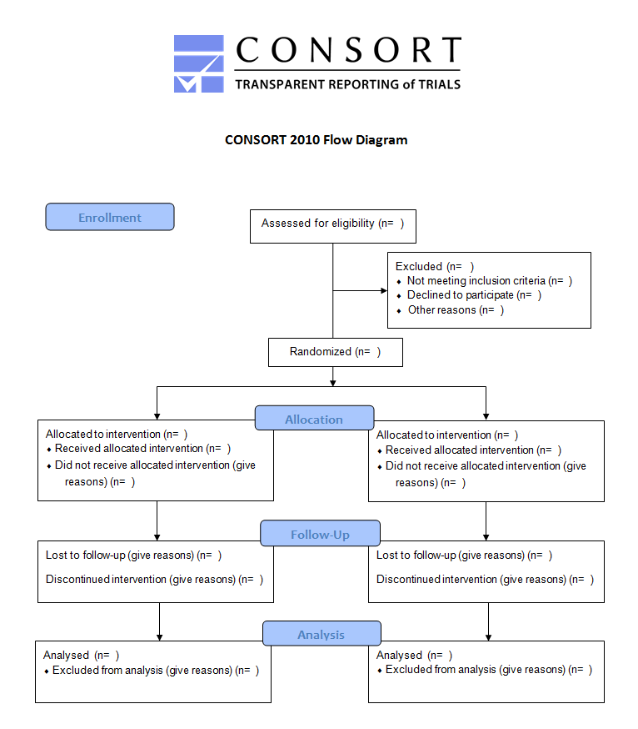
Dr Jay K Varma | https://drjayvarma.com

Slide 46
TRIAL ASSESSMENT
Dr Jay K Varma | https://drjayvarma.com

Slide 47
General
Background
Relevance, importance, novelty of topic
Rationale clear
Hypothesis
Primary hypothesis stated
Trial Registered, e.g., Clinicaltrials.gov
Trial reported per guidelines, CONSORT
Dr Jay K Varma | https://drjayvarma.com

Slide 48
Design
Randomization
Computer generated by uninvolved individual
Allocation concealed (opaque covering)
Block size stated
Blinding
Patients, caregivers, investigators blinded
Method of blinding
Dr Jay K Varma | https://drjayvarma.com

Slide 49
Design
Population
Inclusion, exclusion criteria clearly stated
Consecutive patients enrolled
Intervention and Control
Characterized fully
Clinically appropriate
Simulate standard practice
Control is an acceptable standard of care
Dr Jay K Varma | https://drjayvarma.com

Slide 50
Design
Primary and additional outcomes defined
Clinically relevant
Appropriately measured
Sample size assumptions, calculation
Superiority vs. non-inferiority study
Assumptions reasonable
Dr Jay K Varma | https://drjayvarma.com

Slide 51
Analysis
Population
ITT vs. per-protocol
Full accounting of subjects
Primary and additional analyses
Predefined analyses presented
Post hoc analyses
Dr Jay K Varma | https://drjayvarma.com

Slide 52
Conclusions
Do results support conclusions
Limitations discussed
Potential sources of bias
Magnitude and precision of results
Generalizability
Results placed in context
Outcomes not studied, e.g., cost, availability,
Consider relevant evidence outside study
Dr Jay K Varma | https://drjayvarma.com

Slide 53
WHY NOT DO RCT?
Dr Jay K Varma | https://drjayvarma.com

Slide 54
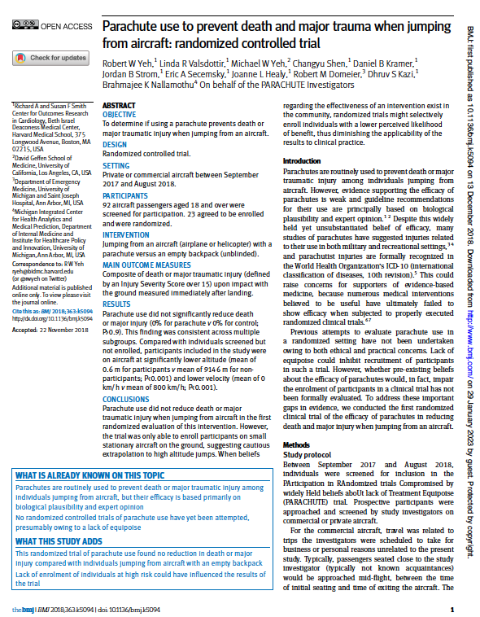
Dr Jay K Varma | https://drjayvarma.com

Slide 55
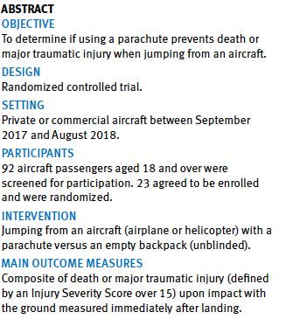
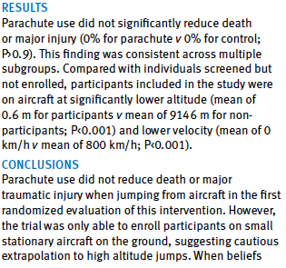

Dr Jay K Varma | https://drjayvarma.com

Slide 56
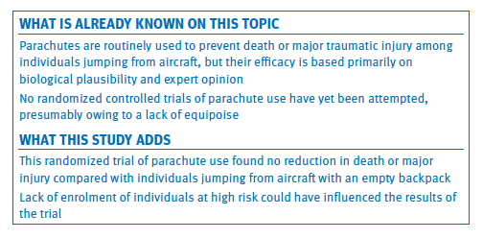
Dr Jay K Varma | https://drjayvarma.com

Slide 57
Not Ethical or Practical
Not ethical/possible to assign intervention
Cigarette smoking and lung cancer
H. pylori infection and ulcers
Impractically large sample size
Very low-incidence event, eg, rare side effect
Impractically long duration
Outcome requires years to develop, eg, cancer
Dr Jay K Varma | https://drjayvarma.com

Slide 58
More than One Way to Find “Truth”
Medicine is different than other natural sciences in elevating the RCT to gold standard
If you can directly measure the outcomes and all the relevant variables, then you do not need an RCT to control for noise (“unmeasured confounding”)
This is true for engineering
You do not need an RCT to prove a new Iphone performs faster and better than an old Iphone
Dr Jay K Varma | https://drjayvarma.com

Slide 59
Parachute Example Again
Design involves
High quality numeric models
Scale testing
Full-scale testing
Certification testing with live parachute trials, involving real people
Initial simulation, then physical design, with parameters measured with high accuracy
Dr Jay K Varma | https://drjayvarma.com

