Slide 1
Evidence-Based Decision Making
In Healthcare
Imprecision, Inconsistency, and Indirectness
Dr Jay K. Varma
https://drjayvarma.com
Dr Jay K. Varma | https://drjayvarma.com
Notes:
1

Slide 2
GRADE
Summary of evidence and systematic approach to make recommendations
Reviews quality of evidence with the study design
5 reasons to rate down, 3 reasons to rate up
Dr Jay K. Varma | https://drjayvarma.com

Slide 3
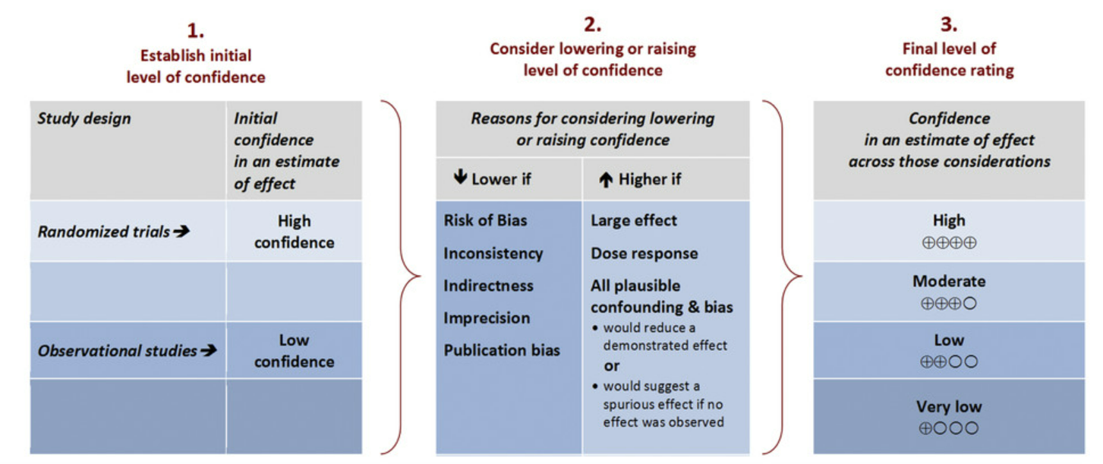
Rating Quality of Evidence
Source: Environment International 2016
Dr Jay K. Varma | https://drjayvarma.com

Slide 4
Rating Quality of Evidence
Source: Environment International 2016
Dr Jay K. Varma | https://drjayvarma.com

Slide 5
Grading Quality of Evidence
Grade | Definition
High | We are very confident that the true effect lies close to that of the estimate of the effect
Moderate | We are moderately confident in the effect estimate: the true effect is likely to be close to the estimate of the effect, but there is a possibility that it is substantially different
Low | Our confidence in the effect estimate is limited: the true effect may be substantially different from the estimate of the effect
Very Low | We have very little confidence in the effect estimate: the true effect is likely to be substantially different from the estimate of effect
Dr Jay K. Varma | https://drjayvarma.com

Slide 6
IMPRECISION
Dr Jay K. Varma | https://drjayvarma.com

Slide 7
Confidence Intervals
Primary criteria are width of CI intervals
Dependent on sample size and number of events
Wide confidence intervals (CI) around the estimate of treatment effect occur when studies have relatively few patients and few events
If CI is not sufficiently narrow, then downgrade quality of evidence
Dr Jay K. Varma | https://drjayvarma.com

Slide 8
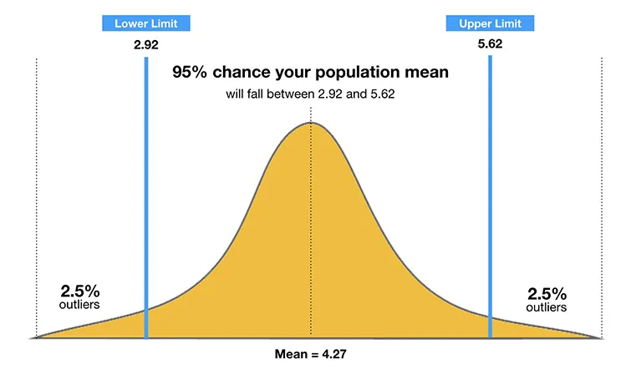
Confidence Interval
The 95% CI contains the true mean of the population
As the sample size increases, the range of interval values will narrow (more precise), and the mean is more accurate
Dr Jay K. Varma | https://drjayvarma.com

Slide 9
Optimal Information Size
Secondary Criteria: Optimal Information Size (OIS)
If total number of patients included in systematic review is less than number generated by conventional sample size calculation for single adequately powered trial, then downgrade for quality of evidence
Dr Jay K. Varma | https://drjayvarma.com

Slide 10
Power & Sample Size
Factors to consider for Power & Sample Size calculations:
Delta (Effect Size):
With a larger effect size, we either achieve a higher power with a fixed sample size or require a smaller sample for achieving a fixed desired power.
Standard deviation:
It represents the variability in the distribution of hospital stay. With a higher standard deviation, we need a larger sample to achieve the desired power.
Alpha:
Threshold for type I error. It’s usually set to be 0.05.
Beta:
Threshold for type II error. (Note that 1-beta is the “power” and it’s usually set to be 0.2)
Dr Jay K. Varma | https://drjayvarma.com
Notes:
Similar process as for binary variables, initially considering the upper and lower limits of the CI, and subsequently calculating an OIS.

Slide 11

α, β, and ∆
Type I and Type II Error
Type I error = Rejecting the H₀, when H₀ is true Type II error = Fail to rejecting the H₀, when H₀ is false
 | H₀
 | True | False
Reject H₀ | Type I error
Fail to reject H₀ |  | Type II error
α = Probability of Type I error
β = Probability of type II error
Power = 1 - β
∆ = The difference (CI)
Example: H₀ = John’s car is safe to drive
Scenario (1): John thinks his car may be safe to drive, in fact, it is not safe.
Scenario (2): John thinks his car may be safe to drive, in fact it is safe.
Scenario (3): John thinks his car may NOT be safe to drive, in fact, it is not safe.
Scenario (4): John thinks his car may NOT be safe to drive, in fact, it is safe.
T2E
T1E
Dr Jay K. Varma | https://drjayvarma.com

Slide 12
Optimal Information Size
Simulation: Generating sample size
Systematic review of fluoroquinolone prophylaxis for patients with neutropenia and infection-related mortality (95% CI: 0.21, 0.69).
Total number of events only 69, total patients 1022
Considering control group risk=6.9%, α=0.05, β=0.2, RRR of 25% → OIS=6400 patients
Fails to meet OIS, so rate down for imprecision
Dr Jay K. Varma | https://drjayvarma.com

Slide 13
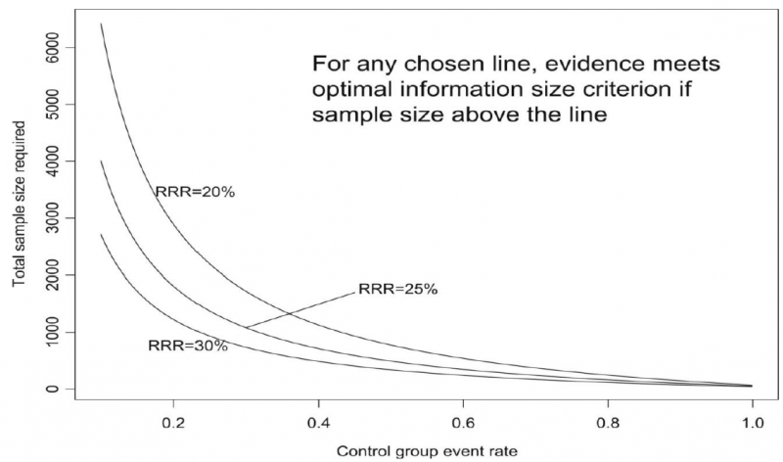
Optimal Information Size
Required sample size (α=0.05, β=0.2) for RRR of 20%, 25%, 30% across varying control group risks
If best estimate of control group risk is 0.2 and want to measure RRR of 25%, OIS ~ 2000 patients
Dr Jay K. Varma | https://drjayvarma.com

Slide 14
Optimal Information Size
Total Number of Events | Relative Risk Reduction | Implications for meeting OIS threshold
100 or less | ≤ 30% | Will almost never meet threshold whatever control event rate
200 | 30% | Will meet threshold for control event rates for ~25% or greater
200 | 25% | Will meet threshold only control event rates for ~50% or greater
200 | 20% | Will meet threshold only for control event rates for ~80% or greater
300 | ≥ 30% | Will meet threshold
300 | 25% | Will meet threshold for control event rates ~25% or greater
300 | 20% | Will meet threshold for control event rates ~60% or greater
400 or more | ≥ 25% | Will meet threshold for any control event rate
400 or more | 20% | Will meet threshold for control event rates of ~40% or greater
Dr Jay K. Varma | https://drjayvarma.com

Slide 15
Probiotics in Crohn’s Disease
Point estimate of risk ratio (0.96) suggests no difference
CI includes both reduction in likelihood of remission and an increase in the likelihood (95% CI: 0.56, 1.69)
 | Remission | No remission | Total
Treatment | 4 (0.8) | 1 | 5
Control | 5 (0.83) | 1 | 6
Total | 9 | 2 | 11
Risk Ratio (RR) | 0.96 (0.8 / 0.83) ➔ No difference
CI (95%) | 0.5 (0.56 and 1.69)
Rate down quality of evidence, because:
Few events (OIS)
CI includes both appreciable benefit (RR>1.25) and harm (RR<0.75)
Dr Jay K. Varma | https://drjayvarma.com

Slide 16
INCONSISTENCY
Dr Jay K. Varma | https://drjayvarma.com

Slide 17
What is Inconsistency?
Inconsistency is an unexplained heterogeneity or variability of study outcomes between studies
Reduces the confidence in the generalizability of findings
Lower quality of evidence
Dr Jay K. Varma | https://drjayvarma.com

Slide 18

Why Assess Inconsistency?
Determine if it is appropriate to combine study results to estimate the right outcome
Apples to apples vs. apples to oranges
Dr Jay K. Varma | https://drjayvarma.com

Slide 19
Questions to Ask
Are there different patient subgroups with different effects?
Are there different interventions?
Are there different outcomes defined in the studies?
Are there differences in the quality of the studies?
Dr Jay K. Varma | https://drjayvarma.com

Slide 20
Rating Inconsistency
Magnitude of inconsistency in the results
Ambiguous or conflicting conclusions
Rating for inconsistency
Not serious (no change in the grading of quality)
Serious (downgrade quality by 1 level)
Very Serious (downgrade quality by 2 levels)
Dr Jay K. Varma | https://drjayvarma.com

Slide 21
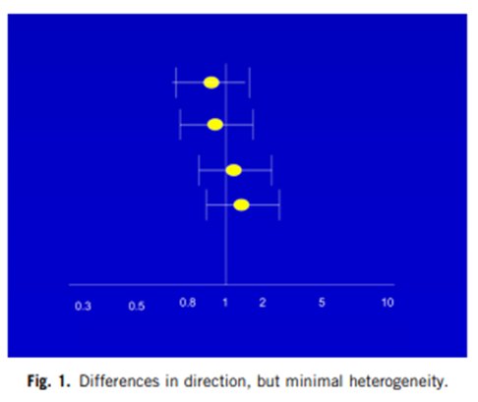
Differences in direction, but minimal variability
Differences in direction small
Differences in point estimate small
Dr Jay K. Varma | https://drjayvarma.com

Slide 22
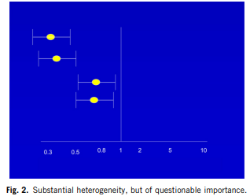
Inconsistency Large, but Differences between Small and Large Benefit
Large variability
Differences are between small and large treatment effects
Dr Jay K. Varma | https://drjayvarma.com

Slide 23
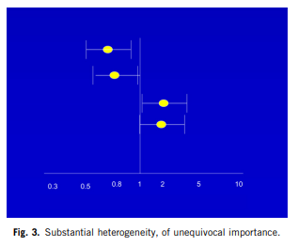
Substantial Heterogeneity, of Unequivocal Importance
Magnitude of difference in treatment effects identical to previous example
But previous example showed same direction
Here you have mix of benefit & harm→ grade
Dr Jay K. Varma | https://drjayvarma.com

Slide 24
Inconsistency Leads to Decreased Quality of Evidence
Rate down for inconsistency, not up for consistency
Search for alternative explanation
If observed inconsistency cannot be explained, assess seriousness of inconsistency and why the authors may have made the conclusion
Determine if subgroup analysis is appropriate
Dr Jay K. Varma | https://drjayvarma.com
Notes:
Meraf

Slide 25
Potential Causes of Inconsistency
Population Subgroups
Larger relative effects in sicker populations
Treatment on different diagnosis: cancer vs CHF
Age
Interventions
Larger effects with higher drug doses
Outcomes
Duration of follow-up
Study Methods
Intervention vs observation
Randomized clinical trials with higher and lower risk of bias
Dr Jay K. Varma | https://drjayvarma.com
Notes:
Meraf

Slide 26
Rate Down Quality of Evidence
Point estimates vary widely across studies
Confidence intervals show minimal/no overlap
Statistical test for heterogeneity
Large I² –variation in point estimates due to true variation among study differences
Low p-value
Dr Jay K. Varma | https://drjayvarma.com
Notes:
Meraf

Slide 27
Assessing Heterogeneity
Visually inspect
Tables describing heterogeneity
Differing baseline characteristics
Do the estimates line up, do they overlap?
Review the statistical test for heterogeneity (I²)
Dr Jay K. Varma | https://drjayvarma.com

Slide 28
INDIRECTNESS
Dr Jay K. Varma | https://drjayvarma.com

Slide 29
Why Do We Care about Indirectness?
Evidence can be direct or indirect
If indirect evidence, quality decreases when differences in…
Population
Intervention
Outcome measures, including surrogate outcomes
Comparison (A vs. placebo, B vs. placebo, not A vs. B)
Mechanism (A and B different, but same class of drugs)
Dr Jay K. Varma | https://drjayvarma.com

Slide 30
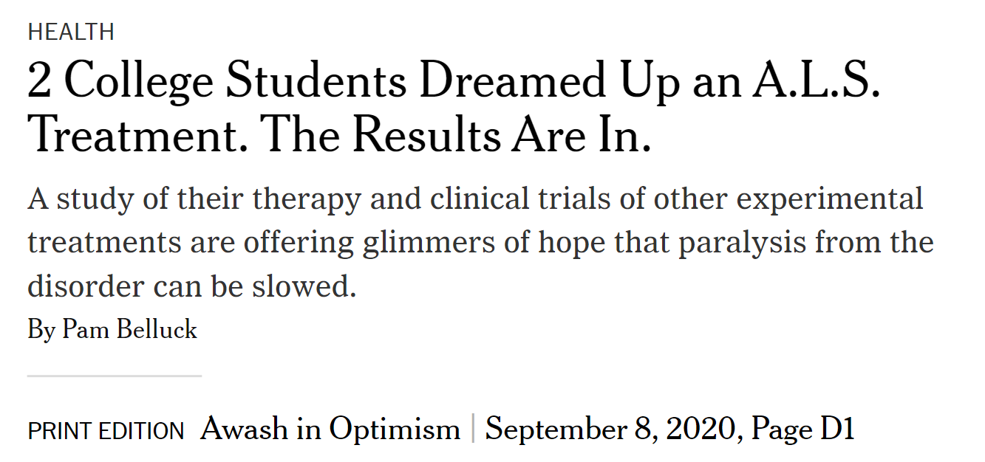


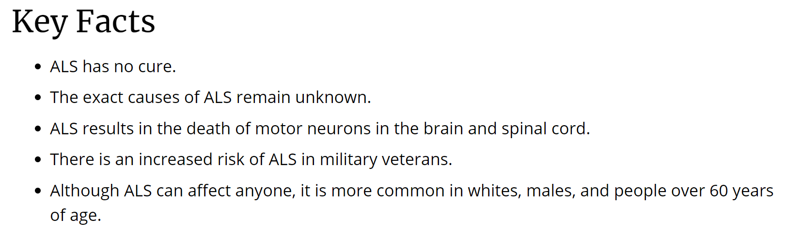
Outcome: ALS drug
Specify every important outcome of interest
Use of substitute or surrogate endpoints
Has the surrogate been validated, and/or repeatedly established in RCT?
Dr Jay K. Varma | https://drjayvarma.com

Slide 31
AMX0035 in ALS - Primary Outcomes
ClinicalTrials.gov Identifier: NCT03127514
Functional rating scale-revised (ALSFRS-R) slope change
Number with adverse events
Number in each group able to remain on study drug until planned discontinuation
[ Time Frame: 24 weeks ]
Dr Jay K. Varma | https://drjayvarma.com

Slide 32
AMX0035 in ALS – Secondary Outcomes
ClinicalTrials.gov Identifier: NCT03127514
Accurate testing of limb isometric strength (ATLIS) total score change
Change in level of phosphorylated axonal neurofilament H subunit (pNF-H)
Rate of decline in slow vital capacity (SVC)
Death, tracheostomy, and hospitalization
[ Time Frame: 24 weeks ]
Dr Jay K. Varma | https://drjayvarma.com

Slide 33
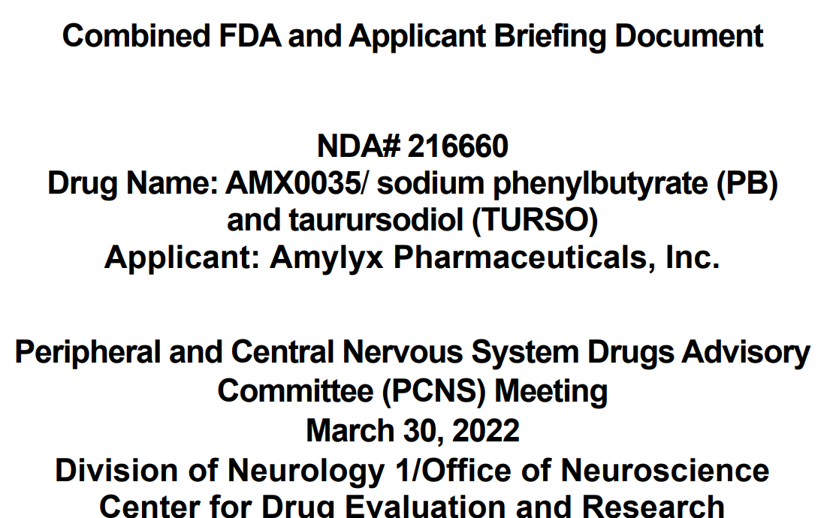
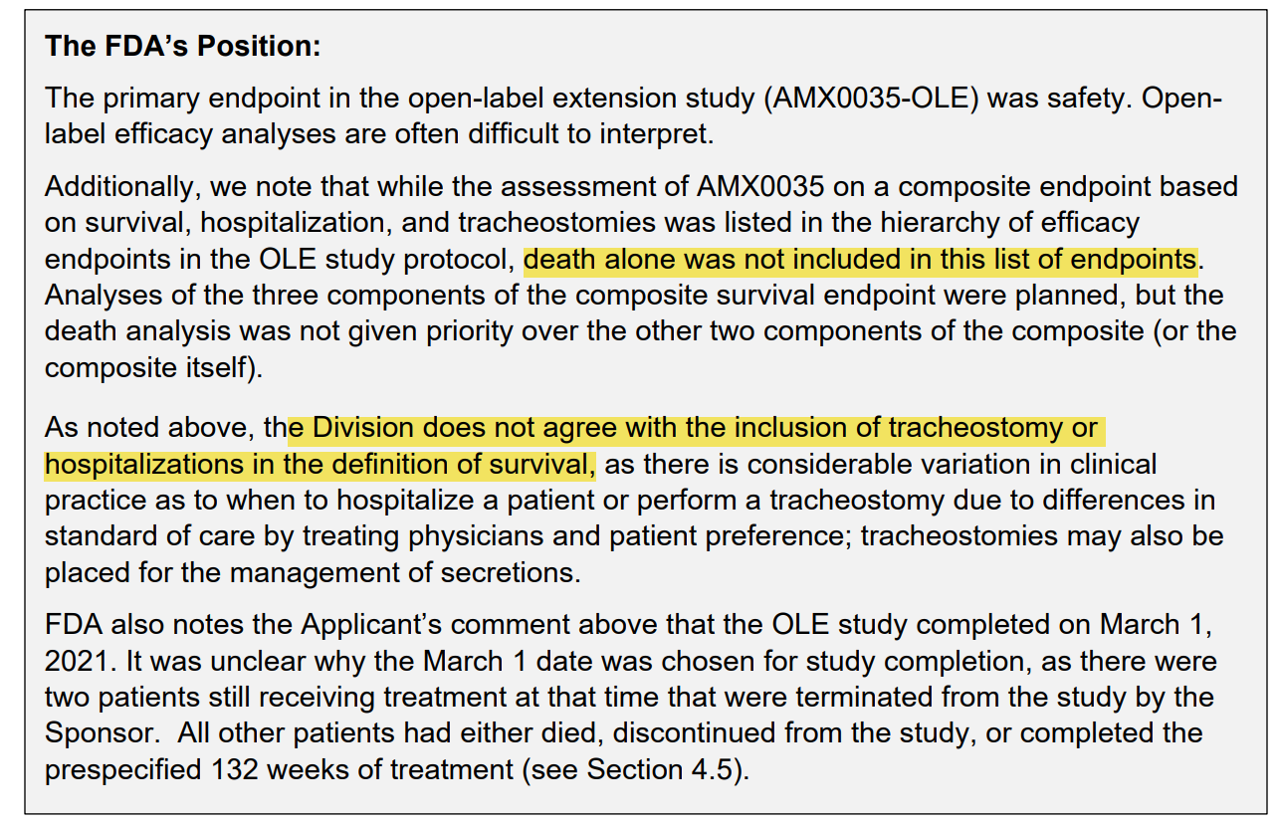
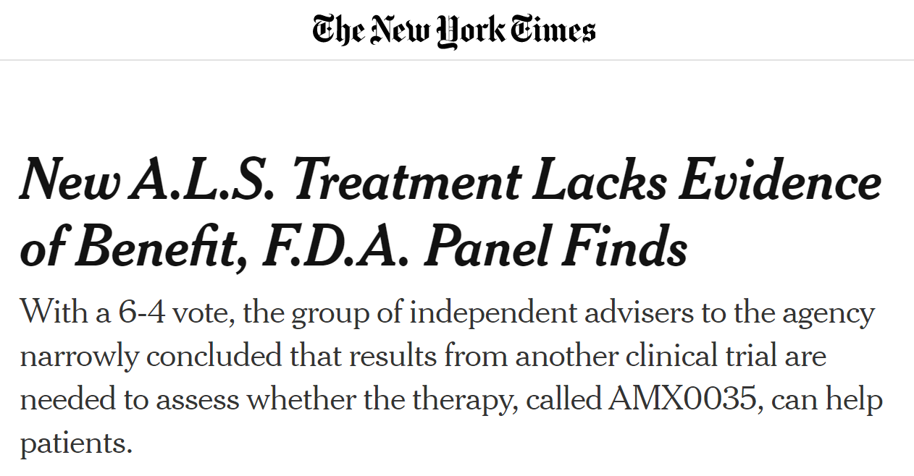
FDA Specialty Panel Concerns
Dr Jay K. Varma | https://drjayvarma.com

Slide 34
FDA Reviews Again – Approves
“residual uncertainty about the evidence of effectiveness”
“without any significant safety signals of concern”
“given the serious and life-threatening nature of A.L.S. and the substantial unmet need, this level of uncertainty is acceptable in this instance”
https://www.accessdata.fda.gov/drugsatfda_docs/nda/2022/216660Orig1s000SumR.pdf
Dr Jay K. Varma | https://drjayvarma.com

Slide 35
What GRADE Says
“In general, evidence based on surrogate outcomes should usually trigger rating down, whereas the other types of indirectness will require a more considered judgment.”
Dr Jay K. Varma | https://drjayvarma.com

