Slide 1
Evidence-Based Decision Making
in Healthcare
Risk of Bias in Studies and Publication Bias
Dr. Jay K. Varma
https://drjayvarma.com
Dr. Jay K. Varma | https://drjayvarma.com
Notes:
1

Slide 2
GRADE
Summary of evidence and systematic approach to make recommendations
Reviews quality of evidence with the study design
5 reasons to rate down, 3 reasons to rate up
Dr. Jay K. Varma | https://drjayvarma.com

Slide 3
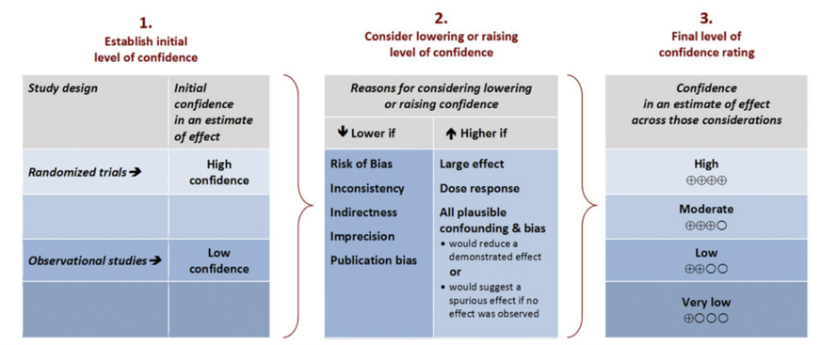
Rating Quality of Evidence
Source: Environment International 2016
Dr. Jay K. Varma | https://drjayvarma.com

Slide 4
Rating Quality of Evidence
Source: Environment International 2016
Dr. Jay K. Varma | https://drjayvarma.com

Slide 5
Grading Quality of Evidence
Grade | Definition
High | We are very confident that the true effect lies close to that of the estimate of the effect
Moderate | We are moderately confident in the effect estimate: the true effect is likely to be close to the estimate of the effect, but there is a possibility that it is substantially different
Low | Our confidence in the effect estimate is limited: the true effect may be substantially different from the estimate of the effect
Very Low | We have very little confidence in the effect estimate: the true effect is likely to be substantially different from the estimate of effect
Dr. Jay K. Varma | https://drjayvarma.com

Slide 6
Bias
A systematic error, or deviation from the truth, in results or inferences
Risk of bias may be different for each outcome
Risk of bias should be assessed within each studies and across all studies together
Risk of bias can downgrade, or reduce, the rating quality by one or two levels
Dr. Jay K. Varma | https://drjayvarma.com

Slide 7
Major Types of Bias in Clinical Trials
Selection bias, e.g., lack of allocation concealment
Performance bias, e.g., lack of blinding
Attrition bias, e.g., incomplete accounting of patients and outcome events
Selective outcome reporting bias
Dr. Jay K. Varma | https://drjayvarma.com

Slide 8
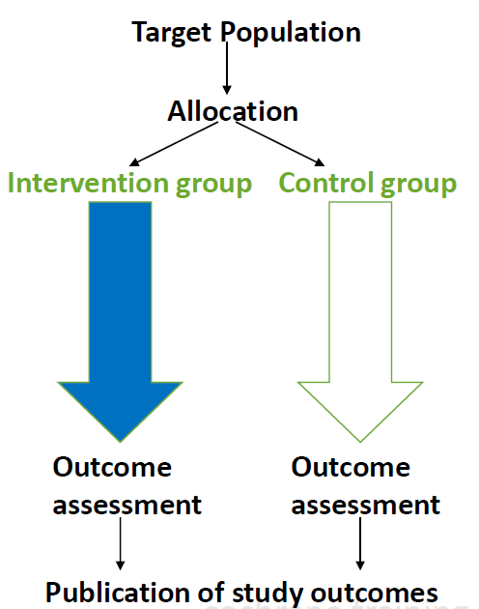
Trial Flow Chart
Source: Cochrane Training Guide
Dr. Jay K. Varma | https://drjayvarma.com

Slide 9
SELECTION BIAS
Dr. Jay K. Varma | https://drjayvarma.com

Slide 10
Selection Bias
Sampling of a population for a study should, ideally, be randomized, blinded, and representative of the population that will receive the test or treatment
Limits likelihood that results represent “truth”
Limits generalizability – can you apply these results to your population in real life and get similar results?
Dr. Jay K. Varma | https://drjayvarma.com
Notes:
Lack of Allocation Concealment (Selection Bias)
Lack of Blinding (Performance Bias)
Incomplete Accounting of Patients and Outcome Events (Attrition Bias)
Selective Outcome Reporting Bias
Other Limitations

Slide 11
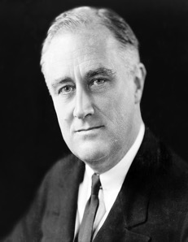
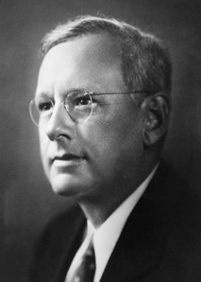
A Famous Example Outside Medicine
1936 election
Democratic President Franklin D. Roosevelt
Republican Alf Landon
A referendum on Roosevelt’s progress on Great Depression
Dr. Jay K. Varma | https://drjayvarma.com

Slide 12
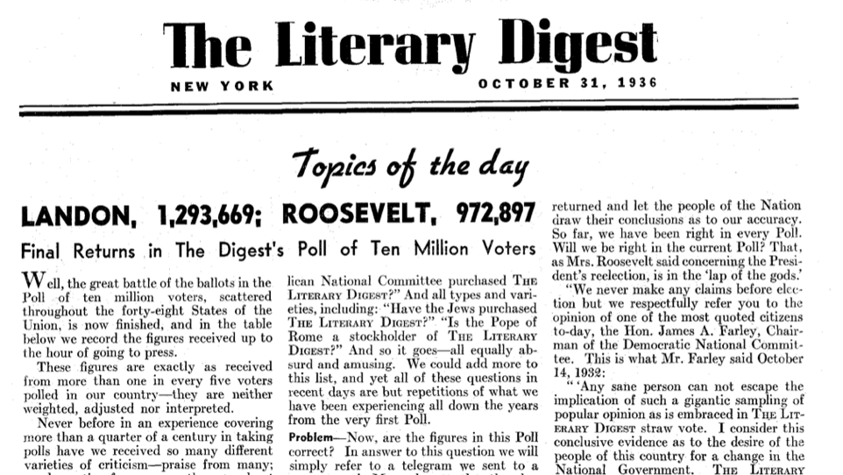

Slide 13
Literary Digest 1936 Poll
Poll set to ~10M people
~2.4M responses
Dr. Jay K. Varma | https://drjayvarma.com

Slide 14
Literary Digest 1936 Poll
Poll set to ~10M people
~2.4M responses
Landon by a landslide (>60%)
Dr. Jay K. Varma | https://drjayvarma.com

Slide 15
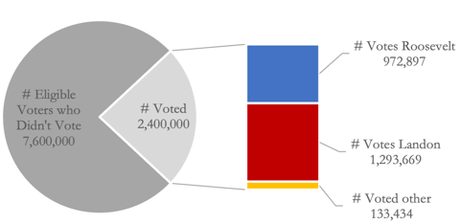
Literary Digest
Poll response rate = 24%
Dr. Jay K. Varma | https://drjayvarma.com

Slide 16
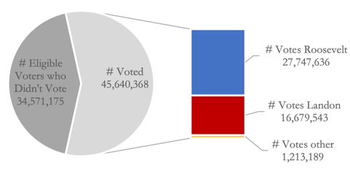
Literary Digest
Actual Vote
Poll response rate = 24%
Actual voter turnout = 57%
Dr. Jay K. Varma | https://drjayvarma.com

Slide 17
Actual Result
Dr. Jay K. Varma | https://drjayvarma.com

Slide 18
How Did Literary Digest Poll Fail?
Context: 1936, Great Depression
Sampled homes using telephone numbers obtained from magazine subscriptions and club memberships
Who is rich enough to have these memberships?
Who has a phone?
Who has a reliable address?
Who has time and interest to fill out a poll?
Dr. Jay K. Varma | https://drjayvarma.com

Slide 19
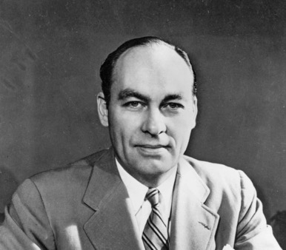
Did Gallup Get It Right?
1936 Presidential Poll
Sample size 50,000
“randomized” sampling
Predicted Roosevelt Victory 56% (reality would be 61%)
Limitation: no effort to replicate population proportions
Dr. Jay K. Varma | https://drjayvarma.com

Slide 20

Framingham Heart Study
Intended to identify risk factors for developing cardiovascular disease
Initiated in 1948
Initially recruited 5,209 people without cardiovascular disease
Prospective cohort design
Dr. Jay K. Varma | https://drjayvarma.com

Slide 21
Impact of Framingham Study
Considered one of the most important prospective observational studies ever conducted
Source of concept of identifying and quantifying “risk factors” for chronic disease
Identified smoking, hypertension, hyperlipidemia, and obesity as risk factors
Identified aspirin as protective factor
Dr. Jay K. Varma | https://drjayvarma.com

Slide 22
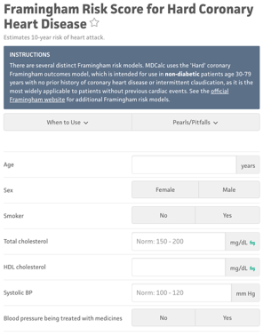
Impact of Framingham Study
“Framingham risk score”
Over 3000 manuscripts published based on study
Dr. Jay K. Varma | https://drjayvarma.com

Slide 23
Limitations of Framingham Study
Almost entirely white ethnic cohort
One small geographic area
Very narrow range of socioeconomic diversity:
Initial participants were themselves the very doctors and nurses performing the study
Spread to their friends and acquaintances through social networks
Dr. Jay K. Varma | https://drjayvarma.com

Slide 24
Selection Bias in Framingham Study
Dr. Jay K. Varma | https://drjayvarma.com

Slide 25
Generalizability of Framingham Study
Not a random sample
Not reflective of national population
Additional studies funded subsequently, including Jackson Heart Study, to “over-sample” black population
Dr. Jay K. Varma | https://drjayvarma.com

Slide 26
PERFORMANCE BIAS
Dr. Jay K. Varma | https://drjayvarma.com

Slide 27
Performance Bias = Lack of Blinding
Blinding means people involved in study do not know who is getting intervention and who is getting placebo/control
Patients
Researchers
Recorders and/or adjudicators of outcomes
Data analysts
Dr. Jay K. Varma | https://drjayvarma.com
Notes:
Reduces bias in care, testing, recording outcomes, and interpretation of results

Slide 28
Why Is Blinding Important?
Reduces bias in care, testing, recording outcomes, and interpretation of results
Such bias is subtle and may not be perceptible
Ideally study report should specify which groups were blinded, how blinding was maintained, and whether there were violations of blinding
Dr. Jay K. Varma | https://drjayvarma.com

Slide 29
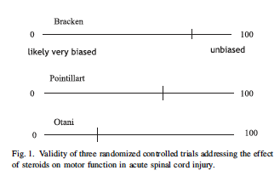
Example from Reading
3 clinical trials assessed impact of steroids on all-cause mortality and physical function in patients with spinal injury
One trial did not blind patients or doctors to steroids vs. placebo
Can bias assessment of physical function
Dr. Jay K. Varma | https://drjayvarma.com

Slide 30
ATTRITION BIAS
Dr. Jay K. Varma | https://drjayvarma.com

Slide 31
Accounting of Patients & Outcomes
Loss to follow-up
Failure to adhere to intention-to-treat or failure to conduct analyses considering only those who adhered to treatment and all patients for whom outcome data are available
Dr. Jay K. Varma | https://drjayvarma.com

Slide 32
Loss to Follow-Up
Importance of loss to follow-up varies widely
Loss to follow-up of 5% in both intervention and control groups unlikely to bias study if event rates were 20% and 40%, respectively
Bias increased if
Increased proportion lost to follow-up in relation to intervention and control event rates
Differences in loss to follow-up between intervention and control groups
Dr. Jay K. Varma | https://drjayvarma.com

Slide 33
Incomplete Assessment of Outcomes
Some outcomes should be easier to achieve completeness: all cause mortality (is study patient alive at end of study?)
Other outcomes require complete assessment, e.g., quality of life
Dr. Jay K. Varma | https://drjayvarma.com

Slide 34
Mitigating Bias During Analysis
Could loss to follow-up or incomplete outcome assessment change results in an important way?
Binary outcome: Test a variety of assumptions
Code missing as “dead” -> one extremne
Code missing as “alive” -> other extreme
True effect lies between extremes
Continuous outcome: Conduct sensitivity analyses
Dr. Jay K. Varma | https://drjayvarma.com

Slide 35
SELECTIVE REPORTING BIAS
Dr. Jay K. Varma | https://drjayvarma.com

Slide 36
Selective Outcome Reporting
Incomplete reporting of some outcomes and not others – generally to suppressing negative and undesirable findings
May result in policy or practice using an intervention when it may not be beneficial
Downgrade quality when using the GRADE framework
Dr. Jay K. Varma | https://drjayvarma.com

Slide 37
Bias in Changing Study Endpoints
Some investigators change endpoints even after registering a protocol
Can influence results
Statistically significant results with a changed primary endpoint can be misleading
Adequately Registered RCTs
147 Adequately registered RCTs in cardiology, gastroenterology, and rheumatology
Influence on Outcome
Influence of the discrepancy could only be measured in 23 of 46 RCTs
31%
50%
83%
Statistical Significance
19 of 23 RCTs demonstrated statistically significant results
Change in Starting and Ending Endpoints
46 RCTs had discrepancies between registered vs. published primary endpoints
Source: Mathieu S, Boutron I, Moher D, Altman DG, Ravaud P. Comparison of registered and published primary outcomes in randomized controlled trials. JAMA 2009;302:977e84.
Dr. Jay K. Varma | https://drjayvarma.com

Slide 38
Bias from Unreported Outcomes
One study found >1 efficacy outcome that was not reported in 33% of RCTs in PubMed in 2000
Fully or partially reported outcomes are 2x as likely to have statistically significant efficacy results vs. unreported outcomes
Source: Chan AW, Altman DG. Identifying outcome reporting bias in randomized trials on PubMed: review of publications and survey of authors. BMJ 2005;330:753.
Dr. Jay K. Varma | https://drjayvarma.com

Slide 39
How to Detect Selective Reporting Bias
Study protocol from before the study started
Suspect reporting bias if: 1) the study does not include a key expected outcome or 2) composite outcomes are presented without individual component outcomes
Consider rating down a body of evidence if suspecting selective reporting bias
Dr. Jay K. Varma | https://drjayvarma.com

Slide 40
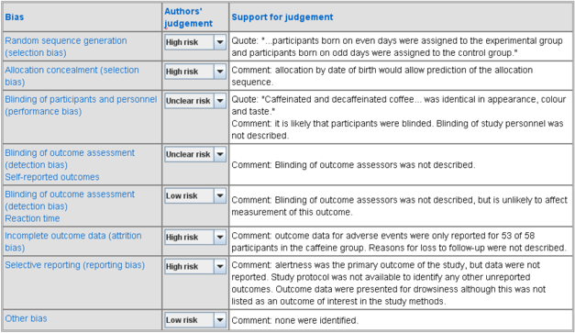
An Example of Table Assessing Bias
Source: Cochran Reviews, Chapter 8
Dr. Jay K. Varma | https://drjayvarma.com

Slide 41
PUBLICATION BIAS
Dr. Jay K. Varma | https://drjayvarma.com

Slide 42
Defining Publication Bias
Selective reporting bias = study published, but negative outcomes not reported
Publication bias = study not published at all because of negative outcomes
Systematic reviews when only a few studies are available can overestimate effects, because positive studies more likely to be published initially
Dr. Jay K. Varma | https://drjayvarma.com

Slide 43
Positive Findings
Negative Findings
~73% published
~Published within 4-5 yrs
~41% published
~Published within 6-8 yrs
Dr. Jay K. Varma | https://drjayvarma.com

Slide 44
Gray Literature
Theses, book chapters, compendia of meeting abstract submissions
Authors may
Perceive studies as uninteresting and not see
Deterred by rejection from prominent journals
Submit studies to local, non-English journals
Leads to publishing in obscure journals not indexed at major databases
Dr. Jay K. Varma | https://drjayvarma.com
Notes:
Theses, book chapters, compendia of meeting abstract submissions
Frequently omitted from systematic reviews without comprehensive searching
Authors may
Perceive studies as uninteresting and not seek publishing
Be deterred by repeated rejection at prominent journals
Submit studies to local, non-English journals
Leads to publishing in obscure journals not indexed at major databases

Slide 45

Mirror Image Phenomenon
A study may be published more than once with slight variations (different authors, presentation) and lead to double counting results in systematic reviews
Dr. Jay K. Varma | https://drjayvarma.com

Slide 46
Randomized Controlled Trials
The risk of publication bias may be higher for reviews that are based on small randomized controlled trials (RCTs), whereas RCTs including large numbers of patients are less likely to remain unpublished or ignored and tend to provide more precise estimates of the treatment effect, whether positive or negative
Discrepancies between results of meta-analyses of small studies and subsequent large trials may occur as often as 20% of the time, and publication bias may be a major contributor to the discrepancies
Although large studies are more likely to be published, sponsors who are displeased with the results may delay or even suppress publication
Dr. Jay K. Varma | https://drjayvarma.com

Slide 47
Observational Studies
Risk of publication bias is larger for observational studies than for RCTs
Considered lower standard of evidence, so more likely to be rejected by prominent journals, especially if “negative” findings (eg, no effect shown)
Dr. Jay K. Varma | https://drjayvarma.com

Slide 48
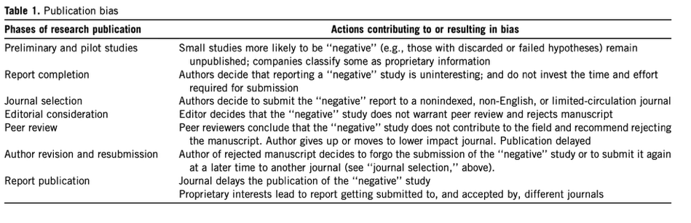
Dr. Jay K. Varma | https://drjayvarma.com

Slide 49
Assessment of Publication Bias
The pattern of study results can indicate bias
Funnel plots are most popular, but have limitations
Suspicion increases if asymmetrical rather than symmetrical data surrounding the pooled estimate
Dr. Jay K. Varma | https://drjayvarma.com

Slide 50
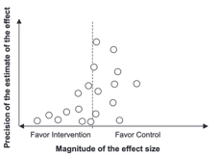
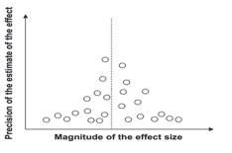
Funnel Plot
Larger studies tend to be closer to the pooled estimate
Effect sizes of smaller studies symmetrically distributed around pooled estimate
Smaller studies not symmetrically distributed around either pooled estimate or the results of the larger trials
Trials expected in the bottom right quadrant are missing
Dr. Jay K. Varma | https://drjayvarma.com

Slide 51
Pitfalls of Funnel Plots
Publication bias not only explanation for asymmetry
If smaller studies suffer from greater study limitations, they may yield biased overestimates of effects
A more restricted study population or a more careful administration of the intervention may reveal a larger effect in the small studies
Dr. Jay K. Varma | https://drjayvarma.com

Slide 52
Challenges in Publication Bias
Difficult to be confident publication bias is absent
GRADE suggests saying publication bias are ‘‘undetected’’ and ‘‘strongly suspected’’
GRADE suggests rating down a maximum of one level (rather than two) for suspicion of publication bias
Dr. Jay K. Varma | https://drjayvarma.com

Slide 53
Example of Publication Bias in Medicine
In 1980, a clinical trial of an anti-arrhythmic drug ‘Lorcainide’ was conducted in 100 patients. Half of the patients were given Lorcainide, half given a placebo
10 patients given the drug died vs. 1 patients given placebo died
Results never published, and development of drug halted. Other companies pursued developed and sold of anti-arrhythmic drugs.
~100,000 patients prescribed these drugs died. Unpublished 1980 results could have prevented some of these deaths.
Dr. Jay K. Varma | https://drjayvarma.com
Notes:
https://pubmed.ncbi.nlm.nih.gov/8349379/

Slide 54
Example of Publication Bias in Medicine
Seven studies were conducted to compare Reboxetine, an antidepressant, with a placebo. One of these was positive and subsequently published. Other six were negative and left unpublished.
Three trials were published comparing reboxetine with other antidepressants where reboxetine was just as effective; however, three times as many patients' worth of data was collected that showed reboxetine was worse than the other treatments.
Dr. Jay K. Varma | https://drjayvarma.com
Notes:
https://pubmed.ncbi.nlm.nih.gov/8349379/

Slide 55
Summary
Publication bias can result in substantial overestimates of effect
Suspect when evidence comes from small studies, most of which have been commercially funded
Funnel Plot is most commonly used to assess for publication bias, but has limitations
Dr. Jay K. Varma | https://drjayvarma.com

