Slide 1
Evidence-Based Decision Making in Healthcare
Summarizing Evidence
Dr. Jay K. Varma
https://drjayvarma.com
Dr Jay K Varma | https://drjayvarma.com
Notes:
1

Slide 2
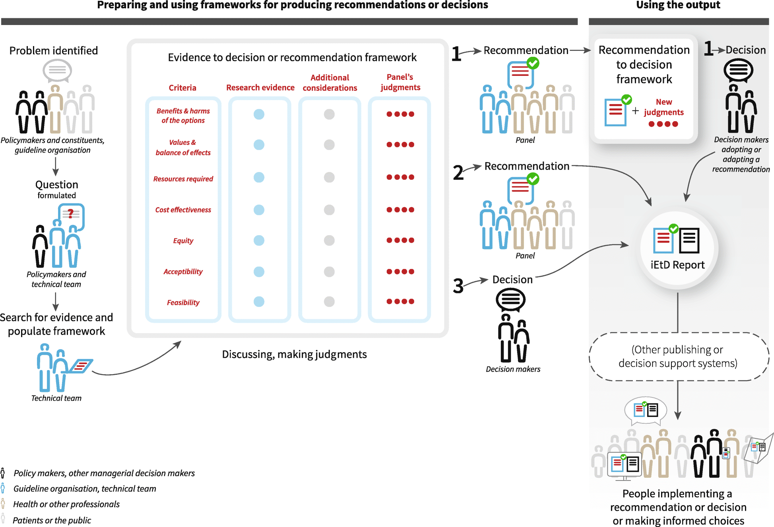
https://health-policy-systems.biomedcentral.com/articles/10.1186/s12961-018-0320-2/figures/1
Dr Jay K Varma | https://drjayvarma.com
Notes:
https://health-policy-systems.biomedcentral.com/articles/10.1186/s12961-018-0320-2/figures/1

Slide 3
Common Problems
Rating quality is subjective
Reasonable people will disagree
GRADE approach is rigid
Requires you to judge quality using discrete categories
But quality is a continuum and multiple small problems across different categories may lower overall quality substantially
Dr Jay K Varma | https://drjayvarma.com

Slide 4
Example to Review
Should catch-up HPV vaccination be recommended for primary prevention of HPV infection and HPV-related disease for all persons ages 27 through 45 years?
Dr Jay K Varma | https://drjayvarma.com

Slide 5
Example to Review
Population: Persons aged 27 through 45 years at initiation of vaccination
Intervention: Catch-up vaccination with 3 doses of HPV vaccine
Comparison: Persons aged 27 through 45 years with no catch-up HPV vaccination
Outcome: Primary prevention of HPV infection and HPV-related disease
Dr Jay K Varma | https://drjayvarma.com

