Slide 1
Evidence-Based Decision Making
in Healthcare
Designing Studies on Health Issues
Dr. Jay K. Varma
https://drjayvarma.com
Dr Jay K Varma | https://drjayvarma.com
Notes:
1

Slide 2
Why Do Studies?
Identify who is getting sick, e.g., age, location, race, other health conditions
Generate ideas about why people are getting sick
These are called “descriptive studies”
Dr Jay K Varma | https://drjayvarma.com

Slide 3
Why Do Studies?
Prove that X causes Y
Test whether an action prevents sickness or cures people who are sick
These are called “analytical studies”
Dr Jay K Varma | https://drjayvarma.com

Slide 4
Basic Design of Studies
Define an exposure, e.g., eating apples
Define an outcome, e.g., having a heart attack
Count the number of people with the exposure
Count the number of people with the outcome
Calculate the relationship between exposure and outcome using division and statistical methods
Dr Jay K Varma | https://drjayvarma.com

Slide 5
All Studies
Descriptive
Qualitative
Quantitative
Dr Jay K Varma | https://drjayvarma.com

Slide 6
All Studies
Descriptive
Analytic
Observational
Qualitative
Quantitative
Cohort study
Cross-sectional
(Analytic)
Case-control study
Investigator has no control over which people get exposed
Dr Jay K Varma | https://drjayvarma.com

Slide 7
All Studies
Descriptive
Analytic
Experimental
Observational
Qualitative
Quantitative
Controlled Trial
Cohort study
Randomized Controlled Trial
Cross-sectional
(Analytic)
Investigator controls which people get exposed
Case-control study
Investigator has no control over which people get exposed
Dr Jay K Varma | https://drjayvarma.com

Slide 8
Descriptive Studies
Qualitative studies
Collect unstructured information from participants
Ask people to tell you about a problem
“narrative”
Quantitative studies
Collect structured information from participants
yes/no, multiple choice
“survey”
Dr Jay K Varma | https://drjayvarma.com

Slide 9
Descriptive Studies
Help you generate ideas about how an exposure and outcome may be related
We interviewed hundreds of people
Most of those who said they had a heart attack said they often eat candy
Could eating candy cause heart attacks?
Dr Jay K Varma | https://drjayvarma.com

Slide 10
Analytical Studies
Allow you to test a hypothesis
Observational = investigator has no control over who was exposed or not
Controlled = investigator decides which patients get exposed and which do not
Dr Jay K Varma | https://drjayvarma.com

Slide 11
Does Candy Cause Heart Attacks?
Cross-sectional
Interview people
Did you ever have a heart attack?
How much candy do you eat every week?
What % of people who had a heart attack said they eat candy every week VS % of people who have never had a heart attack that eat candy every week?
Dr Jay K Varma | https://drjayvarma.com

Slide 12
Does Candy Cause Heart Attacks?
Case-Control
Cases: visit ER, diagnosed with heart attack
Controls: visit ER, no heart attack
Ask each group how much candy they eat
Do cases (heart attack) have a greater percentage of people that eat candy than controls (no heart attack)?
Dr Jay K Varma | https://drjayvarma.com

Slide 13
Does Candy Cause Heart Attacks?
Cohort
Enroll 1000 people in a study
Interview them today and check in on them every three months for next five years
What percentage of people that developed a heart attack in those 5 years also reported eating candy every week vs. those that did not have a heart attack during those 5 years?
Dr Jay K Varma | https://drjayvarma.com

Slide 14
Does Candy Cause Heart Attacks?
Controlled Trial
Enroll 1000 people in a study
Ask 500 people to eat candy every week
Ask 500 people not to eat candy every week
Interview them today and check in on them every three months for next five years
What percentage of people developed heart attack in candy group vs. no candy group?
Dr Jay K Varma | https://drjayvarma.com

Slide 15
Does Candy Cause Heart Attacks?
Randomized Controlled Trial
Enroll 1000 people in a study
Randomly assign people to
Eat candy every week
Not to eat candy every week
Interview them today and check them every 3 months for next 5 years
What percentage of people developed heart attack in candy group vs. no candy group?
Dr Jay K Varma | https://drjayvarma.com

Slide 16
Systematic Review & Meta-Analysis
Search databases of research to find all studies on your topic
Review them in a standardized way
Summarize your findings
Meta-analysis is when you do the review above AND use special statistical methods to combine the results and report a composite result
Dr Jay K Varma | https://drjayvarma.com

Slide 17
Does Candy Cause Heart Attacks?
Meta-Analysis
Search databases to find all studies that compared heart attacks and candy consumption
Select those studies that are highest quality, e.g., all the randomized controlled trials
Use statistical methods to calculate a composite estimate of whether candy causes heart attacks
Dr Jay K Varma | https://drjayvarma.com

Slide 18
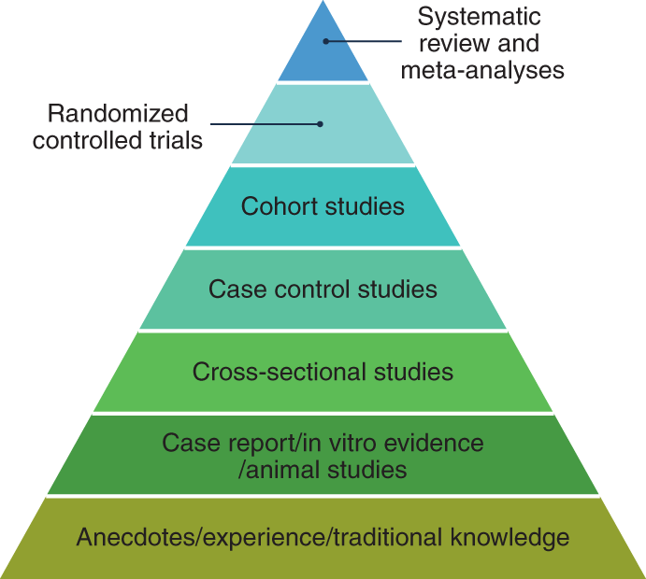
Hierarchy of Evidence
https://www.nature.com/articles/s43016-021-00388-5/figures/1
Dr Jay K Varma | https://drjayvarma.com
Notes:
https://www.nature.com/articles/s43016-021-00388-5/figures/1

Slide 19
Hierarchy of Evidence - Critique
Not always ethical or practical to do an RCT
Emergency
Public health policy
Disease incidence is low
RCTs have strict enrollment criteria, so do not always reflect who gets medicine in real world
Dr Jay K Varma | https://drjayvarma.com

Slide 20
Hierarchy of Evidence - Critique
Meta-analyses considered the highest standard, but susceptible to “garbage in, garbage out”
Observational studies are valuable
Represent what happens in real world
Can measure outcomes that only occur after a long time (decades, rather than years for RCT)
Can measure outcomes that occur rarely (e.g., 1 in a million)
Dr Jay K Varma | https://drjayvarma.com

Slide 21
Causal Inference
Does X truly cause Y?
The challenge of all health-related studies
Criteria proposed originally in 1965 by British epidemiologist Austin Bradford Hill, who helped “prove” that cigarettes “cause” lung cancer
Others have critiqued, but still widely used
Dr Jay K Varma | https://drjayvarma.com

Slide 22
Causal Inference
1. Strength: the magnitude of the effect
2. Consistency: the association is consistent when results are replicated with studies done in different settings using different methods
3. Specificity: doing X causes Y to happen; doing Z does not cause Y to happen
Dr Jay K Varma | https://drjayvarma.com

Slide 23
Causal Inference
4. Temporality: Exposure first, disease second
5. Dose-response: More exposure, more disease; less exposure, less disease
6. Experimental evidence: an experiment that interrupts the causal pathway prevents disease; an experiment that amplifies the causal pathway increases disease
Dr Jay K Varma | https://drjayvarma.com

Slide 24
Causal Inference
7. Biologically plausible: Association between X and Y is supported by laboratory studies and basic science
8. Coherence: Association compatible with existing theory and knowledge (similar to biologically plausible)
9. Analogy: Similar factors cause similar diseases, e.g., something similar to asbestos causes a different type of lung disease
Dr Jay K Varma | https://drjayvarma.com

Slide 25
Cause is Multiple Components
One disease can have multiple causes
Each cause can have multiple components
Some components necessary
Some components sufficient
Some components neither
Dr Jay K Varma | https://drjayvarma.com

Slide 26
Necessary, Sufficient, Neither?
Exposure to influenza virus necessary, but not sufficient, to make you sick from the flu
Cigarettes cause lung cancer, but cigarettes are neither necessary nor sufficient to cause lung cancer
Some people get lung cancer without smoking
Some people smoke, but never get lung cancer
HIV is both necessary and sufficient to cause AIDS
Dr Jay K Varma | https://drjayvarma.com

Slide 27
Evidence-Based Decision Making
This course starts with understanding how evidence is generated in health-related studies
Next two lectures
Observational studies
Randomized controlled trials
Subsequent lectures will discuss how to evaluate different types of studies for bias
Dr Jay K Varma | https://drjayvarma.com

