Slide 1
Evidence-Based Decision Making
in Healthcare
Observational Studies
Jay K. Varma, MD
https://drjayvarma.com
Dr Jay K Varma | https://drjayvarma.com
Notes:
1

Slide 2
All Studies
Descriptive
Analytic
Experimental
Observational
Qualitative
Quantitative
Controlled Trial
Cohort study
Randomized Controlled Trial
Cross-sectional
(Analytic)
Investigator controls which people get exposed
Case-control study
Investigator has no control over which people get exposed
Dr Jay K Varma | https://drjayvarma.com

Slide 3
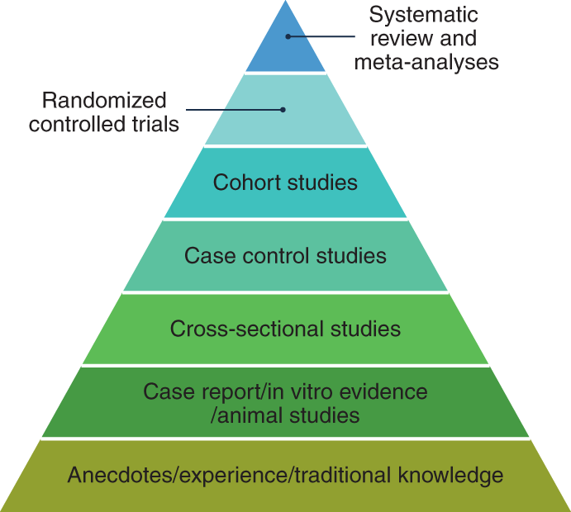
Hierarchy of Evidence
https://www.nature.com/articles/s43016-021-00388-5/figures/1
Dr Jay K Varma | https://drjayvarma.com

Slide 4
Cross-Sectional: Design
Interview, examine, and/or test large group of people
Classify
Patient characteristics
Exposures
Outcomes
Dr Jay K Varma | https://drjayvarma.com

Slide 5
Cross-Sectional: Measurement
Prevalence: X% of people have Y condition
Correlation: X% of people with Y condition are old, have arthritis, and live in the Northeast
Everything depends on:
How representative your sample population is
How you defined exposures & outcomes
How you measured exposures & outcomes
Dr Jay K Varma | https://drjayvarma.com
Notes:
ss

Slide 6
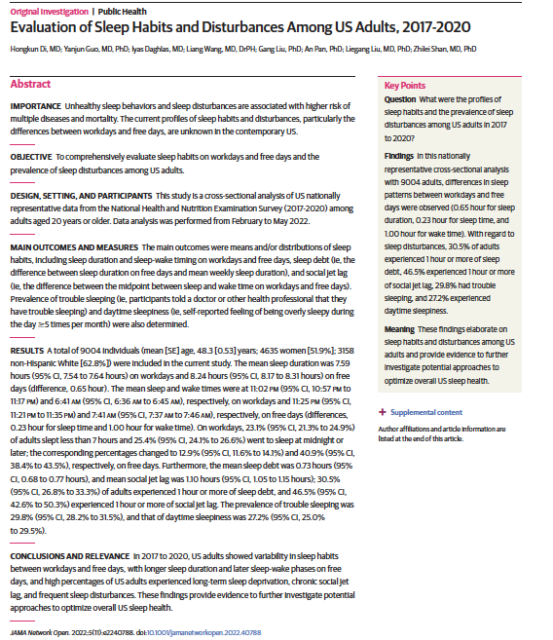
Dr Jay K Varma | https://drjayvarma.com
Notes:
s

Slide 7
Dr Jay K Varma | https://drjayvarma.com
Notes:
s

Slide 8
Dr Jay K Varma | https://drjayvarma.com
Notes:
s

Slide 9
Dr Jay K Varma | https://drjayvarma.com
Notes:
s

Slide 10
Dr Jay K Varma | https://drjayvarma.com
Notes:
s

Slide 11
Case-Control: Design
Define a case using strict criteria
Define a control using similar criteria
Should have had equal opportunity to be exposed to the factor you are concerned about
These are (almost always) retrospective studies
The outcome has already happened
You are now trying to figure out factors that led to that outcome
Dr Jay K Varma | https://drjayvarma.com

Slide 12
Case-Control: Design
Some students report they started vomiting after attending class on March 25th
All of them said they ate lunch that day
Can we figure out what the cause might be?
Dr Jay K Varma | https://drjayvarma.com

Slide 13
Case-Control: Design
Cases:
Students who attended EMBA class on March 25th
and
Developed vomiting on March 25, 26, 27, or 28
Who are the controls?
Dr Jay K Varma | https://drjayvarma.com

Slide 14
Case-Control Studies: Design
Cases:
Adults who attended EMBA class on March 25th
and
developed vomiting on March 25, 26, 27, or 28
Controls
Adults who attended EMBA class on March 25th
and
Did not have vomiting on March 25, 26, 27, or 28
Dr Jay K Varma | https://drjayvarma.com

Slide 15
Case-Control: Design
Interview, examine, test cases and controls using the same identical methods
If asking, “did you eat any food from the salad bar on March 25th,” make sure you phrase question exactly the same for cases and control
Ideally interviewers and examiners are “blinded” to who is a case and who is a control
Dr Jay K Varma | https://drjayvarma.com

Slide 16
Case-Control: Measurement
Analyze exposures for cases and control
Calculate an “odds ratio”
A number > 1 = risk factor
A number < 1 = protective factor
Dr Jay K Varma | https://drjayvarma.com

Slide 17
Case-Control: Measurement
 | Cases | Controls | Total
Ate salad | 10 | 5 | 20
Did not eat salad | 20 | 50 | 120
Total | 30 | 55 | 85
50% of cases vs. 10% of controls ate salad on March 25th
Odds ratio = (10/20) / (5/50) = 5.0
The odds of eating salad were five times greater in those that developed vomiting that those that did not
Eating salad is a risk factor for vomiting
Dr Jay K Varma | https://drjayvarma.com

Slide 18
Case-Control: Pros and Cons
Pros | Cons
Excellent for diseases that are rare or with long lag between exposure & disease | Difficult if exposure is not common
Cheap and quick | Selection bias, especially with controls
No loss to follow-up | Observation bias when collecting information about exposures
Dr Jay K Varma | https://drjayvarma.com

Slide 19
Cohort: Design
Define a large group
Interview members of the group for exposures that you are interested in
Follow them over time: interview, examine, and test at regular intervals
Can also enroll more than one group and compare the outcomes in the different groups
Dr Jay K Varma | https://drjayvarma.com

Slide 20
Cohort: Measurement
Compare % of people with an outcome who had an exposure vs. % of people with an outcome who did not have that exposure
If disease rate is higher in a group exposed to X compared to a group not exposed to X, then exposure to X is a risk factor for the disease
Dr Jay K Varma | https://drjayvarma.com

Slide 21
Cohort: Framingham Heart Study
Started in 1948
5,209 people from Framingham, Massachusetts
Interviews, physical examinations, blood tests
Followed over time for heart disease and strokes
Dr Jay K Varma | https://drjayvarma.com

Slide 22
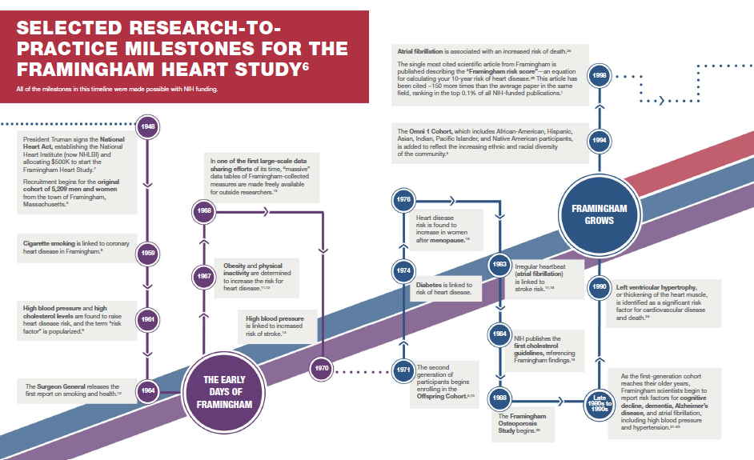
https://www.nih.gov/sites/default/files/about-nih/impact/framingham-heart-study.pdf
Dr Jay K Varma | https://drjayvarma.com

Slide 23
Cohort: Measurement
 | Heart Attack | No Heart Attack | Total
Eat apples | 200 | 3800 | 4000
Don’t eat apples | 100 | 900 | 1000
Total | 300 | 4700 | 5000
200/4000 (5%) of those that eat apples regularly got a heart attack after five years vs. 10/1000 (10%) that do not
Relative risk of heart attack is 5/10 for eating apples = 0.5 = the risk of developing a heart attack is 50% less in those that apples compared with those that do not eat apples
Dr Jay K Varma | https://drjayvarma.com

Slide 24
Cohort: Pros and Cons
Pros | Cons
Higher quality data than other observational studies regarding exposure | Expensive and time-consuming
Less prone to bias because exposure assessed before outcome occurs | Hard to do if long lag between exposure and disease onset
 | Loss to follow-up can make it hard to interpret findings
Dr Jay K Varma | https://drjayvarma.com

Slide 25
What Type of Study Is This?
Persons diagnosed with new-onset Lyme disease were asked how often they walk through woods, use insect repellant, wear short sleeves and pants, etc. Twice as many patients without Lyme disease from the same physician’s practice were asked the same questions, and the responses in the two groups were compared.
Dr Jay K Varma | https://drjayvarma.com

Slide 26
What Type of Study Is This?
Occurrence of cancer was identified between April 1991 and July 2002 for 50,000 troops who served in the first Gulf War (ended April 1991).
Dr Jay K Varma | https://drjayvarma.com

Slide 27
What Type of Study Is This?
Representative sample of residents were telephoned and asked how much they exercise each week and whether they currently have or have ever been diagnosed with heart disease.
Dr Jay K Varma | https://drjayvarma.com

