Slide 1
Class Overview & Prerequisite Review
ME 357

Slide 2
Introduction
Dr. Joseph M. Mahoney
jmm694@psu.edu
225 Gaige
Office Hours: TR 14:00-15:00, W 10:00-11:30, and by appointment
Textbooks
K. Ogata, System Dynamics, 4th ed., 2004
ISBN: 0131424629
3rd or 2nd edition acceptable (ISBN: 0136757456)
W.J. Palm, System Dynamics, 3rd ed., 2014
ISBN: 0073398063

Slide 3
Objectives
By the end of this section, you should
Understand purpose of system dynamics
Understand how system dynamics is applied to real-world problems
Review topics that will be used throughout course that you should already know
Laplace Transforms
Partial Fraction Expansion
Matrix/Linear Algebra
Electrical Components

Slide 4
System Dynamics
Describe real-world dynamic systems in terms of connected, idealized components with simple physics relations
Create and solve differential equations to analyze and predict behavior of system given initial conditions and/or external forcing
This course and vibrations are largely applied differential equations classes
Notes:
This is an applied math course

Slide 5
System Dynamics
Modeling
Turn physical systems (in this course: mechanical, electrical, fluid, thermal) into idealized/simplified models
Create systems of differential equations using models
Create transfer function or state space model of system
Analysis
Solve system of equations to predict system behavior
E.g., position, current, temperature over time
E.g., maximum values, response time
Find how system will behave when excited at different frequencies
Control
Modify or add components (e.g., stiffen springs, increase resistance) to adjust behavior of system (passive control)
Control input(s) into system to have it behave as desired (active control)
Notes:
Structure of course
make a differential equation
solve the differential equation
modify the differential equation to have a solution we desire

Slide 6
Real-World Applications
Mechanical
Design stiffness and damping of shock absorbers in car for smooth ride
Electrical
Design filters for electrical signals
Biological
Model cellular dynamics and see what different drugs will do
Create population model to recommend how many deer to hunt or fish to catch
Geoscience
Use climate models to predict magnitude and impact of global warming
Financial
Model economy and predict what inputs/changes in system (e.g., taxes, QE, Federal Funds Rate) will do
Notes:
This is a very short list of examples and domains
can explore in presentation

Slide 7
Prerequisite Topics
Laplace Transforms (Math 250/1)
Partial Fraction Expansion (Math 141)
Simultaneous Equations in Matrix Form (Math 220)
Electronic Components (EE 211, PHYS 212)
Prerequisite quiz on 1/22/2020. Similar to practice quiz posted to Canvas.
Notes:
These are all topics that you have covered before

Slide 8
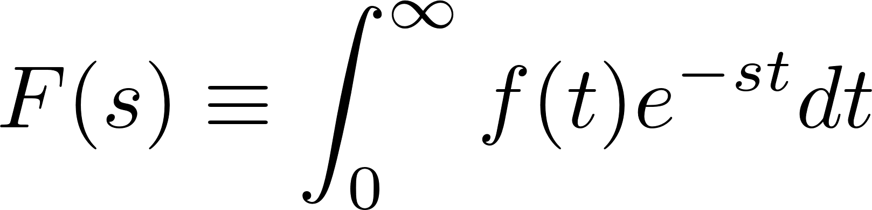
Laplace Transform
Used to solve ordinary differential equations
Finds dependent variable based on relationship to its time derivatives and external inputs
Solves homogeneous- and particular solution simultaneously
Uses initial conditions for solution
Used to find closed-form (total) solutions quicker and easier (sometimes) than other methods
Good for single-dependent-variable systems
Notes:
review this topic from Math 251
Can use LT table on quiz and exams

Slide 9
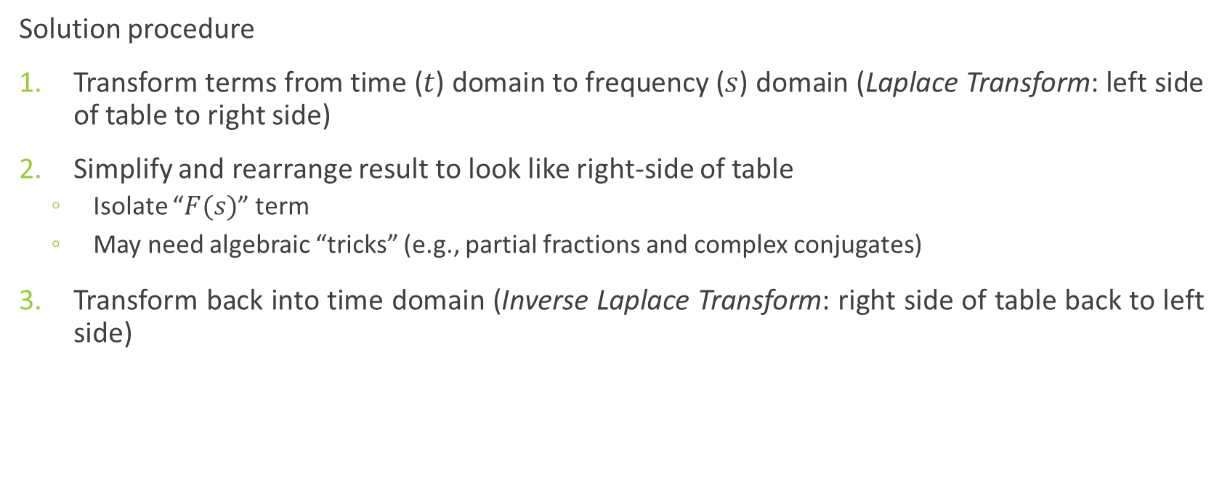
Laplace Transform
Solution procedure
Transform terms from time ($t$) domain to frequency ($s$) domain (Laplace Transform: left side of table to right side)
Simplify and rearrange result to look like right-side of table
Isolate “$F(s)$” term
May need algebraic “tricks” (e.g., partial fractions and complex conjugates)
Transform back into time domain (Inverse Laplace Transform: right side of table back to left side)
Notes:
You may use the table on homework, quizzes and exams

Slide 10
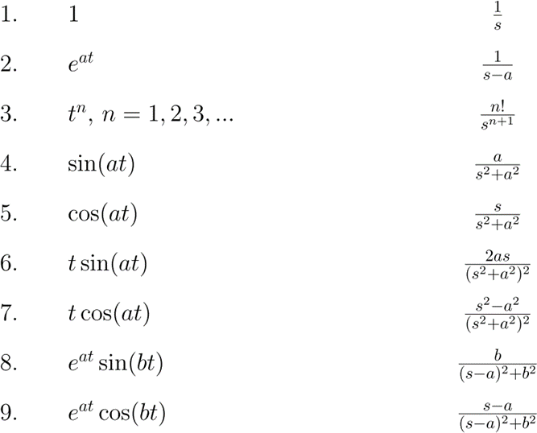
Laplace Transform Table (1)
Notes:
this has the more common terms but is not exuastive. You may need a more extensive table or to use algebraic "tricks" to have terms look like these

Slide 11
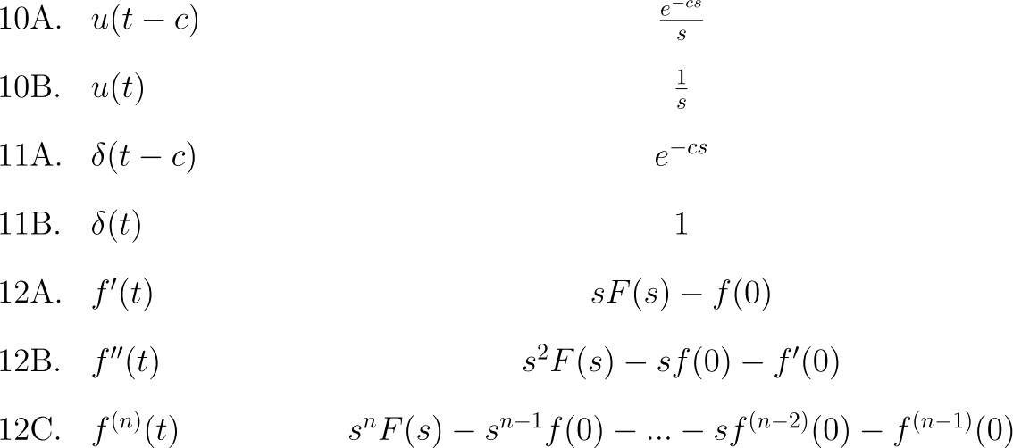
Laplace Transform Table (2)
Notes:
the delta term is the Dirac delta

Slide 12
Laplace Transform Rules
Notes:
You have to use a convolution integral for multiplication

Slide 13
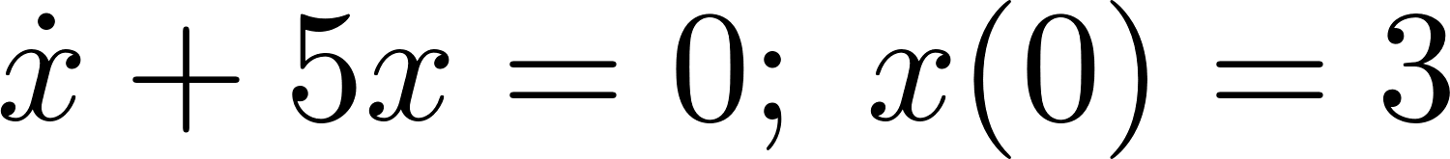
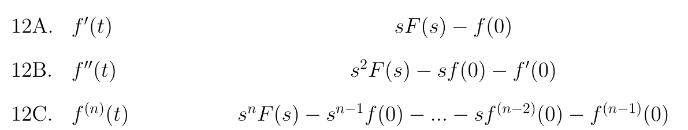
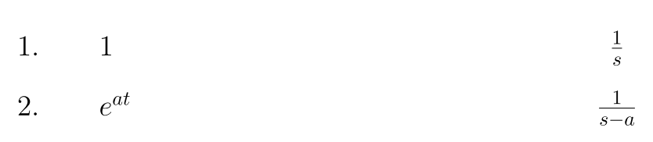
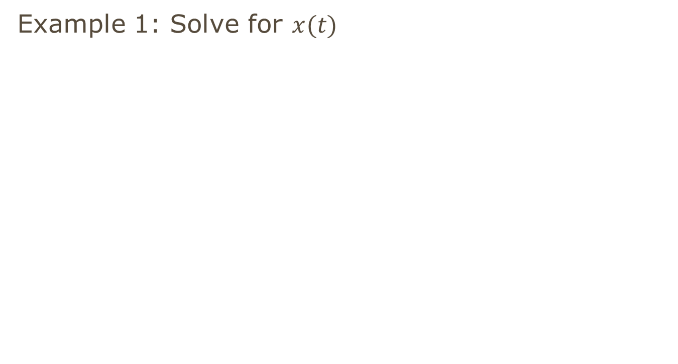
Laplace Transform
Example 1: Solve for $x(t)$

Slide 14

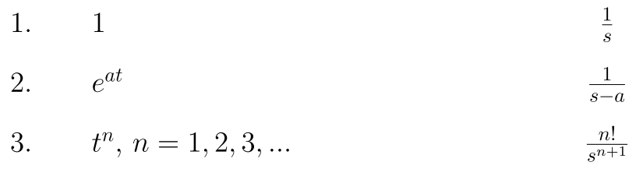

Laplace Transform
Example 2: Solve for $x(t)$

Slide 15
Partial Fraction Expansion
Useful for making equations match table to take inverse Laplace Transforms
Can use Mathematica function Apart or MATLAB function residue
Usual procedure
Factor denominator of fraction
Equate original fraction to sum of fractions using denominators of factors in descending powers with unknown numerators
Create system of equations to solve for unknown numerators
Notes:
review this topic from Math 141
https://en.wikipedia.org/wiki/Partial_fraction_decomposition#Procedure

Slide 16
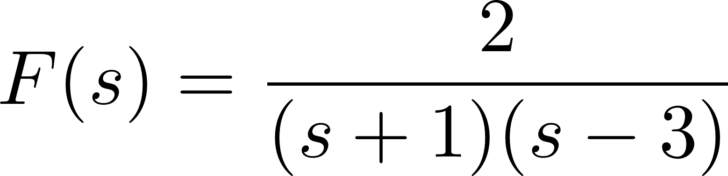
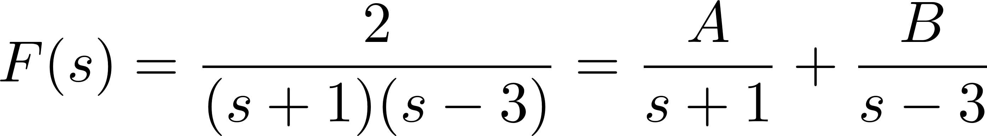
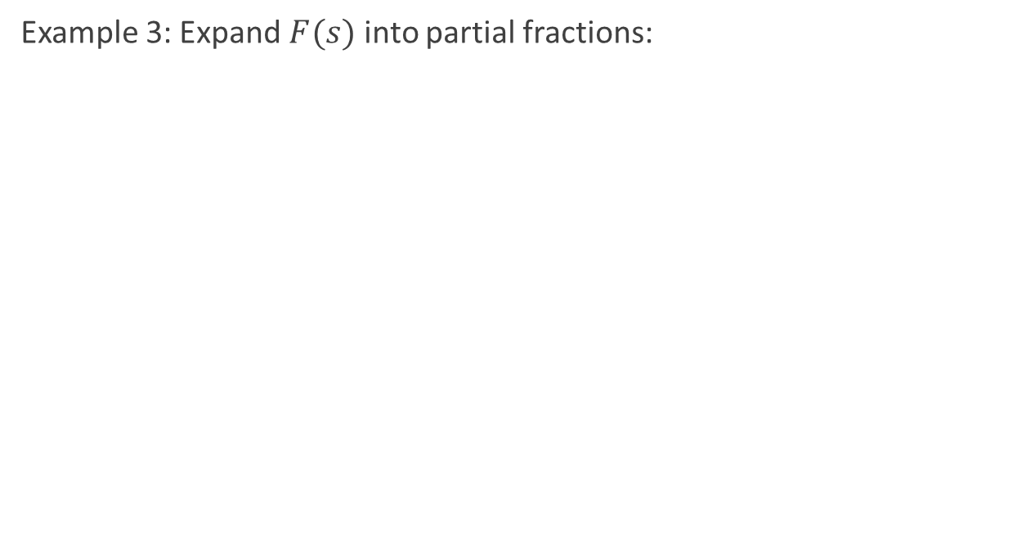
Partial Fraction Expansion
Example 3: Expand $F(s)$ into partial fractions:

Slide 17
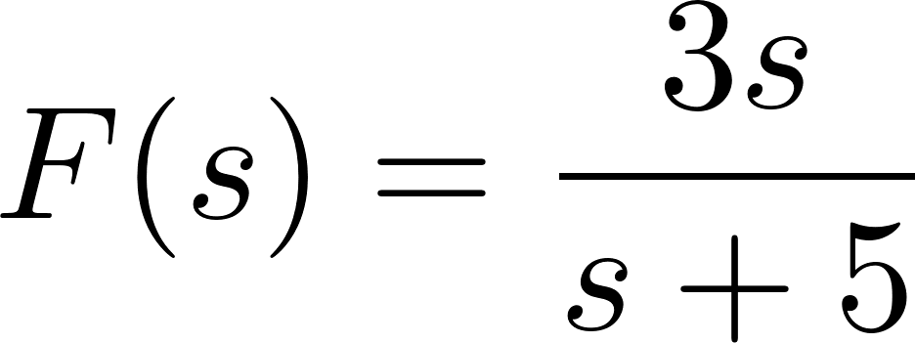
Partial Fraction Expansion Polynomial Division
Example 4: Expand into partial fractions (numerator same degree as denominator):
Notes:
use polynomial division first since the degree of the numerator matches that of the denominator

Slide 18

Matrix Form
Put equations into standard form
Constant term on RHS
Variables on LHS in identical order
For linear systems it will be in form:
Notes:
review this topic from Math 220

Slide 19
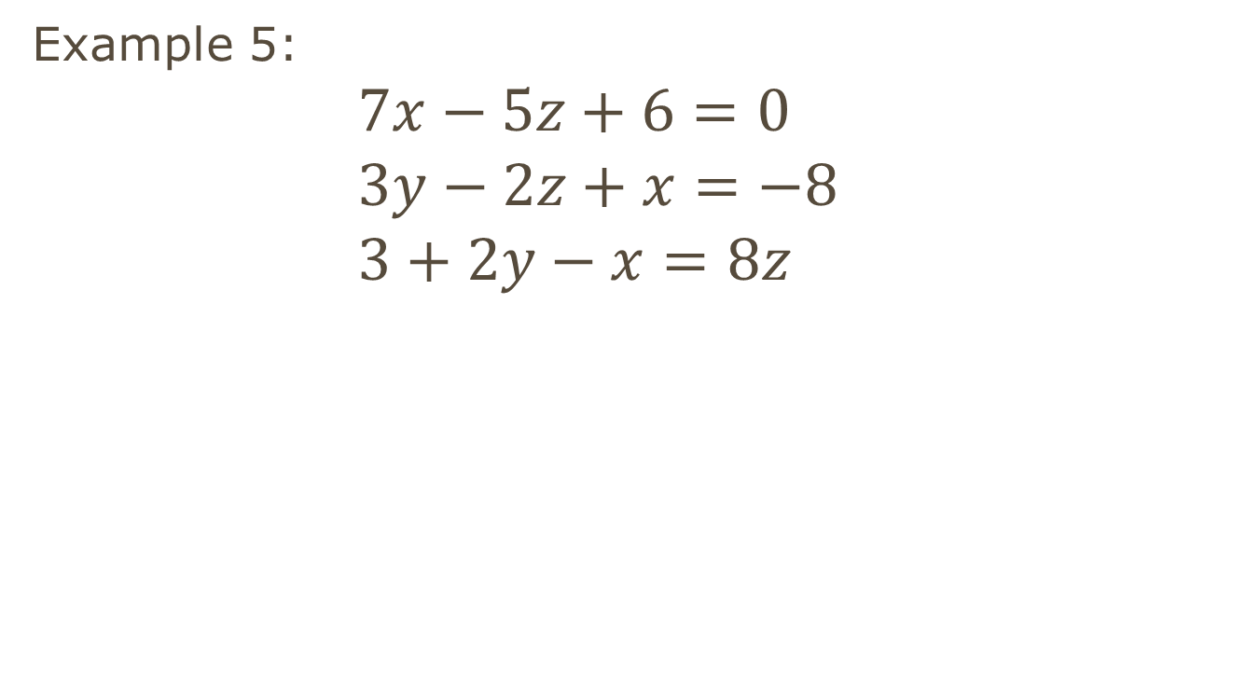
Matrix Form
Example 5:
$$7x−5z+6=0 \\ 3y−2z+x=−8 \\ 3+2y−x=8z$$
Notes:
line up the variables the same in each column (I chose x,y,z) and place all constants on the RHS

Slide 20
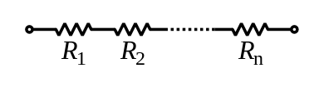


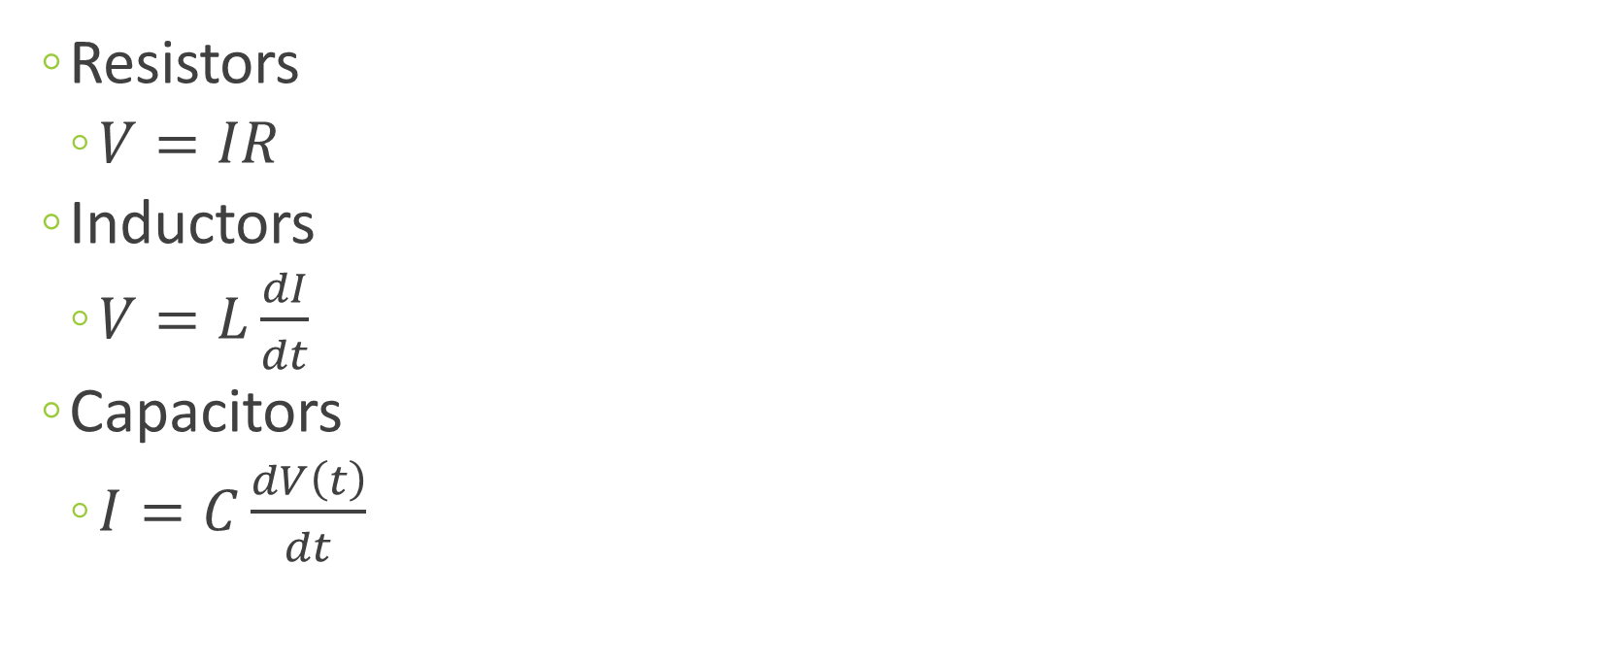
Electronic Components
Resistors
$V=IR$
Inductors
$V=L\frac{dI}{dt}$
Capacitors
$I=C\frac{dV\left(t\right)}{dt}$
Notes:
review this topic from EE 211/212

Slide 21
Electronic Components
Examples
Notes:
review this topic from EE 211/212

