Slide 1
Intro to MATLAB and MATHEMATICA
ME 357

Slide 2
Objectives
By the end of this section, you should be able to
Use both Matlab and Mathematica to expand partial fractions
Find inverse Laplace transforms of complicated expressions using partial fraction expansion
Use Matlab to create transfer functions with tf command

Slide 3
MATLAB Residue function
[r, p, k] = residue([num],[den])
num is vector of coefficients in front of s terms in numerator in descending order
Must include zeros where appropriate
Same for den
r are the “residue” or numerator
p are the poles of the denominators
Denominators in form (s-p)
Repeated values of p in order of (s-p), (s-p)², …
k are “direct terms” or values without denominators
Order matters as r and p are associated

Slide 4

MATLAB Residue function
[r, p, k] = residue([num],[den])
Example: $H\left(s\right)=\frac{2}{s^{2}−2s−3}$
[r, p, k] = residue([2],[1 -2 -3])
r = [0.5, -0.5]
p = [3, -1]
k= []
Notes:
Same as example we did by hand

Slide 5

Mathematica Apart function
fraction//Apart
Example: $H\left(s\right)=\frac{2}{s^{2}−2s−3}$

Slide 6
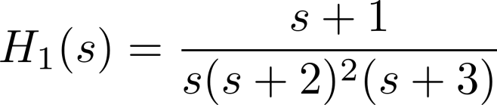
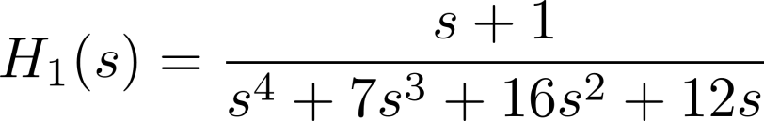
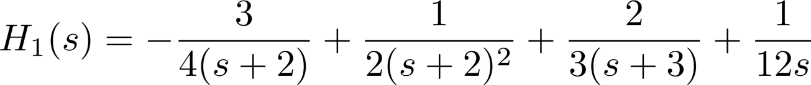
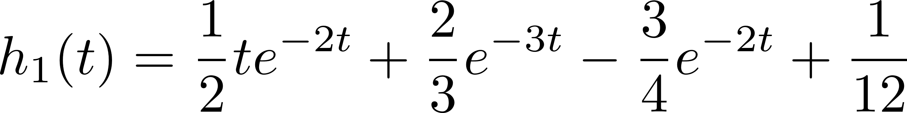
Example 1
[r, p, k] = residue([1 1],[1 7 16 12 0])
r =[ 2/3 -3/4 1/2 1/12]
p = [ -3 -2 -2 0 ]
k = []

Slide 7
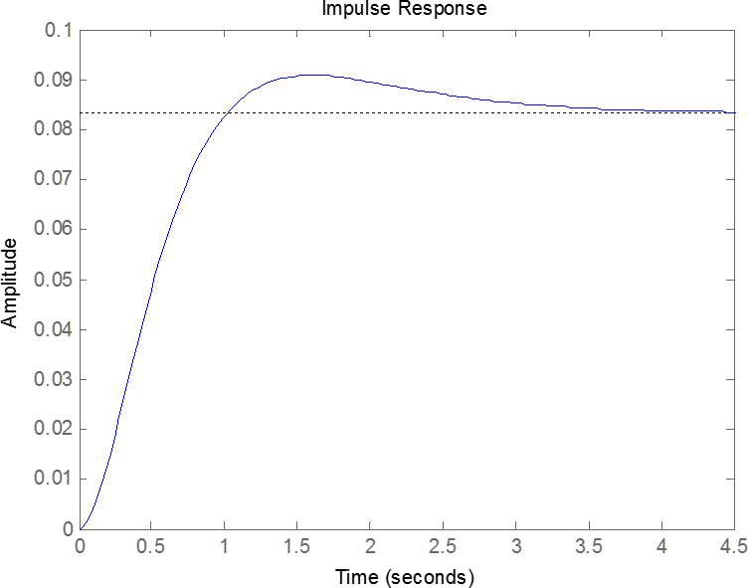
Example 1
sys = tf([1 1],[1 7 16 12 0])
impulse(sys)

Slide 8
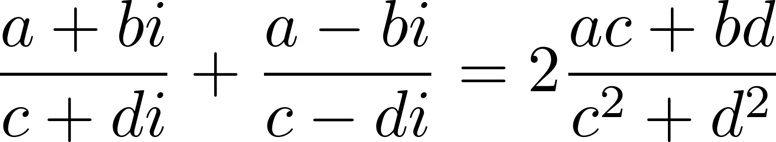
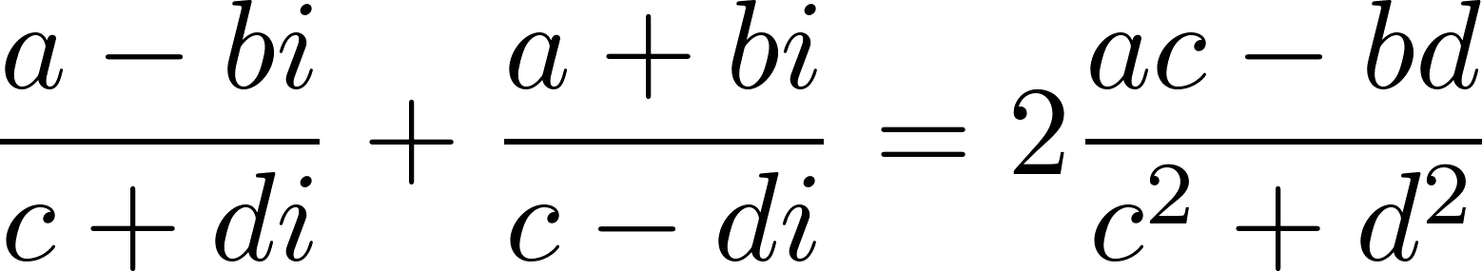
Complex Roots & Poles
Imaginary terms do not appear on our Laplace Transform table
Rearrange terms to match table

Slide 9
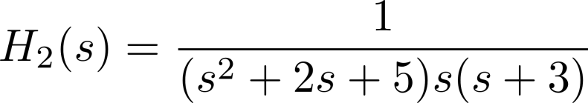
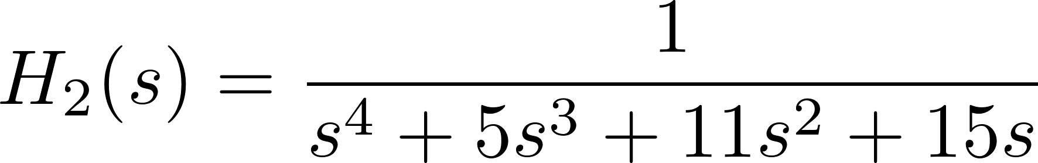
Example 2
[r, p, k] = residue([1],[1 5 11 15 0])
r =[ -1/24 (-1/80 + 3/80i)
(-1/80 - 3/80i ) 1/15]
p = [-3 (-1+2i) (-1 -2i) 0 ]
k = []

Slide 10
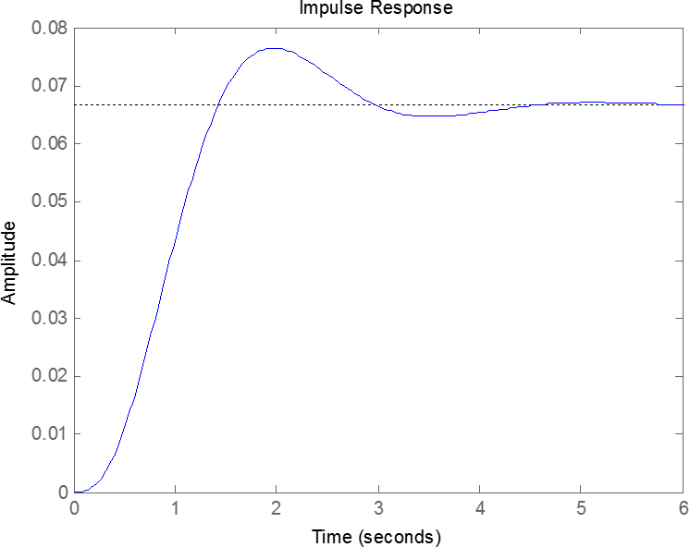
Example 2
sys = tf([1],[1 5 11 15 0])
impulse(sys)

Slide 11
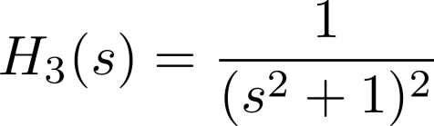
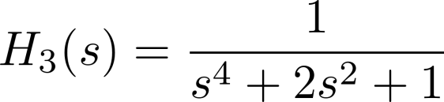
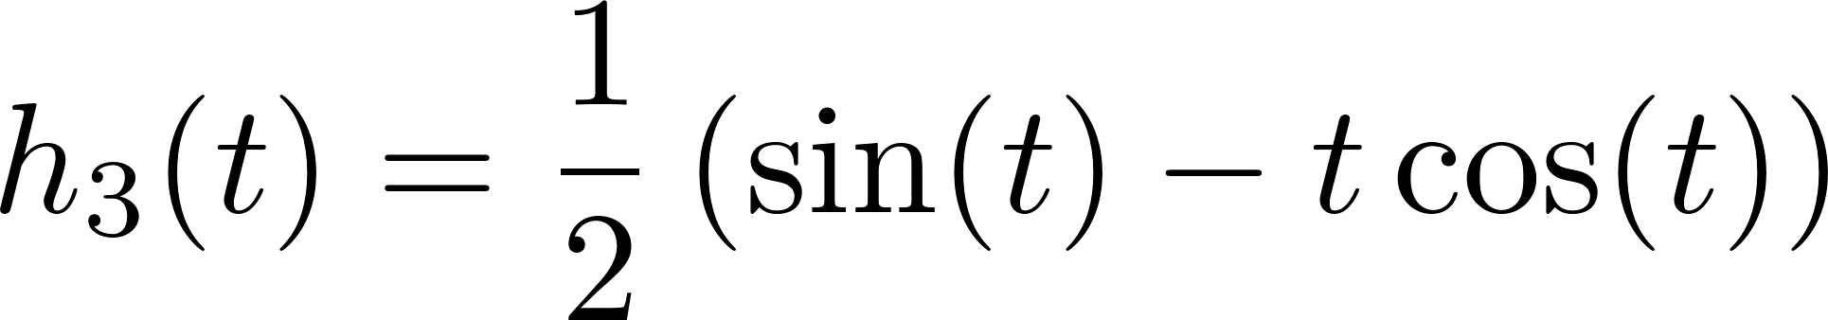
Example 3
[r, p, k] = residue([1],[1 0 2 0 1])
r =
0.0000 - 0.2500i
-0.2500
0.0000 + 0.2500i
-0.2500
p =
0.0000 + 1.0000i
0.0000 + 1.0000i
0.0000 - 1.0000i
0.0000 - 1.0000i
k =
[]

Slide 12
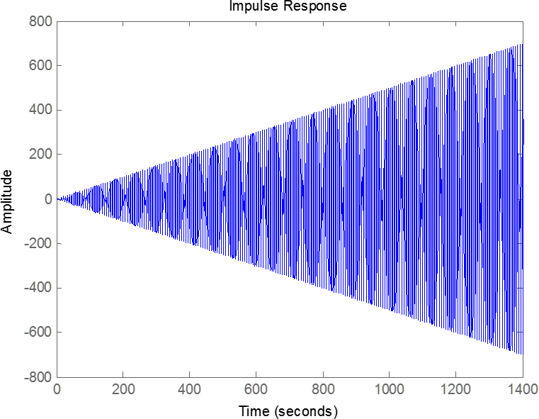
Example 3
sys = tf([1],[1 0 2 0 1])
impulse(sys)

