Slide 1
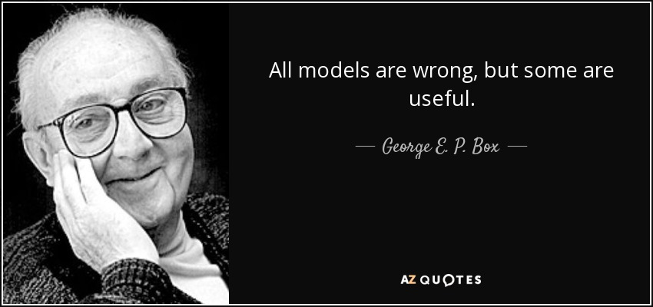
Intro to Mechanical Modeling
ME 357
Notes:
Will continue modeling then after math section is fully covered

Slide 2
Objectives
By the end of this section, you should be able to
Create FBDs for simple spring-mass-damper (SMD) systems
Create equations of motion (EOM) for single-element mechanical system
Find closed-form solutions for the displacement of mass in SMD system

Slide 3
Notes:
The model is a simplification of reality. We may not know what exact relationships are or the math would be overly complex. The model may still be useful to study the general behavior of the system
We are not trying to account for everything that is in the real world

Slide 4
Modeling Mechanical Systems
Take real-world mechanical system and represent with only simplified components: masses, springs, dampers
Using idealized model, create differential equation(s) using Newton’s Law (remember EMCH 212)
Create FBD for every mass and node
Include forces on mass/node due to springs, dampers and applied loads
Create equation of motion (EOM) by summing forces along and around every relevant axis
In vibrations, will discuss alternate method
Solve EOM to track position of mass(es) and node(s) over time
Always taking measurements from equilibrium position
Typically ignore force (weight) of gravity
Notes:
Modeling is where ODEs come from that we have been solving in Math 251 and first week here
Engineer’s greater value in creating eqs, not solving them. However, we will still be solving them.

Slide 5
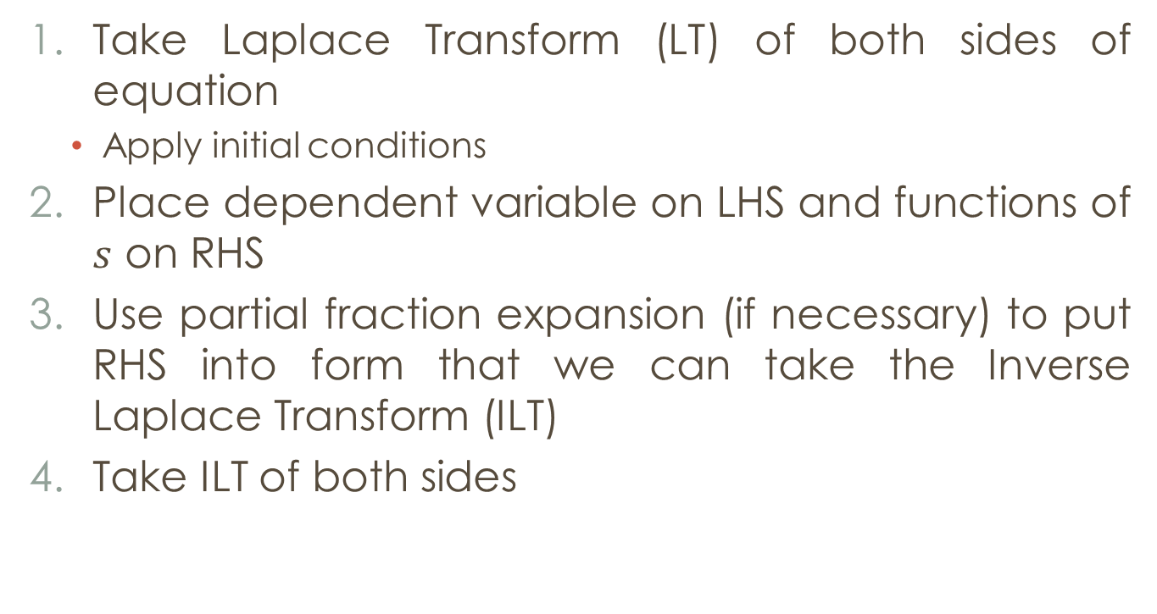
Solving ODEs with LT
Take Laplace Transform (LT) of both sides of equation
Apply initial conditions
Place dependent variable on LHS and functions of $s$ on RHS
Use partial fraction expansion (if necessary) to put RHS into form that we can take the Inverse Laplace Transform (ILT)
Take ILT of both sides
Notes:
Repeat from lecture 1

Slide 6
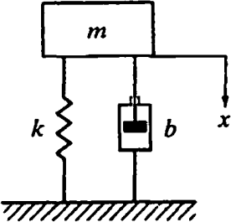


Example 1
$$x(0)=0, \dot{x}(0)=0$$
$$m=1 kg$$
$$b=5 Ns/m$$
$$k=6 N/m$$
$f(t)=δ(t) Ns$ (unit impulse)
Solve for position, $x(t)$, and plot response over 5 seconds
$$f(t)$$
Notes:
Applying impulse, ~ hitting it with hammer of 1 N-s of impulse
Always assume that springs and dampers in tension, then write correct quantity as force in terms of DOF.
Ignore weight in FBD, is usually small compared to applied force and accounted for already.
x measured from equilibrium

Slide 7

Example 1
Create FBD for each mass and node. DOF defined as deviation from equilibrium point.
Use FBD(s) to create equation(s) of motion (EOM)
Solve EOMs using LT and initial conditions
$$f(t)$$
$$x(0)=0, \dot{x}(0)=0$$
$$m=1 kg$$
$$b=5 Ns/m$$
$$k=6 N/m$$
$f(t)=δ(t) Ns$ (unit impulse)
Solve for position, $x(t)$, and plot response over 5 seconds
Notes:
Step 1 is the only new step since lecture 1

Slide 8
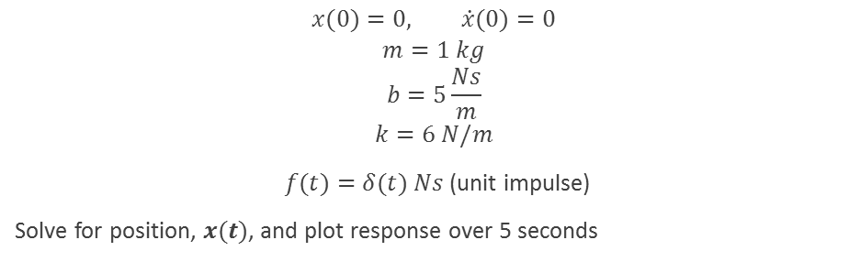

Example 1
$$x(0)=0, \dot{x}(0)=0$$
$$m=1 kg$$
$$b=5\frac{Ns}{m}$$
$$k=6 N/m$$
$f(t)=δ(t) Ns$ (unit impulse)
Solve for position, $x(t)$, and plot response over 5 seconds
$$f(t)$$
Notes:
The sign on the plot matches the sign in the diagram, positive down

Slide 9
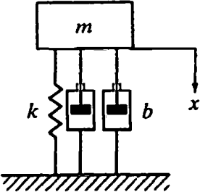
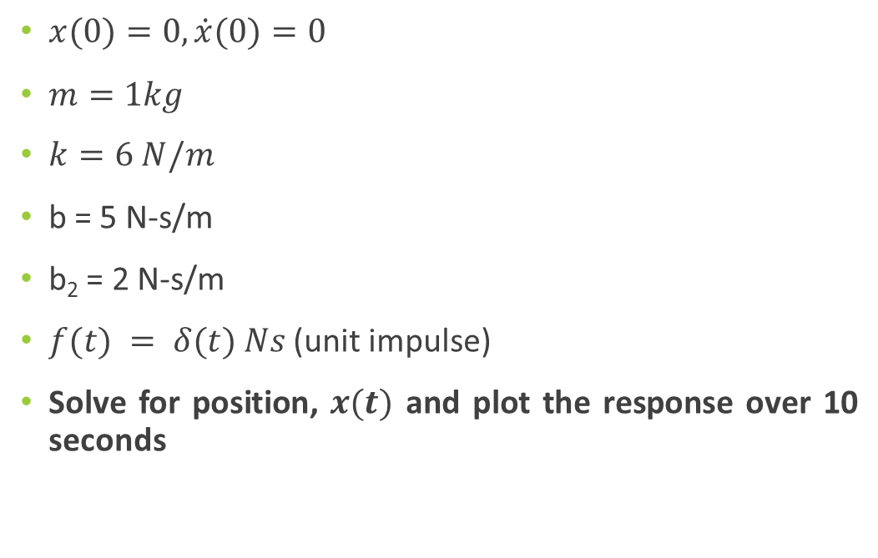


Example 2
$x(0)=0, \dot{x}(0)=0$
$m=1kg$
$k=6 N/m$
b = 5 N-s/m
b₂ = 2 N-s/m
$f(t) = δ(t) Ns$ (unit impulse)
Solve for position, $x(t)$ and plot the response over 10 seconds
$$f(t)$$
$$b2$$

Slide 10



Example 2
$x(0)=0, \dot{x}(0)=0$
$m=1kg$
$k=6 N/m$
b = 5 N-s/m
b₂ = 2 N-s/m
$f(t) = δ(t) Ns$ (unit impulse)
Solve for position, $x(t)$ and plot the response over 10 seconds
$$f(t)$$
$$b2$$

Slide 11
System Comparison
Notes:
Note the responses of the system differ to the same input. The less damped system has a higher peak- displacement and time
Will be able to analyze systems using TF in coming lectures

