Slide 1
Initial/Final Value Theorems
ME 357

Slide 2
Objectives
By the end of this section, given a frequency-domain equation, you should be able to
Identify if system is stable/unstable based on poles in frequency domain
Determine steady-state value of system using final value theorem
Determine initial state of system using initial value theorem.

Slide 3

Initial/Final Value Theorems
When dependent variable is put into frequency domain ($s$), can assess its initial- and steady-state values in time domain ($t$)
Only if variable is stable (goes to constant value given enough time)
May not be easy to return to time domain for exact solution, thus we may not know what happens in-between
Notes:
Will be able to look at what happens in-between as we go to Unit II

Slide 4

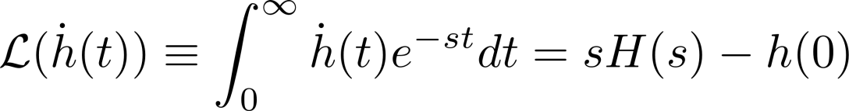
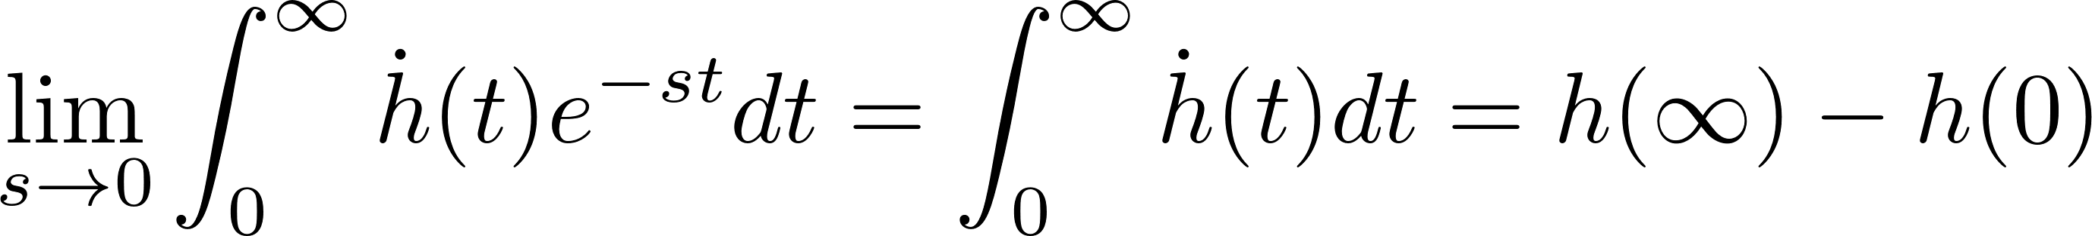

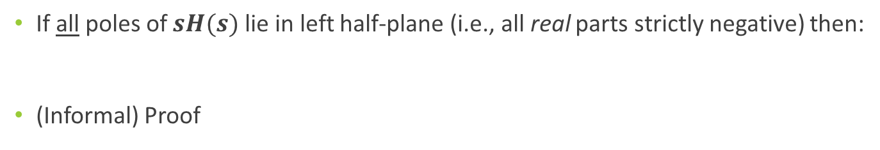
Final Value theorem
If all poles of $sH(s)$ lie in left half-plane (i.e., all real parts strictly negative) then:
(Informal) Proof
Notes:
Note that we are analyzing sH(s), not simply H(s)
h(t) is just some function of time e.g., x(t), v(t)

Slide 5

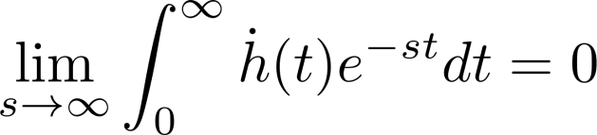

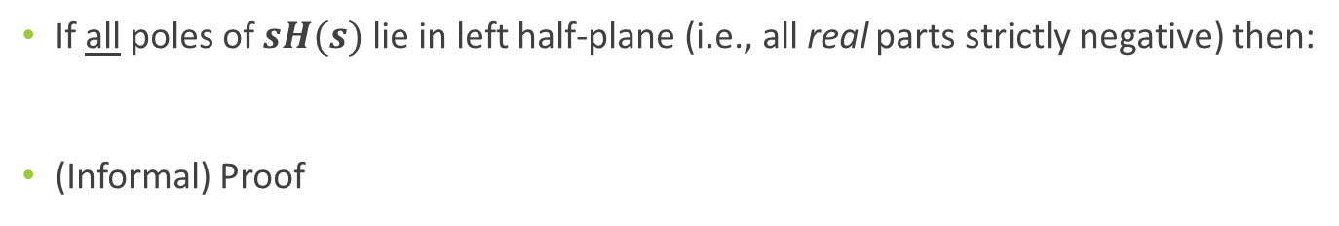
Initial Value theorem
If all poles of $sH(s)$ lie in left half-plane (i.e., all real parts strictly negative) then:
(Informal) Proof
Notes:
Note that we are analyzing sH(s), not simply H(s)

Slide 6
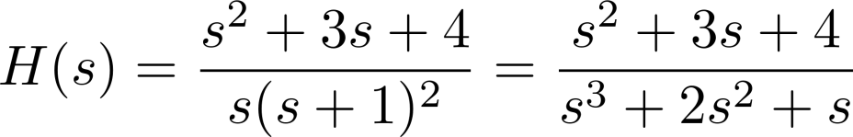

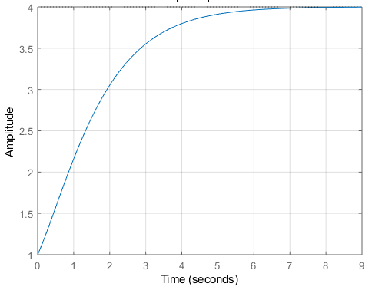
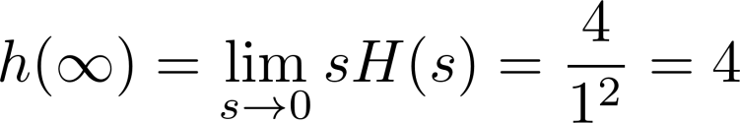
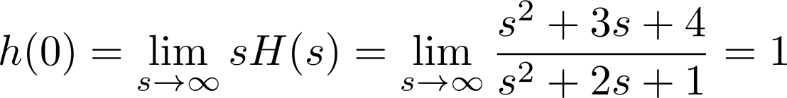
Example 1
Notes:
Poles of sH(s)

Slide 7
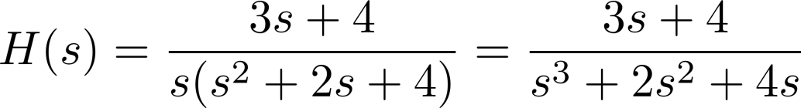
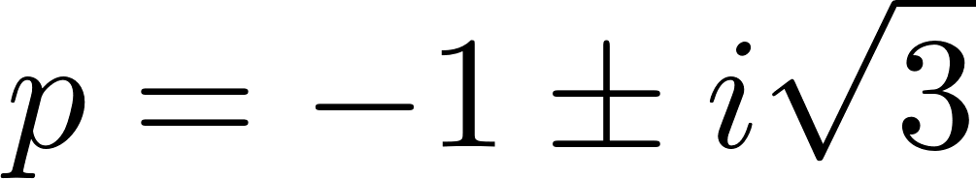
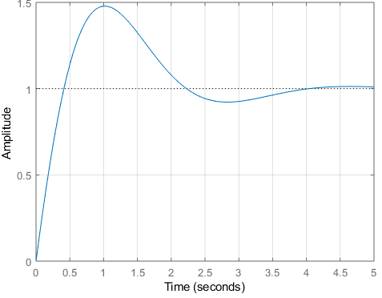
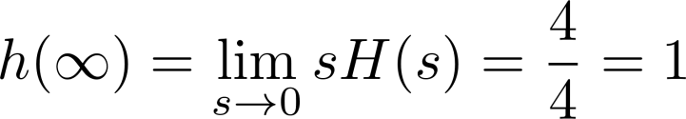
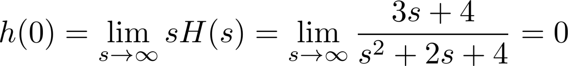
Example 2
Notes:
Poles of sH(s)

Slide 8
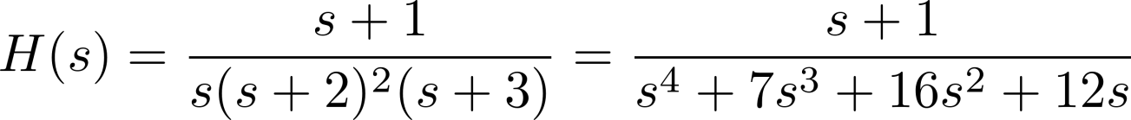

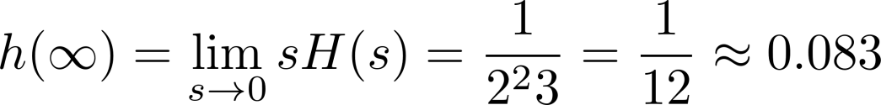
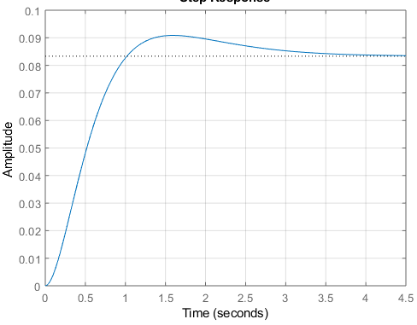
Example 3
Notes:
Poles of sH(s)

Slide 9

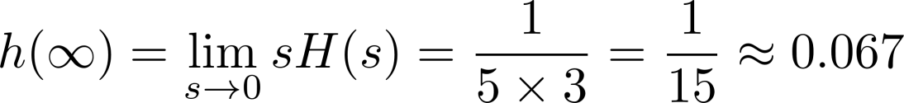
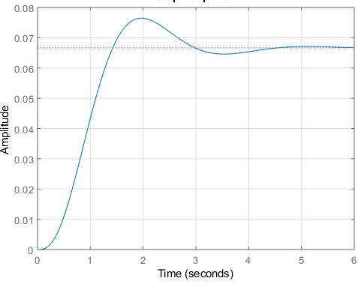
Example 4
Notes:
Poles of sH(s)

Slide 10
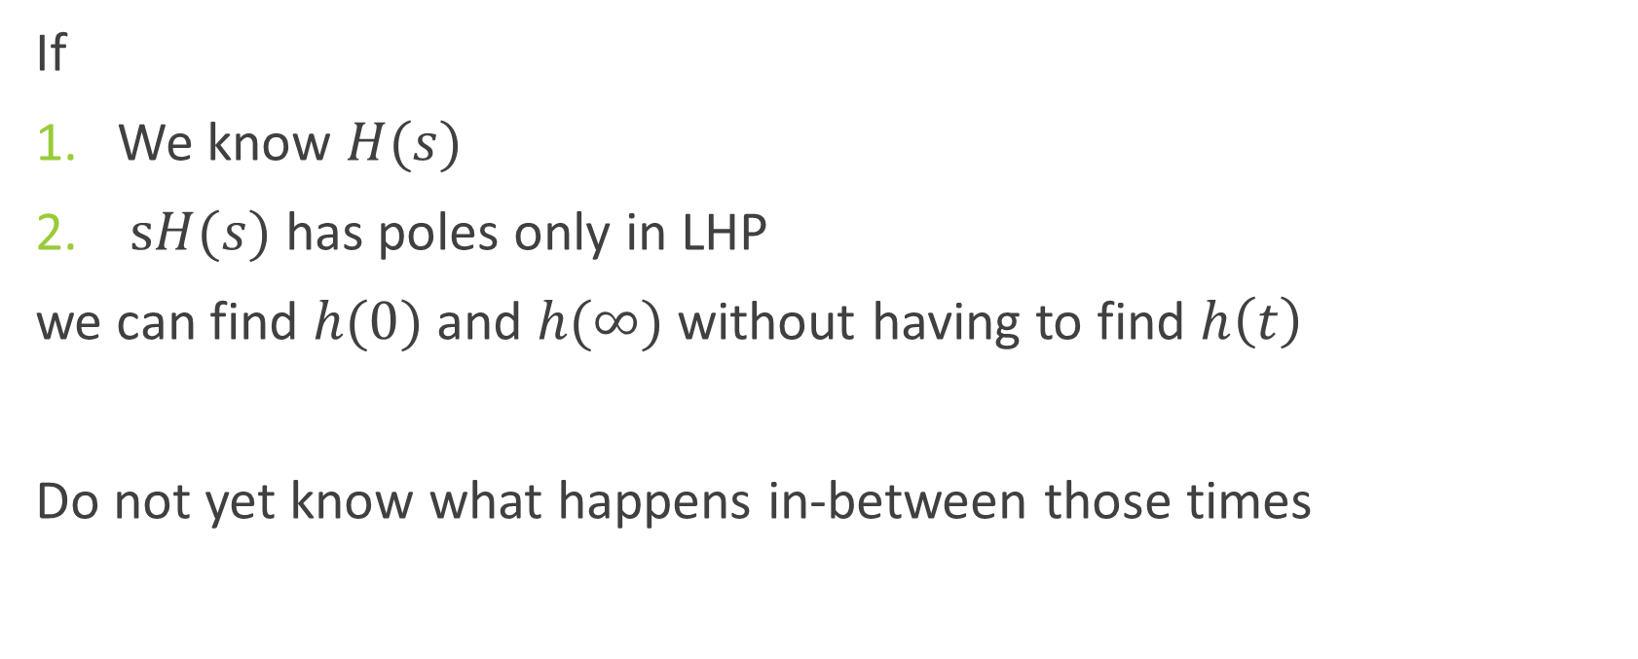
Summary
If
We know $H(s)$
$sH(s)$ has poles only in LHP
we can find $h(0)$ and $h(∞)$ without having to find $h\left(t\right)$
Do not yet know what happens in-between those times

