Slide 1
Transfer Functions Mechanical Modeling
ME 357

Slide 2
Objectives
By the end of this section, you should be able to
Create FBDs for linear and rotational mechanical systems (single- and multi-element)
Use FBDs to derive EOMs for system
Use EOMs to create transfer functions for I/O forces/displacements for SMD systems
Use Mathematica to assist with algebraic steps in deriving TF
Use Matlab to simulate step- and impulse inputs into TF

Slide 3






Mechanical Element Modeling
Create ODEs from Newton’s Law
Linear
Rotational
Pay attention to the coordinate system
Elements
Spring
Damper
Consider relative displacement of ends of springs and relative velocity of ends of dampers

Slide 4
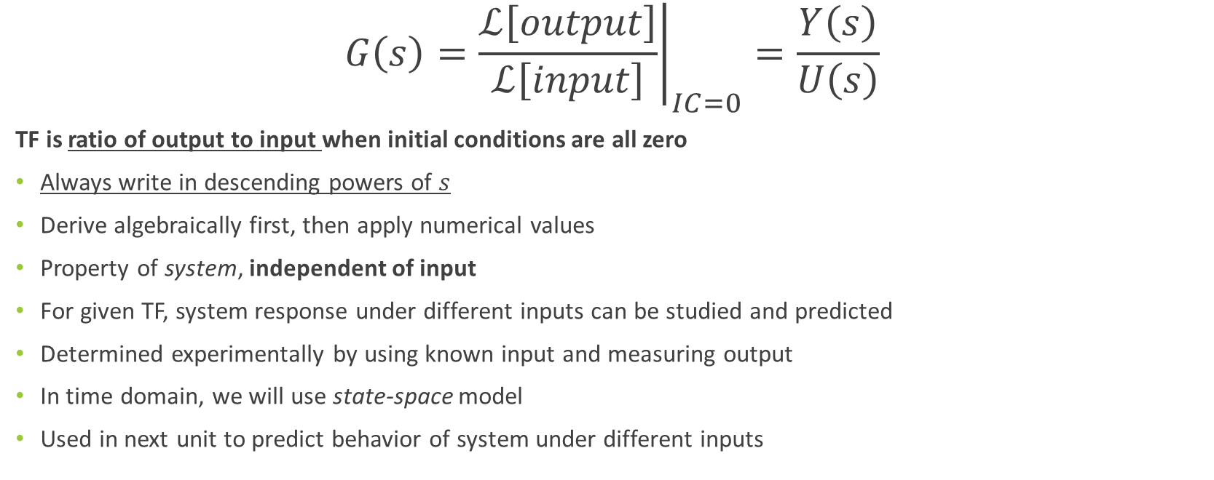
Transfer Function (TF)
$$G\left(s\right)={\left.\frac{ℒ\left[output\right]}{ℒ\left[input\right]}\right|}_{IC=0}=\frac{Y\left(s\right)}{U\left(s\right)}$$
TF is ratio of output to input when initial conditions are all zero
Always write in descending powers of $s$
Derive algebraically first, then apply numerical values
Property of system, independent of input
For given TF, system response under different inputs can be studied and predicted
Determined experimentally by using known input and measuring output
In time domain, we will use state-space model
Used in next unit to predict behavior of system under different inputs
Notes:
This is different than what we looked at before. The TF exists independent of the input
We always use this starting from rest. Can be modified for non-zero ICs

Slide 5
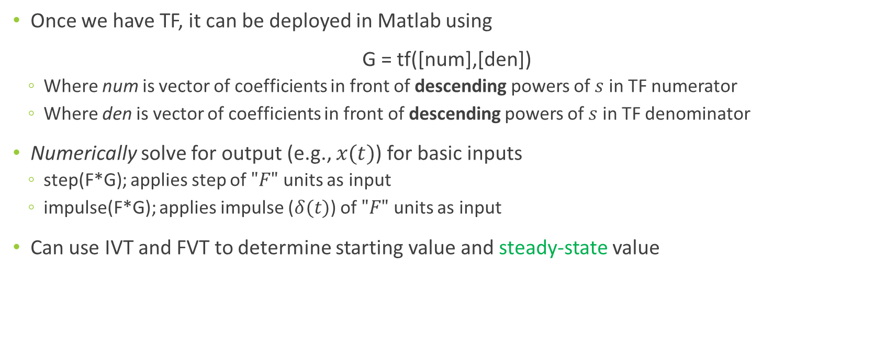
Numeric Solutions
Once we have TF, it can be deployed in Matlab using
G = tf([num],[den])
Where num is vector of coefficients in front of descending powers of $s$in TF numerator
Where den is vector of coefficients in front of descending powers of $s$in TF denominator
Numerically solve for output (e.g., $x(t)$) for basic inputs
step(F*G); applies step of $"F"$ units as input
impulse(F*G); applies impulse ($δ(t)$) of $"F"$ units as input
Can use IVT and FVT to determine starting value and steady-state value
Notes:
You must account for coefficients of zero in the tf

Slide 6
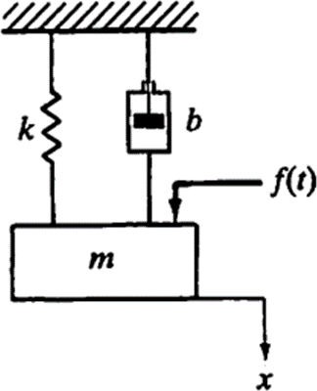
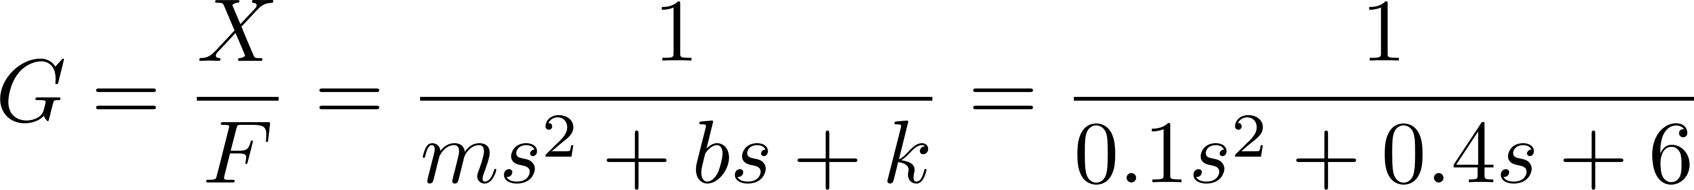

Example 1A
Consider the mechanical system shown. The system is initially at rest. The displacement x is measured from the equilibrium position. Assuming that $f(t)$is a force input and the displacement $x(t)$is the output, [1] obtain the algebraic transfer function of the system. Then, [2] applying $m=0.1$kg, $b=0.4$N-s/m, $k=6$N/m and $f(t)$ is a step force of magnitude 10 N (i.e., $f\left(t\right)=10u(t)$), plot numeric solution (in Matlab) for $x(t)$. Verify with IVT and FVT.

Slide 7
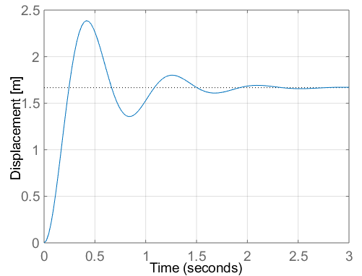
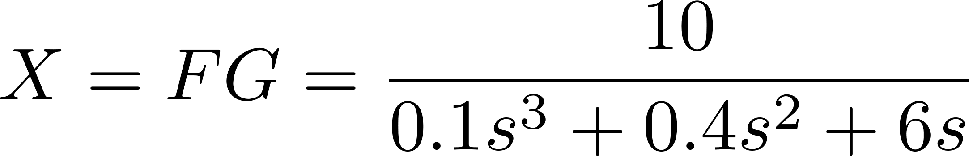
Example 1A
Notes:
FVT predicts 10/6
IVT predicts 0 = 10/inf

Slide 8
Multi-DOF Systems
System may have multiple DOFs due to multiple masses, nodes or ability of one mass to move in multiple directions
Create EOM for each DOF, usually making FBD for each
Take Laplace Transform of each
Identify one output you need for desired TF
Need to eliminate other output variables
Use algebraic substitution to solve for the TF
May want to use Mathematica to assist for complicated systems
There cannot be any dependent variables on the RHS

Slide 9
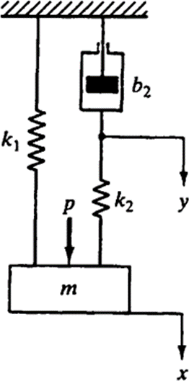
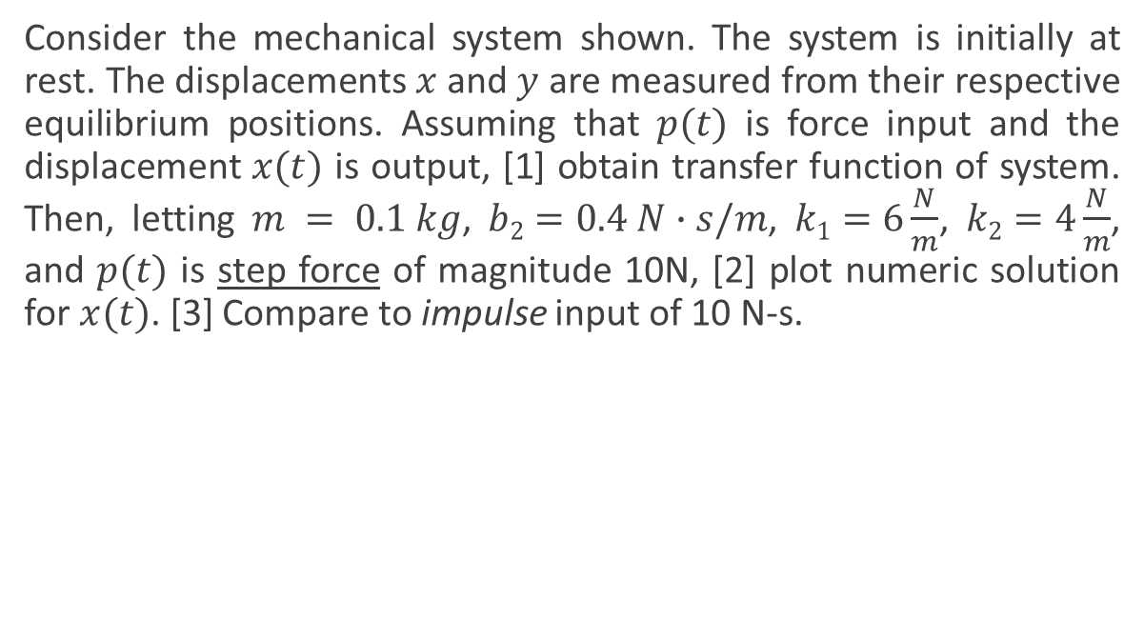
Example 1B
Consider the mechanical system shown. The system is initially at rest. The displacements $x$ and $y$ are measured from their respective equilibrium positions. Assuming that $p(t)$ is force input and the displacement $x(t)$ is output, [1] obtain transfer function of system. Then, letting $m = 0.1 kg$, $b2=0.4 N∙s/m$, $k1=6\frac{N}{m}$, $k2=4\frac{N}{m}$, and $p(t)$ is step force of magnitude 10N, [2] plot numeric solution for $x(t)$. [3] Compare to impulse input of 10 N-s.

Slide 10

Example 1B Mathematica Steps
https://youtu.be/79m5Qg2sLsA

Slide 11
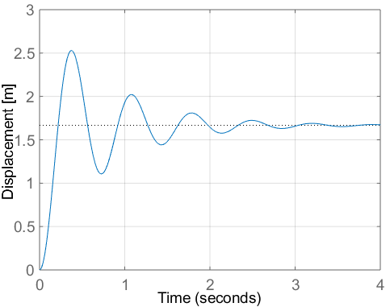
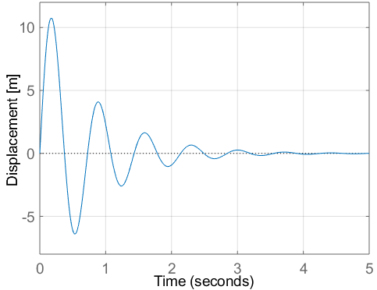
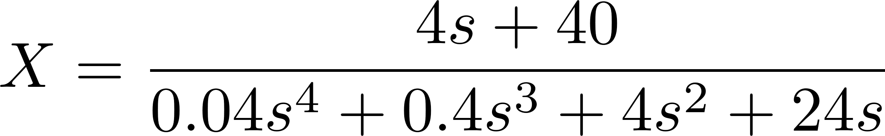
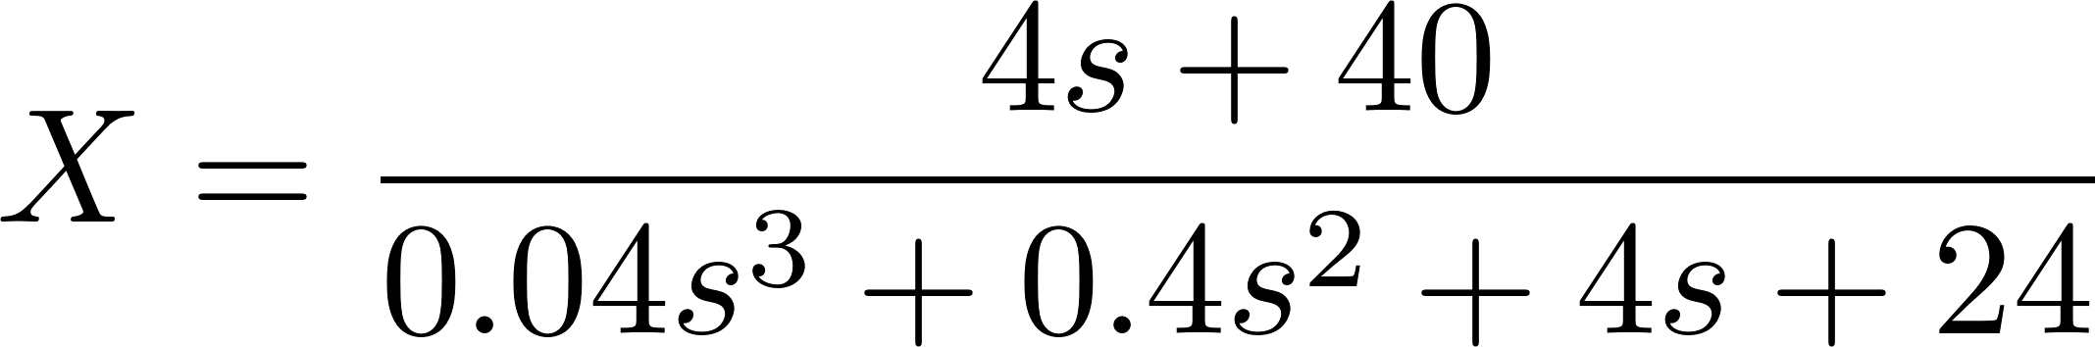
Example 1B Matlab Results
Step Input of 10 N
Impulse Input of 10 N-s

Slide 12
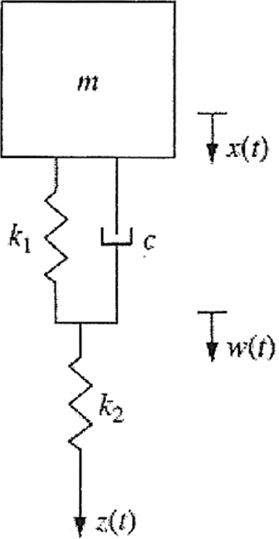
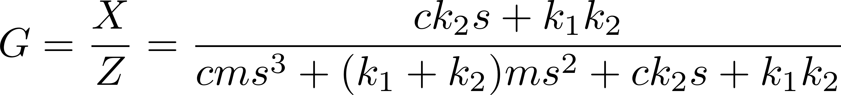
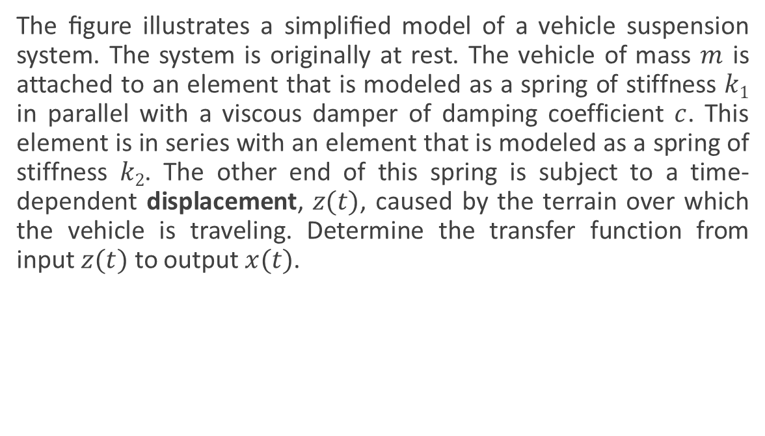
Example 2
The ﬁgure illustrates a simpliﬁed model of a vehicle suspension system. The system is originally at rest. The vehicle of mass $m$ is attached to an element that is modeled as a spring of stiffness $k1$ in parallel with a viscous damper of damping coefficient $c$. This element is in series with an element that is modeled as a spring of stiffness $k2$. The other end of this spring is subject to a time-dependent displacement, $z(t)$, caused by the terrain over which the vehicle is traveling. Determine the transfer function from input $z(t)$ to output $x(t)$.

Slide 13
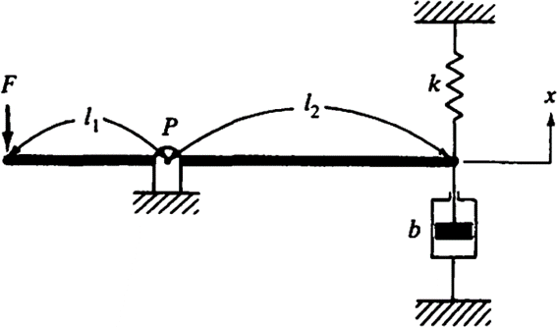
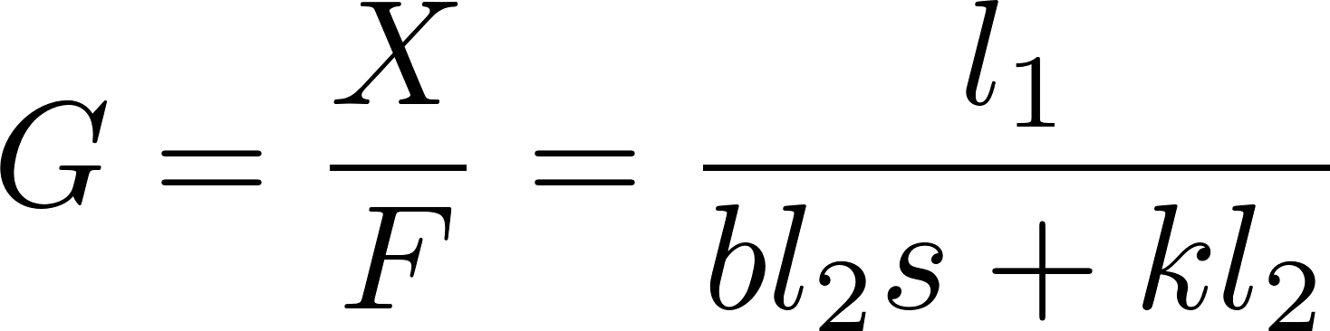

Example 3
In the mechanical system, one end of the lever is connected to a spring and a damper, and a force $f(t)$ is applied to the other end of the lever. Derive the transfer function for the output of $x(t)$to the input of $f(t)$. Assume that the displacement $x$ is small and the lever is rigid, intertialess and massless. The system is originally at rest.

Slide 14
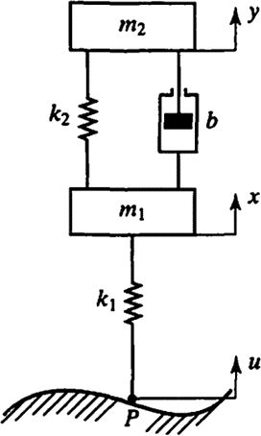

Example 4
Obtain transfer functions $X/U$ and $Y/U$ for system shown. The vertical displacement, $u$ (at point $P$) is the input. This system is a simplified version of an automobile or motorcycle suspension system. $m1$ and $k1$ represent wheel mass and tire stiffness, respectively. Assume that displacements $x$ and $y$ are measured from their respective equilibrium positions in absence of input $u$. The system is originally at rest.

Slide 15
Example 4 Mathematica Steps
https://youtu.be/3zq0Tf67ByQ

Slide 16
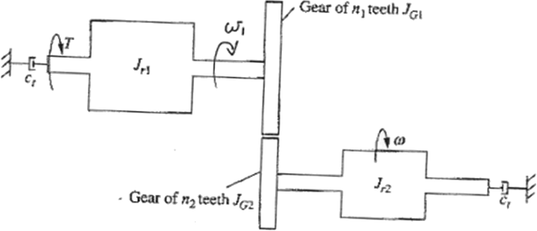
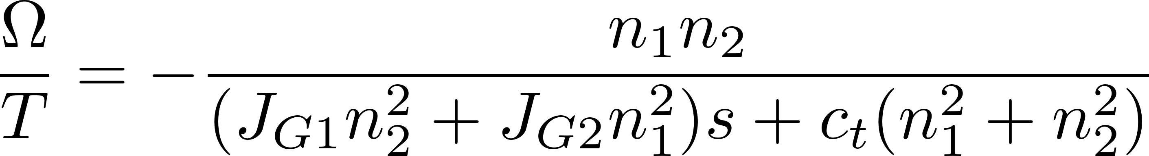

Example 5
A gear reduction system is used to increase angular velocity from an input motor as illustrated below. The angular velocity of output rotor is $ω$. Rotors are mounted on identical shafts, each of which has torsional viscous damping coefﬁcient $ct$. There is no slipping between gears. Input shaft is subject to torque $T$. Derive transfer function from T to $ω$ using only given parameters. Use $R=\frac{r_{1}}{r_{2}}=\frac{n_{1}}{n_{2}}=−\frac{ω}{ω_{1}}$ for these externally-meshed gears. The system is originally at rest.
Notes:
Use knowledge from 380
Signs depend on definition of positive axes
Rotor 2 will (generally) turn opposite the torque direction

Slide 17
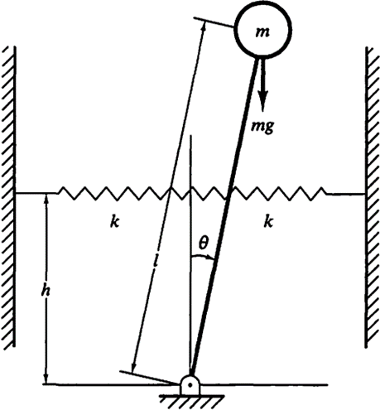
Example 6
Consider the spring-loaded inverted pendulum. Assume that the spring force acting on the pendulum is zero when the pendulum is vertical. Assume that the friction involved is negligible. Obtain a mathematical model of the system when the angle is small. Also, obtain the natural frequency of the system.

Slide 18
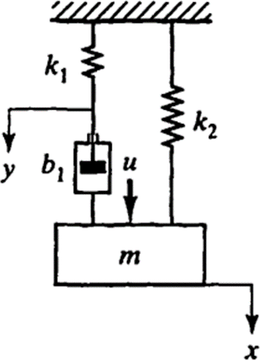

Example
Obtain the transfer function $X/U$ of the system shown, where$u$is the force input. The displacement $x$ is measured from the equilibrium position.

