Slide 1
Fluid System Modeling
ME 357

Slide 2
Objectives
By the end of this section, you should be able to
Find analogous resistances, capacitances and inductances in fluid systems
Model fluid systems using electrical analogs
Create transfer functions for input/output flows/pressures
Use Simulink to simulate solutions to transfer functions

Slide 3
Electrical Analogs
Analyze systems when perturbed from steady state
Change in volumetric flow rate and change in pressure
Analysis based on “small” changes from steady state
To simplify analysis of fluid systems, use electrical analogs
Volumetric flow rate (Q) analogous to current
Pressure (P) analogous to voltage / potential difference
Inertia of the fluid analogous to inductance
Tanks analogous to capacitance
Wall resistance or valve restriction analogous to resistance

Slide 4
Electrical Analogs
Input flows can be treated as current sources
Output flows can be treated as sinks
Treat as going to ground
Will write as “pressure” and “flow rate” but really are changes to steady-state pressures and flow rates

Slide 5
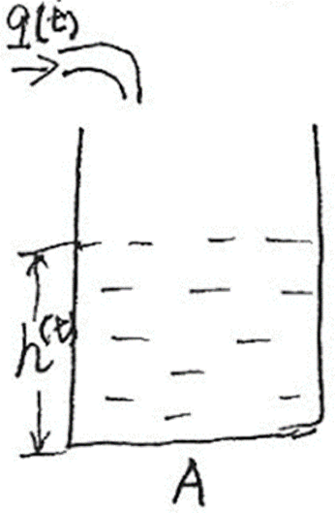
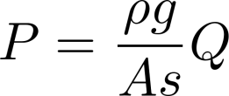
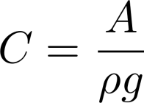
Tanks
For derivation, assume tank is prismatic
Equivalent capacitances can be derived for non-prismatic shapes as well

Slide 6
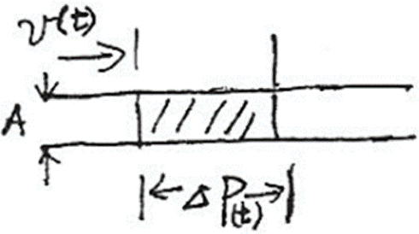
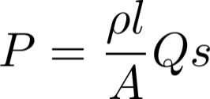
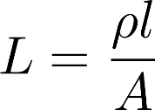
Fluid Inertia
Often we will ignore fluid inertia
Negligible if pipe has “large” cross-sectional area
For derivation, assume pipe has prismatic cross-section

Slide 7
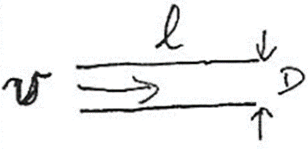
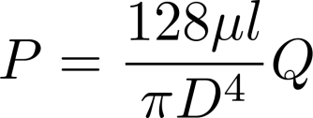
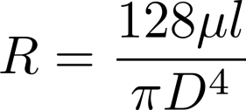
Wall Resistance
Often we can ignore wall resistance
Negligible if pipe has “large” diameter
Resistance is significant factor when diameter narrows or at valve
For derivation, assume laminar flow in circular cross-section
https://en.wikipedia.org/wiki/Reynolds_number#Flow_in_pipe
https://en.wikipedia.org/wiki/Darcy%E2%80%93Weisbach_equation

Slide 8
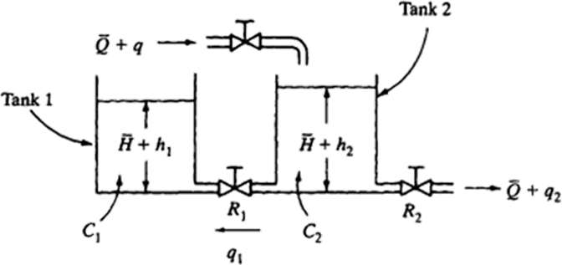
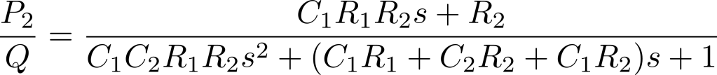

Example
Consider the liquid-level system below. At steady state, the inflow rate and out-flow rate are both $Q$, the flow rate between the tanks is zero, and the heads of tank 1 and tank 2 are both $P$. At t = 0, the inflow rate is changed from $Q$ to Q + q, where q is “small.” The resulting changes in the pressures (P_{I} and P₂) and flow rates (q_{l} and q₂) are assumed to be small as well. The capacitances of tanks 1 and 2 are C_{I} and C₂, respectively. The resistance of the valve between the tanks is R_{l} and that of the outflow valve is R₂. Derive the transfer function for the system when $Q(s)$ is the input and P₂ is the output. Ignore the wall resistance in pipes and the fluid inertia.
Notes:
“Bottom” of tanks is “ground” external to system is “ground”

Slide 9
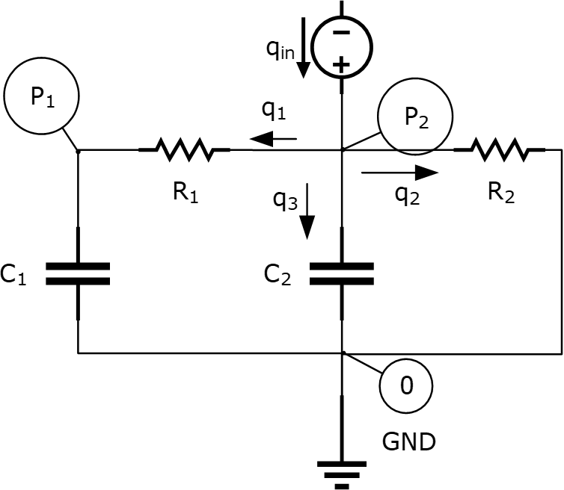
Circuit Schematic

Slide 10
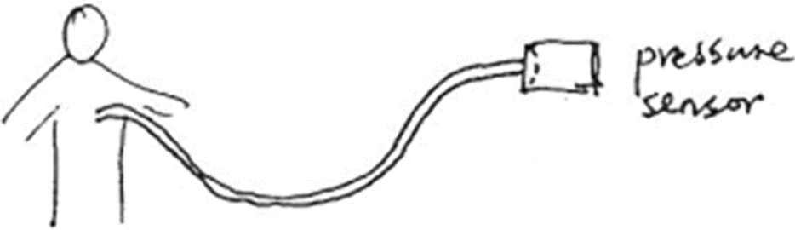
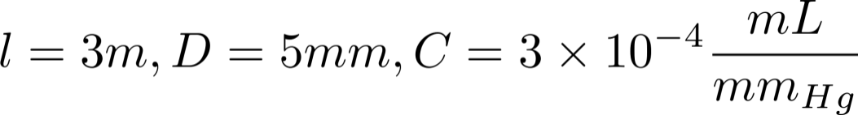
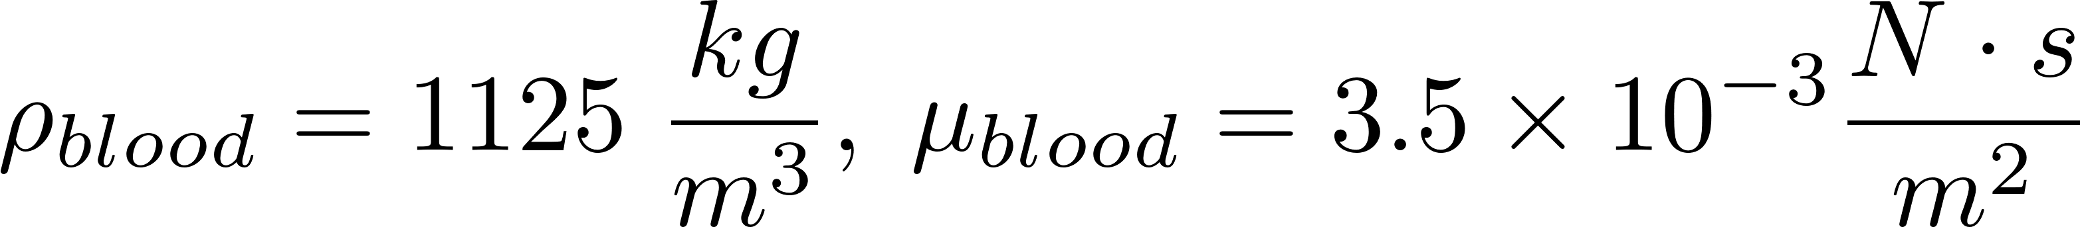
LV Catheter Example
We want to measure the pressure of the left ventricle with sensor outside the body. We attach a small catheter within the ventricle to our external pressure sensor. How does measured pressure compare to actual pressure within the organ? What happens to measured pressure when device parameters are changed.
Notes:
https://en.wikipedia.org/wiki/Hemorheology#Normal_level
https://hypertextbook.com/facts/2004/MichaelShmukler.shtml

Slide 11
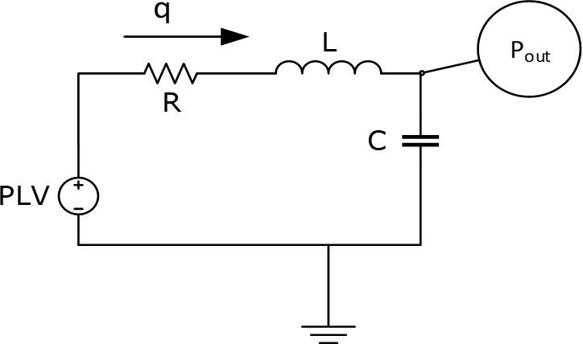
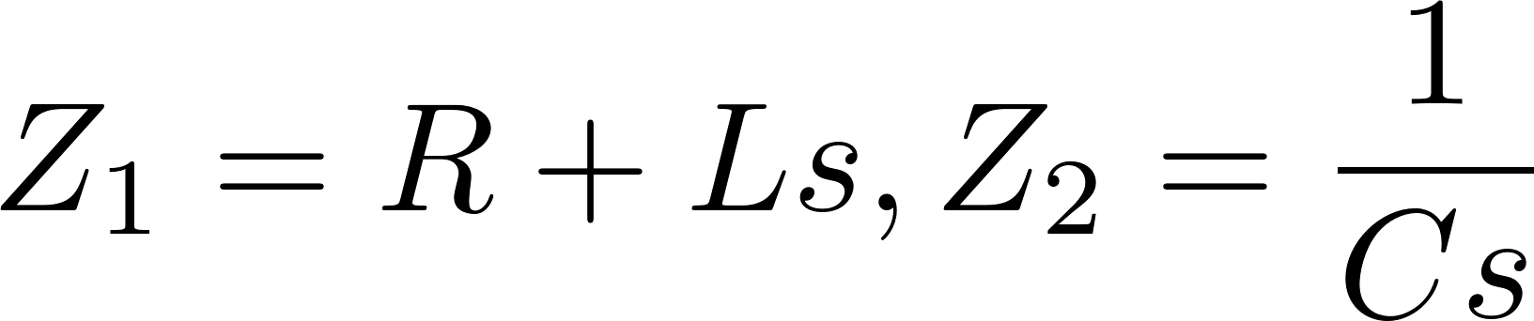
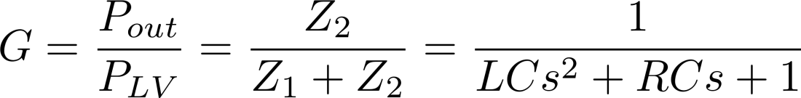
LVC Fluid Model

Slide 12
LVC Simulink Model

Slide 13

LVC Simulink Creation
https://youtu.be/AFqgom0Z3dk

Slide 14
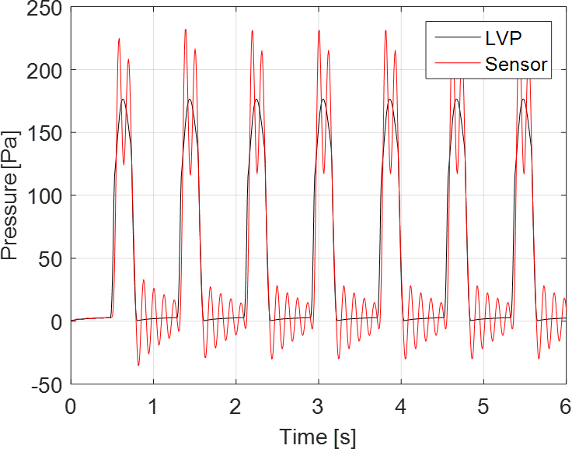
LVC Simulation
Using given design parameters, output from sensor does not match amplitude or shape of left ventricle
Output rings after pressure drops

Slide 15
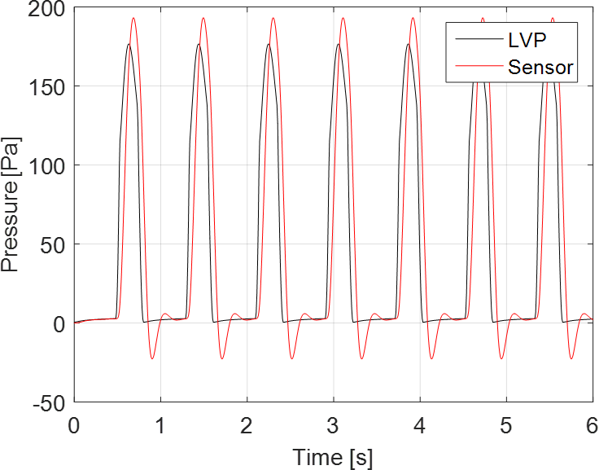
LVC Simulation
By adjusting design, measured output more closely mirrors input
Slight lag between input and output

