Slide 1
Electro-Mechanical Systems
ME 357

Slide 2
Objectives
By the end of this section, you should be able to
Model systems that transfer signals from electric circuits to mechanical systems
Use equations that link the two types of systems together
Find transfer functions for EM systems to relate input / output of voltages / currents / displacements / forces

Slide 3


Electro-Mechanical Systems
Create equation(s) for electrical system
Create EOM(s) for mechanical system
Take Laplace Transform(s)
Couple systems together with additional motor equations
Back EMF
Motor Torque
Notes:
This example is rotational, but linear transducers will have similar relationships

Slide 4
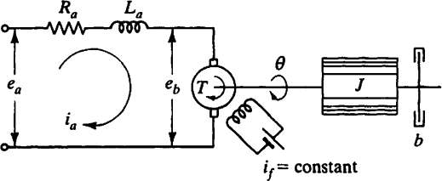
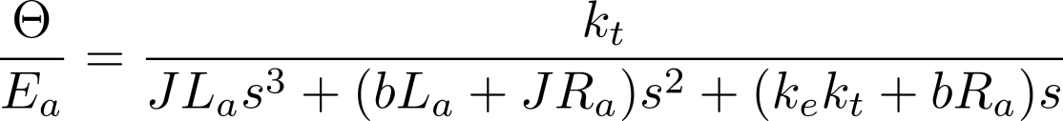
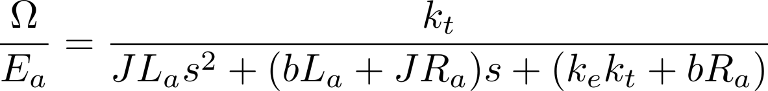
Example
Find transfer functions for motor’s angular position and –velocity to input voltage for the electric motor assembly.
Notes:
In Laplace domain, a derivative is multiplying by s

