Slide 1
State Space Modeling
ME 357

Slide 2
Objectives
By the end of this section, you should be able to
Understand benefits/drawbacks of state-space (SS) models versus transfer functions (TF)
Know when each may be appropriate to use
Create SS models for linear mechanical systems and identify state vector and matrices that describe system
Do this for SISO, SIMO, MISO and MIMO systems
Numerically solve SS models using Matlab (ode45)
Convert SS model to TF and vice-versa in Matlab

Slide 3
State Space (SS) Model
In SS model, remain in time domain, no transforming into frequency domain
SS models are generally easier than TF for
Analyzing MISO, SIMO, MIMO systems
Systems with non-zero initial conditions
Good numerical methods available to solve SS systems
Can analyze matrices for stability properties
To use matrix form we can only use linear or linearized systems
SS form also works for non-linear systems

Slide 4


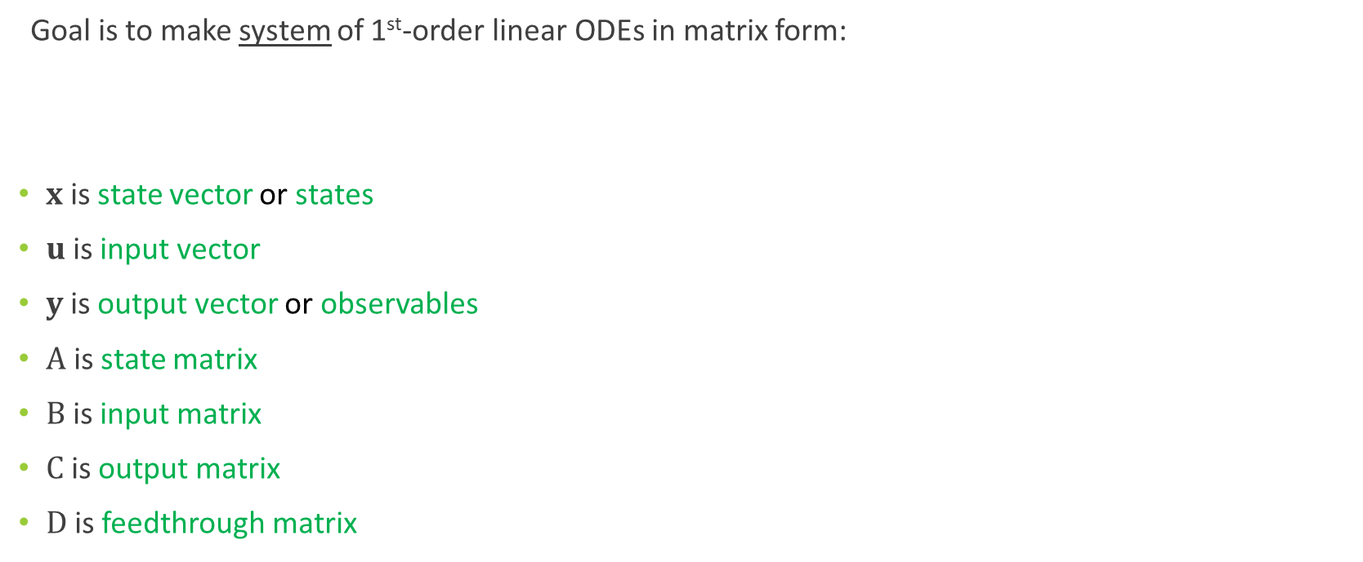
State Space Form
Goal is to make system of 1st-order linear ODEs in matrix form:
$x$ is state vector or states
$u$ is input vector
$y$ is output vector or observables
$A$ is state matrix
$B$ is input matrix
$C$ is output matrix
$D$ is feedthrough matrix
Notes:
“States” are a set of coordinates that completely describe the system | not unique
“y” is also called the observables | what we can/do actually measure with sensors
A system of 1st-order ODEs may be better than one 2nd-order ODE etc.

Slide 5
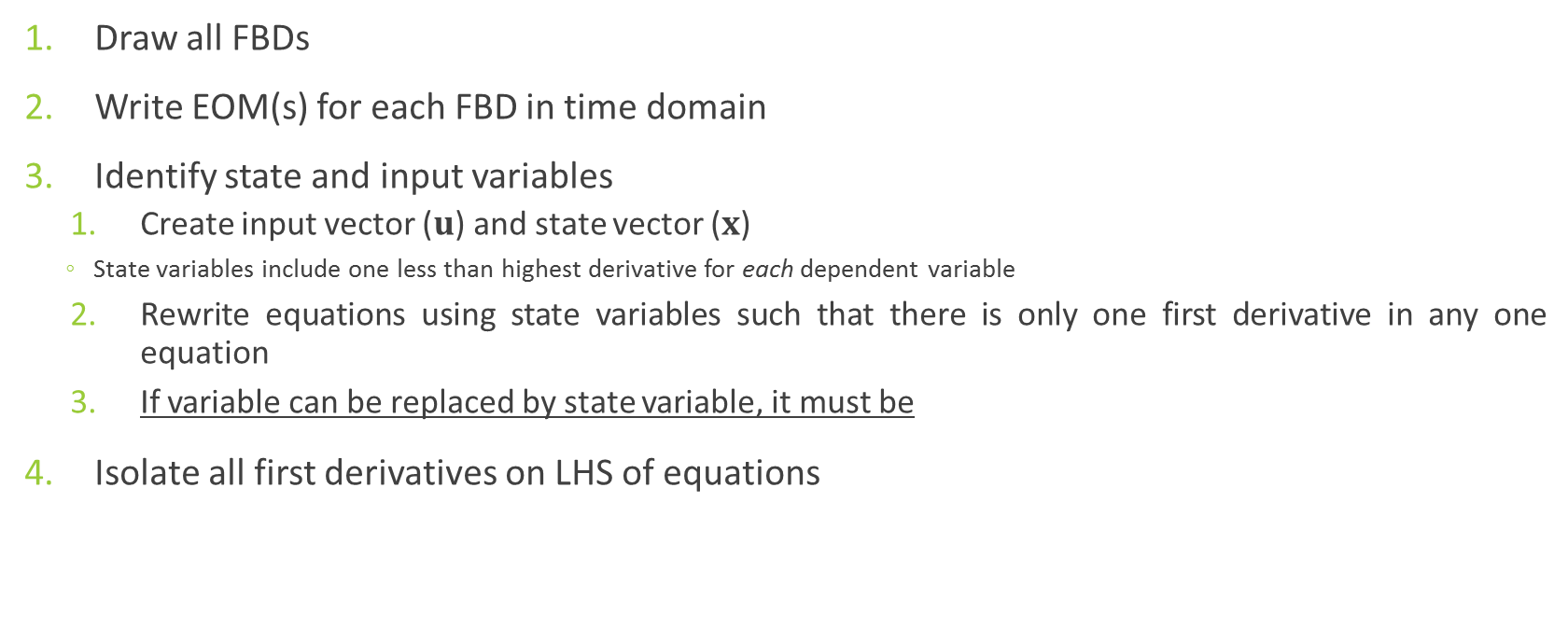
Steps for Modeling Mechanical Systems
Draw all FBDs
Write EOM(s) for each FBD in time domain
Identify state and input variables
Create input vector ($u$) and state vector ($x$)
State variables include one less than highest derivative for each dependent variable
Rewrite equations using state variables such that there is only one first derivative in any one equation
If variable can be replaced by state variable, it must be
Isolate all first derivatives on LHS of equations

Slide 6
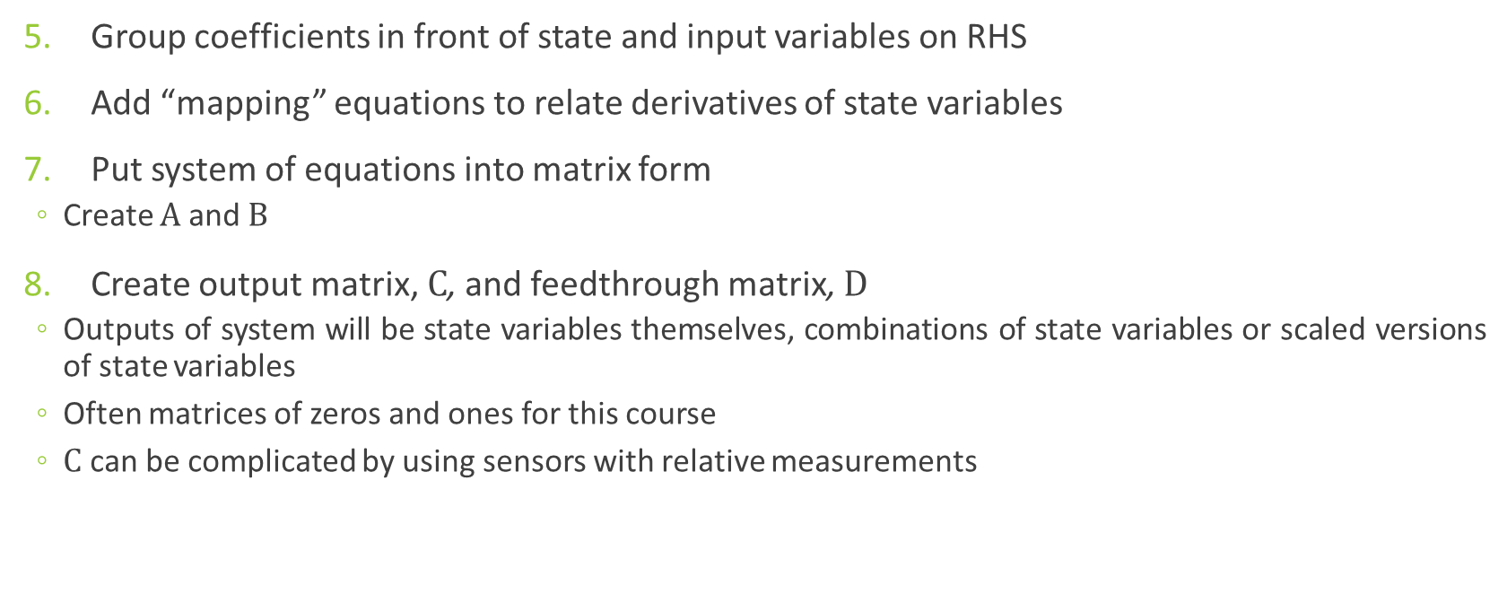
Steps for Modeling Mechanical Systems
Group coefficients in front of state and input variables on RHS
Add “mapping” equations to relate derivatives of state variables
Put system of equations into matrix form
Create $A$ and $B$
Create output matrix, $C$, and feedthrough matrix, $D$
Outputs of system will be state variables themselves, combinations of state variables or scaled versions of state variables
Often matrices of zeros and ones for this course
$C$ can be complicated by using sensors with relative measurements
Notes:
We may sense the distance between two moving objects rather than mounting to an inertial frame
In this course, we will assume that we can perfectly measure state variables. Will consider observability and controllability in future controls courses

Slide 7
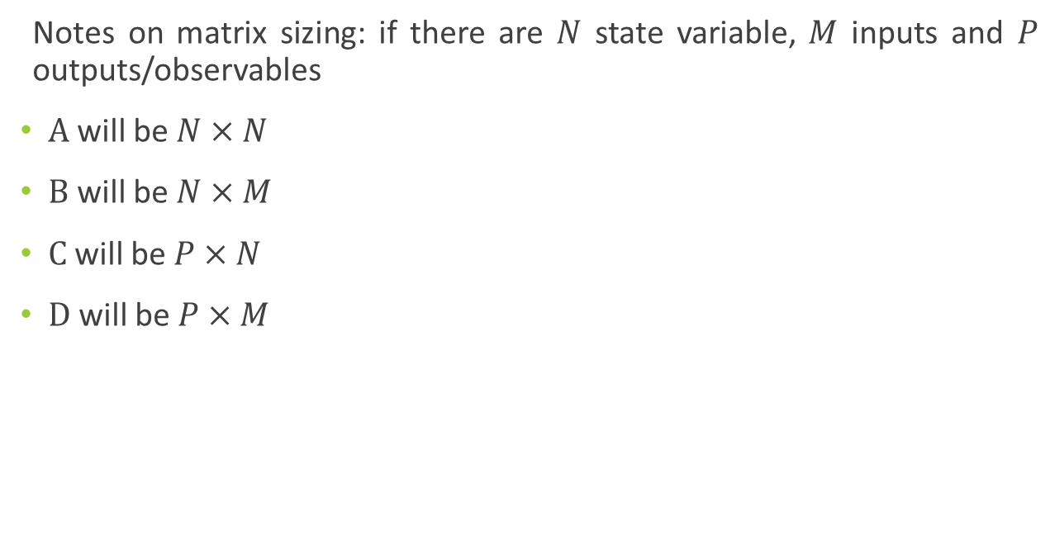
Steps for Modeling Mechanical Systems
Notes on matrix sizing: if there are $N$ state variable, $M$ inputs and $P$ outputs/observables
$A$ will be $N×N$
$B$ will be $N×M$
$C$ will be $P×N$
$D$ will be $P×M$
Notes:
A is always square

Slide 8
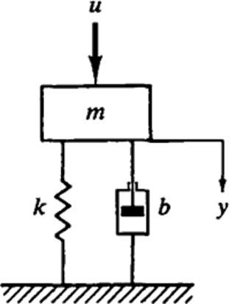
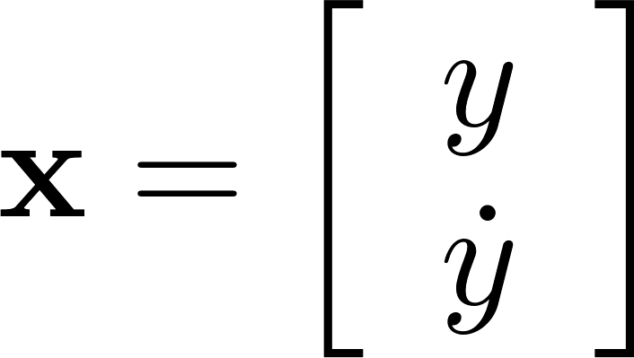
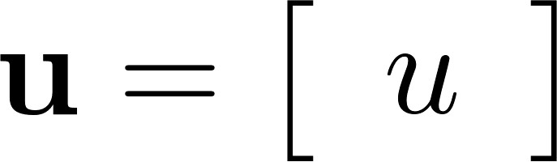
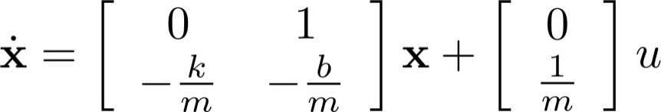

Example 1
Create state space model for given system for input force, $u$, and output of displacement, $y$
A
B
C
D

Slide 9
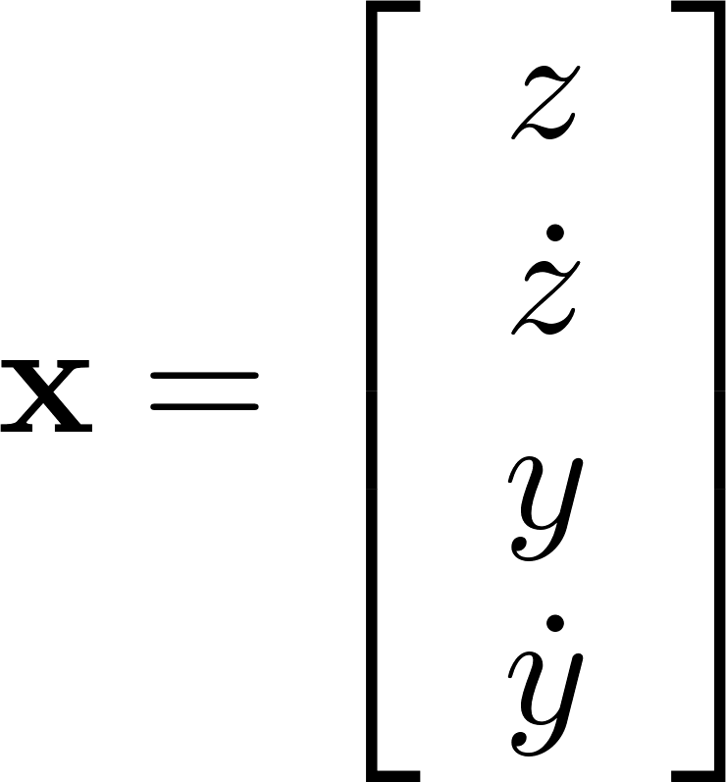
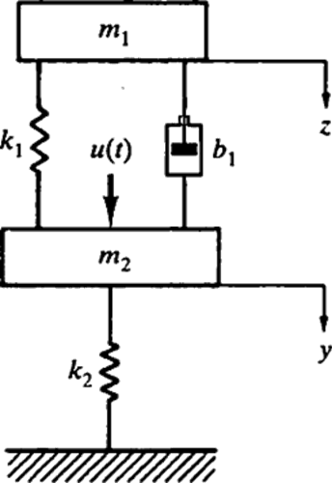
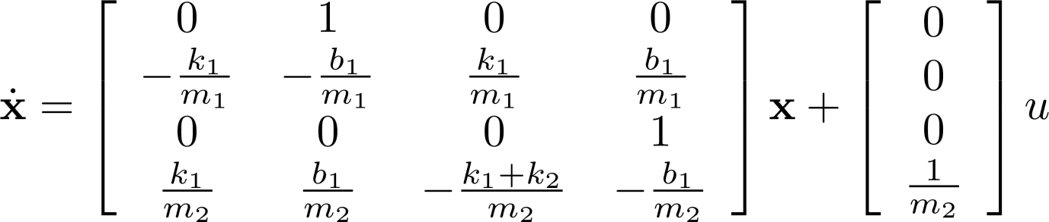
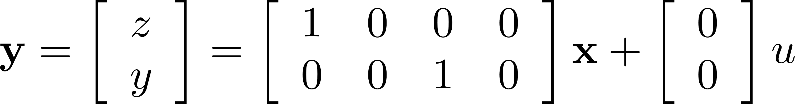

Example 2
Create state space model for given system for input force, $u$, and outputs of displacements, $y$ and $z$
A
B
C
D

Slide 10
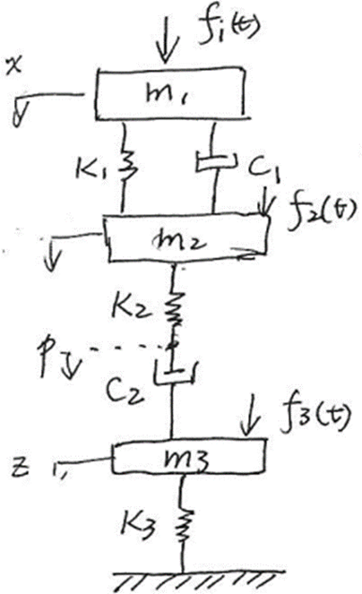

Example 3
Find algebraic state-space model for this system with three inputs and output of $z$.

Slide 11
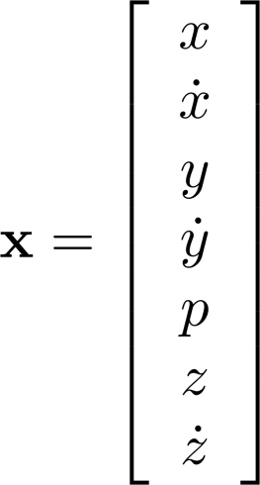
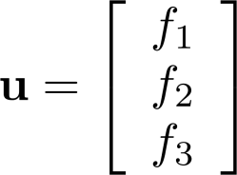
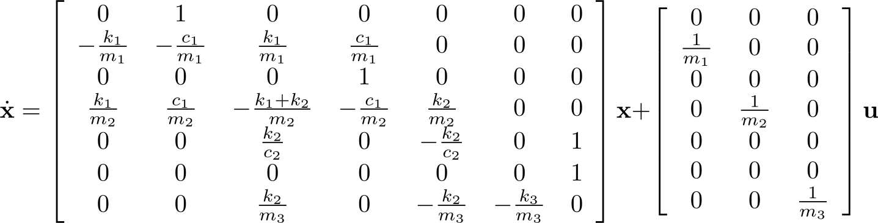
Example 3

Slide 12
End Unit 1
System Modeling

Slide 13
Unit 2
System Analysis
ME 357

Slide 14
Numeric Solutions
Solve for state variables numerically in MATLAB using ODE solvers when system in SS form*
ODE45: medium accuracy, use first
ODE23: lower accuracy, higher speed
ODE15s: for “stiff” matrices, if 45 and 23 are slow
[T, X] = ode45( @(t,y) myfun(t,y,[]), [t0, tf], [x0, xd0, y0, yd0, …] );
Y = (C*X’)’ + D*u; % ‘ makes it correct shape
% ---- the following is its own m file ----
[xd] = myfun(t,x,[])
xd = A*x + B*u;
return;
* The ODE solvers are robust and work with non-linear systems as well: system must be in SS form, but cannot be placed into matrix form.
Notes:
Uses some form of runge-kutta solver

Slide 15
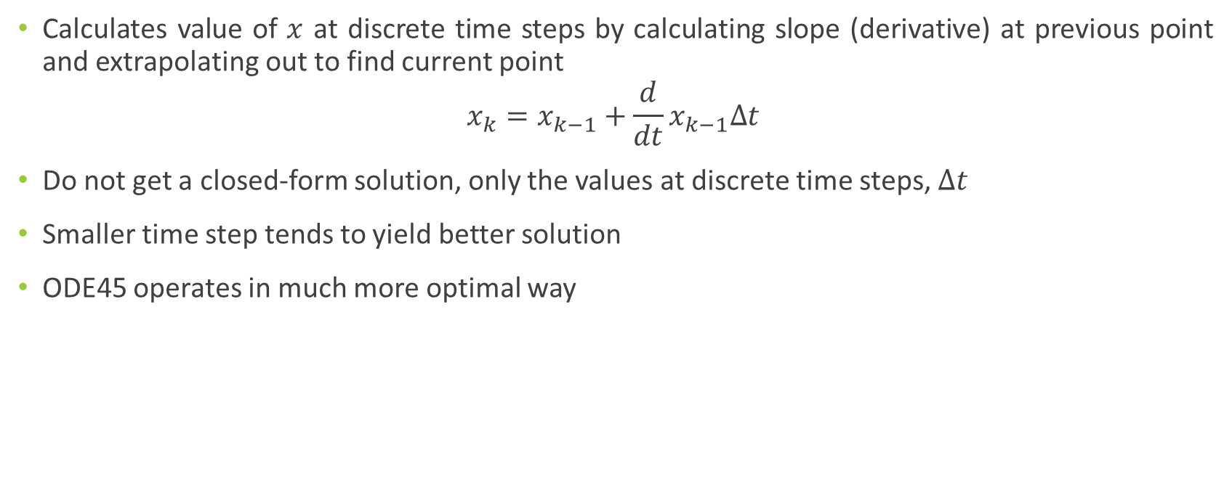
Runge-Kutta (Euler) Method
Calculates value of $x$ at discrete time steps by calculating slope (derivative) at previous point and extrapolating out to find current point
$$x_{k}=x_{k−1}+\frac{d}{dt}x_{k−1}∆t$$
Do not get a closed-form solution, only the values at discrete time steps, $∆t$
Smaller time step tends to yield better solution
ODE45 operates in much more optimal way
Notes:
This simple version is the Euler method which develops into Runge-Kutta

Slide 16
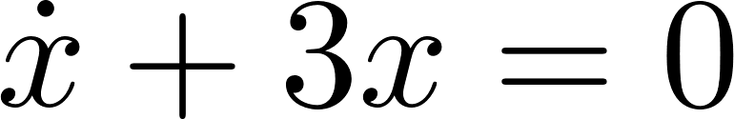
Runge-Kutta Example 1
As more points are used (i.e., smaller time steps) the numerical solution approaches (converges to) the analytic solution
Notes:
Dashed line is analytic solution

Slide 17

Runge-Kutta
This process can be done in multiple dimensions
$$x_{k}=x_{k−1}+\frac{d}{dt}x_{k−1}∆t$$
State space models work because we develop a system of 1st-order ODEs rather than having higher-order equations

Slide 18
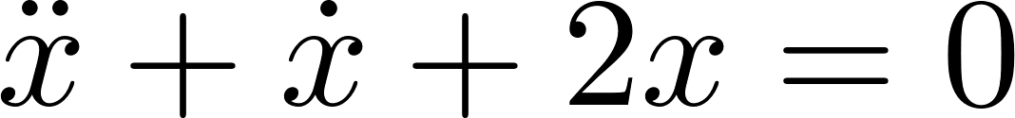
Runge-Kutta Example 2
As more points are used (i.e., smaller time steps) the numerical solution approaches (converges to) the analytic solution
Notes:
Dashed line is analytic solution

Slide 19
Numeric Solutions
For more examples on using ODE45 refer to:
https://sites.psu.edu/cmpsc200/content/lecture-9/

Slide 20


Example 1A
Create state space model for given system for input force, $u$, and output of displacement, $y$. Simulate using various masses, spring- and damping constants, inputs and initial conditions.

Slide 21
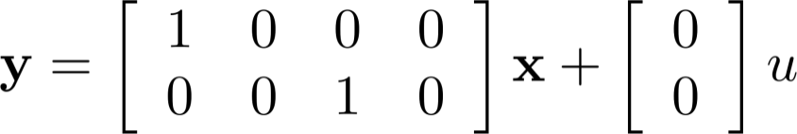

Example 2A
Create state space model for given system for input force, $u$, and outputs of displacements, $y$ and $z.$Simulate using various masses, spring and damping constants, inputs and initial conditions.

Slide 22
Example 3A
Find algebraic state-space model for this system
Simulate positions of system using values below:
m₁=5 kg, m₂= 2 kg, m₃ = 3kg
k₁ = 3 N/m, k₂ = 2 N/m, k₃ = 5 N/m
c₁ =c₂ = 6 N-s/m
Various inputs f₁, f₂, f₃

Slide 23
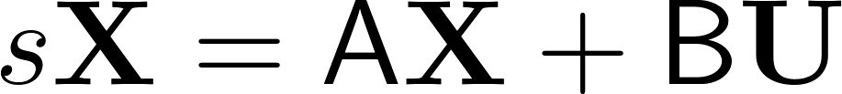



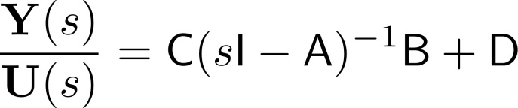
Converting SS to TF
Taking Laplace Transform of state equation
Taking Laplace Transform of output equation
Subbing in X

Slide 24
SS2TF in Matlab
[b,a] = ss2tf(A,B,C,D)
Returns numerator(s) and denominator(s) for TF for given SS model
b will have as many rows as number of observables (rows of C/D)
a will have multiple rows when there are multiple inputs
sys_{i} = TF(b(i,:),a)
Creates transfer function for i^{th} observable

Slide 25

Example 1B
Starting with the SS model, convert into the TF for $Y/U$.
Let m=1 kg, b = 10 N-s/m, k = 16 N/m
Let m=1 kg, b = 2 N-s/m, k=5 N/m
Let m=1 kg, b = 10 N-s/m, k=0 N/m

Slide 26

Example 2B
Starting with the SS model, convert into the TF for $Y/U$ and $Z/U$.
Let m₁=10 kg, m₂=1kg, k₁=100N/m, k₂=30N/m, b₁ = 20 N-s/m

