Slide 1
Linearization of Non-linear Systems
ME 357

Slide 2
Objectives
By the end of this section, you should be able to
Be able to approximate non-linear systems as linear systems
Understand limitations of linearizing non-linear systems

Slide 3
Nonlinear Systems
Analysis thus far has looked only at systems of linear equations
Often able to find closed-form / analytic solutions to these problems
Behavior of linear systems is predictable and easy to control
Systems may include non-linear relationships
Closed-form solutions may be difficult or impossible to find
Difficult to predict behavior of system after a “long” time (e.g. weather, economy)
Can get exact answer to an approximate problem (linearization) or an approximate answer to the exact problem (numerical solutions)

Slide 4
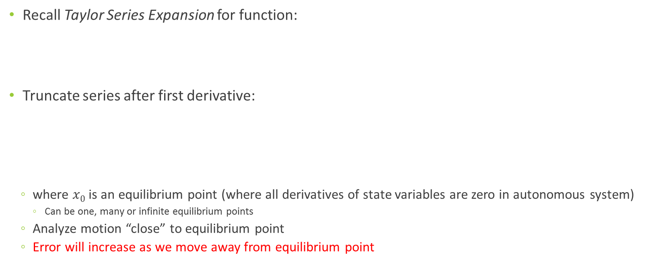
Linearization
Recall Taylor Series Expansion for function:
Truncate series after first derivative:
where $x0$ is an equilibrium point (where all derivatives of state variables are zero in autonomous system)
Can be one, many or infinite equilibrium points
Analyze motion “close” to equilibrium point
Error will increase as we move away from equilibrium point

Slide 5
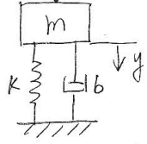

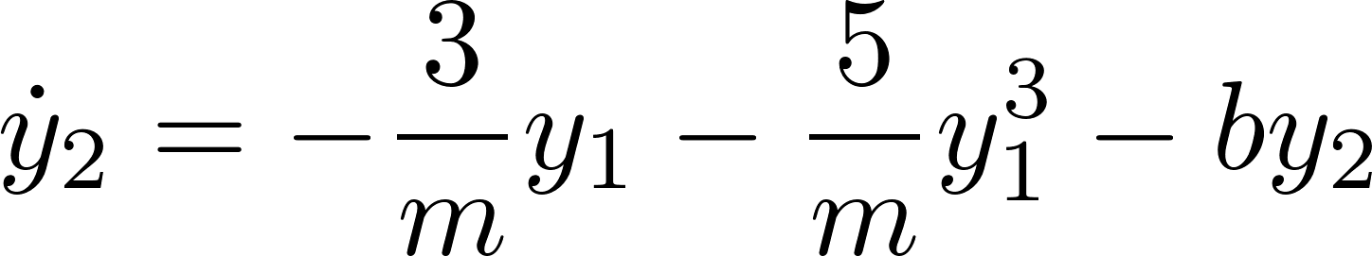
Example 1 Stiffening Spring
m= 1 kg
b = 1 Ns/m
F_{k}= -(3y + 5y³)N

Slide 6
Example 1 (Contd.)
m= 1 kg
b = 1 Ns/m
F_{k}= -(3y + 5y³)N
x₀ = 0.25m
x₀’ = 0

Slide 7
Example 1 (Contd.)
m= 1 kg
b = 1 Ns/m
F_{k}= -(3y + 5y³)N
x₀ = 0.5m
x₀’ = 0

Slide 8
Example 1 (Contd.)
m= 1 kg
b = 1 Ns/m
F_{k}= -(3y + 5y³)N
x₀ = 1m
x₀’ = 0

Slide 9

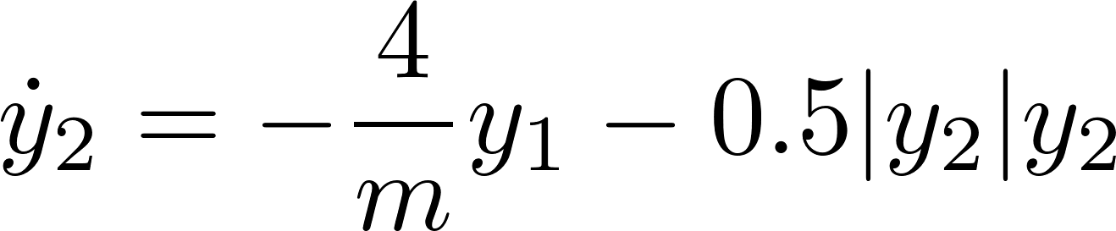
Example 2 Air Resistance
m= 1 kg
k= 4 N/m

Slide 10
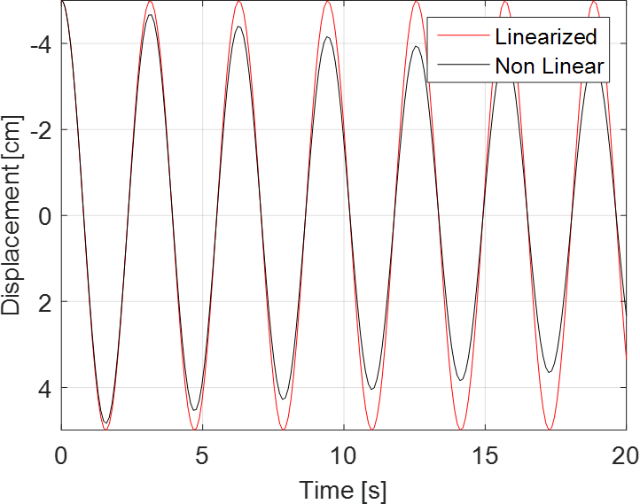
Example 2 (Contd.)
m= 1 kg
k= 4 N/m
x₀ = -5 cm
x₀’ = 0

Slide 11
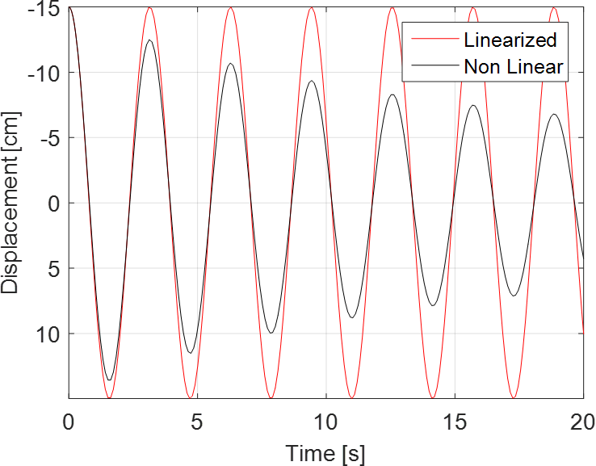
Example 2 (Contd.)
m= 1 kg
k= 4 N/m
x₀ = -15 cm
x₀’ = 0

Slide 12
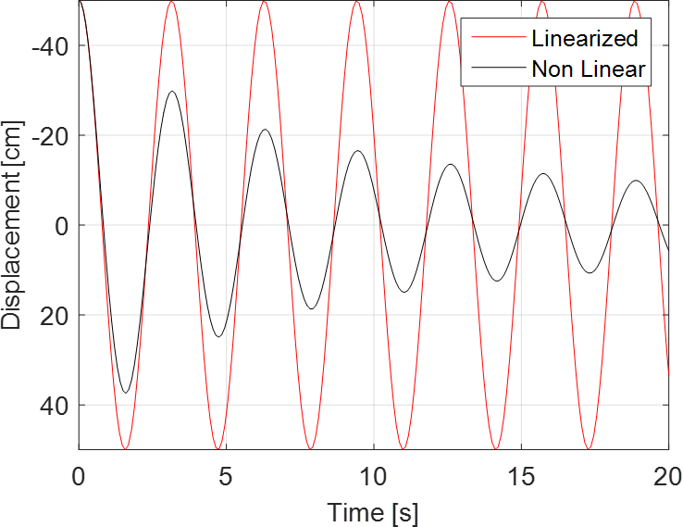
Example 2 (Contd.)
m= 1 kg
k= 4 N/m
x₀ = -50 cm
x₀’ = 0

Slide 13
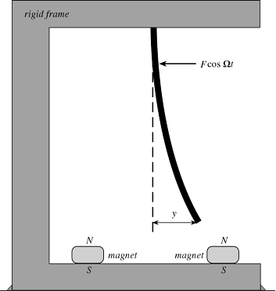
“Moonbeam”

