Slide 1
Block Diagrams
ME 357

Slide 2
Objectives
By the end of this section, you should be able to
Represent transfer functions as blocks
Calculate transfer functions using block diagrams

Slide 3
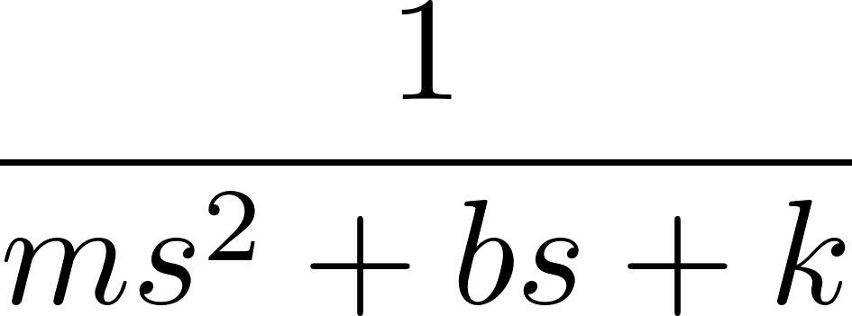
Block Diagrams
We can represent signals going through a transfer function or several transfer functions using block diagrams
force
Machine
displacement
voltage
Amplifier
K
voltage

Slide 4
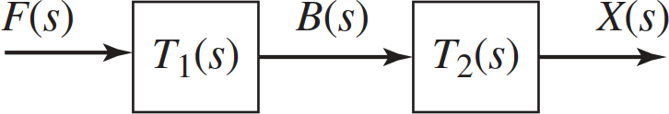
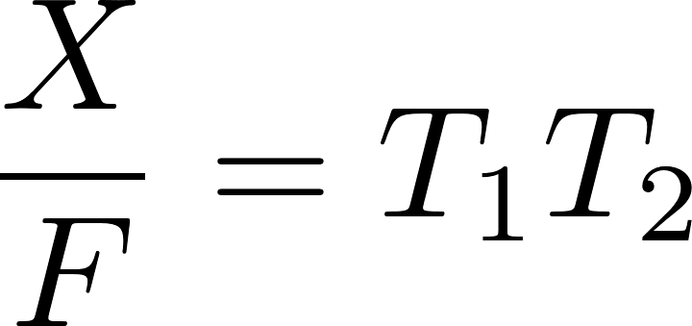
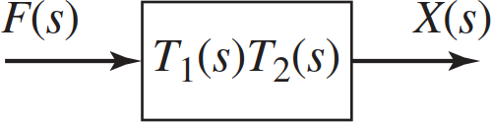

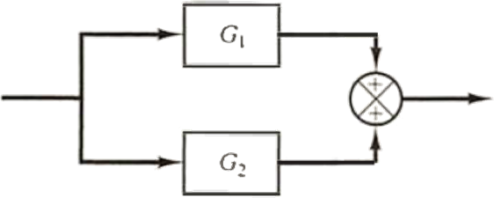



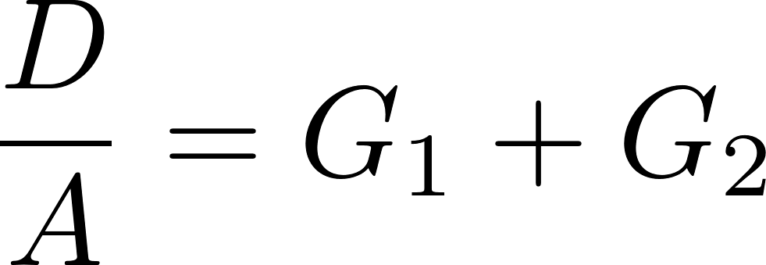

Block Diagram Algebra (1)
Simplify signals going through multiple transfer functions
Series
Parallel

Slide 5
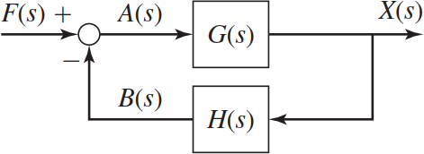
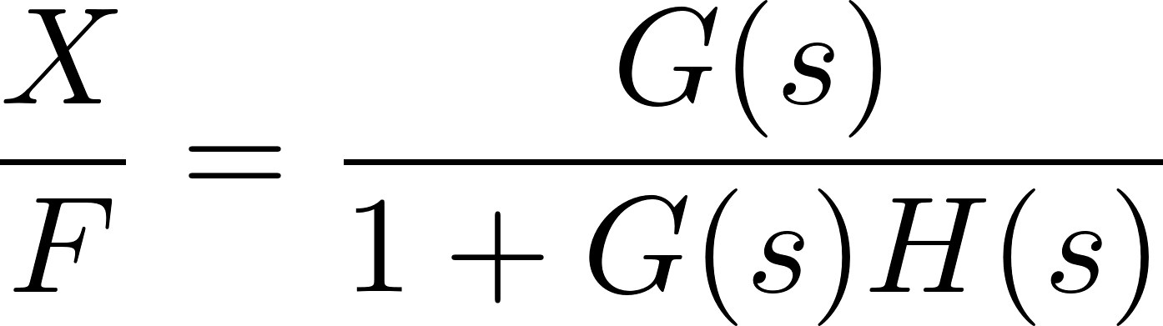
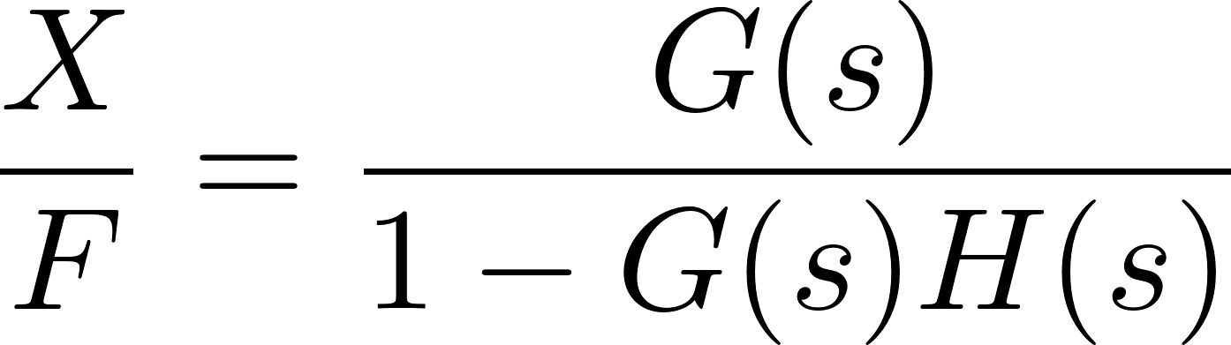
Block Diagram Algebra (2)
Negative Feedback
Positive Feedback

Slide 6
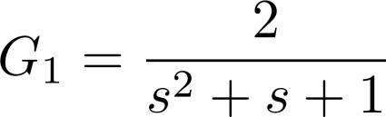


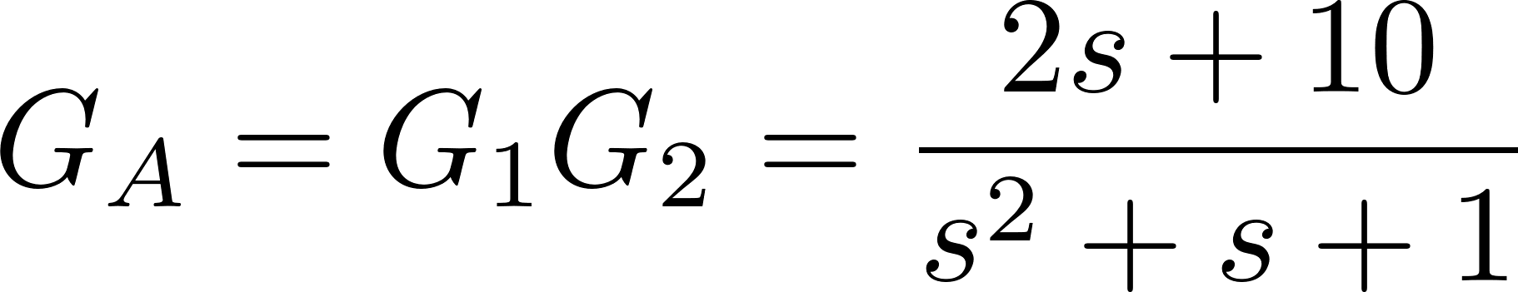
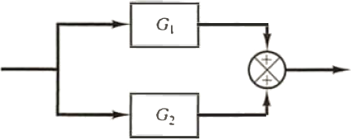
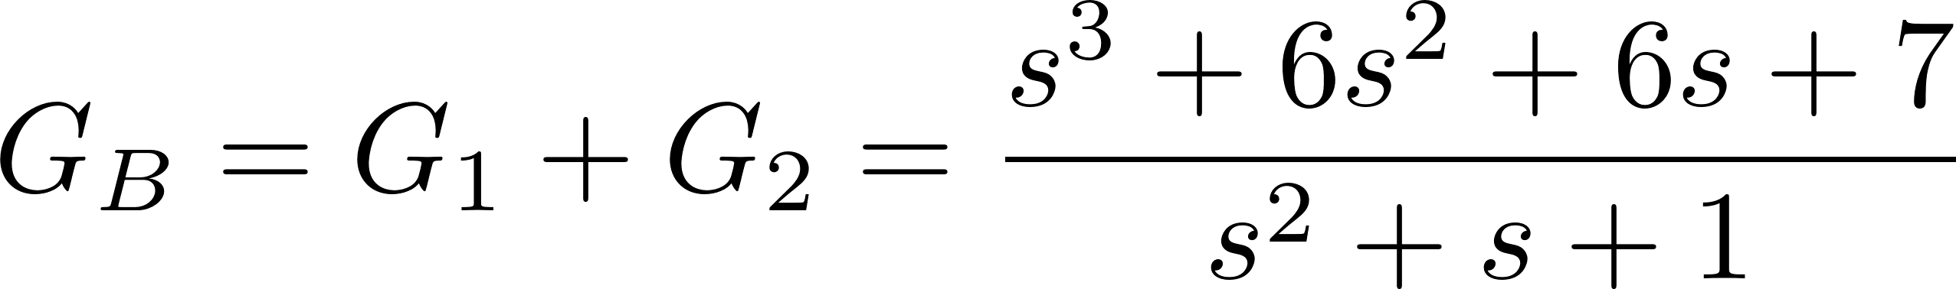


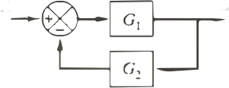
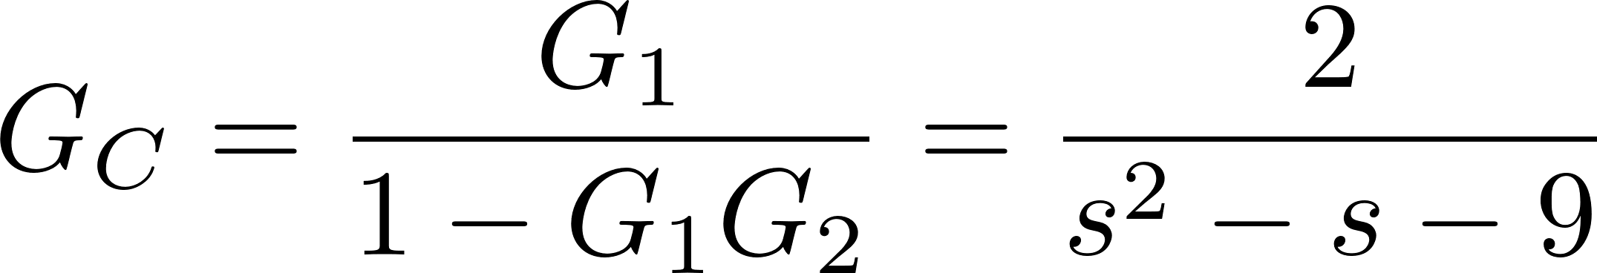
Examples

