Slide 1
1st-Order System Response
ME 357

Slide 2
Objectives
By the end of this section, you should be able to
Place 1st-order systems into standard form
Identify the defining parameters of system
Sketch response of system due to step input

Slide 3
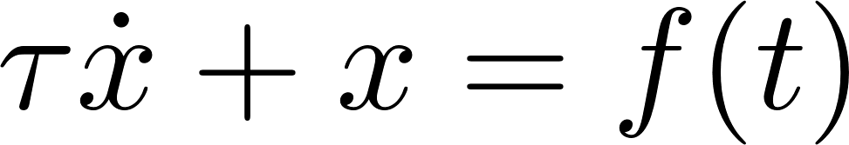
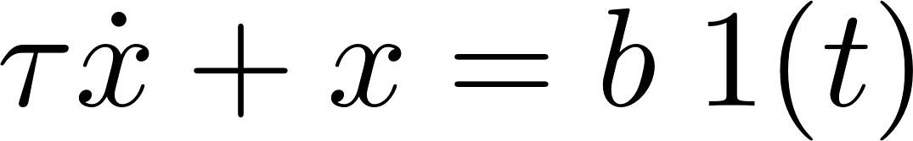
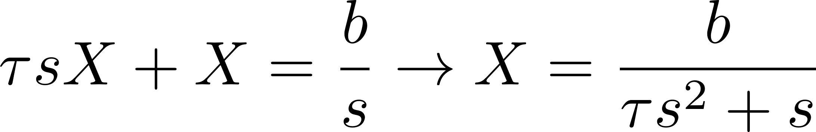
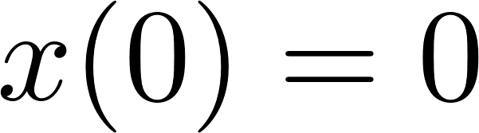
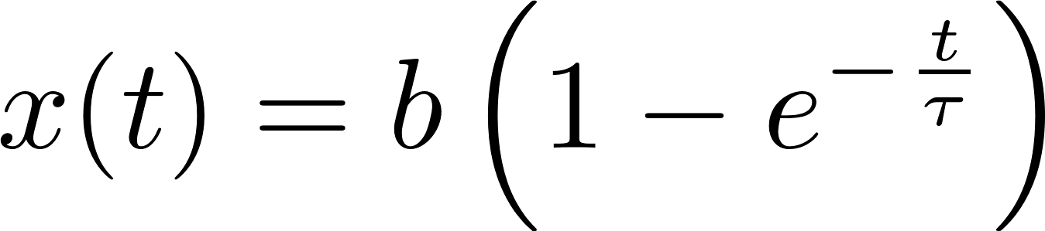
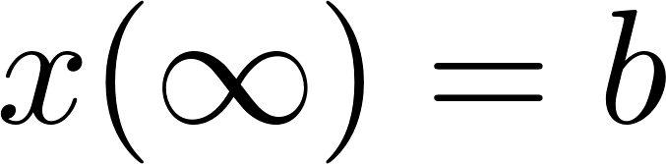

1st-Order Systems
General form for a 1st-order system
When the input is a step function of magnitude $b$
Taking the Laplace transform ($x(0)=0$) and then solving for $X(s)$
Solving the Inverse Laplace transform
Notes:
We have now solved every ODE that is in this form
We will not go into the time domain to do our analysis of “key” features of the response

Slide 4
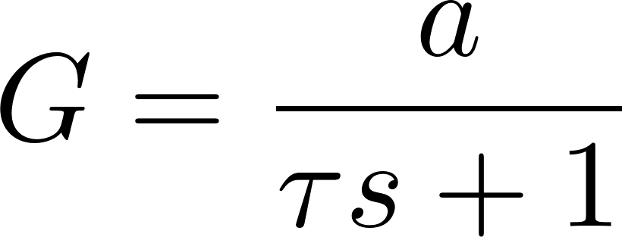
1st-Order Systems
Interested in predicting response of 1st-order system (e.g. RC circuit, or SMD with negligible mass) due to step function
Can implement passive control by tuning components in system (e.g. springs, masses, capacitors) to make system behave in desired way
First, place transfer function into standard form for 1st-order system

Slide 5


Time Constant, $τ$
Measure of how quickly system responds to input
For step input, time to reach $\sim 63\%$of SS value
Determines bandwidth or cutoff frequency of system when given periodic input

Slide 6
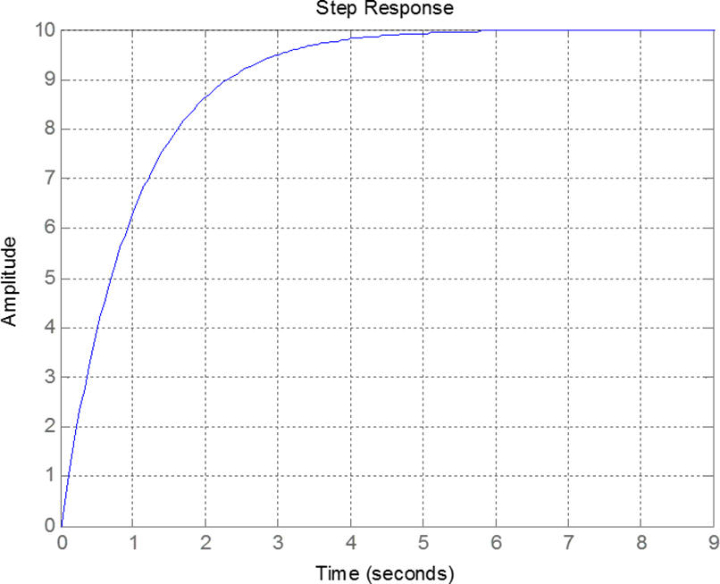
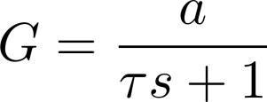
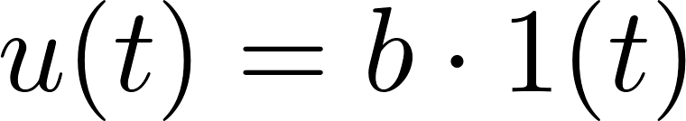

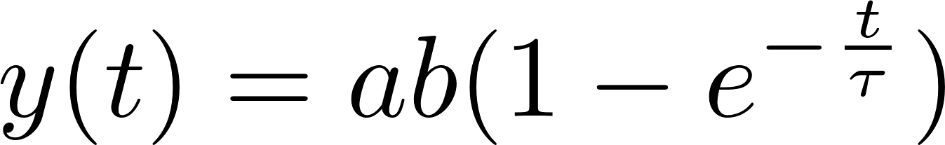
1st-Order Systems Time Domain Response
Notes:
These come from the closed-form solution that we already know

Slide 7
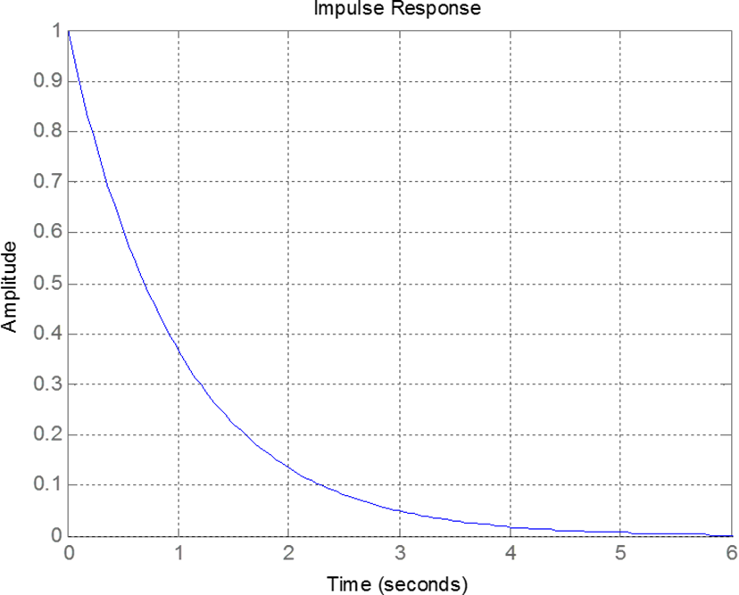

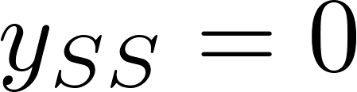
1st-Order Systems Time Domain Response

Slide 8
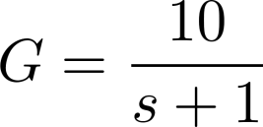
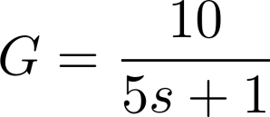
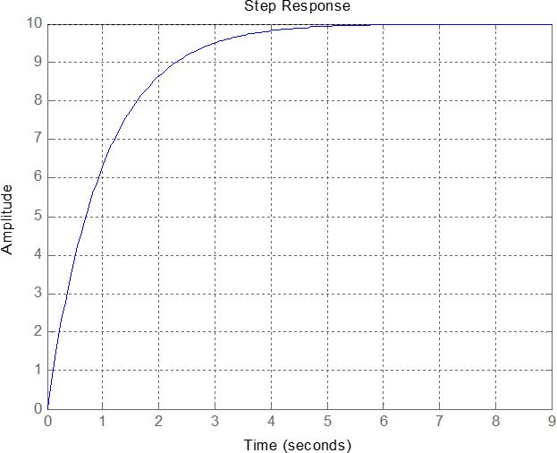

1st-Order Systems Effect Of Time Constant

Slide 9
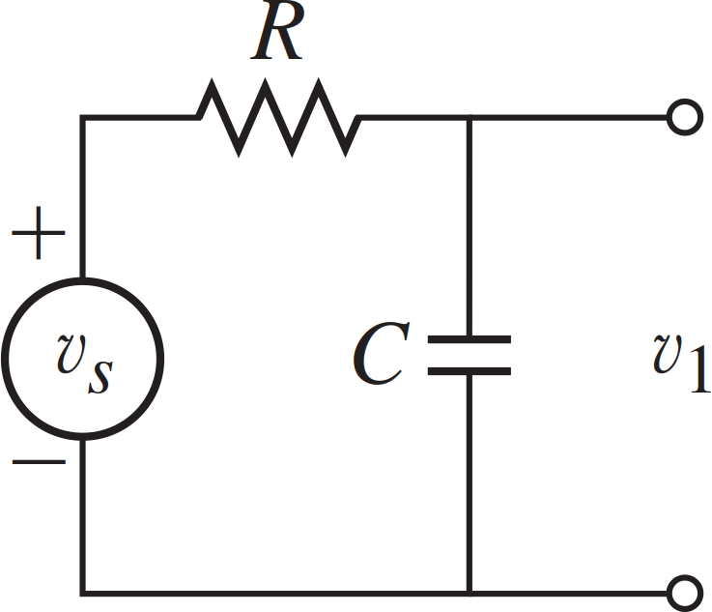
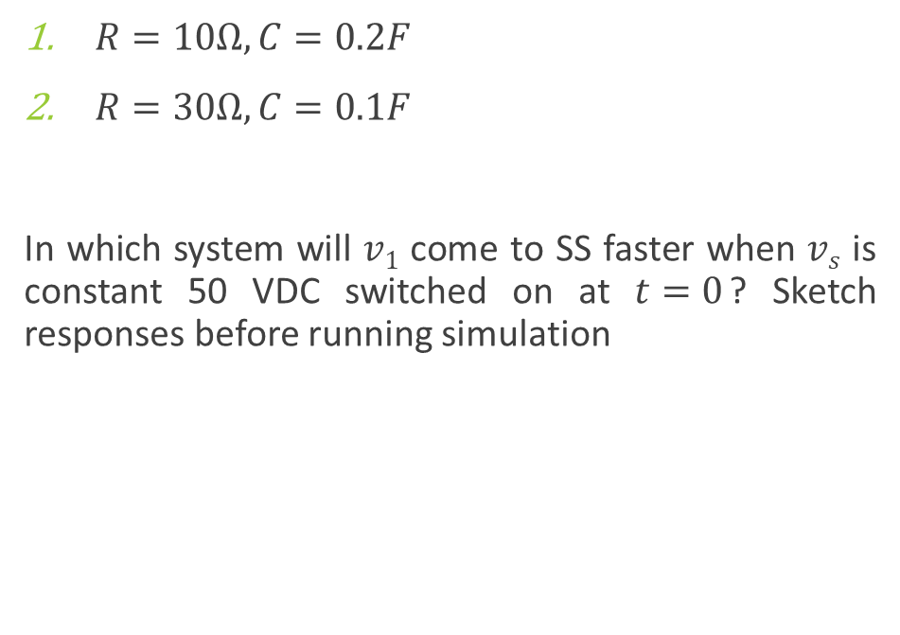
Example 1
$R=10Ω, C=0.2F$
$R=30Ω, C=0.1F$
In which system will $v1$ come to SS faster when $vs$ is constant 50 VDC switched on at $t=0$? Sketch responses before running simulation

Slide 10
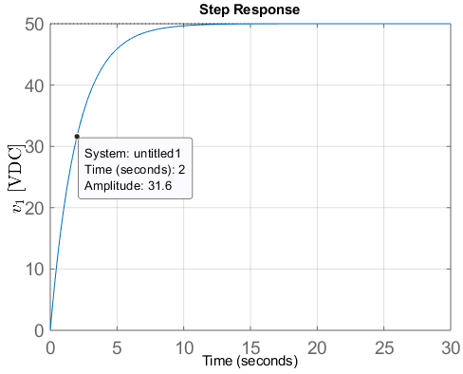
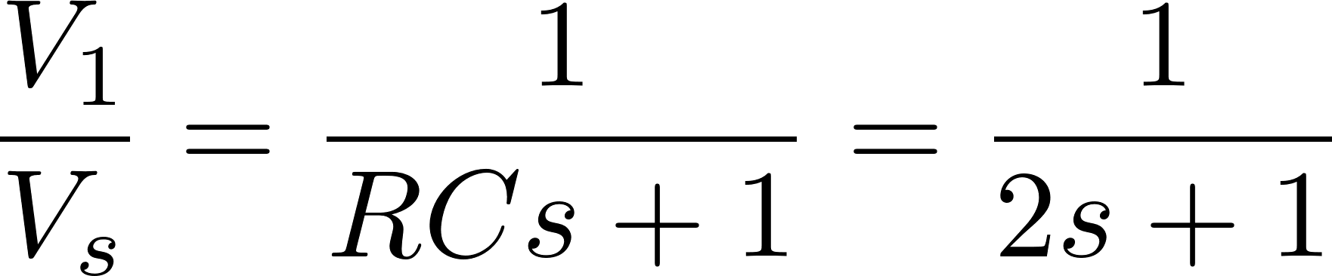

Example 1 (Contd.)
$R=10Ω, C=0.2F$
In which system will $v1$ come to SS quicker when $vs$ is a constant 50 VDC switched on at $t=0$? Sketch responses before observing simulation

Slide 11
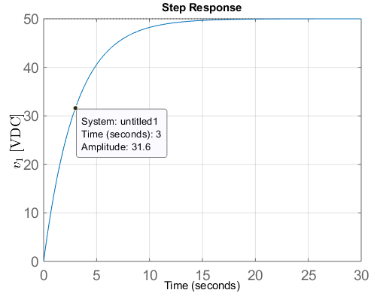


Example 1 (Contd.)
$R=30Ω, C=0.1F$
In which system will $v1$ come to SS quicker when $vs$ is a constant 50 VDC switched on at $t=0$? Sketch responses before observing simulation

Slide 12
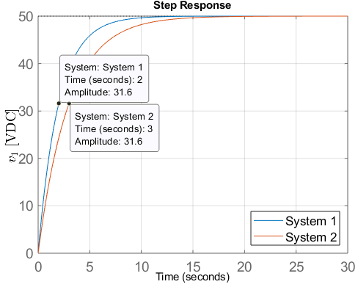

Example 1 (Contd.)
Which system will come to steady state quicker when $vs$ is a constant 50VDC and switched on? Sketch the responses before observing simulation

Slide 13
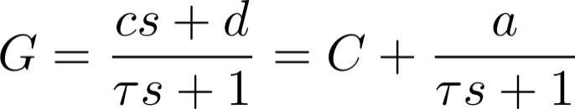
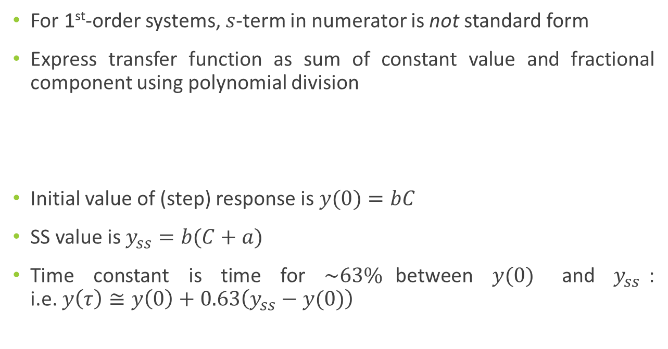
Placing in Standard Form s-term in Numerator
For 1st-order systems, $s$-term in numerator is not standard form
Express transfer function as sum of constant value and fractional component using polynomial division
Initial value of (step) response is $y(0)=bC$
SS value is $y_{ss}=b(C+a)$
Time constant is time for $\sim 63\%$between $y(0)$ and $y_{ss}$: i.e. $y\left(τ\right)≅y\left(0\right)+0.63\left(y_{ss}−y(0)\right)$

Slide 14
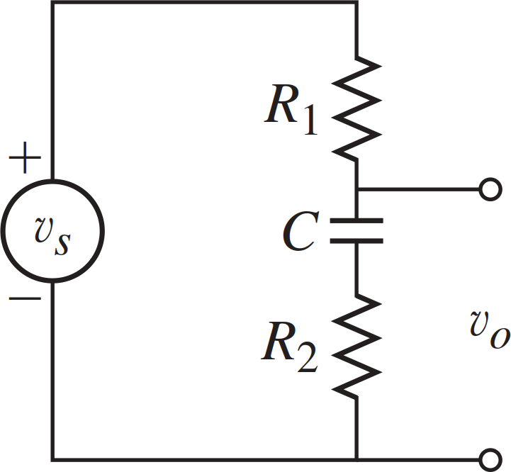
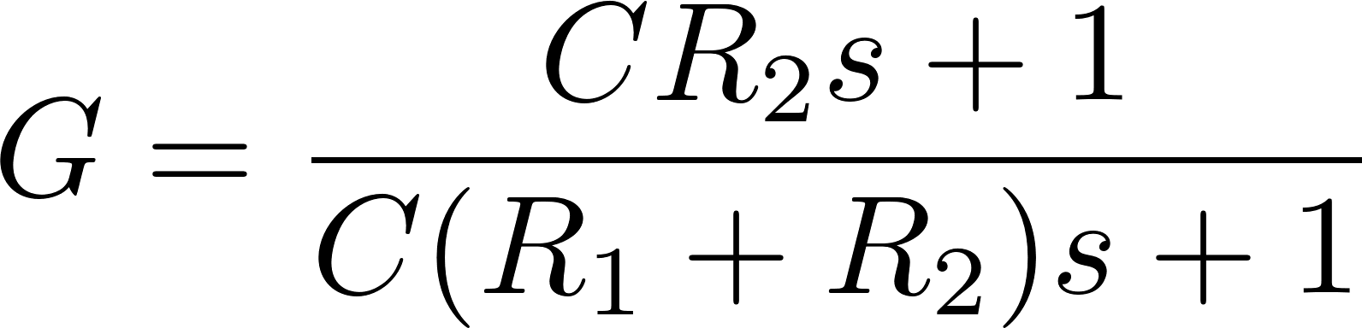
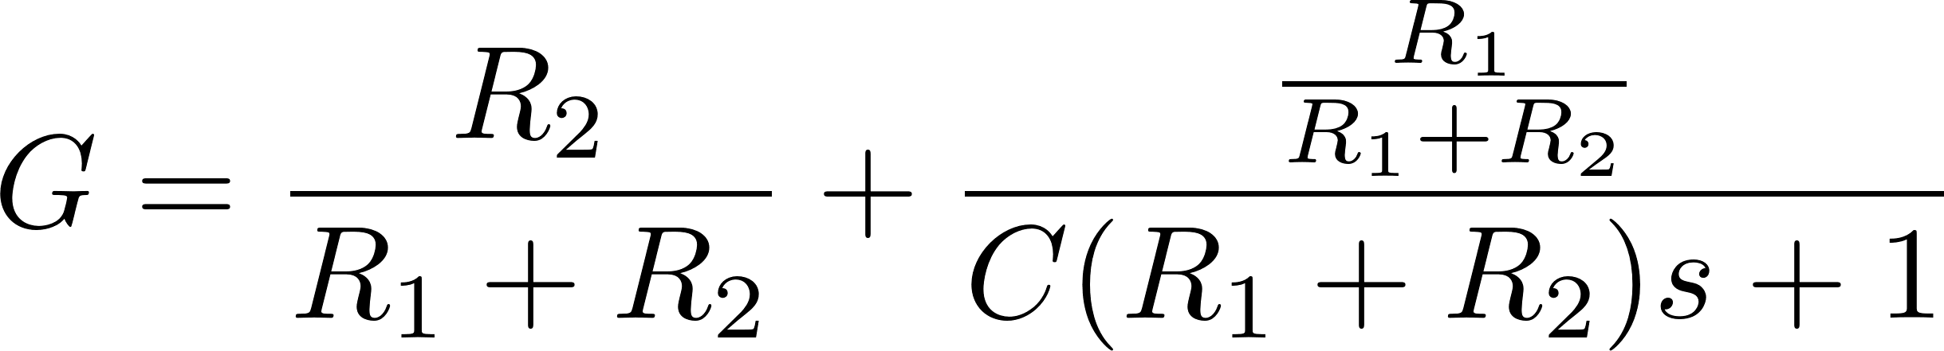

Example 2: s in Numerator
$$R1 =7Ω, R2=5Ω,$$
$$C =0.3F$$
$$vs=5∗1(t)$$
Sketch system response

Slide 15
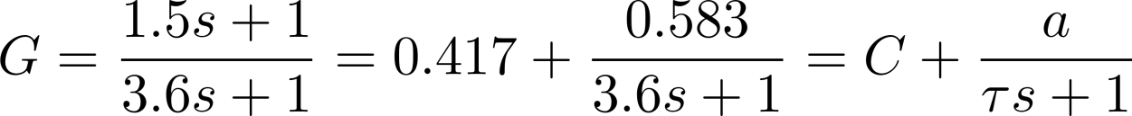
Example 2: s in Numerator

