Slide 1
2nd-Order System Response
ME 357

Slide 2
Objectives
By the end of this section, you should be able to
Put 2nd-order systems into standard form
Identify defining parameters of system
Classify stability of system in TF or SS form
Sketch response of system due to step input
Modify sketch when extra poles or zeros are added

Slide 3
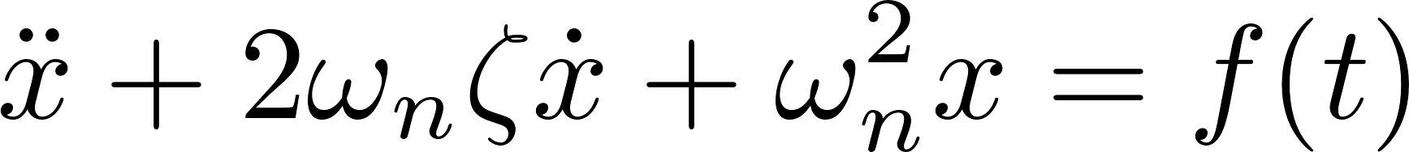
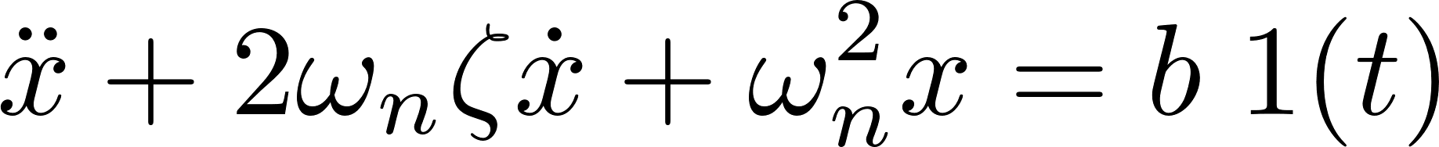
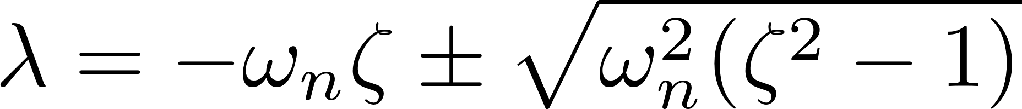

2nd-Order Systems
General form for a 2nd-order system
When the input is a step function of magnitude $b$
Roots of characteristic equation
General homogeneous solution
Notes:
Oscillation depends on roots – value of zeta

Slide 4
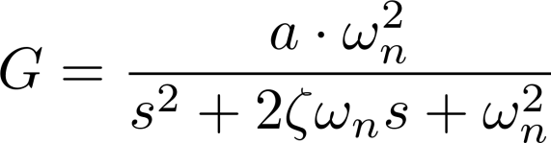
2nd-Order Systems
Interested in predicting response of 2nd-order system (e.g. LRC circuit, or SMD) due to step function
Can implement passive control by tuning components in system (e.g. springs, masses, capacitors) to make system behave in desired way
Place transfer function into standard form for 2nd-order system
Notes:
This form appropriate when there are no zeros

Slide 5


2nd-Order Systems Time Domain Response
where
is natural frequency.
is damping ratio.
is damped frequency (if underdamped system)

Slide 6
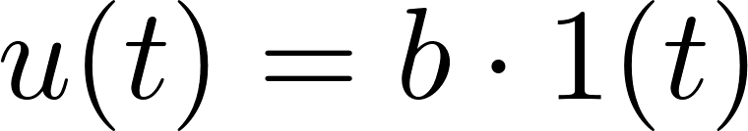




2nd-Order Systems Time Domain Response
Under-damped, oscillation around SS value
Critically-damped, no oscillation around SS
Over-damped, no oscillation around SS, slower convergence than critically damped
Notes:
Step input response

Slide 7
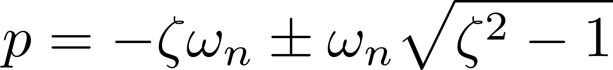



2nd-Order Systems Time Domain Response
Complex poles
Real, repeated poles
Real, distinct poles
Purely imaginary roots: neutral stability
Poles in right half plane: unstable

Slide 8
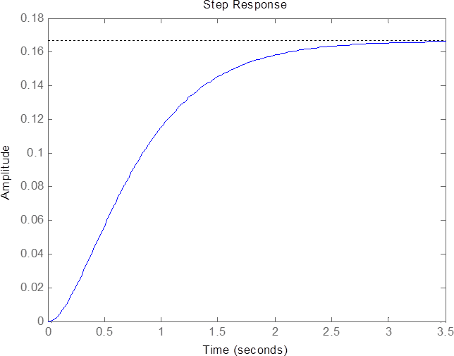
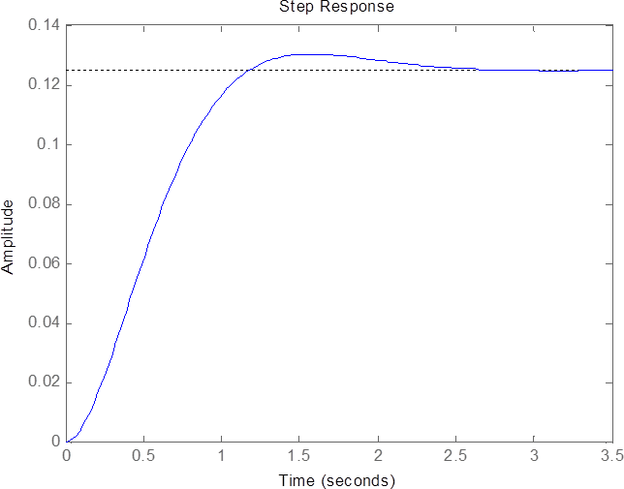

Typical Responses Step Input

Slide 9
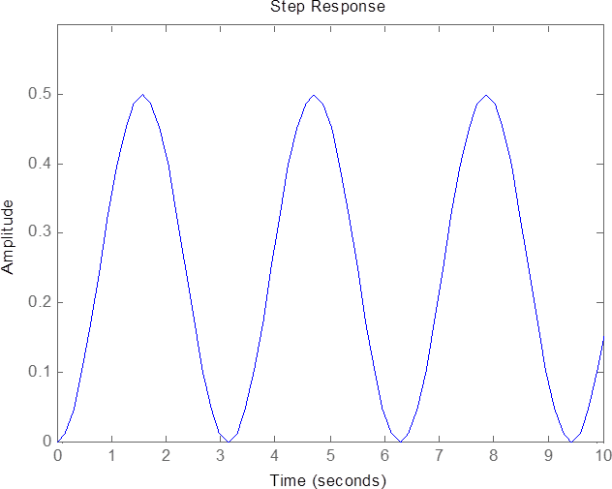
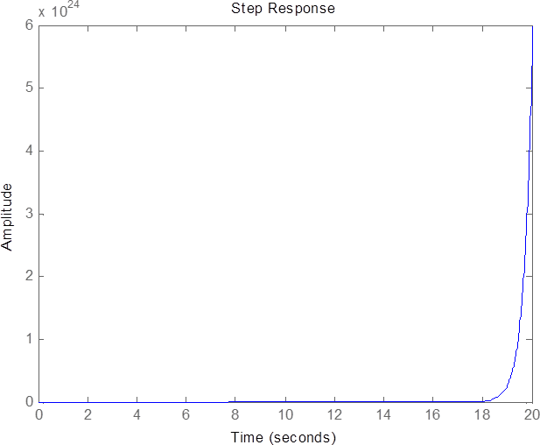
Typical Responses Step Input

Slide 10
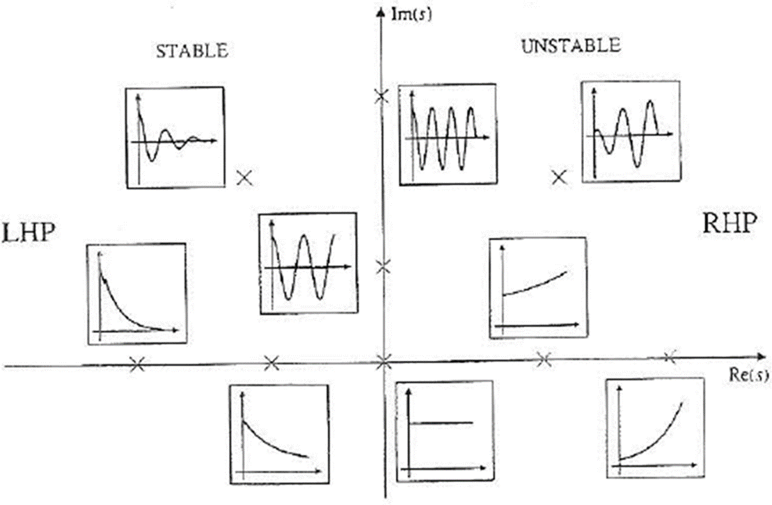
Pole Location Response

Slide 11
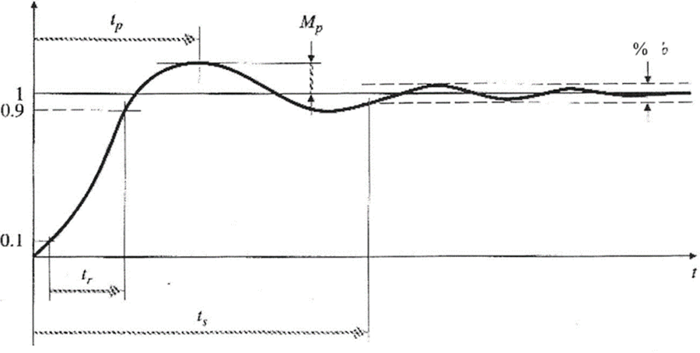
Key Features of Under-Damped Systems
Rising time
Peak time
Overshoot
Settling time

Slide 12
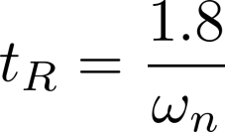
Rising Time
Time to increase/decrease from 10% to 90% of steady-state value
Notes:
Not used often in this course

Slide 13
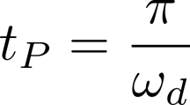
Peak Time
Time from start to maximum value
Notes:
This is half a period of oscillation

Slide 14

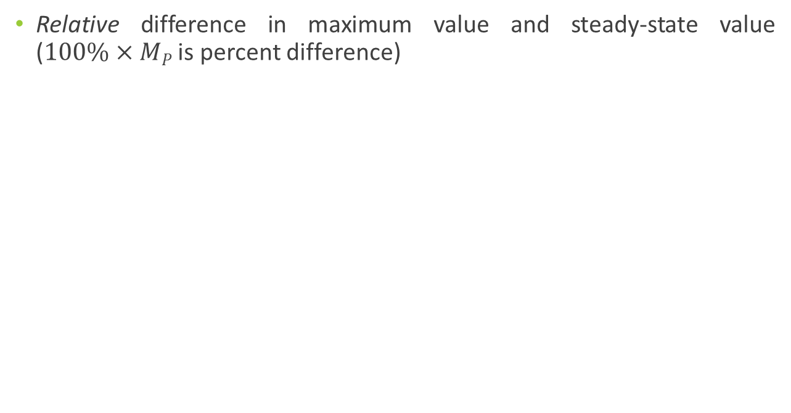
Maximum Overshoot
Relative difference in maximum value and steady-state value ($100\%×MP$ is percent difference)
Notes:
This is *not* the maximum value itself

Slide 15
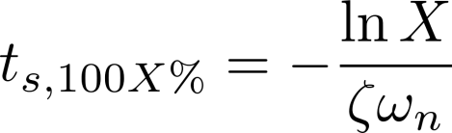
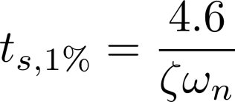
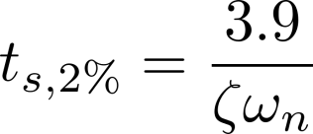
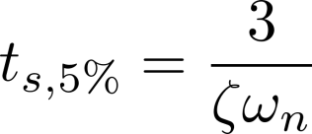
Settling Time
Time to be bound within (100X)% of SS value

Slide 16
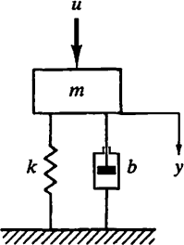
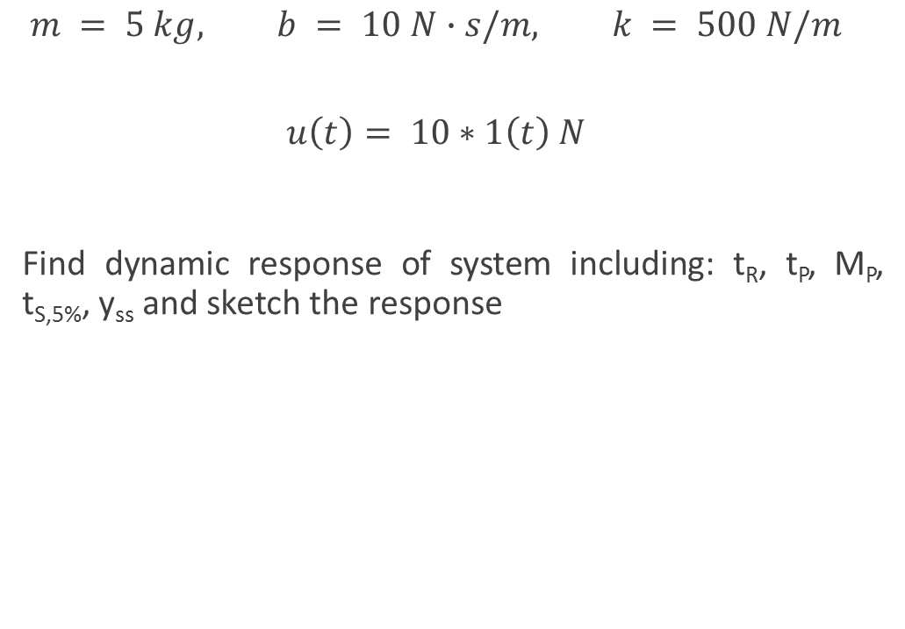
Example 1
$$m = 5 kg, b = 10 N∙s/m, k = 500 N/m$$
$$u\left(t\right)= 10∗1\left(t\right) N$$
Find dynamic response of system including: t_{R}, t_{P}, M_{P}, t_{S,5%}, y_{ss} and sketch the response

Slide 17
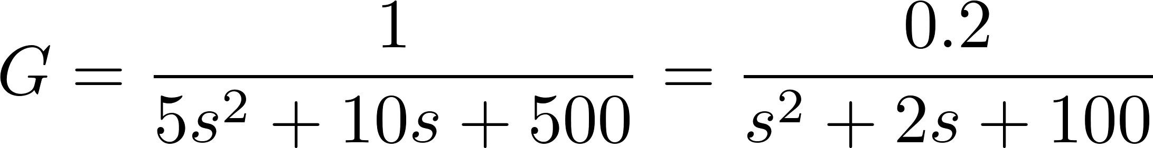
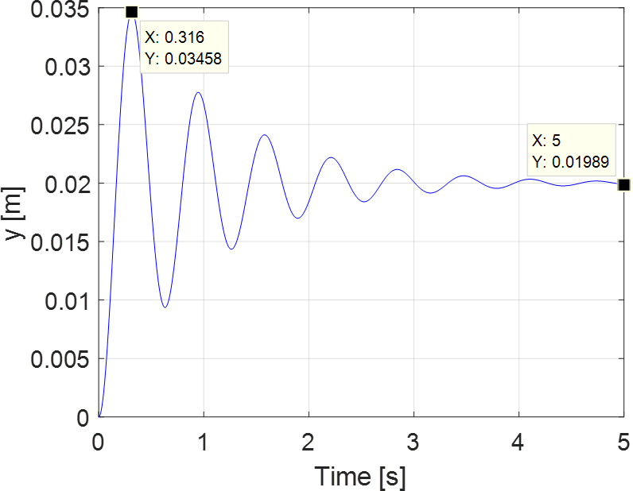
Example 1

Slide 18
Attenuation
Stable, under-damped systems oscillate around SS value, gradually losing energy
Bound of oscillations has exponential decay
Frequency of oscillation not natural frequency, but rather damped frequency

Slide 19
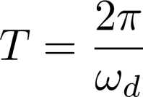
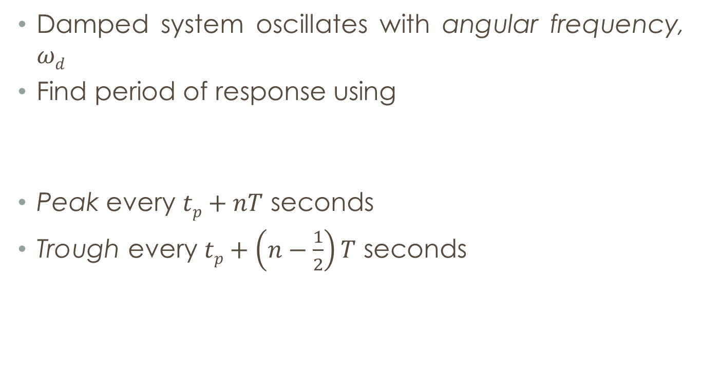
Frequency of Response Damped system
Damped system oscillates with angular frequency, $ωd$
Find period of response using
Peak every $tp+nT$ seconds
Trough every $tp+\left(n−\frac{1}{2}\right)T$ seconds

Slide 20

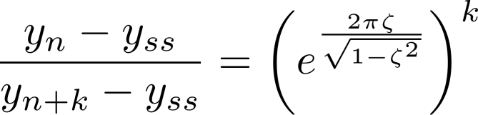
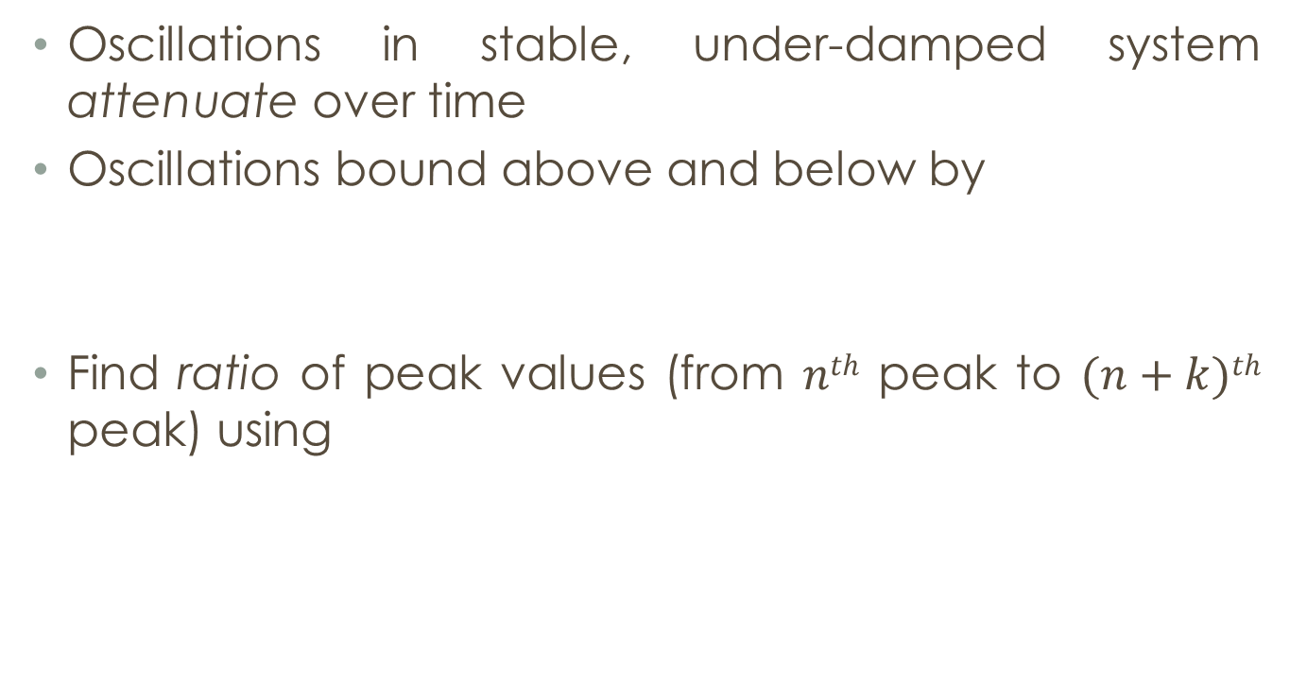
Attenuation of Response Damped system
Oscillations in stable, under-damped system attenuate over time
Oscillations bound above and below by
Find ratio of peak values (from $nth$ peak to $(n+k)th$ peak) using

Slide 21

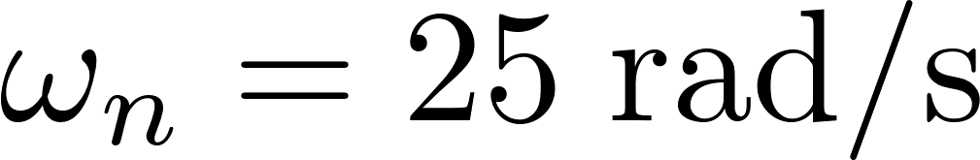


Example 2
Assume 2nd-order system with
Sketch response with proper attenuation and frequency

Slide 22
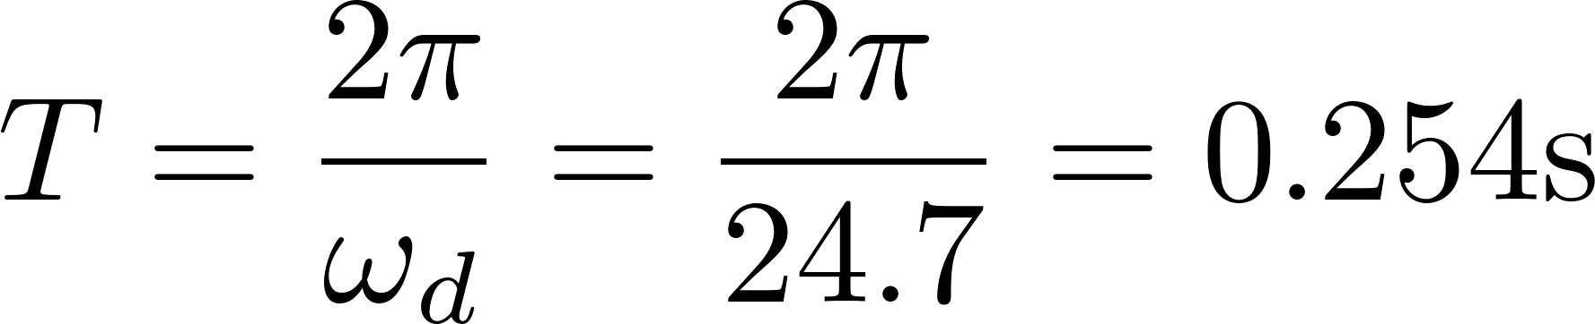
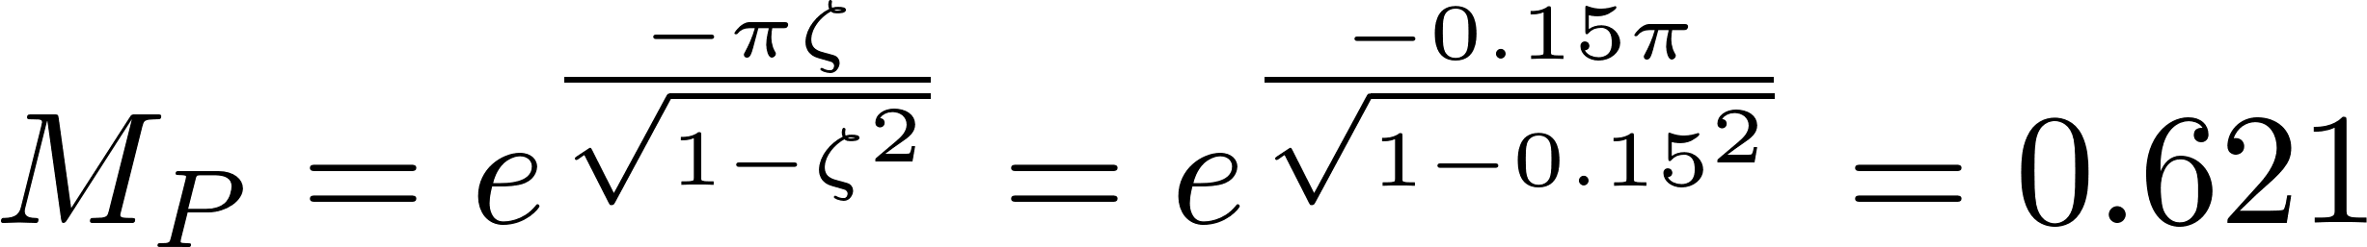
Example 2

Slide 23
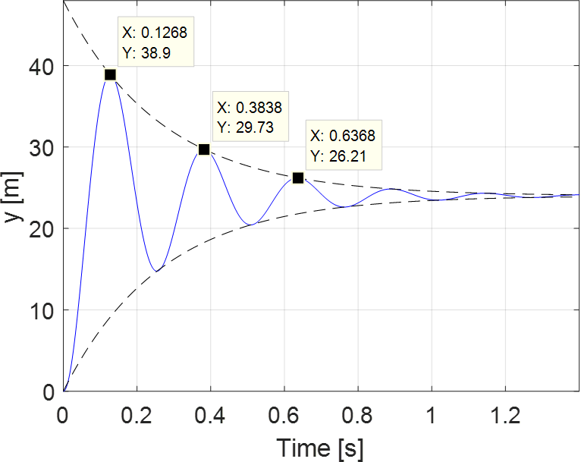
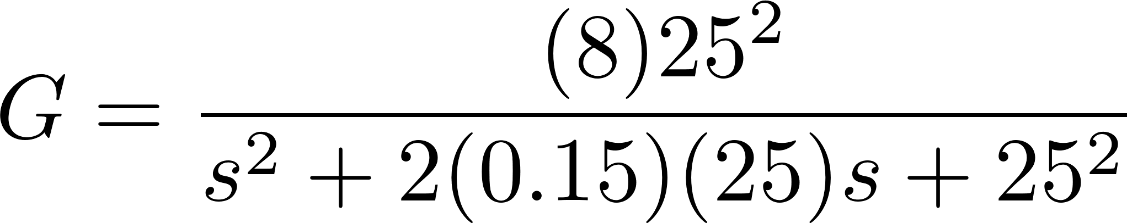
Example 2

Slide 24
State Space and 2nd-Order Response
ME 357

Slide 25


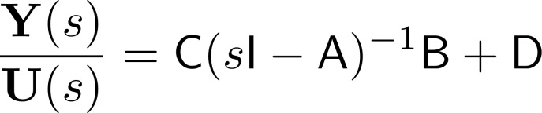
State Space
Recall from state space model
Converting to transfer function
Thus, eigenvalues of A are poles TF
Demonstrate same stability properties
Notes:
With hand waiving:
sI-A is the “denominator” of the TF, thus its roots are the poles of the TF.

Slide 26

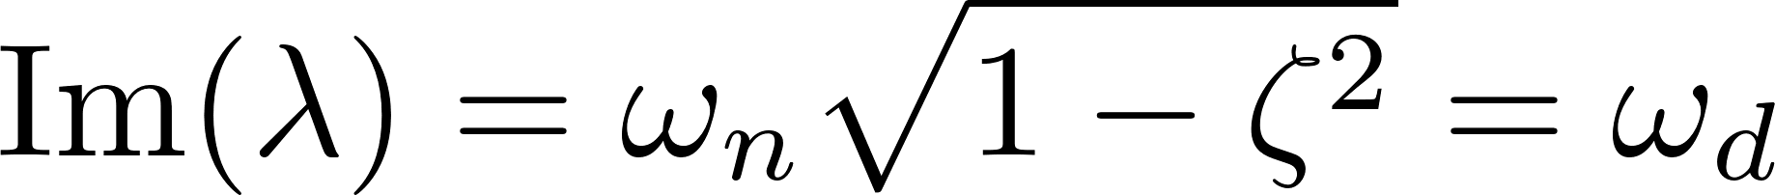

State Space
From transfer function
Therefore, if eigenvalues/poles are in LHP and complex
Notes:
There will not be an imaginary part if \zeta>=1

Slide 27
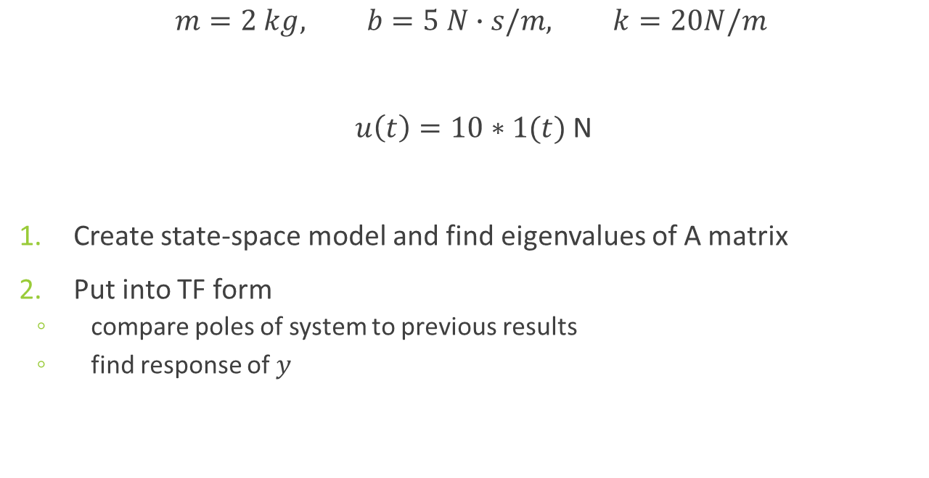
Example 3
$$m=2 kg, b=5 N∙s/m, k=20N/m$$
$u\left(t\right)=10∗1(t)$ N
Create state-space model and find eigenvalues of A matrix
Put into TF form
compare poles of system to previous results
find response of $y$

Slide 28
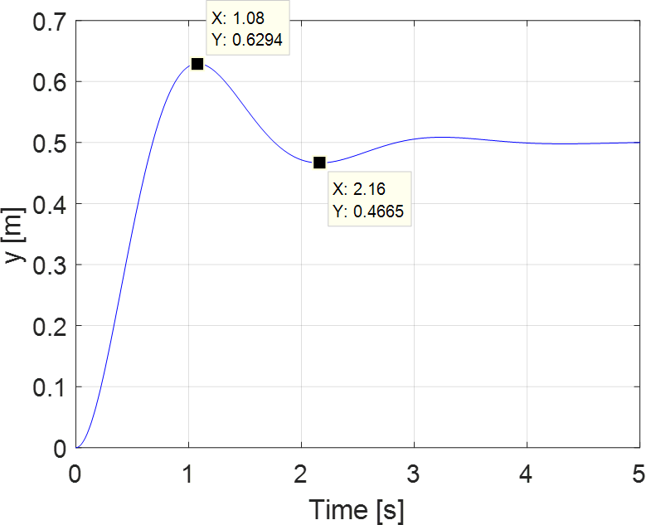
Example 3

Slide 29
Extra Poles and Zeroes 2nd-Order Systems
ME 357

Slide 30
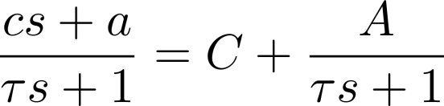


1st-Order Review
Zero changed 1st-order system from standard form
System has initial value of
Steady-state value
How are 2nd-order systems impacted by additional zeroes and poles?

Slide 31
Adding Poles and Zeroes
Compared to standard under-damped 2nd-order response, in general, adding:
Pole in LHP increases rising time and decreases overshoot significantly if extra pole is within four times real part of dominant poles
Pole in RHP will make system unstable
Zero in LHP increases overshoot and decreases rise time if zero is within four times real part of dominant poles
Zero in RHP depresses overshoot, but introduces initial undershoot
Zero in LHP “close” to extra pole may cancel effect of pole
Notes:
Dominant poles are the complex conjugate pair from “base system”
Looking at qualitative changes

Slide 32
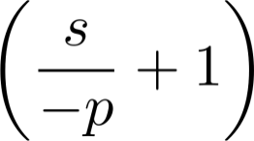
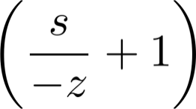
Adding Poles and Zeroes
In short:
Pole in LHP decreases overshoot and increases rising time, especially within 4 times real part of dominant pole
Add as:
Zero in LHP increases overshoot and decreases rising time, especially within 4 times real part of dominant pole
Add as:

Slide 33
How are Poles and Zeros Added to System?
Instead of having open-loop systems, will be adding feedback control in next unit
Modify system response with specified input
Can add zeroes using derivatives of signals
Can add poles using integrals of signals

Slide 34
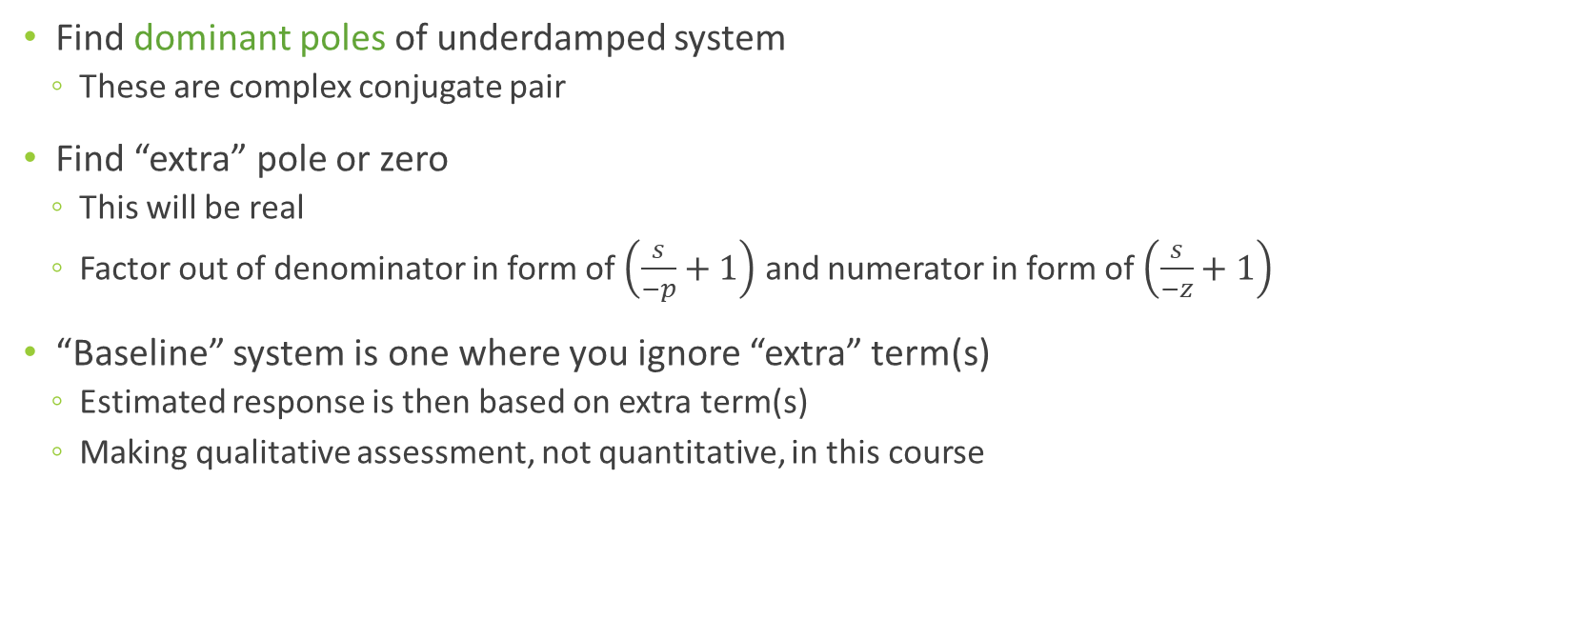
Analysis Method
Find dominant poles of underdamped system
These are complex conjugate pair
Find “extra” pole or zero
This will be real
Factor out of denominator in form of $\left(\frac{s}{−p}+1\right)$ and numerator in form of $\left(\frac{s}{−z}+1\right)$
“Baseline” system is one where you ignore “extra” term(s)
Estimated response is then based on extra term(s)
Making qualitative assessment, not quantitative, in this course
Notes:
May find poles numerically

Slide 35
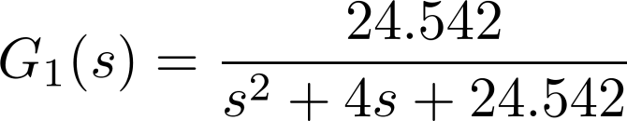
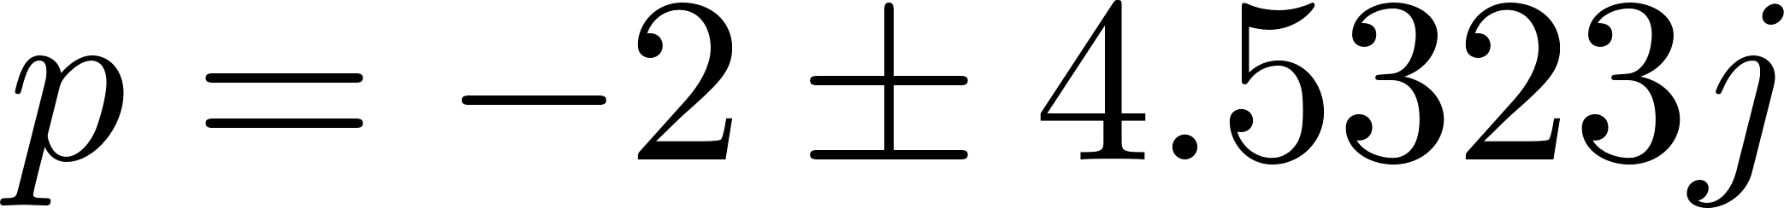
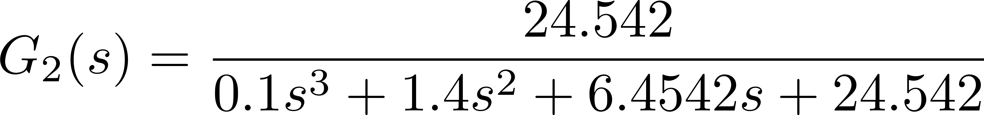
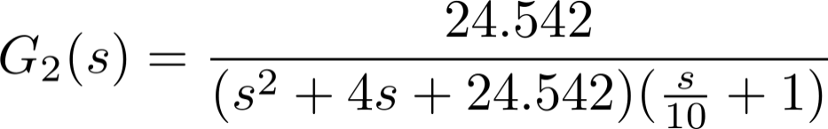
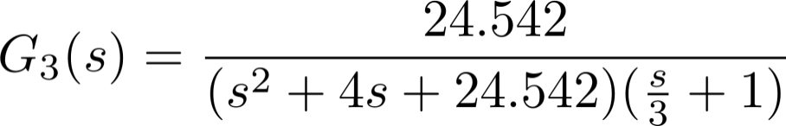
Additional LHP Pole
Notes:
Will show factoring only in first example

Slide 36
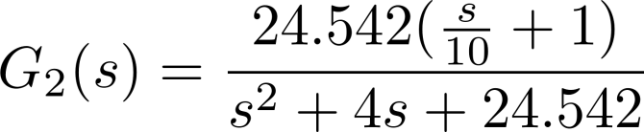
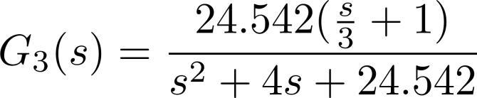
Additional LHP Zero

Slide 37
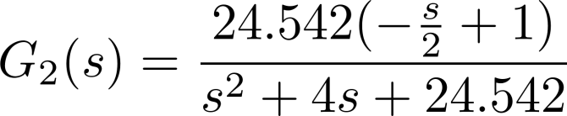
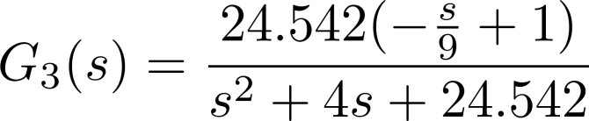
Additional RHP Zero

Slide 38


Additional Zero close to Additional Pole

