Slide 1
Feedback Control
ME 357

Slide 2
Objectives
By the end of this section, you should be able to understand
The general concept of feedback control
How using amplification of error as input into a system can change its behavior (P Controller)
How using amplification of the sum of the error as input into a system can change its behavior (I Controller)
The success of a controller is dependent on the “plant” and the desired response

Slide 3
Feedback Control
Previously looked at passive control
e.g., changing spring constants or resisters to change response behavior
Now look at active control
Prescribing input function to system to achieve desired output response
Use output(s)/observable(s) to determine input(s) into system
In Unit 2, given input into system (step or sinusoidal) found output response
This section we do opposite: have desired output response and determine system input to “best” achieve it
Consider only step outputs in this course

Slide 4
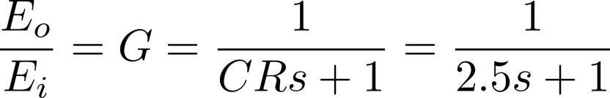
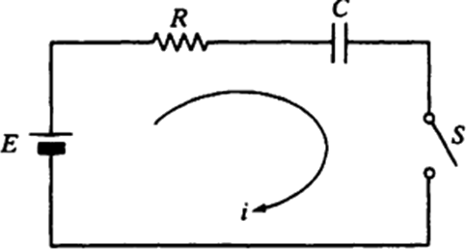
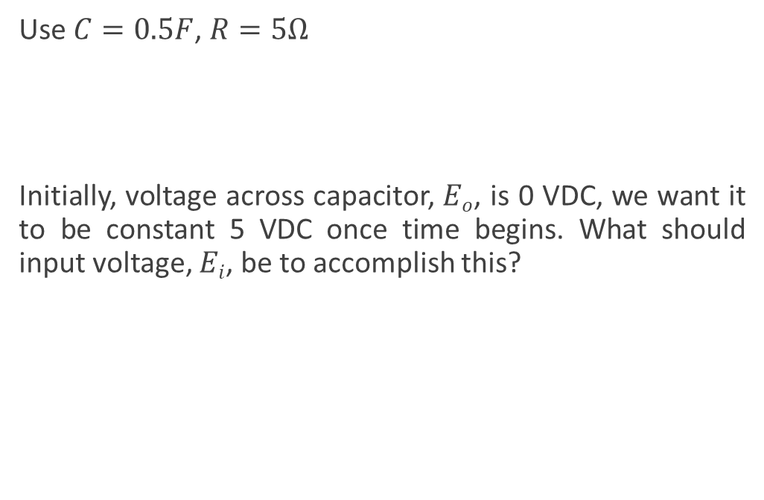
Intro Example
Use $C=0.5F$, $R=5Ω$
Initially, voltage across capacitor, $Eo$, is 0 VDC, we want it to be constant 5 VDC once time begins. What should input voltage, $Ei$, be to accomplish this?
Notes:
Looking for SS output of 5 VDC. Ideally, it would get there instantly

Slide 5
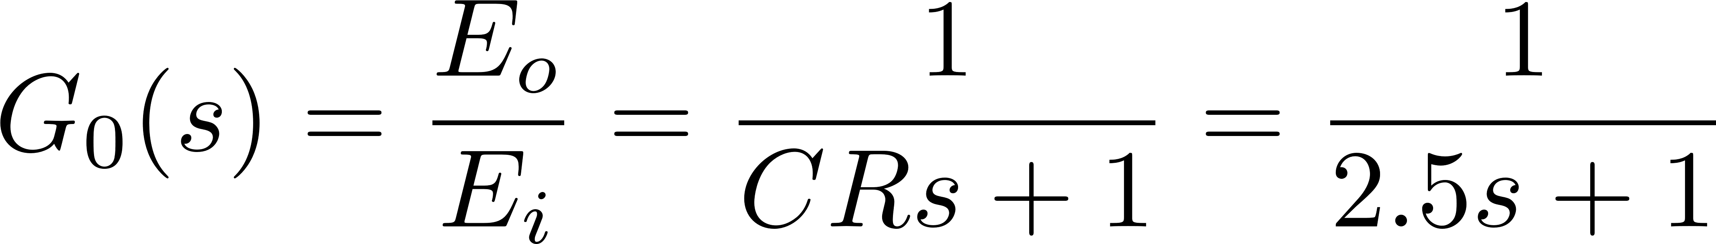
Intro Example
Use step input of 5 VDC for E_{i} (Open Loop)
Ramp input to 5 VDC for E_{i} (Open Loop)
Change E_{i} dynamically based on the value of E_{o} (Closed Loop)
Notes:
These are only three examples, there are infinite number of inputs that would provide desired SS output

Slide 6
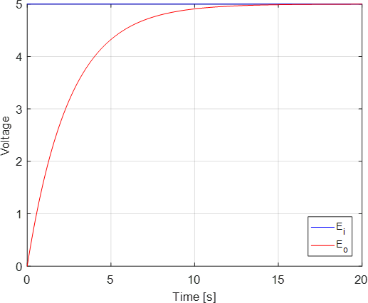
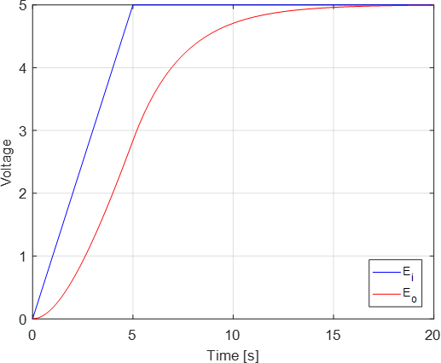
Comparison (1 & 2)
Step Input
Ramp Input
Notes:
notice the different input profiles produce different output profiles

Slide 7



Closing the Loop
E_{i}
G₀(s)
E_{o}
Open-Loop System
R
$$R−Eo=err$$
$$K∙err=Ei$$
$$Eo$$
G₀(s)
+-
K
Closed-Loop System
Notes:
Reference is how we want output to look
Error is difference between current value and our desire
Error is zero when they match

Slide 8
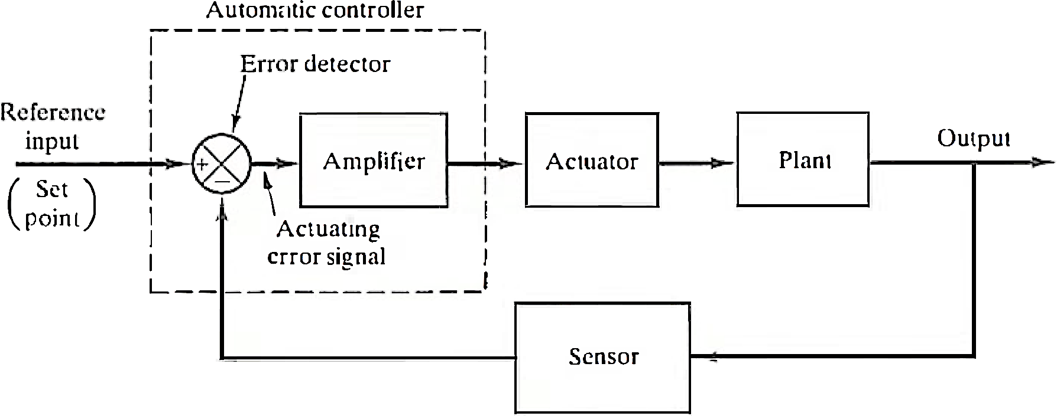
General Feedback Controller Schematic
Notes:
For this course, we typically ignore (set to “1”) actuator and sensor. These will have their own TFs that affect response of system

Slide 9
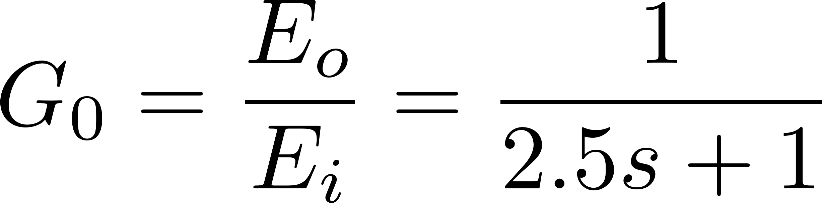
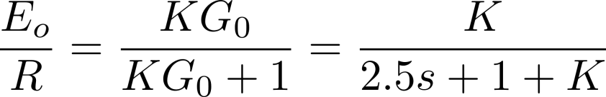
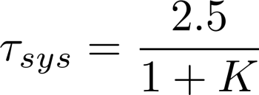
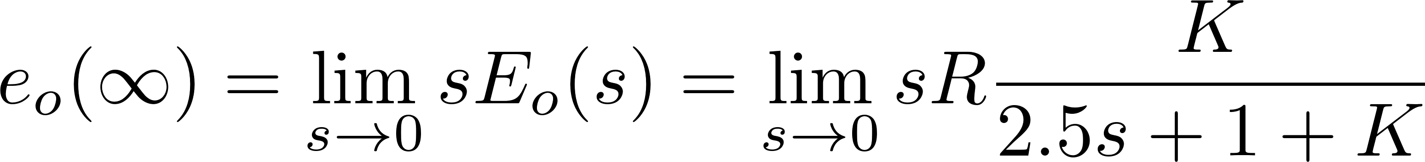
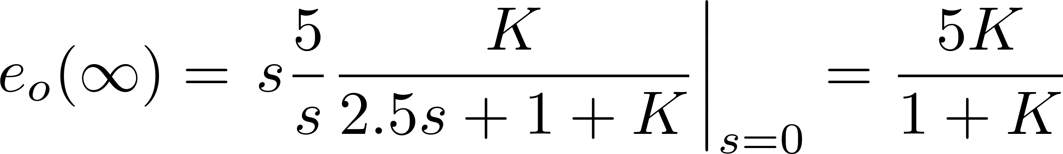
Proportional (P) Control
R-E_{o}=err
K err = E_{i}
R
E_{o}
G₀(s)
+-
K
Notes:
SS value / Error is dependent on gain
Note that system’s TF is now different than plant
G0= Eo/Ei will be referred to as OL system or plant
Eo/R is CL system or feedback system

Slide 10
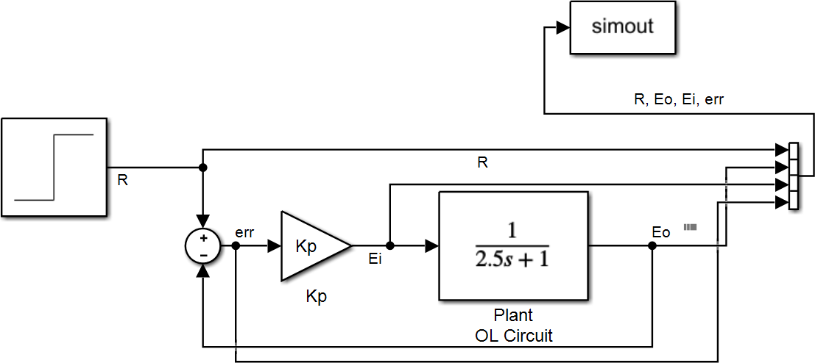
Proportional (P) Control Simulink Schematic

Slide 11
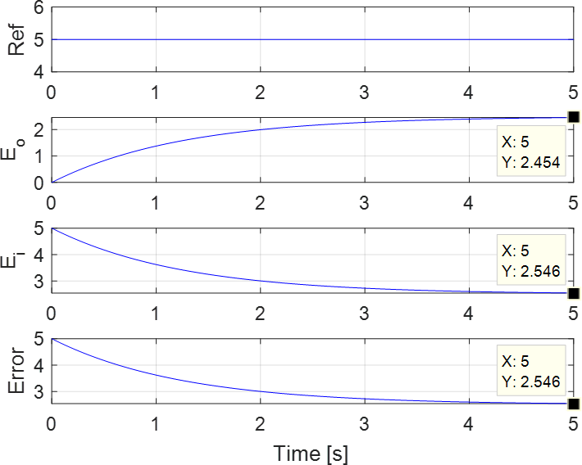
K_{P}=1

Slide 12
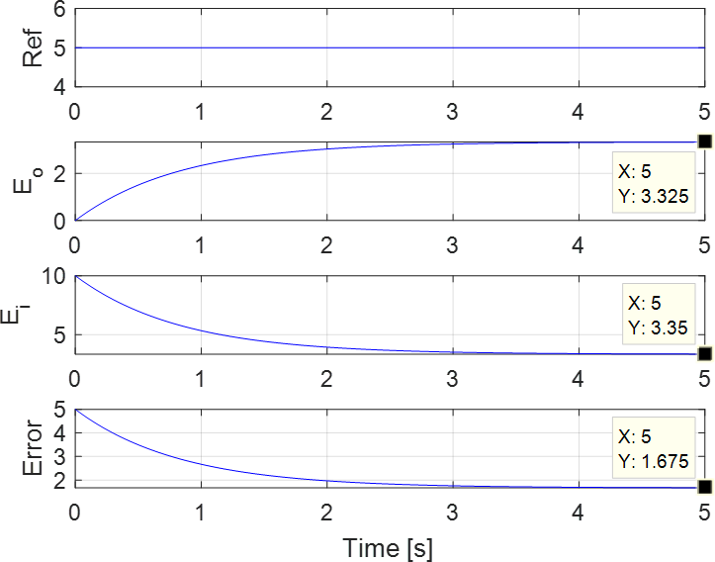
K_{P}=2

Slide 13
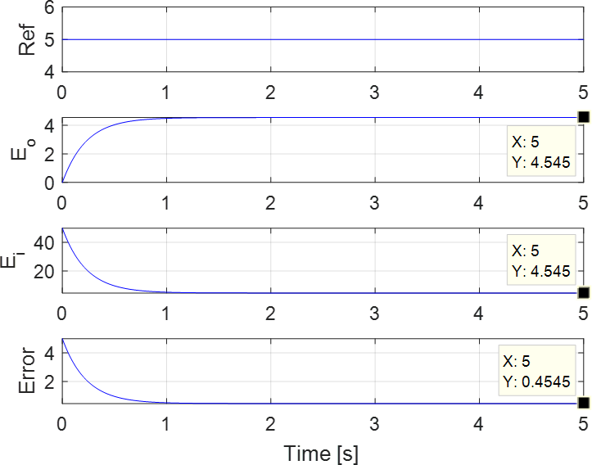
K_{P}=10

Slide 14
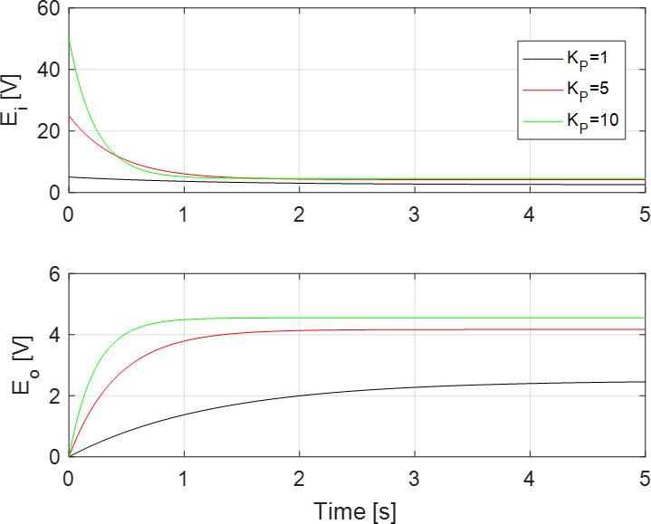
Comparison
Notes:
The output voltage increases as the gain increases

Slide 15
Proportional (P) Control
Proportional controller cannot drive error to zero for this plant
Not universally the case
Steady-state error can be driven toward zero asymptotically, but requires very high gain
High gain causes high peak input voltage into system
Need more than just proportion of error to drive input in this system
Notes:
Success of controller depends on the open-loop TF (i.e., plant)

Slide 16
Integral (I) Control
Instead (or in addition) to driving error itself to zero, can drive summation (integral) of error to zero
Area under error curve
Positive and negative values will cancel out over time
Error itself will have to go to zero for its integral to go to zero
Will change the order of CL system
Notes:
This is another possible controller choice

Slide 17
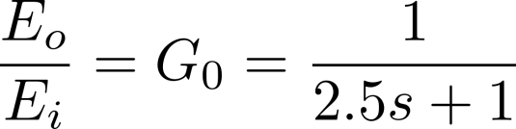
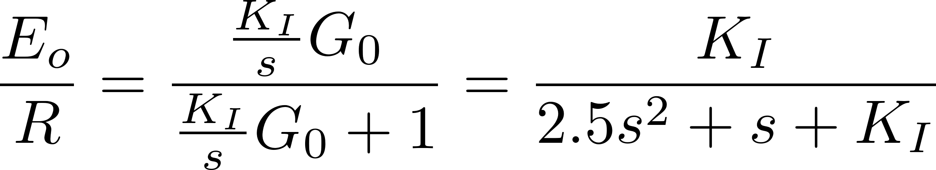
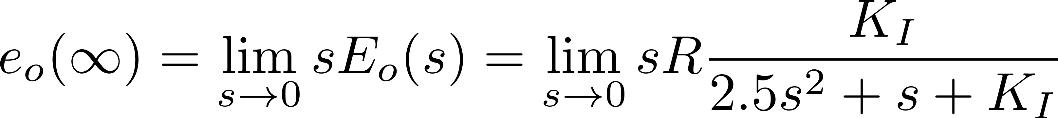
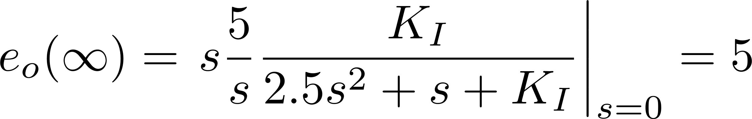
Integral (I) Control
R
R-E_{o}=err
K_{I}/s err = E_{i}
E_{o}
1/s
G₀(s)
+-
K_{I}
Notes:
OL system is 1st-order, CL system is 2nd-order with I controller
The steady-state output is now always 5 regardless of gain

Slide 18
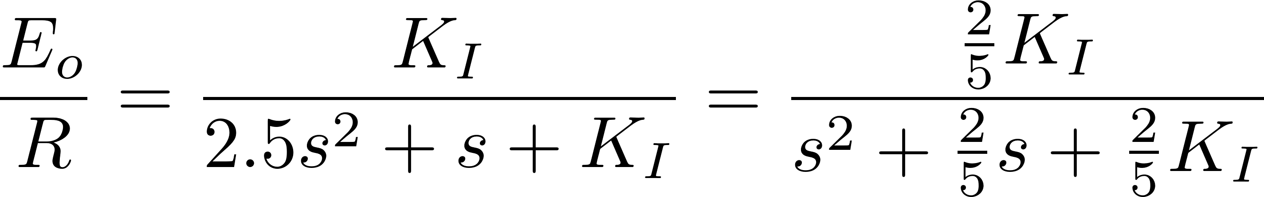
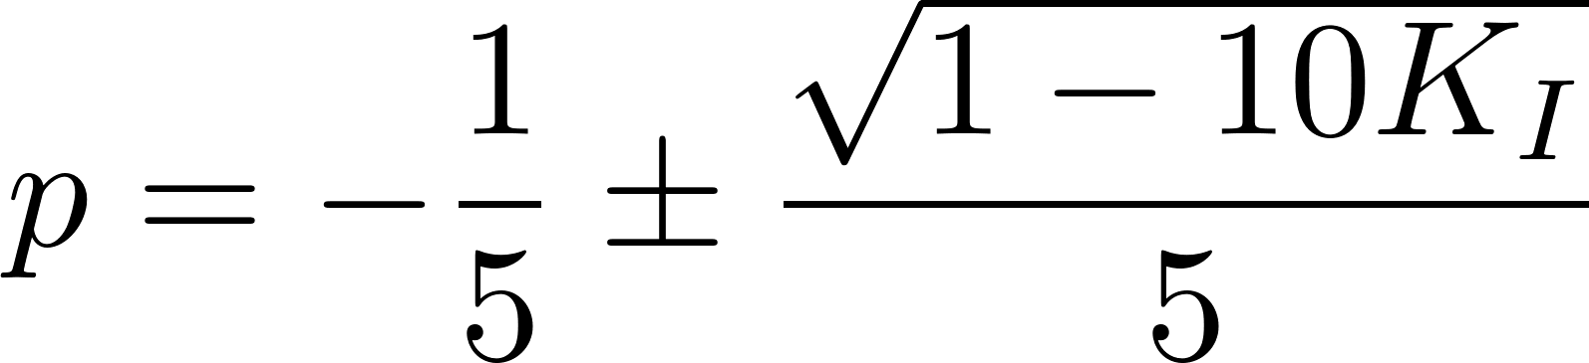
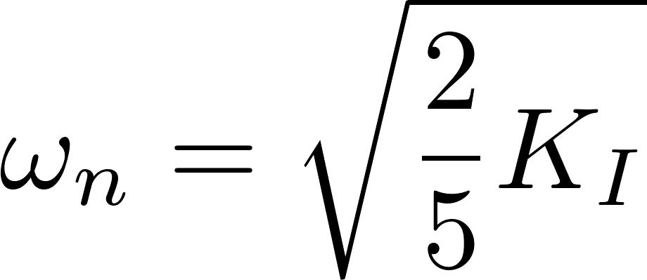
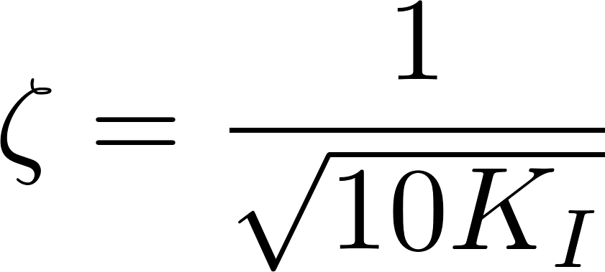
Integral (I) Control
R
R-E_{o}=err
K_{I}/s err = E_{i}
E_{o}
1/s
G₀(s)
+-
K_{I}
Notes:
CL TF is 2nd order
choice of gain effects natural frequency and damping ratio. Thus, it effects peak time and max overshoot

Slide 19
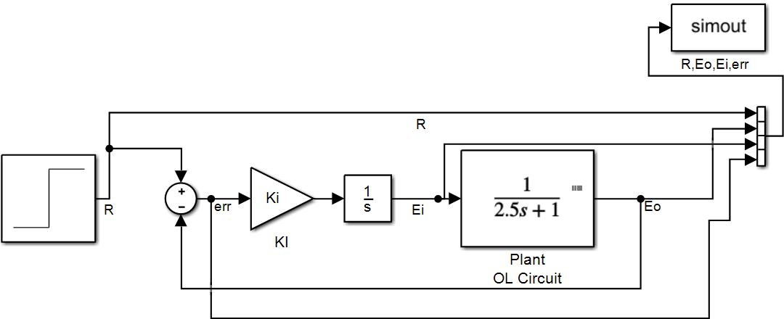
Integral (I) Control

Slide 20
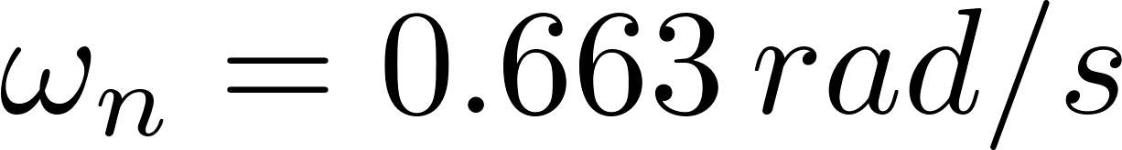
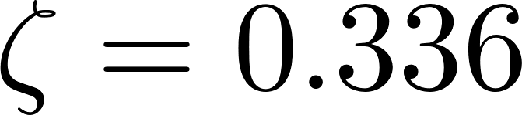
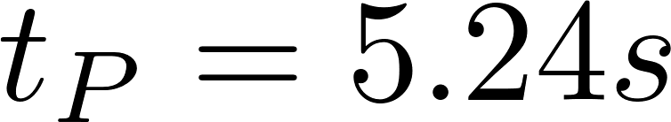
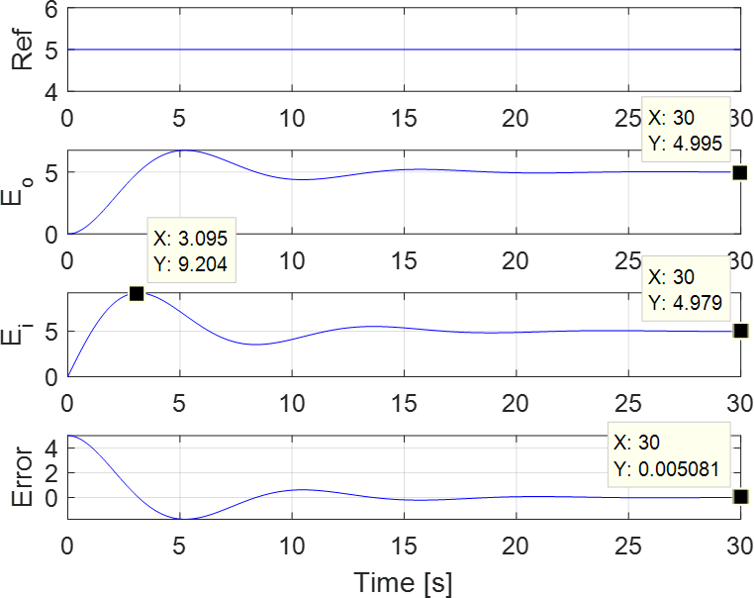
K_{I}=1

Slide 21
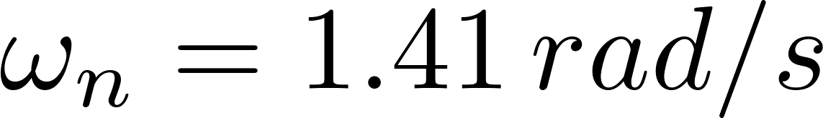
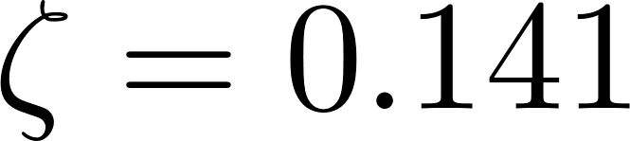
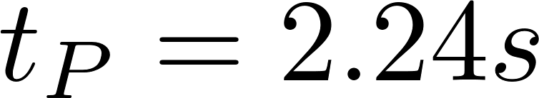
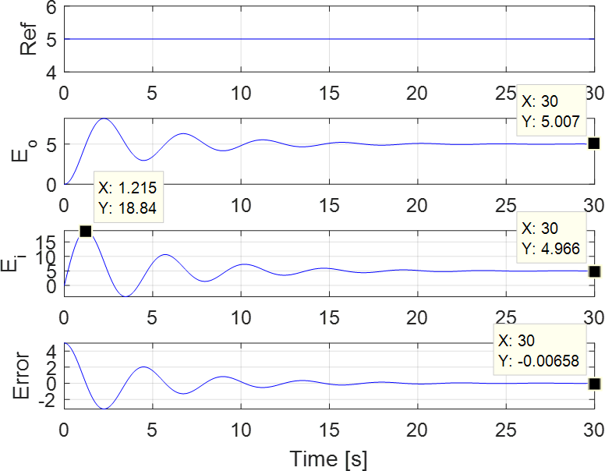
K_{I}=5

Slide 22
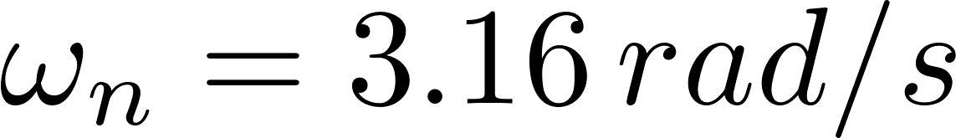
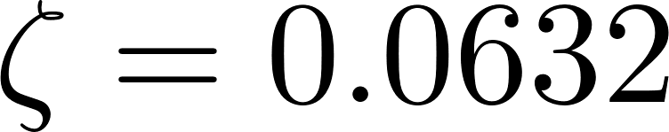
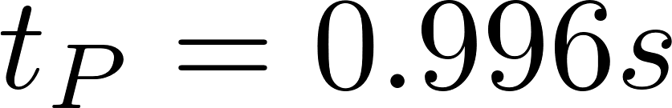
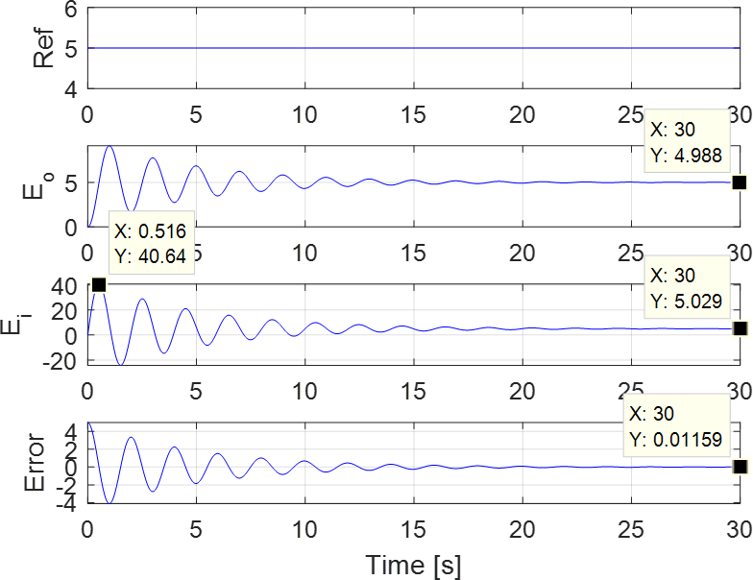
K_{I}=25

Slide 23
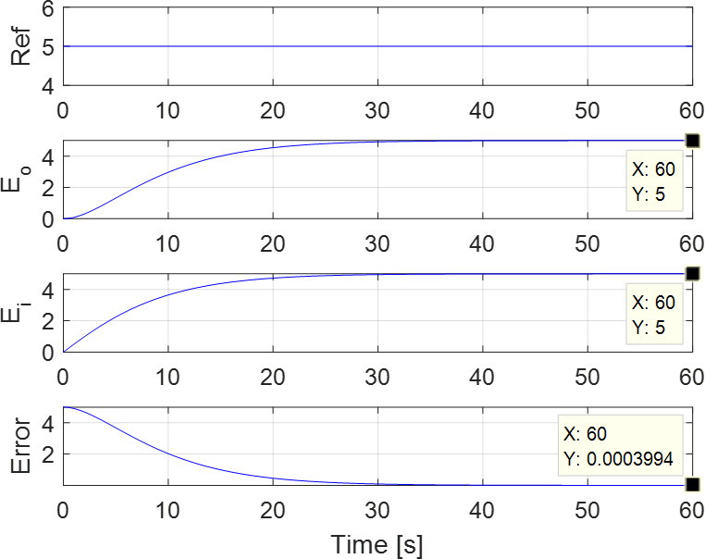
K_{I}=0.1: Critically Damped

Slide 24
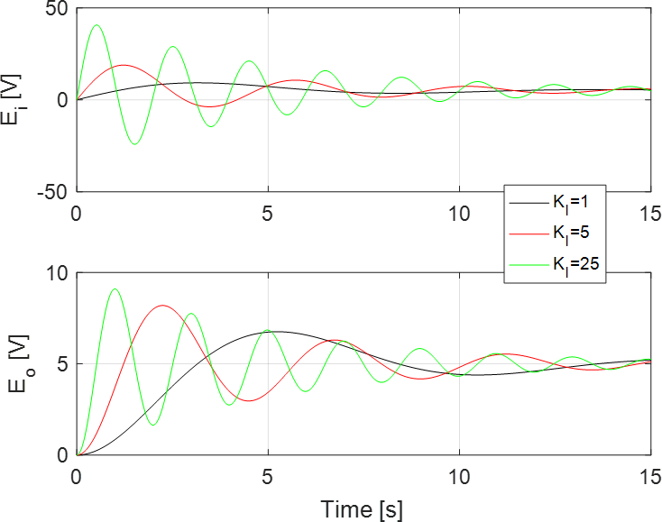
Comparison

Slide 25
Integral (I) Control
Integral controller drives error to zero for this system regardless of gain
Not universally true
Increasing gain (and thus maximum input voltage) drives system to steady state differently
Different damped frequency, overshoot, etc.
Eventually reaches SS regardless of chosen gain
Closed-loop system is open-loop system with additional pole (and gain)
Effectively increases order of this system to 2nd-order
Introduces oscillations and overshoot despite having 1st-order plant (OL system)

