Slide 1
Root Locus and 2nd-Order Systems
ME 357

Slide 2
Objectives
By the end of this section, you should be able to
Use Root Locus method to design P and PD controller
Use Simulink to implement and test controllers numerically

Slide 3


Selection of $K$
As seen in previous examples, value of $K$ affects profile of input (into plant) and resulting output response
Which value of $K$ is “best?”

Slide 4
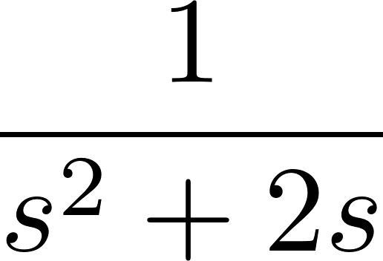
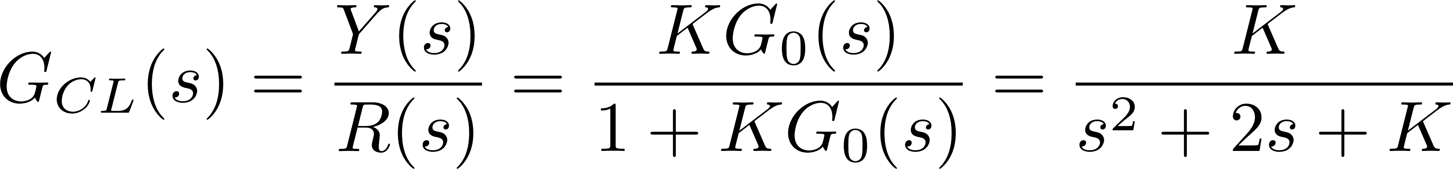
2nd-Order System Example
R
err
U
Y
+-
K
Notes:
back to P-controller but 2nd-order plant
The plant is *not* stable
note, this plant not stable as OL system

Slide 5
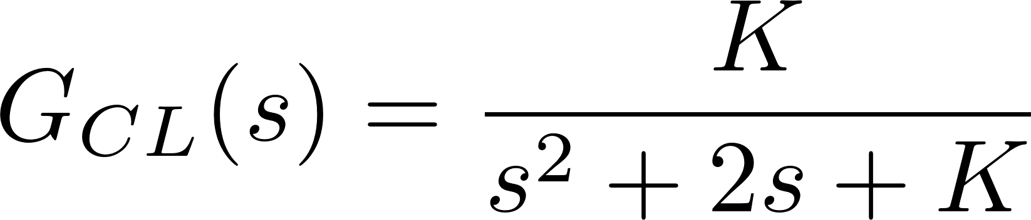

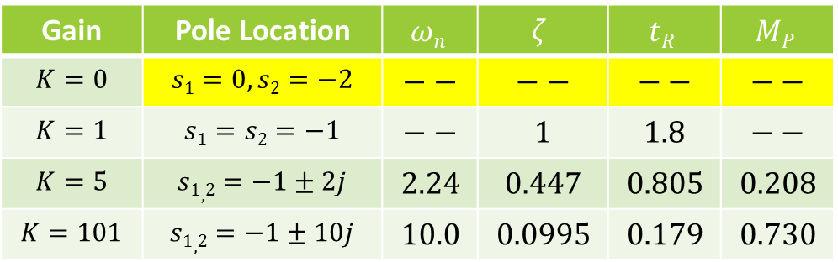
Second Order System with Feedback
TF in form:
How does choice of $K$ affect CL response?
Gain | Pole Location | $$ωn$$ | $$ζ$$ | $$tR$$ | $$MP$$
$$K=0$$ | $$s1=0, s2=−2$$ | $$−−$$ | $$−−$$ | $$−−$$ | $$−−$$
$$K=1$$ | $$s1=s2=−1$$ | $$−−$$ | $$1$$ | $$1.8$$ | $$−−$$
$$K=5$$ | $$s1,2=−1±2j$$ | $$2.24$$ | $$0.447$$ | $$0.805$$ | $$0.208$$
$$K=101$$ | $$s1,2=−1±10j$$ | $$10.0$$ | $$0.0995$$ | $$0.179$$ | $$0.730$$

Slide 6
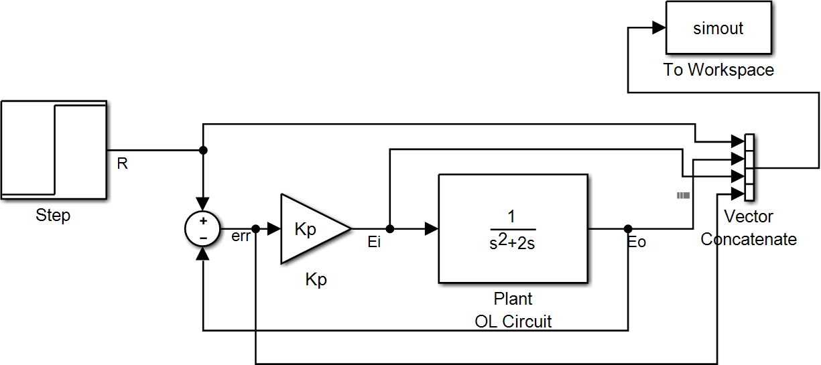
Simulink Schematic

Slide 7
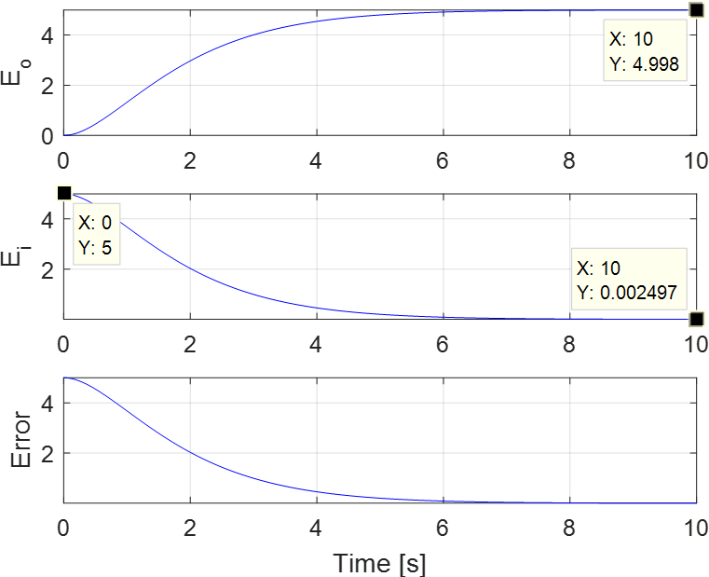
K = 1

Slide 8
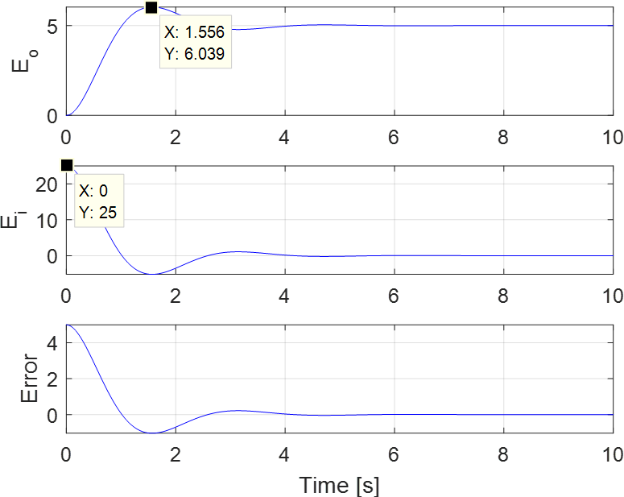
K = 5

Slide 9
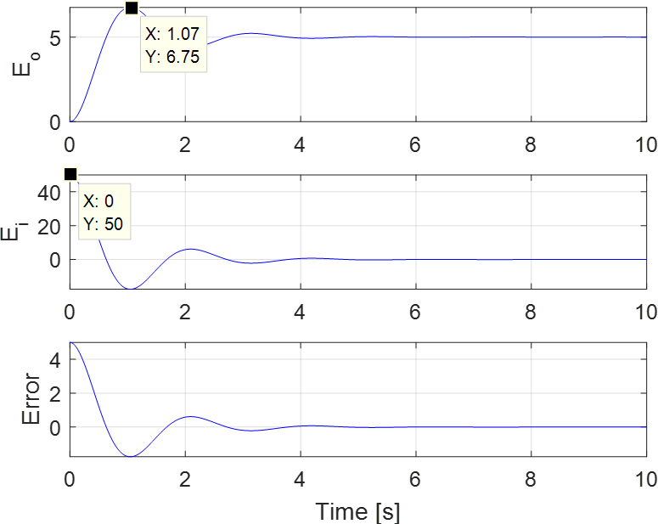
K = 10

Slide 10
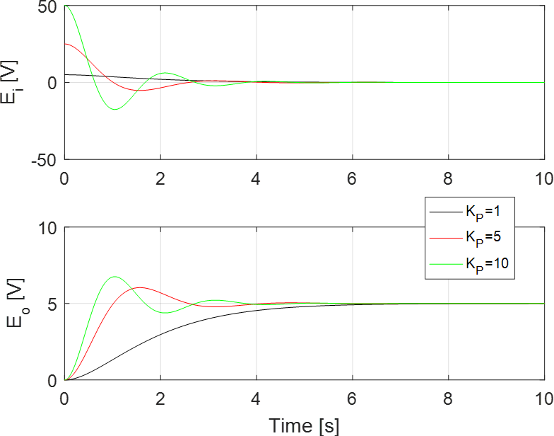
Performance Comparison

Slide 11
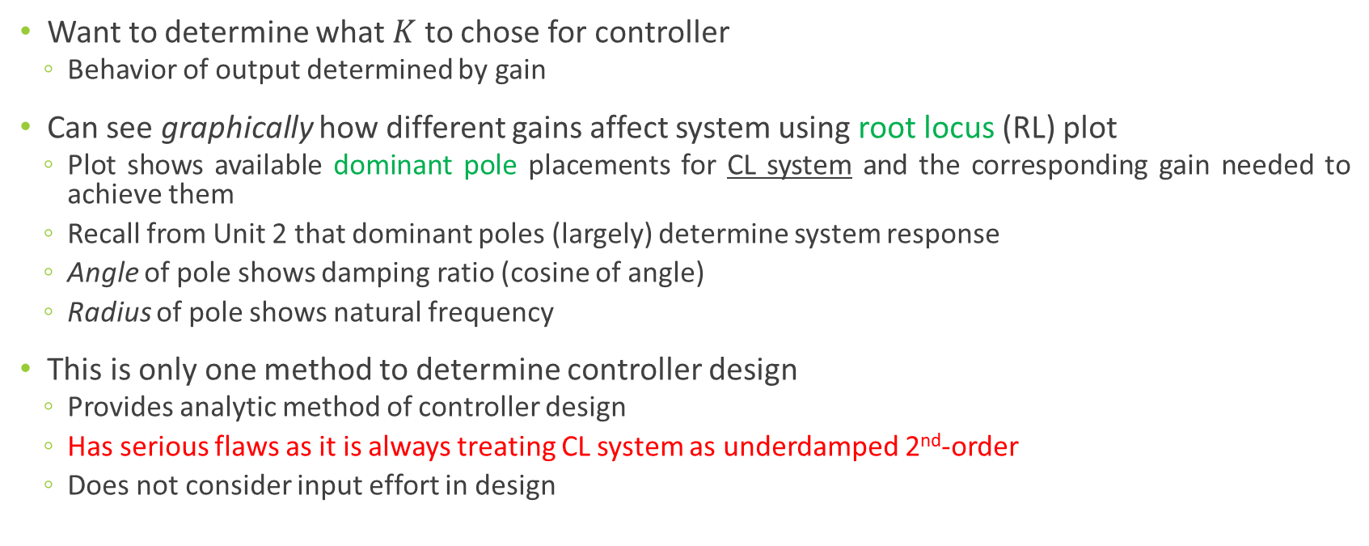
Root Locus
Want to determine what $K$ to chose for controller
Behavior of output determined by gain
Can see graphically how different gains affect system using root locus (RL) plot
Plot shows available dominant pole placements for CL system and the corresponding gain needed to achieve them
Recall from Unit 2 that dominant poles (largely) determine system response
Angle of pole shows damping ratio (cosine of angle)
Radius of pole shows natural frequency
This is only one method to determine controller design
Provides analytic method of controller design
Has serious flaws as it is always treating CL system as underdamped 2nd-order
Does not consider input effort in design

Slide 12
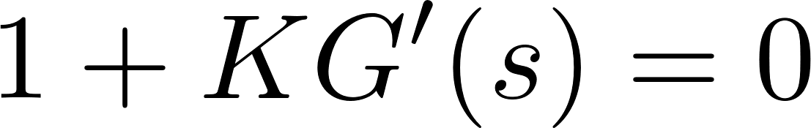
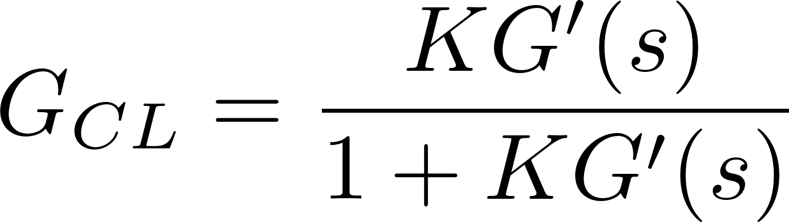
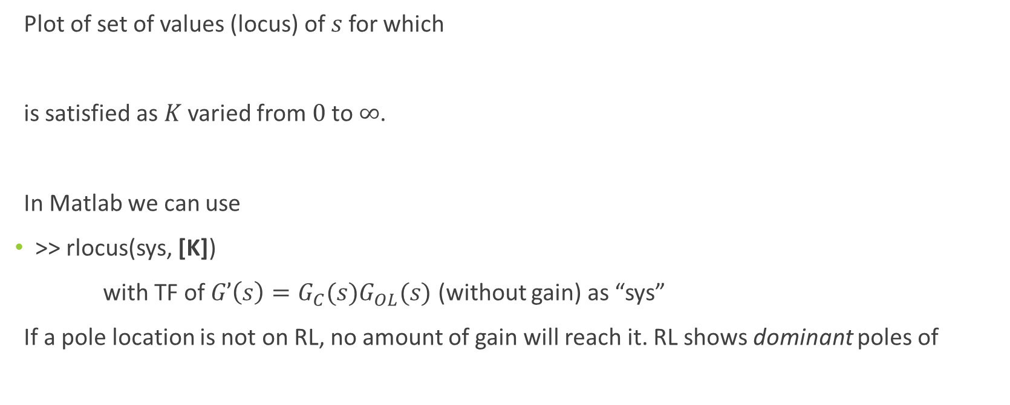
Root Locus
Plot of set of values (locus) of $s$for which
is satisfied as $K$ varied from $0$to $∞$.
In Matlab we can use
>> rlocus(sys, [K])
with TF of $G’\left(s\right)=G_{C}(s)G_{OL}(s)$ (without gain) as “sys”
If a pole location is not on RL, no amount of gain will reach it. RL shows dominant poles of
Notes:
We are choosing the poles of the CL system

Slide 13
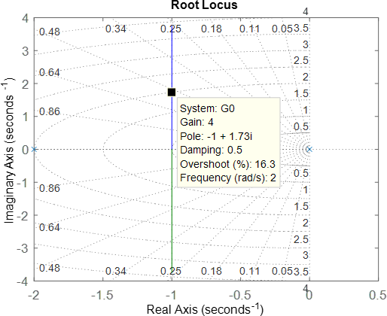
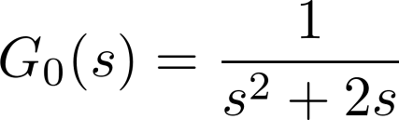

Example Root Locus
For the open-loop TF
Find required gain for P-controller that results in damping ratio of $ζ=0.5$
Notes:
G’ = GOL = G0

Slide 14
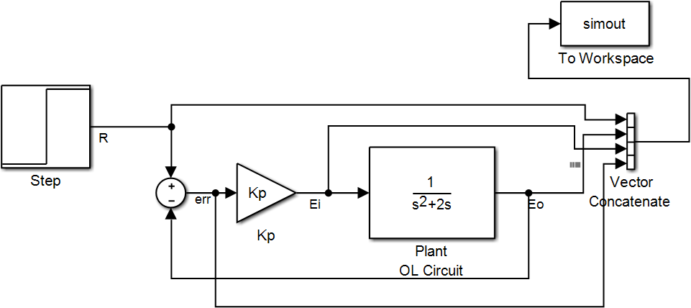
Simulink Model

Slide 15
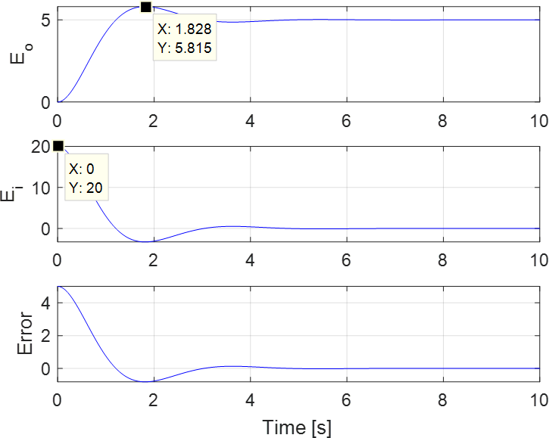

Example Response at $K=4$

Slide 16
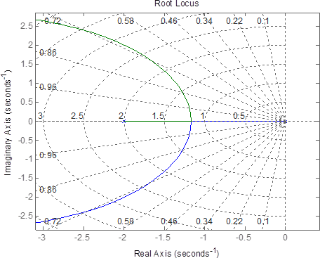
Discussion
Looking at RL for this P controller, can increase damping only by decreasing natural frequency (and vice-versa)
What if we desire both to increase?
Would reduce both overshoot and rise time
Would want root locus to curve to left
Cannot do it with P controller since those poles are not on root locus
Try PD controller…

Slide 17
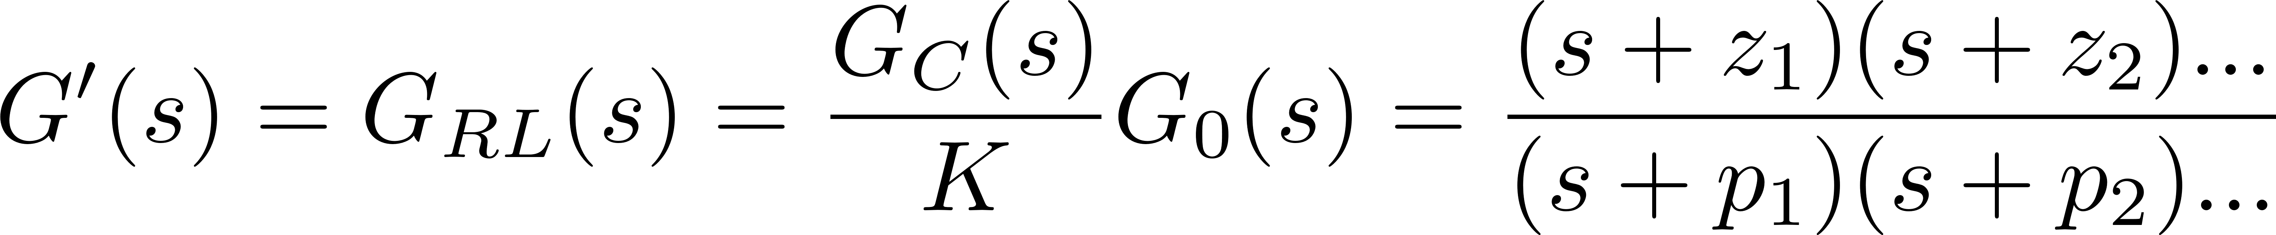
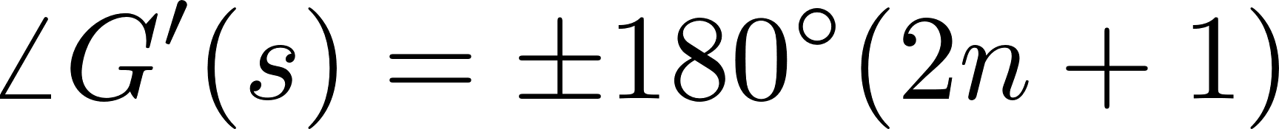
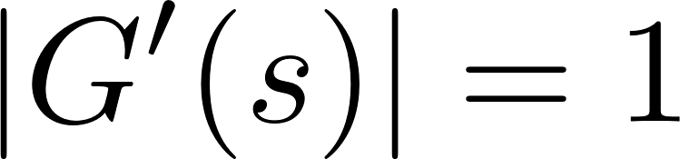
Root Locus (Continued)
For a TF in form:
Angle relationship:
Summation of angles for any s on root locus
Magnitude rule:

Slide 18
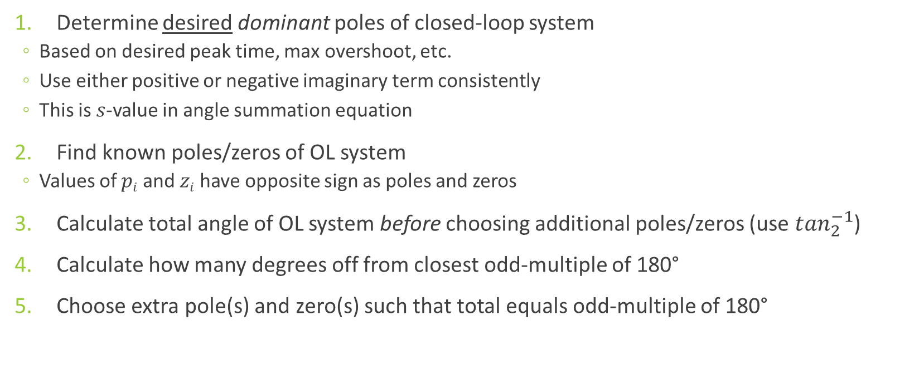
Desired Pole Root Locus Procedure
Determine desired dominant poles of closed-loop system
Based on desired peak time, max overshoot, etc.
Use either positive or negative imaginary term consistently
This is $s$-value in angle summation equation
Find known poles/zeros of OL system
Values of $pi$ and $zi$ have opposite sign as poles and zeros
Calculate total angle of OL system before choosing additional poles/zeros (use $\tan_{2}^{−1}$)
Calculate how many degrees off from closest odd-multiple of 180°
Choose extra pole(s) and zero(s) such that total equals odd-multiple of 180°
Notes:
Multiple can be positive ort negative

Slide 19
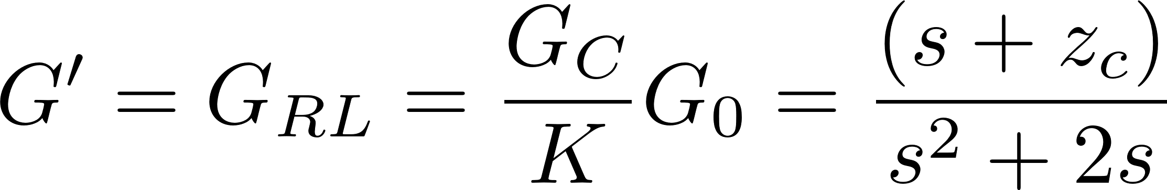
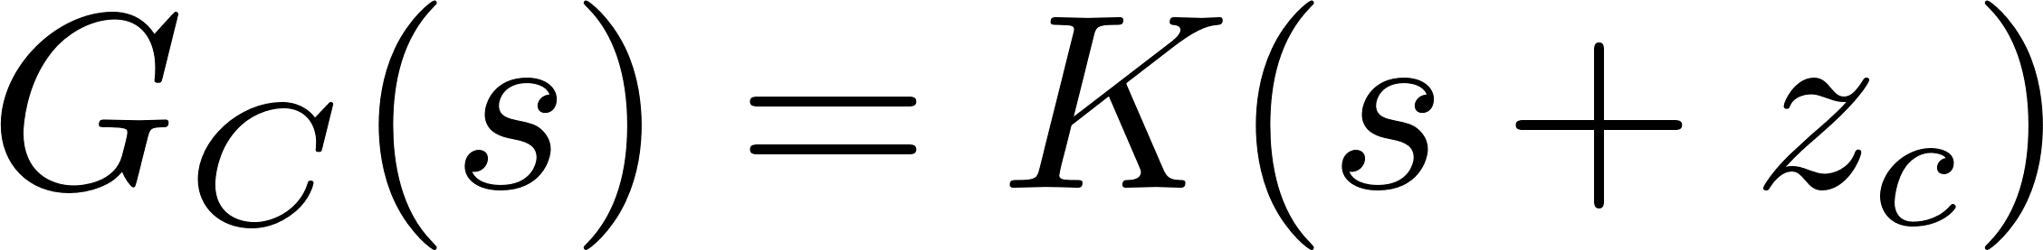
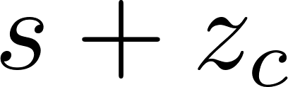
PD Controller
Plant
Add controller in form of
R
err
U
Y
+-
K
Notes:
This schematic is not how we will actually implement but the TFs are identical
“s” term takes a derivative

Slide 20
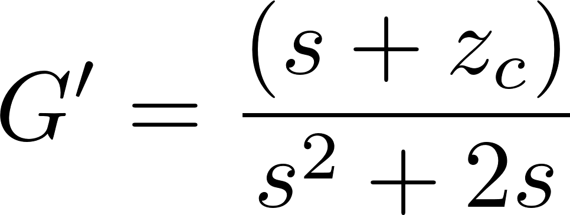
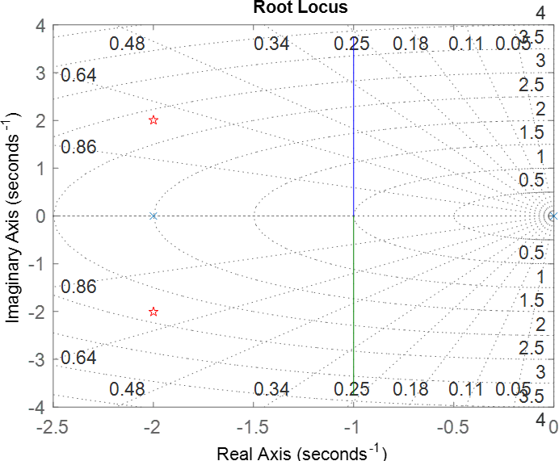
Desired Pole (PD Controller)
Point already on RL
Notes:
Choosing the pole arbitrarily for this example

Slide 21
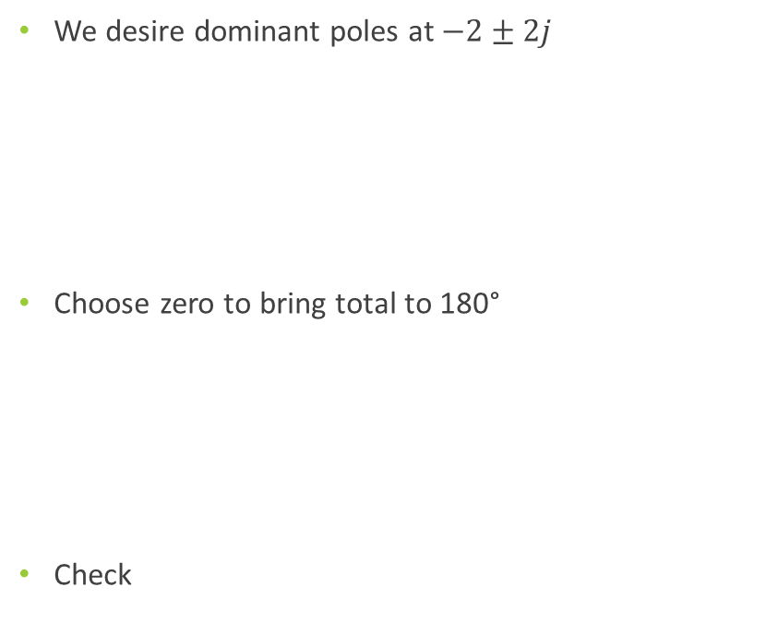
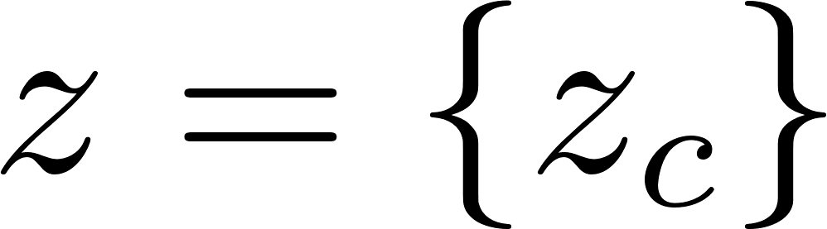
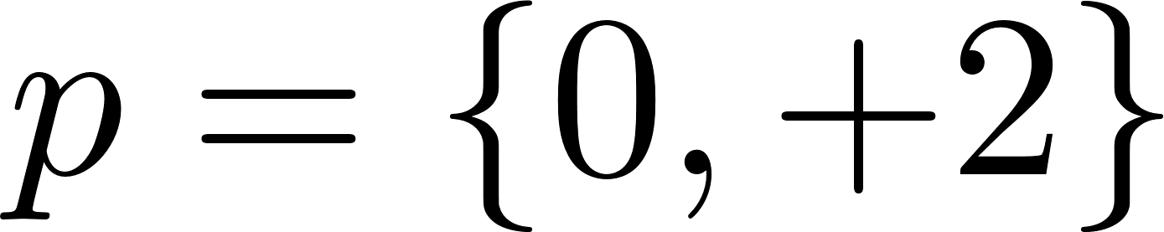
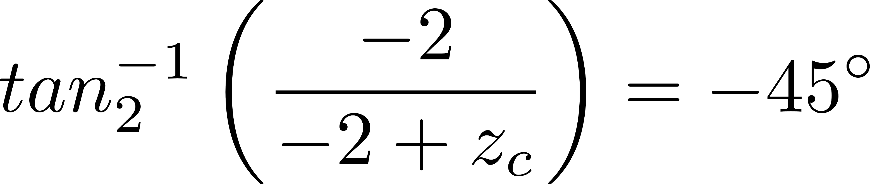
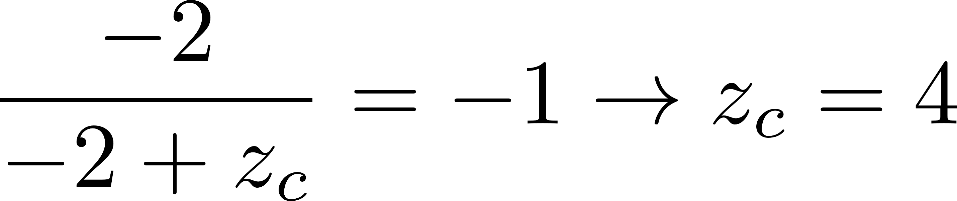
Desired Pole (PD Controller)
We desire dominant poles at $−2±2j$
Choose zero to bring total to 180°
Check
Notes:
Choosing the pole arbitrarily for this example

Slide 22
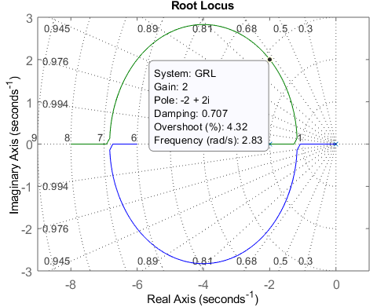
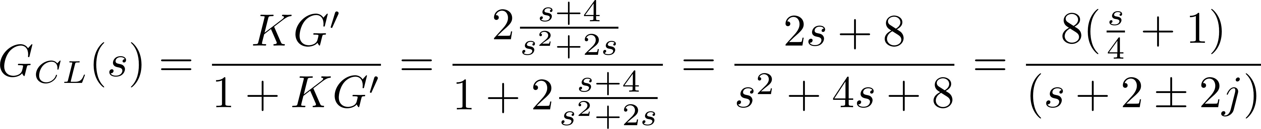

Extra Zero at $zc=4$
Notes:
Our desired pole (as well as infinite others ) are on the root locus
Zero at -4 Poles at -2+-2j
The design method did not account for the extra zero added by the controller

Slide 23
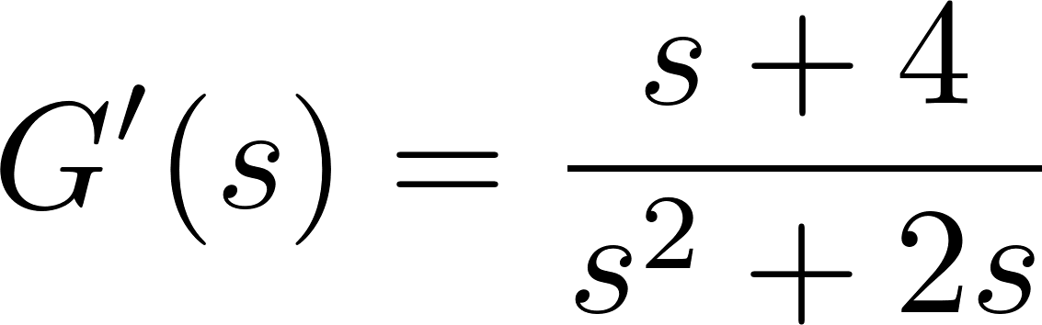

Extra Zero The PD Controller
By adding zero with $zc=4$, we get desired CL dominant pole placement at $s=−2±2j$
However, need to find gain to do so
Gain could be very high to achieve desired pole
Our controller will now be $K\left(s+4\right)=Ks+4K=K_{D}s+K_{P}$ rather than simply $K$
This effectively uses proportion (P) and derivative (D) of error to compute input
Notes:
This what we put into the RL

Slide 24
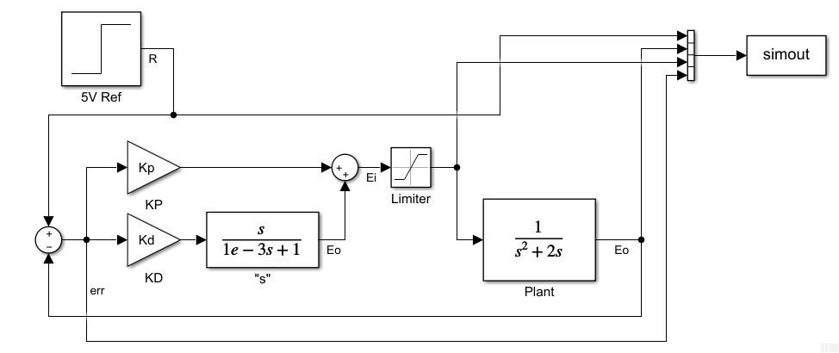
Simulink Implementation
Notes:
for PD, PI, PID we need multiple gains for practical hardware implementation.
Simulink does not allow simply an “s” term as a TF
Derivative control always begins with very high input. There is a limiter here to account for maximum input possible by actuator

Slide 25
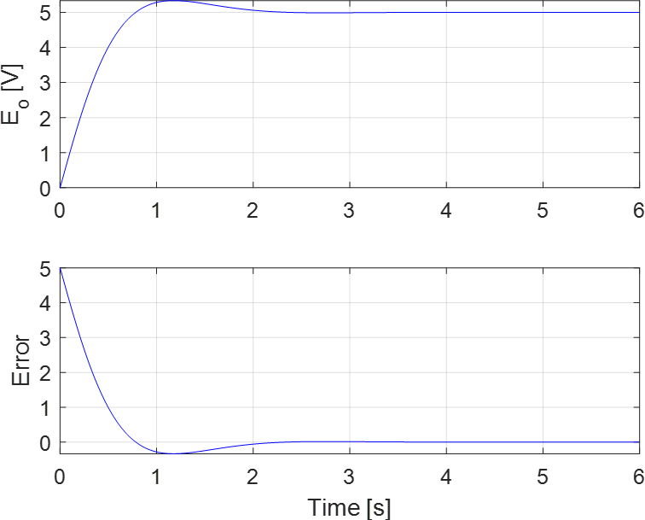

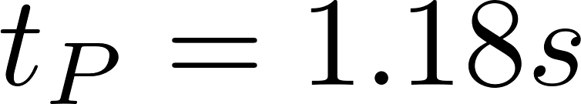

Simulation $$K_{D}=2,K_{P}=8$$

Slide 26


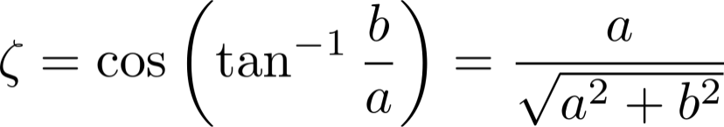
System Response from Desired Pole
Notes:
This process usually happens in the opposite order

Slide 27
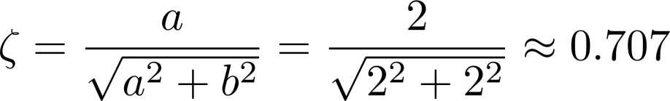


System Response from Desired Pole
Predicted
Simulation
Notes:
Extra zero pulled the actual response away from the theoretical since -4 is within 4 times -2 but it does not have much impact in this problem

Slide 28
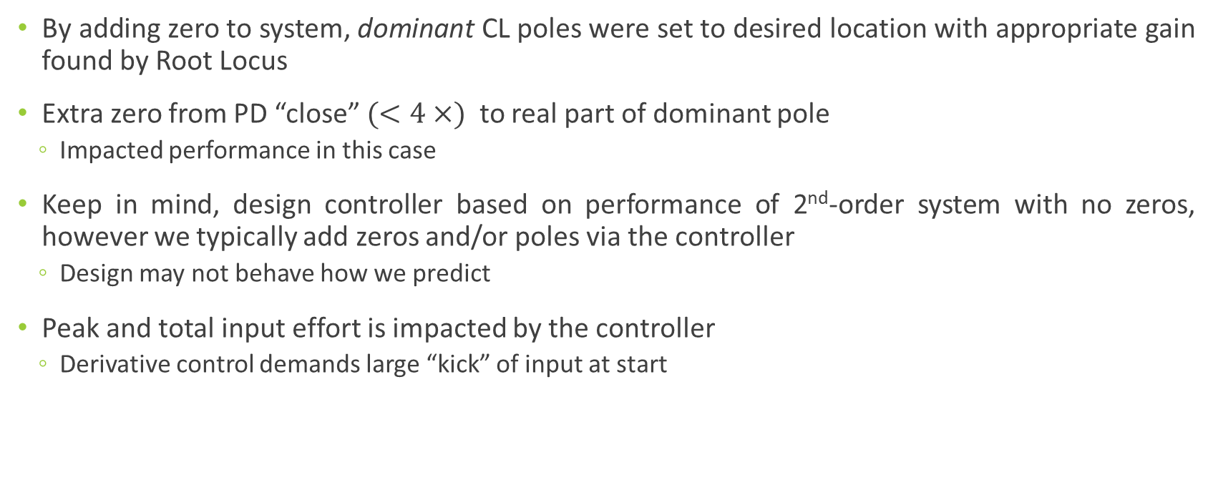
Discussion
By adding zero to system, dominant CL poles were set to desired location with appropriate gain found by Root Locus
Extra zero from PD “close” $(<4×)$ to real part of dominant pole
Impacted performance in this case
Keep in mind, design controller based on performance of 2nd-order system with no zeros, however we typically add zeros and/or poles via the controller
Design may not behave how we predict
Peak and total input effort is impacted by the controller
Derivative control demands large “kick” of input at start

