Slide 1
Lead/Lag Compensator
ME 357

Slide 2
Objectives
By the end of this section, you should be able to
Use Root Locus method to design lead compensator controller
Use Simulink to implement and test controller

Slide 3
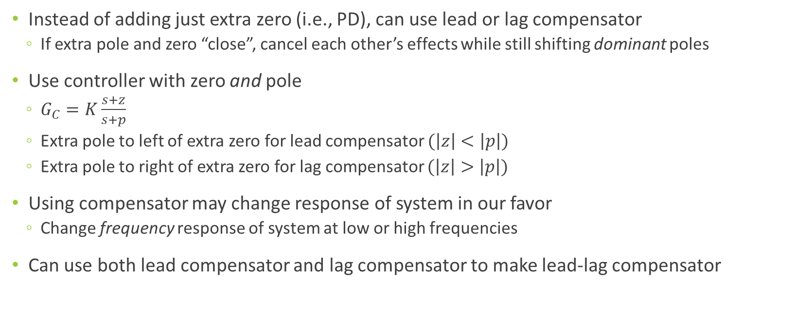
Compensators
Instead of adding just extra zero (i.e., PD), can use lead or lag compensator
If extra pole and zero “close”, cancel each other’s effects while still shifting dominant poles
Use controller with zero and pole
$G_{C}=K\frac{s+z}{s+p}$
Extra pole to left of extra zero for lead compensator $(\left|z\right|<\left|p\right|)$
Extra pole to right of extra zero for lag compensator $(\left|z\right|>\left|p\right|)$
Using compensator may change response of system in our favor
Change frequency response of system at low or high frequencies
Can use both lead compensator and lag compensator to make lead-lag compensator

Slide 4
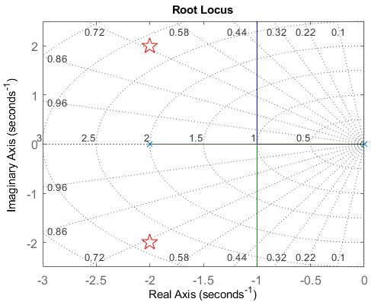
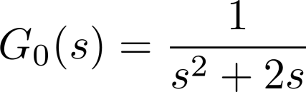
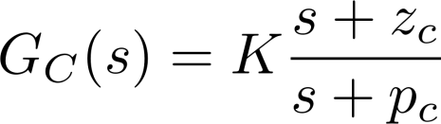
Lead Compensator Example
Plant
Add controller in form of

Slide 5
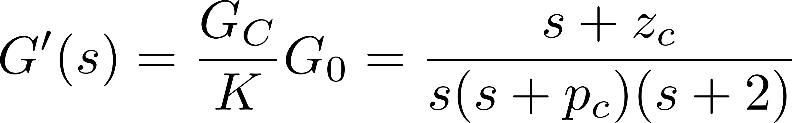
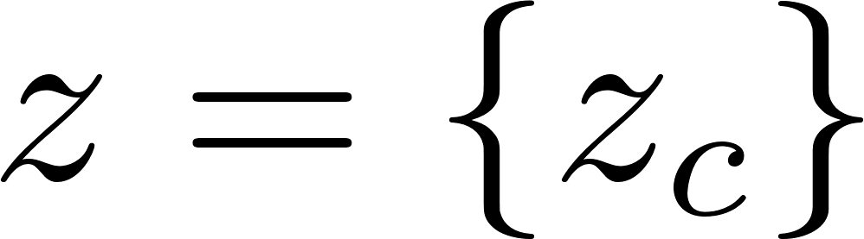
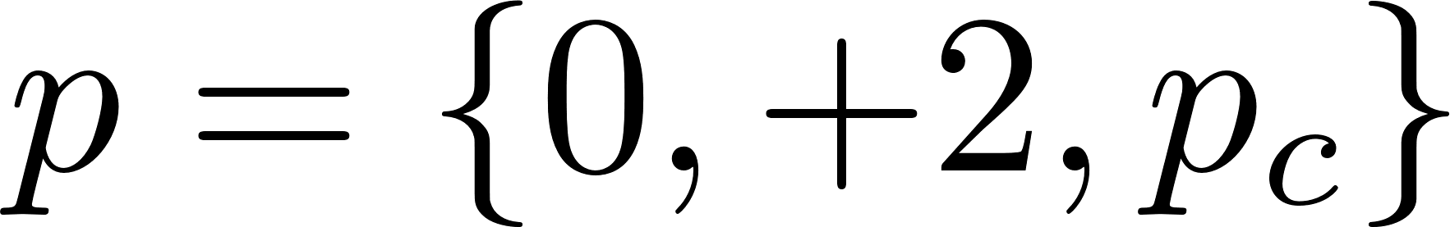
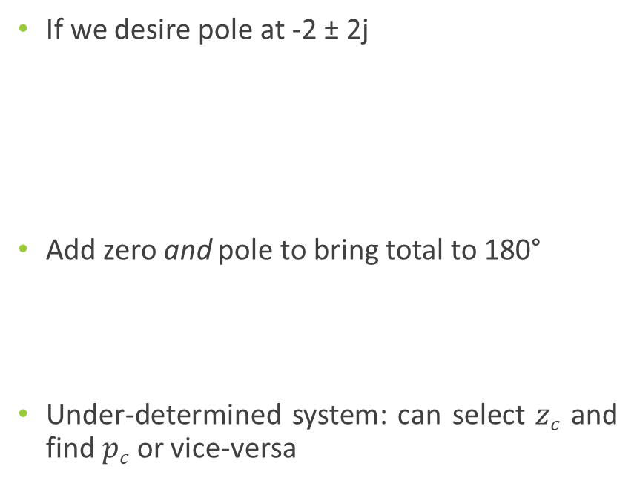
Desired Pole
If we desire pole at -2 ± 2j
Add zero and pole to bring total to 180°
Under-determined system: can select $zc$ and find $pc$ or vice-versa

Slide 6
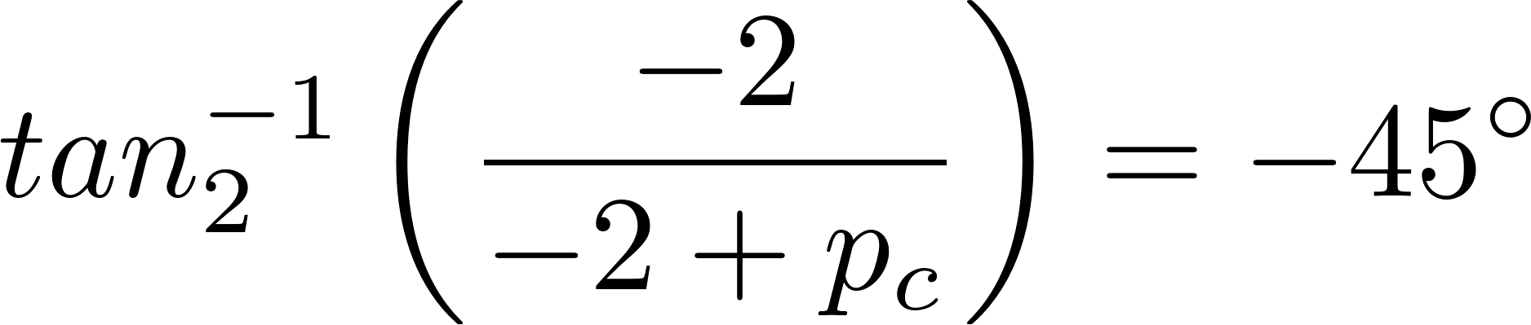
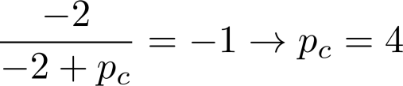
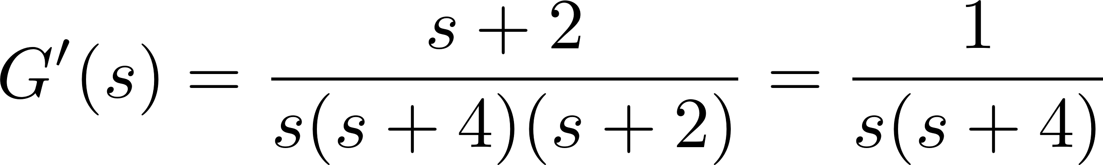
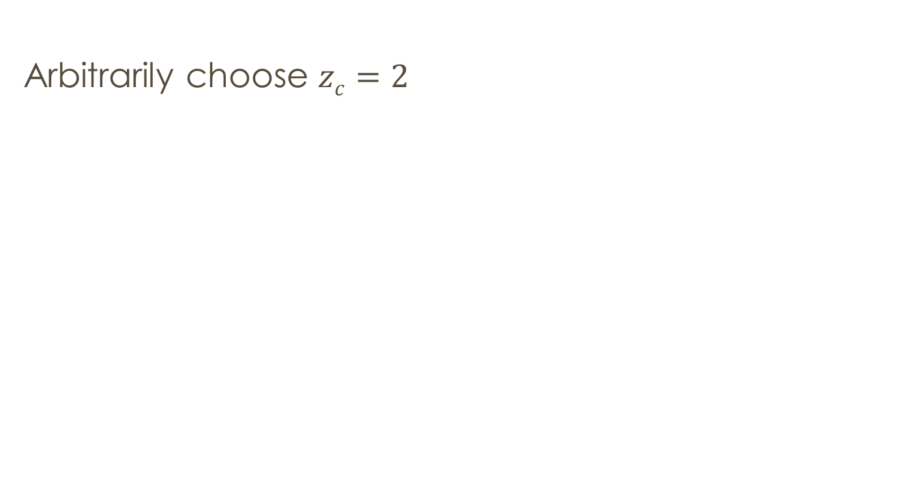
Design 1
Arbitrarily choose $zc=2$

Slide 7
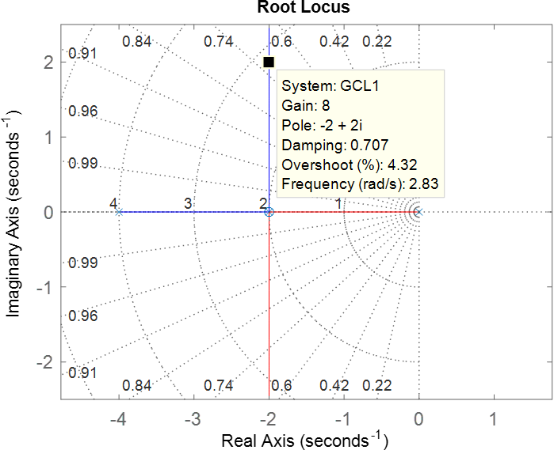
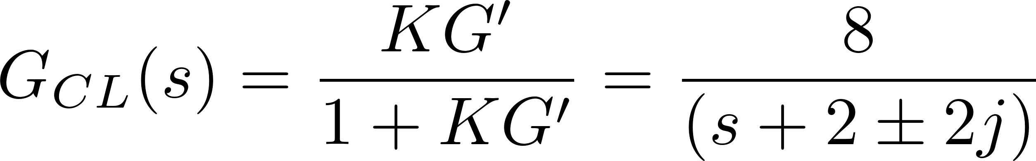
Design 1 Root Locus
Notes:
No zeros
Poles at -2+-2j

Slide 8
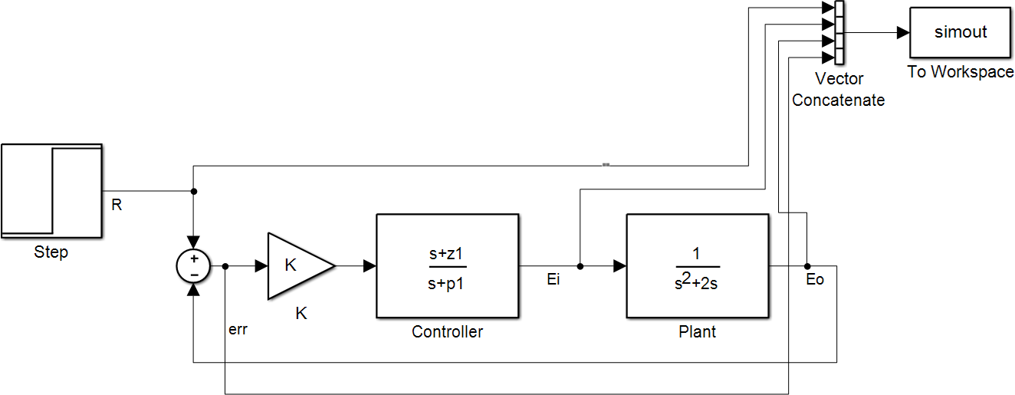
Lead Compensator Design

Slide 9
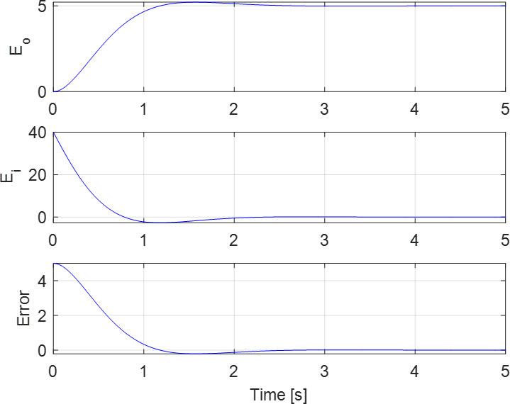


Design 1 Response

Slide 10
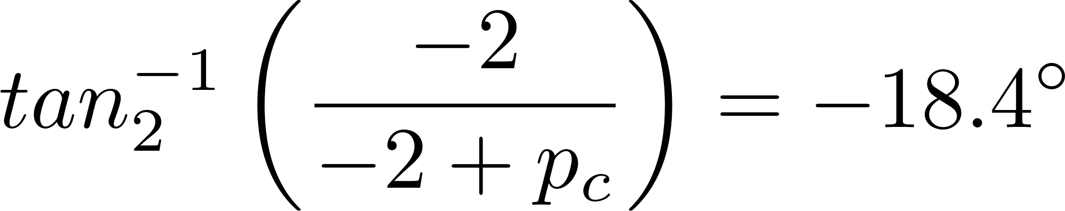
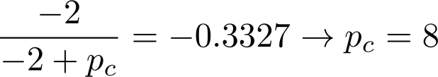
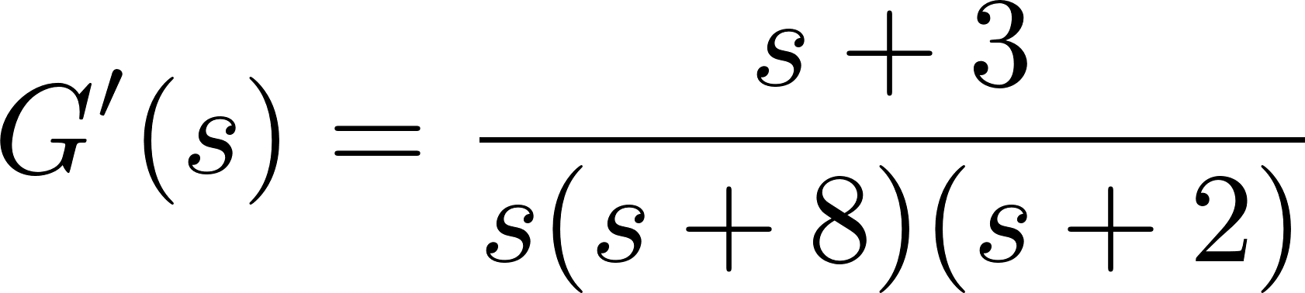

Design 2
Arbitrarily choose $zc=3$

Slide 11
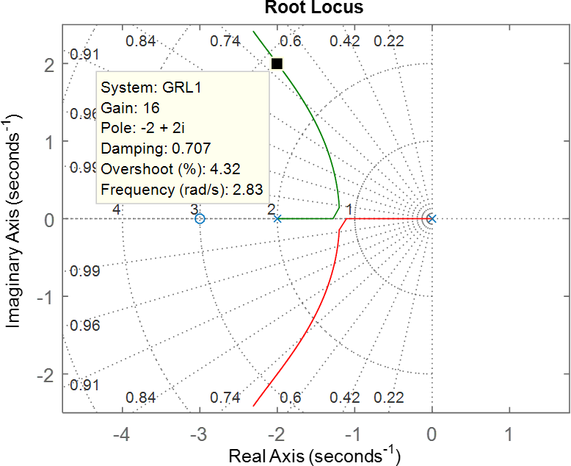
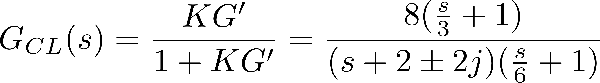
Design 2 Root Locus

Slide 12
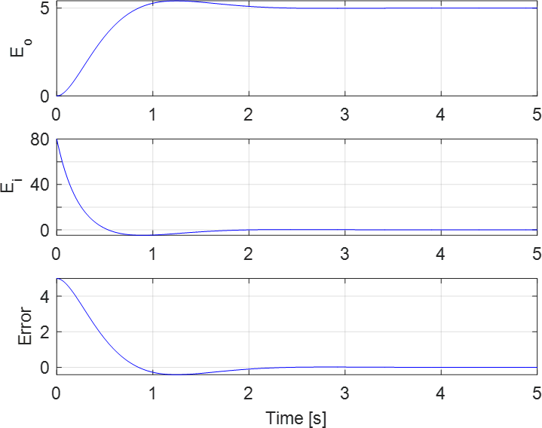
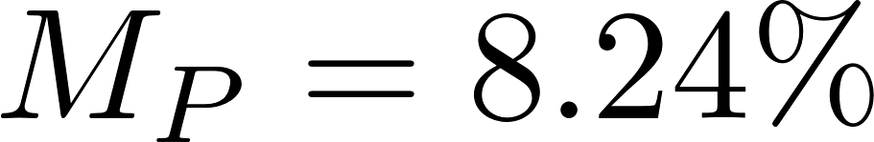

Design 2 Response

Slide 13
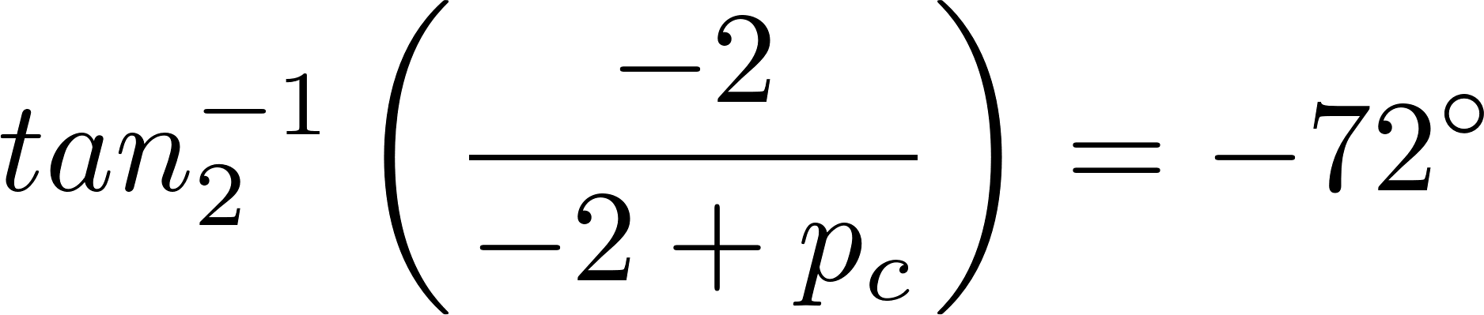
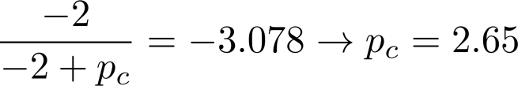
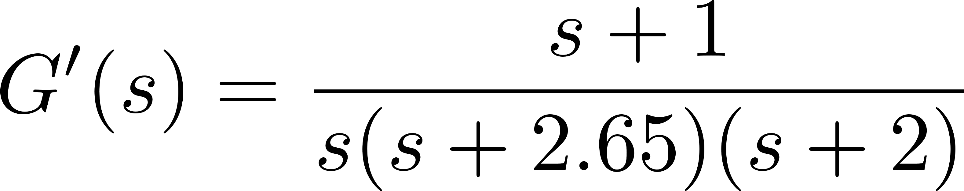

Design 3
Arbitrarily choose $zc=1$

Slide 14
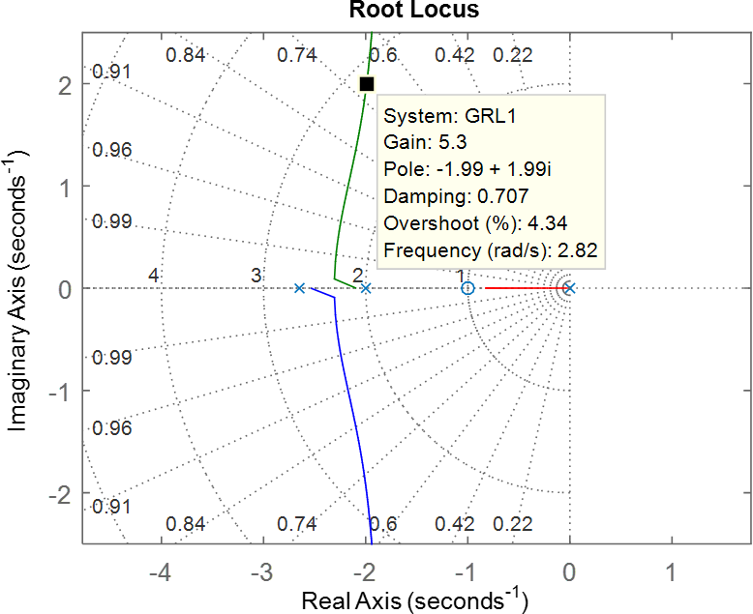
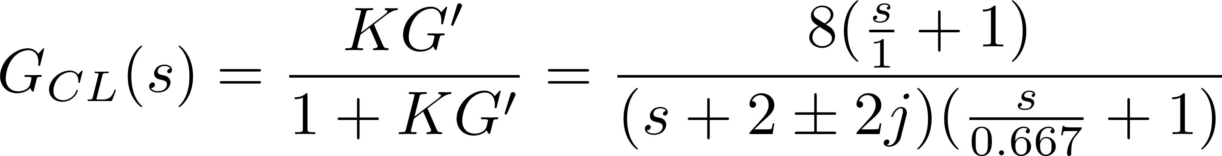
Design 3 Root Locus
Notes:
Extra zero and poles are to the right of the dominant in these design

Slide 15
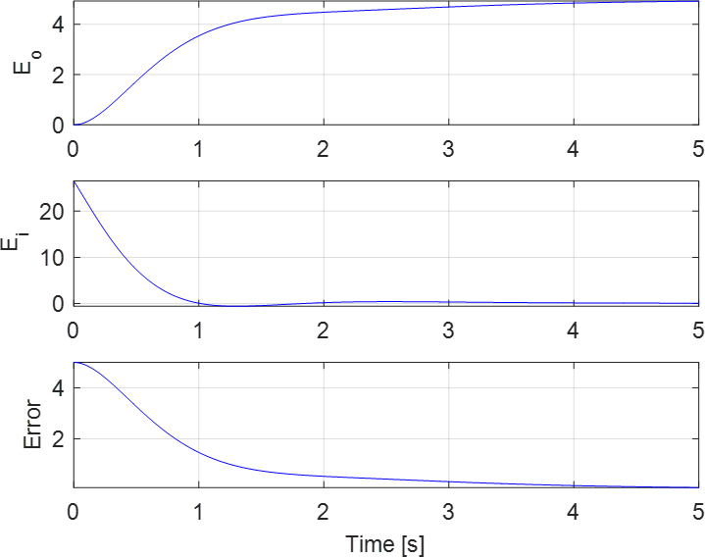


Design 3 Response

Slide 16
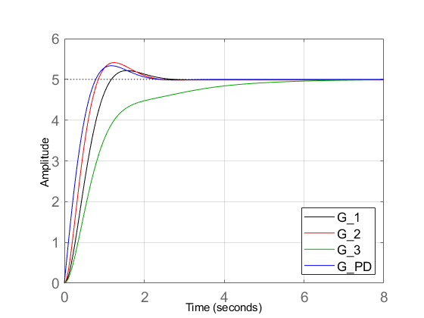
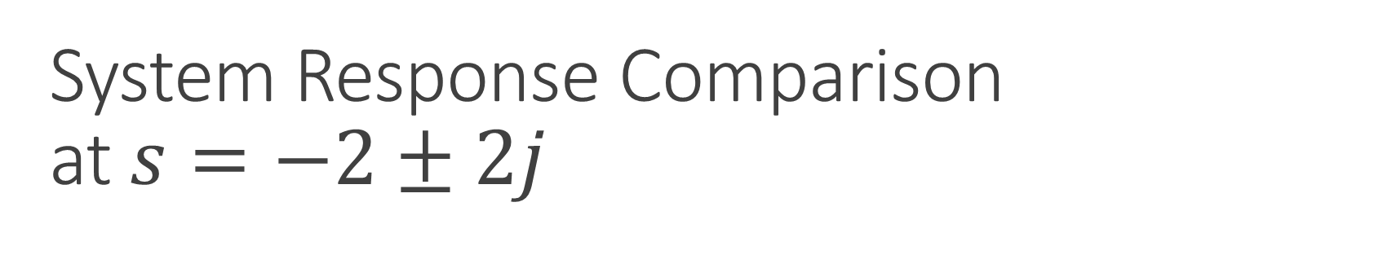
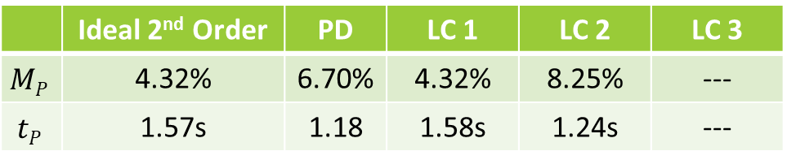
System Response Comparison at $s=−2±2j$
 | Ideal 2nd Order | PD | LC 1 | LC 2 | LC 3
$$MP$$ | 4.32% | 6.70% | 4.32% | 8.25% | ---
$$tP$$ | 1.57s | 1.18 | 1.58s | 1.24s | ---

Slide 17
Zero/Pole Choices
Notes:
Cannot make a lag compensator for this plant at this pole

Slide 18
System Comparison Bode Plot

Slide 19
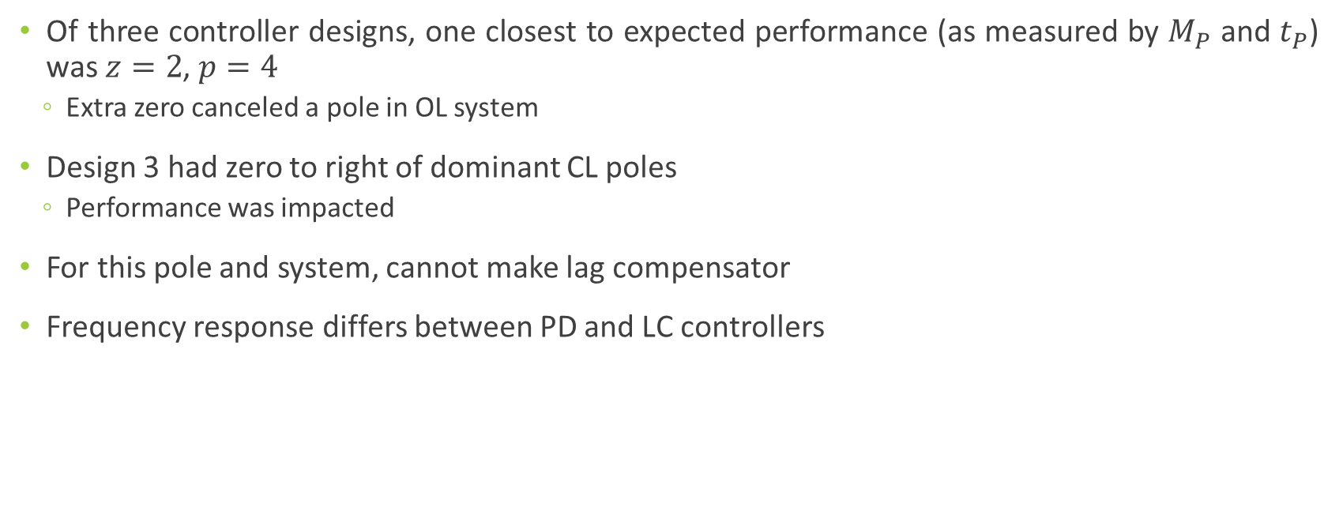
Discussion
Of three controller designs, one closest to expected performance (as measured by $M_{P}$ and $t_{P}$) was $z=2$, $p=4$
Extra zero canceled a pole in OL system
Design 3 had zero to right of dominant CL poles
Performance was impacted
For this pole and system, cannot make lag compensator
Frequency response differs between PD and LC controllers

