Slide 1
PID Controller
ME 357
Notes:
…and controller design process

Slide 2
Objectives
By the end of this section, you should be able to
Use Root Locus method to design PID controllers
Use Simulink to implement and test PID controllers
Conduct simple controller design and validation from beginning to end

Slide 3
PID Controller
Building on PD controller, can add two zeros (of our choice) and pole, at zero, to plant
Additional zeros could be real or complex conjugates
Increases choices for controller implementation
Controller expressed in forms:

Slide 4
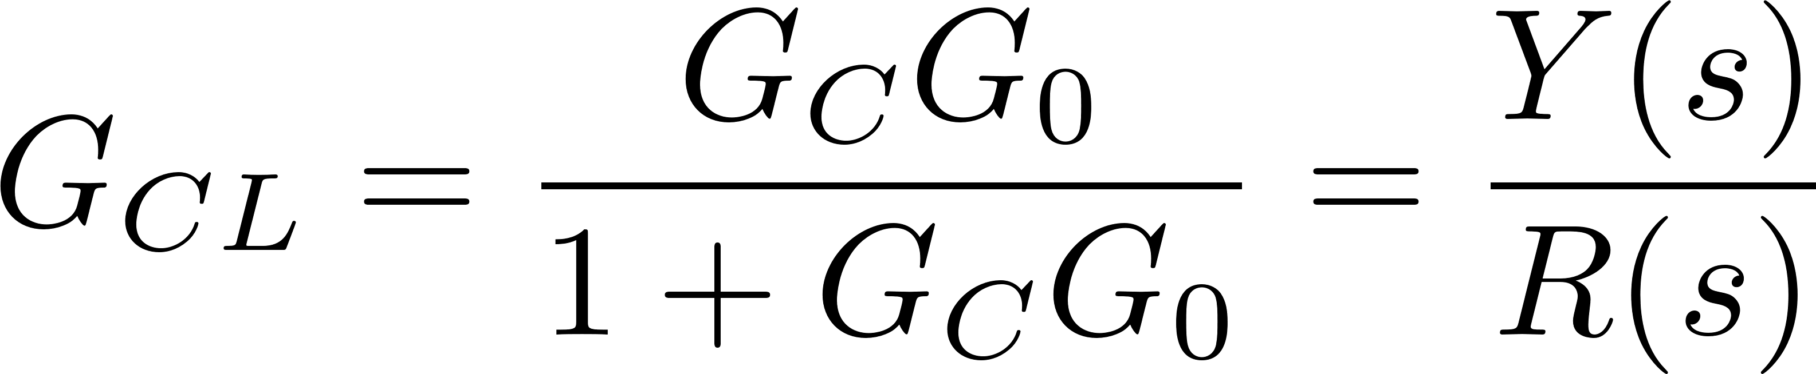
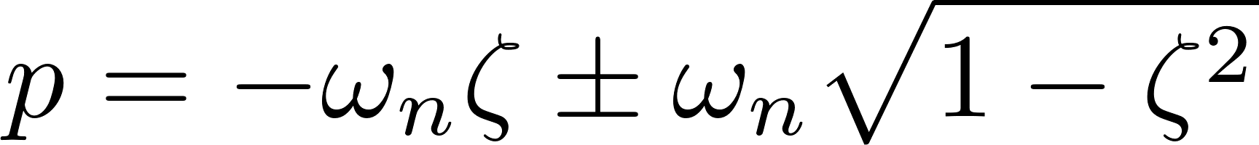
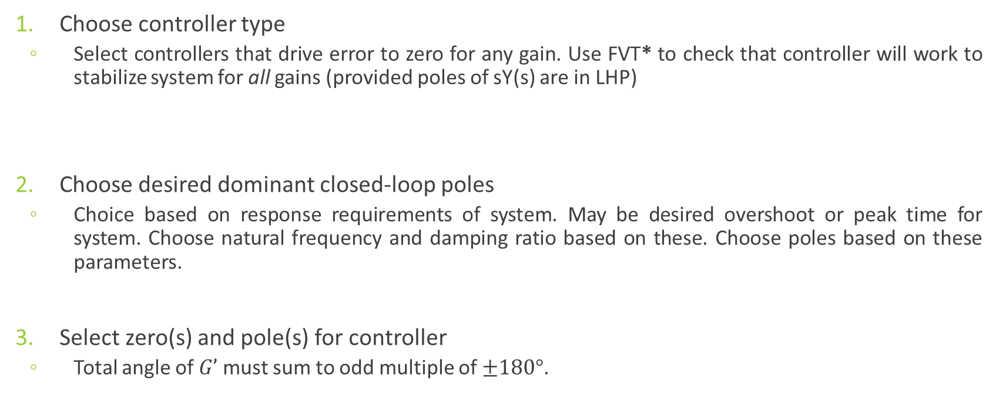
General “Recipe” for Controller Design
Choose controller type
Select controllers that drive error to zero for any gain. Use FVT* to check that controller will work to stabilize system for all gains (provided poles of sY(s) are in LHP)
Choose desired dominant closed-loop poles
Choice based on response requirements of system. May be desired overshoot or peak time for system. Choose natural frequency and damping ratio based on these. Choose poles based on these parameters.
Select zero(s) and pole(s) for controller
Total angle of $G’$ must sum to odd multiple of $±180°$.
Notes:
* remember, FVT only works when all poles are all in LHP

Slide 5
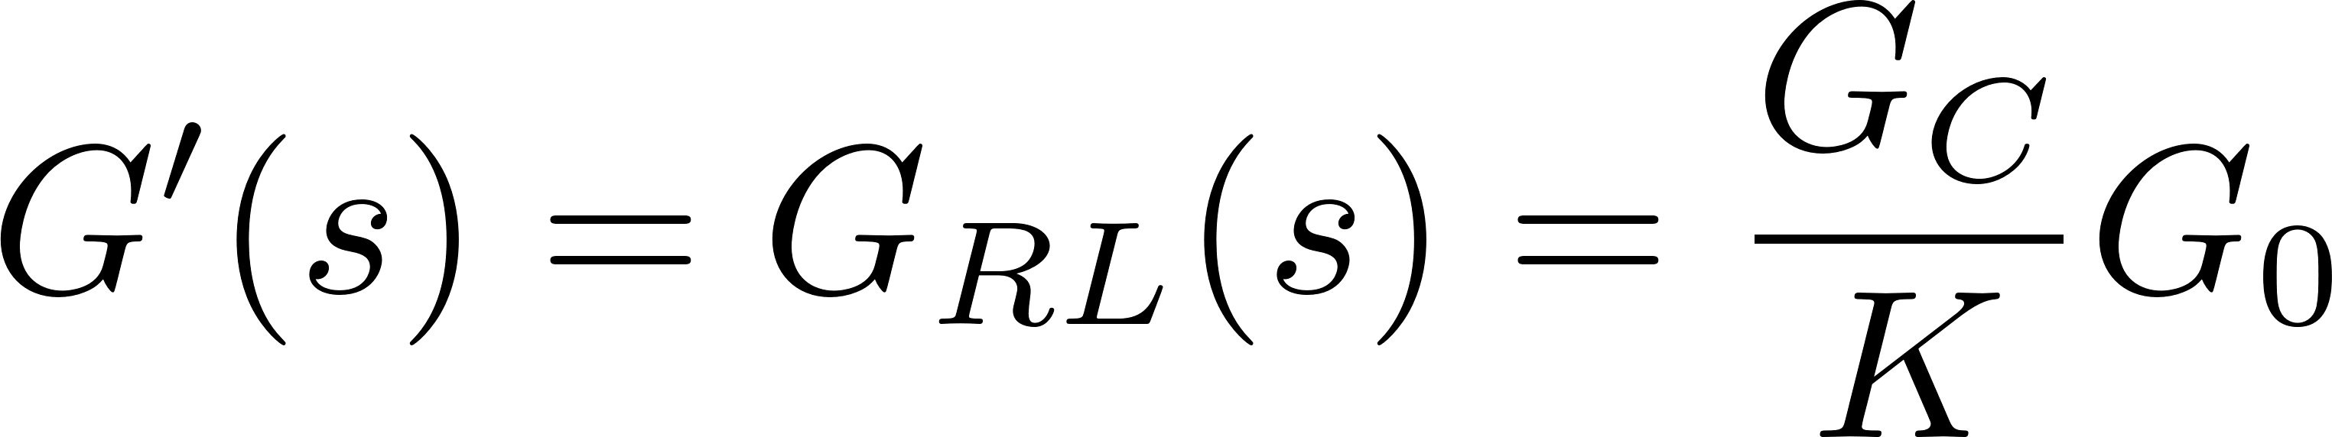
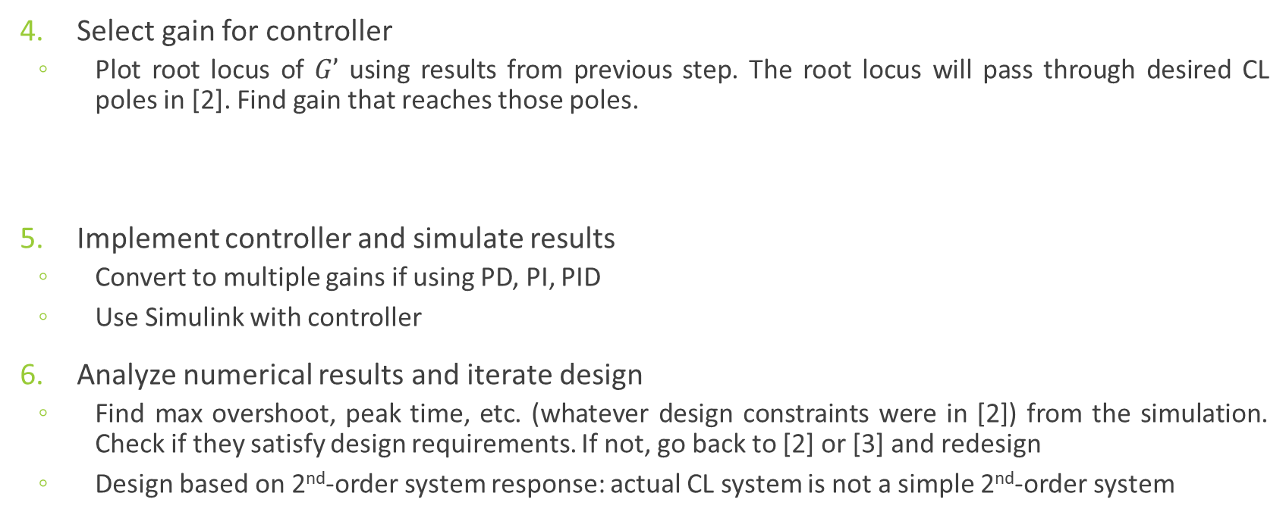
General “Recipe” for Controller Design
Select gain for controller
Plot root locus of $G’$ using results from previous step. The root locus will pass through desired CL poles in [2]. Find gain that reaches those poles.
Implement controller and simulate results
Convert to multiple gains if using PD, PI, PID
Use Simulink with controller
Analyze numerical results and iterate design
Find max overshoot, peak time, etc. (whatever design constraints were in [2]) from the simulation. Check if they satisfy design requirements. If not, go back to [2] or [3] and redesign
Design based on 2nd-order system response: actual CL system is not a simple 2nd-order system

Slide 6
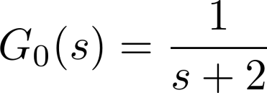
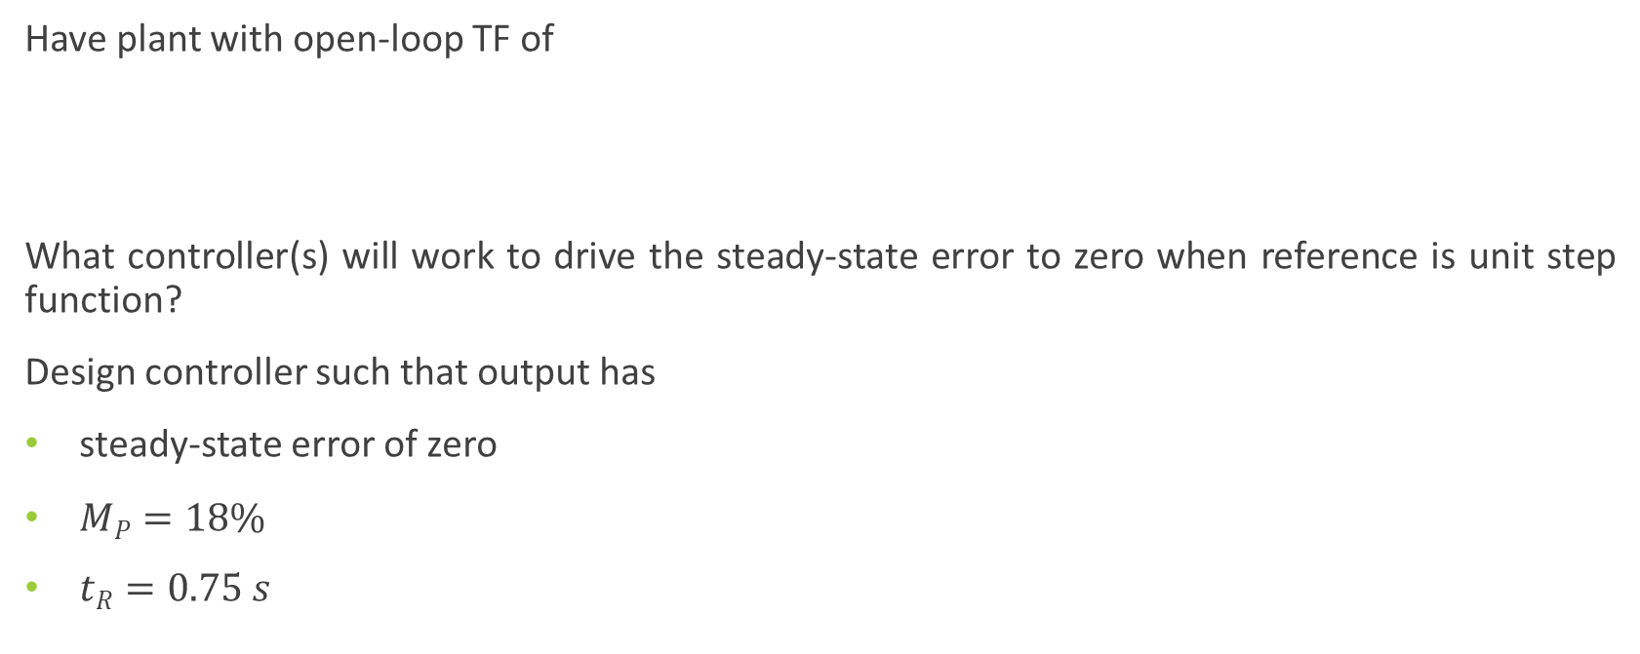
Example
Have plant with open-loop TF of
What controller(s) will work to drive the steady-state error to zero when reference is unit step function?
Design controller such that output has
steady-state error of zero
$MP=18\%$
$tR=0.75 s$

Slide 7
Choosing Controller
Controller must drive error to zero before we proceed with remainder of design
Possible that P, PD, PID, Lag Compensator could all drive error to zero, but can check feasible controllers analytically
If a control scheme is feasible, then proceed to design it

Slide 8
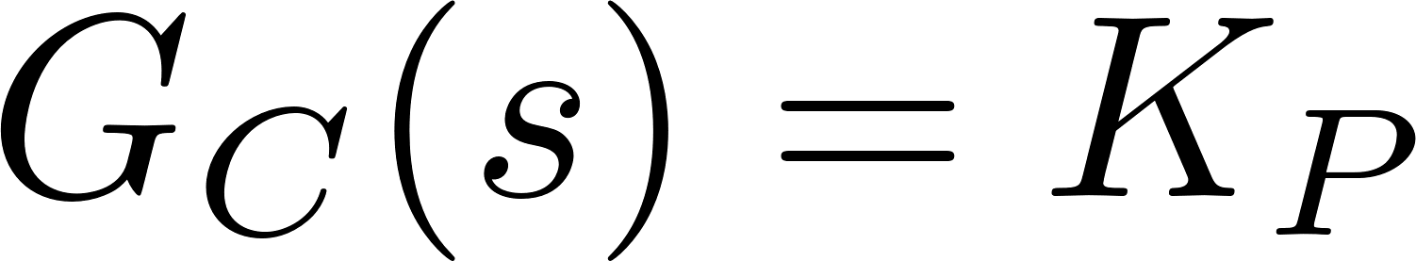
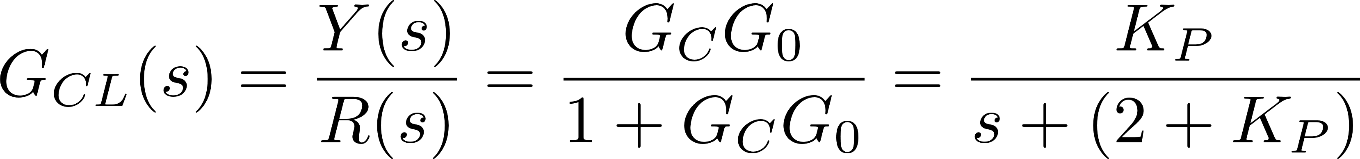
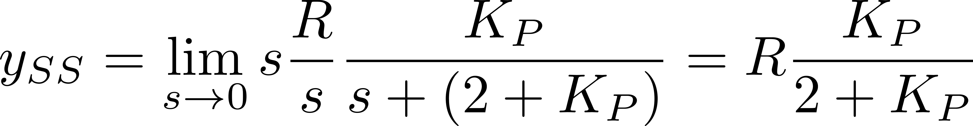
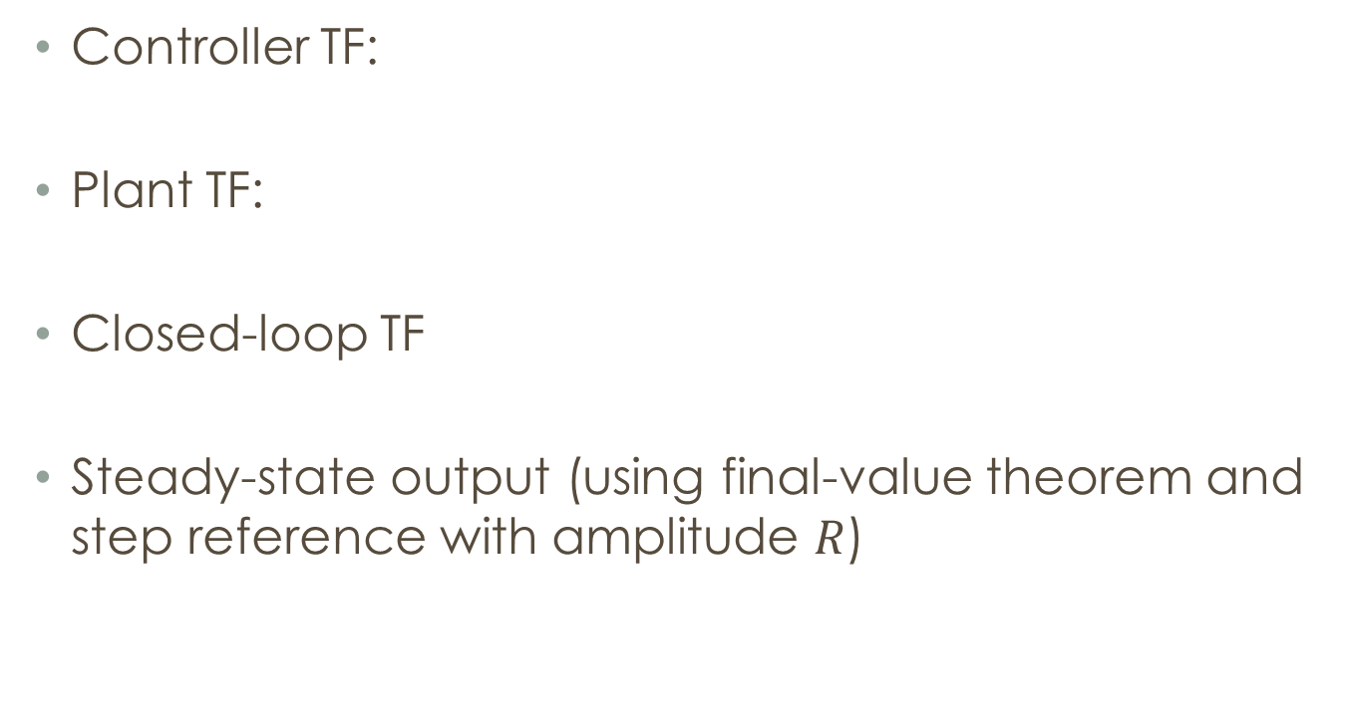
P Controller
Controller TF:
Plant TF:
Closed-loop TF
Steady-state output (using final-value theorem and step reference with amplitude $R$)
Notes:
Does not work for this plant

Slide 9
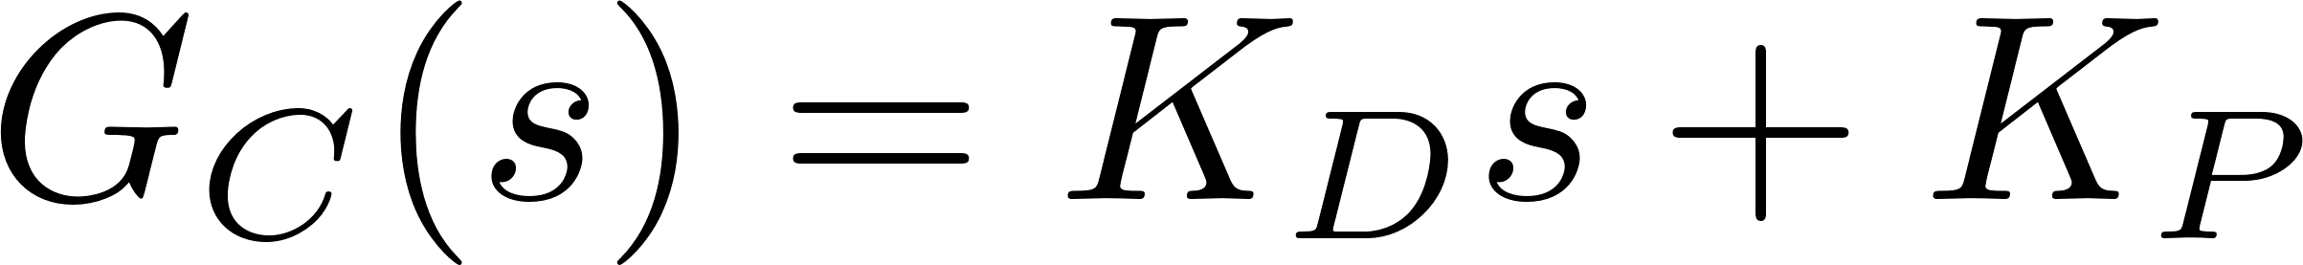
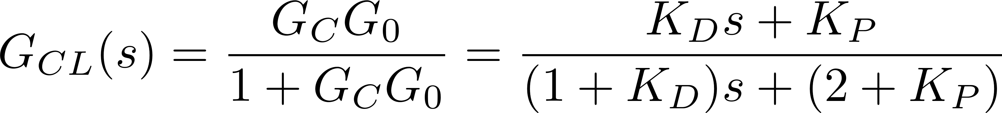
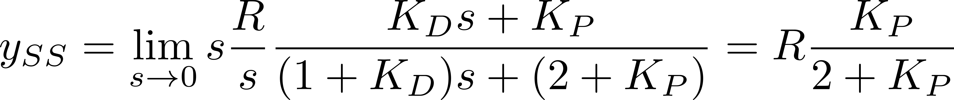
PD Controller
Controller TF:
Plant TF:
Closed-loop TF
Steady-state output (using final-value theorem and step reference with amplitude $R$)
Notes:
Does not work for this plant

Slide 10
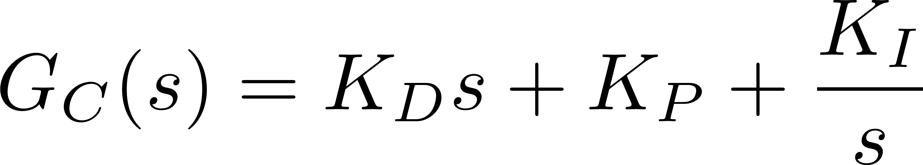
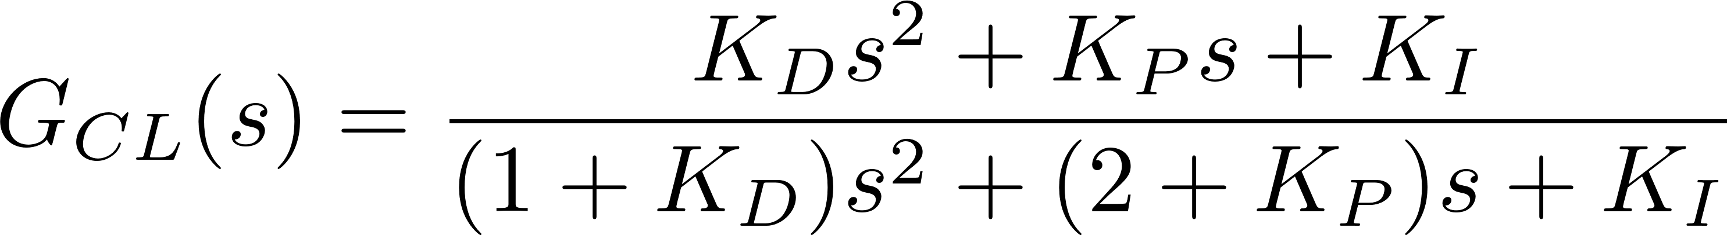
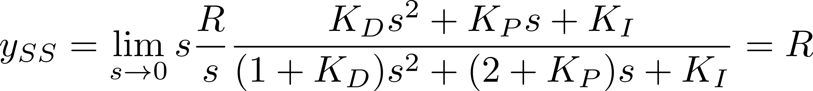

PID Controller
Controller TF:
Plant TF:
Closed-loop TF
Steady-state output (using final-value theorem and step reference with amplitude $R$)
Notes:
***Goes to R provided that poles are all in LHP***

Slide 11
Choosing Zeros/Gains for PID
For PID controller, have non-unique choice of additional zeros (which translate to three gains) that result in desired pole being on root locus
Our choice of zeros/gains will affect actual system response (e.g., overshoot, rise time) and control effort
May be good to start with a zero that will cancel an OL pole

Slide 12
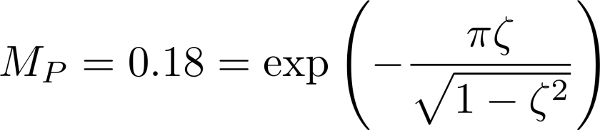
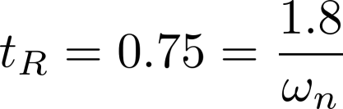
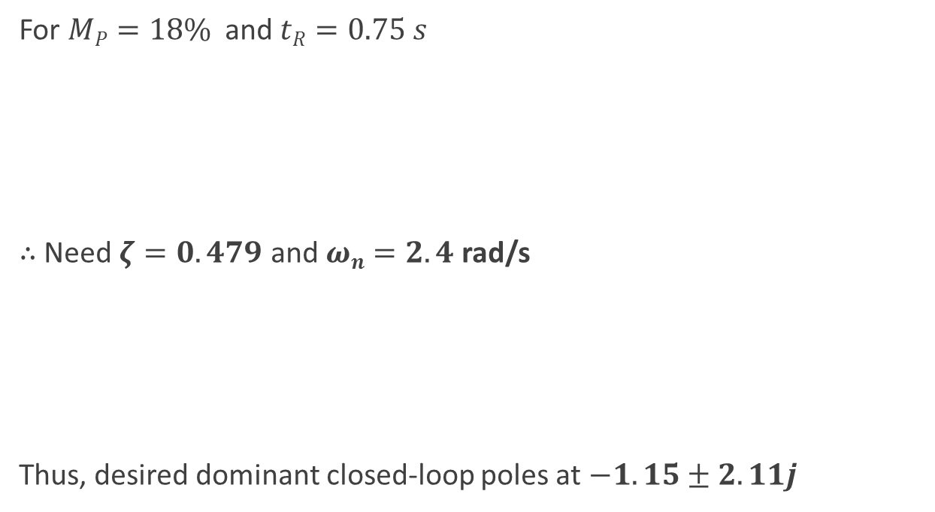
Continuing Example
For $MP=18\%$ and $tR=0.75 s$
$∴$ Need $ζ=0.479$ and $ωn=2.4$ rad/s
Thus, desired dominant closed-loop poles at $−1.15±2.11j$

Slide 13
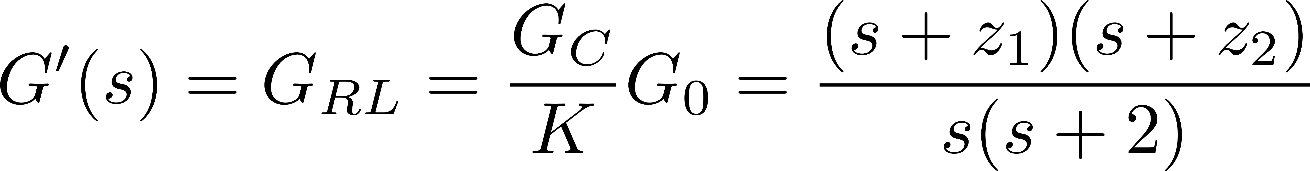
Continuing Example
For plant (open-loop TF):
We have RL TF using PID of:

Slide 14
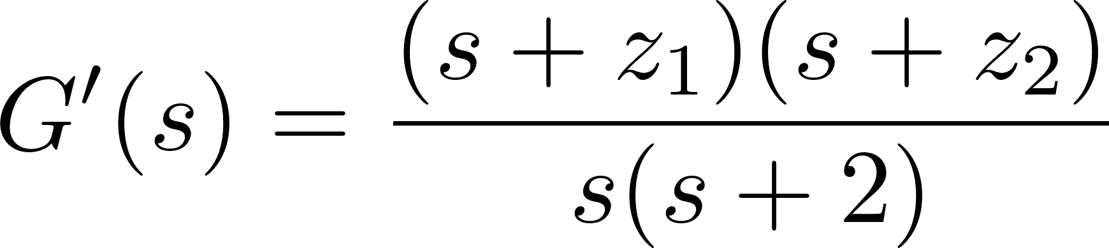
Root Locus
Rewrite CL TF in terms of two zeros
Use this function for root locus
Controller can alternatively be written as

Slide 15
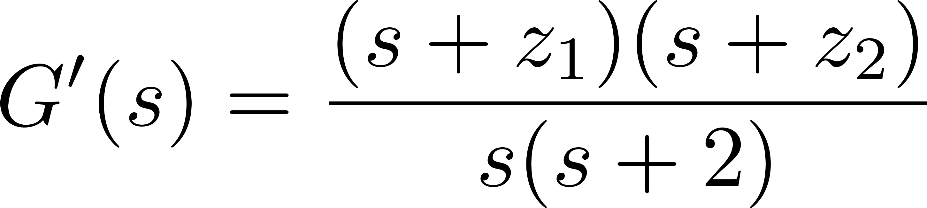
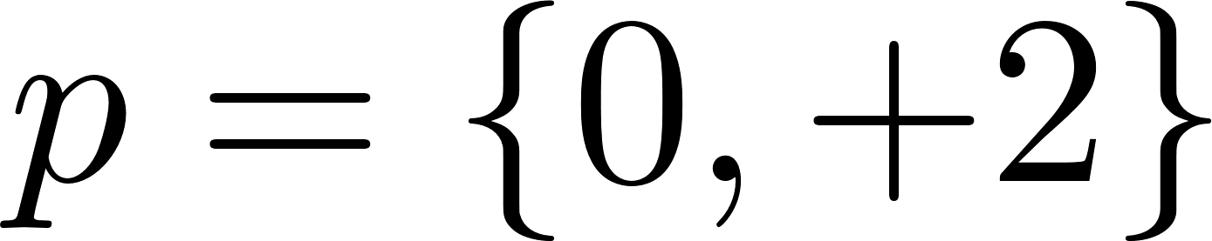
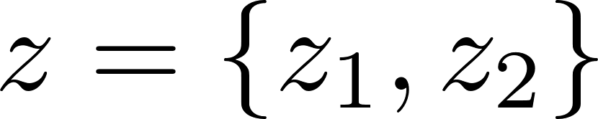

Desired Pole
Desire pole at $s=−1.15±2.11j$
7° off from odd-multiple of 180°
Add two zeros to bring total to 180°
Under-determined system: can select z₁ and z₂
Notes:
Using s = -1.15-2.11j for this example

Slide 16
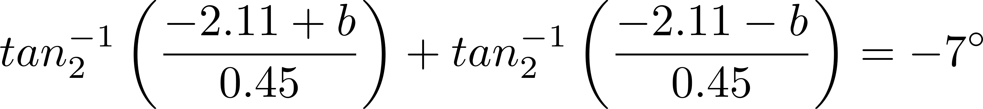


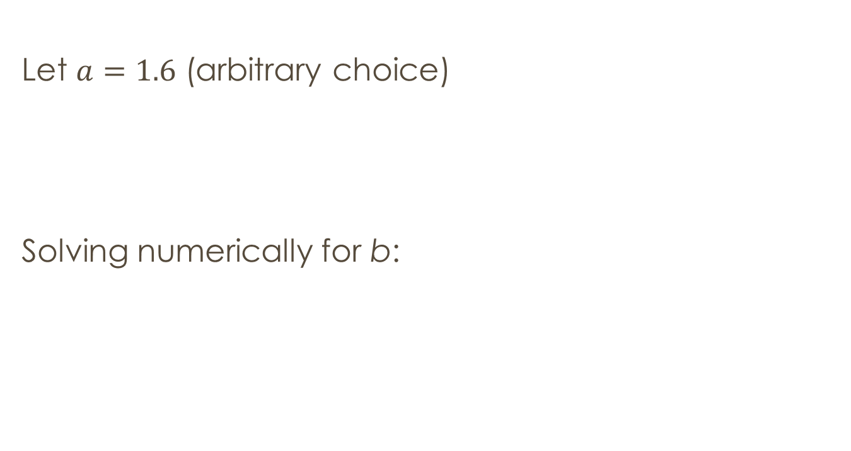
Controller Design 1 $$z1={z2}^{∗}=a±bj$$
Let $a=1.6$ (arbitrary choice)
Solving numerically for b:
Notes:
Choose a real part (based on OL poles) and find required imaginary part

Slide 17
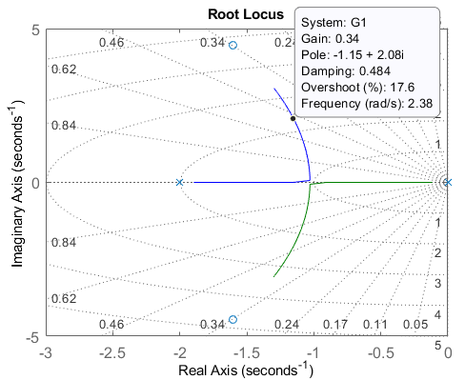

Design 1 $$z_{1,2}=1.6±4.44j$$
Notes:
we rounded slightly in finding "b" so the pole is not quite where we want. This is close enough

Slide 18



Design 1 $$z_{1,2}=1.6±4.44j$$
Controller Gains:
Therefore:

Slide 19
Controller Implementation
Notes:
Limiter on because of D

Slide 20
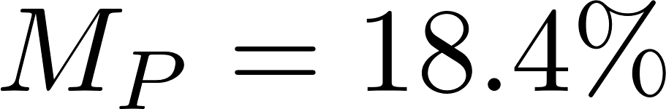
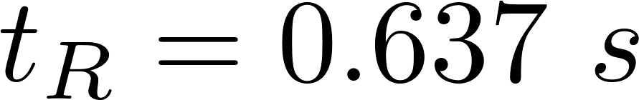
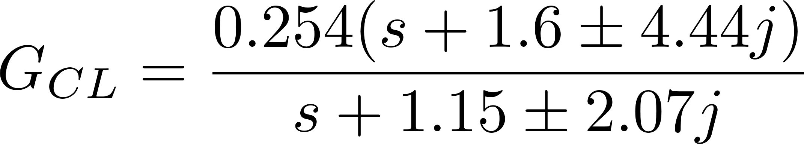
Design 1 $$z_{1,2}=1.6±4.44j$$

Slide 21


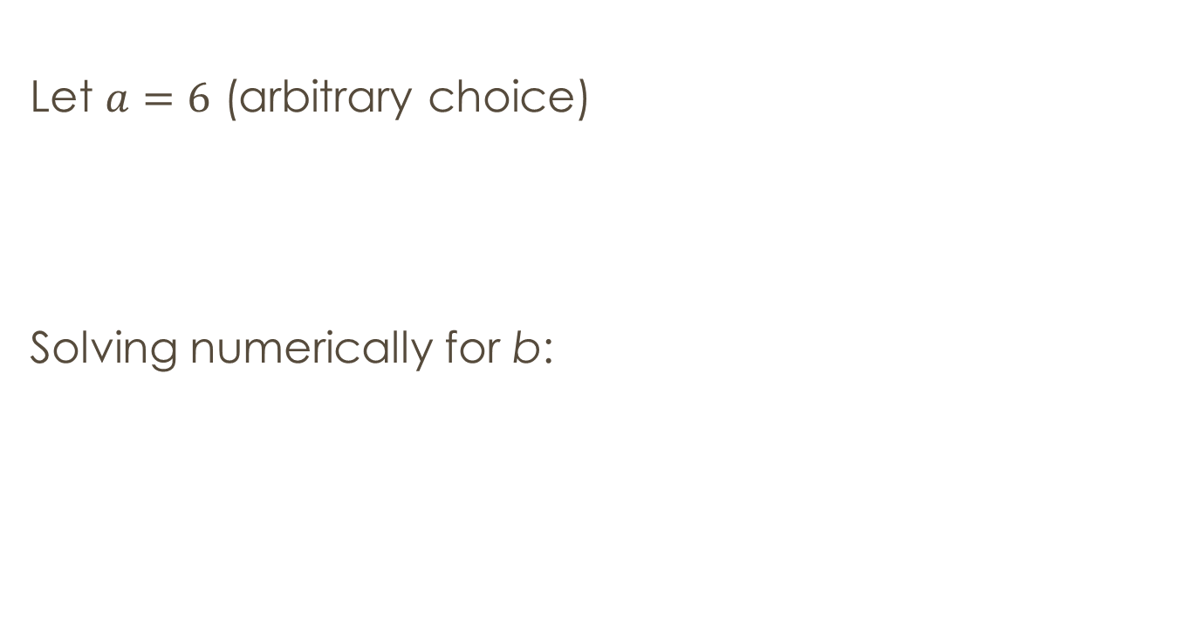

Controller Design 2 $$z1={z2}^{∗}=a±bj$$
Let $a=6$ (arbitrary choice)
Solving numerically for b:

Slide 22
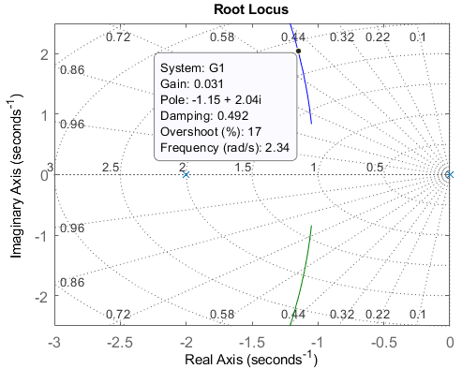

Design 2 $$z_{1,2}=6±12.1j$$
Notes:
we rounded "b" so this pole is close enough

Slide 23



Design 2 $$z_{1,2}=6±12.1j$$
Controller Gains:
Therefore:

Slide 24

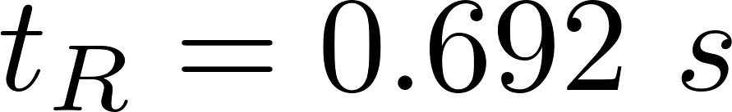
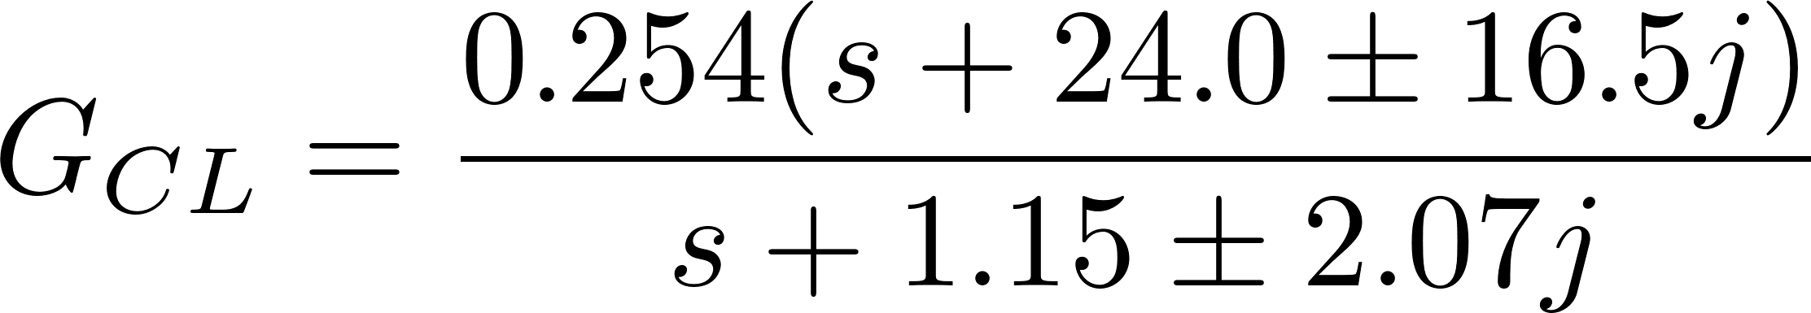
Design 2 $$z_{1,2}=6±12.1j$$

Slide 25
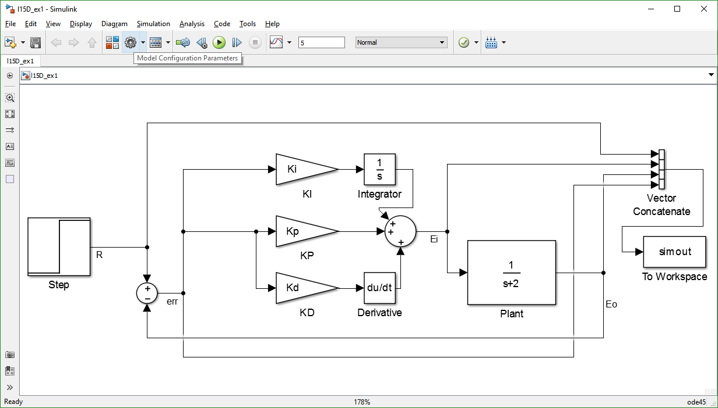
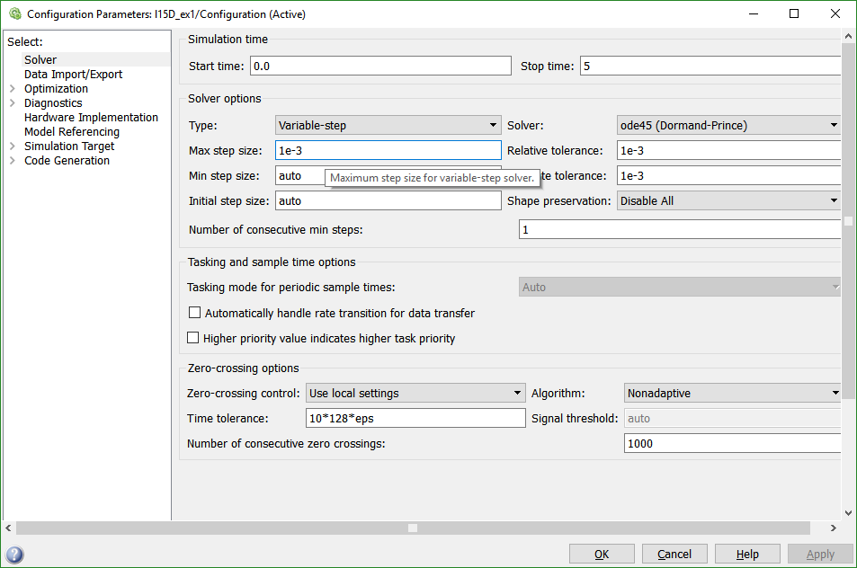
Adjust Time Step
Make max time-step smaller than default (try 1e-3 or 1e-4) to increase accuracy
Too small will take too long to run
Can also decrease tolerance values

Slide 26
Response Comparison
Design 1
Design 2

Slide 27
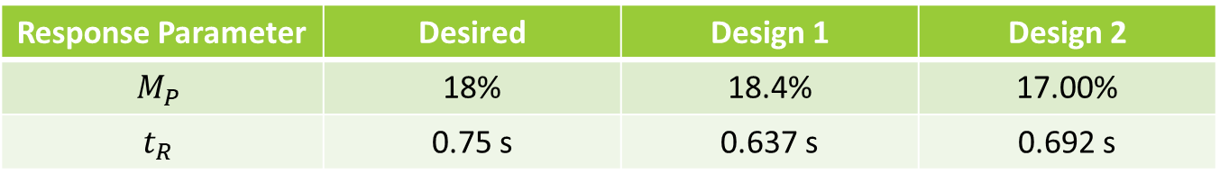
Response Comparison
Response Parameter | Desired | Design 1 | Design 2
$$M_{P}$$ | 18% | 18.4% | 17.00%
$$t_{R}$$ | 0.75 s | 0.637 s | 0.692 s
Neither design matched desired response
CL TF has two LHP zeros in addition to poles so we cannot really use what we know from Unit 2
Limiting maximum input effects response of system
Shows limitations of Root Locus method
Always validate design in simulation

Slide 28
PID Tuning
For desired dominant poles, have continuum of choices for two zeros
Just observed differences in only two implementations
Different response from prediction
Different control effort required
Ziegler-Nichols Method
Two methods presented in book for selecting three gains
Useful when TF of plant is known (all of our examples)
Can also be used for control when plant is unknown
Other methods in literature
Derivative term susceptible to noise in measurement

Slide 29
End Unit 3
Control

