Slide 1
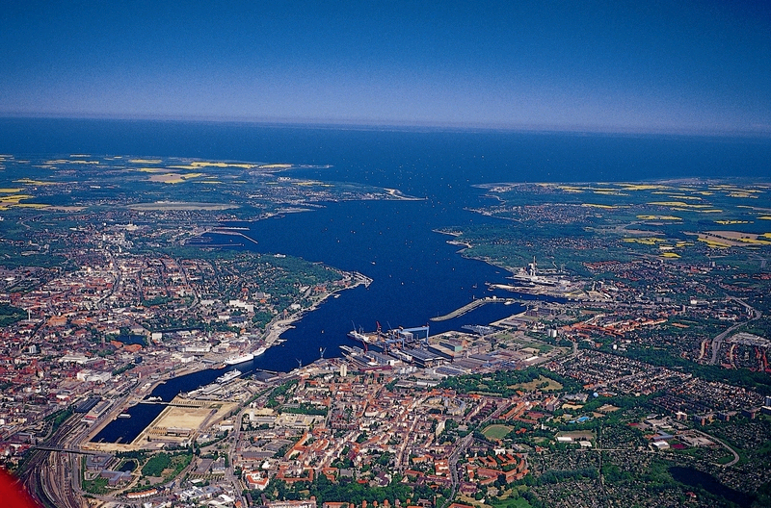

Programmieren in C/C++ und MATLAB
Jens-Olaf Delfs
Sebastian Bauer
Institut für Geowissenschaften
Christian-Albrechts-Universität zu Kiel
Programmieren in C/C++ und MATLAB
CAU 9-<number>

Slide 2
Theis IV
Der Theiss-Löser in solveProblem():
void CSimulator::solveProblem(void)
{
double factors[2];
for(int i=0; i< (int)times.size(); i++)
{
for(int ii=0; ii< (int)nodes.size(); ii++)
nodes[ii]->resetDrawdown();
for(int j=0; j< (int)wells.size(); j++)
{
factors[0] = wells[j]->getPumpingRate() / ( 4 * M_PI *aquifer.transmissivity);
factors[1] = aquifer.storativity / ( 4 * aquifer.transmissivity * times[i]);
for(int k=0; k< (int)nodes.size(); k++)
{
nodes[k]->incrementDrawdown(factors[0] \
* Wu(factors[1] * distance_squared ( wells[j]->getLocation(), nodes[k]->getLocation())));
}
}
writeResults(times[i]);
}
}
Getter in node.cpp:
double* CNode::getLocation(void)
{
return &location[0];
}
double CNode::getDrawdown(void)
{
return drawdown;
}
Setter in node.cpp:
void CNode::incrementDrawdown(double value)
{
drawdown += value;
}
void CNode::resetDrawdown(void)
{
drawdown = 0;
}
Programmieren in C/C++ und MATLAB
CAU 9-<number>

Slide 3
Theis IV
Brunnenfunktion als globale Funktion
in simulator.cpp (Deklaration in simulator.h):
double Wu(double u)
{
double Wu = -0.577216 - log(u); // Euler Mascheroni constant
double sign = 1;
double multi_u = u;
double denominator = 1;
double changeInWu;
for(int i=1; i <= 100; i++)
{
changeInWu = sign * multi_u / denominator;
Wu += changeInWu;
std::cout << i << " " << changeInWu << " ";
if( fabs(changeInWu) < 1.e-5)
break;
multi_u *=u;
sign *= -1;
denominator *= (i + 1) * (i + 1) / i;
}
std::cout << std::endl;
return Wu;
}
Abstand zwischen Brunnen und Knoten über globale Inline-Funktion (in simulator.h):
inline double distance_squared (double x[], double y[])
{
return ( x[0] - y[0] ) * ( x[0] - y[0] ) + ( x[1] - y[1] ) * ( x[1] - y[1] );
}
Programmieren in C/C++ und MATLAB
CAU 9-<number>

