Slide 1
Lecture 13 Natural Language Processing
Dr. Johnny Cheng

Slide 2
Lessons Intended Learning Outcomes
On completion of this lesson, students are expected to be able to:
Identify the applications of natural language processing.
Identify the functionality of Python package for natural language processing.
Implement some introductory applications of natural language processing.

Slide 3
Natural Language Processing (NLP)
NLP with Python
Word Clouds
N-gram Models
Grammars
Gibbs Sampling
Topic Modeling

Slide 4
NLP with Python
Natural language processing (NLP) refers to computational techniques involving language.
It usually deals with natural languages (or human languages).
Sometimes, it is called computational linguistics.
NLTK is a leading platform for building Python programs to work with human language data.
It provides easy-to-use interfaces to over 50 corpora and lexical resources such as WordNet.
It comes along with a suite of text processing libraries for classification, tokenization, stemming, tagging, parsing, and semantic reasoning, wrappers for industrial-strength NLP libraries, and an active discussion forum.

Slide 5
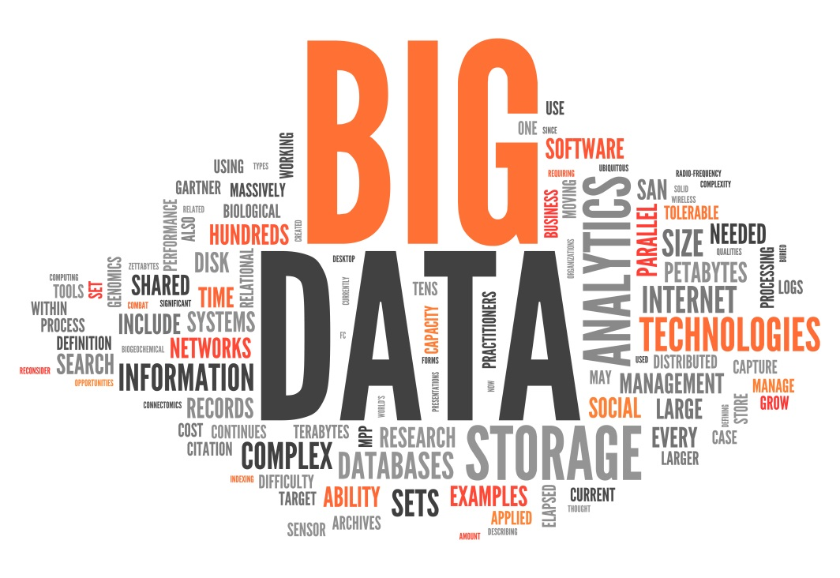
Word Clouds
One approach to visualizing words and counts is word clouds, which artistically lay out the words with sizes proportional to their counts.
Here is an example of a word cloud of big data buzzwords:

Slide 6
Word Clouds (cont.)
Here we will look at a more meaningful word cloud.
Suppose, for each of some collection of data science-related buzzwords, we have two numbers between 0 and 100:
The first representing how frequently it appears in job listings, and
The second how frequently it appears on resumes.
>>> data = [ ("big data", 100, 15), ("Hadoop", 95, 25), ("Python", 75, 50), ("R", 50, 40), ("machine learning", 80, 20), ("statistics", 20, 60), ("data science", 60, 70), ("analytics", 90, 3), ("team player", 85, 85), ("dynamic", 2, 90), ("synergies", 70, 0), ("actionable insights", 40, 30), ("think out of the box", 45, 10), ("self-starter", 30, 50), ("customer focus", 65, 15), ("thought leadership", 35, 35)]

Slide 7
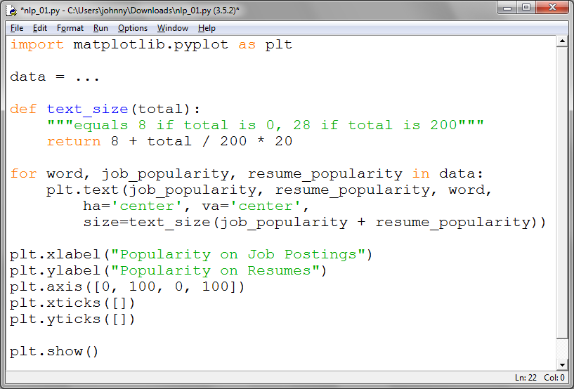
Word Clouds (cont.)
We will scatter these buzzwords so that horizontal position indicates posting popularity and vertical position indicates resume popularity.
Then we produce a visualization that conveys a few insights.
lec13/nlp_01.py

Slide 8
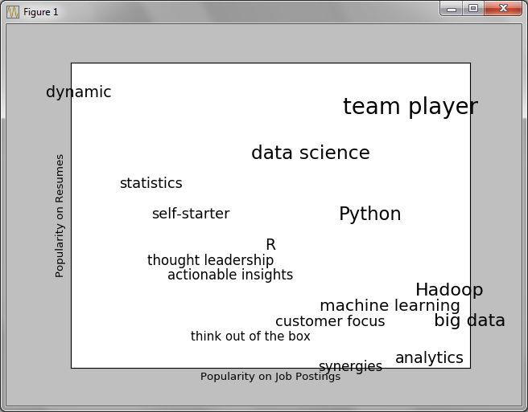
Word Clouds (cont.)
The corresponding visualization is:

Slide 9
N-gram Models
Suppose you are asked to write thousands of web pages for a business company so that your website will rank higher in search results for data science-related terms.
Think whether you can somehow programmatically generate these web pages.
To do this, we’ll need some way of modeling language.
Our approach is to start with a corpus of documents and learn a statistical model of language.
There are a couple of issues worth calling attention to.

Slide 10
N-gram Models (cont.)
The first is that the apostrophes in the text are actually the Unicode character u“\u2019”.
We create a helper function to replace them with normal apostrophes:
>>> def fix_unicode(text):
return text.replace(u"\u2019", "'")
The second issue is that once we get the text of the web page, we’ll want to split it into a sequence of words and periods.
Thus we can tell where sentences end.
We will do this using re.findall().

Slide 11
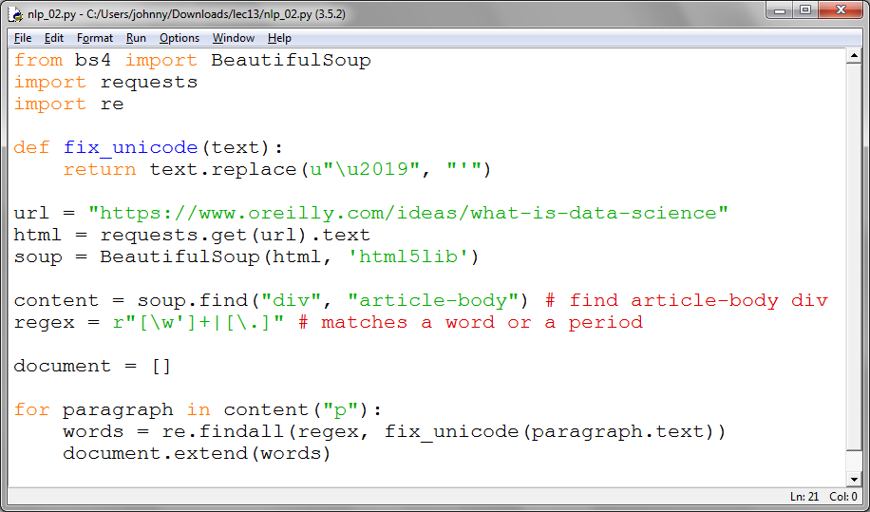
N-gram Models (cont.)
lec13/nlp_02.py

Slide 12
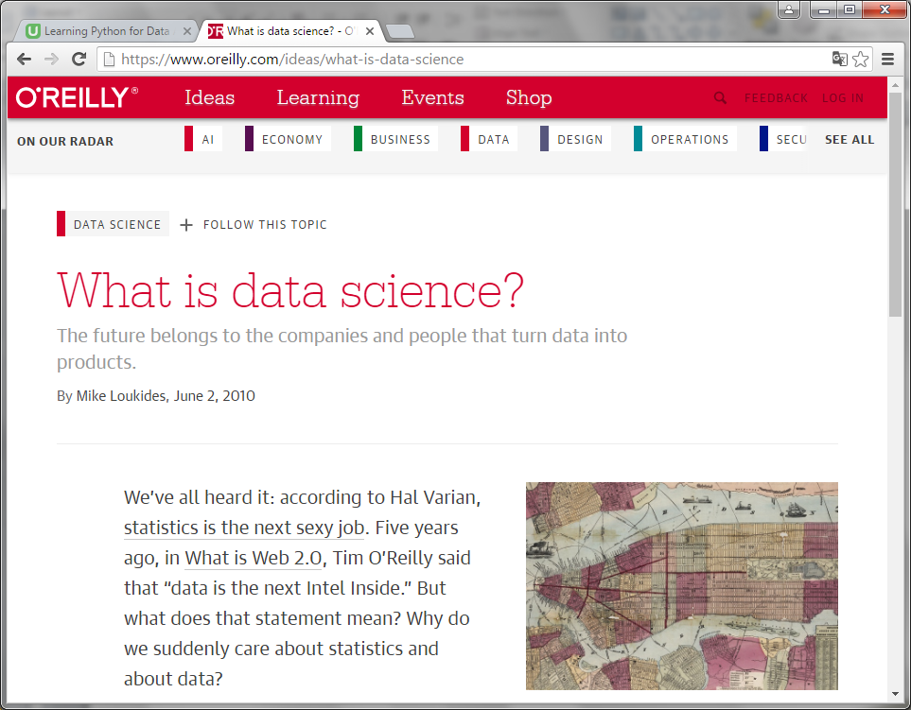
N-gram Models (cont.)
The website we will work with is
https://www.oreilly.com/ideas/what-is-data-science

Slide 13
N-gram Models (cont.)
Now we got a list of words from the web page:
>>> document
["We've", 'all', 'heard', 'it', 'according', 'to', 'Hal', 'Varian', 'statistics', 'is', 'the', 'next', 'sexy', 'job',
...
'Release', 'Python', 'Data', 'Science', 'Handbook', 'Early', 'Release']
>>> len(document)
5112
Then we will model language in the following way:
Given some starting word (say “book”) we look at all the words that follow it in the source document.
We randomly choose one of these to be the end of the sentence.

Slide 14
N-gram Models (cont.)
We call this a bigram model, as it is determined completely by the frequencies of the bigrams (word pairs) in the original data.
To start, let’s precompute the possible word transitions.
We use zip(document, document[1:]) to generate precisely the pairs of consecutive elements of document.
Then we can generate sentences by a starting word, which is randomly picked from words that follow a period.
The following code fragment will do this task.
Note that we need to append this fragment to ‘nlp_02.py’ to form ‘nlp_02a.py’.

Slide 15
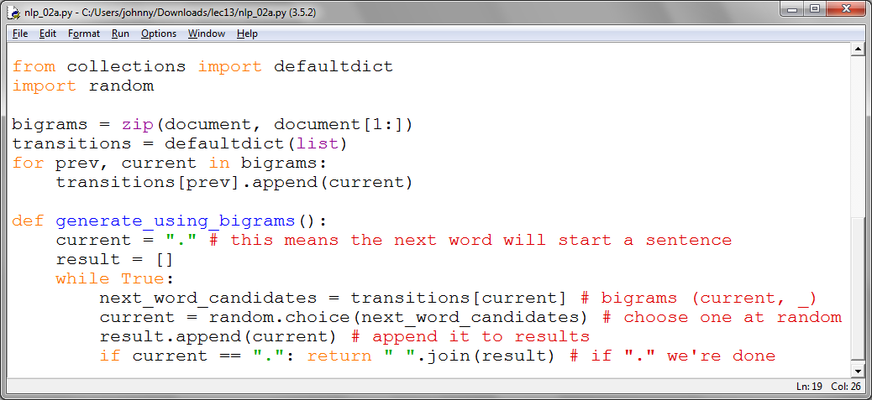
N-gram Models (cont.)

Slide 16
N-gram Models (cont.)
Now we can generate sentences:
>>> generate_using_bigrams()
"But that's generated by Jeff Hammerbacher said that people spending more scatter plots trying to explore and use of this difference between 5 ."
>>> generate_using_bigrams()
"The data science group at the space you need to consume Atom data that's where Moore's law as storage capacity storage capacity continues to making data speak coherently ."

Slide 17
N-gram Models (cont.)
We can make the sentences less gibberishy by looking at trigrams, triplets of consecutive words.
More generally, you might look at n-grams consisting of n consecutive words.
Now, in trigram model, the transitions will depend on the previous two words:
trigrams = zip(document, document[1:], document[2:])
trigram_transitions = defaultdict(list)
starts = []
for prev, current, next in trigrams:
if prev == ".":
starts.append(current)
trigram_transitions[(prev, current)].append(next)

Slide 18
N-gram Models (cont.)
Then we can generate sentences in pretty much the same:
def generate_using_trigrams():
current = random.choice(starts)
prev = ".”
result = [current]
while True:
next_word_candidates = trigram_transitions[(prev, current)]
next_word = random.choice(next_word_candidates)
prev, current = current, next_word
result.append(current)
if current == ".":
return " ".join(result)
Part of lec13/nlp_03.py

Slide 19
N-gram Models (cont.)
This produces better sentences like:
>>> generate_using_trigrams()
'To do it well you need to be ready for whatever comes and be willing to use and a 32 GB microSD card weighs about half a gram .'
>>> generate_using_trigrams()
"While rock solid consistency is crucial to each stage of the experiments in real time data analysis is comparative if you're looking at events that members attended ."

Slide 20
Grammars
A different approach to modeling language is with grammars, rules for generating acceptable sentences.
For example, you might say that a sentence necessarily consists of a noun followed by a verb.
We’ll define a slightly more complicated grammar:
grammar = {
"_S" : ["_NP _VP"],
"_NP" : ["_N", "_A _NP _P _A _N"],
"_VP" : ["_V", "_V _NP"],
"_N" : ["data science", "Python", "regression"],
"_A" : ["big", "linear", "logistic"],
"_P" : ["about", "near"],
"_V" : ["learns", "trains", "tests", "is"]
}

Slide 21
Grammars (cont.)
In grammar, each entry is a grammar rule, with a key (starting with an underscore) referred as a non-terminal, and a value.
The value may be:
List of terminal(s): [“data science”, “Python”, “regression”], or
List of replacement(s): [“_NP _VP”], [“_V”, “_V _NP”], etc.
Thus, for instance, “_S” is the sentence rule, which produces a “_NP” (“noun phrase”) rule followed by a “_VP” (“verb phrase”) rule.

Slide 22
Grammars (cont.)
Next we will see how to generate sentences from this grammar.
Let’s start with a list containing the sentence rule ['_S'].
And then we’ll repeatedly expand each rule by replacing it with a randomly chosen one of its productions.
We will stop when we have a list consisting solely of terminals.
For instance, we have a progression like this:
['_S']
['_NP','_VP']
['_N','_VP']
['data science','_VP']
['data science','_V','_NP']
['data science','learns','_NP']
['data science','learns','N']
['data science','learns','Python']

Slide 23
Grammars (cont.)
Now we start to implement this.
First we’ll create a simple helper function to identify terminals:
def is_terminal(token):
return token[0] != "_"
Next we need to write a function to convert a list of tokens into a sentence.
We’ll look for the first non-terminal token.
Then we randomly choose one this non-terminal’s production.
If that production is a terminal (i.e., a word), we simply replace the token with it.

Slide 24
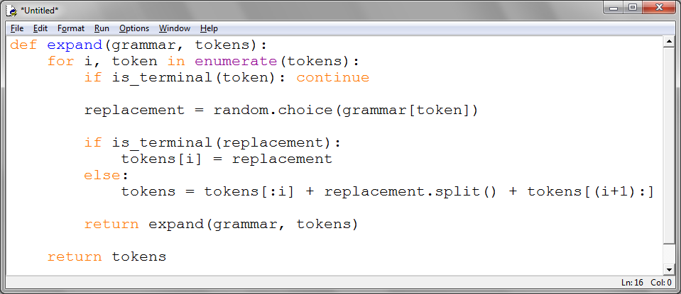
Grammars (cont.)
Otherwise it’s a sequence of space-separated non-terminal tokens that we need to split and then splice into the current tokens.
Either way, we repeat the process on the new set of tokens.

Slide 25
Grammars (cont.)
lec13/nlp_04.py
And we can generate sentences using:
def generate_sentence(grammar):
return expand(grammar, ["_S"])
The results may look like:
>>> generate_sentence(grammar)
['data science', 'learns']
>>> generate_sentence(grammar)
['data science', 'tests', 'logistic', 'regression', 'near', 'big', 'data science']
>>> generate_sentence(grammar)
['Python', 'is', 'linear', 'linear', 'big', 'linear', 'data science', 'about', 'linear', 'regression', 'about', 'big', 'Python', 'about', 'logistic', 'regression', 'near', 'linear', 'data science']

Slide 26
Gibbs Sampling
Generating samples from some distributions is easy.
We can get uniform random variables with:
random.random()
However, some distributions are harder to sample from.
Gibbs sampling is a technique for generating samples from multidimensional distributions when we only know some of the conditional distributions.
For instance, suppose we roll two dice.
Let x be the value of the first die and y be the sum of the dice, and we need to generate lots of (x, y) pairs.
Add the import statement first:
import random

Slide 27
Gibbs Sampling (cont.)
In this case it’s easy to generate the samples directly:
def roll_a_die():
return random.choice([1,2,3,4,5,6])
def direct_sample():
d1 = roll_a_die()
d2 = roll_a_die()
return d1, d1 + d2
In this case it’s easy to generate the samples directly:
>>> direct_sample()
(1, 2)
>>> direct_sample()
(4, 9)
>>> direct_sample()
(5, 8)

Slide 28
Gibbs Sampling (cont.)
However, imagine that you only knew the conditional distributions.
The distribution of y conditional on x is easy—if you know the value of x, y is equally likely to be, say, x + 1:
def random_y_given_x(x):
return x + roll_a_die()
The other direction is more complicated.
For instance, if you know that y is 2, then necessarily x is 1.
If y is 7, then has to be either 3 or 4.
def random_x_given_y(y):
if y <= 7:
return random.randrange(1, y)
else:
return random.randrange(y - 6, 7)

Slide 29
Gibbs Sampling (cont.)
The way Gibbs sampling works is that we start with any (valid) value for x and y and repeatedly alternate replacing x with a random value picked conditional on y and replacing y with a random value pick conditional on x.
After a number of iterations, the resulting values of x and y will represent a sample from the unconditional join distribution:
def gibbs_sample(num_iters=100):
x, y = 1, 2 # doesn't really matter
for _ in range(num_iters):
x = random_x_given_y(y)
y = random_y_given_x(x)
return x, y

Slide 30
Gibbs Sampling (cont.)
We can compare this with the direct sampling:
def compare_distributions(num_samples=1000):
counts = defaultdict(lambda: [0, 0])
for _ in range(num_samples):
counts[gibbs_sample()][0] += 1
counts[direct_sample()][1] += 1
return counts
This technique will be used in the next section, “Topic Modeling”.
lec13/nlp_05.py

Slide 31
Topic Modeling
Consider a scenario that you are a data scientist of a large blog site and you are asked to understand your users’ interests.
One approach is to try to identify the topics that underlie those interests.
A technique called Latent Dirichlet Analysis (LDA) is commonly used to identify common topics in a set of documents.
We’ll apply it to documents that consist of each user’s interests.
In particular, we have a collection of documents each of which is a list of words.

Slide 32
Topic Modeling (cont.)
And we have a corresponding collection of document_topics that assigns a topic ( a number between 0 and K − 1) to each word in each document.
For instance, the fifth word in the fourth document is
documents[3][4]
And the topic from which that word was chosen is:
document_topics[3][4]
We can estimate the likelihood that topic 1 produces a certain word by comparing how many times topic 1 produces that word with how many topic 1 produces any word.

Slide 33
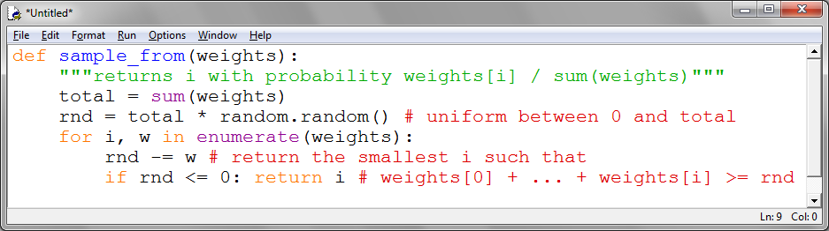
Topic Modeling (cont.)
We start by assigning every word in every document a topic completely at random.
To start with, we need a function to randomly choose an index on an arbitrary set of weights:
For instance, if you give it weights [1, 1, 3] then one-fifth of the time it will return 0, one-fifth of the time it will return 1, and three-fifths of the time it will return 2.

Slide 34
Topic Modeling (cont.)
Our documents are our users’ interests, which look like:
documents = [
["Hadoop", "Big Data", ..., "Cassandra"],
["NoSQL", "MongoDB", ..., "Postgres"],
["Python", "scikit-learn", ..., "pandas"],
...
["databases", "HBase", ..., "MongoDB"],
["libsvm", "regression", "support vector machines"]
]
And we’ll try to find K = 4 topics.
In order to calculate the sampling weights, we’ll need to keep track of several counts.
First we create the data structures for them.

Slide 35
Topic Modeling (cont.)
Counter is a dict subclass for counting hashable objects
How many times each topic is assigned to each document:
# a list of Counters, one for each document
document_topic_counts = [Counter() for _ in documents]
How many times each word is assigned to each topic:
# a list of Counters, one for each topic
topic_word_counts = [Counter() for _ in range(K)]
The total number of words assigned to each topic:
# a list of numbers, one for each topic
topic_counts = [0 for _ in range(K)]
The total number of words contained in each document:
# a list of numbers, one for each document
document_lengths = list(map(len, documents))

Slide 36
Topic Modeling (cont.)
The number of distinct words:
distinct_words = set(word for document in documents for word in document)
W = len(distinct_words)
And the number of documents:
D = len(documents)
For example, once we populate these, we can find the number of words in documents[3] associated with topic 1 as:
document_topic_counts[3][1]
And we can find the number of times nlp is associated with topic 2 as:
topic_word_counts[2]["nlp"]

Slide 37
Topic Modeling (cont.)
The number of distinct words:
def p_topic_given_document(topic, d, alpha=0.1):
"""the fraction of words in document _d_
that are assigned to _topic_ (plus some smoothing)"""
return ((document_topic_counts[d][topic] + alpha) /
(document_lengths[d] + K * alpha))
def p_word_given_topic(word, topic, beta=0.1):
"""the fraction of words assigned to _topic_
that equal _word_ (plus some smoothing)"""
return ((topic_word_counts[topic][word] + beta) /
(topic_counts[topic] + W * beta))

Slide 38
Topic Modeling (cont.)
We use these to create the weights for updating topics:
def topic_weight(d, word, k):
"""given a document and a word in that document,
return the weight for the kth topic""“
return p_word_given_topic(word, k) *
p_topic_given_document(k, d)
def choose_new_topic(d, word):
return sample_from([topic_weight(d, word, k)
for k in range(K)])

Slide 39
Topic Modeling (cont.)
Next we start by assigning every word to a random topic, and populating our counters appropriately:
random.seed(0)
document_topics = [[random.randrange(K) for word in document]
for document in documents]
for d in range(D):
for word, topic in zip(documents[d], document_topics[d]):
document_topic_counts[d][topic] += 1
topic_word_counts[topic][word] += 1
topic_counts[topic] += 1
Our goal is to get a join sample of the topics-words distribution and the documents-topics distribution.
We do this using a form of Gibbs sampling that uses the conditional probabilities defined previously.

Slide 40
Topic Modeling (cont.)
for iter in range(1000):
for d in range(D):
for i, (word, topic) in enumerate(zip(documents[d],
document_topics[d])):
# remove this word / topic from the counts
# so that it doesn't influence the weights
document_topic_counts[d][topic] -= 1
topic_word_counts[topic][word] -= 1
topic_counts[topic] -= 1
document_lengths[d] -= 1
# choose a new topic based on the weights
new_topic = choose_new_topic(d, word)
document_topics[d][i] = new_topic
# and now add it back to the counts
document_topic_counts[d][new_topic] += 1
topic_word_counts[new_topic][word] += 1
topic_counts[new_topic] += 1
document_lengths[d] += 1

Slide 41
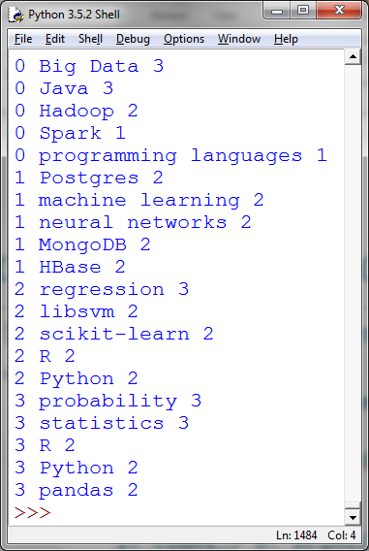
Topic Modeling (cont.)
Now we can check the five most heavily weighted words for each:
for k, word_counts in enumerate(topic_word_counts):
c = 0
for word, count in word_counts.most_common():
c += 1
if c > 5: break
if count > 0:
print(k, word, count)
The previous code fragments are combined in
lec13/nlp06.py

Slide 42
Topic Modeling (cont.)
So far the topics are just numbers 0, 1 , 2, and 3.
We assign a topic name to each of them:
>>> topic_names = ["Big Data and programming languages", "Python and statistics", "databases", "machine learning"]
Then we can see how the model assigns topics to each user’s interests:
>>> for document, topic_counts in zip(documents, document_topic_counts):
print(document)
for topic, count in topic_counts.most_common():
if count > 0:
print(topic_names[topic], count, '', end='')
print()

Slide 43
Topic Modeling (cont.)
The code gives:
['Hadoop', 'Big Data', 'HBase', 'Java', 'Spark', 'Storm', 'Cassandra']
Big Data and programming languages 7
['NoSQL', 'MongoDB', 'Cassandra', 'HBase', 'Postgres']
Python and statistics 5
['Python', 'scikit-learn', 'scipy', 'numpy', 'statsmodels', 'pandas']
Python and statistics 2 databases 2 machine learning 2
...
['databases', 'HBase', 'Postgres', 'MySQL', 'MongoDB']
Python and statistics 5
['libsvm', 'regression', 'support vector machines']
databases 3

Slide 44
Self Study Guide

Slide 45
Self Study Guide
Reference
Joel Grus (2015). Data Science from Scratch, O’Reilly. (Read Ch. 20)
Steven Bird, Ewan Klein, and Edward Loper (2009). Natural Language Processing with Python, O’Reilly . (Read Ch. 1)
Online Resources:
http://nltk.org/
http://www.nltk.org/book/
http://radimrehurek.com/gensim/

