Slide 1
Lecture 9 Data Aggregation
ITP4869 Analysis with Programming Tools
(AY 2018/19)
Dr. Johnny Cheng

Slide 2
Lessons Intended Learning Outcomes
On completion of this lesson, students are expected to be able to:
Identify the operations in data aggregation.
Compute group summary statistics.
Apply group-wise transformations.
Compute pivot tables and cross-tabulation.

Slide 3
Introduction
GroupBy Mechanics
Aggregation
Splitting, Applying and Combining
Pivot Tables and Cross-Tabulation

Slide 4
Data Aggregation
Categorizing a data set and applying a function to each group is often a critical component of a data analysis workflow.
pandas provides a flexible and high-performance groupby facility, enabling us to slice and dice, and summarize data sets in a natural way.
With the expressiveness and power of Python and pandas, we can perform complex grouped operations by utilizing any function that accepts a pandas object or NumPy array.

Slide 5
GroupBy Mechanics
GroupBy Mechanics
GroupBy on DataFrames
GroupBy on Dict and Series

Slide 6
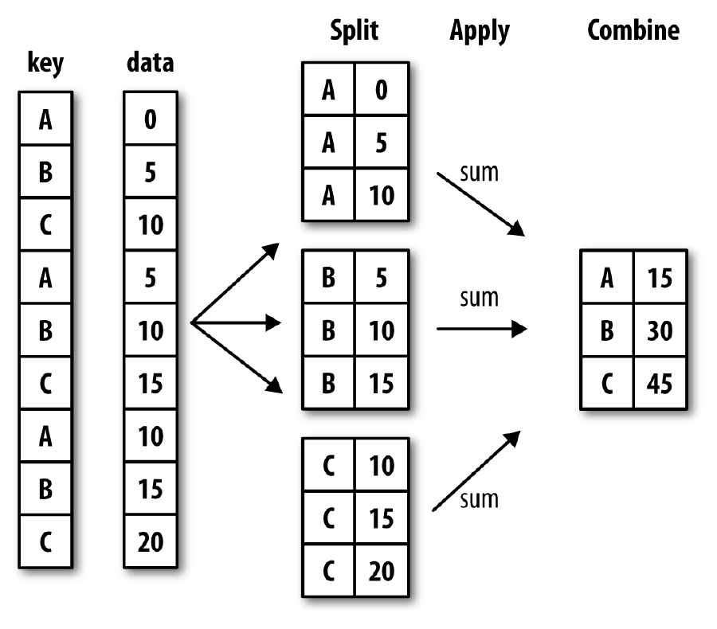
GroupBy Mechanics
Group operations can be described as a split-apply-combine process, as illustrated below:

Slide 7
GroupBy Mechanics (cont.)
Each grouping key can take many forms, and the keys do not have to be all of the same type:
A list or array of values that is the same length as the axis being grouped
A value indicating a column name in a DataFrame
A dict or Series giving a correspondence between the values on the axis being grouped and the group names
A function to be invoked on the axis index or the individual labels in the index
We will look at the examples of all of these methods in this lesson.

Slide 8
GroupBy on DataFrames
Let’s start a group operation on a DataFrame:
>>> df = DataFrame({'key1':['X','X','Y','Y','Z'],
'key2':['alpha','beta','alpha','beta','alpha'],
'data1':np.random.randn(5),
'data2':np.random.randn(5)})
>>> df
data1 data2 key1 key2
0 0.266415 -2.132725 X alpha
1 1.083685 0.542522 X beta
2 0.303349 -0.225276 Y alpha
3 -1.107238 2.750476 Y beta
4 -0.976152 1.703181 Z alpha

Slide 9
GroupBy on DataFrames (cont.)
Now we want to compute the mean of the data1 column using the group label key1:
>>> group1 = df['data1'].groupby(df['key1'])
>>> group1
<pandas.core.groupby.SeriesGroupBy object at 0x013B69D0>
>>> group1.mean()
key1
X 0.675050
Y -0.401945
Z -0.976152
Name: data1, dtype: float64

Slide 10
GroupBy on DataFrames (cont.)
We can use group keys that are series as well:
>>> cities = np.array(['NY','LA','LA','NY','NY'])
>>> month = np.array(['Jan','Feb','Jan','Feb','Jan'])
>>> df['data1'].groupby([cities,month]).mean()
LA Feb 1.083685
Jan 0.303349
NY Feb -1.107238
Jan -0.354869
Name: data1, dtype: float64

Slide 11
GroupBy on DataFrames (cont.)
We can also pass column names as group keys:
>>> df.groupby('key1').mean()
data1 data2
key1
X 0.675050 -0.795101
Y -0.401945 1.262600
Z -0.976152 1.703181
>>> df.groupby(['key1','key2']).mean()
data1 data2
key1s key2
X alpha 0.266415 -2.132725
beta 1.083685 0.542522
Y alpha 0.303349 -0.225276
beta -1.107238 2.750476
Z alpha -0.976152 1.703181

Slide 12
GroupBy on DataFrames (cont.)
Another useful groupby method is getting the group sizes:
>>> df.groupby(['key1']).size()
key1
X 2
Y 2
Z 1
dtype: int64
>>> df.groupby(['key2']).size()
key2
alpha 3
beta 2
dtype: int64

Slide 13
GroupBy on DataFrames (cont.)
We can also iterate over groups:
>>> for name, group in df.groupby('key1'):
print("This is the %s group" %name)
print(group, '\n')
This is the X group
data1 data2 key1 key2
0 0.266415 -2.132725 X alpha
1 1.083685 0.542522 X beta
This is the Y group
data1 data2 key1 key2
2 0.303349 -0.225276 Y alpha
3 -1.107238 2.750476 Y beta
This is the Z group
data1 data2 key1 key2
4 -0.976152 1.703181 Z alpha

Slide 14
GroupBy on DataFrames (cont.)
Iterate with multiple keys:
>>> for (key1,key2), group in df.groupby(['key1','key2']):
print("Key1 = %s Key2 = %s" %(key1,key2))
print(group, '\n')
Key1 = X Key2 = alpha
data1 data2 key1 key2
0 0.266415 -2.132725 X alpha
Key1 = X Key2 = beta
data1 data2 key1 key2
1 1.083685 0.542522 X beta
Key1 = Y Key2 = alpha
data1 data2 key1 key2
2 0.303349 -0.225276 Y alpha
Key1 = Y Key2 = beta
data1 data2 key1 key2
3 -1.107238 2.750476 Y beta
Key1 = Z Key2 = alpha
data1 data2 key1 key2
4 -0.976152 1.703181 Z alpha

Slide 15
GroupBy on DataFrames (cont.)
A possibly useful tactic is creating a dictionary of the data pieces:
>>> group_dict = dict(list(df.groupby('key1')))
>>> group_dict['X']
data1 data2 key1 key2
0 0.266415 -2.132725 X alpha
1 1.083685 0.542522 X beta
>>> group_dict
{'Z': data1 data2 key1 key2
4 -0.976152 1.703181 Z alpha,
'Y': data1 data2 key1 key2
2 0.303349 -0.225276 Y alpha
3 -1.107238 2.750476 Y beta,
'X': data1 data2 key1 key2
0 0.266415 -2.132725 X alpha
1 1.083685 0.542522 X beta }

Slide 16
GroupBy on DataFrames (cont.)
By default groupby groups on axis=0 (rows), but we can group on any of the axes.
We can group the columns by dtype:
>>> df.dtypes
data1 float64
data2 float64
key1 object
key2 object
dtype: object

Slide 17
GroupBy on DataFrames (cont.)
>>> group2 = df.groupby(df.dtypes, axis=1)
>>> dict(list(group2))
{dtype('O'): key1 key2
0 X alpha
1 X beta
2 Y alpha
3 Y beta
4 Z alpha,
dtype('float64'): data1 data2
0 0.266415 -2.132725
1 1.083685 0.542522
2 0.303349 -0.225276
3 -1.107238 2.750476
4 -0.976152 1.703181}

Slide 18
GroupBy on Dict and Series
Now we use dictionary or Series with groupby.
Consider the DataFrame:
>>> animals = DataFrame(np.arange(16).reshape(4, 4),
columns=['W', 'X', 'Y', 'Z'],
index=['Dog', 'Cat', 'Bird', 'Mouse'])
>>> animals.loc[1:2, ['W', 'Y']] = np.nan
>>> animals
W X Y Z
Dog 0.0 1 2.0 3
Cat NaN 5 NaN 7
Bird 8.0 9 10.0 11
Mouse 12.0 13 14.0 15

Slide 19
GroupBy on Dict and Series (cont.)
Now we make a dictionary with behavior values in it:
>>> behavior_map = {'W': 'good', 'X': 'bad', 'Y': 'good','Z': 'bad'}
Then we can groupby using this mapping and apply sum operation:
>>> animal_col = animals.groupby(behavior_map, axis=1)
>>> animal_col.sum()
bad good
Dog 4.0 2.0
Cat 12.0 NaN
Bird 20.0 18.0
Mouse 28.0 26.0
groupby column values
[Bird][good] = [Bird][W] + [Bird][Y]

Slide 20
GroupBy on Dict and Series (cont.)
We try it with a Series:
>>> behav_series = Series(behavior_map)
>>> behav_series
W good
X bad
Y good
Z bad
dtype: object
Now we groupby the Series:
>>> animals.groupby(behav_series, axis=1).count()
bad good
Dog 2 2
Cat 2 0
Bird 2 2
Mouse 2 2

Slide 21
GroupBy on Dict and Series (cont.)
We can groupby the length of the animal names:
>>> animals.groupby(len).sum()
W X Y Z
3 0.0 6 2.0 10
4 8.0 9 10.0 11
5 12.0 13 14.0 15
We can also mix functions with arrays, dicts, and Series for groupby methods:
>>> keys = ['A', 'B', 'A', 'B']
>>> animals.groupby([len, keys]).max()
W X Y Z
3 A 0.0 1 2.0 3
B NaN 5 NaN 7
4 A 8.0 9 10.0 11
5 B 12.0 13 14.0 15

Slide 22
GroupBy on Dict and Series (cont.)
We can groupby can also be applied with hierarchical index levels:
>>> hier_col = pd.MultiIndex.from_arrays([['NY','NY','NY','HK','HK'], [1,2,3,1,2]], names=['City','sub_value'])
>>> df_hr = DataFrame(np.arange(25).reshape(5,5),columns=hier_col)
>>> df_hr = df_hr*100
>>> df_hr
City NY HK
sub_value 1 2 3 1 2
0 0 100 200 300 400
1 500 600 700 800 900
2 1000 1100 1200 1300 1400
3 1500 1600 1700 1800 1900
4 2000 2100 2200 2300 2400

Slide 23
GroupBy on Dict and Series (cont.)
To group by level, pass the level number or name using the level keyword:
>>> df_hr.groupby(level=‘City', axis=1).count()
City HK NY
0 2 3
1 2 3
2 2 3
3 2 3
4 2 3

Slide 24
Data Aggregation

Slide 25
Data Aggregation
Data aggregation consists of operations that result in a scalar, such as mean, sum and count.
Optimized groupby methods are shown as below:
Function | Description
count | Number of non-NA values in the group
sum | Sum of non-NA values
mean | Mean of non-NA values
median | Arithmetic median of non-NA values
std, var | Unbiased (n - 1 denominator) standard deviation and variance
min, max | Minimum and maximum of non-NA values
prod | Product of non-NA values
first, last | First and last non-NA values

Slide 26
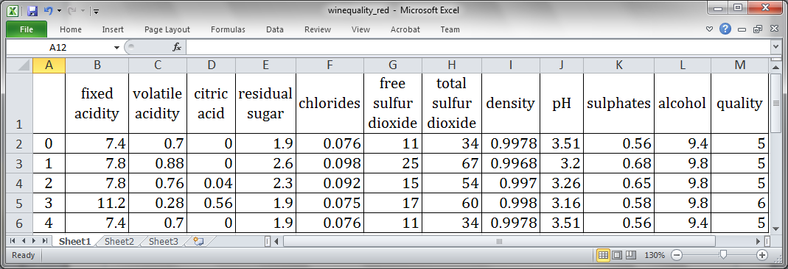
Data Aggregation (cont.)
Consider the DataFrame created from a CSV file:
>>> df_wine = pd.read_csv('winequality_red.csv', sep=';')
The first few rows of the file are shown:

Slide 27
Data Aggregation (cont.)
We find out the average alcohol content for the wine:
>>> df_wine['alcohol'].mean()
10.422983114446529
We can create our own aggregation function:
>>> def max_to_min(arr):
return arr.max() ‐ arr.min()
>>> # Let's group the wines by "quality"
>>> wino = df_wine.groupby('quality')
To use our own aggregation functions, pass the function that aggregates an array to the aggregate or agg method:
>>> wino.agg(max_to_min)
An example of an aggregation

Slide 28
Data Aggregation (cont.)
We can also pass string methods through aggregate:
>>> wino.agg('mean')
We can add quality to alcohol content ratio:
>>> df_wine['qual/alc ratio'] = df_wine['quality'] / df_wine['alcohol']
>>> df_wine.head()
 | fixed acidity | volatile acidity | citric acid | residual sugar | … | alcohol
quality
3 | 4.9 | 1.14 | 0.66 | 4.5 | … | 2.6
4 | 7.9 | 0.9 | 1 | 11.6 | … | 4.1
5 | 10.9 | 1.15 | 0.79 | 14.3 | … | 6.4
6 | 9.6 | 0.88 | 0.78 | 14.5 | … | 5.6
7 | 10.7 | 0.795 | 0.76 | 7.7 | … | 4.8
8 | 7.6 | 0.59 | 0.69 | 5 | … | 4.2
Check the added column

Slide 29
Splitting, Applying and Combining

Slide 30
Splitting, Applying and Combining
The most general purpose GroupBy method is apply.
apply splits the object being manipulated into pieces, invokes the passed function on each piece, then attempts to concatenate the pieces together.
Recalling the wine data example:
>>> df_wine = pd.read_csv('winequality_red.csv', sep=';')
Create a function that assigns a rank to each wine based on alcohol content, , with 1 being the highest alcohol content.
def ranker(df):
df['alc_content_rank'] = np.arange(len(df)) + 1
return df

Slide 31
Splitting, Applying and Combining (cont.)
Now we sort the dframe by alcohol in ascending order:
>>> df_wine.sort_values(by='alcohol', inplace=True)
Now we group by quality and apply our ranking function:
>>> df_wine = df_wine.groupby('quality').apply(ranker)
>>> df_wine.head()
... alcohol quality qual/alc ratio alc_content_rank
517 8.4 3 0.357143 1
544 8.4 6 0.714286 1
1436 8.5 5 0.588235 1
528 8.7 6 0.689655 2
371 8.7 6 0.689655 3

Slide 32
Splitting, Applying and Combining (cont.)
Now we get the number of quality counts:
>>> num_of_qual = df_wine['quality'].value_counts()
>>> num_of_qual
5 681
6 638
7 199
4 53
8 18
3 10
Name: quality, dtype: int64

Slide 33
Splitting, Applying and Combining (cont.)
Now we select the wines where alc_content_rank == 1:
>>> df_wine[df_wine.alc_content_rank == 1]
... alcohol quality qual/alc ratio alc_content_rank
517 8.4 3 0.357143 1
544 8.4 6 0.714286 1
1436 8.5 5 0.588235 1
18 9.0 4 0.444444 1
243 9.2 7 0.760870 1
440 9.8 8 0.816327 1

Slide 34
Pivot Tables and Cross-Tabulation

Slide 35
Pivot Tables
A pivot table is a data summarization tool that aggregates a table of data by one or more keys.
It arranging the data in a rectangle with some of the group keys along the rows and some along the columns.
Consider the data set about tipping:
>>> tips = pd.read_csv('tips.csv')
>>> tips['tip_pct'] = tips['tip'] / tips['total_bill']
>>> tips[:6]
total_bill tip sex smoker day time size tip_pct
0 16.99 1.01 Female No Sun Dinner 2 0.059447
1 10.34 1.66 Male No Sun Dinner 3 0.160542
2 21.01 3.50 Male No Sun Dinner 3 0.166587
3 23.68 3.31 Male No Sun Dinner 2 0.139780
4 24.59 3.61 Female No Sun Dinner 4 0.146808
5 25.29 4.71 Male No Sun Dinner 4 0.186240

Slide 36
Pivot Tables (cont.)
Compute a table of group means arranged by sex and smoker on the rows:
>>> tips.pivot_table(index=['sex', 'smoker'])
size tip tip_pct total_bill
sex smoker
Female No 2.592593 2.773519 0.156921 18.105185
Yes 2.242424 2.931515 0.182150 17.977879
Male No 2.711340 3.113402 0.160669 19.791237
Yes 2.500000 3.051167 0.152771 22.284500
Default aggregation

Slide 37
Pivot Tables (cont.)
Suppose we want to aggregate only tip_pct and size, and additionally group by day.
>>> tips.pivot_table(['tip_pct', 'size'], index=['sex', 'day'], columns='smoker')
tip_pct size
smoker No Yes No Yes
sex day
Female Fri 0.165296 0.209129 2.500000 2.000000
Sat 0.147993 0.163817 2.307692 2.200000
Sun 0.165710 0.237075 3.071429 2.500000
Thur 0.155971 0.163073 2.480000 2.428571
Male Fri 0.138005 0.144730 2.000000 2.125000
Sat 0.162132 0.139067 2.656250 2.629630
Sun 0.158291 0.173964 2.883721 2.600000
Thur 0.165706 0.164417 2.500000 2.300000

Slide 38
Cross-Tabulation
A cross-tabulation (or crosstab for short) is a special case of a pivot table that computes group frequencies.
Consider the data set:
>>> data = """
Sample Gender Handedness
1 Female Right-handed
2 Male Left-handed
3 Female Right-handed
4 Male Right-handed
5 Male Left-handed
6 Male Right-handed
7 Female Right-handed
8 Female Left-handed
9 Male Right-handed
10 Female Right-handed"""
>>> df = pd.read_table(StringIO(data), sep='\s+')
Include “from io import StringIO”

Slide 39
Cross-Tabulation (cont.)
We want to summarize this data by gender and handedness.
We can use pivot_table to do this, but the pandas.crosstab function is very convenient:
>>> pd.crosstab(df.Gender, df.Handedness,margins=True)
Handedness Left-handed Right-handed All
Gender
Female 1 4 5
Male 2 3 5
All 3 7 10

Slide 40
Cross-Tabulation (cont.)
The first two arguments to crosstab can each either be an array or Series or a list of arrays.
As in the tips data:
>>> pd.crosstab([tips.time, tips.day], tips.smoker, margins=True)
smoker No Yes All
time day
Dinner Fri 3 9 12
Sat 45 42 87
Sun 57 19 76
Thur 1 0 1
Lunch Fri 1 6 7
Thur 44 17 61
All 151 93 244

Slide 41
Self Study Guide

Slide 42
Self Study Guide:
Reference
Wes McKinney (2017). Python for Data Analysis, 2nd ed., O’Reilly. (Read Ch. 10)
Online Resources
http://pandas.pydata.org/pandas-docs/stable/api.html
http://docs.scipy.org/doc/numpy/reference/index.html

