Slide 1
Version Control
It’s a tool that allows you to track all the changes made to a file.
For example, when working on text document over multiple days you can easily view current and previous changes you’ve made to the document.
You can also compare different versions and even merge them together.
How does it do this ?
It creates internal copies of the selected file called versions.
Tools like Microsoft Office and Google Docs use version control to track your saves and changes in documents

Slide 2
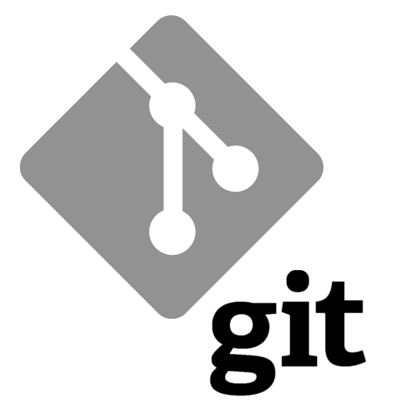
Git Version Control
Git is the most popular version control software available
It’s used commonly by developers, but it is not limited to development
It’s available for Windows, Mac, and Linux operating systems
It’s FREE

