Slide 1

Notes:
Say you have a piece of text – an interesting anonymous article or a mysterious message. You don’t know who wrote it, but you have a list of possible candidates and it’s up to you to use what you learned in 530 and find out who’s the most likely author.

Slide 2

Authorship Identification
Notes:
This is what we call Author Identification – the study of linguistic and computational characteristics of the written documents of individuals.

Slide 3


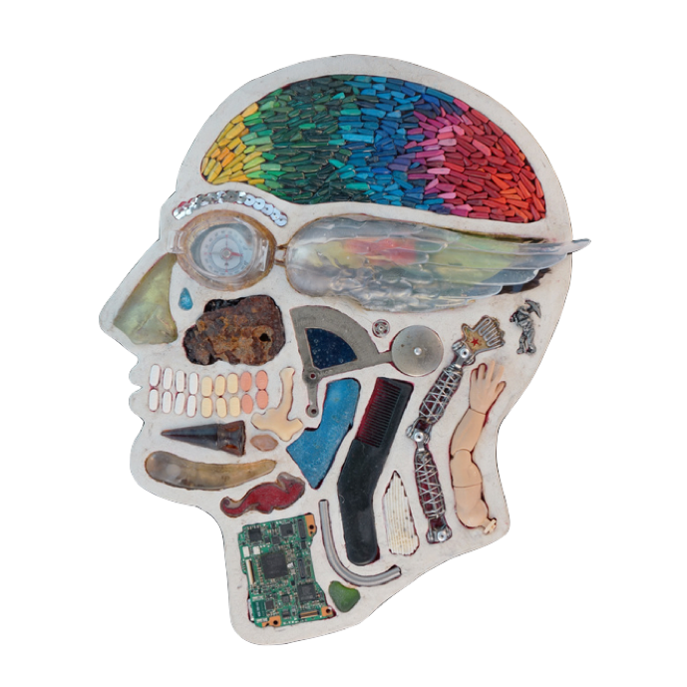


Past Approaches & Data
Experimental Design & Results
The Problem
530 Topics & New Insights
Excited
Team!
Chloe Sheen – Joseph Liu – Mia Mansour – Tina Huang – Worthan Kwan
Notes:
My team will be presenting our project on Authorship Identification. We will first start by diving into what the problem is. We will then present some of our literature review the data sources we considered for the task. We will explain how 530 was useful in creating our model and how we learned new things on the topic. We will then explain the experiments that we designed and the many results we obtained with different model variations of BERT specifically. Finally, we will tell you exactly how much our team was excited to have worked on authorship identification.

Slide 4
Authorship identification is an important Natural Language Processing (NLP) topic. It enables us to identify the most likely author of articles, news or messages. Authorship identification can be applied to tasks such as identifying anonymous author, detecting plagiarism, finding ghost writer.^{[1]}
[1] Qian, He, Zhang (2017)
Notes:
We begin by identifying the problem. Authorship identification is an important Natural Language Processing (NLP) topic. It enables us to identify the most likely author of articles, news or messages. Authorship identification can be applied to tasks such as identifying anonymous author, detecting plagiarism, finding ghost writer.

Slide 5
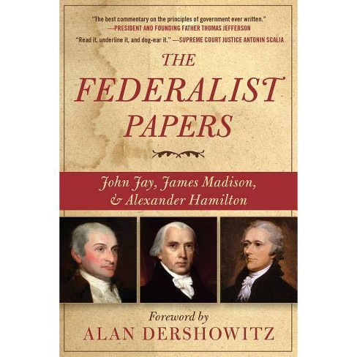
Authors have unique writing styles to their works and are often consistent across topics.
Authorship Identification aka Stylometry
In the late 1780’s, Jay, Madison, and Hamilton wrote a series of anonymous essays to convince New York voters to ratify the new US Constitution.
Notes:
When first learning about authorship identification, we came across the term “stylometry”. Authors have unique writing styles to their works and are often consistent across topics. That means, no matter what topic I choose to write about, my writing style can be detected as my unique “identity”. Authorship identification has been a topic of interest since the 18th century. Jay, Madison, and Hamilton wrote a series of anonymous essays to convince New York voters to ratify the new US Constitution. These are the Federalist papers

Slide 6
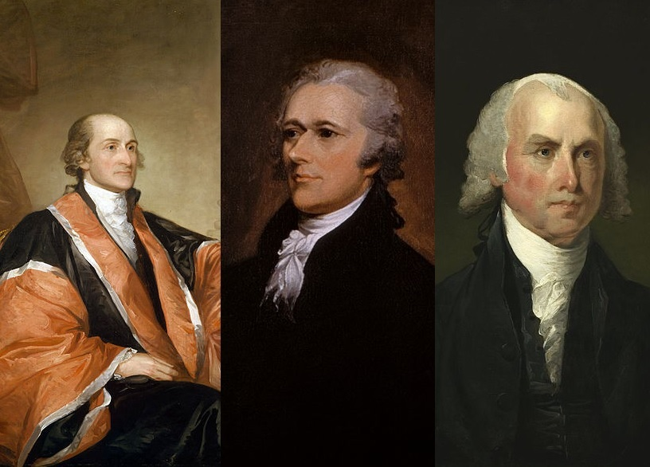
Authors have unique writing styles to their works and are often consistent across topics.
Authorships of the Federalist Papers were attributed to:
12 in dispute between Hamilton & Madison
?
&
Jay
Hamilton
Madison
Notes:
Many scholars have identified the exact author of the Federalist Papers. However, 12 of them were in dispute between Hamilton and Madison and it was impossible to tell which of the two was the true author.

Slide 7
Authors have unique writing styles to their works and are often consistent across topics.
Authorships of the Federalist Papers were attributed to:
Madison
?
✓
In 1963, Mosteller & Wallace^{[2]} solved the problem by identifying function words as good candidates for authorship analysis.
Notes:
In 1963, Mosteller & Wallace solved the problem by identifying function words as good candidates for authorship analysis. This is only one example of how authorship identification began. This topic is now expanding to many current state-of-the-art real-world applications.

Slide 8
Authorship identification is an example of a classification problem.
Authorship identification is..
Applications
Historical scholarship
Plagiarism detection
Investigative forensic identification
Original author of reprinted articles
Similar author recommendations
the process of identifying the author
of an anonymously written document from a group of candidate authors
according to his writing samples (sentences, paragraphs or short articles)^{[1]} and based on his unique writing style (irrelevant of the topic).
[1] Qian, He, Zhang (2017)
Notes:
As a recap, Authorship identification is essentially an example of a classification problem. It is the process of identifying the author of an anonymously written document from a group of candidate authors according to his writing and based on his unique writing style (irrelevant of the topic). Authorship identification can be used for a wide variety of applications including but not limited to historical scholarship, plagiarism detection, investigative forensic identification, original authorship, author recommendation, etc,

Slide 9



There is a wide range of datasets that can be used for authorship identification.
Project Gutenberg
Collection of published works across different genres
Includes author & publication details
English Gigaword
Produced by Linguistic Data Consortium
Comprehensive archive of newswire text data
Four international sources
Reuters 50 50
Subset of RCV1
Collection of English language news stories
Four hierarchical categories
Notes:
To address the problem we began by exploring the wide range of data sources that can be used. The first is Project Gutenberg, which is a collection of published works across many different genres. The second is the English gigaword corpus, produced by the Linguistic Data Consortirum or LDC. And The third is the Reuters 50 50 dataset, a collection of over 800,000 English language news stories. Reuters 5050 is made up of four topical categories: corporate, econ, social, and markets. Our team will be using the Reuters 50 50 dataset to train and test our model.

Slide 10
Our team aggregated multiple approaches when conducting the literature review.
Deep Learning based Authorship Identification
Tweets Classification with BERT for Disaster Management
(Qian et al., 2017)
Reuters 50-50 & Gutenberg
Gradient Boosting Classifier (Baseline) 12.24%
Article-level GRU 69.1% - 89.2%
Article-level LSTM 62.7%
(Ma, 2019)
GloVe Twitter 27B embeddings
Bidirectional LSTM with GloVe embeddings (Baseline) 64%
Default BERT 67%
BERT + Nonlinear Layers 67%
BERT + LSTM 67%
BERT + CNN 67%
Notes:
Our team aggregated multiple approaches when conducting the literature review.
In the first paper Deep Learning based Authorship Identification, the datasets used were both the Reuters 50-50 and Project Gutenberg. The three major models were a GRU (Gated Recurrent Unit) network, LSTM (Long Short Term Memory) network, and a Siamese network. The baseline as presented in this paper with just the Gradient Boosting Classifier on the C50 dataset achieved only an accuracy of 12.24%, which they were able to bring up to an impressive 99.8% using an article-level Siamese network on both datasets, used for verification.
In the second paper, which applies deep learning techniques to address Tweets classification problems in the disaster management field, the authors tested different combinations to achieve a marginally better result of 67% accuracy using BERT with a convolutional neural network.

Slide 11
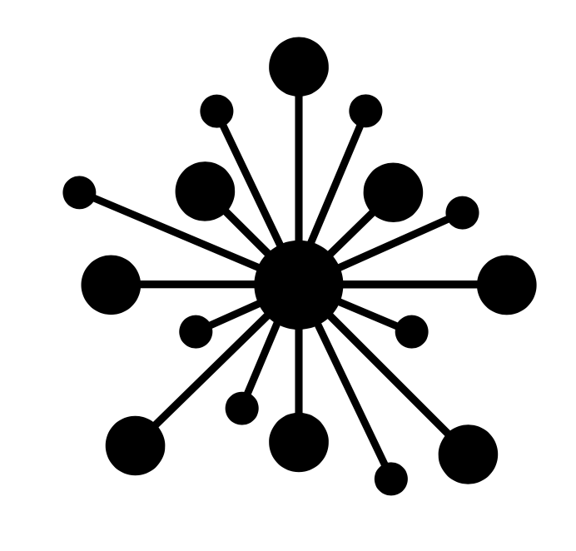


Authorship identification relates to many topics we learned in CIS 530.
Past approaches to authorship identification have included embeddings that we have explored in class, such as Word2Vec and GloVe embeddings
Issue: We have seen that there is a problem with such context-free word embeddings
Solution: train contextual representations on text corpus. Train LSTM Language model, and fine-tune on classification task
Issue: Language understanding is bidirectional
Solution: The approach we are taking (BERT) has been producing state-of-the-art results across most NLP tasks.
Notes:
Authorship identification relates to many topics we learned in CIS 530.
Past approaches to authorship classifications utilized Word2Vec embeddings or using the bag-of-words model. As mentioned in lectures, we have seen that there is a problem with such context-free word embeddings, which was then solved by training contextual representations on text corpus (such as using LSTM and fine-tuning). With BERT, which can be used as an encoder to produce sentence embeddings, and to produce context-based word embeddings, these issues will be taken care of.

Slide 12


The wide range of literature offered our team many insights on this topic.
There is a wide range of authorship classification applications
Plagiarism checking
Identifying most likely authors of anonymous documents
Recommending authors to readers based on the reader’s preferred style of writing
One challenge is to disentangle authorship identification from topic classification
Looking at the style separately from the substance (stylometry)
Splitting training and dev. data to help avoid topic bias
Notes:
The wide range of literature offered our team many insights on this topic. In particular, we noticed the wide application of a seemingly narrow topic of authorship classification, such as identifying most likely authors of documents, plagiarism checking, and as a new way for recommending authors to readers based on the reader’s preferred style of writing.
We also noted that there was a need to make sure to disentangle authorship identification and topic classification while conducting our research.

Slide 13
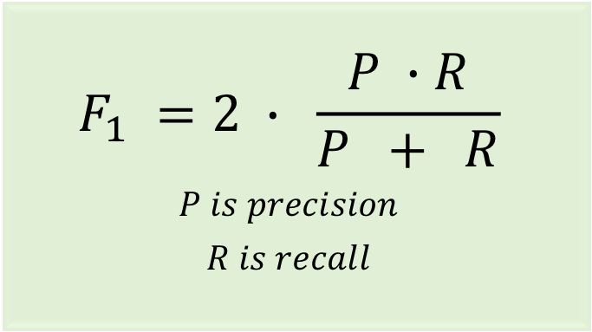
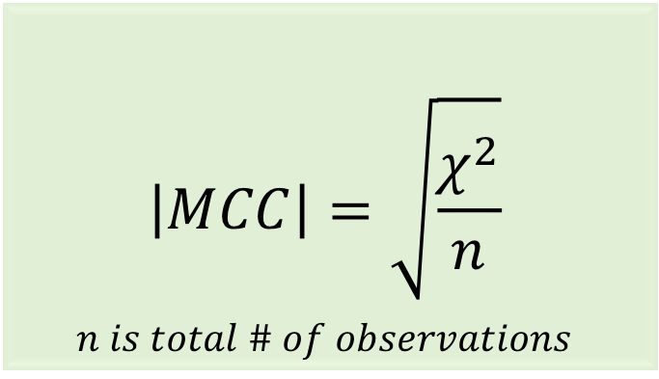
The team selected the dataset to minimize impact of topic on identification.
Disentangling authorship identification and topic classification
At least one subtopic of the class CCAT (corporate/industrial) selected to minimize the topic factor in distinguishing among texts.
Reuters 50 50
5,000 stories by the top 50 authors
8:1:1 train, test, dev split
Notes:
Reuters_50_50 is a subset of Reuters Corpus Volume 1 (RCV1), which is a collection of over 800,000 English language news stories dating from August 20, 1996 to August 19, 1997 that have been made available by Reuters, Ltd. We chose this corpus because it has already been used in author identification experiments [1]. The dataset consists of 5000 stories by the top 50 authors (according to the number of stories written) with at least one subtopic of the class CCAT (corporate/industrial) selected to minimize the topic factor in distinguishing among texts. The average number of words per document is approximately 500. The train/test split is 50:50 with each set consisting of 2,500 texts (50 per author). However, in a similar experiment by Qian et al [1], the dataset was reorganized into a 9:1 train/test split, so in order to benchmark our results accordingly, we also followed this split.
The chosen evaluation metric is F1 score. However, Precision, Recall, Matthews Correlation Coefficient, and Accuracy were also calculated in order to get a more complete view of model performance. Matthews Correlation Coefficient (originally Pearson’s phi coefficient) is a common machine learning metric which uses observed and predicted binary classifications to score a value [-1,1]. -1 represents complete incorrect prediction, 1 represents completely correct prediction, and 0 represents the equivalent of random prediction. The formula for MCC is as follows.

Slide 14
The data was pre-processed for both BERT and non-BERT models.
BERT
Non-BERT
WordPiece Tokenization: break down words & truncate to fit 512 limit
Special tokens: classification [CLS], separation [SEP]
Attention Mask: signals which token to focus on
Bag of Words
Punctuation Removal
Lemmatization
Stopword Removal
Vectorization
TF-IDF
Notes:
Data preprocessing for non-BERT models focused on using techniques such as Bag of Words and TF-IDF. While BERT and its respective encodings are involved in most if not all of the leading author classification models, these other techniques were used in conjunction and independently of BERT.
Bag of Words was developed in several steps
Punctuation Removal
Lemmatization
Stopword Removal
Vectorization (transformation to Bag of Words)
Bag of Words performs best when words are reduced to base form and special characters are removed. Processing data in the way allows models to more easily differentiate between authors without requiring as much data.
TF-IDF was developed using a vectorizer with removal of stopwords and a specified maximum vector size. This was utilized to remove infrequent words which would not be informative to our model.

Slide 15
We have conducted 6 experiments in our search for the best BERT model.
1
Simple Baseline
Published Baseline
BERT & other variations
BERT embeddings + Bag of Words Random Forest
BERT embeddings + Bag of Words XGBoost
BERT embeddings + Bag of Words Neural Net
2
3
4
5
6
Notes:
We have conducted 6 experiments in our search for the best BERT model.
Simple Baseline
Published Baseline
BERT
BERT embeddings + Bag of Words Random Forest
BERT embeddings + Bag of Words XGBoos
BERT embeddings + Bag of Words Neural Net

Slide 16
F₁ score & MCC were used to evaluate both simple and published baselines.
1
2
Simple Baseline
Published Baseline
Assignment of all texts as first author of test set
Bag of words utilizing random forest with 10000 estimators
F1 Measure = 0.02
MCC = 0
F1 Measure = 0.49
Notes:
Our simple baseline assigns all the texts in the test set to the first author of the featured on the test set. This yielded the F1 score of 0.02.
We used the baseline described by Garibay et al. 2015 linked: http://ceur-ws.org/Vol-1391/72-CR.pdf. The published baseline is a bag of words model utilizing random forest with 10000 estimators.
Our published baseline performed at F1 of 0.49.

Slide 17
BERT: We tested on different variations of BERT
3
BERT
bert-base-uncased
12-layer, 768-hidden, 12-heads, 110M parameters, train on lower-cased English
BERT
bert-base-cased
12-layer, 768-hidden, 12-heads, 110M parameters, train on cased English
BERT
bert-large-cased
24-layer, 1024-hidden, 16-heads, 340M parameters, train on cased English
ALBERT
albert-base-v2
12 repeating layers, 128 embedding, 768-hidden, 12-heads, 11M parameters
F1 = 0.616
MCC = 0.615
Accuracy = 0.625
F1 = 0.712-0.734
MCC = 0.713- 0.735
Accuracy = 0.721-0.742
F1 = 0.727
MCC = 0.727
Accuracy = 0.730
F1 = 0.586
MCC = 0.587
Accuracy = 0.599
Notes:
In our search for the best BERT model for the task, we tuned the following hyperparameters and received the following results: Max sequence length: 128 or 512.
Cased or uncased: whether the model was pre-trained or cased or lower-cased English text.
Variations of BERT architecture.
These results were obtained using the AdamW optimizer (Adam with weight decay) and an initial learning rate of 4e-5, which was recommended in the original BERT paper. The learning rate follows a schedule that linearly decreases after linearly increasing during an initial warmup period.Models that have been pre-trained on cased text performed better than models that have been pre-trained on lower-cased text. A higher maximum sequence length confers better performance, although not as much as we’d expect. This seems to indicate that a maximum length of 128 tokens is enough to capture the essence of a writer’s style. Out of all the different architectures, XLM performed the best, which is surprising because XLM was adapted for cross-lingual tasks. However, it also varies the way it does pre-processing, which may explain the difference in results.

Slide 18
BERT: We tested on different variations of BERT
3
Distibert
distilbert-base-cased
6-layer, 768-hidden, 12-heads, 65M parameters, distilled bert-base-cased
XLM – RoBERTa
xlm-roberta-base
12-layer, 768-hidden, 8-heads, ~125M parameters, 2.5 TB CommonCrawl data
XLM
Xlm-mlm-en-2048
12-layer, 2048-hidden, 16-heads, XLM English model
XLNet
xlnet-base-cased
12-layer, 768-hidden, 12-heads, 110M parameters, XLNet English model
F1 = 0.688
MCC = 0.690
Accuracy = 0.706
F1 = 0.001
MCC = 0.000
Accuracy = 0.02
F1 = 0.747- 0.753
MCC = 0.747- 0.756
Accuracy = 0.756-0.762
F1 = 0.723
MCC = 0.728
Accuracy = 0.726
Notes:
In our search for the best BERT model for the task, we tuned the following hyperparameters and received the following results: Max sequence length: 128 or 512.
Cased or uncased: whether the model was pre-trained or cased or lower-cased English text.
Variations of BERT architecture.
These results were obtained using the AdamW optimizer (Adam with weight decay) and an initial learning rate of 4e-5, which was recommended in the original BERT paper. The learning rate follows a schedule that linearly decreases after linearly increasing during an initial warmup period.Models that have been pre-trained on cased text performed better than models that have been pre-trained on lower-cased text. A higher maximum sequence length confers better performance, although not as much as we’d expect. This seems to indicate that a maximum length of 128 tokens is enough to capture the essence of a writer’s style. Out of all the different architectures, XLM performed the best, which is surprising because XLM was adapted for cross-lingual tasks. However, it also varies the way it does pre-processing, which may explain the difference in results.

Slide 19
BERT: We tested on different variations of BERT
3
XLM
Xlm-mlm-en-2048
12-layer, 2048-hidden, 16-heads, XLM English model
Max sequence length: 128 or 512
Cased or Uncased
Variation of BERT architectures
AdamW Optimizer
Learning Rate = 4e-5
F1 = 0.747- 0.753
MCC = 0.747- 0.756
Accuracy = 0.756-0.762
Cased text, 128 sequence length, XLM architecture
✓
Notes:
In our search for the best BERT model for the task, we tuned the following hyperparameters and received the following results: Max sequence length: 128 or 512.
Cased or uncased: whether the model was pre-trained or cased or lower-cased English text.
Variations of BERT architecture.
These results were obtained using the AdamW optimizer (Adam with weight decay) and an initial learning rate of 4e-5, which was recommended in the original BERT paper. The learning rate follows a schedule that linearly decreases after linearly increasing during an initial warmup period.Models that have been pre-trained on cased text performed better than models that have been pre-trained on lower-cased text. A higher maximum sequence length confers better performance, although not as much as we’d expect. This seems to indicate that a maximum length of 128 tokens is enough to capture the essence of a writer’s style. Out of all the different architectures, XLM performed the best, which is surprising because XLM was adapted for cross-lingual tasks. However, it also varies the way it does pre-processing, which may explain the difference in results.

Slide 20
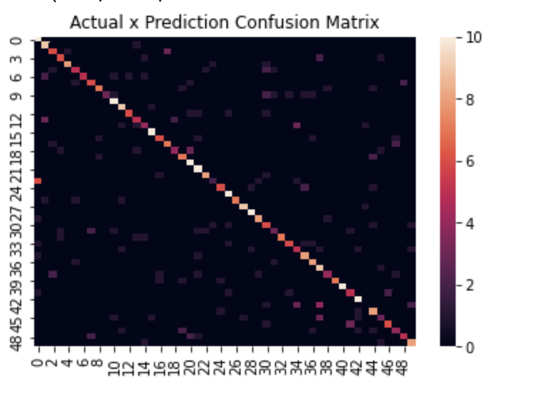
BERT Embedding + Bag of Words Random Forest.
4
Actual X Predicted Authors Confusion Matrix
Model | F1-Score
Bag of Words Baseline | 0.49
BERT Embeddings + Bag of Words (estimators = 100) | 0.67
BERT Embeddings + Bag of Words (estimators = 1000) | 0.68
✓
Some authors are especially prone to be miscategorized.
Notes:
Next, we combined the BERT embeddings with the bag of words representations as features for a simple random forest model. The BERT embeddings significantly improved our model from the previously recorded F1 of 0.49 baseline. We heuristically performed hyperparameter tuning, yielding the best results of X. Results are illustrated in the table.
The following figure is a confusion matrix for the actual X predicted authors for the texts.
There are some authors that are especially prone to be miscategorized

Slide 21
BERT Embedding + Bag of Words XGBoost.
5
We used the BERT embeddings and bag of words as features for the XGBoost model, with the following parameters:
Learning Rate = 0.1
Maximum Depth = 8
Minimum Child Weight = 7
Gamma = 0.1
Subsample ratio of columns for tree construction, colsample_bytree = 0.4
The model yields an F-1 score of 0.69
✓
Notes:
Similarly, we used the BERT embeddings and bag of words as features for the XGBoost model. We performed a random search for the hyperparameter tuning of learning rate, maximum depth, minimum child weight, gamma, and the subsample ratio of columns when constructing each tree. These parameters and their search space were from https://github.com/krishnaik06/Diabetes-Prediction/blob/master/Diabetes_Prediction.ipynb. The results of the random search yielded the following best parameter values:
Learning rate = 0.1
Maximum depth = 8
Minimum child weight = 7
Gamma = 0.1
colsample_bytree = 0.4
The model yielded a F1 score of 0.69.

Slide 22
BERT Embedding + Bag of Words Neural Net: Comes down to 2 methods.
6
We used the BERT sentence embeddings as features in combination with a bag of words in simple forward-feed neural net:
A
Method A.
Separate Embedding & Classification
Method B.
End-to-end Embedding & Classification
B
Notes:
In our final experiment we used the sentence embeddings outputted by BERT as features in combination with a bag of words and fed them into a simple forward-feed neural net. We tested two ways of implementing this. The first method maintains a degree of separation between BERT and the neural net. The second method combines embedding and classification within a single neural net to form an end-to-end differentiable classifier.

Slide 23
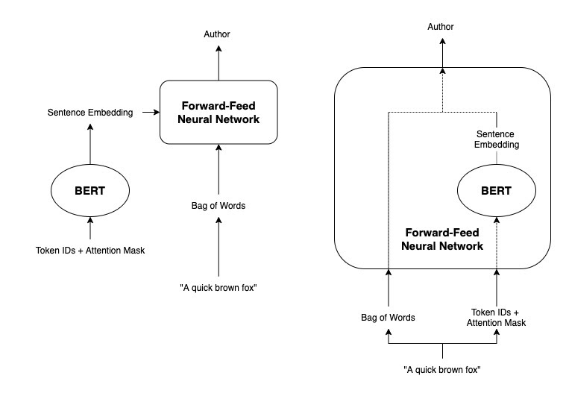
BERT Embedding + Bag of Words Neural Net: A Degree of Separation.
6
A
BERT model pre-trained on cased test with max sequence length of 128. Single embedding vector of size 768 + bag of words to feed to NN.
NN
Layers: 1 hidden layer with ReLU activation & dropout layer (p=0.5)
Loss Function: Cross Entropy Loss
Hyperparameters
Optimizer: Adam
Learning Rate: 0.001
Epochs: 100
Precision 0.841 | Recall 0.828 | F1 Score 0.826 | MCC 0.827 | Accuracy 0.827
Notes:
keeping embedding and classification separate.
For our first implementation, a standard BERT model pre-trained on cased English text with a max sequence length of 128 was fine-tuned on our classification task. We then took an average of the 128 output embedding vectors to obtain a single embedding vector of size 768 that we combined with bag of words to feed into a neural net. The neural net consisted of a single hidden layer with a ReLU activation unit and a dropout layer (p=0.5), which was optimized with cross entropy loss as its loss function. We tested various hyperparameters and found the following settings gave the most stable results:
Optimizer: Adam
Learning rate: .001
Epochs: 100

Slide 24
BERT Embedding + Bag of Words Neural Net: End-to-end differentiable classifier.
6
B
BERT model pre-trained on cased test with max sequence length of 128. BERT as embedding layer in NN to optimize for both embedding & classification.
NN
Layers: 1 hidden layer with ReLU activation & dropout layer (p=0.5)
Loss Function: Cross Entropy Loss
Hyperparameters
Optimizer: Adam
Learning Rate: 4e-5
Gamma = 0.1 every 20
Epochs: 20
Precision 0.901 | Recall 0.886 | F1 Score 0.886 | MCC 0.888 | Accuracy 0.885
✓
✓
Notes:
combining embedding and classification in an end-to-end differentiable neural net.
For the second implementation we decided to incorporate the BERT model as an embedding layer in the neural net so that the neural net can optimize for both embedding and classification. The idea stems from the fact that that the first implementation does not optimize the embedding part in combination with bag of words. Our hope was that by optimizing for both tasks together, we would be able to improve performance.Again, we took a standard BERT model pre-trained on cased English text with a maximum sequence of 128 tokens, but this time the model was not fine-tuned. The BERT model was incorporated as a layer in the neural net, which again, consisted of a single hidden layer with a ReLU activation unit and a dropout layer (p=0.5). We found the following hyperparameters gave the most stable results:
Optimizer: AdamW
Learning rate: 4e-5 with decay rate of gamma=0.1 every 20 steps
Epochs: 20

Slide 25
Our best performing model achieves an F1 Score of 92.9% and MCC of 93.1%.
✓
BERT sentence embeddings as features + bag of words in simple forward-feed neural net
End-to-end embedding & classification method
bert-base-cased with max Sequence Length of 512
AdamW Optimizer, Learning Rate 1e-4, Epochs 20
NN: 1 hidden layer ReLU + dropout (p=0.5), Cross Entropy Loss
6
B
✓
BERT
bert-base-cased
✓
✓
✓
Notes:
Afterfinding the right hyperparameters, we optimizedfor the best BERT model to deliver our best per-formance so far with an accuracy and F1 score of92.9% and an MCC of 93.1%
Our best performing model has:
BERT sentence embeddings as features + bag of words in simple forward-feed neural net
End-to-end embedding & classification method
bert-base-cased with max Sequence Length of 512
Adam Optimizer, Learning Rate 4e-5, Gamma 0.1, Epochs 20
NN: 1 hidden layer ReLU + dropout (p=0.5), Cross Entropy Loss
Thestate-of-the-art performance on a previously pub-lished paper in 2017 (Qian et al., 2017) usingarticle-level GRU achieves a result of 69.1% ac-curacy on the same dataset. Our implementationwas able to reach beyond this performance onthe authorship classification task.

Slide 26
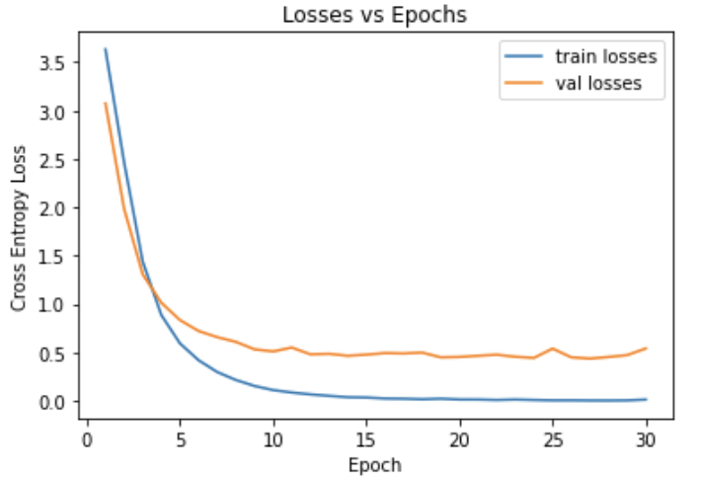
Our best performing model achieves an F1 Score of 92.9% and MCC of 93.1%.
✓
BERT sentence embeddings as features + bag of words in simple forward-feed neural net
Losses vs Epochs
F1 Score 0.929
MCC 0.931
Accuracy 0.929*
–– Train losses
–– Val losses
✓
Attempt to avoid overfitting as much as possible
Cross Entropy Loss
Epoch
* compared to 69.1% (Qian et al., 2017)
Notes:
Afterfinding the right hyperparameters, we optimizedfor the best BERT model to deliver our best per-formance so far with an accuracy and F1 score of92.9% and an MCC of 93.1%
Our best performing model has:
BERT sentence embeddings as features + bag of words in simple forward-feed neural net
End-to-end embedding & classification method
bert-base-cased with max Sequence Length of 512
Adam Optimizer, Learning Rate 4e-5, Gamma 0.1, Epochs 20
NN: 1 hidden layer ReLU + dropout (p=0.5), Cross Entropy Loss
Thestate-of-the-art performance on a previously pub-lished paper in 2017 (Qian et al., 2017) usingarticle-level GRU achieves a result of 69.1% ac-curacy on the same dataset. Our implementationwas able to reach beyond this performance onthe authorship classification task.

Slide 27


Our qualitative error analysis highlights where the model fails to classify authors correctly.
Authors like to use the same sentence.. A lot!
The French government Wednesday called off its controversial sale of state electronics group Thomson SA to Lagardere Groupe but President Jacques Chirac vowed to complete the privatisation.
✓
✓
Shareholders of electronics group Thomson SA rubber-stamped an 11 billion franc ($2.12 billion) state capital injection of Friday as the government reviewed how to relaunch the privatisation process.
"I believe we need a few days to think things over.
Authored by Marcel Michelson

Slide 28
Our qualitative error analysis highlights where the model fails to classify authors correctly.
Authors like to use the same sentence.. A lot!
The French government on Wednesday called off a controversial sale of the state electronics group Thomson SA to Lagardere Groupe but President Jacques Chirac vowed to bring the sell-off to fruition.
✓
✓
The French government on Wednesday called off the controversial sale of electronics group Thomson SA in a major policy U-turn after weeks of staunchly defending its choice of buyer.
Authored by Marcel Michelson

Slide 29
Our qualitative error analysis highlights where the model fails to classify authors correctly.
Authors like to use the same sentence.. A lot!
The French government called off the controversial sale of electronics group Thomson SA Wednesday in a major policy reversal after weeks of staunchly defending its controversial choice of a buyer.
✓
Within a few years, some two million severely handicapped people in Europe could communicate with each other over the global Internet using a special eye-movement control to run a personal computer.
𝗫
Authored by Marcel Michelson

Slide 30

Our qualitative error analysis highlights where the model fails to classify authors correctly.
✓
Topic bias still remains..
China gave new details on Wednesday of the failed launch of a satellite aboard its Long March 3B rocket in February, confirming that the cause lay with the new generation launcher.
China has begun shipping corn from key growing areas in the north to other parts of the country, cutting northern stockpiles in a bid to keep weak prices there from falling further.
However, domestic corn prices, already under pressure, were likely to extend their slide, industry officials said on Tuesday.
China vowed on Friday to get tough in its drive to keep banks out of the stock market and accused big financial institutions of fueling a speculative bubble on the nation's bourses.
China on Tuesday rejected Hong Kong Governor Chris Patten's criticism of its proposal to abolish a series of laws in the territory after it reverts to Beijing's control, saying it was an internal affair.
✓
✓
𝗫
Authored by Wiliam Kazer

Slide 31

Our qualitative error analysis highlights where the model fails to classify authors correctly.
Topic bias still remains..
China on Tuesday rejected Hong Kong Governor Chris Patten's criticism of its proposal to abolish a series of laws in the territory after it reverts to Beijing's control, saying it was an internal affair.
𝗫
China's Communist Party boss Jiang Zemin, in a renewed overture to rival Taiwan, urged the island not to set up new obstacles to ties, major Chinese newspapers said on Friday.
Chinese dissident Liu Xiaobo has filed a lawsuit against Beijing authorities for sending him to a labor camp without trial, his wife said on Tuesday. Liu urged Beijing's Xuanwu District Court to overturn a decision by the Beijing Re-education through Labor Committee to send him to a labor camp for three years.
Authored by Wiliam Kazer
Classified as Benjamin Kang Lim

Slide 32

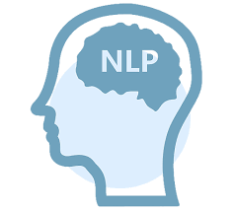

Our team is excited to work on this topic for many reasons.
Explore new NLP techniques & learn about BERT
Identify the patterns that contribute to an author’s style
Learn about many state-of-the-art general-purpose architectures
Discover many exciting real-world applications
Isolate Stylometry from typical topics
Notes:
Our team is very excited to have worked on this topic for many reasons. Authorship identification allows us to discover many exciting real-world applications It allowed us to explore new NLP techniques we haven’t learned in 530, but also explore BERT even further and learn about many state-of-the-art general—purpose architecture. The topic is very fascinating: our team was curious to understand what patterns contribute to an author’s unique style in writing. It was also interesting to isolate and disentangle stylometry from the typical topics the author usually addresses.

Slide 33





Our team is excited to work on this topic for many reasons.
Chloe: Excited to be working on one of the more recent area of NLP research that combines CIS & psycholinguistics!
Mia: This topic has a wide range of current applications such as detecting plagiarized content & forensic identification.
Tina: Interested in the patterns unique to an author & how they remain consistent across topics.
Joseph: I’m very interested in BERT & learning more about leading NLP techniques.
Worthan: Excited to work on a project with so many applications to current real-world problems.
Notes:
We all were equally motivated to be working on this project – and for many reasons. Chloe was excited to be working on one of the more recent area of NLP research. Like her, Joseph was very interested in BERT & learning more about leading NLP techniques. Worthan and I were motivated by the importance of the applications such as detecting plagiarized content & forensic identification. And finally, Tina was really interested in discovering the patterns unique to an author & how these remain consistent across topics.

Slide 34
Authorship Identification
Notes:
All in all, this was a fun project, especially seeing our model perform well. Our team has really enjoyed working on Authorship identification - an important Natural Language Processing (NLP) topic that enables us to identify the author of an anonymously written document based on their unique writing style.

