Slide 1



CHASE Digital Texts Workshop
James Baker
Lecturer in Digital History
This work is licensed under a Creative Commons Attribution-ShareAlike 4.0 International License. Exceptions: logos, embeds to and from external sources and direct quotations

Slide 2
Where to go for help
Your neighbour! And if that fails...
Sticky note up!
@j_w_baker

Slide 3
Schedule
1100-1110 Welcome
1110-1145 Digital Texts as Data
1145-1230 Shell (an approach to working with data)
1230-1315 Lunch
1315-1400 Counting and Mining Texts
1400-1445 Ripping a Text Apart
1445-1530 Finding People and Places
1530-1600 Next Steps
@j_w_baker

Slide 4
Digital Texts as Data
The why (Adam Crymble: Big Data + Old History)
@j_w_baker

Slide 5
Digital Texts as Data
The what
Digitisation of texts (or increasingly born-digital texts)
Metadata about texts
Data that represents texts
@j_w_baker

Slide 6
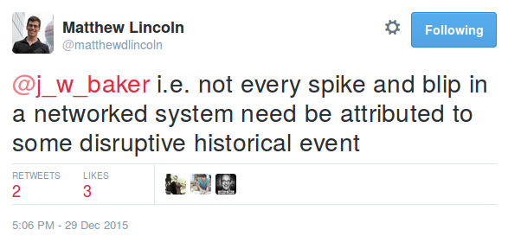
Digital Texts as Data
The how
Trends in the metadata about the texts
Trends in representations of the texts
Trends in the scans of the texts
      … all of which complements our close reading rather than replaces it: https://twitter.com/matthewdlincoln/status/681884035510046720
@j_w_baker

Slide 7
Basics (navigation)
pwd
ls -lh
cd
@j_w_baker

Slide 8
Basics (file interaction)
mv
cp
cat
rm
*
@j_w_baker

Slide 9
Counting and Mining
wc -w -l
>
grep -c
grep -i
grep -v
grep –w
@j_w_baker

Slide 10
Ripping a text apart
Free text exercise
@j_w_baker

Slide 11
Ripping a text apart
tr ' ' '\n' < gulliver-clean.txt | sort | uniq -c > gulliver-final.txt
@j_w_baker

Slide 12
NER (Named Entity Recognition)
Step 1... stanford-ner/ner.sh gulliver-noheadfootpunct.txt > gulliver_ner.txt
Step 2... sed 's/\/O / /g' < gulliver_ner.txt > gulliver_ner-clean.txt
Step 3... egrep -o -f personpattr gulliver_ner-clean.txt | sed 's/\/PERSON//g' | sort | uniq -c | sort -nr > gulliver_ner-pers-freq.txt
@j_w_baker

Slide 13
Where to go next...
Ray & Ray, Unix and Linux: visual quickstart guide, 4th edition (2009)
Invaluable reference guide
The Command Line Crash Course
http://cli.learncodethehardway.org/book/
'Learn Code the Hard Way'
Al Sweigart, Automate the Boring Stuff with Python (2015)
http://automatetheboringstuff.com/
'Practical Programming for Total Beginners'
@j_w_baker

Slide 14
Where to go next...
Coursera Computer Science 101
https://www.coursera.org/course/cs101
'essential ideas of CS for a zero-prior-experience audience'
Programming for Everybody (Python)
https://www.coursera.org/course/pythonlearn
'The basics of programming computers using Python'
The Programming Historian
http://programminghistorian.org/
'a bridge between broad ‘getting started’ portals and generic 'programming’ resources'
@j_w_baker

Slide 15
CHASE Digital Texts Workshop
James Baker
Lecturer in Digital History
This work is licensed under a Creative Commons Attribution-ShareAlike 4.0 International License. Exceptions: logos, embeds to and from external sources and direct quotations

