Slide 1

Transformation and mapping of data
Kamarul Imran Musa
drkamarul@usm.my

Slide 2

Objectives
Understand why we need to transform or map data
How to transform or map data
Reproducibility

Slide 3
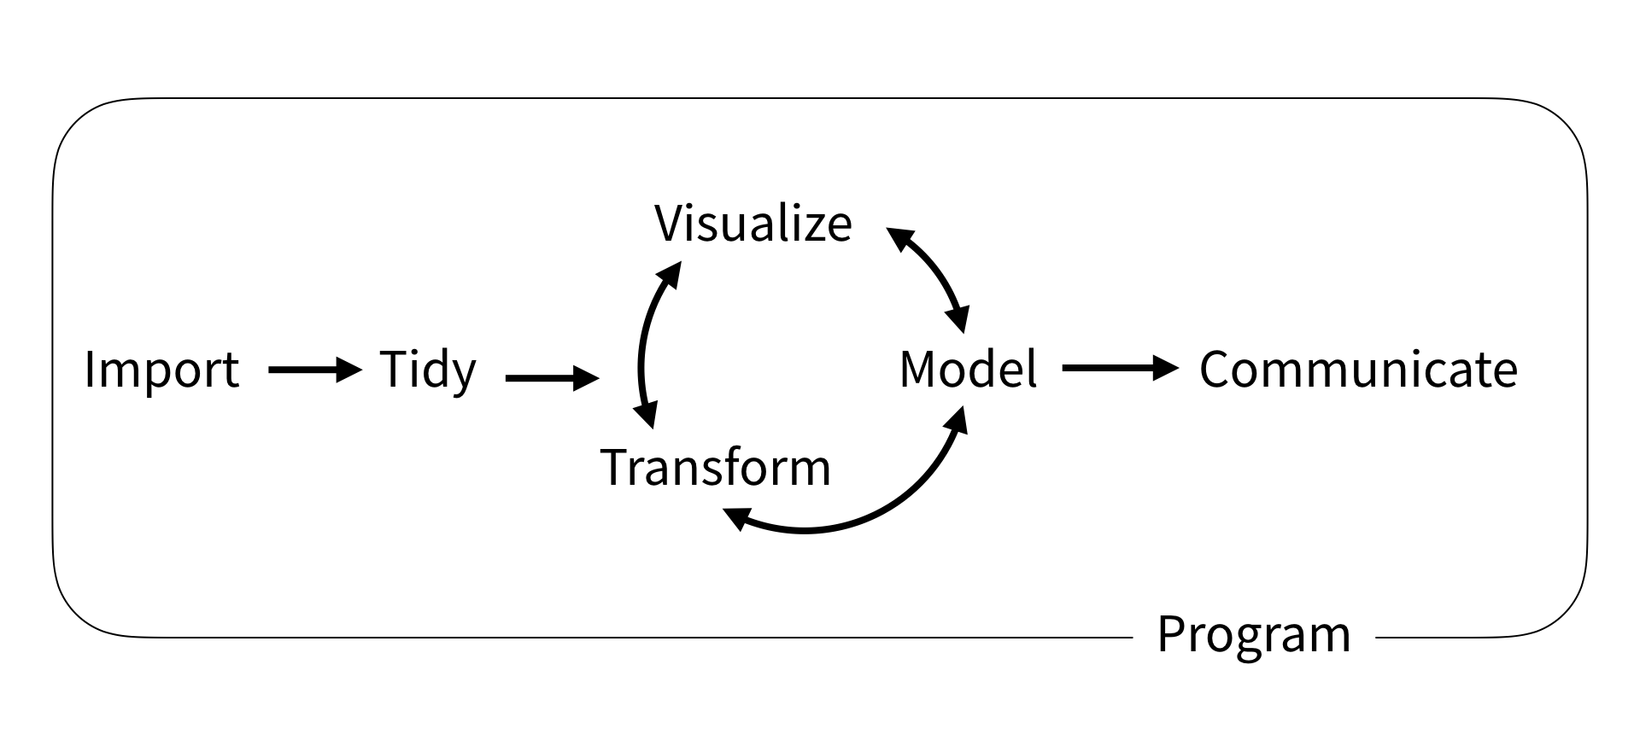
https://rstudio-education.github.io/tidyverse-cookbook/how-to-use-this-book.html

Slide 4
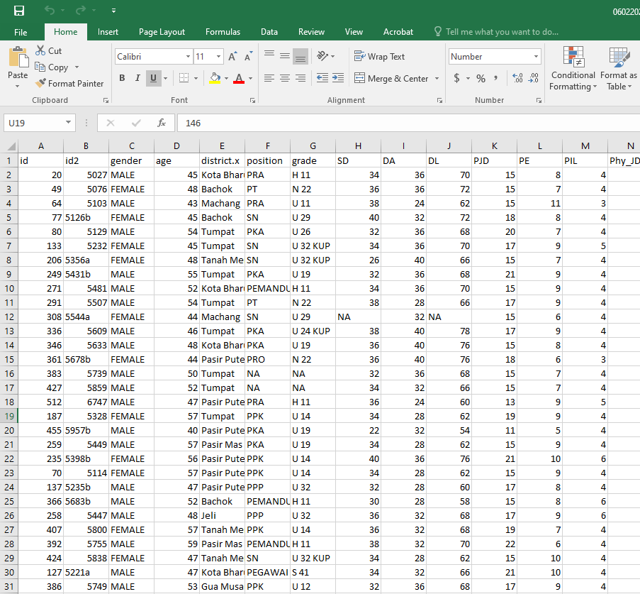
Remember
Data – variables in tabular format
Variables
In columns
Observations
In rows

Slide 5
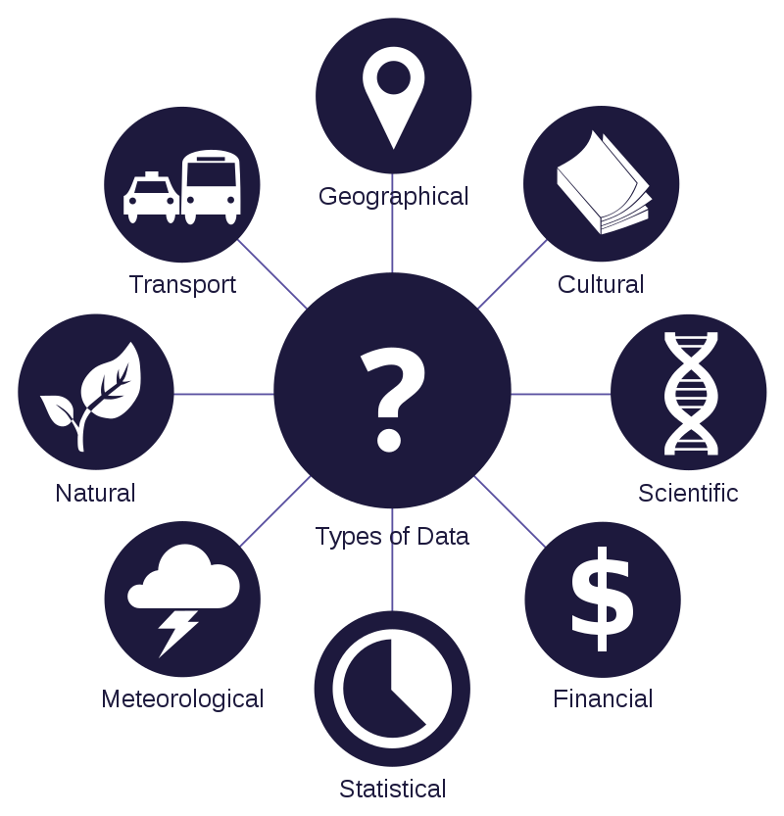
Definition : data
Data are characteristics or information
usually numerical
that are collected through observation.[1]
https://en.wikipedia.org/wiki/Data#/media/File:Data_types_-_en.svg

Slide 6
Data is a set of values of qualitative or quantitative variables
They are about one or more persons or objects, while a datum (singular of data) is single value of a single variable.[2]
https://en.wikipedia.org/wiki/Data#/media/File:Data_types_-_en.svg

Slide 7
Definition : variables
A variable is any characteristics, number, or quantity that can be measured or counted.
https://www.abs.gov.au/websitedbs/a3121120.nsf/home/statistical+language+-+what+are+variables

Slide 8
Types of variables: Numeric
Numeric variables = quantitative variables
'how many' or 'how much'
A continuous variable = height, time, age, and temperature.
A discrete variable is a numeric variable = a value based on a count from a set of distinct whole values.
Examples:
number of registered cars
number of business locations
number of children in a family
https://www.abs.gov.au/websitedbs/a3121120.nsf/home/statistical+language+-+what+are+variables

Slide 9
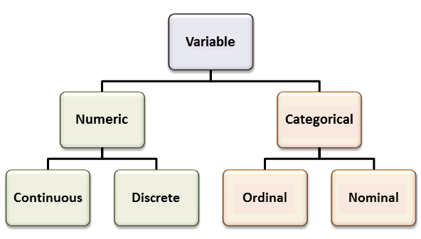
https://www.abs.gov.au/websitedbs/a3121120.nsf/home/statistical+language+-+what+are+variables

Slide 10
Types of variables : Categorical
Categorical variables = have values that describe a 'quality' or 'characteristic' of a data unit
'what type' or 'which category‘
Categorical variables may be further described as ordinal or nominal:
An ordinal variable = a value that can be logically ordered or ranked.
Size = small, medium, large, extra large
Attitudes = strongly agree, agree, disagree, strongly disagree
A nominal variable = NO logical sequence.
Sex = male, female
Business type = insurance, healthcare, retail
Race = Asian, Caucasian, African

Slide 12
Remember
Data – variables in tabular format
Variables
In columns
Observations
In rows

Slide 13
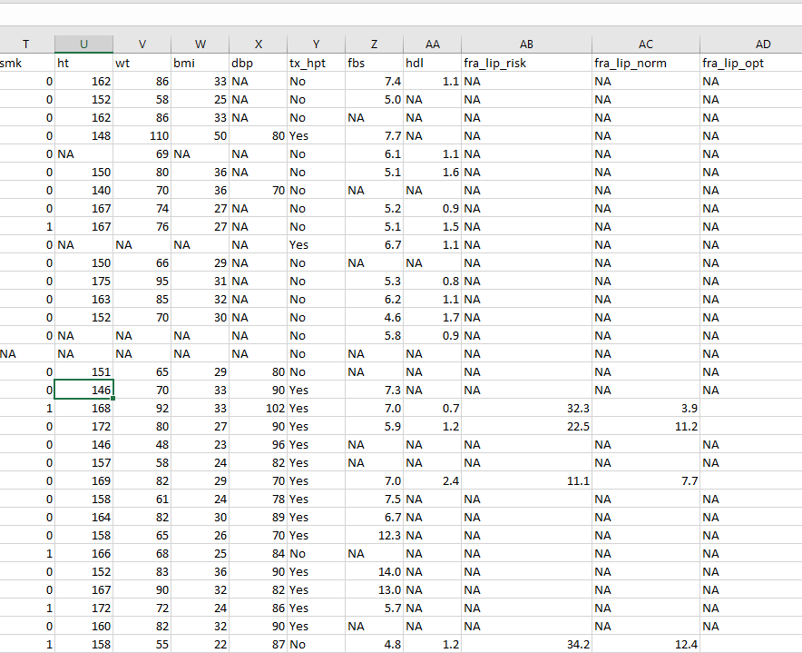
Understand why we need to transform or map data
Not all data come in clean
Most are ‘dirty’
Variables
Many categories
Not categorized
Wrongly categorized
Missing data

Slide 14
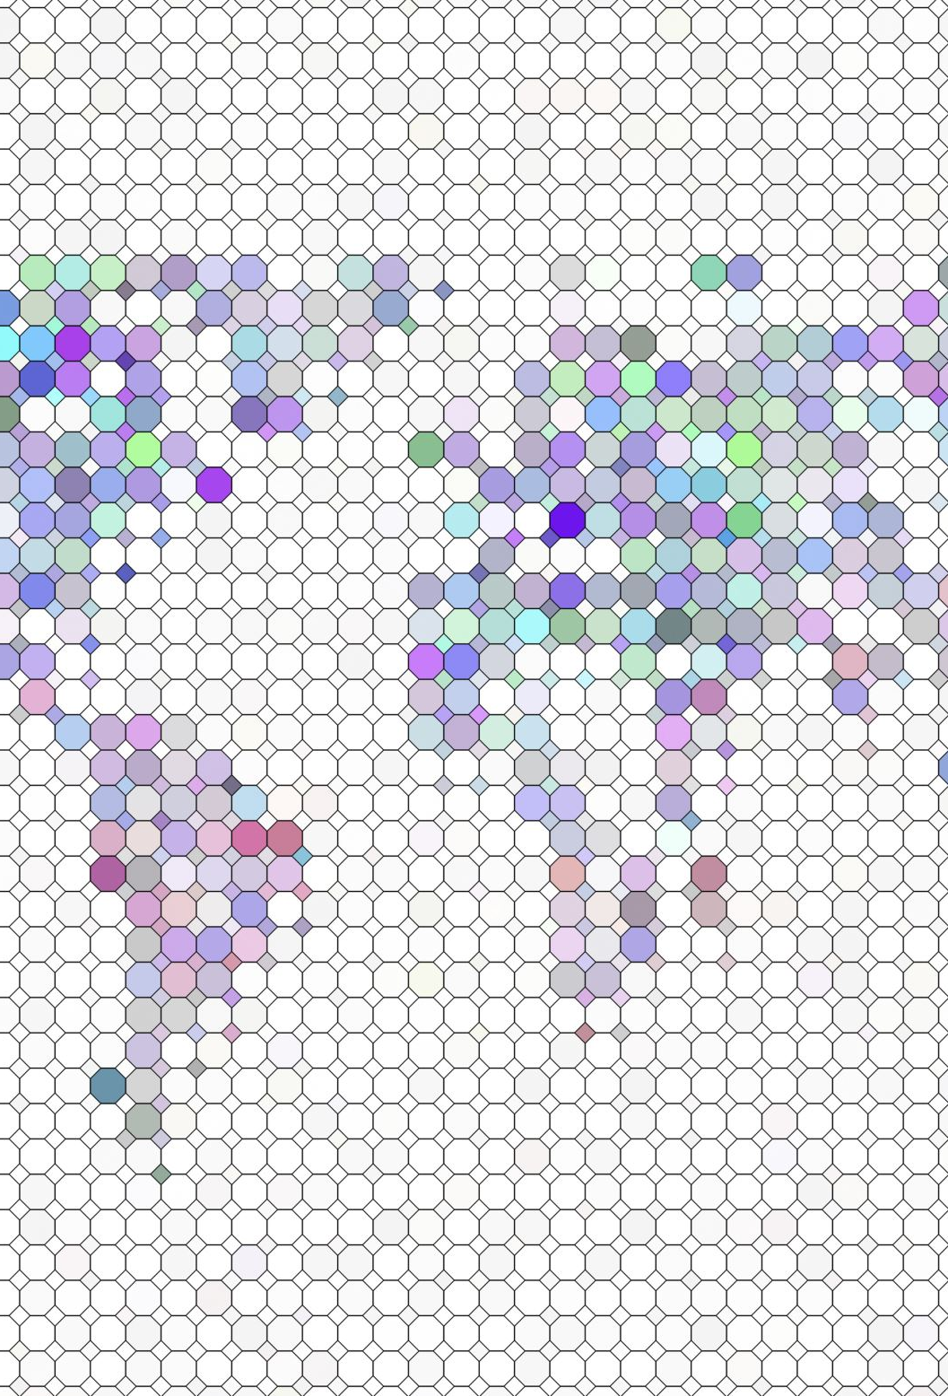
How to transform or map data
Create a new variable
New variable from existing variables
Values in var C = Values in var A + values in var B
Rename an existing variable
Give a new name to a column
Variable age1475ab => var age_30_40

Slide 15
Group categories in a variable
Combine or categorize values or groups in a variable
10 small groups => 3 more meaningful larger groups
Age by 5 years group => age by every 15 years group
Arrange values in a variable
Ascending= arrange values in a variable in ascending order
Descending = arrange values in a variable in descending order

Slide 16
Select some columns in data
To reduce number of columns or variables
Data with 70 columns (variables) => data with 15 columns (variables)
Select some observations in data
To filter observations based on certain criteria
Observations that fulfil =
Sex = FEMALE
AGE = 30-40 age group
RESIDENCE = Urban area

Slide 17
Convert numeric variable to categorical variable
Transform a variable with numeric value to categories
Income per month => income categories (low, high)
Regroup existing categorical variable
From 6 groups (very low, low, mod, high, very high) => 3 groups (low , mod, high)

Slide 18


Reproducibility
You can all those transformation in spreadsheets
But are they reproducible?
Can we check your transformation?

Slide 19

end

