Slide 1
Data Visualization
Kamarul Imran Musa
Associate Professor (Statistics and Epidemiology)
MD, M Community Med, PhD
Email: drkamarul@usm.my
Twitter: https://twitter.com/kamarul_imran
Personal website: www.myanalytics.com.my

Slide 2
What is data visualization
Data visualization or data visualisation is viewed by many disciplines as a modern equivalent of visual communication.
It involves the creation and study of the visual representation of data
This means "information that has been abstracted in some schematic form, including attributes or variables for the units of information".
https://en.m.wikipedia.org/wiki/Data_visualization
Michael Friendly (2008). "Milestones in the history of thematic cartography, statistical graphics, and data visualization".

Slide 3
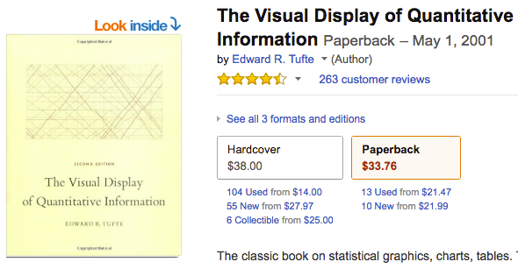
Brief history
In his 1983 book The Visual Display of Quantitative Information, Edward Tufte defines 'graphical displays' and principles for effective graphical display
"Excellence in statistical graphics consists of complex ideas communicated with clarity, precision and efficiency.”

Slide 4
Visualization and graphics
Visualization is the process of
representing data graphically and
interacting with these representations
Why?
to gain insight into the data.
http://researcher.watson.ibm.com/researcher/view_group.php?id=143

Slide 5
What should graphics display?
Data
substance rather than about methodology, graphic design, the technology of graphic production or something else
avoid distorting what the data has to say
present many numbers in a small space

Slide 6
What graphics should display?
make large data sets coherent
encourage the eye to compare different pieces of data
reveal the data at several levels of detail, from a broad overview to the fine structure
serve a reasonably clear purpose: description, exploration, tabulation or decoration
be closely integrated with the statistical and verbal descriptions of a data set.

Slide 7
Graphics in R
R is rich with facilities for creating and developing interesting graphics.
Base R contains functionality for many plot types including coplots, mosaic plots, biplots, and the list goes on.
There are devices such as postscript, png, jpeg and pdf for outputting graphics as well as device drivers for all platforms running R
https://cran.r-project.org/

Slide 8
Packages
Popular
graphics
ggplot2
Lattice
Many other packages

Slide 9
graphics
This package contains functions for ‘base’ graphics.
Base graphics are traditional S-like graphics, as opposed to the more recent grid graphics.
For a complete list of functions with individual help pages, use library(help = "graphics").
https://stat.ethz.ch/R-manual/R-devel/library/graphics/html/graphics-package.html

Slide 10
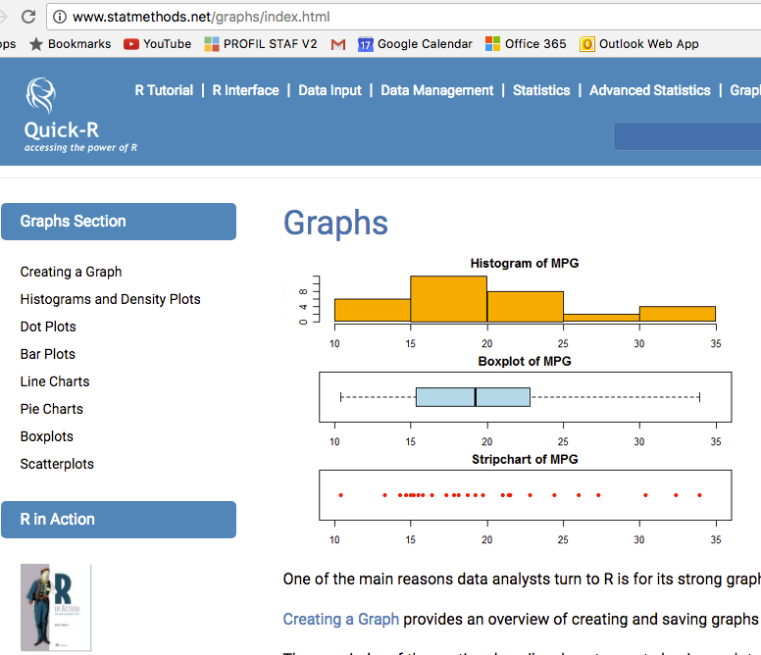
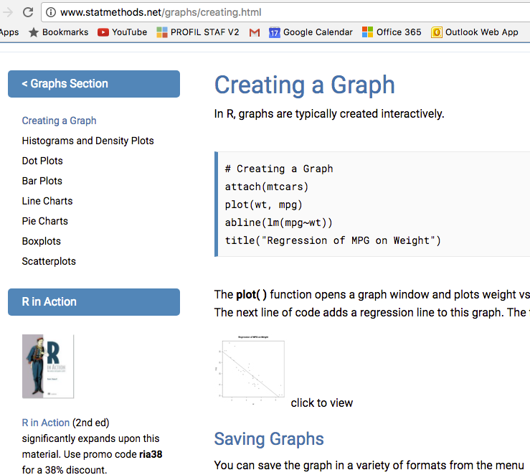
Beginner : graphics
http://www.statmethods.net/graphs/index.html

Slide 11
Hands-on 1
hist()
plot()
dotchart()
barplot()
barplot(, beside = TRUE)
boxplot(VAR1 ~ VAR2)

Slide 12
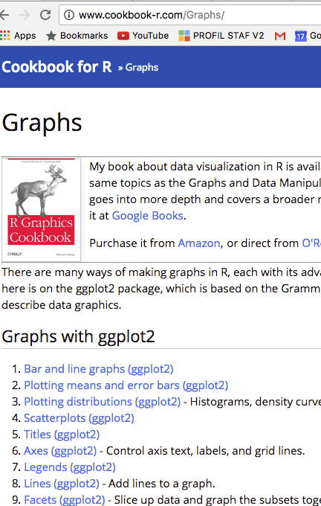
Beginner: ggplot2
The ggplot2 package, created by Hadley Wickham, offers a powerful graphics language for creating elegant and complex plots.
http://www.cookbook-r.com/Graphs/

Slide 13
Its popularity in the R community has exploded in recent years.
Originally based on Leland Wilkinson's The Grammar of Graphics.
ggplot2 allows you to create graphs that represent both univariate and multivariate numerical and categorical data in a straightforward manner.
http://ggplot2.org/

Slide 14
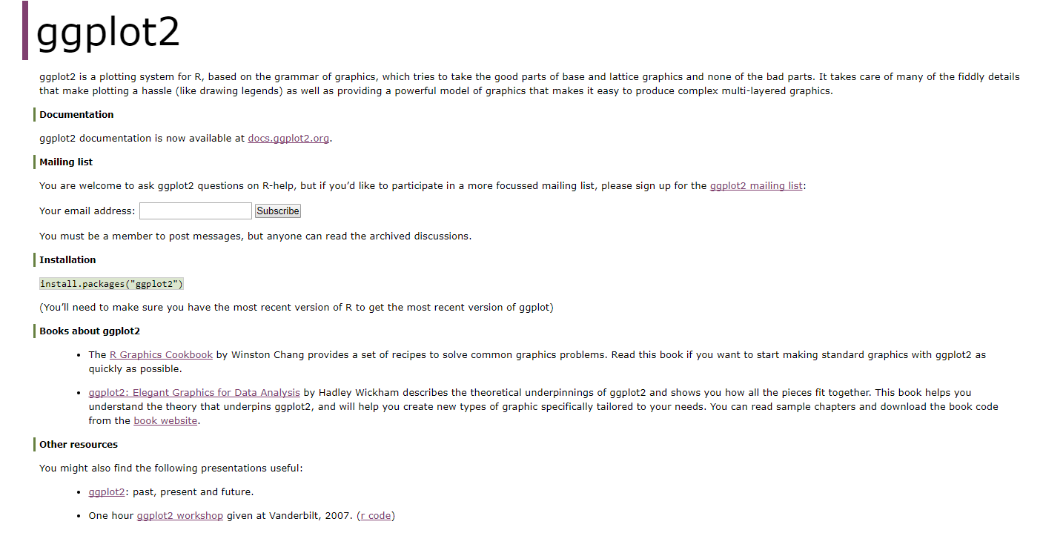

Slide 15
All ggplot2 plots with a call to ggplot(), supplying default data and aesthethic mappings, specified by aes().
You then add layers, scales, coords and facets with +.
To save a plot to disk, use ggsave().
https://www.rstudio.com/wp-content/uploads/2015/03/ggplot2-cheatsheet.pdf

Slide 16
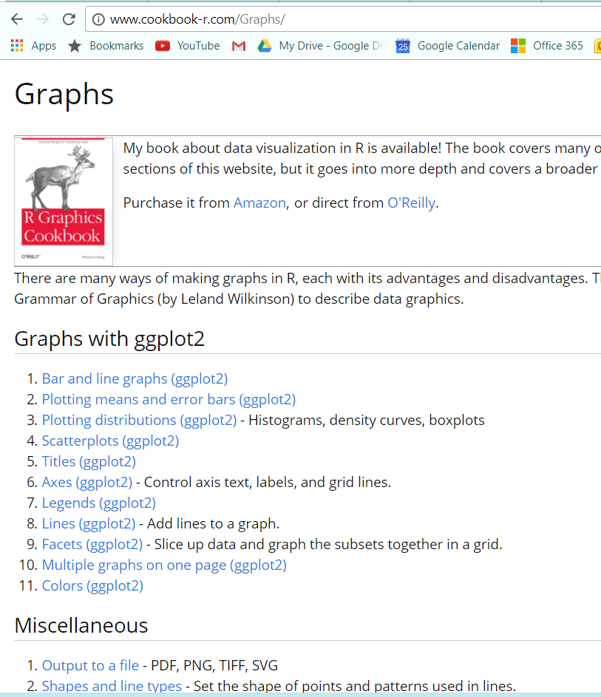

Slide 17
Hands-on 2
> library(ggplot2)
> ggplot(mpg, aes(hwy, cty)) +
geom_point(aes(color = cyl)) +
geom_smooth(method ="lm") +
coord_cartesian() +
scale_color_gradient() +
theme_bw()
> ggsave("plot.png", width = 5, height = 5)

Slide 18
Beginner: lattice
The lattice package, attempts to improve on base Rgraphics
It provides better defaults and the ability to easily display multivariate relationships.
the package supports the creation of trellis graphs
graphs that display a variable or the relationship between variables, conditioned on one or more other variables.
http://www.statmethods.net/advgraphs/trellis.html

Slide 19
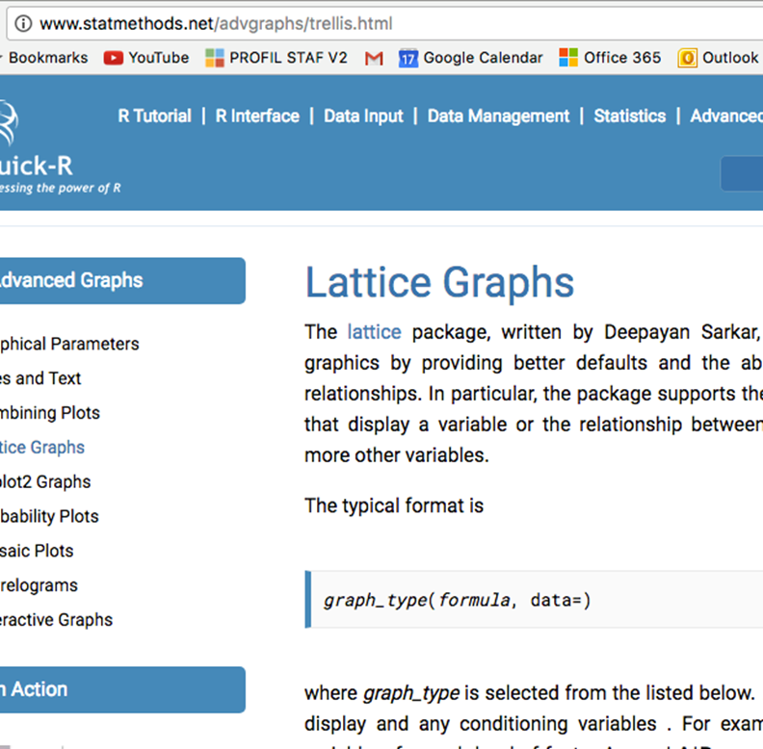

Slide 20
Hands-on 3
>densityplot(~ mpg, data = mtcars)
>densityplot(~ mpg | factor(gear), main="Density Plot by Number of Cylinders", xlab="Miles per Gallon", data = mtcars)
>bwplot(factor(cyl) ~ mpg | factor(gear), ylab = "Cylinders", xlab = "Miles per Gallon", main = "Mileage by Cylinders and Gears", layout=(c(1,3)), data = mtcars)
>xyplot(mpg~wt| factor(cyl) * factor(gear), main="Scatterplots by Cylinders and Gears", ylab="Miles per Gallon", xlab="Car Weight", data = mtcars)
>splom(mtcars[c(1,3,4,5,6)], main="MTCARS Data")

Slide 21
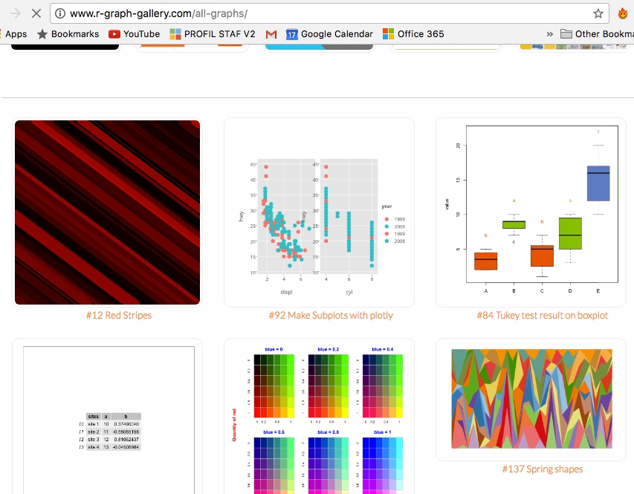
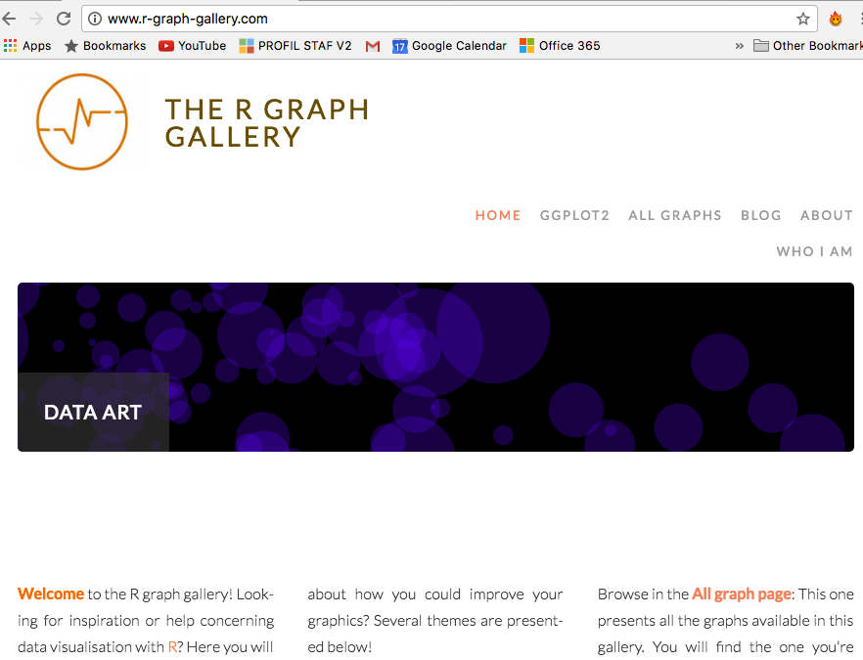
Varieties
http://www.r-graph-gallery.com/

Slide 22
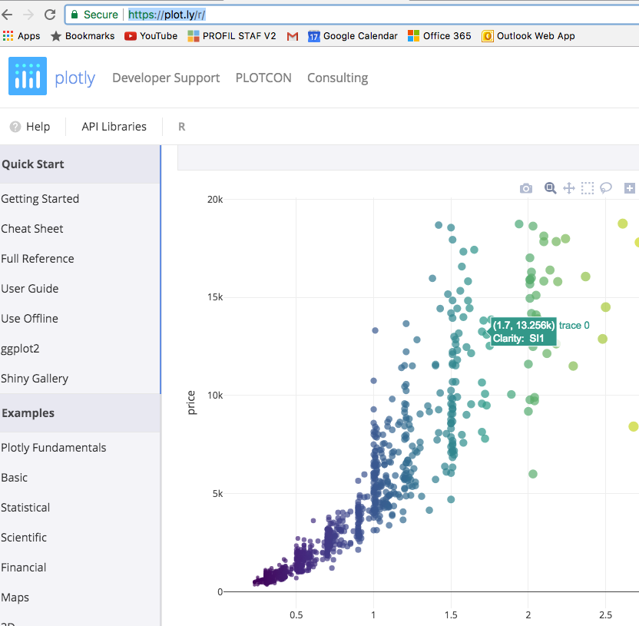
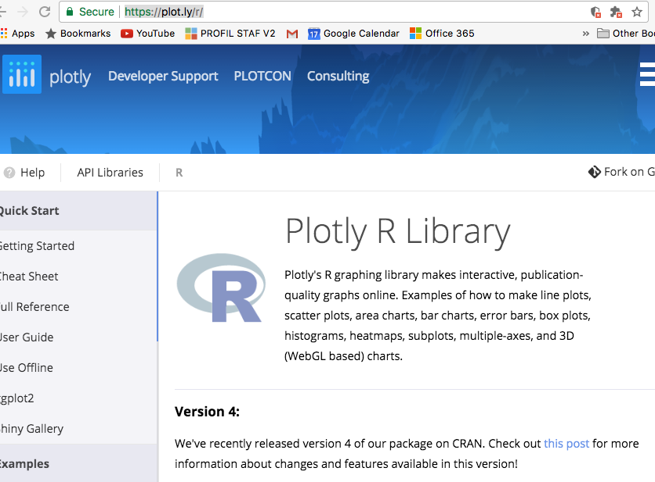
Interactive plots
https://plot.ly/r/

Slide 23
Hands-on 4

Slide 24
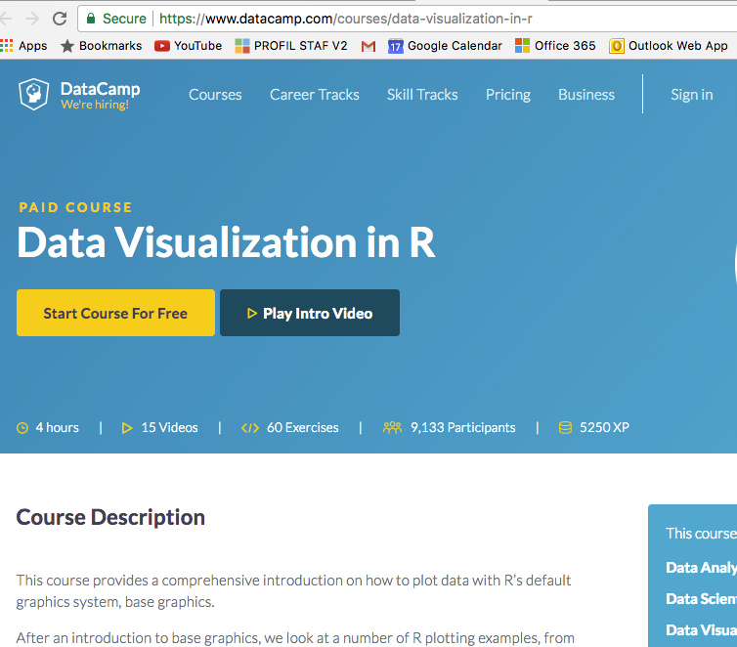
Resources
https://www.datacamp.com/courses/data-visualization-in-r

Slide 25
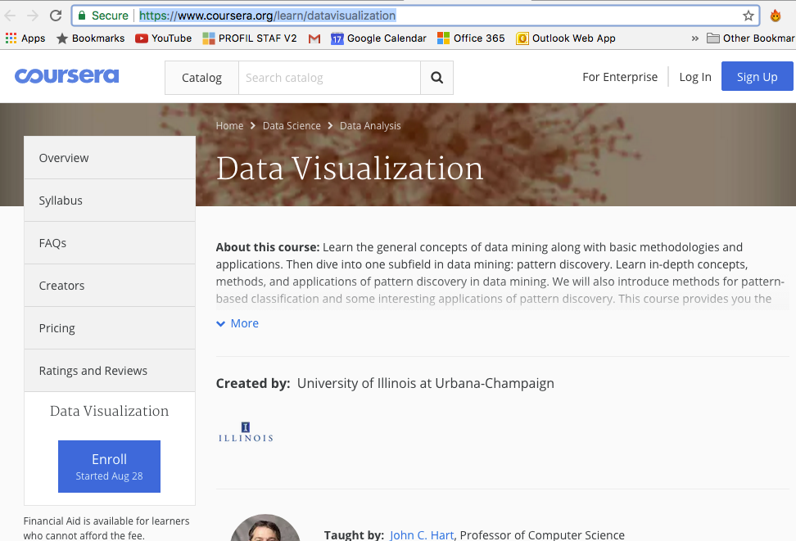
https://www.coursera.org/learn/datavisualization

Slide 26
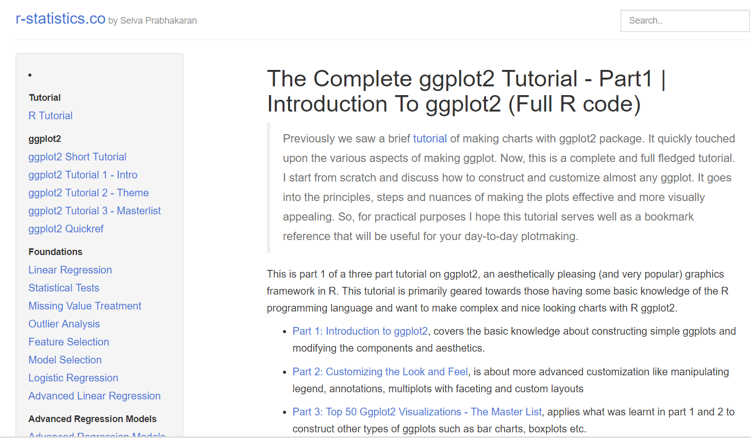
Take home exercise
http://r-statistics.co/Complete-Ggplot2-Tutorial-Part1-With-R-Code.html

