Slide 1

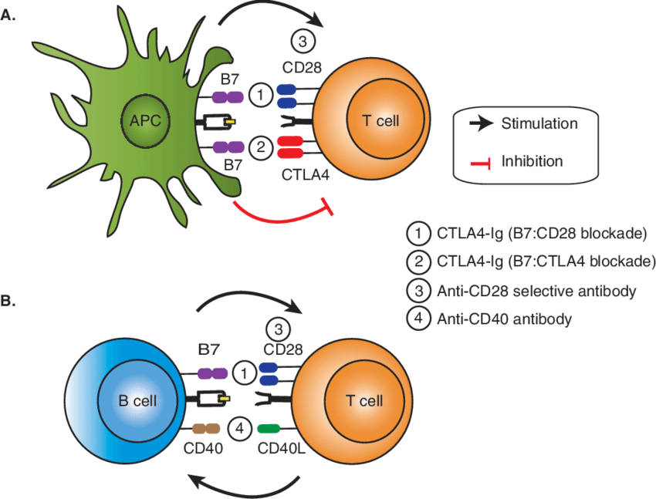
1:Poster of Distinction
American Transplant Congress
(Seattle, Washington, USA)
May 2013
Project: Immune tolerance across a full MHC barrier in a swine hind limb transplantation model using a combined co-stimulatory blockade and donor bone marrow cell approach.

Slide 2
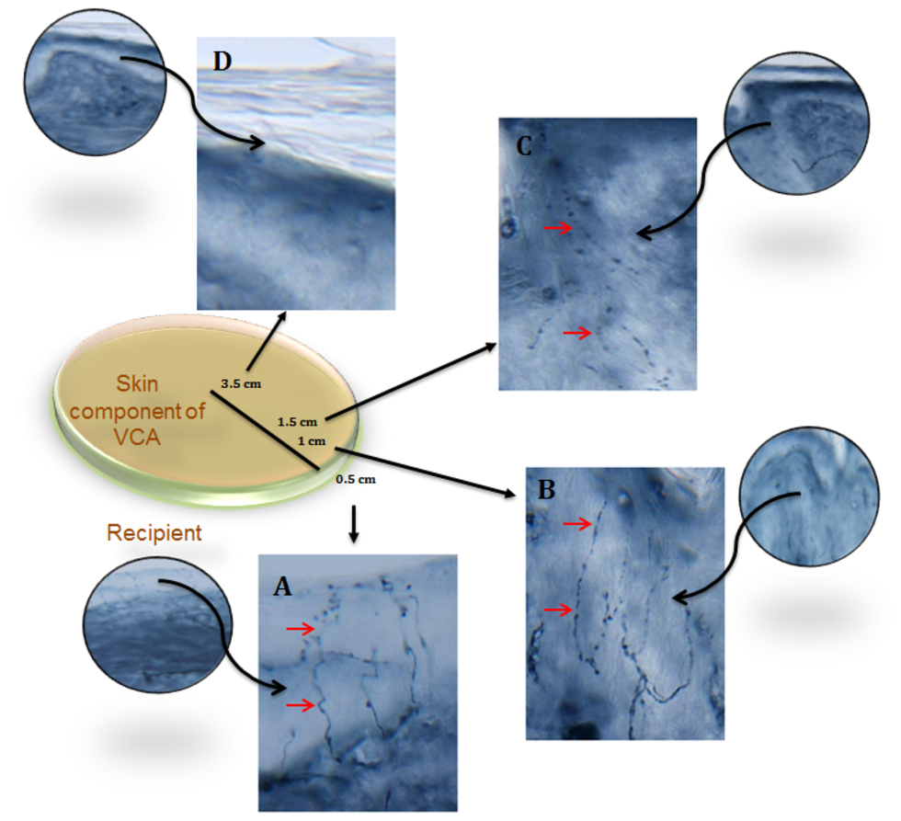
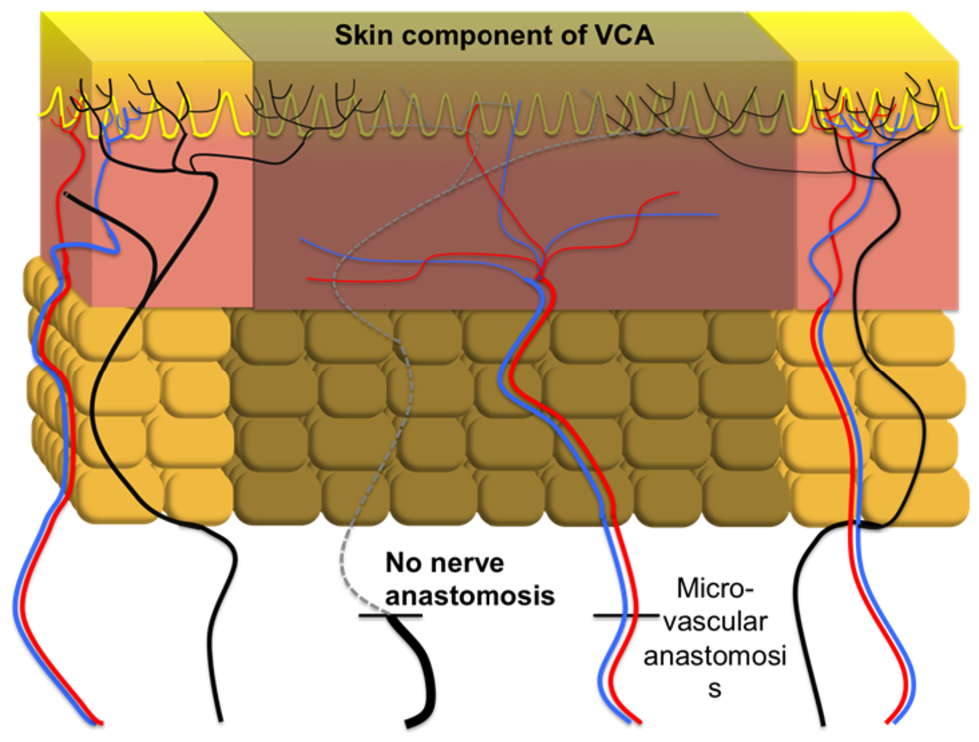
2: Best Poster Award
58th Annual Conference of the Plastic Surgery Research Council
(Santa Monica, California, USA)
May 2013
Project: Cutaneous collateral axonal sprouting re-innervates the skin component and restores sensation of denervated swine osteomyocutaneous alloflaps

Slide 3

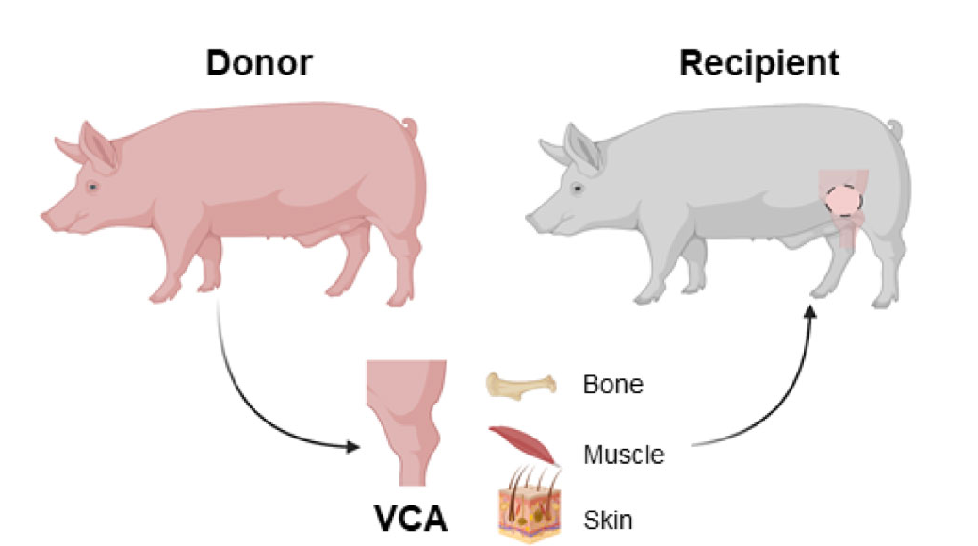
3: Resident Research Award
Baltimore Academy of Surgery Research Day
(Baltimore, Maryland , USA)
June 2013
Project: Combined Co-Stimulatory Blockade and Donor Bone Marrow Cells Induce Robust Immune Tolerance in a Fully MHC-Mismatched Swine Hind Limb Transplant Model

Slide 4
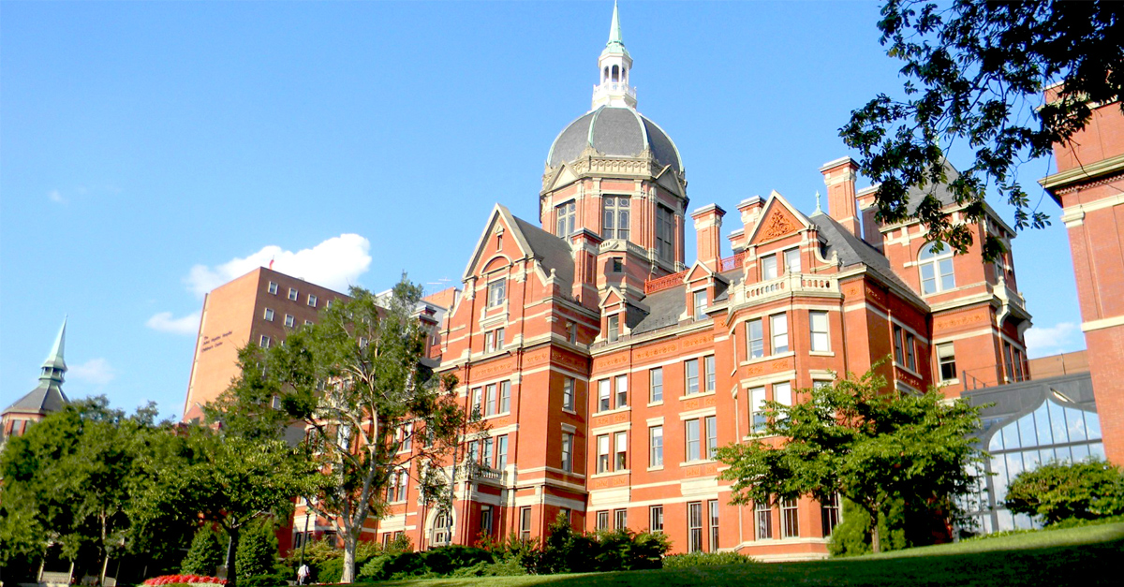
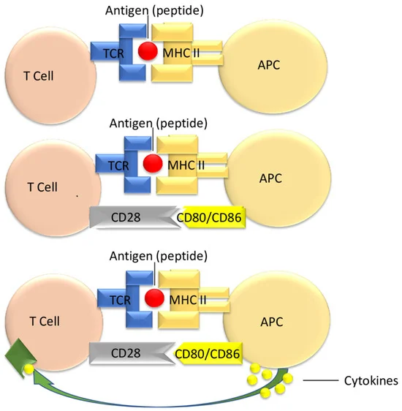
4: Best Research Poster
7th Annual Research Poster Session of the Johns Hopkins Department of Surgery
(Baltimore, Maryland , USA)
July 2013
Project: Combined Co-stimulatory Blockade and Donor Bone Marrow Cells Induce Robust Immune Tolerance in A Fully SLA-mismatched Swine Hind Limb Transplantation Model

Slide 5


5: Highest Podium Presentation Score
99th Annual Clinical Congress of the American College of Surgeons
(Washington, DC, USA)
October 2013
Project: Building a Clinical Risk Model to Predict Morbidity after Breast Surgery

Slide 6
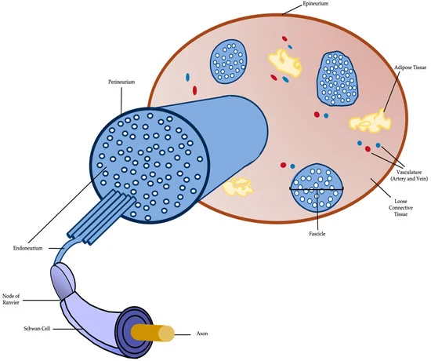
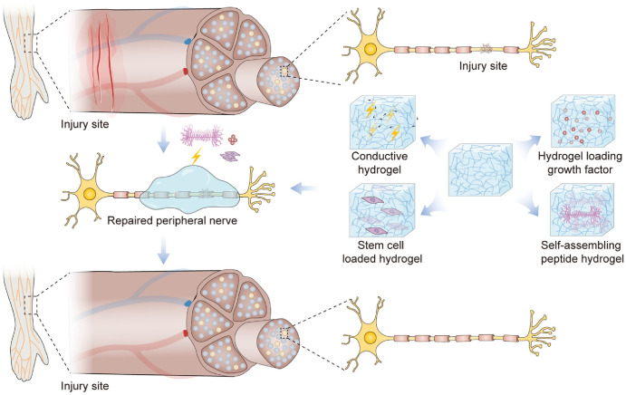
6: Best Paper Session
59th Annual Conference of the Plastic Surgery Research Council
(New York, NY, USA)
March 2014
Project: Selectively Permeable Nanofiber Constructs to Prevent Inflammatory Scarring And Enhance Nerve Regeneration in Peripheral Nerve Injury

Slide 7
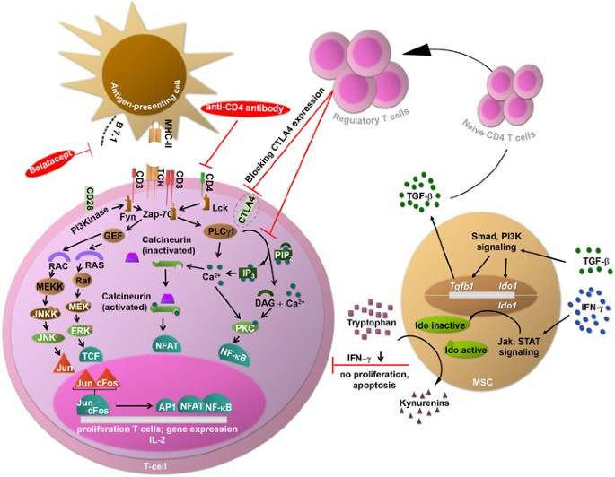
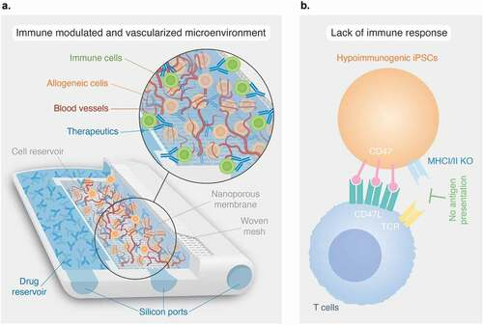
7: Best Paper Award
59th Annual Conference of the Plastic Surgery Research Council
(New York, NY, USA)
March 2014
Project: Immunosuppression-free Vascularized Composite Allotransplantation across a Full MHC Mismatch Using Cadaveric Bone Marrow Infusion and Costimulation Blockade in a Translational Large Animal Model

Slide 8
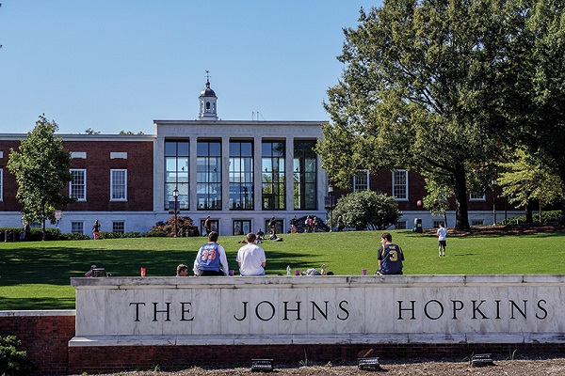
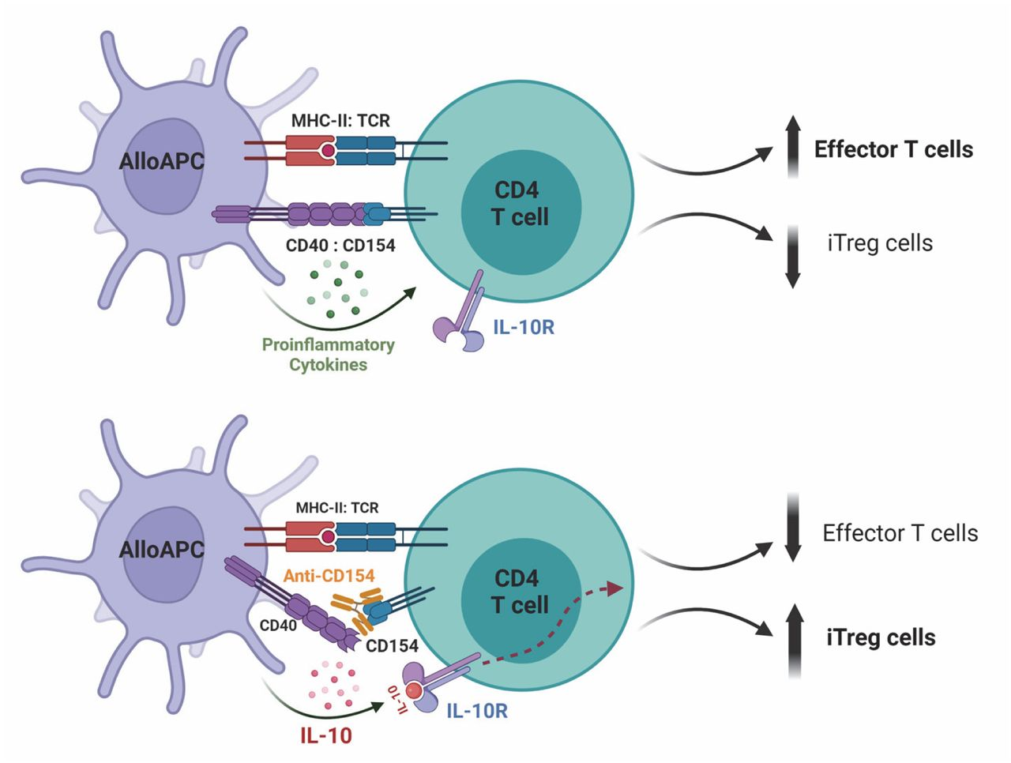
8: Best Research Poster
8th Annual Research Poster Session of the Johns Hopkins Department of Surgery
(Baltimore, MD, USA)
July 2014
Project: Costimulatory Blockade in Combination with Donor Bone Marrow Infusion Induces Immune Tolerance Across a Full MHC Barrier in a Translational Large Animal Vascularized Composite Allotransplantation Model

Slide 9
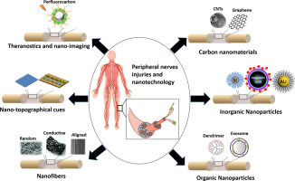
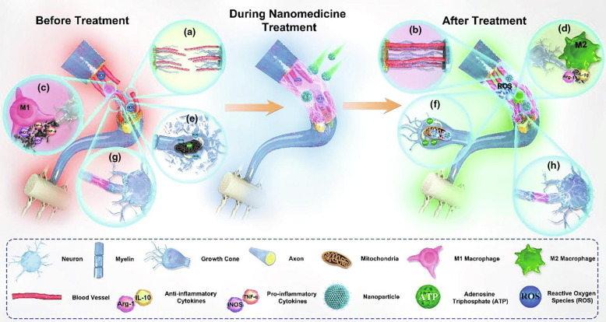
9: Best Basic Science Paper
6th Annual Resident Research Symposium of the Johns Hopkins/University of Maryland Departments of Plastic Surgery
(Baltimore, MD, USA)
July 2014
Project: Selectively permeable nanofiber construct for optimizing peripheral nerve repair

Slide 10
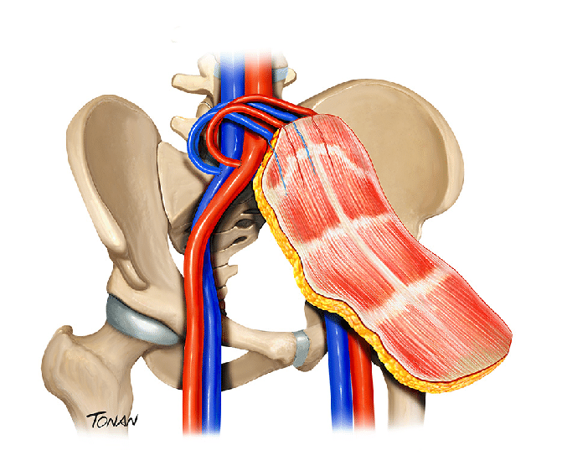
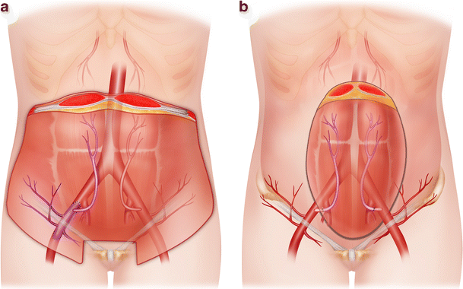
10: Best Resident Poster
94th Annual Conference of the American Association of Plastic Surgeons
(Scottsdale, AZ, USA)
April 2015
Project: Functional abdominal wall reconstruction using an innervated abdominal wall vascularized composite allografts

Slide 11


11: American College of Surgeons Travel Scholarship
Leadership Conference and Advocacy Summit
(Washington, DC, USA)
March 2020

