Slide 1
Retractions in Management Scholarship: Speaking to the Elephant in the Room
Authors:
Dr. Karthikeyan Balakumar, Marketing Area, IIM Sirmaur
Dr. Parijat Lanke, OB & HRM Area, IIM Sirmaur
Dr. Advaita Rajendra, Public Policy Area, IIM Sirmaur
Presenters
Dr. Karthikeyan Balakumar & Dr. Parijat Lanke

Slide 2


INTRODUCTION
Kintsugi (Japanese Art)
Standing on Weak Shoulders
Notes:
A repair might not restore the bowl to the original.

Slide 3
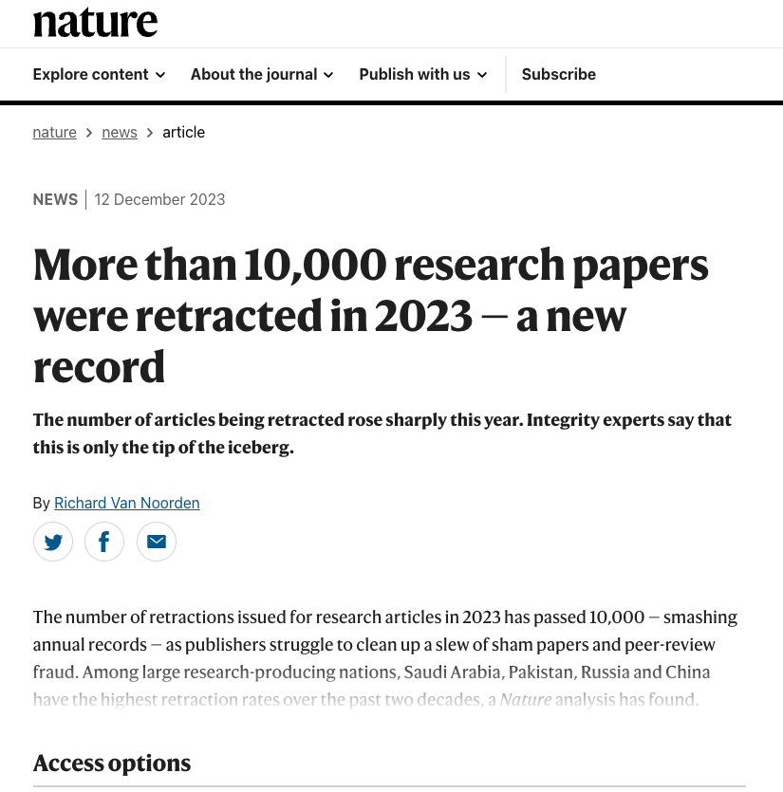
INTRODUCTION
Retraction
Formally withdrawing or removing a previously published article from the scholarly literature
Help identifying and rectifying intentional errors (Pourhoseingholi et al., 2021)
Help correcting the scientific record and maintain its integrity (Bakker et al., 2022).
Do we really?
Unethical origins?
Paper Mills
Paid Publications
Quid Pro Quos
Academic Vultures
Breaking records that should not be broken?
Notes:
The discourse so far has been all about science.

Slide 4
OBJECTIVES
Understand the pasture of retracted papers in management scholarship
Dwell deeper into the meanings that these retractions hold for the progress of management scholarship
Speech Act Theory
Idea of Normative Power

Slide 5
METHOD
Data
Retraction Watch dataset, Scopus, and ABDC data
49806 datapoints (as on 25th December, 2023)
4000+ categorized as Management
883 in ABDC ranked journals
Complete data on 735 articles
Articles include review papers and in press articles
Analysis
R Packages
Asnipe
Vegan
SNA
Bibliometrix
Tidyverse
VOS Viewer™
Correlation between relationship matrices
Network graphs
Co-citation analysis
Data Structure
Title of the paper
Subject
Institution
Journal
Publisher
Country
Author
URLs
Article Type
Retraction Date
Retraction DOI
Retraction PubMed ID
Original Paper Date
Original Paper DOI
Original Paper PubMed ID
Retraction Nature
Reason
Retraction Year
Duration in Months

Slide 6
RESULTS

Slide 7
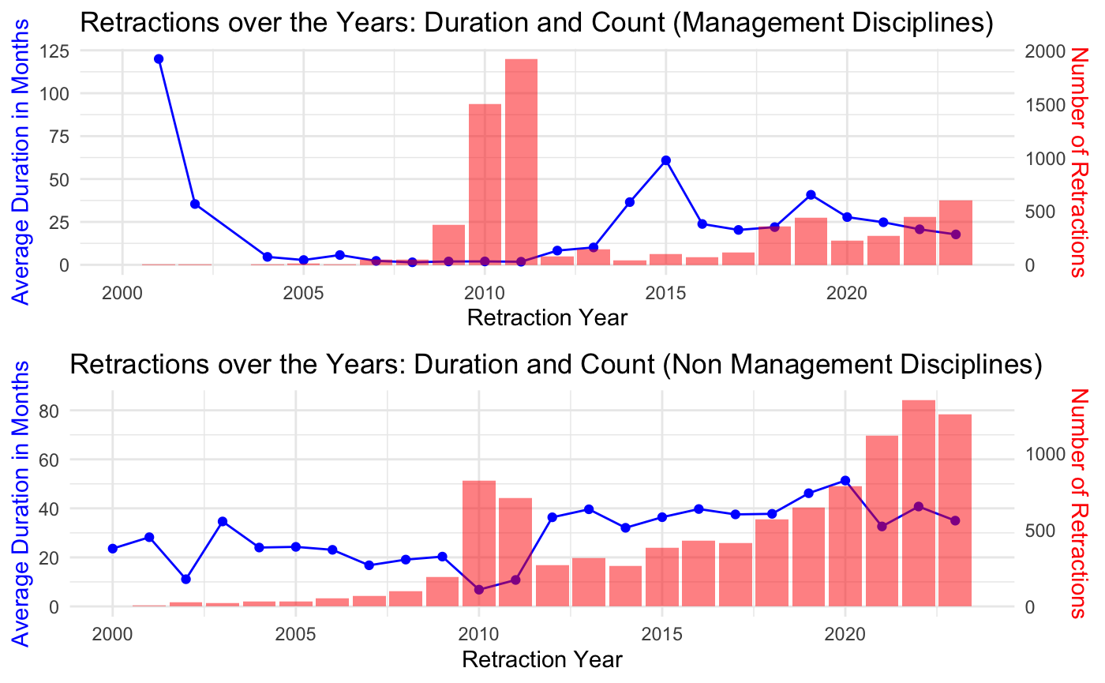
THE KINTSUGI ANTITHESIS
Notes:
Management literature is the kitsugi anti thesis.with 25 to 50 months for each retraction to be retracted.. There is lot of time to cause damage..

Slide 8
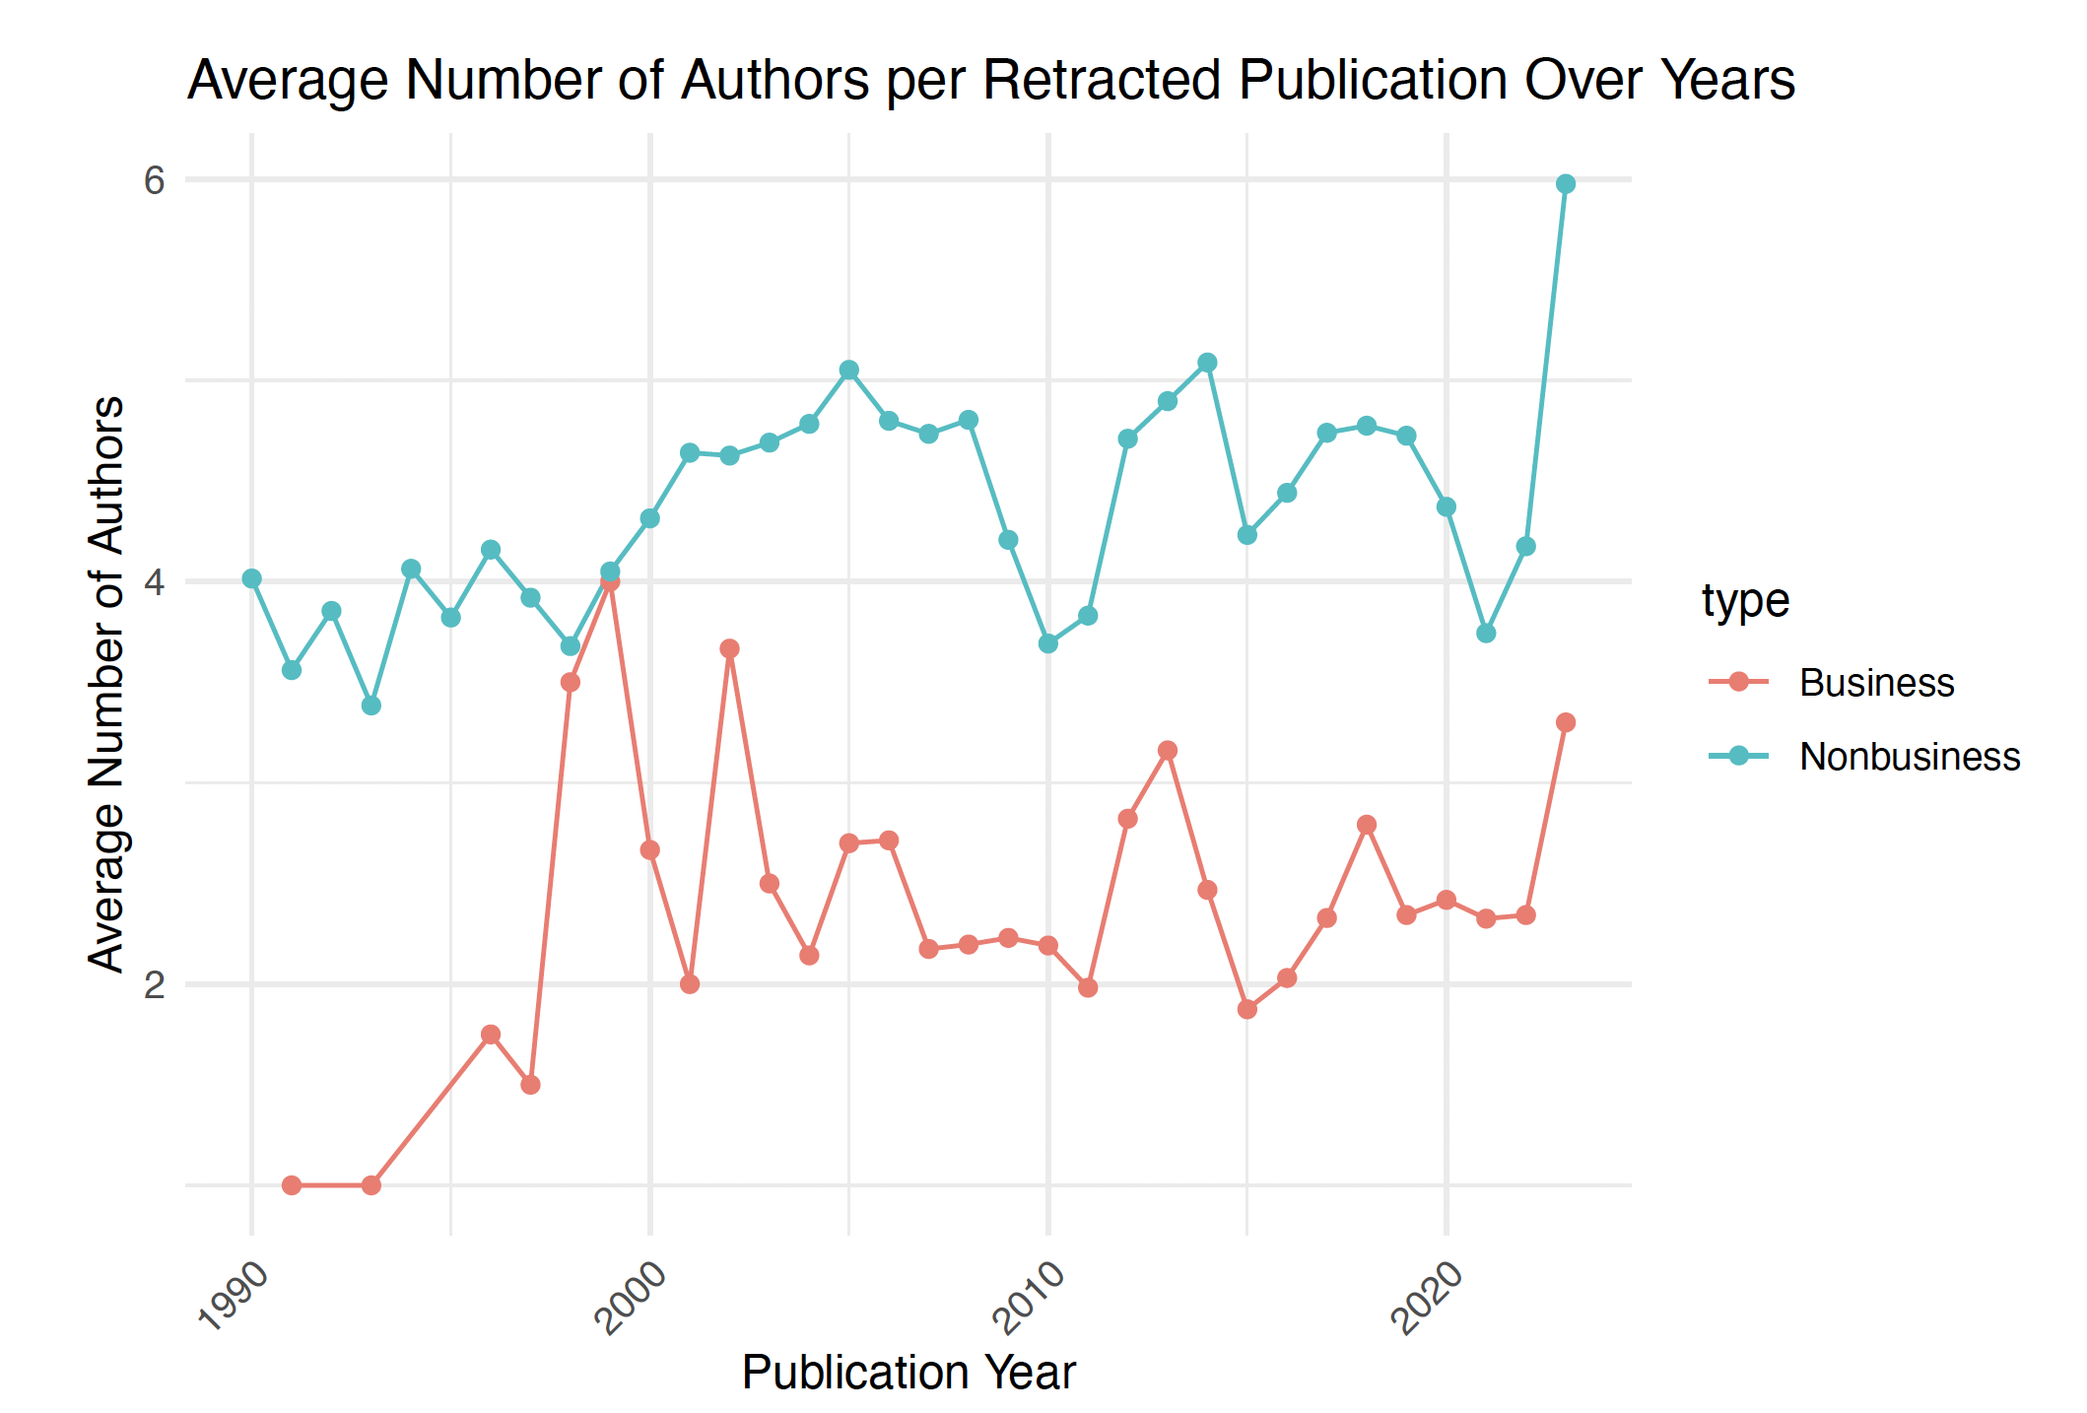
AUTHORS (BUSINESS & NON-BUSINESS)

Slide 9
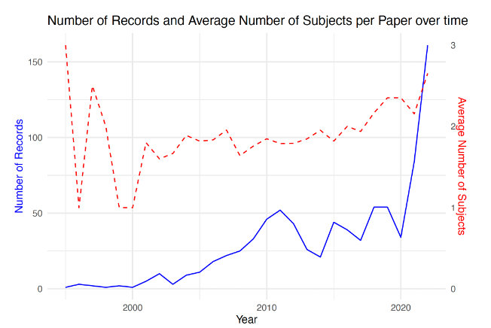
RISE IN INTER SUBJECT/DISCIPLINE WORK

Slide 10
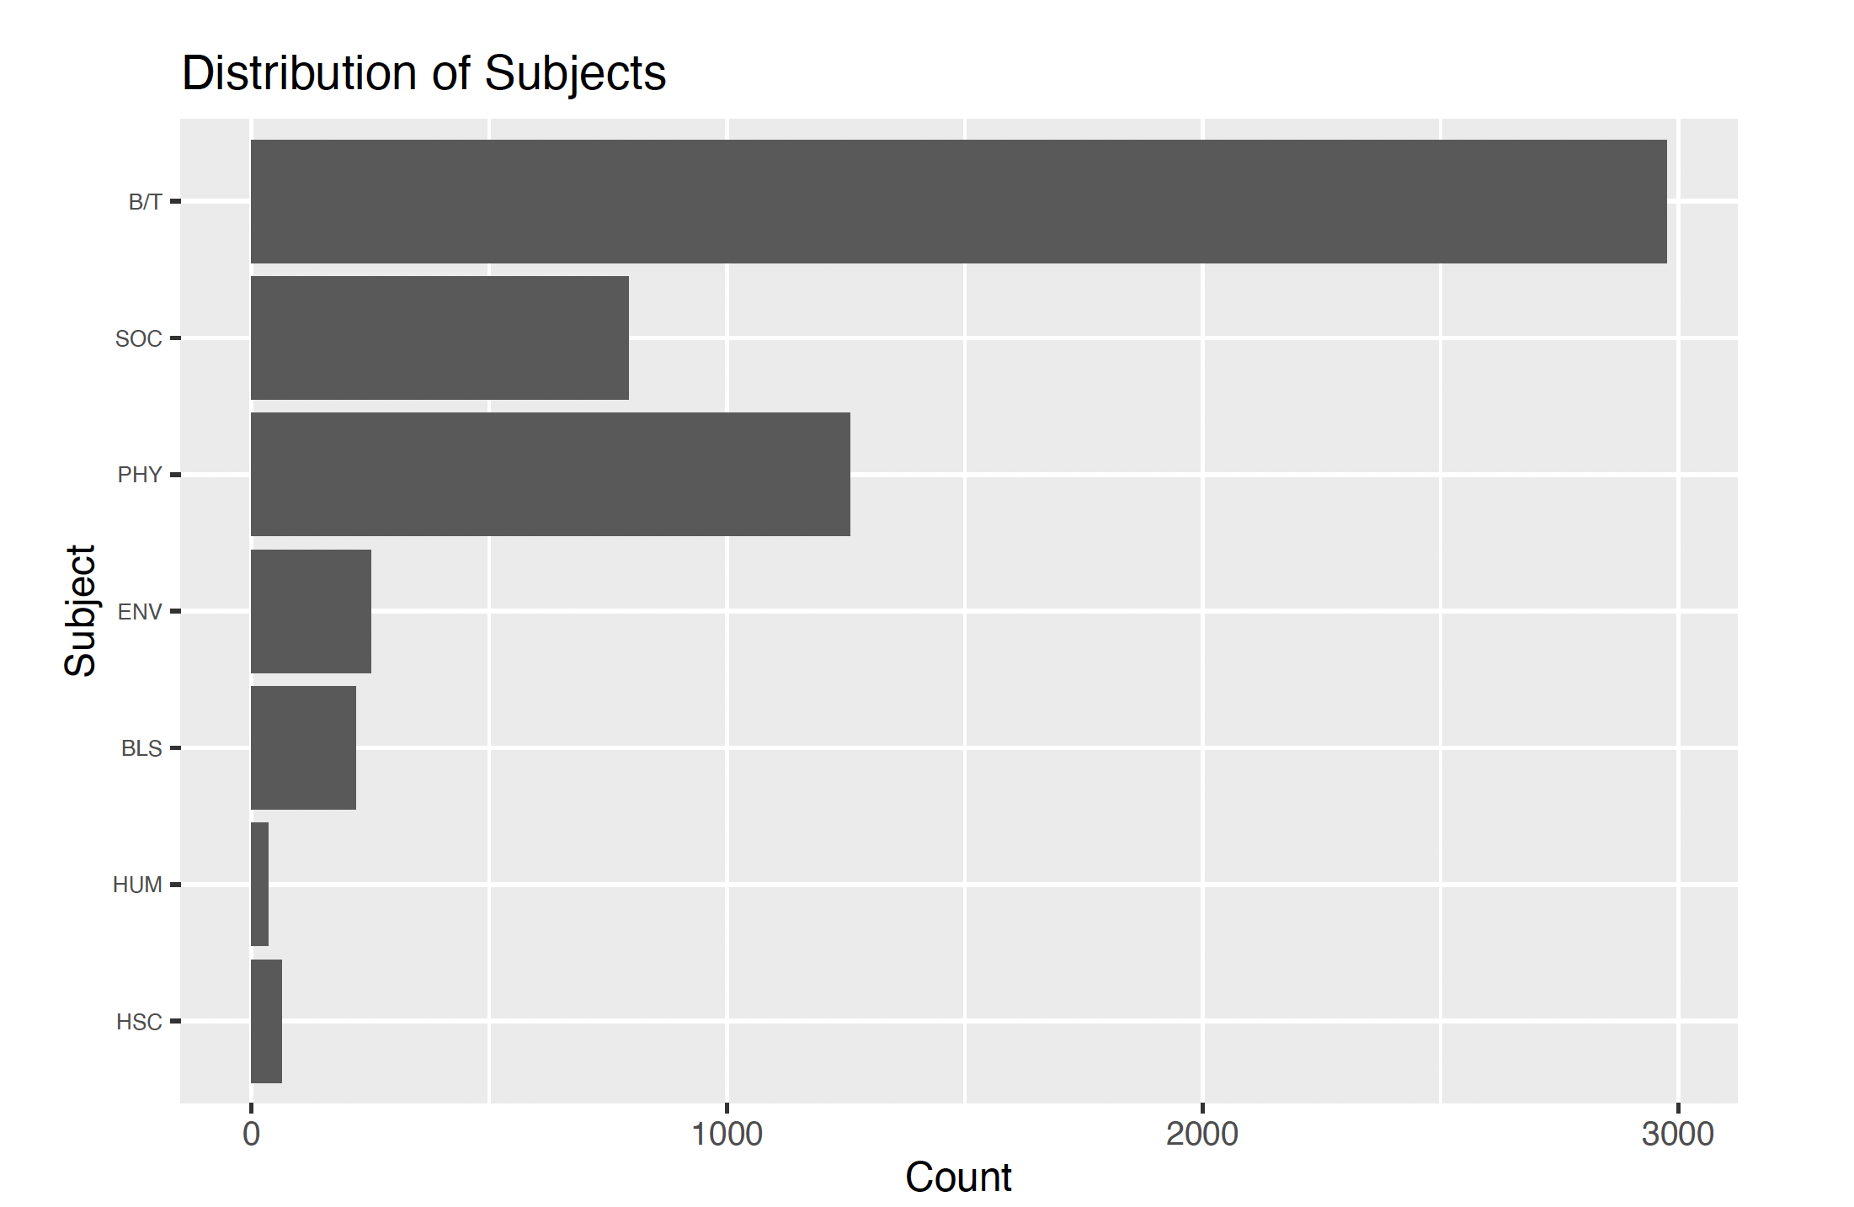
SUBJECT SPREAD

Slide 11
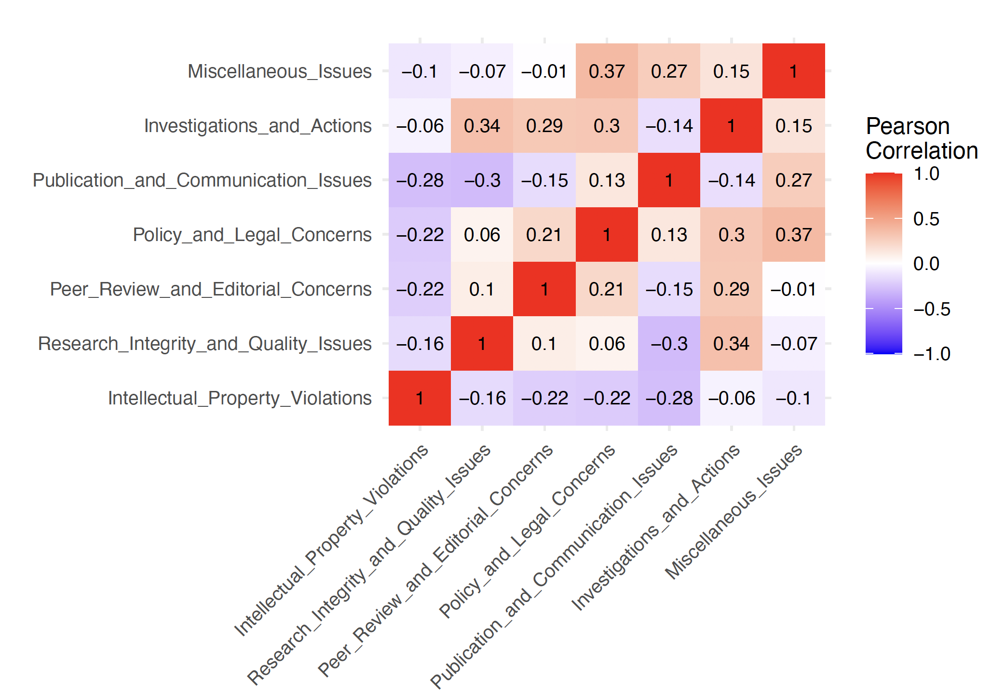
REASONS FOR RETRACTION
Notes:
We originally had over 50 + reasons, these reasons were later clustered into these 6 categories based on authors’ inputs.

Slide 12
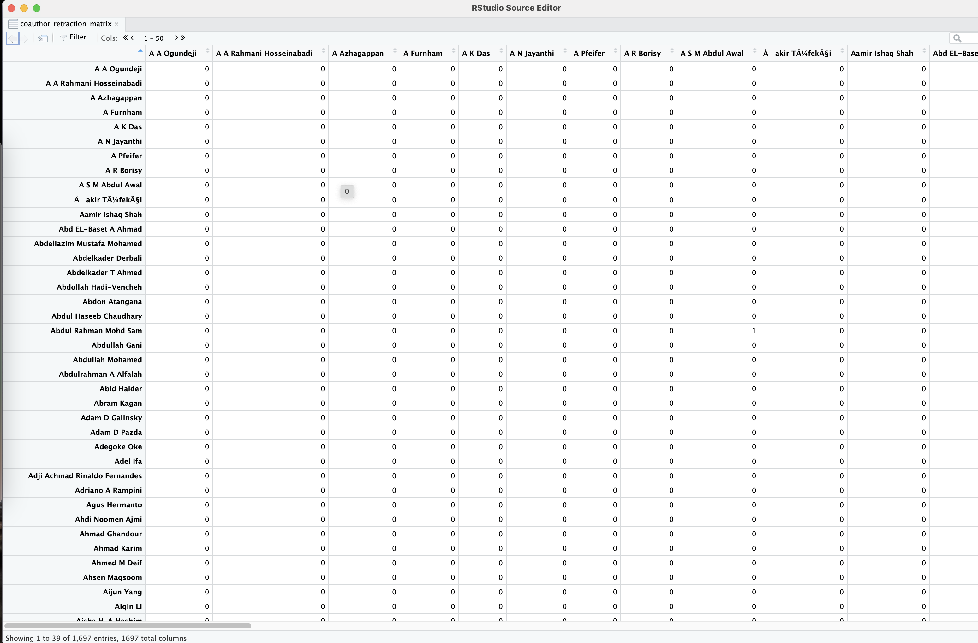
SOCIAL NETWORK ANALYSIS
Generation of Correlation between relationship matrices
Mantel test

Slide 13
MANTEL TEST
Comparison Categories | Mantel Statistic (r) | Significance | 90% Quantile | 95% Quantile | 97.5% Quantile | 99% Quantile
Coauthor Retraction vs. Author Institution | 0.9866 | 0.000999 | 0.00109 | 0.00149 | 0.00189 | 0.00189
Coauthor Retraction vs. Author Country | 0.1181 | 0.000999 | 0.00140 | 0.00183 | 0.00210 | 0.00242
Coauthor Retraction vs. Author Publisher | 0.09124 | 0.000999 | 0.00120 | 0.00152 | 0.00179 | 0.00201
Coauthor Retraction vs. Author Journal | 0.2089 | 0.000999 | 0.00128 | 0.00163 | 0.00190 | 0.00216

Slide 14
RESULTS: BIBLIOMETRICS

Slide 15
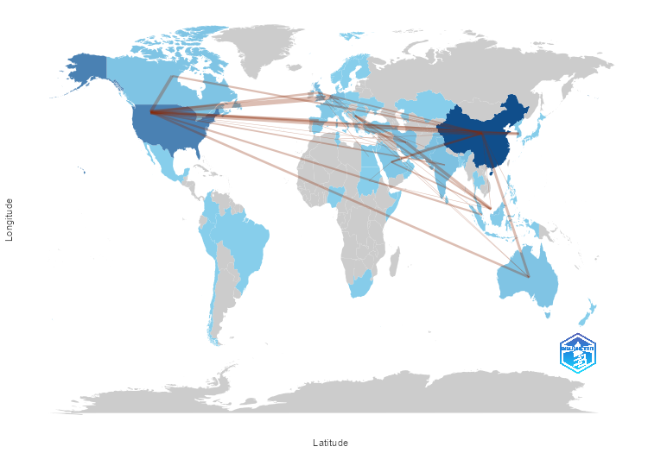
COUNTRIES COLLABORATION NETWORK

Slide 16
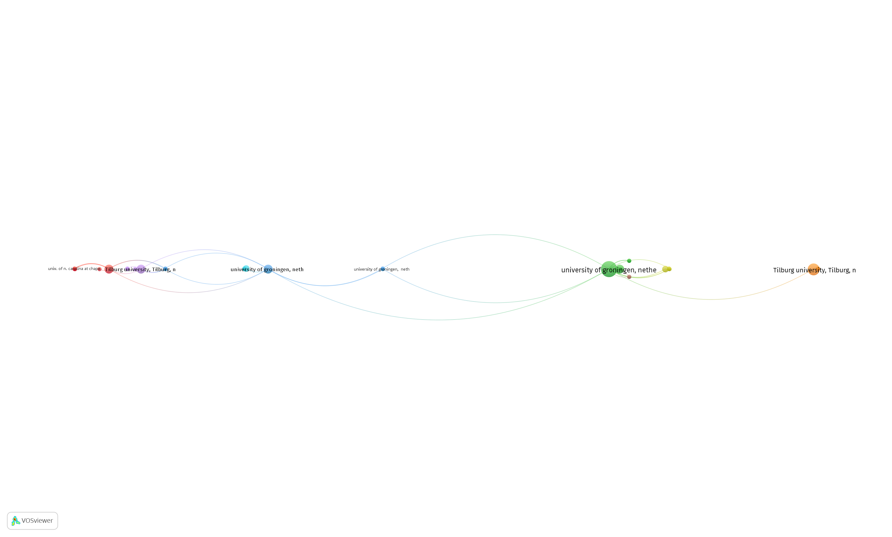
INSTITUTIONAL NETWORKS
Organization
University Of Groningen, Netherlands
Univ. Of N. Carolina At Chapel Hill, Chapel Hill, United States
University Of Iowa, United States
University Of Amsterdam, Netherlands
Diw Berlin, Max Planck Institute For Human Development, Berlin, Germany
Erasmus University, Rotterdam, Netherlands
Stanford University, United States
San Diego State University, United States
San Jose State University, California, United States
Stanford University, United States
Tilburg University, Tilburg, Netherlands
Univ. Of N. Carolina At Chapel Hill, Chapel Hill, United States
University Blaise Pascal, France
University Of Amsterdam
University Of Iowa, United States
University Of Melbourne, Melbourne, Vic, Australia

Slide 17
JOURNALS PRODUCTIVITY
Journal | ABDC Ranking
Mobile Information Systems | NR
Information Systems And E-Business Management | B
Personal And Ubiquitous Computing | A
Perceptual And Motor Skills | NR
Journal Of Personality And Social Psychology | A*
Psychological Science | A*
Economic Modelling | A
Expert Systems With Applications | C
Journal Of Consumer Research | A*
Journal Of Experimental Social Psychology | A
European Journal Of Social Psychology | A
Journal Of Advanced Transportation | A
Journal Of Cleaner Production | A
Journal Of Computational And Applied Mathematics | NR
Journal Of Intelligent Manufacturing | B
Land Use Policy | A
Journal Of Environmental Management | A
Personality And Individual Differences | A
Accounting Review | A*
Applied Energy | A
Bioinformatics | A
Quality And Quantity | NR
Corporate Social Responsibility And Environmental Management | C
International Journal Of Production Economics | A
Leadership Quarterly | A*
Stochastic Environmental Research And Risk Assessment | B

Slide 18
SO WHAT?

Slide 19
THE IDEAS OF SPEECH ACT THEORY & NORMATIVE POWER

Slide 20
SPEECH ACT THEORY (SAT)
A concept that emphasizes not just what is said, but what is done through speaking
Developed by J.L. Austin and furthered by John Searle
Key Components of Speech
Locutionary Act: The actual utterance and its meaning.
Illocutionary Act: The intention behind the utterance.
Perlocutionary Act: The effect the utterance has on the listener.
Context
Why It Matters
Reveals the complex ways in which language functions in communication
Shows how utterances perform actions and carry intentions beyond mere words
Examples
From promising and apologizing to ordering and requesting, our words have the power to act

Slide 21
RETRACTIONS THROUGH SAT
The Act of Writing, What is Written, and the Intentions Behind
Locutionary Act
Announcing the retraction of a scientific paper
The notice includes reasons for retraction, such as research errors or issues with data integrity
Illocutionary Act
Intentionally informs the community that results are unreliable
Maintains the integrity of the scientific record
Corrects the literature and may acknowledge mistakes or misconduct
Perlocutionary Act
Impacts the reputation of authors, journals, and the field
Influences how other researchers view and cite the work
May prompt further investigation or scepticism
Context and Interpretation
Context determines the significance of a retraction
Differentiates between honest errors and intentional misconduct

Slide 22
NORMATIVE POWER
“A person's act is an exercise of a normative power if it brings about or prevents a normative change because it is, all things considered, desirable that that person should be able to bring the change about or prevent it by performing that act” (Raz, 2019)
In World Politics – EU - exemplar of “normative power”
‘sustainability’ although coined by UN, became a norm after EU push via treaties such “Lisbon Treaty”
Normative Power in Academia
Journal Rankings such as FT50; ABDC;ABS
Countries, Journals, Institutions Dominating Retraction Charts
Conferences

Slide 23
Open Floor

Slide 24
THANK YOU

Slide 25
OUT TAKES

Slide 26
CATEGORICAL LIST
Intellectual Property Violations | Research Integrity and Quality Issues | Peer Review and Editorial Concerns | Policy and Legal Concerns | Publication and Communication Issues | Investigations and Actions | Miscellaneous Issues
Plagiarism | Not Reproducible | Fake Peer Review | Breach of Policy | Withdrawal | Investigation by Third Party | Date of Retraction
Duplication | Unreliable Results | Rogue Editor | Issues about Referencing | Limited or No Information | Doing the Right Thing | Randomly Generated Content
Euphemisms for Plagiarism | Error in Text | Investigation by Journal/Publisher | Legal Reasons | Notice - Lack of |  | Original Data not Provided
False/Forged Authorship | Error in Analyses | Error by Journal/Publisher | Lack of Approval | Author Unresponsive |  | Concerns About Image
 | Error in Methods | Objections by Author |  | Update of Prior Notice
 | Error in Data
 | Error in Results
 | Fabrication
 | Falsification
 | Ethical Violations
 | Issues About Data

Slide 27
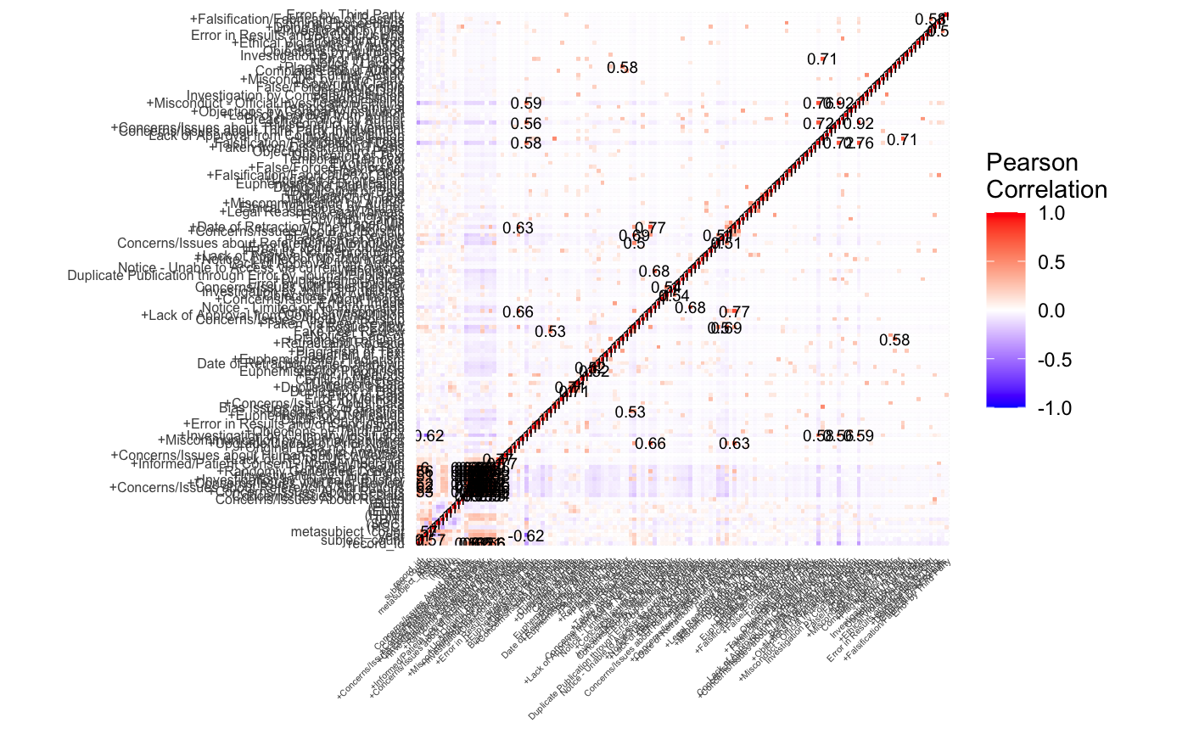
COMPLETE CORRELATION MATRIX - REASONS

