Slide 1
Retractions in Management Scholarship: Speaking to the Elephant in the Room
Authors:
Dr. Karthikeyan Balakumar
Dr. Parijat Lanke
Dr. Advaita Rajendra

Slide 2
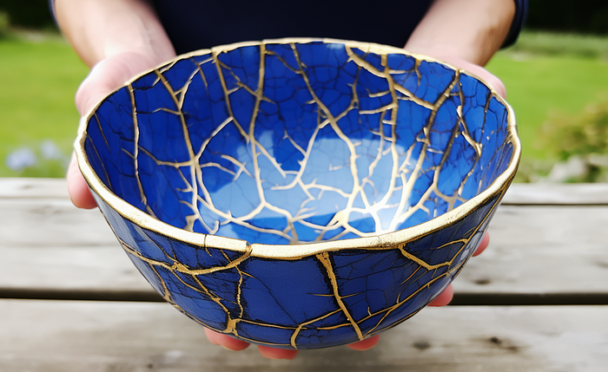
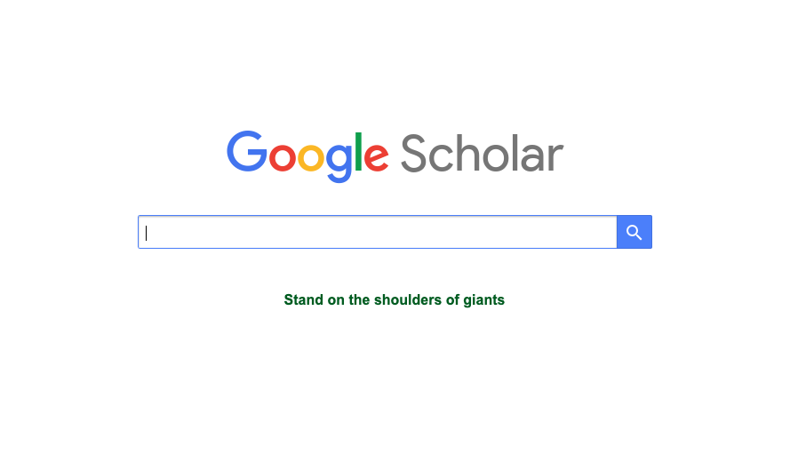
Introduction
Kintsugi
Standing on weak shoulders
Notes:
A repair might not restore the bowl to the original.

Slide 3
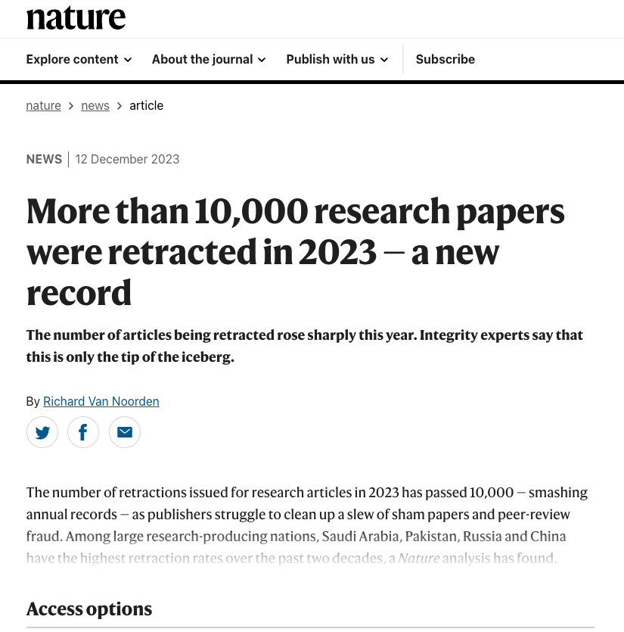
Introduction
Retraction
Formally withdrawing or removing a previously published article from the scholarly literature
Help identifying and rectifying intentional errors (Pourhoseingholi et al., 2021)
Help correcting the scientific record and maintain its integrity (Bakker et al., 2022).
Do we really?
Unethical origins?
Paper Mills
Paid publications
Quid Pro Quos
Academic Vultures
Breaking records that should not be broken?
Notes:
The discourse so far has been all about science.

Slide 4
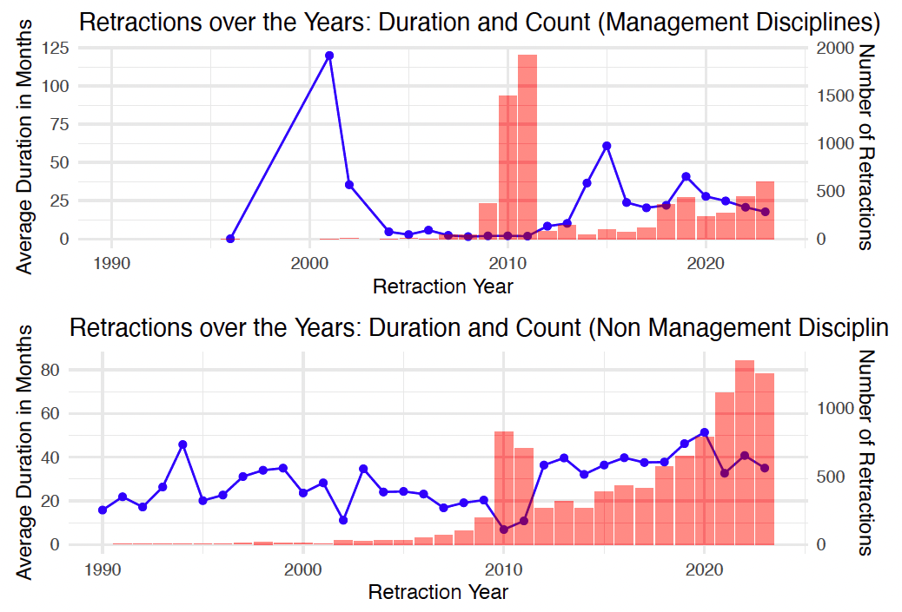
Business Studies Scholarship- The Kintsugi Anti Thesis

Slide 5
Literature review

Slide 6
Objectives
Understands the pasture of retracted papers in management scholarship
Dwell deeper into the meanings that these retractions hold for the progress of management scholarship
Speech Act Theory
Idea of Normative Power

Slide 7
Method
Data
Retraction Watch dataset, Scopus, and ABDC data
49806 datapoints (as on 25th December, 2023)
883 in ABDC ranked journals
Complete data on 750 articles
Articles include review papers and in press articles
Analysis
R Packages
Asnipe
Vegan
SNA
Bibliometrics
Tidyverse
VOS Viewer™
Correlation between relationship matrices
Network graphs
Co-citation analysis
Data Structure
Title of the paper
Subject
Institution
Journal
Publisher
Country
Author
URLs
Article Type
Retraction Date
Retraction DOI
Retraction PubMed ID
Original Paper Date
Original Paper DOI
Original Paper PubMed ID
Retraction Nature
Reason
Retraction Year
Duration in Months

Slide 8
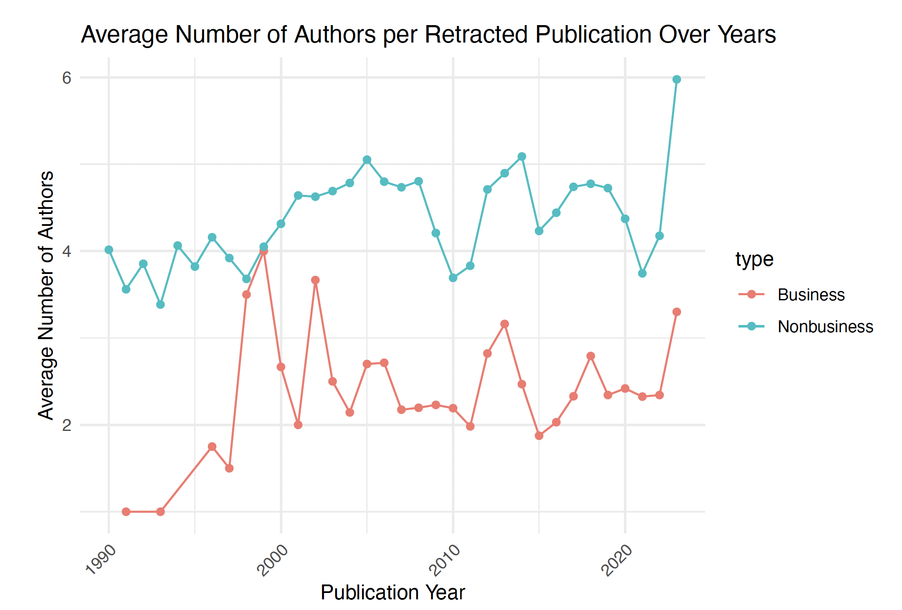
Comparing the number of authors in business and non-business scholarship over time

Slide 9
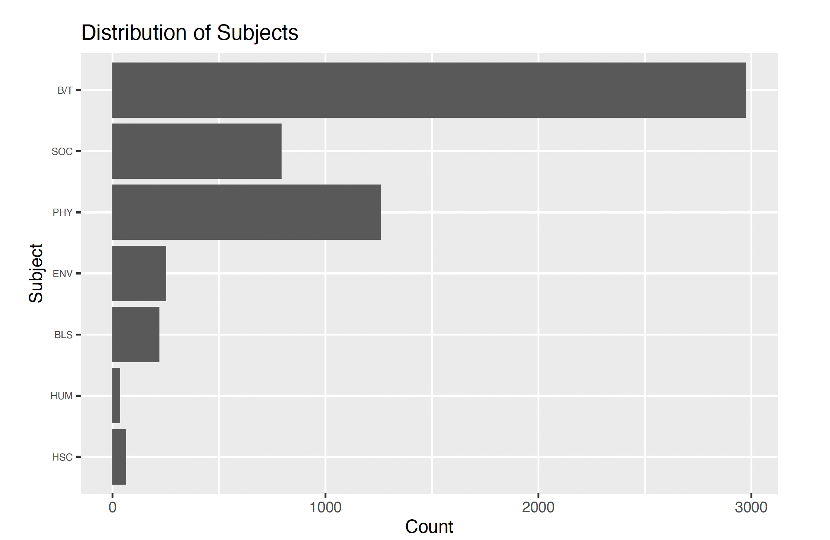
Subject spread in management literature

Slide 10
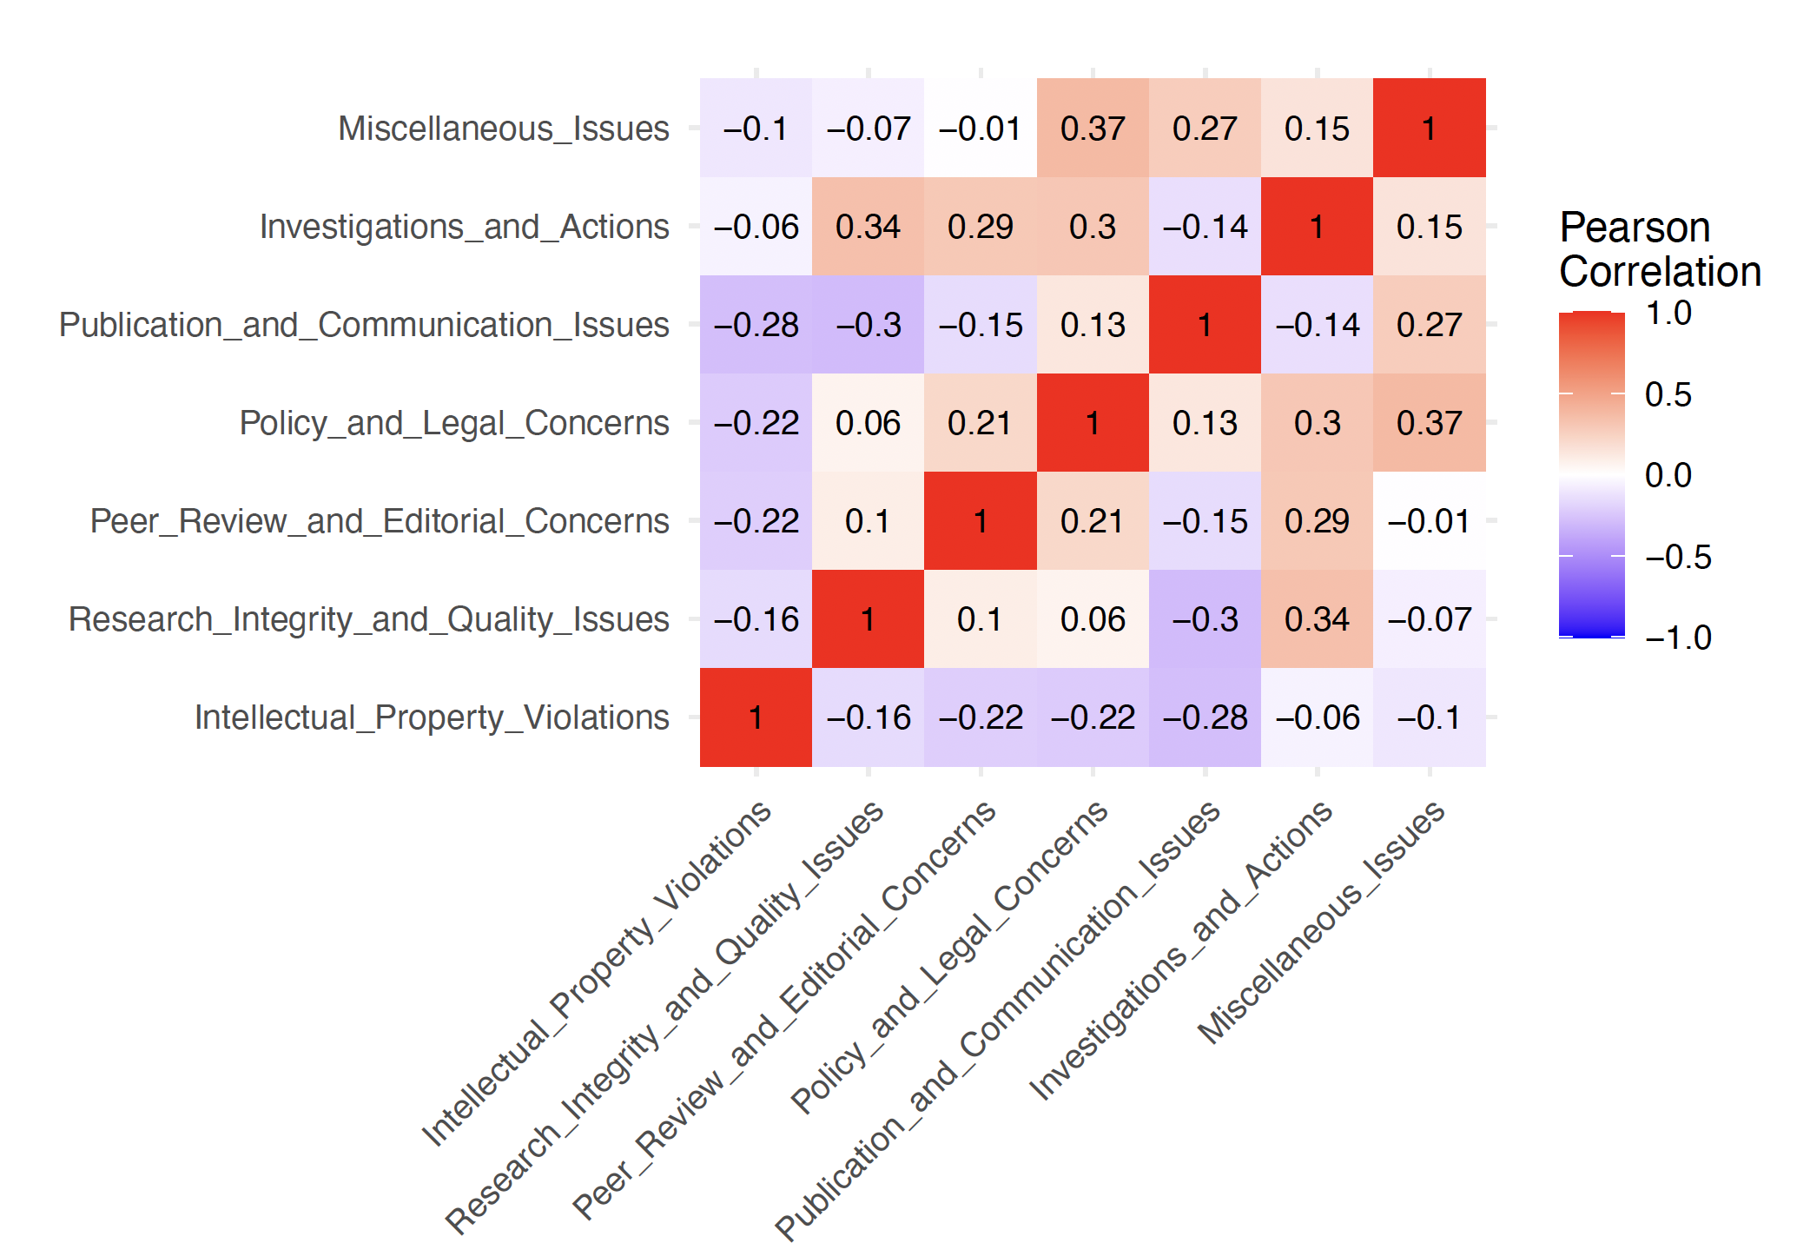
Correlation matrix representing reasons

Slide 11
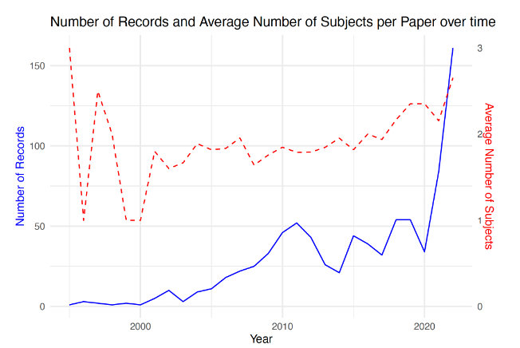
Rise of inter-subject/inter disciplinary work

Slide 12
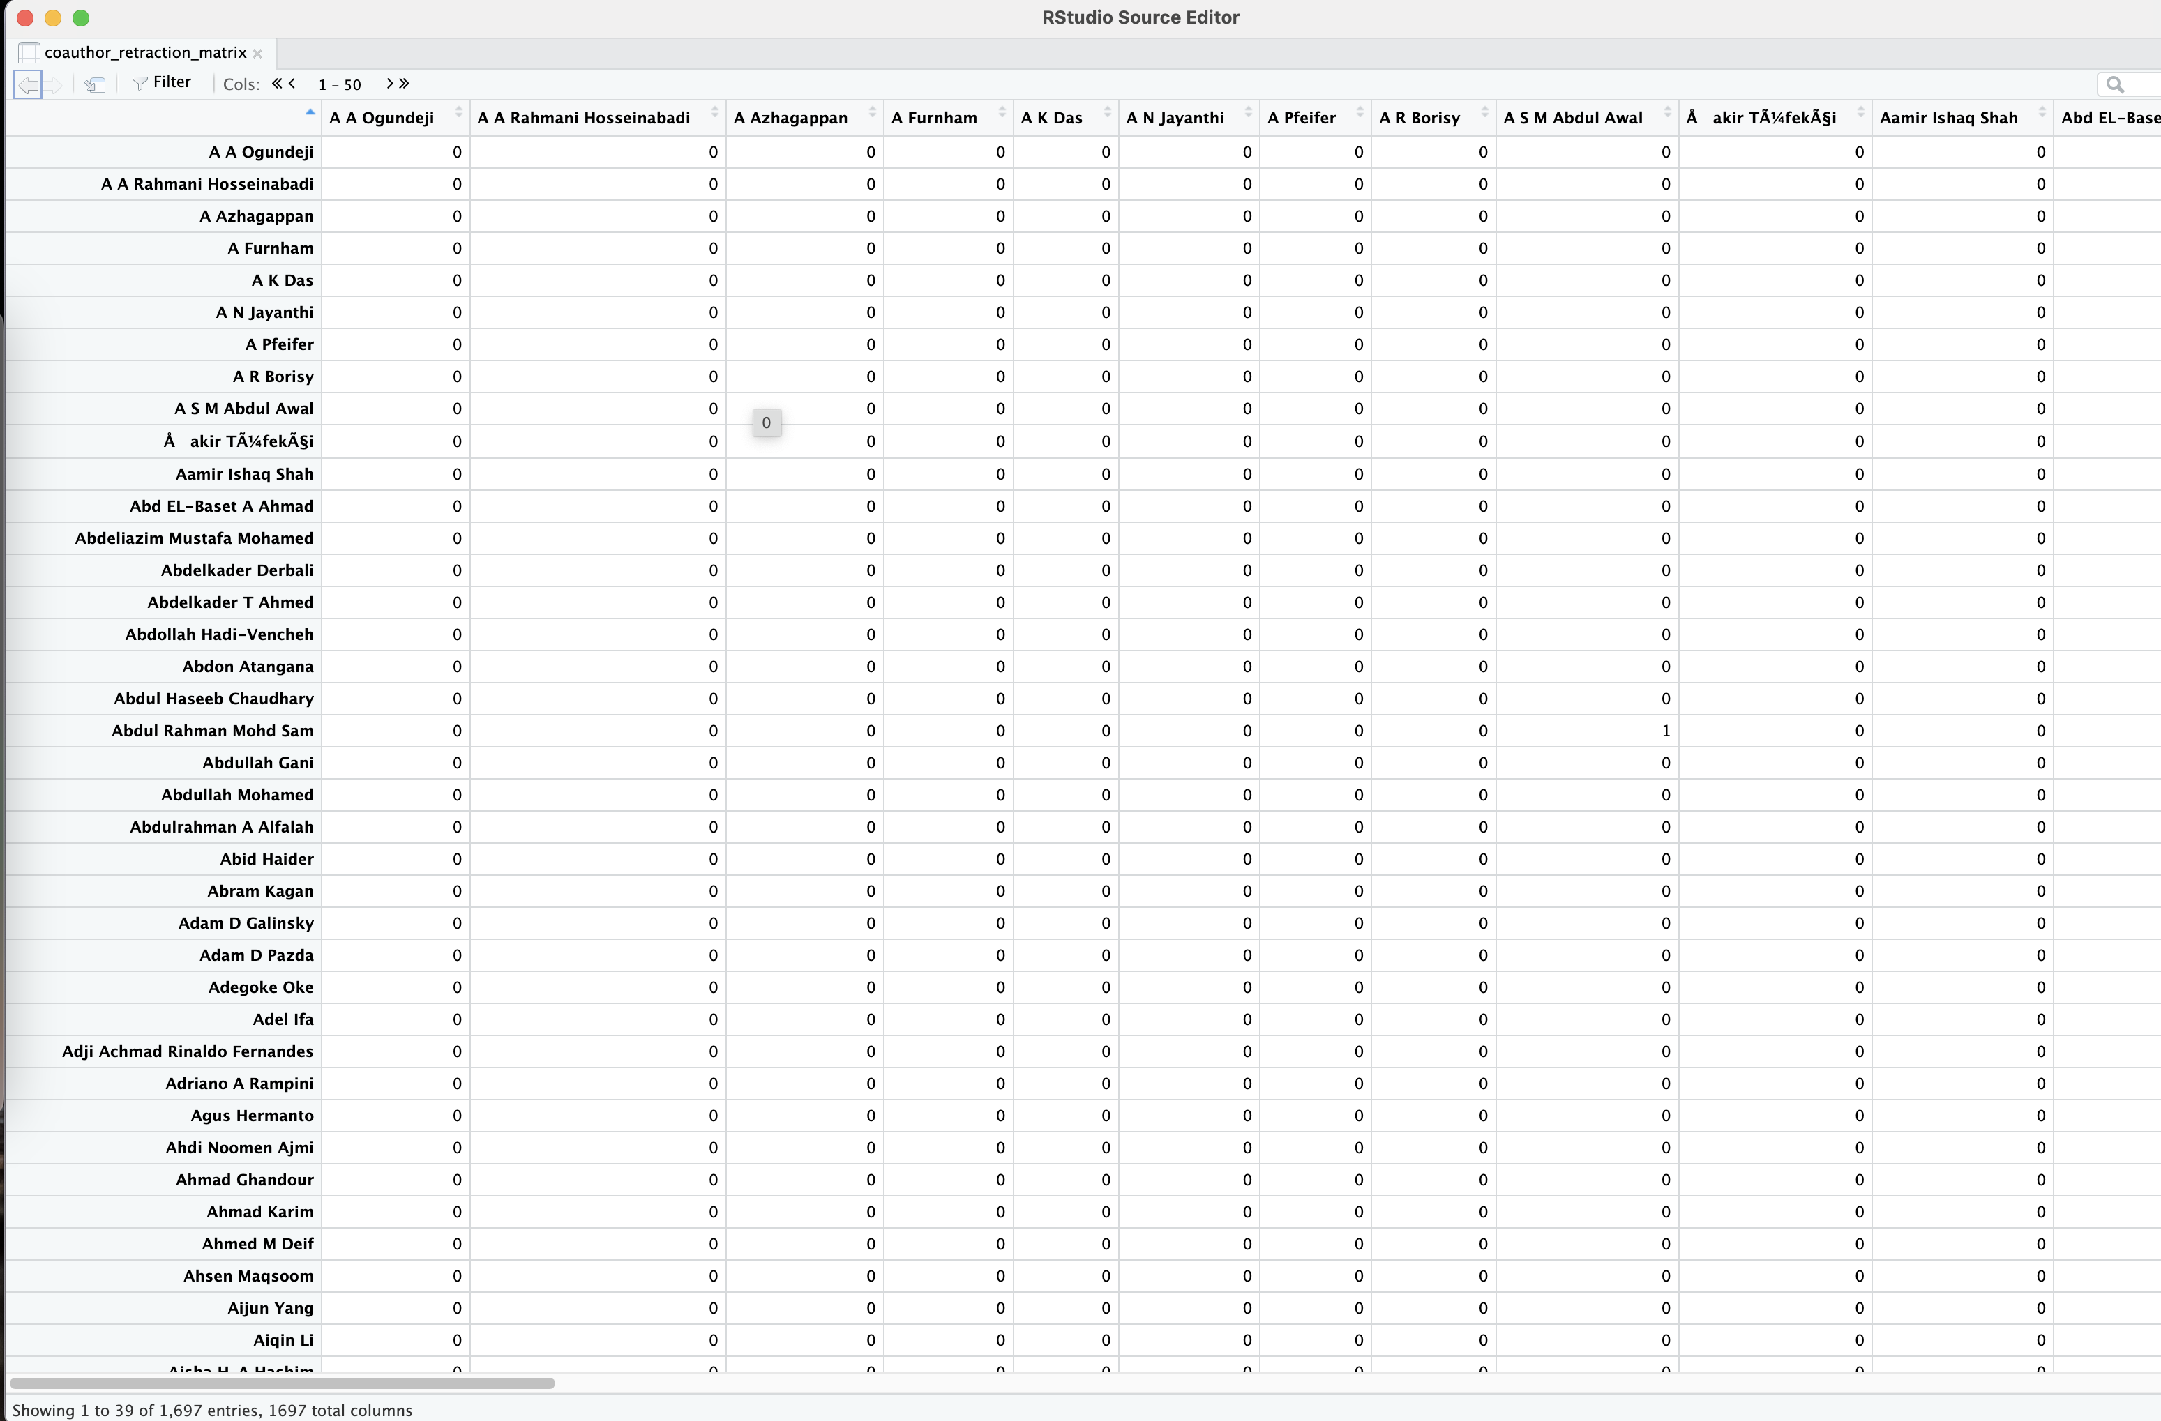
Social Network Analysis
Correlation between relationship matrices
Mantel test

Slide 13
Mantel Test Results
Comparison Categories | Mantel Statistic (r) | Significance | 90% Quantile | 95% Quantile | 97.5% Quantile | 99% Quantile
Coauthor Retraction vs. Author Institution | 0.9866 | 0.000999 | 0.00109 | 0.00149 | 0.00189 | 0.00189
Coauthor Retraction vs. Author Country | 0.1181 | 0.000999 | 0.00140 | 0.00183 | 0.00210 | 0.00242
Coauthor Retraction vs. Author Publisher | 0.09124 | 0.000999 | 0.00120 | 0.00152 | 0.00179 | 0.00201
Coauthor Retraction vs. Author Journal | 0.2089 | 0.000999 | 0.00128 | 0.00163 | 0.00190 | 0.00216

Slide 14
Results – Bibliometrics

Slide 15
Introduction
Retraction:
Retractions also help in identifying and rectifying intentional errors, which are often associated with scientific misconduct (Pourhoseingholi et al., 2021)
A mechanism for correcting the scientific record and maintaining its integrity (Bakker et al., 2022)

Slide 16
In a perfect world, retractions should be seen as a self-correction mechanism created by academics to refine the advance of knowledge.
Many retractions stem from unethical means
Paper Mills
Paid publications
Quid Pro Quos
Academic Vultures

Slide 17
Motivation
Retractions are increasing day by day
important to understand the patterns and reasons behind retractions
a significant number of retracted publications continue to be cited even after retraction,
This leads to inappropriate citation and use of retracted data in otherwise correct (Samp et al., 2012; Cassai et al., 2022)

