Slide 1
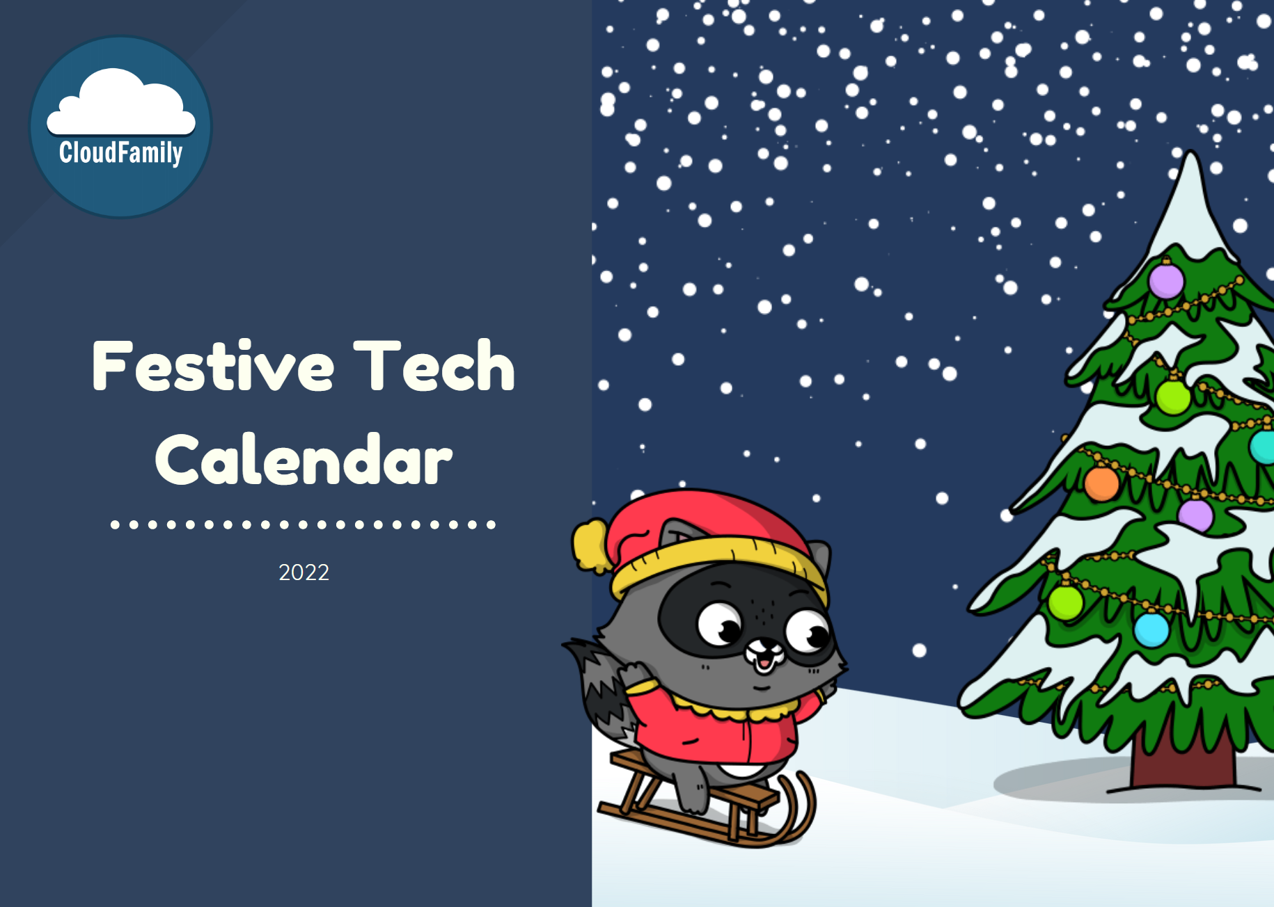
FestiveTechCalendar 2022
https://festivetechcalendar.com

Slide 2

Letters to Santa: Automating text extraction with Azure Cognitive Services.
Sam Gomez

Slide 3




Originally from Mexico.
Tech Lead at Geneca.
Spend time with family, movies, videogames, soccer.
@thesoccerdev
drkclw
samueljgomez

Slide 4

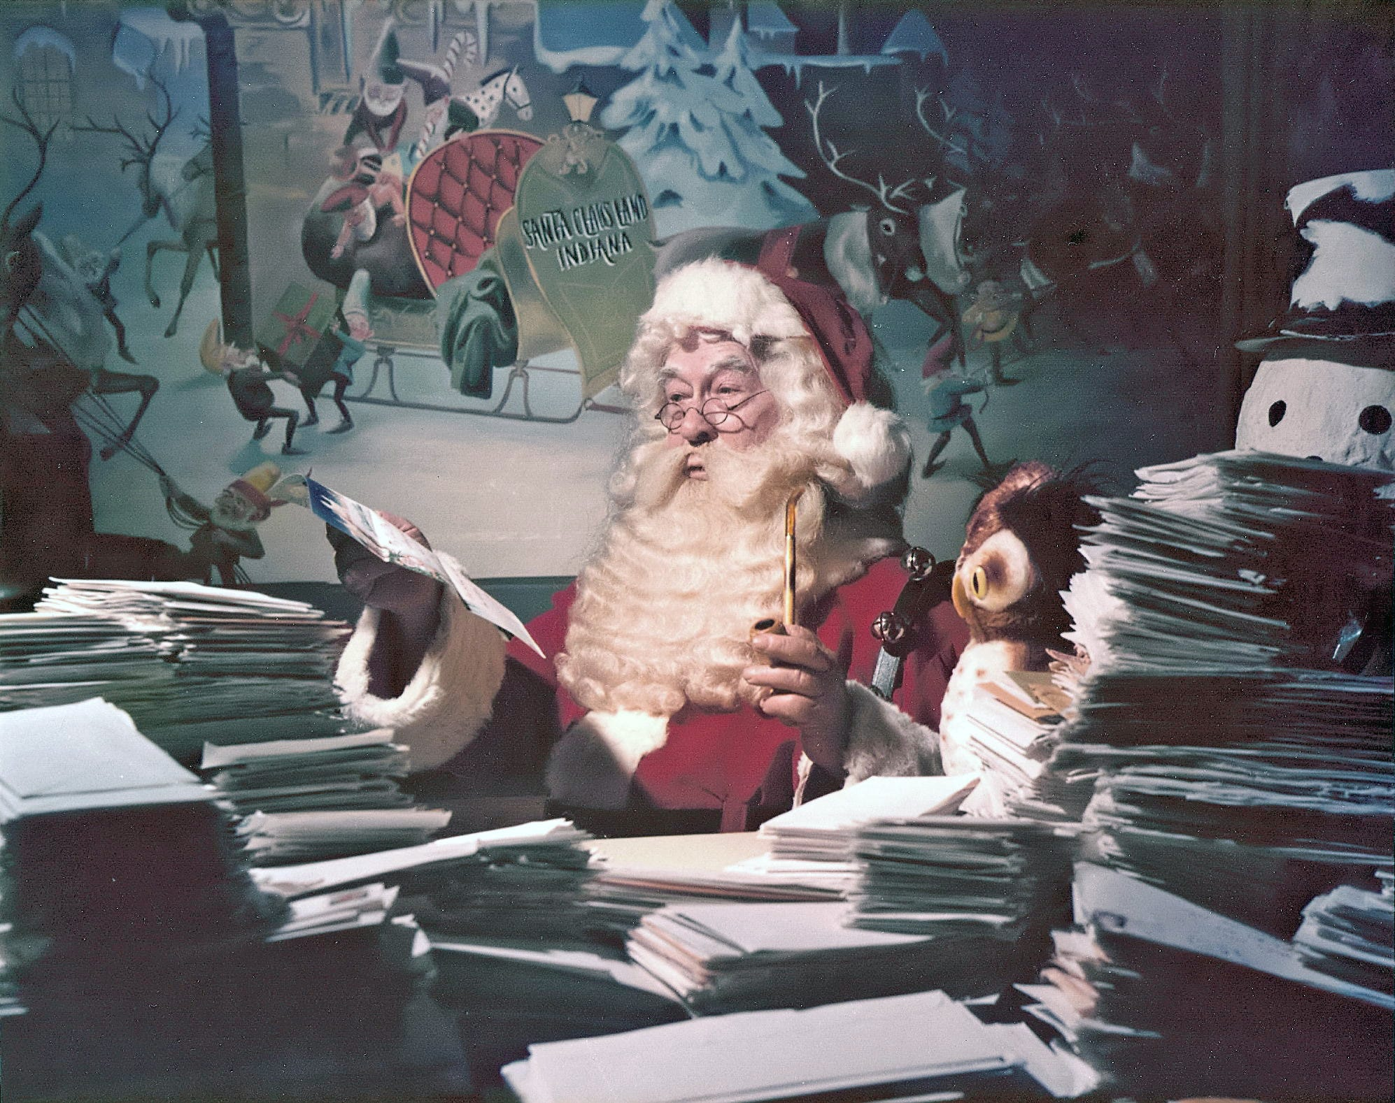
Let's help Santa!
Santa and his elves have a lot of work to do!
What if we could?
Extract text from letters.
Detect the sentiment.
Extract items requested.

Slide 5

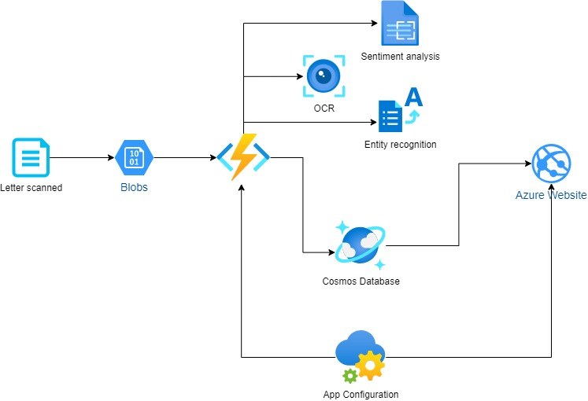
Architecture Diagram

Slide 6
Azure Blob Storage
Storage solution optimized to store unstructured data.
Images.
Audio and video.
Log files.
Backup and restore.
Different access tiers.
Hot, cool and archive.
https://learn.microsoft.com/en-us/azure/storage/blobs/

Slide 7
Azure Functions
Serverless compute solution.
Multiple function triggers.
Blob trigger.
DB changes.
Scheduled tasks.
Analyze IoT data streams.
https://learn.microsoft.com/en-us/azure/azure-functions/functions-overview

Slide 8
Azure Functions
Multiple languages.
C#.
Java.
Javascript.
Python.
https://learn.microsoft.com/en-us/azure/azure-functions/functions-overview

Slide 9
Azure Cosmos DB
NoSQL database offering for Azure.
High performing and scalable.
Multiple APIs available.
NoSQL*.
MongoDB.
Cassandra.
Gremlin.
https://learn.microsoft.com/en-us/azure/cosmos-db/introduction
Notes:
Ideal for web applications
Mutiple APIs allow your applications to treat Azure Cosmos DB as if it were various other databases technologies
*NoSQL is native to Cosmos DB

Slide 10
Azure App Configuration
Cloud service for configuration management.
Decouple configuration and code.
Key features.
Centralized.
Complements key vault.
Dynamic configuration.
Feature flag management.
https://learn.microsoft.com/en-us/azure/azure-app-configuration/overview

Slide 11
Azure Cognitive Services
APIs to add AI functionality to applications.
Easy to integrate with available SDKs:
C#.
Java.
Python.
Go.
Free tier for multiple services.

Slide 12
Azure Cognitive Services
API categories.
Speech.
Language.
Vision.
Decision.

Slide 13
Vision API
Computer Vision
Image analysis
OCR
Custom Vision
Face API
https://learn.microsoft.com/en-us/azure/cognitive-services/computer-vision/overview

Slide 14
Language API
Entity recognition.
Sentiment analysis.
Question answering.
Language understanding.
Translator.
https://learn.microsoft.com/en-us/azure/cognitive-services/language-service/overview

Slide 15
Demo
Cognitive Services tools.
Language Studio
Vision Studio
Speech studio
Application

Slide 16
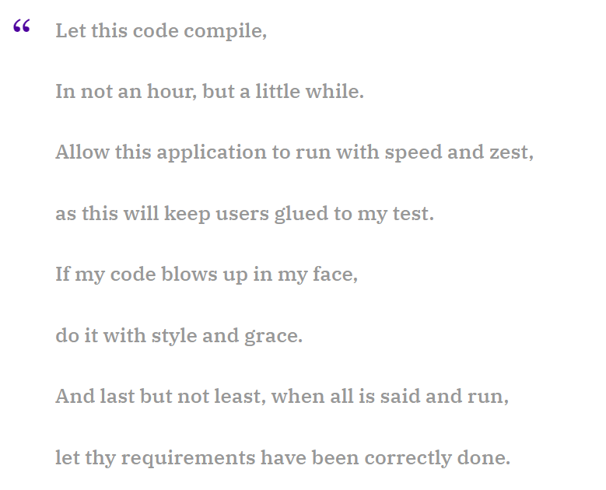
https://www.rambli.com/2016/06/the-prayer-of-the-demo-gods/

Slide 17
Thank you
https://festivetechcalendar.com

