Slide 1
Intro to GitHub

Slide 2

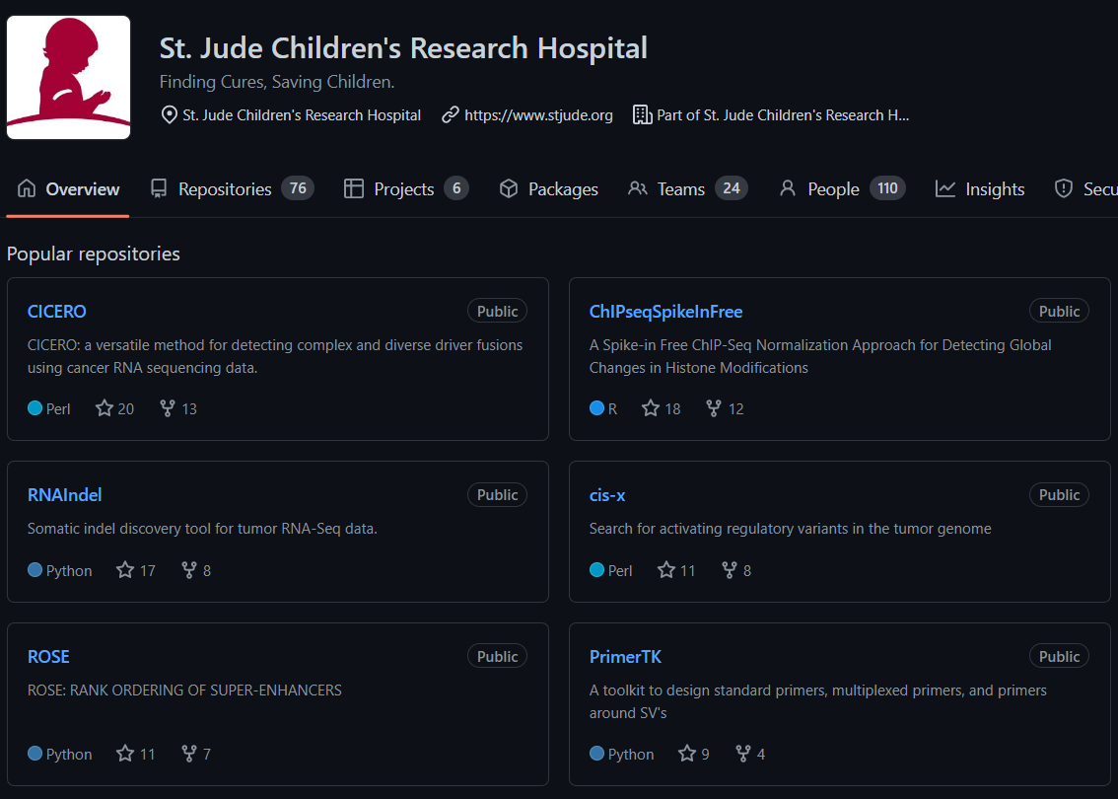
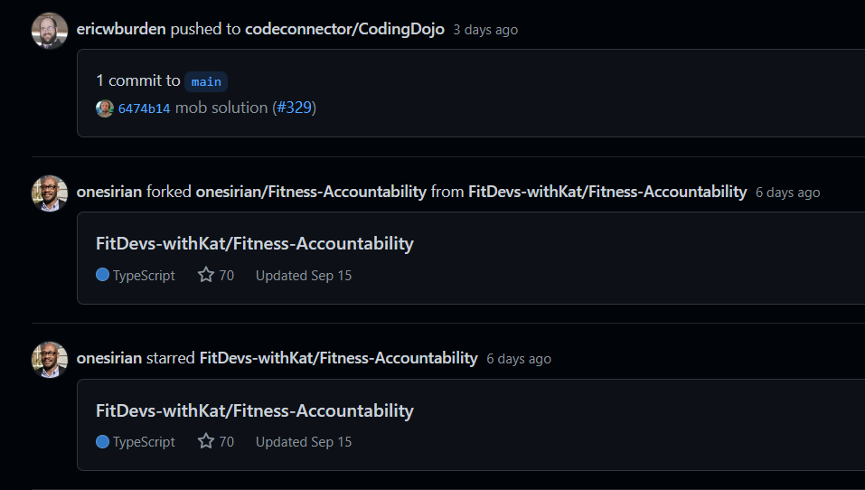
What is GitHub, anyway?
A code sharing and publishing service?
A networking site for developers?
A feature rich git server*?
Notes:
I couldn’t give an intro to github talk without first discussing the question of what GitHub actually is.
Is it a code sharing and publishing service?
Yes! GitHub provides a centralized place for us to publicly publish and share our code. This is powerful because it gives us the advantage of open source.
We want our software and analyses to be the best they can be. Because access is easy, other scientists and developers all over the world can install, use, contribute to, and improve your code all through GitHub.
Is it a networking site for developers?
Yes! As you engage with other developers / projects, you may become interested in their work. GitHub provides an interface by which it is easy to keep track of devs and your favorite projects
All these things are great, but at its heart GitHub is a feature rich git server that successfully abstracts a lot of the complexities of git.
Git is a powerful version control system that will be the focus of much of this talk, developed by Linus Torvalds (the main developer of the linux kernel) because there was no distributed source control manager that met his standards

Slide 3






Before I dive into version control…
Notes:
Maybe in the past, you’ve begun work on some version of code.
In that code, you made it pretty far, and you wanted to try a new thing, but you also wanted to keep track of the old thing, so you made a copy of your file to a new file and gave it a suffix of 2
You like this approach – you now have all your changes scattered across different files in your directory. And since you’re actively working on the project, you can remember all the changes so you know where to look for what.
Now let’s say you get called onto another high priority project that takes precedence so you have to abandon your cool analysis for a bit.
After some time you come back to it with only a vague memory of what the difference between each one is, so you do some mental gymnastics to figure out which files had which important pieces and you realize you need to boil these down to a file that you’ll put in a directory called version 1
You make improvements and updates, maybe even add a few additional files to split up logic, increment the version, and do this all in these directories.
This works for you, and maybe even your team, and other people start using your cool analysis within your institution. Someone has a good idea, and they want to make changes that they want to share with you.
You move your project to a shared location so you can collaborate and you both decide you’ll each have your own directory you work in.
Finally, you’re at a place where you’re both working on that set of files that you gave your collaborator, and you both make changes. You want to come together and compare the changes and iron out what’s best
The thing I’m trying to point out here is that this gets really challenging to do just using filesystem utilities, and at some point, maybe long ago, we’ve all been there to some extent where we’re copying off versions of files so we can incrementally make changes.
If you’ve been fortunate enough to have your analysis published in a paper, maybe you had to scramble to get it into a state where you could release it to the public.

Slide 4

What is a version control system (VCS)
Records a history of file changes over time
VCS consists of:
Repository – database of changes
Working copy – Personal copy of all the files in the repository
Commits – storing local changes in repository
Branch – A track of commit history
Trunk / Main – the primary source code "branch"
Tag – a "named snapshot" of the repository (v1.0, 1.0)
Utility:
Enables multiple people to simultaneously work on a project
Gives access to file and file set history
Notes:
In the simplest form, a version control system (also sometimes called source control management) records a history of file or fileset changes over time.
Doesn't even necessarily have to be software, it can be any file object under the version control system
Consists of a Repository, which is the "kept" warehouse of changes, and working copies for each user.
The repository is essentially a filesystem database, which uses some underlying method to track individual file changes (this method is different depending on which VCS you are using)
Working copy – a user's personal copy of the files in a project. I'll talk about the differences between changing these files locally vs "globally" later on.
VCS compute changes in a working copy vs the repository to track differences between commits
A commit is basically a sign-off stamp that stores local changes in the repository. Commits behave differently depending on VCS type and are generally marked by a revision number or a hash
A branch can be thought of as a branch of a tree. A tree has a trunk, which could also be thought of as the "main" branch of a tree, from which all other branches flow
A branch has a series or track of commits associated with it that each represent the source code at a given point in time, or commit history
Trunk / main is the primary commit track in a repository. Branches can be created off of main, where additional commits can occur, but if they a fruitful, they are generally merged back into the main branch
A tag is essentially a named commit. They basically give humans an easy way to refer to the source code at a memorable point in time (example: v1.0 of software is easier to remember than h57afsdljk, or r180786)
Utility:
- Enables multiple people to work simultaneously on a project and more easily track changes (there is a flow to this)
- You can also integrate work done by multiple people more easily by "pulling" in a team member's changes from the main repository into your working copy, based on their recent commits
- Branching enables multiple people to work on different features of the same code from the same (or different) points in commit history
- Giving access to file and file set history is important when you think of concepts like "versioning" software
- I'll go into more depth about "utility" when I begin discussing git
The diagram at the bottom is just a visual representation of how collaborators might work on a project together.
At point 5, 2 people made a branch off of that commit from the main branch. You can see in the blue line, some additional commits were made in the branch, and in the green line some additional changes were made in the branch
Then, indicated by the arrows (forgive the orange arrow), the blue branch was pulled back into the main branch, then the green branch was pulled back into the main branch.
In each of these cases, each collaborator worked on their own individual feature of the code, and then pulled it back into main when they were done.
Lastly, I'll briefly touch on the 2 main types of version control systems: Centralized vs Distributed before diving into git

Slide 5
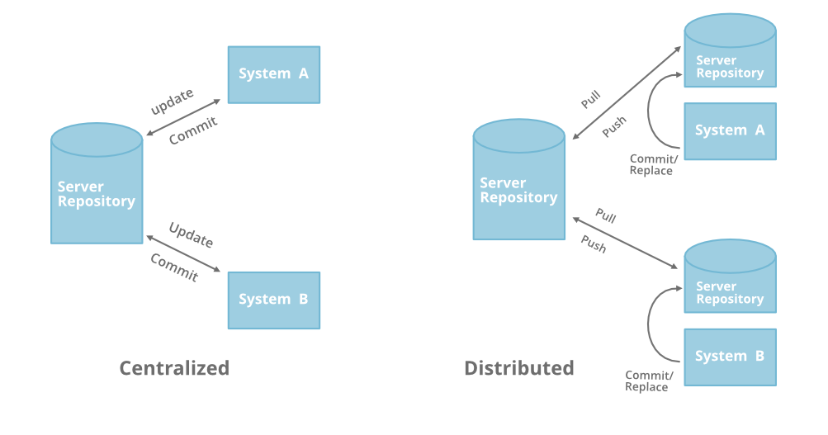
Centralized vs Distributed VCS (should I talk about this?)
geeksforgeeks.com
Notes:
There are really only 3 main types of version control systems (at least that I'm aware of), being local, centralized, and distributed.
Today, I'm only going to discuss centralized vs distributed as local I don't really see any point in discussing the local vcs.
Centralized:
- uses server client model:
- to work on any code, first the client (or user) needs to get the code from the master repository on the server.
- When you commit changes, you must commit them directly to the server, you do not commit changes to your local copy
- all the history also lives on that server.
- so all code comes and goes to this master repo
- if main server dies, at the very least a new main server must be recovered. If you haven't dumped the repo, then you can't completely recover the history, and the best you can do is start from your oldest commit
Distributed:
- Main difference here is that every server where a repository is cloned can act as the "main" server.
- so if me, brent, and andrew all clone a git repository, we all have the full history on our local machine
- we can also commit locally to store changes, without any connection to a main or remote server
- however, if we want to collaborate with each other, then we have to have a remote server that we are all connected to (ehem, github).
- when we want to share changes with friends, we must push our changes to the remote server. If we want to get changes from our friends, we have to pull their changes to our local server from the remote.
- We can have as many remotes as we want. For example, I could have a remote in github, bitbucket, azure devops, and git.stjude.org, and all would be fully capable of acting as the "main" repository
- So, if any of the remotes die a brutal death, the repo can be recovered from any of the other repositories to a new remote just by pushing the repo to it, because each git repo has the entire commit history.

Slide 6
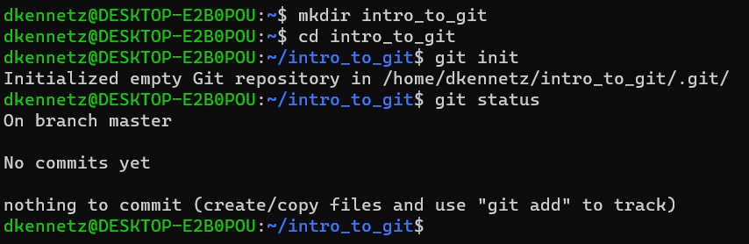
Git init
Notes:
Git is a distributed VCS developed by Linus Torvalds (also the main developer of the linux kernel).
Today, we will be covering the basics of git, and github. Fortunately, the basics will get you pretty far!
Let's begin.
In the pre-meeting instructions, I've asked you to make sure you had a github account, and git installed on whatever computer you decide to do the workshop on.
If you do not have git installed, then you can always just hop on the HPC cluster hpc.stjude.org and do the workshop there.
If you do not have a github account, don't worry. It will be better for you to follow along with the git intro, and you can follow the slides after the workshop when you have an account setup.
Okay, so let's get started. First, we will simply create a repository

Slide 7
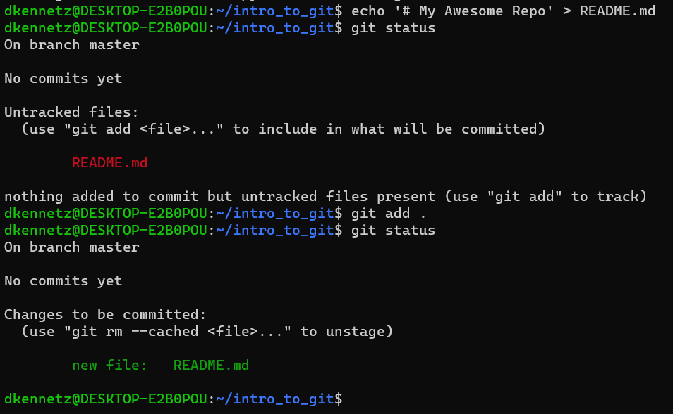
Git add
Notes:
The next most basic step in a workflow is to add a file to be tracked. The git add command basically stages a new addition to be committed.
At this point, these staged changes will be the only thing committed to git. If you add additional changes to the file, git will tell you that you have untracked changes as well as changes to be committed.
Here, I do a git add .
This will add all the files in the current directly to the staging area.
If you want to add a single file by name, you can do that by doing git add filename or git add path/to/filename. I'll show this example later.
Git now shows this file as a new file ready to be committed. Once this is committed, it will be tracked by git until it is removed, and the removal is committed!

Slide 8
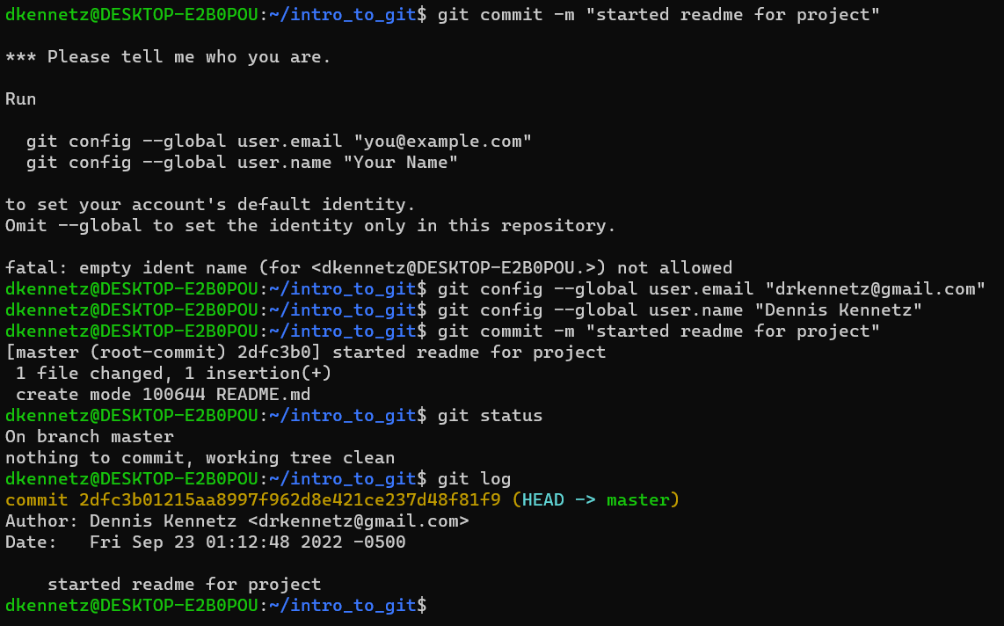
Git commit
Notes:
Now, we will commit our changes to the README.
Uh oh! Git wants, no git demands to know who we are. Fortunately, it gives us a nice help message to tell us how to tell it who we are.
There are many such configurations, but we will only touch on a few.
By running the two commands above, you can set a global configuration for your git environment. The two above will be sufficient to set your email and name.
It can be smart to match this email to the one you use for your github account, although it's not required.
Now that we've added our name, we will commit the readme with a brief, but informative commit message. This way, when we go back through the log, any future users can have an idea about what happened on that commit.
Once a file is added and committed, it will now be tracked by git until it explicitly removed, and that removal is also committed to the repo.
Here's an example of a log.

Slide 9
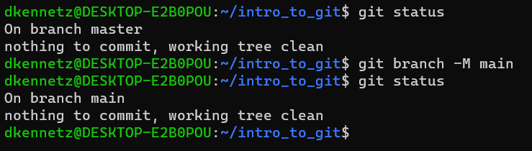
Git branch –M main
Notes:
Historically, git has always created the first branch in a repository with the name master. As the world became more aware of the words it uses to describe things,
There was kind of a consensus to change that from master to main, so I'll show you how to do that.
This is also important, because every new repository you create in github will be created with the main branch as main, so it is necessary to have them in sync.
Great, now our main branch is actually called main.
You may hear other developers call this branch master, as it has been that way for a long time. The two mean the same thing with respect to git.

Slide 10
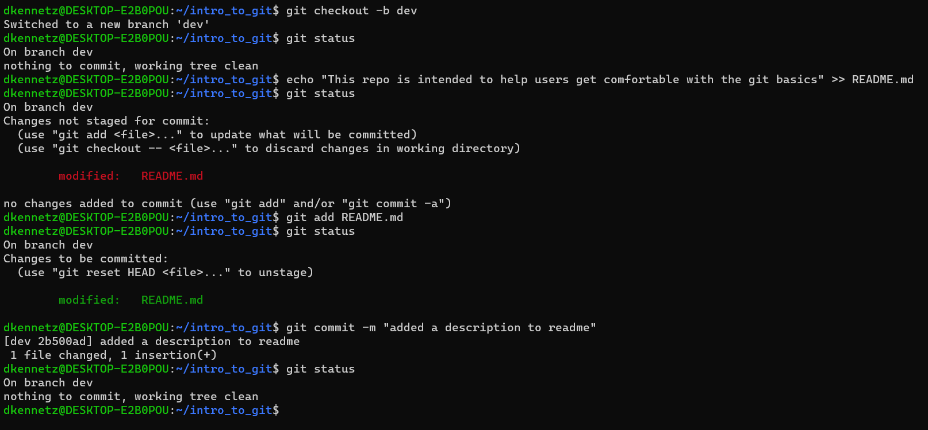
Creating and working on a new branch
Common gitflow model
Create dev off main
main
Create feature1 off dev
dev
feature1
Commits in feature1
merge feature1 back to dev
Run tests, commit bugfix in dev
merge dev back to main, release!
Notes:
There are 2 dominating styles of working in a repository – trunk (main branch) based development, and gitflow.
Trunk based development serves agile teams well, where people are mobbing and actively coding together as a group for a majority of the day, developing a single feature together before moving to the next feature.
As this is unlikely to be the case in our scenario, a gitflow model of development will serve us better. In gitflow, main branch access is pretty strict (IE we aren't performing all of our commits there).
A common gitflow model is shown in the right, and it is pretty good practice to use this if you are working on a project with more than one person
In this model, we create our repo, and pretty much immediately create a development branch.
From the development branch, we begin working on feature, so we create a feature branch.
We finish work on the feature branch, and people have reviewed our code, so we are ready to pull it back into dev.
We run tests and decide we need a bugfix, so we commit the bugfix to dev and run our tests again.
All is well, and the code is reviewed, so we are ready to commit it to main!
Now I'll show that process with the code on the left in the terminal:
Git checkout changes branches. Git checkout –b creates a new branch and checks out to it. Checkout basically just means "switch to that branch"
In fact, in newer versions of git, there is literally a "git switch" command which is used to change branches.
Some of the git terms can be a bit overloaded, so they may take some getting used to.
We've now made some changes, and are ready to commit again, this time to our new branch "dev".

Slide 11
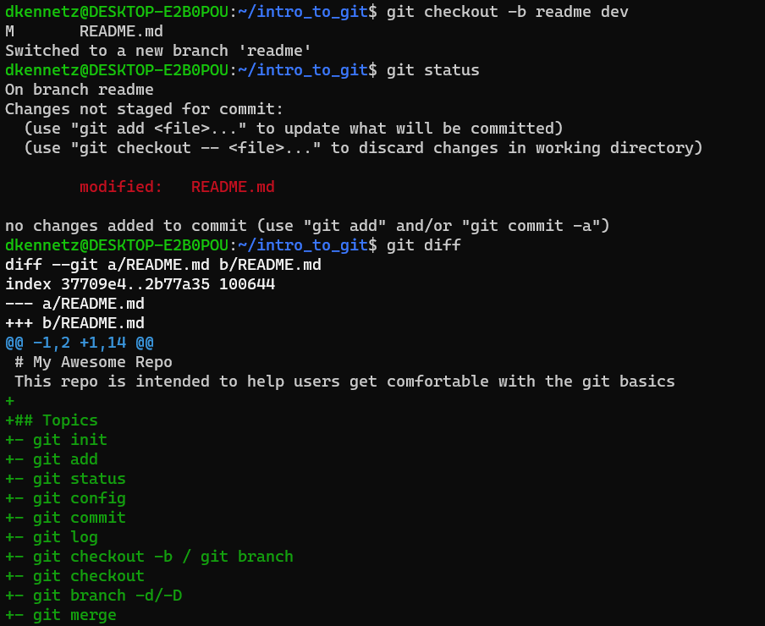
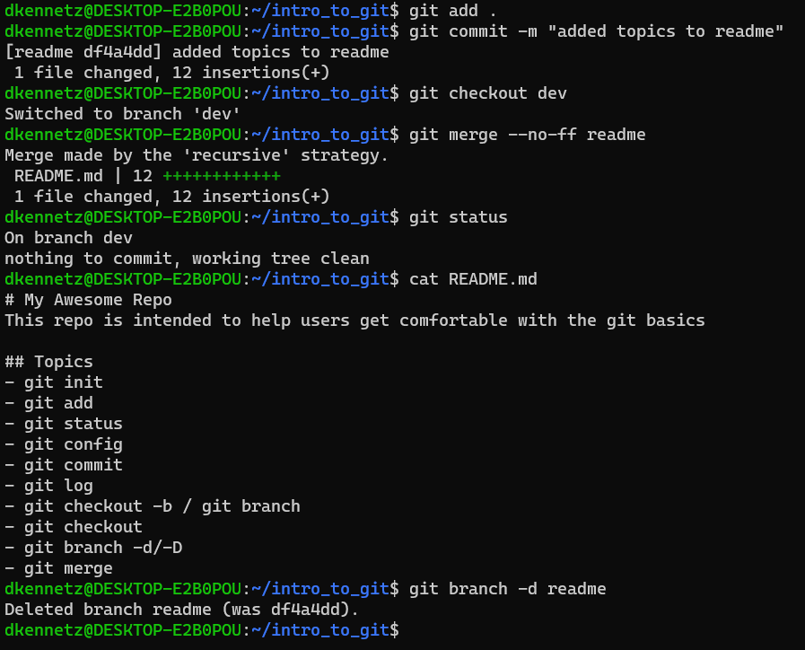
Feature branch, git diff, git merge
Notes:
This slide is jam packed! A lot of it is stuff we have already seen.
So we start by creating our first feature branch – the readme branch!
The format here creates it off of dev by doing git checkout –b feature current
We see there are changes to a file that haven't been staged, and we look at those changes with git diff
We then add those files and commit them.
After we commit them, I decide I am done with my feature branch (they usually live longer than this), so I git checkout (no b) back to dev
Finally, I merge readme back into dev, see the file changes, and delete the readme branch

Slide 12
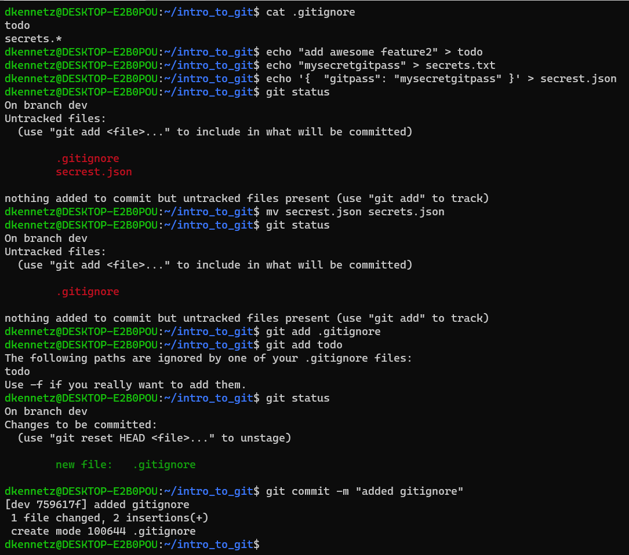
Adding a .gitignore
Notes:
I'm really starting to get busy with this git stuff, and I realize that I'd like to have files in my repository that I don't necessarily want to see on git.
These could be the result of a text editor, an IDE, or having local secrets in your repo.
I'll show you with a simple example. Let's say I want a todo list, but I don't ever want that to be tracked by git.
The gitignore is actually pretty crazy.
One thing about it is that before it has even been committed, it immediately starts ignoring files.
In the example above, you can see that I have "todo" and "secrets.*" (wildcard) in my gitignore file
A wildcard char works just as you'd expect it to on linux. It matches everything after the chars and ignores them.
So we can see, first I add a line to my todo file (which is ignored)
Then, I add my secret github password to my secrets.txt file.
Finally, I add a sweet json file – but oops, I spelled it wrong! When we do the git status, we can see that it is being tracked.
No worries, if I simply move the file before staging it to have the correct name, we can see that it is properly ignored.
And check this out, even if we try to add an ignored file, git will give us a helpful message telling us we are trying to add a file on the gitignore list. We can add it if we really want to, but we explicitly have to pass the –f (force) option.
Finally, we commit our gitignore

Slide 13
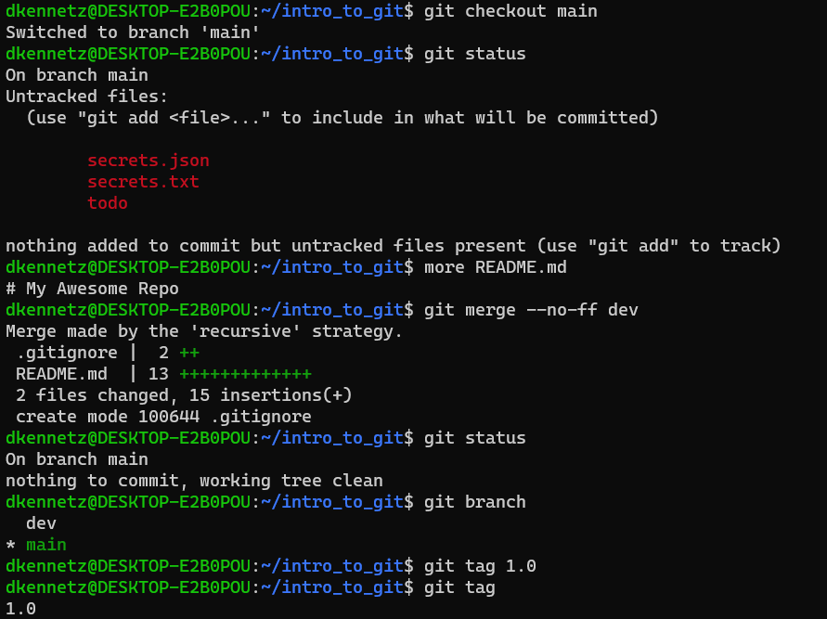
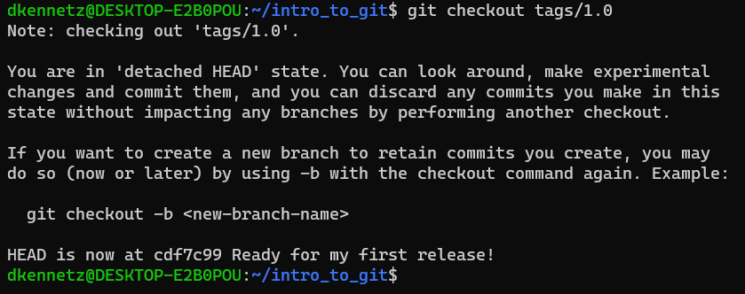
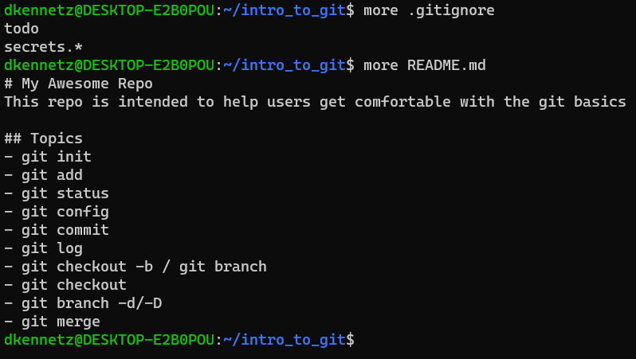
Merge back to main and tag
Notes:
We're ready for the file hoorah of our intro to git, we will move all our work back into main, and tag it.
So to start, we can see that I checkout back to main (so I'm back in my main branch as we see from the message).
Interestingly, if I do a git status, we can see those files I added to the gitignore in dev are now showing up in main.
We can also see that my README.md file still only has that single line: # My Awesome Repo
That's because we haven't merged the dev changes, so let's do that.
I merge dev, and we can see that doing so brings in a gitignore with 2 lines, and adds 13 lines to my README.
Awesome, I think I'm ready to tag this thing!
I list my branches with git branch one more time just to be sure I'm on main, and I tag it with 1.0.
Then I list the tag just to show that there is a tag 1.0
To really show there is a tag, I'll actually check out to the tag and you'll see this weird message, saying we're in a detached HEAD state.
This basically means that I'm not pointing to a branch, but rather a commit and any changes I make while in this state will be lost as soon as I leave.
Finally, I show the contents of the files just to show that all my changes have indeed been brought in.

Slide 14
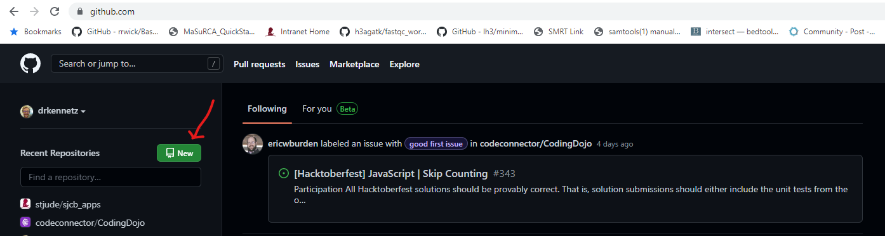
Let's put this puppy on GitHub!
Notes:
Login to github.com and it should take you to what looks like a social media page for developers. Yours may be empty if you don't follow anybody. I follow some friends, so mine has some stuff.
Let's create a new repo by clicking on that big green New button on the left

Slide 15
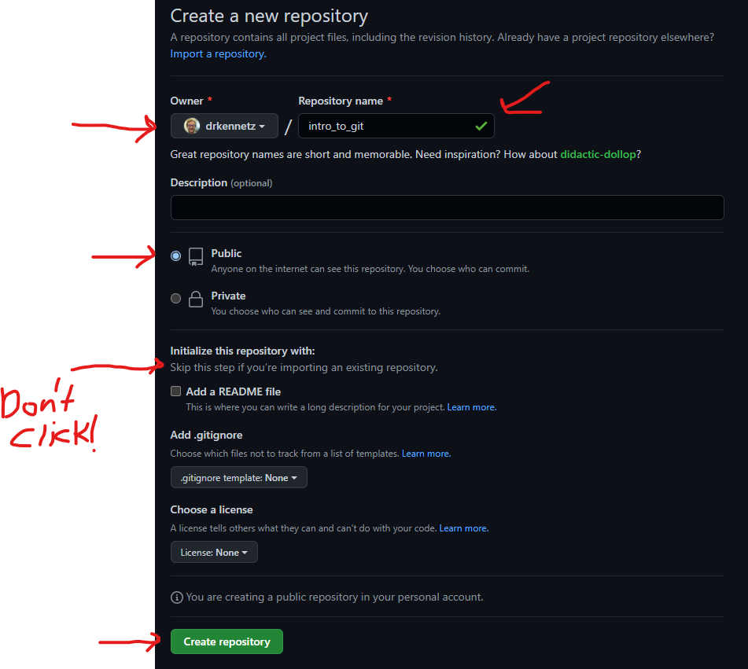
Fill in your repo name
Notes:
Here, we'll select the repository owner (you'll probably only have yourself), and give the repo a name.
Now, a note here. Git repositories don't really have names. This is a namespace used by git in the form of [repo owner]/[repo name] so that repository names don't clash
I'll set mine to public so that you all can clone it – open source babayyy!
There's a line that says "Skip this step if you're importing an existing repository". That's exactly what we are doing so we won't click any of those buttons!
Finally, we'll create repository!

Slide 16
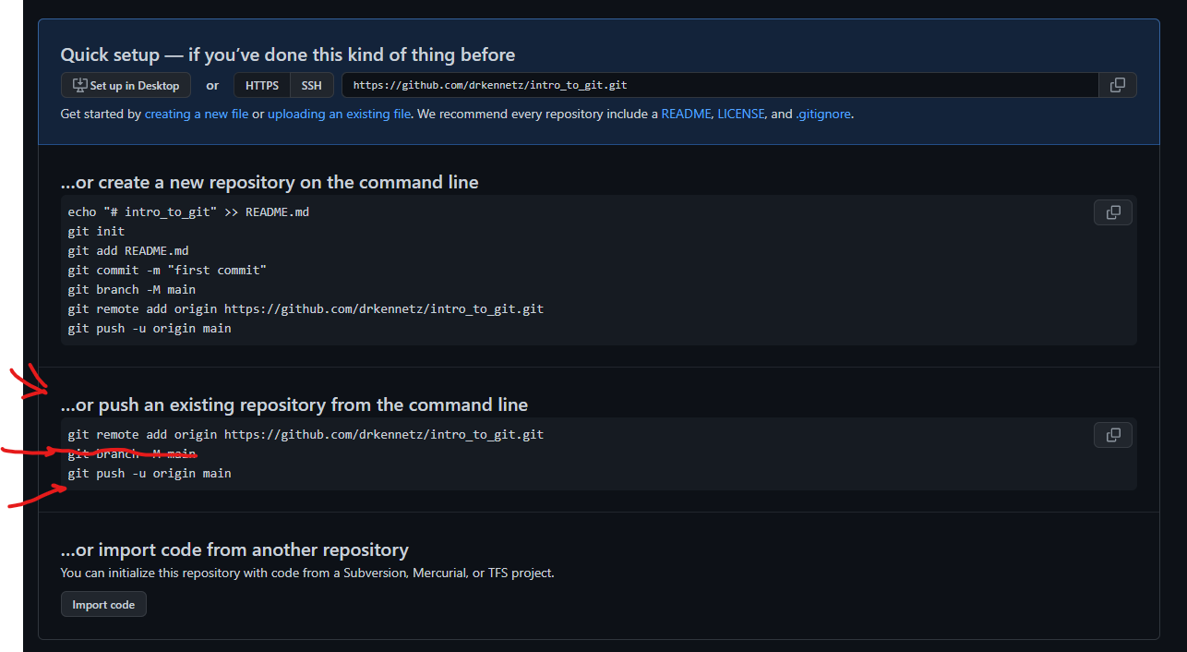
Repository Created – Check out GitHub's helper message
Notes:
One thing I love about github is that they give you these awesome help messages for really all your use cases.
We are doing that middle box – we are pushing an existing repository from the command line. Copy that first command "git remote add origin <url to your repo>"
We already did the git branch –M main, so we don't need to do that. If we didn't do that and had a master, I think github would create a new branch called master.
At this point, they may not even let us do that, I don't know.
Finally, let's try to do that git push command and see what happens

Slide 17
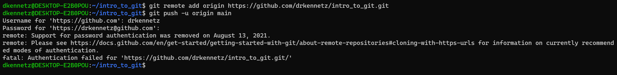
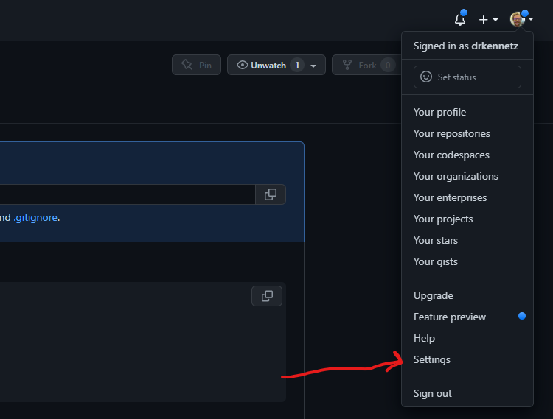
Darn safety nets – let's fix this: Personal Access Tokens!
Notes:
GitHub has a safety nets around pure password logins. I guess that's more secure :D.
In the top right corner, click on your icon which will give you a dropdown menu. Click settings

Slide 18
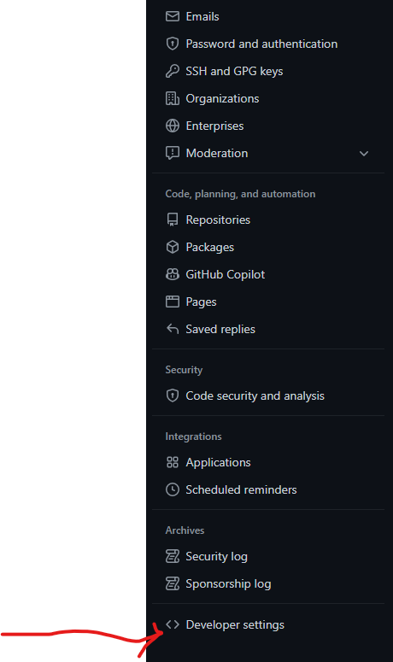
Developer Settings
Notes:
After you click settings, on the left side at the very bottom there is a link called "Developer settings". You might have to scroll down to see it

Slide 19
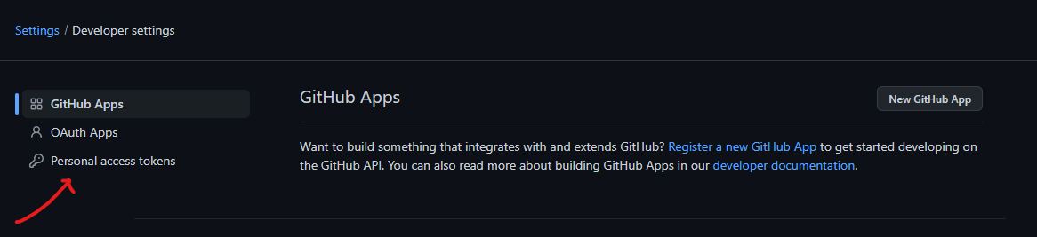
Personal Access Tokens

Slide 20
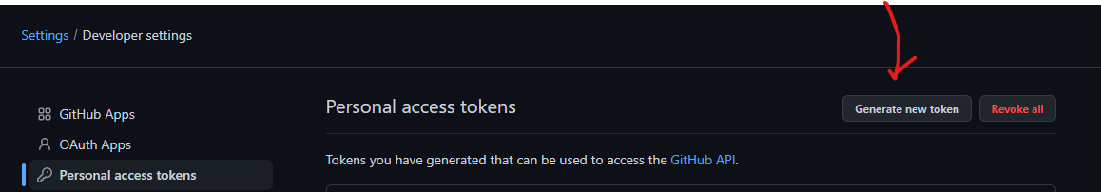
Generate New Token

Slide 21
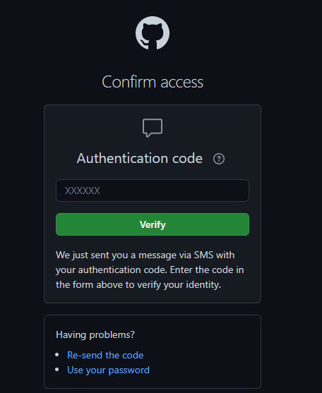
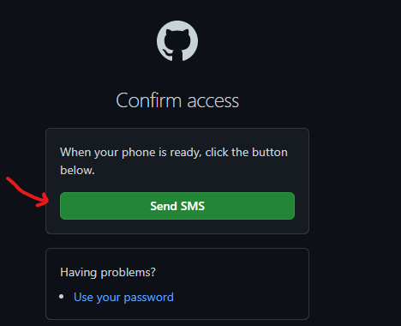
2FA
Notes:
Now, for the 2-factor authentication. Have them send your text (or email), then enter the code that gets sent.

Slide 22
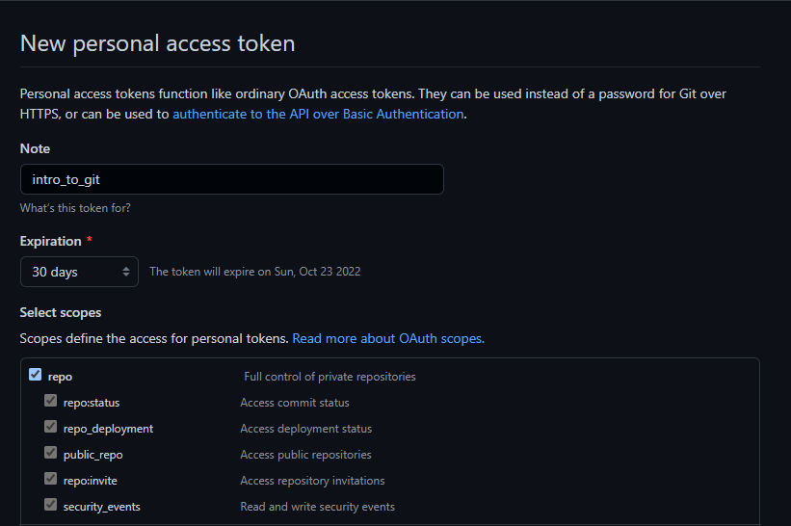
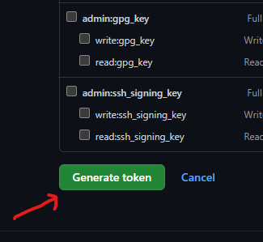
Assign Permissions to the Token
Notes:
Here, you are assigning permissions to what you can do with the token, not what your account can do on github.
If you are logged in to your github account and you own a repo, you can do whatever you want.
Repo level access is sufficient for what we're doing.
After you click the repo box, scroll all the way down and click generate token.
But be careful! Once you are on the next page, if you leave and you didn't save the token, it'll disappear and you'll have to do this again.

Slide 23
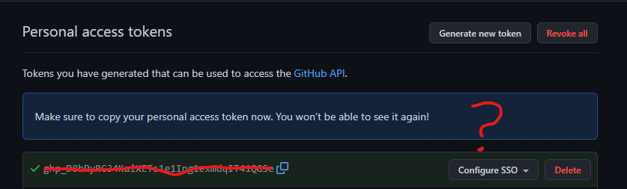
Copy the token to a file
Notes:
It all comes full circle. If you see, I'm in my intro_to_git repo, and I've copied the personal access token toa file called secrets.pat that matches the pattern in my gitignore so it won't show up in my git repo.
There are better ways to handle secrets than putting them in ignored files in your gitignore, but this'll do for now.

Slide 24
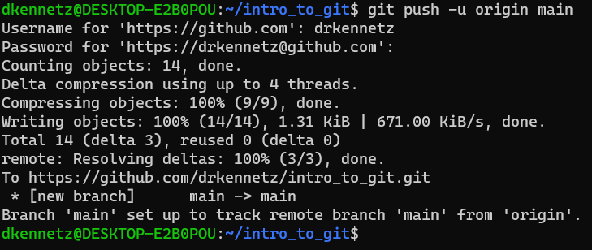
Now we finally push to our repo!

