Slide 1
Distributed communication on a GB300 pair: measure, diagnose, one change, proof
NCCL all-reduce · NVLink vs RDMA vs TCP · DDP scaling · one controlled optimization, and the counters behind every number

Slide 2
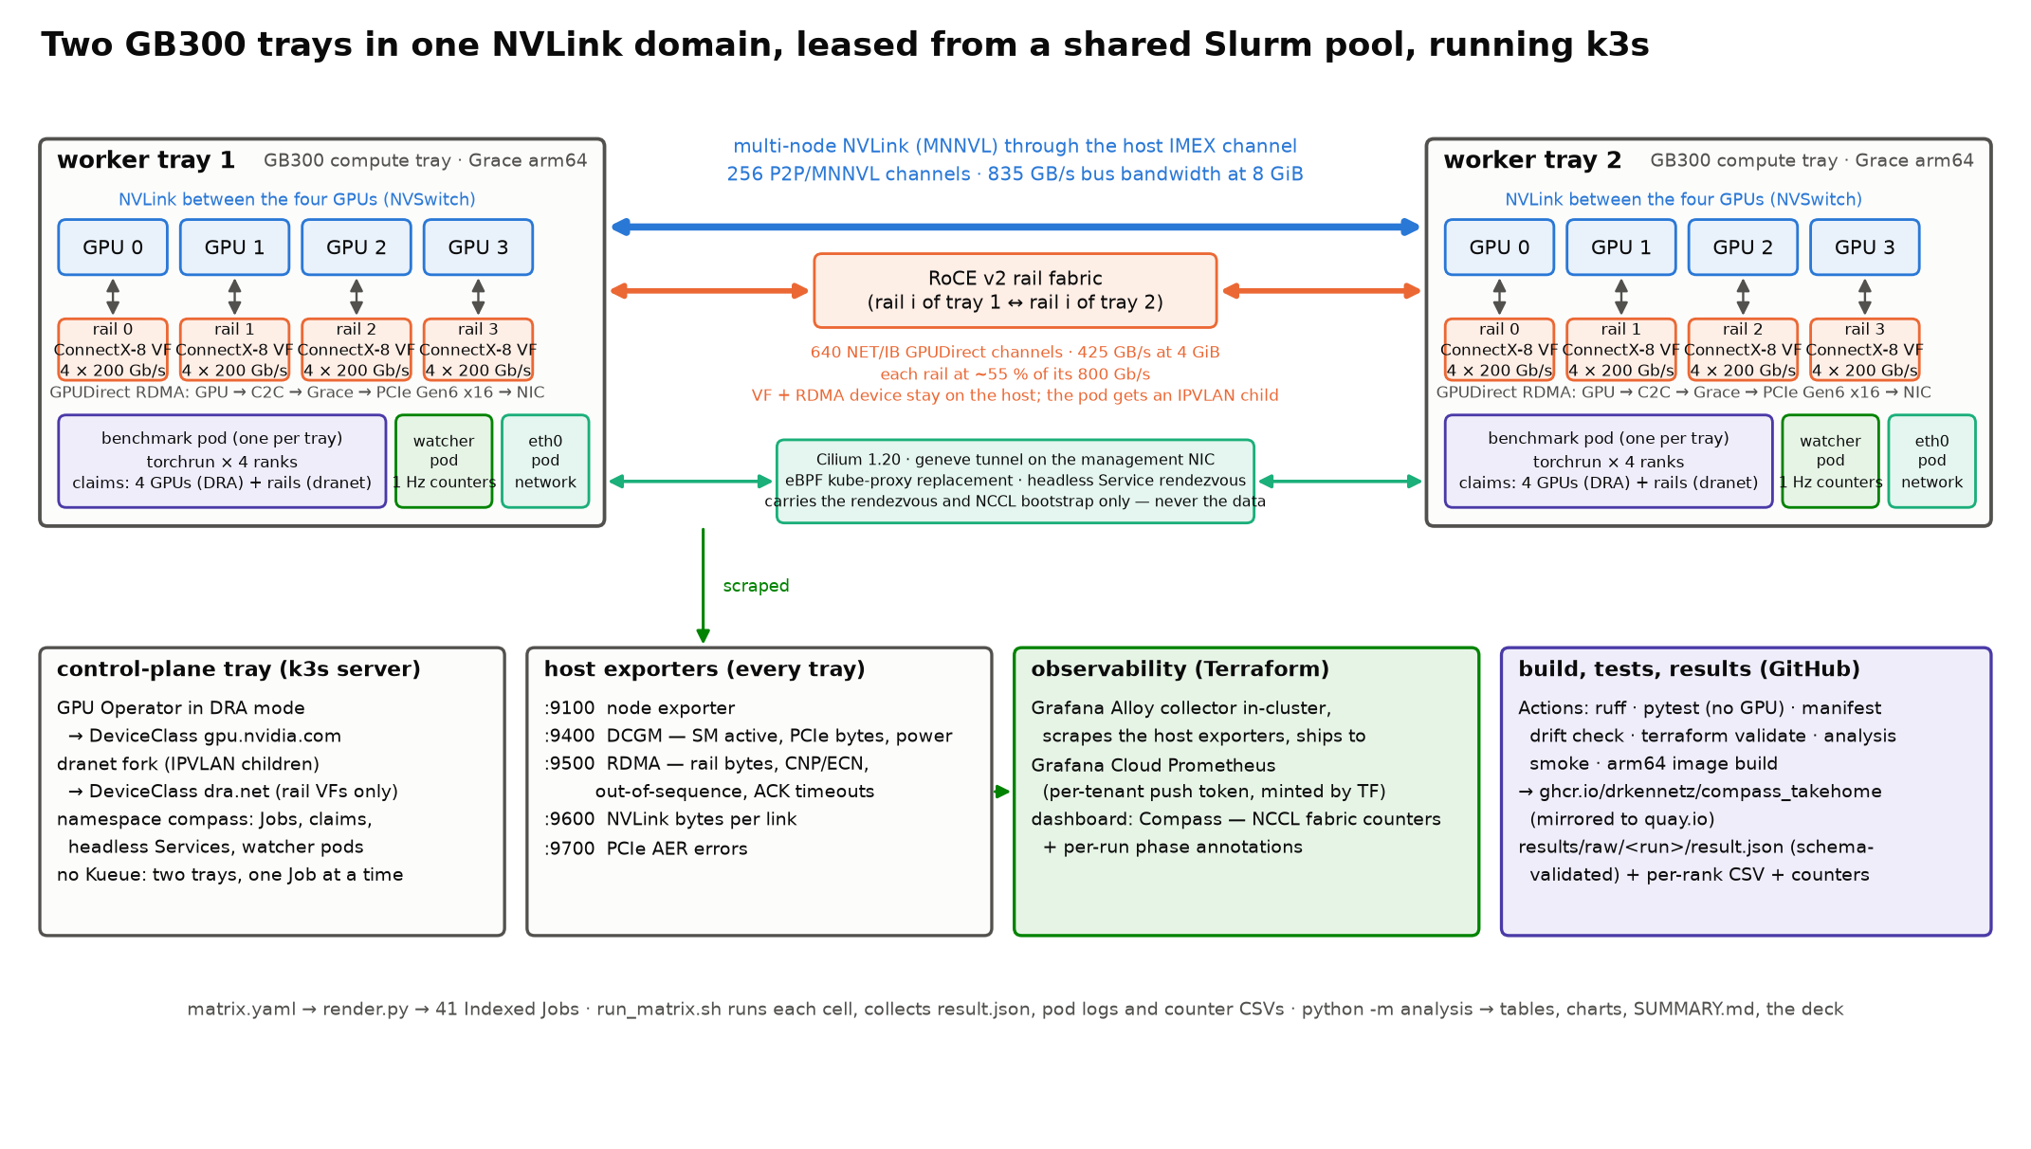
1 · Architecture: two trays, three networks, one Job per experiment
Notes:
ON THE SLIDE (say these):
Two GB300 compute trays (4 GPUs + 4 network rails each) and a small control-plane node, leased from a shared Slurm pool and turned into a Kubernetes (k3s) cluster
Three ways for the trays to talk: NVLink between trays (the fast path), the RDMA rails (RoCE v2), and plain TCP over the pod network — the benchmark runs the same collective over each
Each experiment is one Kubernetes Job with one pod per tray; every pod claims its GPUs and its rails through the same allocation mechanism (DRA); the pods never run with host networking
Every run writes a machine-checked result file plus per-rank timings; a small watcher pod on each tray records the NIC, NVLink and GPU counters once a second; the same counters go to a Grafana dashboard
What the audience needs to know: a GB300 tray is one node with four GPUs joined by NVLink, four RDMA-capable NICs (one per GPU, called rails), and two Grace CPUs. Two such trays sit in the same NVLink domain, so their GPUs can talk directly over NVLink (multi-node NVLink, MNNVL) as well as over the rails.
Why Kubernetes here: the exercise wants a reproducible environment, not a particular scheduler. Kubernetes gives declarative manifests (committed to the repo), a scheduler that allocates GPUs and NICs as first-class devices, and one image that CI builds and publishes. The trays are borrowed, so the bootstrap snapshots every node and proves it goes back unchanged.
Why three networks: the exercise asks us to separate evidence from diagnosis about networking. Running the identical collective over NVLink, over the rails, and over TCP shows what each path can do before we speculate about bottlenecks.

Slide 3
1 · Why DRA instead of the device plugin, and why dranet for the NICs
• Device plugin (the old way): a node advertises an opaque count such as nvidia.com/gpu: 4; the scheduler only counts; a pod cannot say which GPU, cannot ask for a NIC that matches its GPU, and cannot see device attributes
• DRA (Dynamic Resource Allocation, GA in Kubernetes 1.34): devices are published as structured objects with attributes; a pod writes a ResourceClaim against a DeviceClass; the scheduler allocates the concrete devices and the pod's manifest says exactly what it got
• One mechanism for GPUs and NICs: the GPU Operator publishes gpu.nvidia.com; the dranet driver publishes the rail NICs as dra.net devices with their name, RDMA capability and PCI address — so a pod claims 4 GPUs and the rails it needs in the same manifest, and we can vary the rail count (1, 2, 4) per experiment without touching the host
• Why the dranet fork: upstream moves the NIC into the pod, which on this site trips the node health check and gets the tray drained. The fork gives the pod an IPVLAN child of the rail instead — the NIC and its RDMA device stay on the host, the pod still gets RDMA (shared RDMA namespace mode, set at node bring-up before Kubernetes starts)
Notes:
Plain version: with the device plugin you order 'four GPUs' and get four unnamed GPUs; there is no way to also order the network card that sits next to each GPU. With DRA the cluster lists every device with its properties and the pod asks for a set of them; because dranet publishes the NICs through the same interface, the GPU claim and the NIC claim live side by side in one pod spec.
This is what made the rail-count experiment (1 vs 2 vs 4 rails) possible with a one-line change per experiment, and what let us keep the pods unprivileged and off the host network.
The shared RDMA namespace mode is a Linux kernel setting. It can only be changed when no container network namespace exists, which is why the bootstrap sets it on the freshly leased node before installing k3s, and restores the original at teardown.

Slide 4
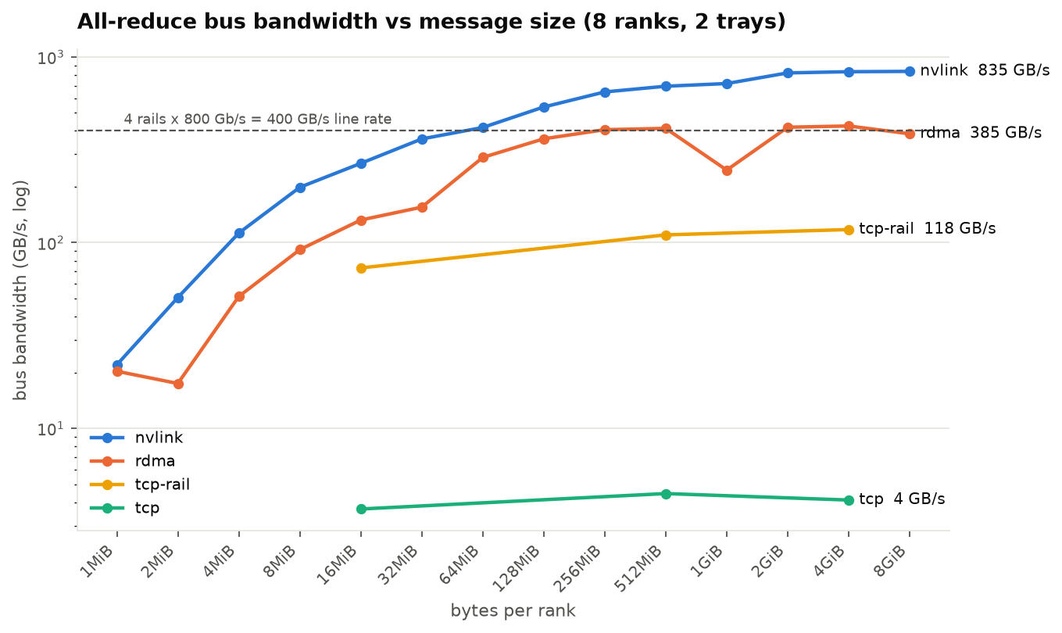
2 · Baseline: all-reduce bandwidth grows with message size, and the network path sets the ceiling
• Same 8-GPU all-reduce, three paths. Over NVLink it reaches 835 GB/s; over the four RDMA rails about 425 GB/s; over TCP on one rail 118 GB/s; over TCP on the pod overlay 4 GB/s
• Small messages are slow on every path because fixed per-operation costs dominate; from a few hundred MiB the wire dominates and the paths separate
• Which path was actually used is read from NCCL's own connection log for every run, not guessed from the speed
size | nvlink | rdma | tcp | tcp-rail
1MiB | 22 | 20.3 | nan | nan
2MiB | 50.6 | 17.5 | nan | nan
4MiB | 113 | 51.3 | nan | nan
8MiB | 199 | 91.7 | nan | nan
16MiB | 267 | 132 | 3.68 | 73.1
Notes:
Bridge from the architecture: we now have three ways to run the very same 8-GPU collective — NVLink, the RDMA rails, TCP. The brief's first job is to measure distributed performance before explaining anything, so this slide is the measurement: one all-reduce, one sweep of message sizes, three paths, and NCCL's own log to prove which path each run took.
Bus bandwidth is the standard way collective benchmarks report speed: bytes moved per second, adjusted so different numbers of GPUs are comparable. Higher is better.
The shape of the curve: for a 1 MiB message the operation takes about 80 microseconds on either NVLink or RDMA — that time is handshakes and kernel launches, not data. As the message grows, the fixed cost is amortised and the curve flattens at the speed of the wire.
The two TCP lines show why the CNI overlay must never carry training traffic, and what a plain Ethernet path costs compared with RDMA on the very same cable (118 vs 425 GB/s).

Slide 5
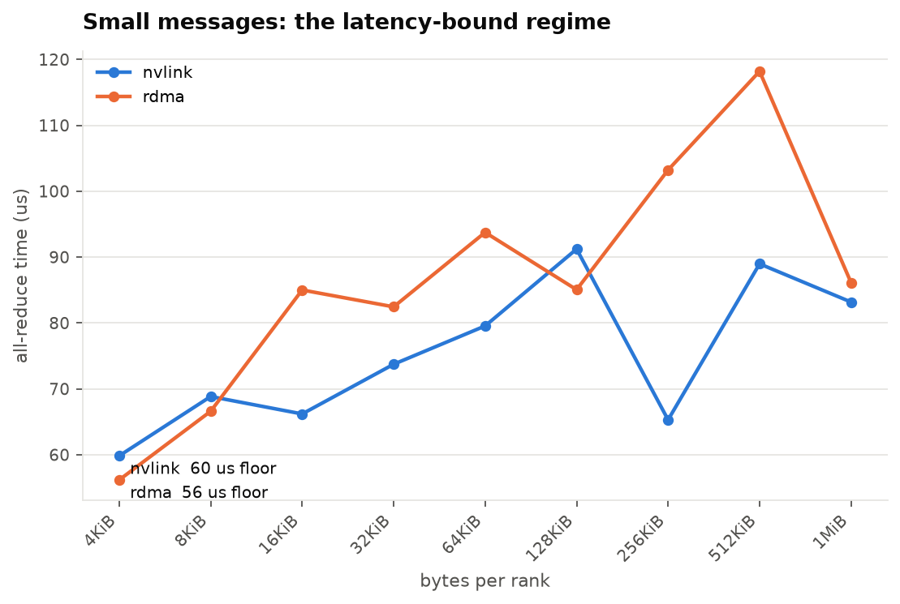
2 · Small messages: the latency floor
• Between 4 KiB and 1 MiB an all-reduce costs roughly the same time whatever the size: around 20 to 80 microseconds
• That fixed cost is the reason a training step with many small gradient messages does not benefit from a faster wire — see the DDP bucket result later
size | nvlink_us | rdma_us
4KiB | 59.8 | 56.2
8KiB | 68.8 | 66.6
16KiB | 66.2 | 85
32KiB | 73.7 | 82.4
64KiB | 79.5 | 93.7
Notes:
Bridge from the baseline: on the left of the previous curve all three paths collapsed to the same speed, which says the cost there is not bytes but a fixed cost per operation. To see that floor cleanly we re-ran the sweep at small sizes, 4 KiB to 1 MiB, on the two fast paths. The number we get here — tens of microseconds per collective regardless of size — is what the training slide and the bucket-size result are built on.
This slide exists to make the diagnosis honest: below a few MiB the network bandwidth is irrelevant; what matters is how many operations you issue. It sets up the bucket-size finding.

Slide 6
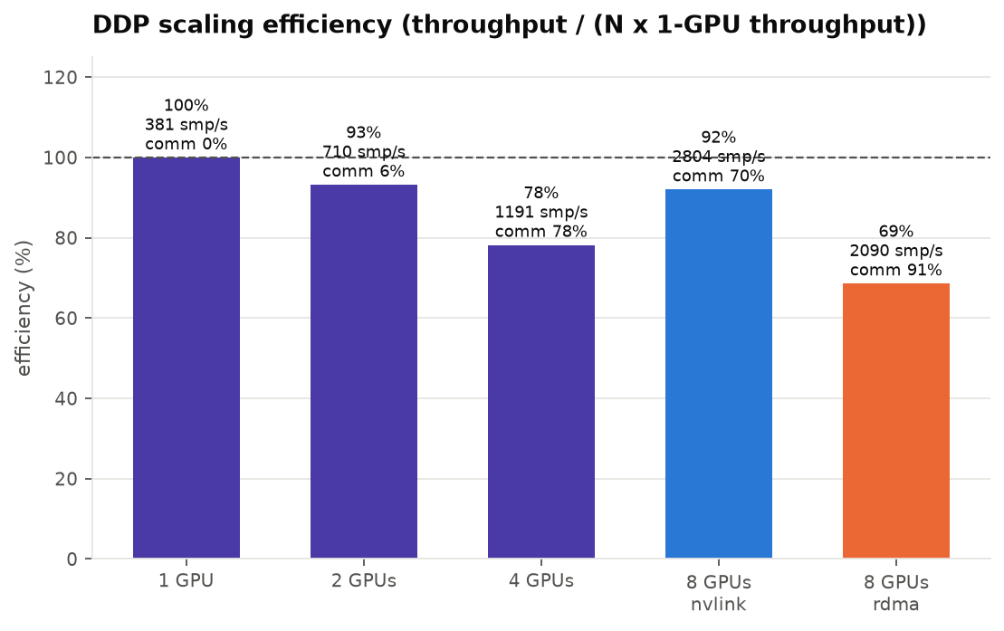
2 · Scaling: the training workload from 1 to 8 GPUs
• Workload: a 124M-parameter GPT trained with PyTorch DDP on synthetic tokens; the same code runs at 1, 2, 4 GPUs on one tray and at 8 GPUs across two trays
• Efficiency = throughput divided by (N times the single-GPU throughput). 93 % at 2 GPUs, 78 % at 4, 92 % at 8 over NVLink, 69 % at 8 over the rails
• The 'comm' figure is how much of each step the GPU spends in communication kernels (from the PyTorch profiler); at this model size the gradient exchange is a large share of every step
run_id | gpus | nodes | transport | path | samples_per_s | step_s | step_p90_s | comm_fraction | speedup | efficiency | bucket_cap_mb
e3-g1 | 1 | 1 | nvlink | local | 381 | 0.021 | 0.021 | 0 | 1 | 1 | 25
e3-g2 | 2 | 1 | nvlink | unknown | 710 | 0.0225 | 0.0225 | 0.057 | 1.86 | 0.932 | 25
e3-g4 | 4 | 1 | nvlink | unknown | 1.19e+03 | 0.0269 | 0.0271 | 0.779 | 3.13 | 0.782 | 25
e3-g8-nvlink | 8 | 2 | nvlink | nvlink | 2.8e+03 | 0.0228 | 0.0228 | 0.696 | 7.36 | 0.92 | 25
e3-g8-rdma | 8 | 2 | rdma | rdma_gdr | 2.09e+03 | 0.0306 | 0.0311 | 0.912 | 5.49 | 0.686 | 25
Notes:
Bridge from the small-message floor: a fixed cost per collective means a workload's speed depends on how many collectives it issues per step as well as on how many bytes it moves. The brief asks for a representative workload at two scales; DDP training is that workload, and at the default bucket size it issues about 19 all-reduces per step — exactly the regime where both the fixed cost and the wire matter, so it is a fair test of what the baseline curve predicts.
Lead with the bucket size. DDP does not all-reduce each gradient separately: it packs gradients into buckets and launches one all-reduce per bucket as the backward pass fills them. The bucket cap here is PyTorch's default, 25 MiB. The model has 124M parameters kept in fp32 under autocast, so about 474 MiB of gradients per step, which is roughly 19 all-reduces of 25 MiB each.
Why that size makes the measurement useful: 25 MiB sits at the knee of the message-size curve from the baseline slide. At that size an all-reduce is already bandwidth-sensitive (NVLink and RDMA are clearly apart: ~300 vs ~150 GB/s), but the fixed cost per collective is still a large share of its time (on either path, 16 MiB runs at about a third of the large-message speed). So with the default bucket the step is sensitive to both things at once: the wire speed, and the number of collectives issued per step.
That lets two comparisons separate the two causes. Same bucket size, different transport (8 GPUs over NVLink vs over the rails: 92 % vs 69 %) isolates the wire. Same transport, different bucket size (25 vs 200 MiB over the rails, next-but-one slide: +32 %, communication share 91 % -> 32 %) isolates the per-collective fixed cost. A correction to the intuition 'kernel launch overhead': the fixed cost is more than the CUDA launch - it includes NCCL's per-collective setup and handshake, the DDP reducer waiting for a bucket to be ready, and on RDMA the posting of work requests on every connection. Launch is one part of it.
Why efficiency drops on one tray from 2 to 4 GPUs (93 % -> 78 %): no NIC is involved, so it is not the network. The step is only ~21 ms of compute, so the ~19 all-reduces and their fixed costs are a bigger fraction, and the 4-rank intra-tray pattern is less efficient than the 8-rank NVSwitch reduction used across trays. Saying this out loud is the brief's 'do not assume networking is the problem'.
Why 8 GPUs over NVLink (92 %) beats 4 on one tray (78 %): across both trays NCCL uses the NVSwitch-based reduction (NVLS), which is faster per byte at 8 ranks than the 4-rank pattern.
The 'comm' figure is NCCL kernel residency over step time from torch.profiler. NCCL kernels overlap with backward compute, so it is an upper bound on exposed communication, not the time the step actually lost - which is why the efficiency numbers, not the comm fractions, are the scaling result.

Slide 7
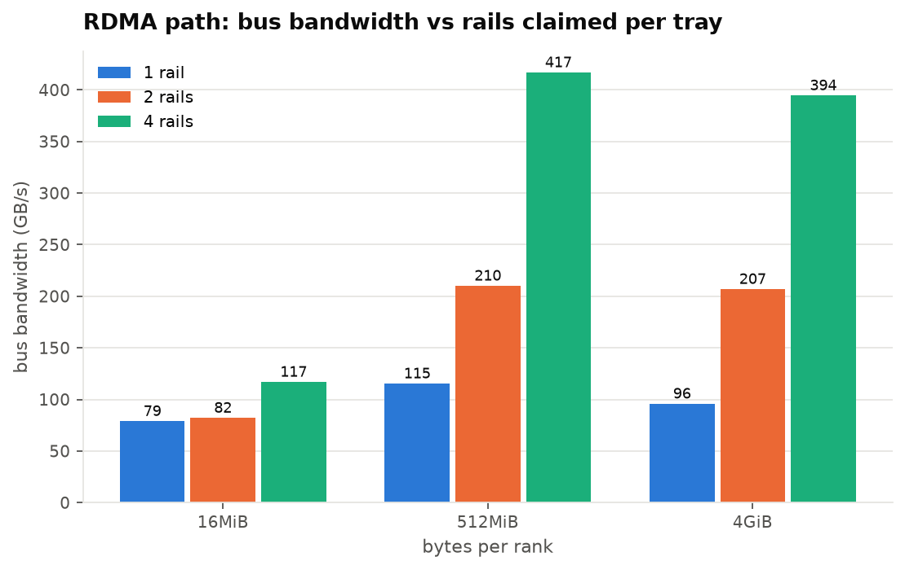
3 · Diagnosis: what limits the RDMA path, with the counters that prove it
• Bandwidth scales with the number of rails a pod claims: 96 GB/s with one rail, 207 with two, 364 with four (4 GiB messages)
• The bytes counted on each rail match the theoretical minimum for a two-node all-reduce exactly — and one rail carried 411 Gb/s, which a 200 Gb/s link cannot do. So a rail is really a 4-plane 800 Gb/s port; sysfs and ethtool report a single plane
• Each rail therefore ran at 51–60 % of its capacity. Congestion counters (CNP, ECN, out-of-sequence, ACK timeouts) stayed at zero; NIC and GPU both negotiate PCIe Gen6 x16 — so it is not the wire, not congestion, not PCIe
• What remains is the per-rail injection path (one NCCL connection per GPU–NIC pair, GPUDirect across the Grace socket). That is a narrowed hypothesis, not a proof; the next experiment is more NCCL channels per NIC
size | rails1 | rails2 | rails4
1MiB | nan | nan | 20.3
2MiB | nan | nan | 17.5
4MiB | nan | nan | 51.3
8MiB | nan | nan | 91.7
16MiB | 78.7 | 81.9 | 117
Notes:
Bridge from scaling: the 8-GPU run lost 23 points of efficiency moving from NVLink to the rails. The tempting story is 'the network is slow'. The brief tells us not to assume that, so this slide takes the RDMA path apart on its own: the same collective with 1, 2 and 4 rails, and a set of sustained runs made only to read the NIC, NVLink and PCIe counters while the collective is in flight. Evidence first, then the diagnosis.
How we know the rails are 800 Gb/s: we watched the NIC's transmitted-bytes counter during a sustained all-reduce and cross-checked it against ethtool's byte counter (they agree to the byte). One rail moved 411 Gb/s. The physical NIC exposes four 200 Gb/s ports per rail, and the virtual function aggregates them.
How we know it is not congestion: the same watcher reads the RoCE congestion-control counters (CNPs sent and handled, ECN-marked packets) and the reliability counters (out-of-sequence, sequence errors, ACK timeouts). All flat at zero per second during every run.
How we know it is not PCIe: lspci shows 64 GT/s x16 on the ConnectX-8 and on the GPU, about 120 GB/s per direction, against about 60 GB/s used per rail.
The GPUDirect-off run (next slide) shows the same bytes on the wire taking 1.6x longer — that is the cost of bouncing through host memory, not a network effect.

Slide 8
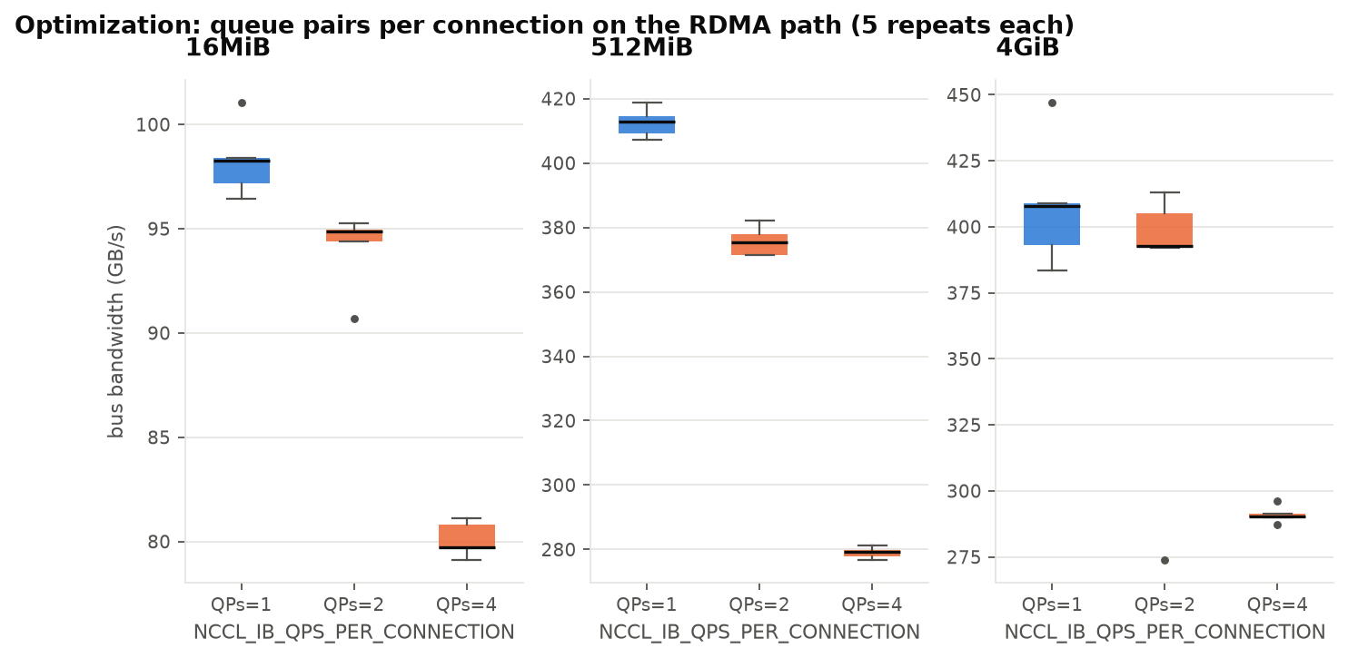
4 · The optimization: more queue pairs per connection (NCCL_IB_QPS_PER_CONNECTION)
• Baseline: RDMA path, four rails, GPUDirect on, one queue pair per NCCL connection (the default) — 98 / 413 / 408 GB/s at 16 MiB / 512 MiB / 4 GiB, five repeats each
• Hypothesis, written before running: the rails have headroom (55 % used), one queue pair per peer serialises each flow, so 2 or 4 queue pairs should raise large-message bandwidth; expected cost is more out-of-order delivery
• Change: only that variable (plus the companion setting that splits each message across the queue pairs), 1 → 2 → 4, five repeats per cell
• Result: worse. 2 QPs: −4 % / −9 % / −8 %. 4 QPs: −19 % / −32 % / −29 %, statistically clear at every size. The counter window at 4 QPs shows each rail at 338 instead of 482 Gb/s, with reordering and congestion counters still at zero
• Conclusion: the headroom is real but this knob cannot reach it — splitting every message across queue pairs shrinks each work request and multiplies completions. Keep the default; look at the injection side instead. A negative result, reported as one
size | qps | n | busbw_mean | busbw_std | busbw_min | busbw_max | spread_pct_mean | delta_pct | p_value
16MiB | 1 | 5 | 98.3 | 1.75 | 96.5 | 101 | 0.418 | 0 | nan
16MiB | 2 | 5 | 94 | 1.9 | 90.7 | 95.3 | 0.219 | -4.31 | 0.0064
16MiB | 4 | 5 | 80.1 | 0.853 | 79.1 | 81.1 | 0.356 | -18.5 | 0
512MiB | 1 | 5 | 413 | 4.53 | 407 | 419 | 0.287 | 0 | nan
512MiB | 2 | 5 | 376 | 4.61 | 371 | 382 | 0.307 | -8.94 | 0
Notes:
Bridge from the diagnosis: it left us with rails at about 55 % of their capacity, no congestion, no PCIe limit, and one NCCL connection per GPU–NIC pair. If the wire has headroom and each connection is a single flow, the obvious single change is to give each connection more queue pairs. That is the hypothesis we wrote down before running anything, and it is the one controlled change the brief asks for.
A queue pair is the RDMA equivalent of a connection between two NICs. NCCL opens one per pair of communicating GPUs by default. The knob lets it open several and stripe a message across them; it is a common tuning recommendation on large fabrics where a single flow cannot fill a link because of how switches spread traffic.
Here there is one switch hop between matching rails, so striping buys nothing and costs overhead. The counters make the explanation concrete: fewer bytes per second on each rail, no errors, no congestion — the sender is simply doing less useful work per unit time.
The p-values are from Welch's t-test across the five repeats of baseline versus change; run-to-run spread within a cell is under 2 % except one 4 GiB outlier, so the differences are real.

Slide 9
5 · Other knobs we measured, and the one that actually helps the workload
• GPUDirect off: −38 % — same bytes on the wire, 1.6× the time; the cost of copying through host memory
• Bigger NCCL buffers: no change. NVLS vs Ring algorithm on NVLink: 474 vs 388 GB/s — the NVSwitch reduction is what keeps the NVLink curve climbing. 'Tree' is not valid for this collective set (NCCL has no tree all-gather)
• TCP with more socket threads: 7× faster than default TCP, still 14× slower than RDMA
• DDP gradient buckets 25 → 200 MiB over the rails: 2090 → 2769 samples/s (+32 %); communication share of the step falls from 91 % to 32 %. On a slower interconnect, change how often you communicate before changing how
run_id | 16MiB | 512MiB | 4GiB
e5-algo-nvls | 297 | 695 | 830
e5-algo-ring | 327 | 635 | 679
e5-buffsize16m | 101 | 420 | 393
e5-buffsize4m | 102 | 402 | 419
e5-counters-gdr-off | nan | nan | 253
e5-counters-nvlink | nan | nan | 833
e5-counters-rails1 | nan | nan | 87.8
e5-counters-rdma | nan | nan | 410
e5-counters-rdma-qps4 | nan | nan | 301
e5-gdr-off | 107 | 222 | 247
e5-sock-nthreads4 | 10.3 | 21.6 | 29.4
Notes:
Bridge from the optimization: the queue-pair change went the wrong way, so the RDMA gap is not the transport's flow count. This slide asks what else could be moving the number — the GPUDirect path into the NIC, NCCL's buffers and algorithm choice, the TCP path's threading — and returns to the small-message finding: if the fixed cost per collective is a large share, issue fewer collectives. That is the DDP bucket change, and it is the one that helped.
The bucket-size result is the practical takeaway for a training team: fewer, larger all-reduces amortise the fixed cost we saw on the small-message slide. It recovers most of the gap between the RDMA and NVLink runs without touching the network.
The Tree entry is kept on purpose: the exercise asks for honest reporting, and 'that configuration is invalid' is a finding too.

Slide 10
5 · Extending this to production multi-node GPU systems
• The manifests scale by node count: one pod per tray, one GPU claim and one rail claim per pod; the same image, the same result schema
• Placement follows topology: inside an NVLink domain use NVLink; between domains budget for the rails and size gradient buckets or accumulation accordingly
• The counters watched here become alerts: a fabric run whose NCCL log shows TCP fallback is a failure, not a slow run; congestion or sequence errors per rail are the network's signal; a rail below its share of line rate during a known-good collective is a rail fault
• Floors are calibrated per rank count and message size, because bus bandwidth is not constant across either — the sweep here is the reference shape
• The whole environment is reproducible from the repository: bootstrap, manifests, image build, results, analysis and this deck
Notes:
Bridge from the results: everything so far was two trays. What carries to a production system is the method — claim devices explicitly, prove the transport from NCCL's log, read the counters behind every number, calibrate floors per width and size — and the specific findings about where the fast path exists and how to size the workload's communication to the path it gets.
If asked about scheduling at scale: add a gang scheduler (Kueue) so multi-pod Jobs start together, and label nodes with their NVLink domain and fabric block so claims land where the fast path exists. Both are outside the two-tray scope but the manifests already assume one pod per tray and per-pod claims.

