Slide 1
LONG ISLAND UNIVERSITY · LEWYT COLLEGE OF VETERINARY MEDICINE
DVM 612 · PRINCIPLES OF SURGERY
Preoperative Evaluation,
Patient Preparation &
Postoperative Care
Dr. Yujin Kim, D.V.M., Ph.D., FFCP
Lecture | 38 slides | 60 minutes
Exam, labs, ASA, then prep. Own the first 24 hours.
Two hospital cases are ASA examples only.
Required: Fossum 2018; Hendrickson & Baird 2013.
Also used: ECFVG CPE Manual of Administration 2026, Anesthesia and Surgery.
1 / 38
Notes:
Welcome. This hour is preoperative evaluation, patient and surgeon preparation, and postoperative care. The competency list is the 2026 CPE Manual of Administration, Anesthesia and Surgery chapters, taught as DVM 612, not as an exam-prep course. Two hospital patients are only ASA examples: Willie, compensated, Status 3-E, sedated for an ear clean; MoMo, uncompensated, Status 4-E, exploratory cancelled. Owner identifiers stay off these slides. Thirty-eight slides. If discussion runs, protect antiseptics, ready-for-prep, and recovery.

Slide 2
DVM 612 WEEK 4 · 38 SLIDES
Learning objectives
▸ Assign ASA after today’s PE and labs. Correct deficits. Write premed, induction, MAC, tube, bag, and fluid rate.
▸ If albumin is low: find the cause, delay elective if you can, and do not flood with crystalloid.
▸ Prep for aseptic surgery: clip, labeled antiseptics, minimum contact time, four-quadrant drape, closed glove.
▸ Name a break in asepsis and correct it, before or after the incision. Classify the wound: clean, clean-contaminated, contaminated, or dirty.
▸ Write the postop plan, the surgical report, and 24-hour emergency criteria.
Exam → labs → ASA → correct deficits → premed → induce → ready for prep → clip, prep, drape → first 24 hours.
DVM 612 | Dr. Yujin Kim, D.V.M., Ph.D., FFCP | Lewyt CVM
2 / 38
Notes:
Read the five objectives aloud. Timer: protect antiseptics, draping, and recovery. The two hospital patients are ASA practice, not the point of the hour.

Slide 3
THEN OWN THE FIRST 24 HOURS. CPE MOA 2026 SURGERY COMPETENCIES.
Prepare the patient and yourself
Causes of SSI
Client-owned patients
Set before you cut
Hair, skin flora, hypothermia, poor hemostasis, dead space, and breaks in asepsis.
Elective OHE patients go home to the owner after recovery. Documentation and the discharge conversation are part of the operation.
Analgesia, antibiotics, temperature management, and client expectations are set in the preoperative period.
Surgeon responsibilities
▸ Prepare the patient for a surgical procedure.
▸ Prepare yourself for a surgical procedure.
▸ Perform the procedure. Then own the first 24 hours: hemorrhage from a weak ligature, or herniation from a weak linea, is still the operation (CPE MOA 2026 Surgery).
DVM 612 | Dr. Yujin Kim, D.V.M., Ph.D., FFCP | Lewyt CVM
3 / 38
Notes:
A closure that hemorrhages in recovery is a failed surgery. The first 24 hours are part of the operation.

Slide 4
EACH PRINCIPLE HAS A PREOPERATIVE OR POSTOPERATIVE ACTION
Halsted’s principles
1. Gentle tissue handling
2. Meticulous hemostasis
Prep trauma, clipper burn, and crushing towel clamps are tissue handling.
Preop coagulopathy; postop hemorrhage is a 24-hour emergency.
3. Preserve blood supply
4. Strict asepsis
Place clamps and bandages so skin perfusion is preserved.
Patient preparation, surgeon preparation, and draping.
5. No tension
6. Accurate apposition
Plan incision location and closure now, not after the fascia splits.
Postop incision care protects the apposition you create.
7. Obliterate dead space
Plan dead space now: sutures, bandage, or a drain with a written pull plan.
DVM 612 | Dr. Yujin Kim, D.V.M., Ph.D., FFCP | Lewyt CVM
4 / 38
Notes:
Two minutes, then move. Every Halsted principle has a preop or postop action, not just an intraoperative one.

Slide 5
TWO TEAM CLOCKS. CPE MOA 2026 ANESTHESIA AND SURGERY.
The perioperative continuum
PRE-OP
PREP
INTRA-OP
POST-OP
PE, labs, ASA
Correct deficits
Premed, induce, MAC
ETT, bag, fluids
Ready for clip:
airway, IV, plane
Hair, skin, position
Drape, gown, glove
Announce incision
Hold asepsis
Halsted, temp, pain
Record every 5–10 min
Airway, pain, heat
Watch 24 hours
Report + discharge
Recheck plan
→
→
→
Anesthesia clock · ready for surgical prep
Surgery clock · last skin suture
From the preoperative exam: airway in and secured, machine on, patent IV running, surgical plane, monitoring started. Then call for prep (CPE MOA 2026 Anesthesia).
From the start of patient preparation to the last skin suture, including re-gowning. Then own the first 24 hours (CPE MOA 2026 Surgery).
DVM 612 | Dr. Yujin Kim, D.V.M., Ph.D., FFCP | Lewyt CVM
5 / 38
Notes:
Do not teach this as a CPE station. Teach the clocks. Anesthesia owns exam through a patient who is ready for clippers: tube in, cuff up, machine on, IV running, surgical plane. Surgery owns clip through the last skin suture, then both own the first 24 hours. Cite ECFVG CPE Manual of Administration 2026, Anesthesia and Surgery sections.

Slide 6
CPE MOA 2026 APPENDIX 3: TPR, MM/CRT, THEN PCV, TP, BUN. THEN ASA. THEN PREMED.
Preoperative physical examination
T · HR · RR
mm / CRT
Temperature, heart rate, respiratory rate. Write the numbers. Do not copy yesterday’s chart.
Mucous membrane color and capillary refill. Pink vs pale vs injected. CRT in seconds.
Heart and lungs
Hydration + site
Auscultate both sides. Record any murmur, arrhythmia, or crackles before you choose drugs.
Skin tent, tacky mm. Look at the surgical site: pyoderma, heat, pain. Abdomen if you might open it.
Minimum labs on the anesthesia record · PCV, TP, BUN (CPE MOA 2026 Appendix 3)
PCV
TP
BUN
Oxygen-carrying capacity. Anemia vs hemoconcentration. With TP: dehydration vs blood loss.
Protein / oncotic pressure. High with PCV: dehydration. Low: loss, liver, or dilution. Changes fluids and healing.
Kidney, hydration, GI bleed. Azotemia: skip NSAIDs, rethink fluids, maybe do not cut today.
DVM 612 | Dr. Yujin Kim, D.V.M., Ph.D., FFCP | Lewyt CVM
6 / 38
Notes:
This is the preoperative exam the record actually holds. CPE MOA 2026 Appendix 3: heart rate, respiratory rate, mucous membranes and CRT, temperature, then PCV, TP, and BUN. Request those three. Interpret them. Then write ASA. Then premed IM or SQ. Do not premedicate before the examination. Add other labs if the PE says so. A normal CBC does not make a vestibular dog Status 1. Azotemia can cancel the cut.

Slide 7
GRUBB ET AL. 2020 AAHA TABLE. CPE MOA 2026 ANESTHESIA APPENDIX 2 USES THE SAME 1–5 SCALE.
ASA physical status
ASA status
Definition
Example
Status 1
Normal healthy patient
Healthy patient for neutering
Status 2
Patient with mild systemic disease
Well compensated mild mitral degeneration
Status 3
Patient with moderate systemic disease
Cat with CKD, IRIS stage 3
Status 4
Severe systemic disease; constant threat to life
Hemoabdomen, bleeding splenic mass
Status 5
Moribund; not expected to survive without the operation
Hypotensive, hypothermic, obtunded septic cat
E = emergency. Status 3 is compensated. Status 4 is uncompensated and a threat to life. Today’s PE writes the number.
DVM 612 | Dr. Yujin Kim, D.V.M., Ph.D., FFCP | Lewyt CVM
7 / 38
Notes:
Read the 2020 AAHA table with MOA Appendix 2: Status 1 healthy, Status 2 mild and compensated, Status 3 moderate and compensated, Status 4 a constant threat to life, Status 5 moribund. E means emergency. Then use the two hospital patients only as practice: compensated vestibular crisis is 3-E; uncompensated azotemia that threatens life is 4-E.

Slide 8
ASSIGN STATUS, THEN SAY WHETHER YOU PROCEED TODAY
ASA practice cases
A
Healthy 8-month Labrador. Elective OHE. Normal PE.
ASA Status 1 · proceed
B
10-year Beagle, BCS 8/9, grade 2/6 murmur, no CHF. Dental.
ASA Status 2 · proceed with a monitoring plan
C
Cavalier, acute ataxia, AS otitis, murmur. CV stable.
ASA Status 3-E. Compensated emergency. Sedation plan.
D
Vomiting cat. Looks like FB. T 98.0 °F, HR 200, tacky mm.
ASA Status 4-E. Uncompensated emergency. Image and labs first. Do not cut today.
DVM 612 | Dr. Yujin Kim, D.V.M., Ph.D., FFCP | Lewyt CVM
8 / 38
Notes:
Cold-call four students. C is a compensated emergency (sedation). D is uncompensated; labs cancelled the exploratory. The names on later slides are only these examples.

Slide 9
ASA EXAMPLE FOR TONIGHT’S EAR CLEAN AND FOR A LATER TECA-LBO. DEXSP: SKIP NSAID.
Willie, ASA Status 3-E
Acute ataxia ~1 hour. Fell off the couch twice. Cytopoint for allergies. Vitals: T 100.8 °F, HR 132, RR 52, mm pink, CRT 2 s, quiet/dull. ASA Status 3-E: moderate systemic disease that is still compensated (acute vestibular disease plus AS otitis plus murmur). Pink, walking, kidneys normal.
Left ear (AS)
Neuro exam
Also on PE
Brown and bloody discharge. Pedal reflex at the pinna base. Canal patent. Cartilage hardened. Tympanic membrane visible but swollen.
Circling left. Horizontal nystagmus, fast left, slow right. Right knuckling. Treat as central vestibular disease until MRI.
Grade II/VI left systolic murmur. Heavy tartar. Soft non-painful abdomen. Compensated tonight.
Tonight: CBC WNL. DexSP already given: skip NSAID. Alfaxalone sedation, deep left-ear clean, cytology/culture, 3-view films. Confine. MRI if neurologic signs persist. If TECA-LBO is needed later, assign a new ASA that morning and re-check the murmur, steroid history, and ear class.
DVM 612 | Dr. Yujin Kim, D.V.M., Ph.D., FFCP | Lewyt CVM
9 / 38
Notes:
Willie is an ASA example, not the thesis of the hour. Tonight is a sedated ear clean. The same findings, DexSP, and murmur are what you re-score if TECA-LBO is planned later. Record the murmur. Right-sided knuckling with left circling: treat as central vestibular plus otitis. Skip NSAID after DexSP.

Slide 10
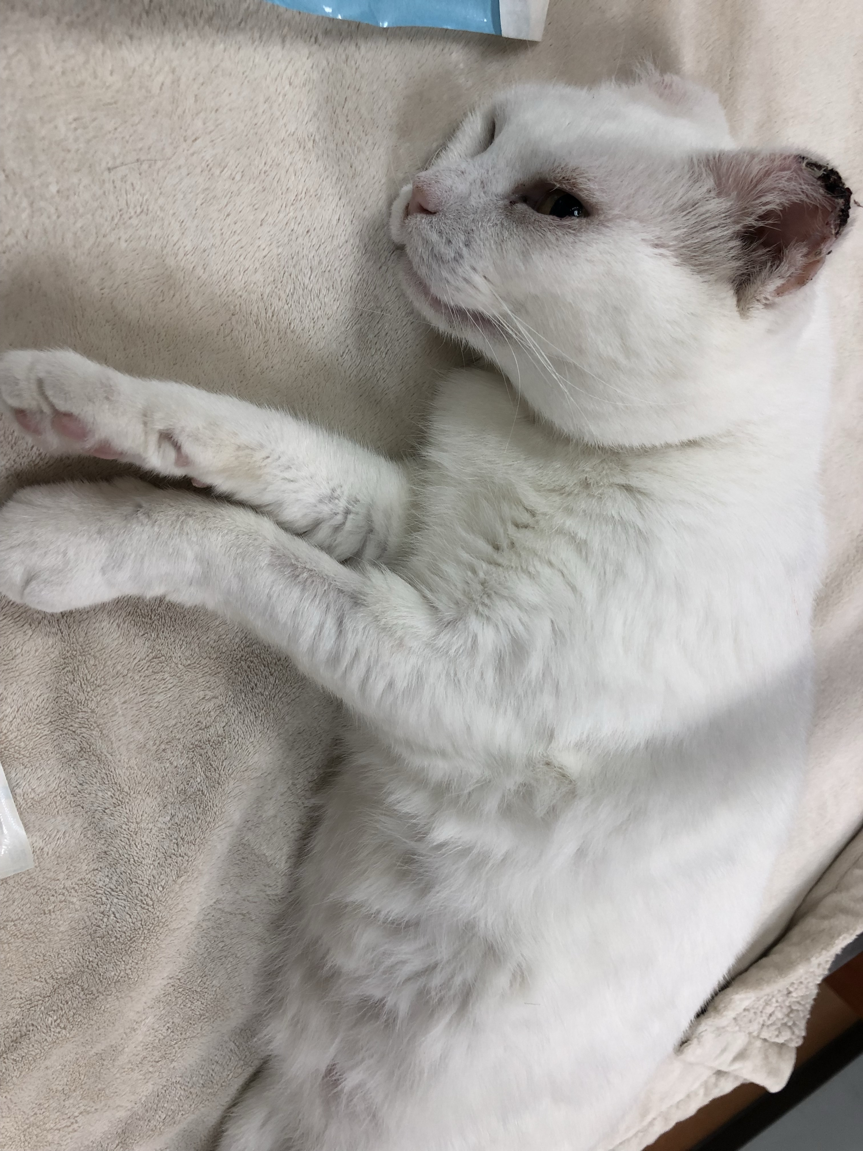
6 YO SF DSH, 4.25 KG, BCS 5/9. THIS IS HER, BEFORE THE EXPLORATORY WAS CANCELLED.
MoMo, ASA Status 4-E
Acute vomiting and lethargy. Two vomits. Household construction. Possible FB. T 98.0 °F, HR 200, RR 30, mm pink tacky, CRT <2 s, QAR. ASA Status 4-E: uncompensated disease that is a constant threat to life.
Why this looked surgical
FB obstruction was on the list. Mildly enlarged abdomen. That is how cats get booked for an exploratory.
What the PE showed
Heart/lungs normal. Ambulatory ×4. Dehydrated. Quiet and recumbent in this photograph. The PE did not prove a foreign body.
Image, labs, then cancel
Right kidney fluid-filled and non-functional on AUS. Progressive azotemia on fluids (creatinine 3.0 → 4.71). Skip NSAIDs. Cancel the exploratory. Owner elected humane euthanasia. Record the decision.
DVM 612 | Dr. Yujin Kim, D.V.M., Ph.D., FFCP | Lewyt CVM
10 / 38
Notes:
This slide is an ASA example, not the point of the hour. Pause on the photograph. Be respectful; this cat died. Cold-call: who would have clipped her on history alone? The photograph is a quiet, recumbent cat. It does not prove a foreign body. Status 3 would be compensated kidney disease. Rising creatinine, hypothermia, and a non-functional kidney made this Status 4-E.

Slide 11
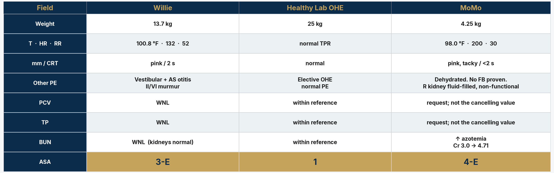
CPE MOA 2026 APPENDIX 3 PAGE 1: TODAY’S PE, THEN PCV, TP, BUN. INTERPRET. THEN CIRCLE ASA.
Pre-anesthetic assessment
PCV / TP: EDTA tube → spin hematocrit → read PCV → snap the capillary tube → refractometer TP. BUN: chemistry or Azo stick. Request, record, interpret. Then ASA. Then premed IM/SQ. Not before the exam.
DVM 612 | Dr. Yujin Kim, D.V.M., Ph.D., FFCP | Lewyt CVM
11 / 38
Notes:
This is Appendix 3 page 1 of the CPE MOA 2026 anesthesia record, taught as a table, not as the copyrighted form. The blanks are weight, HR, RR, mucous membranes and CRT, temperature, other PE findings, PCV, TP, BUN, other labs, then ASA 1 through 5. Perform and record the preoperative examination. Request, record, and interpret the minimum labs. Assign ASA. PCV and TP method: EDTA, spin, read PCV, snap the capillary tube, refractometer TP. Do not invent percentages. A normal CBC does not write Status 1. Azotemia can cancel the cut. High PCV plus high TP is dehydration. Low PCV plus low TP is blood loss. High BUN: skip NSAIDs.

Slide 12
TEACHING BANDS, NOT AN ASA TABLE. GRUBB ET AL. 2020: TODAY’S PE WRITES ASA.
Laboratory values inform risk
Finding
Typical healthy adult
Repeat / stabilize first
PCV
Within reference
Anemia: use severity and chronicity (Grubb 2020)
TP
Within reference
High with PCV: dehydration. Low: loss / dilution
BUN
Within reference
Azotemia: skip NSAID, rethink fluids and the cut
Potassium
Within reference
>6.0 mEq/L (Grubb 2020: correct first)
Albumin
Within reference
<2.0 g/dL: edema, poor healing (Pardo 2024)
MOA minimum is PCV, TP, BUN. A normal CBC does not assign Status 1. Azotemia can cancel the cut. Low albumin is a deficit, not an ASA number.
DVM 612 | Dr. Yujin Kim, D.V.M., Ph.D., FFCP | Lewyt CVM
12 / 38
Notes:
Do not call these ASA cutoffs. The anesthesia record’s minimum labs are PCV, TP, and BUN. AAHA 2020 lists K greater than 6.0 as a condition to correct before anesthesia. Pardo 2024: albumin less than 2.0 grams per deciliter is a negative prognostic indicator. Do not invent PCV cutoffs as ASA numbers.

Slide 13
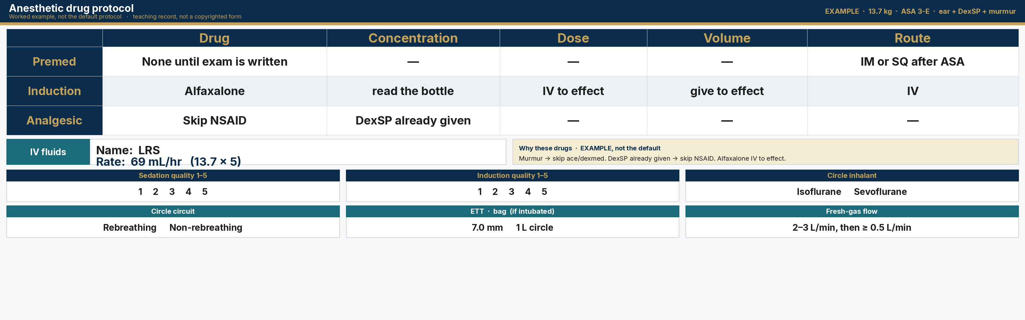
HEALTHY SEQUENCE, THEN ONE WORKED EXAMPLE. WRITE DRUG, CONCENTRATION, DOSE, VOLUME, ROUTE.
Anesthetic drug protocol
1. Premed after ASA
2. Induce IV to effect
3. Iso or sevo to MAC
IM or SQ. Not before the exam. Healthy: DKT or BAA. The table below is not the default.
Alfaxalone, propofol, or ketamine + benzo. Then intubate.
Premed lowers MAC. Circle the inhalant you used.
DVM 612 | Dr. Yujin Kim, D.V.M., Ph.D., FFCP | Lewyt CVM
13 / 38
Notes:
This is Appendix 3 pages 2 and 3, taught as an original record, not the copyrighted form. The three steps at the top are the general sequence. The filled table is one worked example: ear disease, DexSP already given, murmur. Healthy default is not that table. Students write drug, concentration, dose, volume, and route. Then IV fluid name and rate. Then why. Do not invent milligrams.

Slide 14
GRUBB ET AL. 2020: STABILIZE FIRST. PARDO ET AL. 2024: ALBUMIN <2.0 G/DL.
Correct deficits before you cut
Correct these first
If albumin is low
If you still operate
Grubb et al. 2020, before anesthesia:
Dehydration / hypovolemia
K+ >6.0 mEq/L
pH <7.2
Glucose <60 mg/dL
Hypothermia <99 °F
Anemia (severity, chronicity)
Life-threatening arrhythmia
CHF, cyanosis, pneumothorax
Oliguria / anuria
Uncontrolled pain or anxiety
Find the cause: GI loss, kidney, liver, exudate, starvation.
Delay elective surgery if you can treat and feed.
<2.0 g/dL: edema, poor perfusion, poor wound healing (Pardo 2024).
Plasma: about 20–25 mL/kg to raise albumin 0.5 g/dL. Often impractical.
Species-specific albumin if severe and you must operate. Human albumin can cause anaphylaxis.
Do not flood with crystalloid when the problem is oncotic pressure.
Delay elective for pyoderma over the site.
Emergency: resuscitate volume, then cut. You cannot wait for albumin to normalize in GDV or septic abdomen.
Gentle tissue handling. Obliterate dead space. Warm the patient. Nutrition as soon as the gut allows.
Rising creatinine that threatens life: cancel the elective or exploratory cut.
DVM 612 | Dr. Yujin Kim, D.V.M., Ph.D., FFCP | Lewyt CVM
14 / 38
Notes:
Read the Grubb 2020 list: correct potassium greater than 6, pH less than 7.2, glucose less than 60, hypothermia, dehydration, before you induce. Then albumin: Pardo 2024 AAHA fluids, less than 2.0 grams per deciliter is edema and poor healing. Delay elective. Treat the cause. Plasma is a poor albumin replacement, 20 to 25 milliliters per kilogram for half a gram. Do not crystalloid-flood a low-oncotic patient. Emergency: resuscitate and operate. A cancelled cut after you find uncompensated azotemia is a successful preoperative evaluation.

Slide 15
2020 AAHA ANESTHESIA AND MONITORING GUIDELINES; THEN THE RISK TALK
Fasting and informed consent
Fasting (Grubb et al. 2020 AAHA)
Consent, then file it
▸ Healthy adult dog/cat: food 4–6 h; water until premedication.
▸ Some hospitals still use 8–12 h NPO. Teach aspiration versus hypoglycemia.
▸ Neonates / <2 kg: food fast no longer than 1–2 h.
▸ Brachycephalics: same fasting as the adult or neonate row. Pre-oxygenate 3 min with 100% O2 (Grubb 2020). Extubate when they can protect the airway, not at the first swallow.
▸ Ask what was eaten this morning. Clients feed ‘just a biscuit.’
▸ Diabetics: write the insulin dose and a small meal with anesthesia before drop-off.
▸ Procedure name in plain language, and the reason.
▸ Benefits, alternatives including medical management, and what happens if we wait.
▸ Material risks in one sentence each: anesthesia death, hemorrhage, infection, dehiscence. After OHE, name urinary incontinence.
▸ Estimate: what is included and what is not.
▸ Resuscitation code / DNR before induction.
▸ File the signed form. Then start induction.
DVM 612 | Dr. Yujin Kim, D.V.M., Ph.D., FFCP | Lewyt CVM
15 / 38
Notes:
Cite Grubb et al., 2020 AAHA Anesthesia and Monitoring Guidelines: healthy adults, food 4 to 6 hours, water until premedication. Neonates and patients under 2 kg: food fast no longer than 1 to 2 hours. Pre-oxygenation: 3 minutes of 100 percent oxygen gives almost 6 minutes of saturation. Brachycephalics: delay extubation until they can protect the airway. Mention DNR.

Slide 16
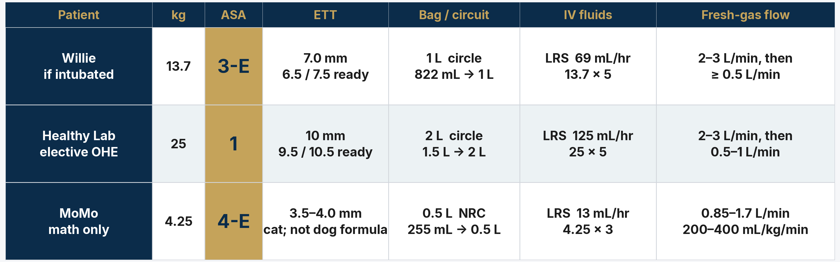
CPE MOA 2026 APPENDIX 3: ASA, ETT SIZE, BAG, CIRCUIT, IV FLUID NAME/RATE, FRESH-GAS FLOW.
ASA, tube, bag, and fluid rate
Endotracheal tube
Reservoir bag
IV fluid rate
ID mm = (kg / 4) + 3.5
mL = kg × 60, round UP
Dog kg × 5 · cat kg × 3–5
Dog start. ±0.5 mm ready. Largest through arytenoids (Grubb 2020). Cat: 3.0–4.5 mm (not the dog formula).
Round up to 0.5, 1, 2, or 3 L. NRC if <3–5 kg. Circle if larger. Leak-test, then OPEN the pop-off.
mL/hr. Balanced crystalloid (Pardo 2024). Not 10 mL/kg/hr. Willie: 13.7 × 5 = 69 mL/hr.
DVM 612 | Dr. Yujin Kim, D.V.M., Ph.D., FFCP | Lewyt CVM
16 / 38
Notes:
Board three formulas, then fill the table the way CPE MOA 2026 Appendix 3 is filled: circle ASA, write ETT size, bag, rebreathing versus non-rebreathing, IV fluid name and rate, fresh-gas flow. Do not project the copyrighted form. Dog tube: kilograms divided by 4, plus 3.5. A 13.7 kg dog: start 7.0 millimeter, 6.5 and 7.5 in the hand. Bag: kilograms times 60, round up. 822 milliliters is a 1 liter bag, circle. Fluids: Pardo 2024, dog 5 milliliters per kilogram per hour; write 69 milliliters per hour. Circle FGF: 2 to 3 liters per minute at induction, then 20 to 40 milliliters per kilogram per minute, minimum 500 milliliters per minute (Grubb 2020). NRC 200 to 400 milliliters per kilogram per minute. After the tube is in: inhalant to effect. Premed already lowered MAC. Then clip, sterile prep, and drape. Do not teach tube math as if a sedated ear-clean patient was intubated.

Slide 17
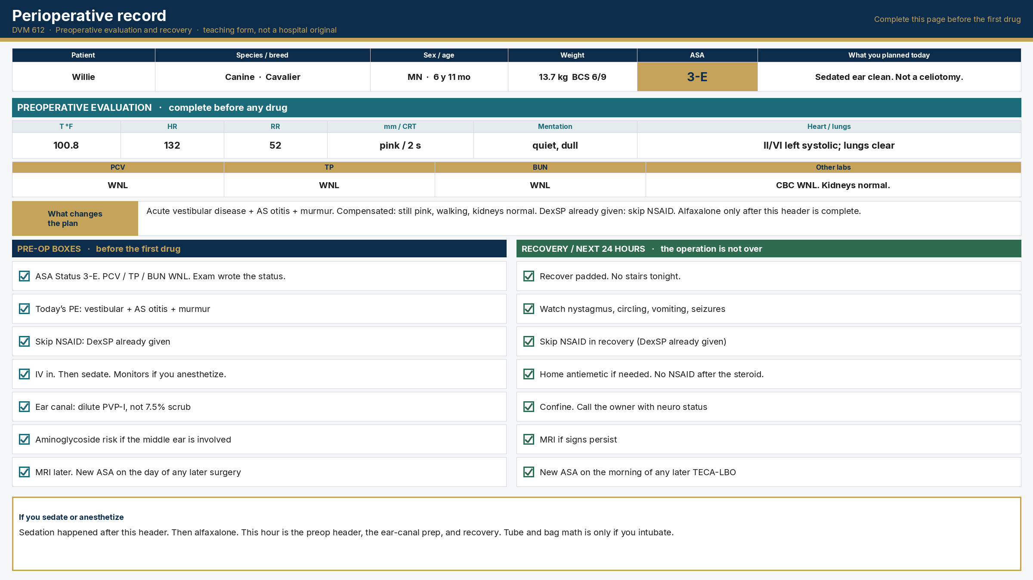
PAGE 1 OF THE TEACHING RECORD: PE, PCV/TP/BUN, ASA. COMPLETE BEFORE THE FIRST DRUG.
Willie’s perioperative record
DVM 612 | Dr. Yujin Kim, D.V.M., Ph.D., FFCP | Lewyt CVM
17 / 38
Notes:
Walk the large boxes: ASA Status 3-E before alfaxalone. PCV, TP, BUN WNL. Skip NSAID after DexSP. Recovery is on the same page. Drug protocol is slide 13. The intra-op chart is slide 30. Tube and bag numbers are only if you intubate.

Slide 18
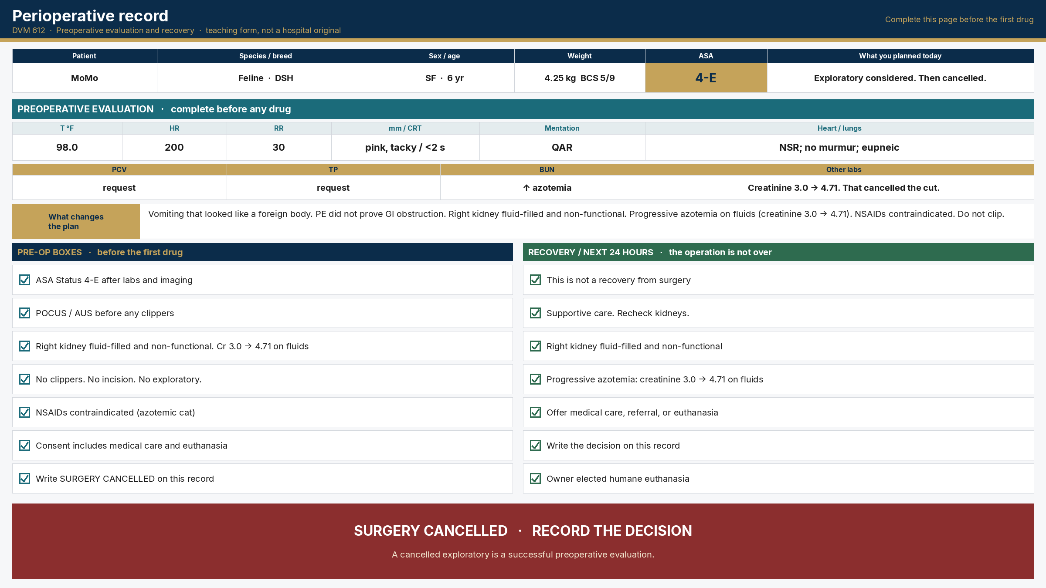
EXPLORATORY CANCELLED. RECORD THE DECISION.
MoMo’s perioperative record
DVM 612 | Dr. Yujin Kim, D.V.M., Ph.D., FFCP | Lewyt CVM
18 / 38
Notes:
The form is not only for patients who get clipped. Preop boxes and SURGERY CANCELLED are the document. Say it once, respectfully, then continue.

Slide 19
CLEAN, CLEAN-CONTAMINATED, CONTAMINATED, DIRTY. THEN DECIDE ANTIBIOTICS. FOSSUM 2018; FREY ET AL. 2022.
Surgical wound classification
1. Clean
2. Clean-contaminated
No infection. Hollow viscus not entered.
Elective OHE, orchiectomy, simple skin mass.
Skip routine prophylaxis (Frey 2022).
GI, respiratory, or urinary tract entered under control. Minor break in asepsis.
Cystotomy. Enterotomy without spillage.
3. Contaminated
4. Dirty / infected
Fresh open trauma. Major viscus spillage. Major break in sterile technique.
Time IV prophylaxis. Fix the break.
Pus, abscess, old trauma, perforated viscus with peritonitis.
Willie’s ear. Pyometra with pus.
This is treatment, not prophylaxis.
Write the class before you draw cefazolin. Clean elective: skip. When prophylaxis is indicated: cefazolin 22 mg/kg IV 30–60 min before incision (Gonzalez 2017; Frey 2022). Second dose if surgery lasts >90 min (Whittem 1999). Stop at closure unless you are treating infection.
DVM 612 | Dr. Yujin Kim, D.V.M., Ph.D., FFCP | Lewyt CVM
19 / 38
Notes:
Board the four National Research Council wound classes that were on the original lecture: clean, clean-contaminated, contaminated, dirty. Elective OHE is clean: skip prophylaxis, Frey 2022. Clean-contaminated: controlled entry into gut, airway, or bladder. Contaminated: fresh trauma or major spillage. Dirty: pus. Willie’s ear is dirty: treatment, not clean prophylaxis. Then say 22 milligrams per kilogram IV. Do not attribute that dose to AAHA 2022.

Slide 20
CPE MOA 2026 SURGERY: HAIR, SKIN, POSITION, DRAPE. THEN ANNOUNCE INCISION.
Sequence of patient preparation
1
2
3
4
Ready for prep: ETT in, cuff to 20 cm H2O, bag on, IV running, surgical plane
Express bladder if abdominal / caudal surgery
Clip with #40, vacuum hair, dirty antiseptic
Move to OR, position, pad, tie, final check
5
6
7
8
Sterile prep. Clock minimum contact time. Skin: 7.5% ~5 min, then 5% paint. Eye: 2 min + 2 min
Four-quadrant towels → large drape
Surgeon: cap, mask, gown, closed glove
Timeout. Announce incision. Clock runs to the last skin suture.
DVM 612 | Dr. Yujin Kim, D.V.M., Ph.D., FFCP | Lewyt CVM
20 / 38
Notes:
Do not clip until the patient is ready for prep: tube in, cuff holds to 20 centimeters of water, correct bag, IV running, surgical plane. CPE MOA 2026 Surgery scores hair, skin, position, and drape, then wants you to announce the incision. Veterinary Betadine labels: 7.5% scrub about 5 minutes, rinse, paint 5% Solution Veterinary, dry. Eye: Roberts 1986, 1:50 of 10% stock, 2 plus 2 minutes.

Slide 21
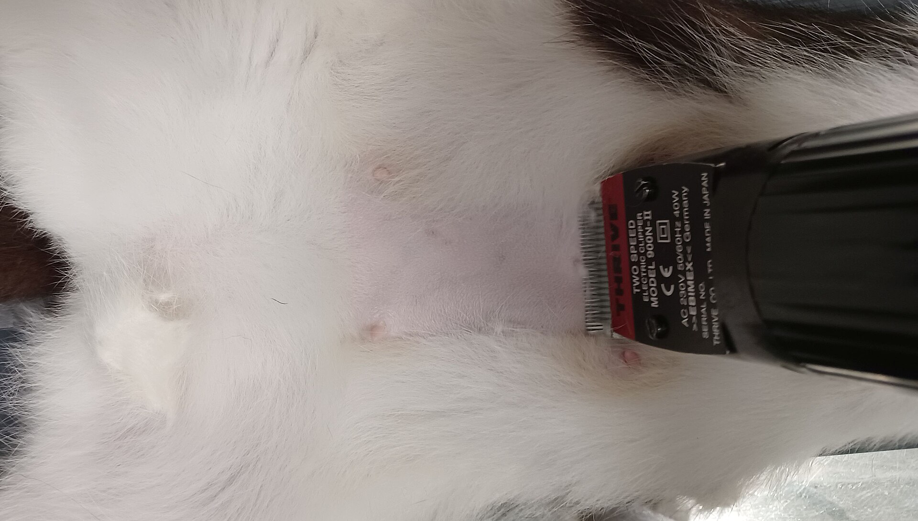
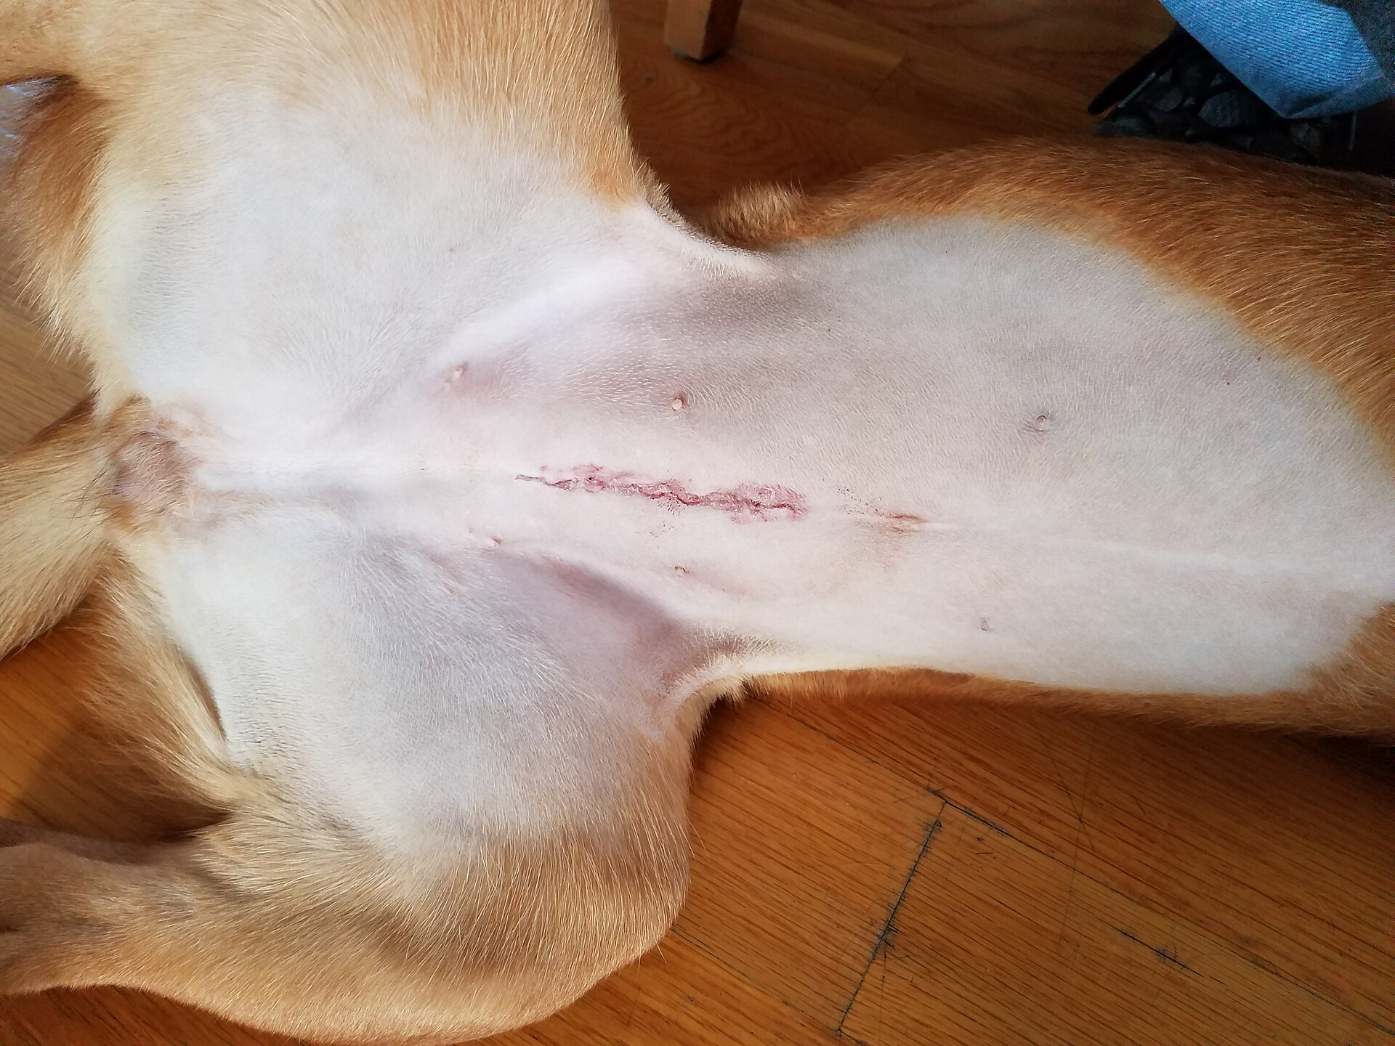
#40 CLIPPER AFTER INDUCTION. FIELD 20 CM BEYOND THE PLANNED INCISION.
Hair removal
Too narrow. Hair at the margin.
24 hours after OHE. Clip was wide enough.
#40 after a surgical plane. Xiphoid to pubis, past the nipples, 20 cm beyond the incision.
Photos: Uwe Gille, CC0; Liannadavis, CC BY-SA 4.0.
DVM 612 | Dr. Yujin Kim, D.V.M., Ph.D., FFCP | Lewyt CVM
21 / 38
Notes:
Left photo is still too narrow. Right is a real 24-hour OHE. Do not teach a TECA clip on a patient whose procedure that day was an ear clean.

Slide 22
MINIMUM CONTACT TIME. CLOCK IT. THEN DRAPE.
Skin antiseptics
Human Betadine Solution = 10% PVP-I. Veterinary paint = 5%, not 10%.
Eye: 10% stock 1:50, or 5% bottle 1:25. Both = 0.2% on the cornea (Roberts 1986).
CHG · Nolvasan
Skin · Betadine vet
Eye · Roberts 1986
2% chlorhexidine acetate
MIN contact: 2 to 4 min
Keep out of eyes
Trunk / intact skin
Alcohol: rinse, then dry
7.5% scrub
MIN contact: about 5 min
Rinse with sterile water
Paint 5% solution
Dry, then drape
Goal: 0.2% on cornea
10% stock → dilute 1:50
5% bottle → dilute 1:25
MIN: 2 min + 2 min
Not full strength
Nolvasan Surgical Scrub: 2% chlorhexidine acetate, DailyMed NDC 54771-8701, wash 2 to 4 min, keep out of eyes.
BETADINE Surgical Scrub Veterinary NDC 67618-154 (7.5%, lather about 5 min). BETADINE Solution Veterinary NDC 67618-155 (5% paint, not 10%).
Eye: both 1:50 of 10% and 1:25 of 5% give 0.2% on the cornea (Roberts 1986). 1:2 of 10% caused corneal edema in 1/15 eyes.
DVM 612 | Dr. Yujin Kim, D.V.M., Ph.D., FFCP | Lewyt CVM
22 / 38
Notes:
Write the bottle math on the board. Veterinary Betadine Solution is 5 percent, not 10 percent. Roberts 1986: 1 to 50 of 10 percent stock, 2-minute scrub plus 2-minute soak. One case of corneal edema at 1 to 2. Nolvasan: 2 percent CHG acetate, wash 2 to 4 minutes, keep out of eyes. Willie: swollen tympanum. Canal and periocular mucosa: detergent-free dilute PVP-I, not 7.5 percent scrub.

Slide 23
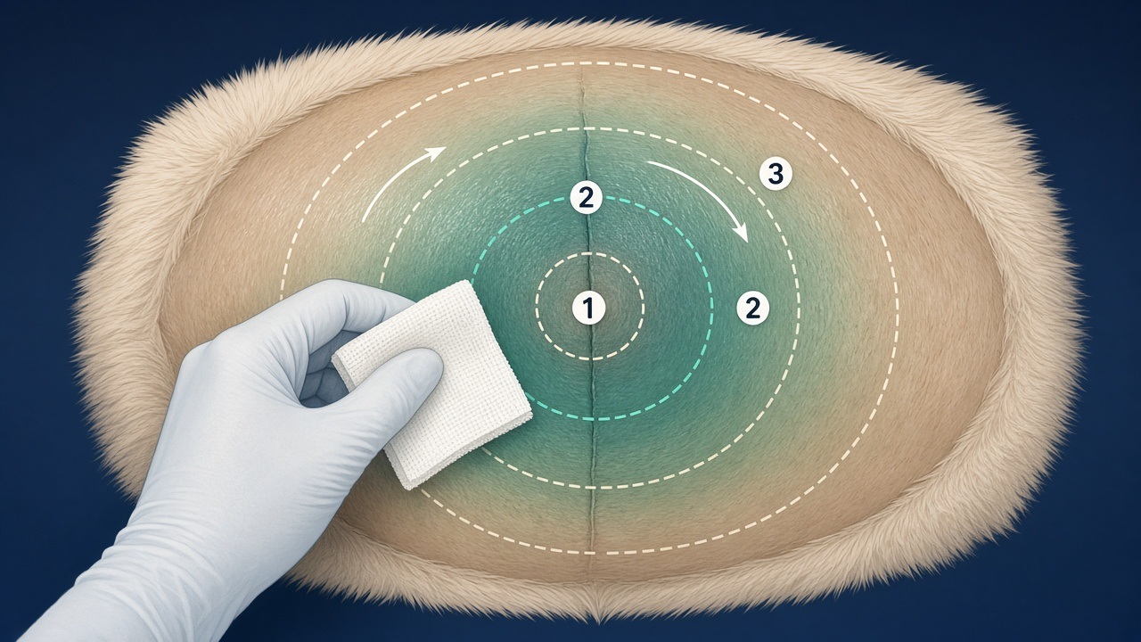
CENTER TO PERIPHERY. DIRTY PREP, THEN STERILE PREP.
Patient skin preparation technique
Technique
▸ Dirty prep, then sterile prep.
▸ Start at the incision. Spiral out. Drop the sponge.
▸ Clock the minimum contact time.
▸ Skin: 7.5% ~5 min, then 5% paint.
▸ Eye: 10% 1:50 or 5% 1:25. Both = 0.2% on the cornea.
▸ Willie canal: dilute PVP-I, not 7.5% scrub.
DVM 612 | Dr. Yujin Kim, D.V.M., Ph.D., FFCP | Lewyt CVM
23 / 38
Notes:
Mime the spiral. Clock about 5 minutes for veterinary Betadine scrub on intact skin. Recite Roberts 1 to 50 of 10 percent stock for the eye: 2 minutes plus 2 minutes. If the bottle is 5 percent veterinary solution, 1 to 25 matches 0.2 percent.

Slide 24
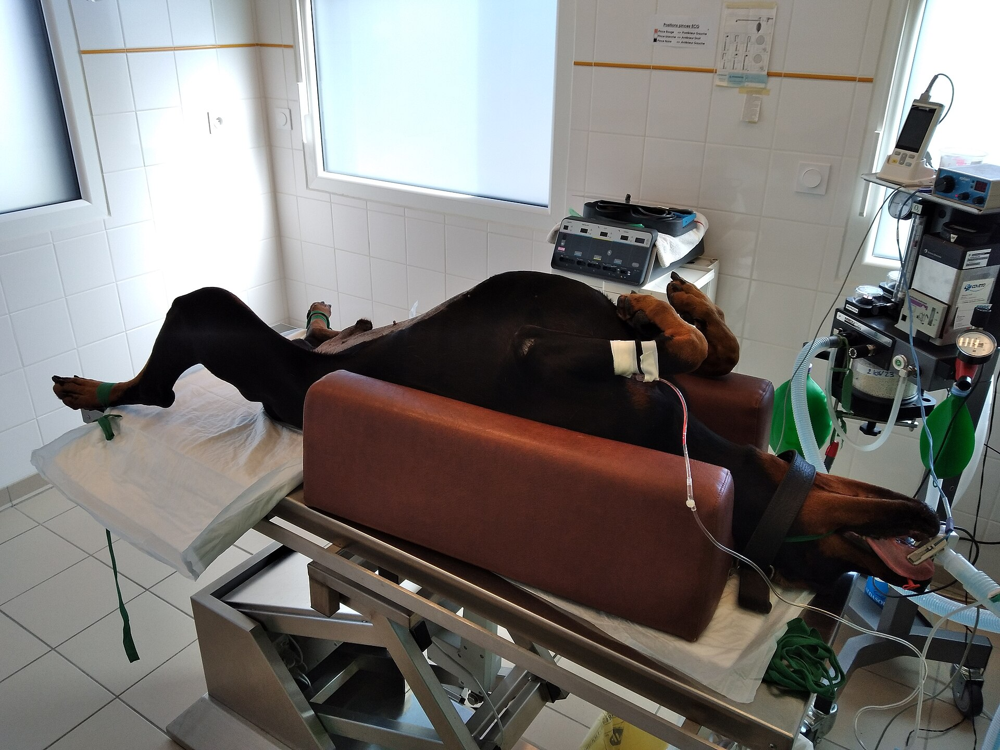
DORSAL RECUMBENCY, AIRWAY, IV CATHETER, MONITORING, V-TROUGH
Patient positioning
Visible in this photograph
• ET tube + pulse ox
• IV catheter + fluids
• Circle + reservoir bag
• V-trough / padding
• Ties snug; pulse distal to each tie
• Clip after a surgical plane
Tube tip: midway larynx to thoracic inlet (Grubb 2020).
Confirm: ETCO2, bag move, no esophageal tube.
Photo: Anja, CC BY-SA 4.0.
DVM 612 | Dr. Yujin Kim, D.V.M., Ph.D., FFCP | Lewyt CVM
24 / 38
Notes:
Name the bag size and the tube size on this photograph. Confirm placement with ETCO2. Keep hips in a neutral spread.

Slide 25
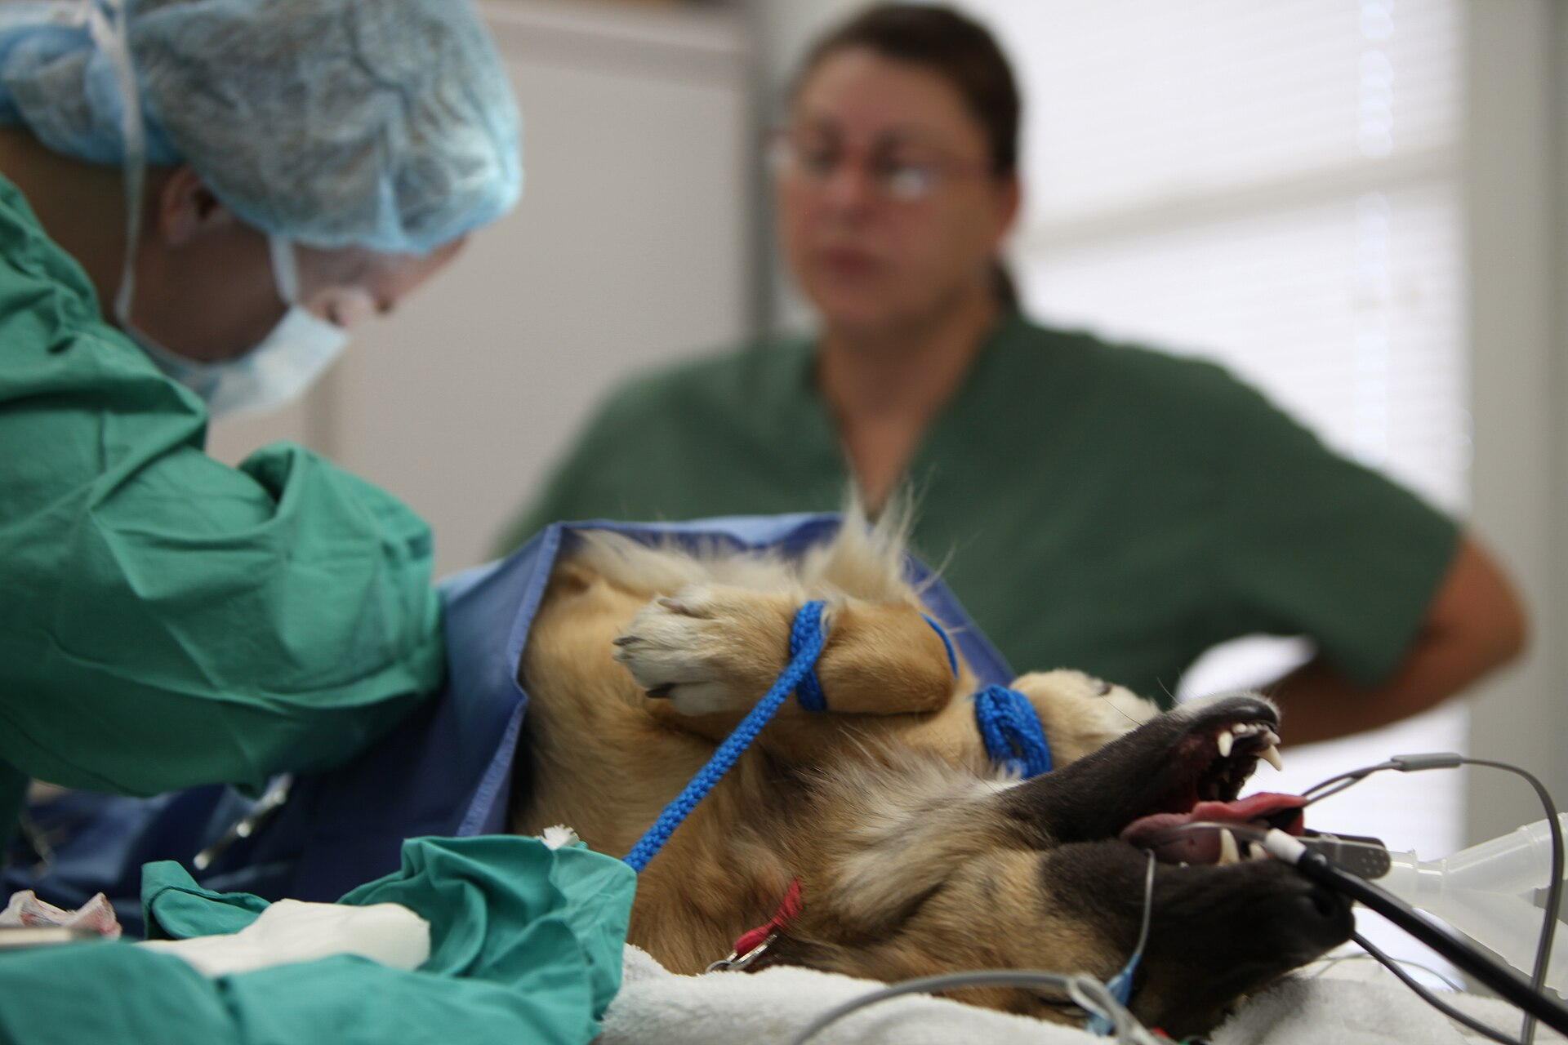
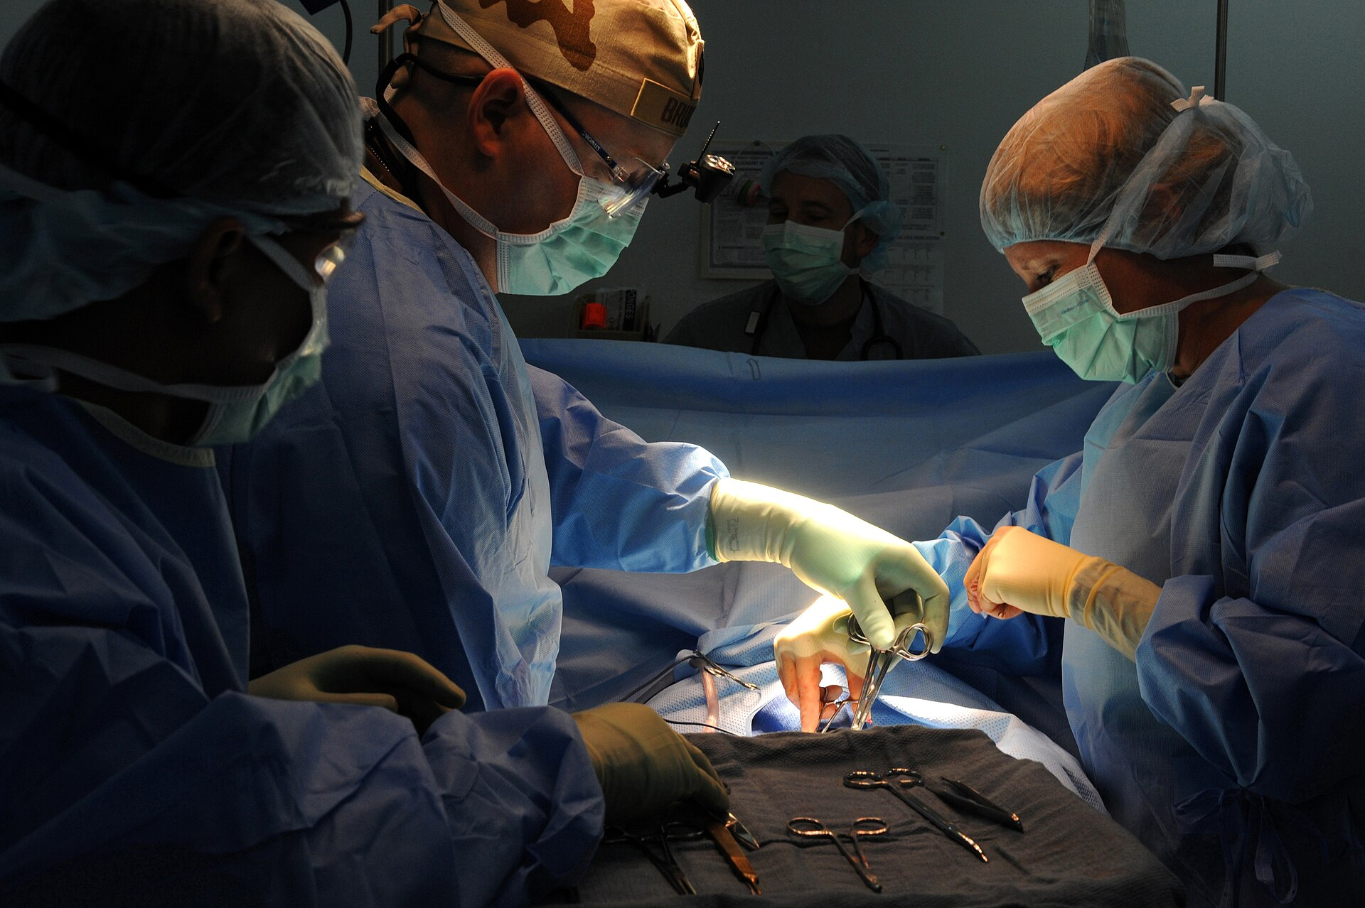
FOUR-QUADRANT TOWELS, THEN THE LARGE DRAPE
Draping
OHE: hair visible at the drape edge
Sterile field: gown, glove, drape
Near towel first. Four towels box the field. Towel clamps on skin, not through the drape to viscera. Large drape last. Only the incision is in the window. Re-clip until the window is hair-free.
Photos: Cpl. Samuel A. Nasso, USMC, public domain; MSgt Carlotta Holley, USAF, public domain.
DVM 612 | Dr. Yujin Kim, D.V.M., Ph.D., FFCP | Lewyt CVM
25 / 38
Notes:
Left is a real spay with hair at the window. Re-clip or re-drape. Four-quadrant towels, then the large drape. Then timeout before you cut.

Slide 26
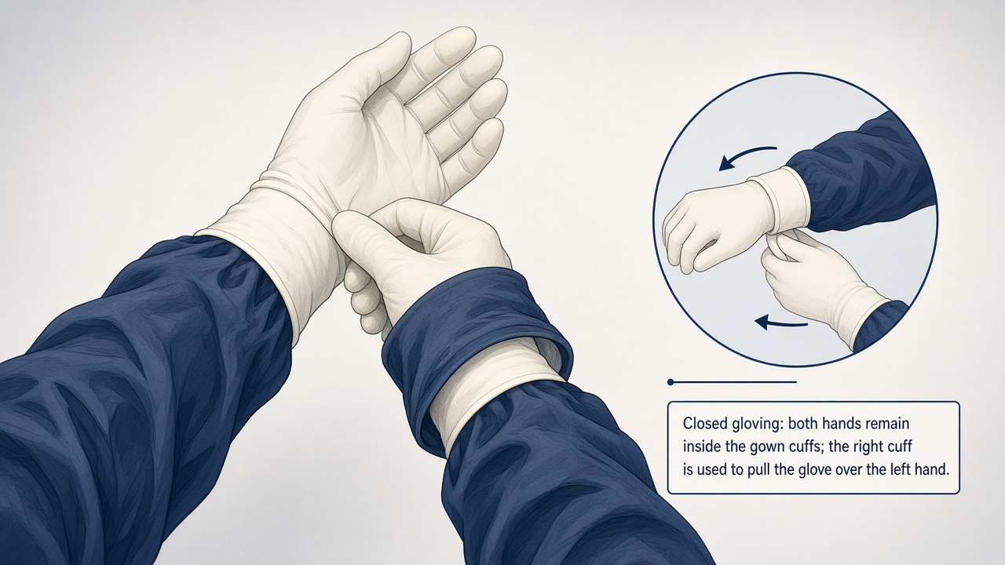
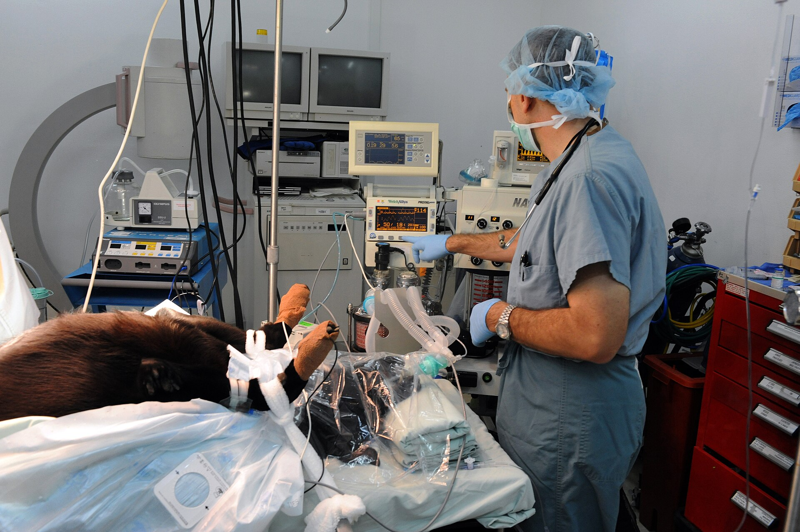
TECHNIQUE DIAGRAM AND OPERATING-ROOM PHOTOGRAPH
Closed gloving and the anesthesia workstation
Left: closed-gloving technique (hands stay inside the gown cuffs). Right: cap, mask, ECG, SpO2, ETCO2, circle system, IV fluids, airway. Name every monitor on the workstation before the first incision.
Photo: MSgt Carlotta Holley, U.S. Air Force, public domain.
DVM 612 | Dr. Yujin Kim, D.V.M., Ph.D., FFCP | Lewyt CVM
26 / 38
Notes:
Call out closed gloving. Students name SpO2, ETCO2, ECG, temp, and fluids off the workstation photo. Do not mix MAC and case names onto this slide.

Slide 27
SAY IT. CORRECT IT. AFTER THE INCISION, EVERY BREAK MUST BE FULLY CORRECTED.
Breaks in asepsis
If you contaminate
Protect the patient
Prep, gown, glove, drape: say it immediately. Re-glove, re-gown, or re-drape. Do not continue with a contaminated field.
After the incision: notice, announce, and fully correct. Sleeve in the abdomen, instrument off the table, hole in a glove: stop and fix it.
1. Control significant hemorrhage.
2. Create a secure abdominal wall closure.
3. Achieve and maintain an aseptic field.
4. Identify and protect adjacent organs before you clamp.
5. Complete a sponge and instrument count before closure.
The operation is not over at the last skin suture. The first 24 hours still count: intra-abdominal hemorrhage from a weak ligature, or herniation from a weak linea, is still the operation (CPE MOA 2026 Surgery).
DVM 612 | Dr. Yujin Kim, D.V.M., Ph.D., FFCP | Lewyt CVM
27 / 38
Notes:
Praise the person who says I just contaminated my sleeve. Then re-glove. Teach the clinical rule, not exam scoring. The 24-hour window is why recovery is in this lecture.

Slide 28
WHAT DO YOU DO NEXT?
Knowledge check
A
When do you clip the OHE field?
After ready for prep: tube in, IV running, surgical plane. Then sterile prep and drape.
B
How do you prep conjunctiva with iodine?
10% stock 1:50. MIN contact 2 min + 2 min. 5% bottle: 1:25.
C
Albumin 1.6 g/dL, elective mass. First move?
Delay. Find the cause. Feed. Do not crystalloid-flood. Do not cut today.
D
13.7 kg dog. Tube, bag, and IV fluid rate if you intubate?
7.0 mm, 1 L circle, LRS 69 mL/hr (5 mL/kg/hr). Murmur: opioid + alfaxalone.
DVM 612 | Dr. Yujin Kim, D.V.M., Ph.D., FFCP | Lewyt CVM
28 / 38
Notes:
Two minutes. C is albumin: delay elective, treat the cause. D is board math for a 13.7 kg dog if you intubate: 7.0 millimeter, 1 liter circle, 69 milliliters per hour, alfaxalone if there is a murmur. B is Roberts 1986. A is airway before clippers, then sterile prep and drape.

Slide 29
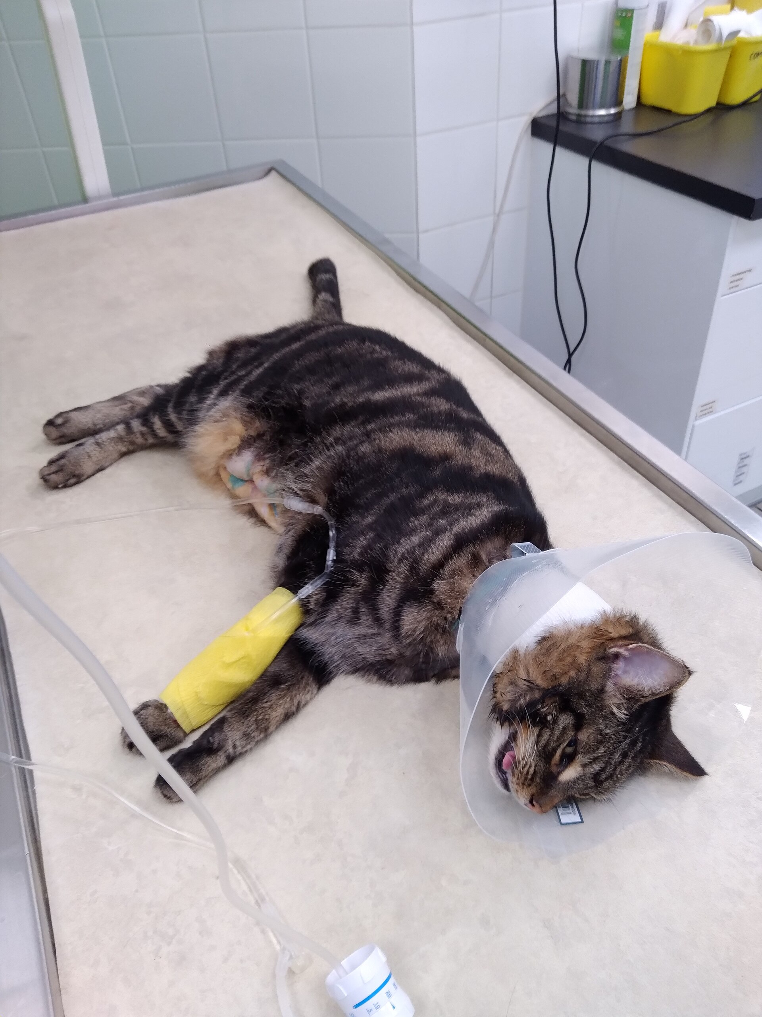
REMAIN WITH THE PATIENT UNTIL AIRWAY AND CIRCULATION ARE STABLE
Immediate recovery
Recovery priorities
▸ Extubate when swallow returns.
▸ Most anesthetic deaths are in recovery, often in the first 3 hours (Grubb 2020).
▸ Pale + tachycardic after celiotomy: return to OR.
▸ NSAID: carprofen in the dog, Onsior in the cat. Do not stack with a steroid.
▸ E-collar on before they can lick.
DVM 612 | Dr. Yujin Kim, D.V.M., Ph.D., FFCP | Lewyt CVM
29 / 38
Notes:
Real recovery: e-collar, IV, clipped abdomen. Pale OHE: stay at the cage, return to OR if unstable.

Slide 30
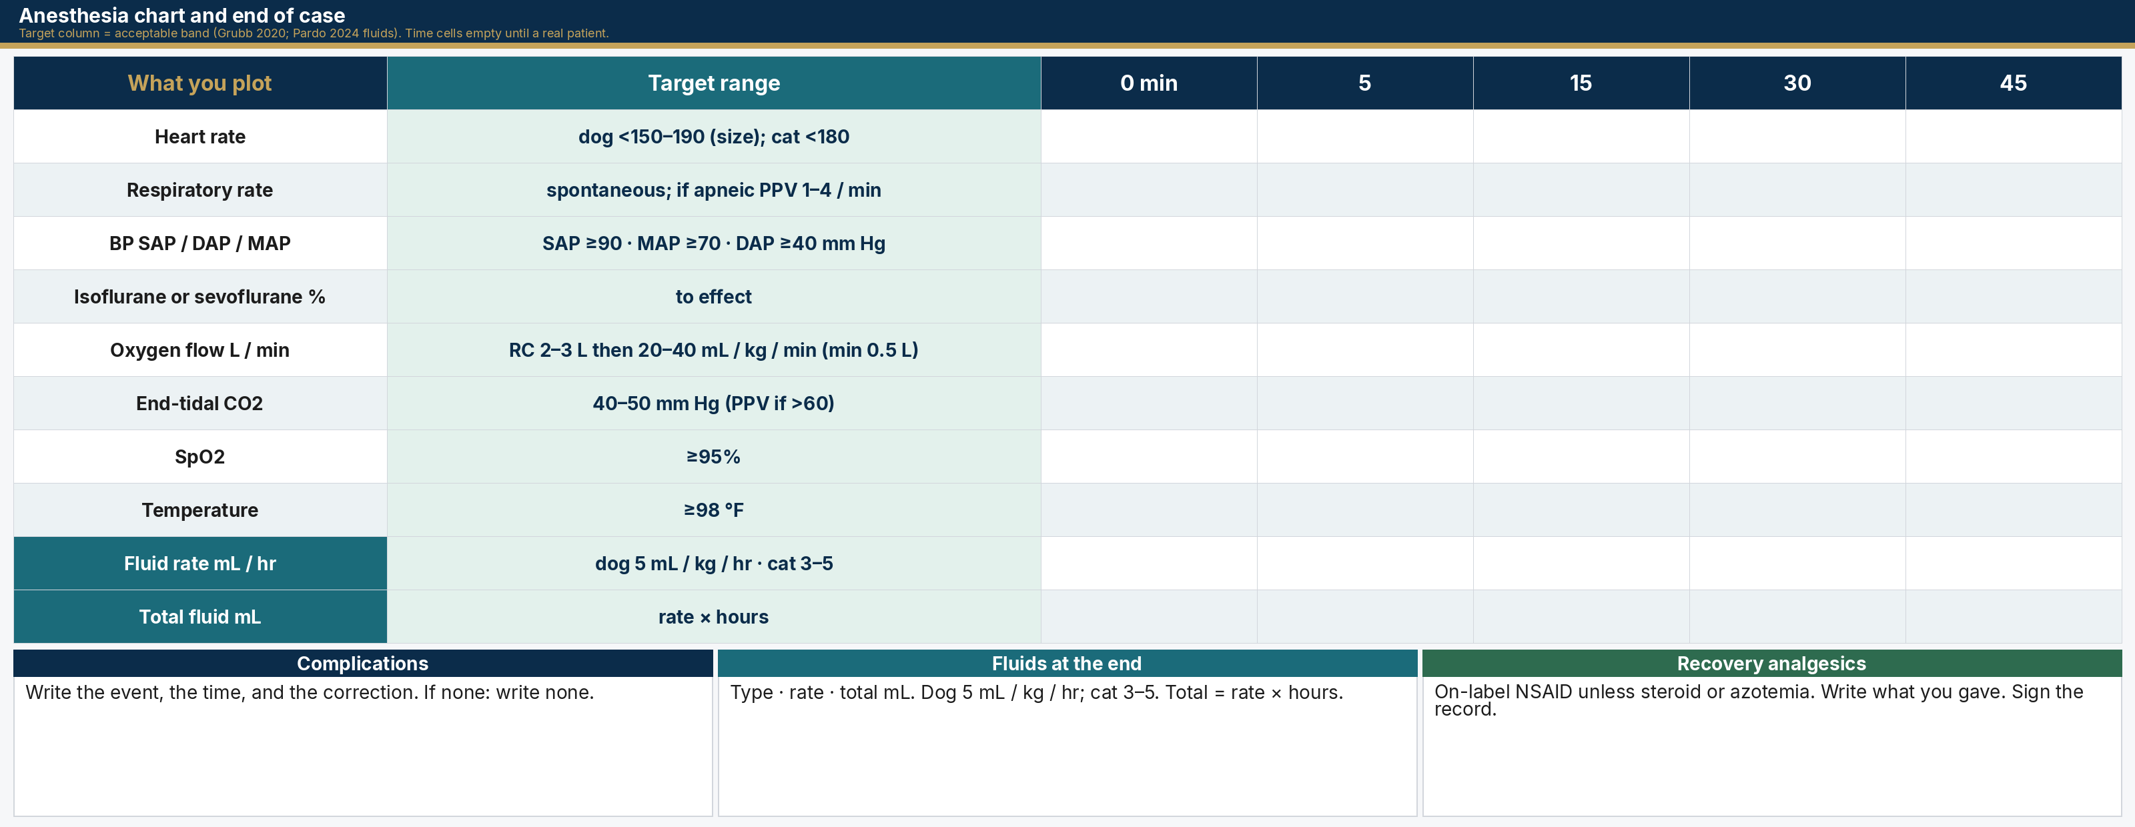
TARGET COLUMN IS THE ACCEPTABLE BAND. TIME CELLS STAY EMPTY UNTIL A REAL PATIENT. THEN COMPLICATIONS, FLUIDS, ANALGESICS, SIGN.
Anesthesia chart and end of case
DVM 612 | Dr. Yujin Kim, D.V.M., Ph.D., FFCP | Lewyt CVM
30 / 38
Notes:
This is Appendix 3 pages 4 and 5, taught as an original chart, not the copyrighted grid. The filled column is the acceptable anesthesia band: Grubb 2020 for monitors, Pardo 2024 for fluids. Heart rate: stay below 150 to 190 in the dog by size, below 180 in the cat. Blood pressure: SAP at least 90, MAP at least 70, DAP at least 40. ETCO2 40 to 50, start PPV if over 60. SpO2 at least 95 percent. Temperature at least 98 Fahrenheit. Circle oxygen 2 to 3 liters then 20 to 40 milliliters per kilogram per minute, minimum 500. Fluids: dog 5 milliliters per kilogram per hour, cat 3 to 5. Inhalant to effect; do not invent a MAC number. Time cells stay empty until you plot a real patient. End of case: complications or none, fluid type rate and total, recovery analgesics, signature. Do not put a hospital case into this chart.

Slide 31
ON-LABEL NSAIDS. DOG: CARPROFEN. CAT: ONSIOR. THEN TEACH THE E-COLLAR.
Postop analgesia and incision care
On-label NSAID
Antibiotic injection and incision
▸ Score pain. Dogs: Glasgow CMPS-SF. Cats: Feline Grimace Scale. Opioid as planned.
▸ Dog: carprofen (Rimadyl) 4.4 mg/kg SQ. Dogs only. Give ~2 hours before incision so levels are on board (pre-emptive; Rimadyl label).
▸ Cat: Onsior (robenacoxib) 2 mg/kg SQ. Cats only. First dose ~30 min before incision so levels are on board. OHE, castration, orthopedic. Up to 3 days.
▸ Dog: carprofen. Cat: Onsior. Do not swap species in this course.
▸ Do not stack an NSAID with a steroid. Skip NSAID if the patient is azotemic.
▸ A postoperative antibiotic injection is treatment. Write the drug, dose, and why.
▸ Clean elective OHE: skip (Frey 2022). Do not send home 14 days of cephalexin.
▸ Dirty or infected: continue as therapy, not prophylaxis.
▸ Look twice daily: swelling, discharge, gapping, smell, heat.
▸ E-collar that stays on. Leash walks 14 days.
▸ Skin sutures typically 10–14 days.
DVM 612 | Dr. Yujin Kim, D.V.M., Ph.D., FFCP | Lewyt CVM
31 / 38
Notes:
This course uses on-label NSAIDs as pre-emptive analgesia: give before incision so levels are on board. Dog: carprofen 4.4 milligrams per kilogram SQ, about 2 hours before incision. Do not use carprofen in cats. Cat: Onsior 2 milligrams per kilogram SQ, about 30 minutes before incision. Do not teach Onsior in the dog. Do not combine NSAID with DexSP. A postop antibiotic shot is not automatic. Clean spay: skip. Infected ear: treat.

Slide 32
THE OPERATION IS NOT OVER AT THE LAST SKIN SUTURE. HEMORRHAGE, HERNIA, DEHISCENCE.
Complications in the first 24 hours
Hemorrhage
Airway / aspiration
Pale mm, tachycardia, distending abdomen, drip from incision, collapsing. Stabilize and return to OR.
Stertor, crackles, regurg on the pillow. Especially brachycephalics and after opioids.
Hernia / evisceration
Dehiscence (later)
Linea failure. Emergency. Protect viscera with sterile moist towels, opioids, OR now.
Often day 3–5. Skin versus fascia: fascial dehiscence is the emergency.
SSI
Seroma / self-trauma
Redness, pain, discharge, fever, usually after day 3. Culture. Open, lavage, and treat the organism you grow.
Dead space + motion. Restrict activity. Bandage if needed. Leave the fluid unless it is infected.
DVM 612 | Dr. Yujin Kim, D.V.M., Ph.D., FFCP | Lewyt CVM
32 / 38
Notes:
Hemorrhage versus seroma. Skin versus fascial dehiscence. Evisceration protocol in one breath.

Slide 33
WHAT THE OVERNIGHT CLINICIAN AND THE OWNER BOTH NEED
Surgical report and discharge
Minimum report elements
Discharge, verbal and written
▸ Date/time, patient ID, surgeon, anesthesia, ASA.
▸ Procedure name and side. Position, clip/prep, approach.
▸ Findings in order. Ligatures, implants, samples.
▸ Suture: layer, material, size, pattern.
▸ Hemostasis, blood loss, sponge count, complications.
▸ Postop plan: fluids, pain, feeding, recheck.
▸ What we did, in one sentence.
▸ When to start food and water, and how much.
▸ Every medication: name, dose, time, with food?
▸ Incision care and 14-day leash walks.
▸ E-collar on except when directly watching.
▸ Next appointment. ER criteria. After-hours number.
DVM 612 | Dr. Yujin Kim, D.V.M., Ph.D., FFCP | Lewyt CVM
33 / 38
Notes:
At 2 a.m. someone opens this record because the abdomen is swelling. They need ligatures, sponge count, linea suture, and whether the client was called.

Slide 34
THE CLIENT MUST BE ABLE TO REPEAT THESE
Emergency criteria for discharge
Come now
Call today
Expected
Collapse. Pale gums. Distended abdomen. Unstoppable bleeding. Can’t breathe. Can’t urinate. Evisceration. Uncontrolled pain.
Not eating by morning. A few vomits. Mild incision redness. Diarrhea. E-collar problems.
Sleepy tonight. Small bruise. Slightly tacky incision. Reduced appetite this evening.
DVM 612 | Dr. Yujin Kim, D.V.M., Ph.D., FFCP | Lewyt CVM
34 / 38
Notes:
Pale gums + distended abdomen after OHE: come now. Return to OR.

Slide 35
ASA EXAMPLE: EAR DISEASE + DEXSP. RE-ASSIGN ASA ON THE DAY OF ANY LATER TECA-LBO.
Willie: complete perioperative plan
Willie · Cavalier · 13.7 kg · ASA Status 3-E · vestibular + AS otitis · skip NSAID
Pre-op
Sedation
Intra
Post
Neuro exam. ASA 3-E. Exam before any drug. Skip NSAID after DexSP. Premed path: opioid + alfaxalone.
Alfaxalone for an ear clean. Tube, bag, and 69 mL/hr only if you intubate a 13.7 kg dog. Canal: dilute PVP-I, not 7.5% scrub.
Timeout. Deep clean + cytology. If you contaminate, say it and re-glove.
No stairs. Watch neuro signs. MRI if signs persist. If TECA-LBO later: new ASA that morning.
DVM 612 | Dr. Yujin Kim, D.V.M., Ph.D., FFCP | Lewyt CVM
35 / 38
Notes:
Walk this as an ASA example, not as the lecture thesis. One sentence on the other example: the same preoperative evaluation cancelled an exploratory when the disease was uncompensated.

Slide 36
ASA EXAMPLES. BOTH RECEIVED A PREOPERATIVE EVALUATION. ONLY WILLIE WAS SEDATED.
Willie and MoMo
Willie, ASA Status 3-E
MoMo, ASA Status 4-E
Proceed with sedation. Cavalier, 13.7 kg. Acute vestibular + AS otitis + murmur. Compensated. Fill the anesthesia record. Alfaxalone, ear clean, skip NSAID after DexSP. If TECA-LBO is needed later, assign a new ASA that morning.
Cancel the exploratory. DSH, 4.25 kg. Vomiting that looked like FB. Right kidney fluid-filled and non-functional on AUS. Progressive azotemia on fluids (creatinine 3.0 → 4.71). NSAIDs contraindicated. Record the decision. Offer supportive care, referral, or euthanasia.
DVM 612 | Dr. Yujin Kim, D.V.M., Ph.D., FFCP | Lewyt CVM
36 / 38
Notes:
Last content slide if time is gone. These two patients are ASA examples only. Healthy Lab OHE is the ASA Status 1 contrast.

Slide 37
CPE MOA 2026 APPENDIX 3 AND SURGERY COMPETENCIES
Key points
1
Pre-anesthetic assessment: TPR, mm/CRT, then PCV, TP, BUN. Interpret. Circle ASA. Then IM or SQ premed.
2
Write drug, concentration, dose, volume, and route. Then IV fluid name and rate, ETT size, circuit, and fresh-gas flow.
3
Ready for surgical prep: airway secured, machine on, patent IV running, surgical plane, monitoring started.
4
Patient: hair, skin, position, drape. Surgeon: attire, gown, closed glove. Announce incision.
5
Fill the chart: HR, RR, BP, inhalant, O2, ETCO2, SpO2, temp, fluids. Then complications, recovery analgesics, and sign.
6
First 24 hours still count: hemorrhage from a weak ligature, or hernia from a weak linea.
DVM 612 | Dr. Yujin Kim, D.V.M., Ph.D., FFCP | Lewyt CVM
37 / 38
Notes:
These six lines are the Appendix 3 record and the Surgery competencies: assessment and ASA, drug protocol and equipment, ready for prep, hair-skin-position-drape, the chart and signature, then the first 24 hours. Do not recap the hospital patients here.

Slide 38
DVM 612 · PRINCIPLES OF SURGERY
Questions
When is the patient ready for clippers?
What do you write before the first IM or SQ premed?
References (course texts, guidelines, labels, and papers used in this hour)
1. Fossum TW. Small Animal Surgery. 5th ed. Elsevier; 2018. ISBN 978-0-323-44344-9. Ch. 4, 5, 6, 9.
2. Hendrickson DA, Baird AN. Turner and McIlwraith’s Techniques in Large Animal Surgery. 4th ed. Wiley-Blackwell; 2013. ISBN 978-1-118-27323-4.
3. Johnston SA, Tobias KM. Veterinary Surgery: Small Animal. 2nd ed. Elsevier Saunders; 2017. ISBN 978-0-323-32065-8.
4. Grubb T, Sager J, Gaynor JS, Montgomery E, Parker JA, Shafford H, Tearney C. 2020 AAHA Anesthesia and Monitoring Guidelines for Dogs and Cats. J Am Anim Hosp Assoc. 2020;56(2):59–82.
5. Frey E, Costin M, Granick J, Kornya M, Weese JS. 2022 AAFP/AAHA Antimicrobial Stewardship Guidelines. J Am Anim Hosp Assoc. 2022;58(4):1–5.
6. Roberts SM, Severin GA, Lavach JD. Am J Vet Res. 1986;47(6):1207–1210.
7. Whittem TL, Johnson AL, Smith CW, et al. J Am Vet Med Assoc. 1999;215(2):212–216.
8. Gonzalez OJ, Renberg WC, Roush JK, KuKanich B, Warner M. Am J Vet Res. 2017;78(6):695–701.
9. BETADINE Surgical Scrub Veterinary. 7.5% povidone-iodine. DailyMed NDC 67618-154. Lather about 5 min, rinse, paint Solution Veterinary, dry.
10. BETADINE Solution Veterinary. 5% povidone-iodine (not 10%). DailyMed NDC 67618-155.
11. Nolvasan Surgical Scrub. 2% chlorhexidine acetate. DailyMed NDC 54771-8701.
12. ECFVG. CPE Manual of Administration. 2026 ed. Anesthesia; Surgery.
13. Pardo et al. 2024 AAHA Fluid Therapy. JAAHA. 2024;60:131–163.
Dr. Yujin Kim, D.V.M., Ph.D., FFCP · Lewyt CVM · Long Island University
38 / 38
Notes:
Take questions. If none: ready for clippers means airway secured, machine on, patent IV running, surgical plane, monitoring started. Before the first premed: today’s PE, PCV, TP, BUN, and ASA. Dismiss on time.

