Slide 1
Machine Learning Class – Capstone Project: Detection & Classification of C. Elegans with Image Processing and Convolutional Neural Networks (CNN)
Prepared by: Yildirim Kocoglu

Slide 2
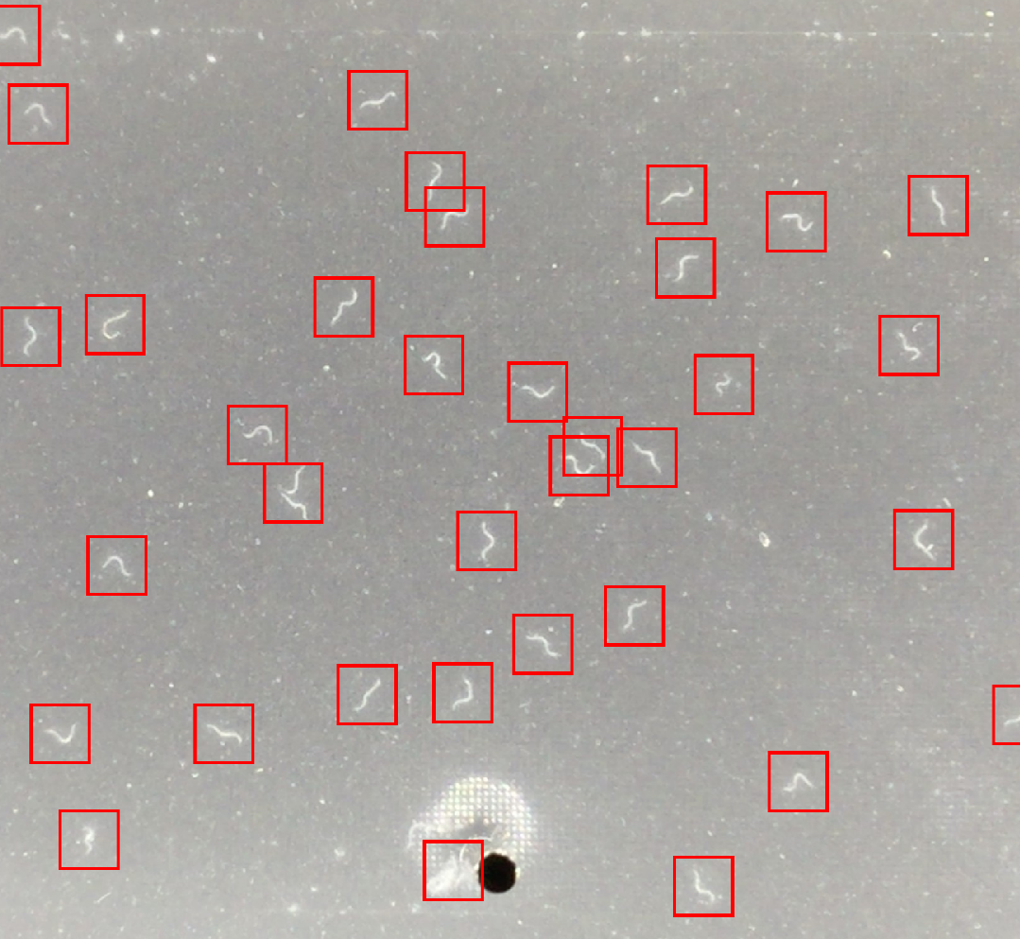
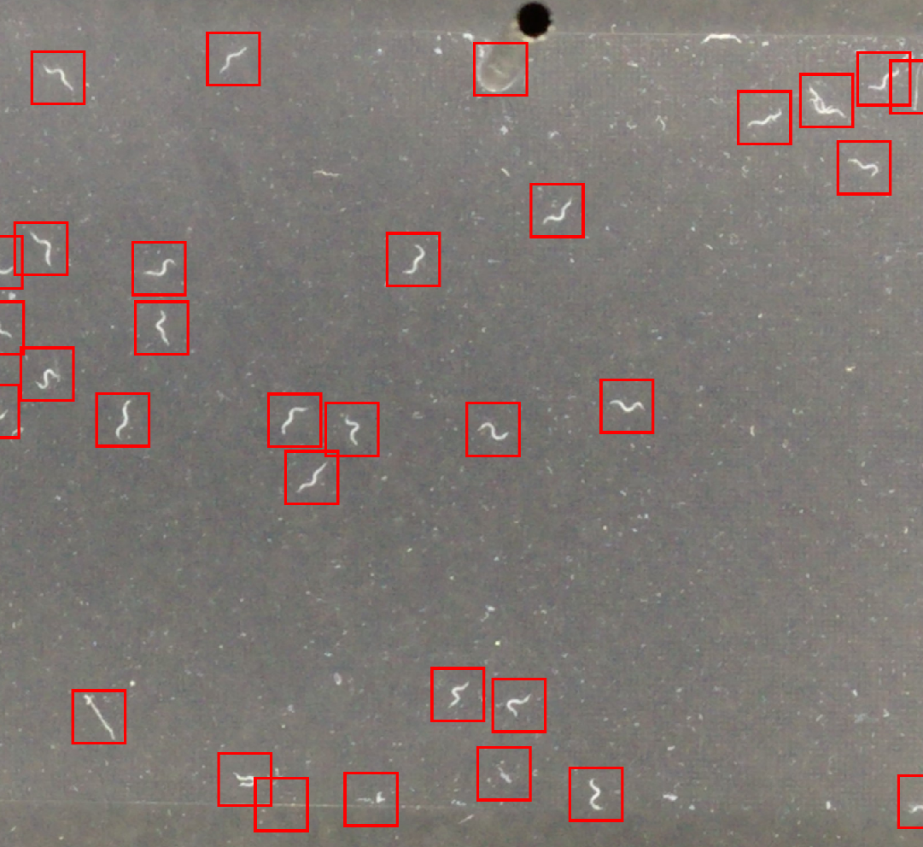
Image Processing Step # 1:
Convert image to grayscale image (single channel)
Detect worms & Draw Bounding Boxes
Example Image # 1
Example Image # 2

Slide 3
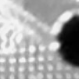
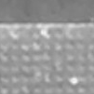
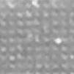
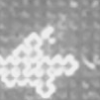
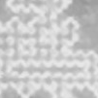
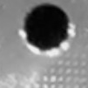
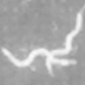
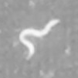
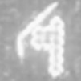
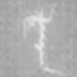

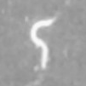
Image Processing Step # 2:
Crop Bounding Boxes
Separate classes (“Worm” vs “No Worm”)
No worm class
Worm class
Possible Dead worm (thin worm) ?

Slide 4
Data Preparation (3rd Step)
Divide data into training, validation, and test sets
Data Type | Number of images (per class) | Percentage (per class)
Training – worm | 5500 | ~ 32.84%
Training – no worm | 5500 | ~ 32.84%
Validation – worm | 1375 | ~ 8.21%
Validation – no worm | 1375 | ~ 8.21%
Test – worm | 1500 | ~ 8.95%
Test – no worm | 1500 | ~ 8.95%
Data was balanced using image augmentation techniques for training, validation, test sets
Data Type | Number of images (total) | Percentage (total)
Training | 11000 | ~65.68%
Validation | 2750 | ~16.42%
Test | 3000 | ~17.90%

Slide 5
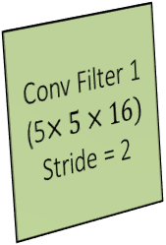
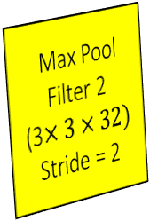

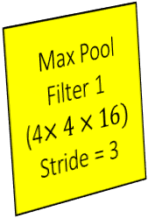
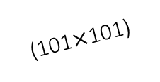
Hyperparameter Optimization (4th step)
Find the optimum model architecture/hyperparameters for optimum model performance
Main Goals:
Avoid overfitting & underfitting
Improve accuracy on training, validation, and test sets simultaneously
Learning Rate | Optimizer | Decay Rate (Rmsprop) | Batch Size
0.01 | Rmsprop | 0.9 | 50
Input image
Batch Normalization 1
ReLU 1
Max Pool
Filter 1
(4$×4×16)$
Stride = 3
Conv Filter 2
(4$×4×32)$
Stride = 1
Batch Normalization 2
ReLU 2
Max Pool
Filter 2
(3$×3×32)$
Stride = 2
Conv Filter 1
(5$×5×16)$
Stride = 2
(101$×$101)
Worm
Fully Connected Layer 1
(units = 5000)
Batch Normalization 3
ReLU 3
Fully Connected Layer 2
(units = 2)
Batch Normalization 4
Softmax
Possible
Categorical
Outputs
Flatten
No Worm

Slide 6
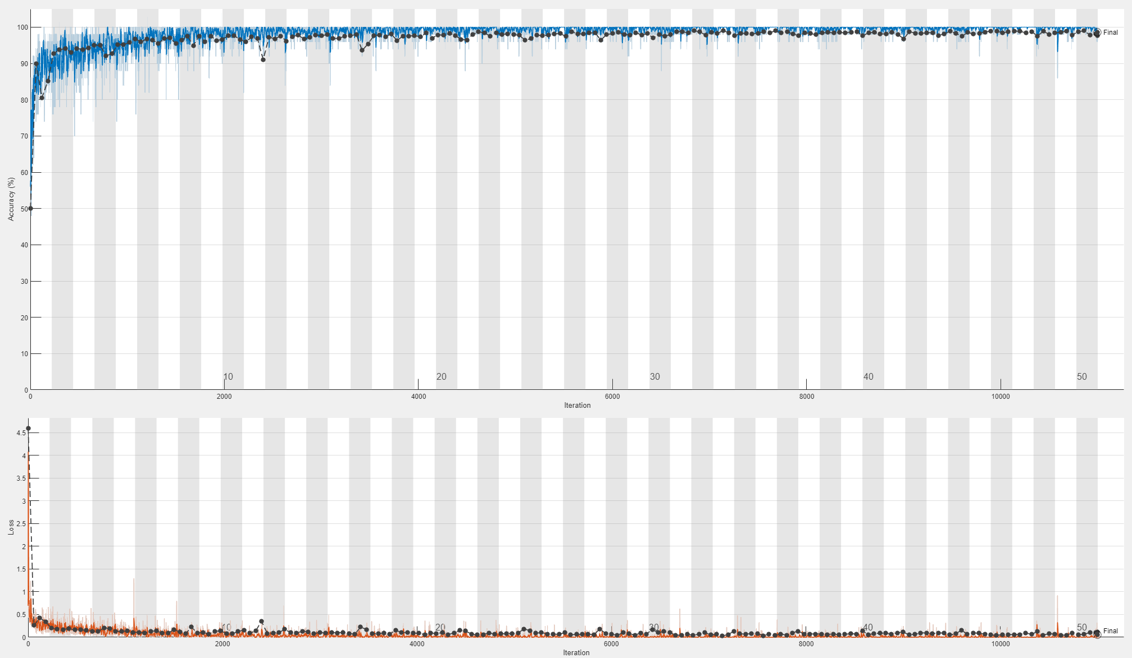
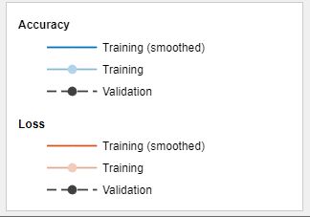
Accuracy & Loss vs Iterations
Total Epochs | Elapsed Training Time (minutes)
50 | 8

Slide 7
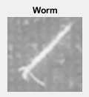
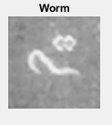
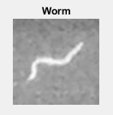
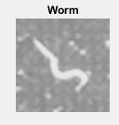
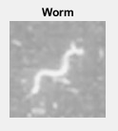
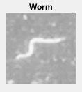
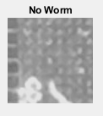
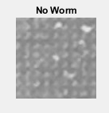
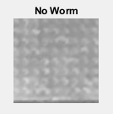
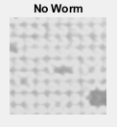
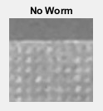
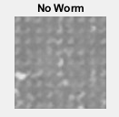
Model Evaluation
Training Accuracy | Validation Accuracy | Test Accuracy
98.93 % | 98.65 % | 97.00 %
CNN Model Predictions on Test Set
Defect or straight worm?
Defect or half-worm?

