Slide 1

Project 1: Hive
Derrick Lin

Slide 2
☕ Setup
Start with data in hdfs /home/pokem/revature-project1/
BranchA.txt, BranchB.txt, BranchC.txt
ConscountA.txt, ConscountA.txt, ConscountA.txt
USE project1;

Slide 3
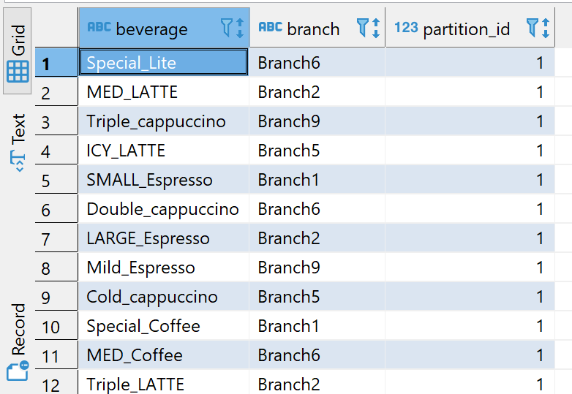
☕ Setup: BevBranch table
A table that shows which branches serve which beverages
CREATE TABLE BevBranch(beverage STRING, branch STRING)
PARTITIONED BY (partition_id INT)
ROW FORMAT DELIMITED FIELDS TERMINATED BY ','
STORED AS TEXTFILE;
LOAD DATA INPATH '/user/pokem/project1/Branch’
INTO TABLE BevBranch
PARTITION(partition_id = 1);

Slide 4
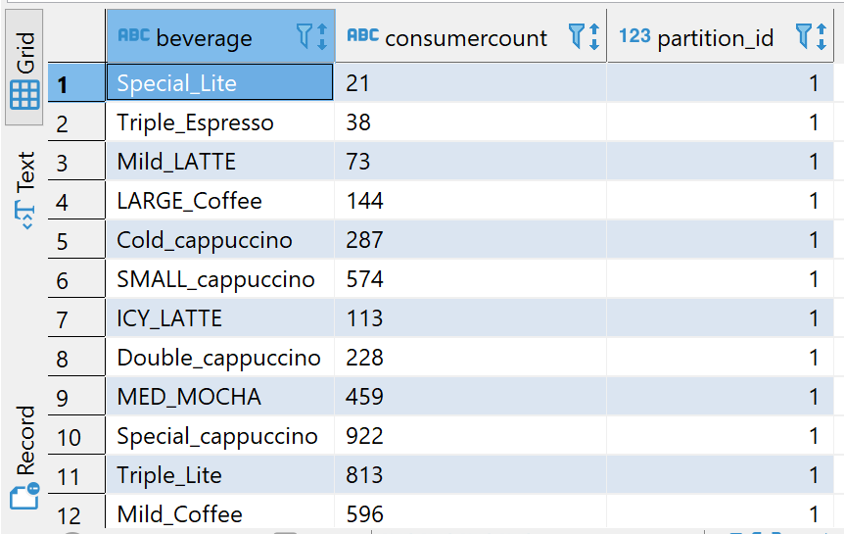
☕ Setup: BevConscount table
A table that shows the size of the customer base for each beverage (note that each row may only be a partial sample of the customer base for each beverage)
CREATE TABLE BevConscount(beverage STRING, consumercount STRING)
PARTITIONED BY (partition_id INT)
ROW FORMAT DELIMITED FIELDS TERMINATED BY ','
STORED AS TEXTFILE;
LOAD DATA INPATH '/user/pokem/project1/Conscount’
INTO TABLE BevConscount
PARTITION(partition_id = 1);

Slide 5
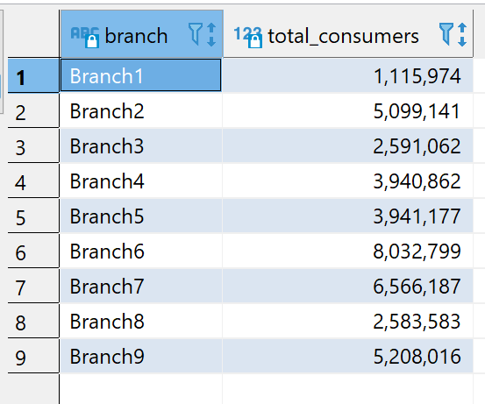
☕ Scenario 1
What is the total number of consumers for Branch1?
What is the number of consumers for the Branch2?
SELECT BB.Branch, sum(BC.consumercount) AS total_consumers
FROM BevBranch BB INNER JOIN BevConscount BC
ON BB.beverage = BC.beverage
GROUP BY BB.Branch;

Slide 6
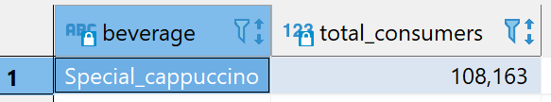
☕ Scenario 2 Question 1
What is the most consumed beverage on Branch1?
SELECT BC.beverage, sum(BC.consumercount) as total_consumers
FROM BevBranch BB INNER JOIN BevConscount BC
ON BB.beverage = BC.beverage
WHERE BB.Branch ='Branch1'
GROUP BY BC.beverage
ORDER BY total_consumers DESC LIMIT 1;

Slide 7
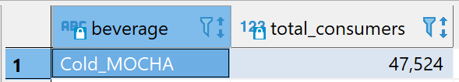
☕ Scenario 2 Question 2
What is the least consumed beverage on Branch2?
SELECT BC.beverage, sum(BC.consumercount) as total_consumers
FROM BevBranch BB INNER JOIN BevConscount BC
ON BB.beverage = BC.beverage
WHERE BB.Branch ='Branch2'
GROUP BY BC.beverage
ORDER BY total_consumers ASC LIMIT 1;

Slide 8
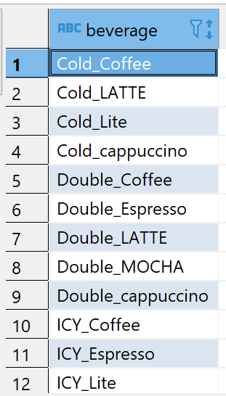
☕ Scenario 3 Question 1
What are the beverages available on Branch10, Branch8, and Branch1?
SELECT DISTINCT beverage FROM BevBranch BB
WHERE branch = 'Branch10’
OR branch = 'Branch8’
OR branch = 'Branch1';

Slide 9
☕ Scenario 3 Question 1 Full Output
Cold_Coffee
Cold_LATTE
Cold_Lite
Cold_cappuccino
Double_Coffee
Double_Espresso
Double_LATTE
Double_MOCHA
Double_cappuccino
ICY_Coffee
ICY_Espresso
ICY_Lite
ICY_MOCHA
ICY_cappuccino
LARGE_Coffee
LARGE_Espresso
LARGE_MOCHA
LARGE_cappuccino
MED_Coffee
MED_Espresso
MED_LATTE
MED_MOCHA
MED_cappuccino
Mild_Coffee
Mild_Espresso
Mild_LATTE
Mild_Lite
Mild_cappuccino
SMALL_Espresso
SMALL_LATTE
SMALL_Lite
SMALL_MOCHA
Special_Coffee
Special_Espresso
Special_LATTE
Special_Lite
Special_MOCHA
Special_cappuccino
Triple_Coffee
Triple_Espresso
Triple_LATTE
Triple_Lite
Triple_MOCHA
Triple_cappuccino
(Total count: 44)

Slide 10
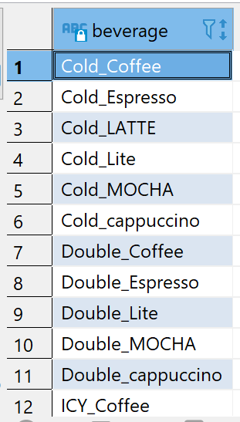
☕ Scenario 3 Question 2
What are the common beverages available in Branch4, Branch7?
SELECT beverage FROM BevBranch BB
WHERE branch = 'Branch4’
INTERSECT SELECT beverage FROM BevBranch BB
WHERE branch = 'Branch7';

Slide 11
☕ Scenario 3 Question 2 Full Output
Cold_Coffee
Cold_Espresso
Cold_LATTE
Cold_Lite
Cold_MOCHA
Cold_cappuccino
Double_Coffee
Double_Espresso
Double_Lite
Double_MOCHA
Double_cappuccino
ICY_Coffee
ICY_LATTE
ICY_Lite
ICY_MOCHA
ICY_cappuccino
LARGE_Coffee
LARGE_Espresso
LARGE_LATTE
LARGE_Lite
LARGE_MOCHA
LARGE_cappuccino
MED_Coffee
MED_Espresso
MED_Lite
MED_MOCHA
MED_cappuccino
Mild_Coffee
Mild_Espresso
Mild_LATTE
Mild_Lite
Mild_MOCHA
Mild_cappuccino
SMALL_Coffee
SMALL_Espresso
SMALL_LATTE
SMALL_Lite
SMALL_MOCHA
SMALL_cappuccino
Special_Coffee
Special_Espresso
Special_LATTE
Special_Lite
Special_MOCHA
Special_cappuccino
Triple_Coffee
Triple_Espresso
Triple_LATTE
Triple_Lite
Triple_MOCHA
Triple_cappuccino
(Total count: 51)

Slide 12
☕ Scenario 4: Partition
Create a partition, index, view for the scenario3.
Nothing changes in the data after running this, but there is another partition for us to store new data, as necessary.
ALTER TABLE BevBranch ADD PARTITION (partition_id = 2);

Slide 13
☕ Scenario 4: Index
Create a partition, index, view for the scenario3.
Again, nothing changes in the data after, but there should be a small speedup for certain queries (the speedup is negligible with the size of the data size we have).
CREATE INDEX bevbranch_on_branch_idx ON TABLE BevBranch(branch)
AS 'org.apache.hadoop.hive.ql.index.compact.CompactIndexHandler’
WITH DEFERRED REBUILD;
ALTER INDEX bevbranch_on_branch_idx ON BevBranch REBUILD;

Slide 14
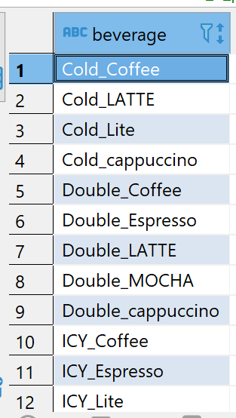
☕ Scenario 4: View (Question 1)
Create a partition, index, view for the scenario3.
CREATE VIEW scenario_3_part1_answer AS
SELECT DISTINCT beverage FROM BevBranch BB
WHERE branch = 'Branch10’
OR branch = 'Branch8’
OR branch = 'Branch1’;
SELECT * FROM scenario_3_part1_answer;

Slide 15
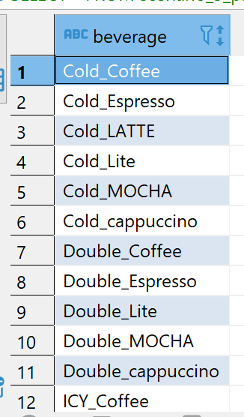
☕ Scenario 4: View (Question 2)
Create a partition, index, view for the scenario3.
CREATE VIEW scenario_3_part2_answer AS
SELECT beverage FROM BevBranch BB
WHERE branch = 'Branch4’
INTERSECT SELECT beverage FROM BevBranch BB
WHERE branch = 'Branch7';
SELECT * FROM scenario_3_part2_answer;

Slide 16
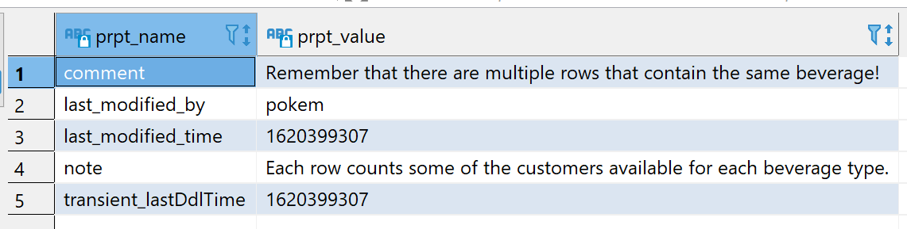
☕ Scenario 5
Alter the table properties to add "note","comment".
ALTER TABLE BevConscount SET TBLPROPERTIES('note'='Each row counts some of the customers available for each beverage type.');
ALTER TABLE BevConscount SET TBLPROPERTIES('comment'='Remember that there are multiple rows that contain the same beverage!');
SHOW TBLPROPERTIES BevConscount;

Slide 17
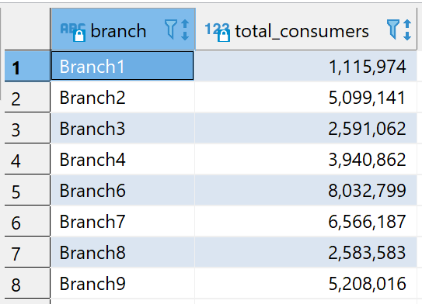
☕ Scenario 6
Remove the row 5 from the output of Scenario 1
SELECT branch, total_consumers FROM (
SELECT BB.Branch, sum(BC.consumercount) AS total_consumers,
ROW_NUMBER() OVER () AS row_num
FROM BevBranch BB INNER JOIN BevConscount BC
ON BB.beverage = BC.beverage
GROUP BY BB.Branch
ORDER BY BB.branch ASC
) S WHERE row_num != 5;

Slide 18
☕ Thank you!
Any questions or comments?

