Slide 1
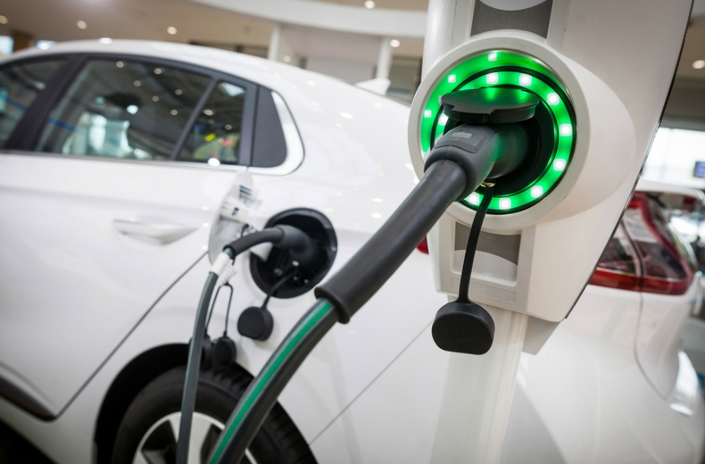
PLUGGING IN
Electric Car Charging Stations Dashboard

Slide 2
INTRODUCTIONS
Dinesh Lamda
Yannick Kalukuta
Vin Dixit
Adil Sarwar
Vijay Bagavatula
Kendall Gouldthorpe

Slide 3
PROPOSAL
Project Objective:
We will be using data that takes into account longitude and latitude of states in the US to find Charging Stations for Electric Vehicles from a set radius. With that data we will then create three visualizations to display information about the charging stations within those states.
Looking specifically at:
How the charging stations range across different states in the US
The different companies of charging stations in each state
Breaking down the types of charging stations (Rapid, Fast, Slow)
Methodology:
We will use an API to pull data and move it into a SQLite Database. From there we will use JavaScript to create various visualizations for a dashboard of different charging stations.

Slide 4
THE DASHBOARD COMPONENTS
API: developer.nrel.gov
SQL Database: List of states and their longitude and latitude
Leaflet: Displaying the location by state of all the charging stations
Plotly: Breaking down the number of each charging station company by state
Chart.js: Types of Charging Stations (Rapid Charges, Fast Charges, Slow Charges)

Slide 5
HOW WE DID IT
TASK #1
Create SQLITE with state, longitude and latitude
TASK #2

