Slide 1
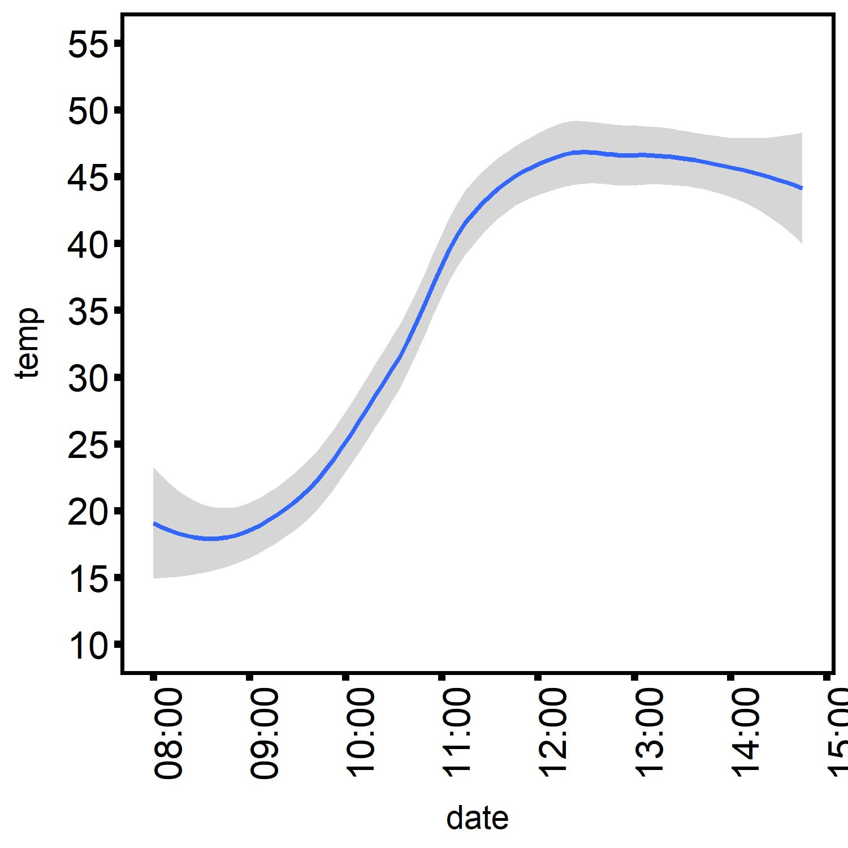
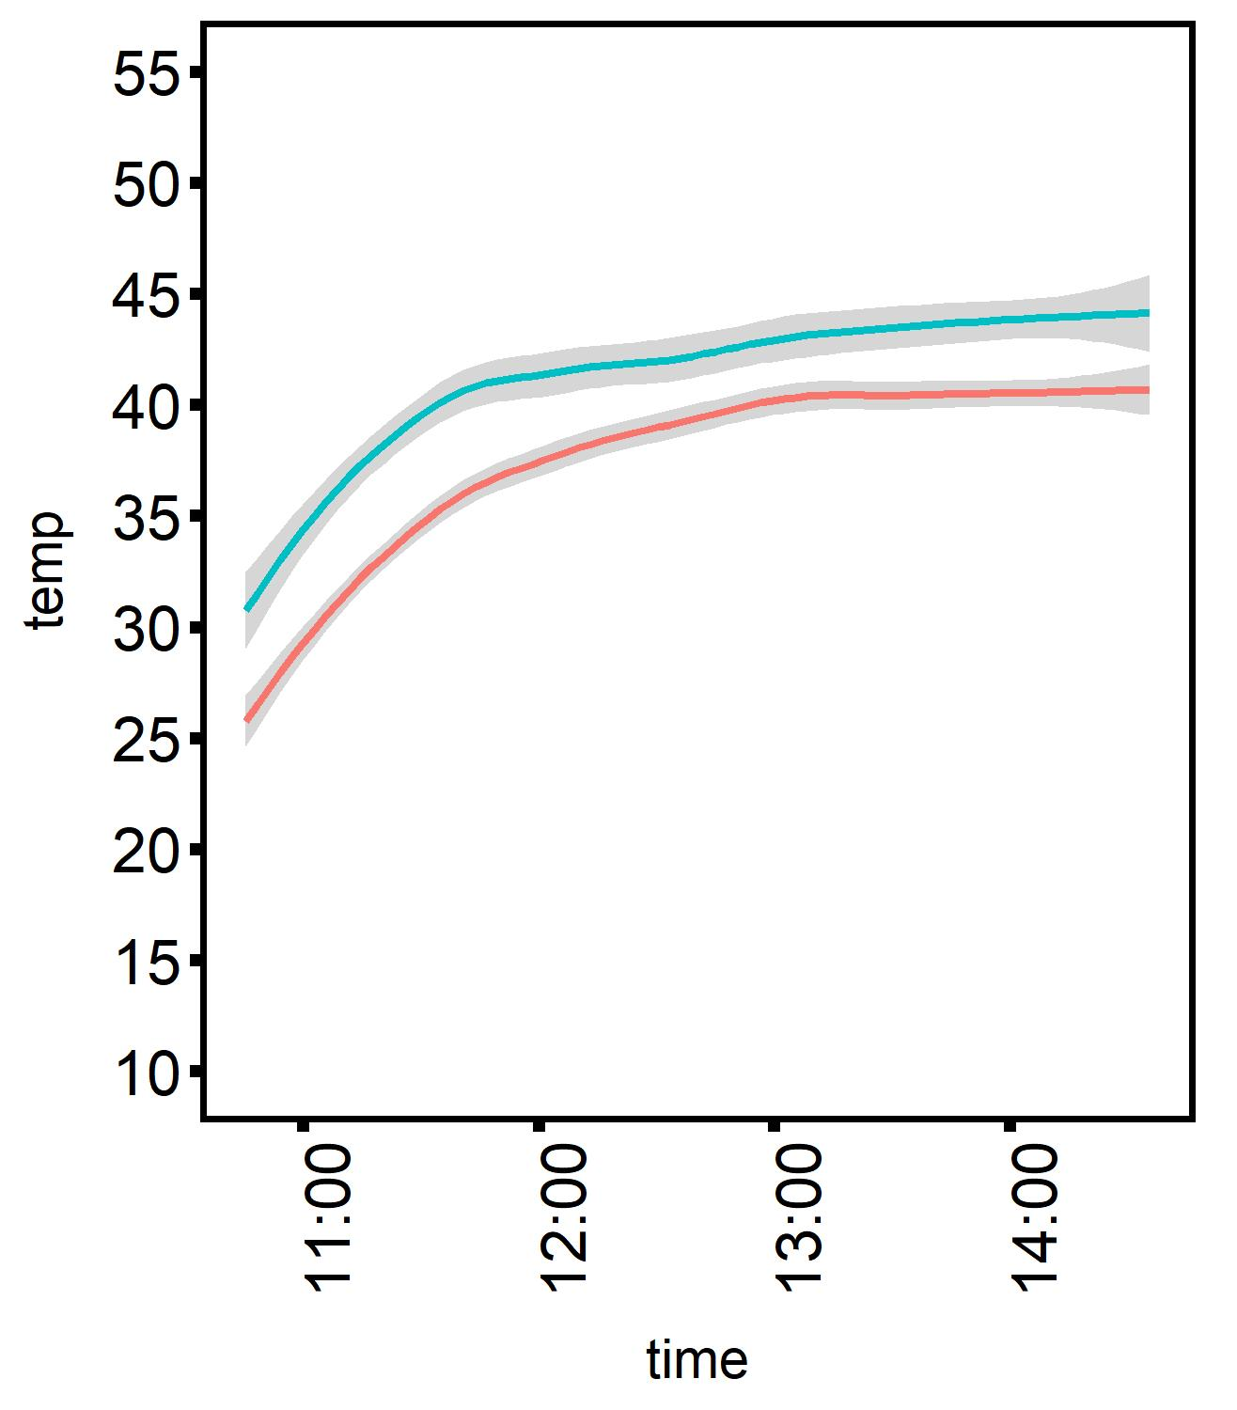
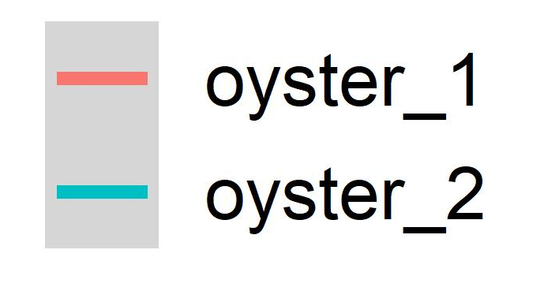
Oyster Internal Temperature
Tank Temperature
44°C target
Temp (°C)
Temp (°C)
large oyster
small oyster
Time (hour)
Time (hour)

