Slide 1
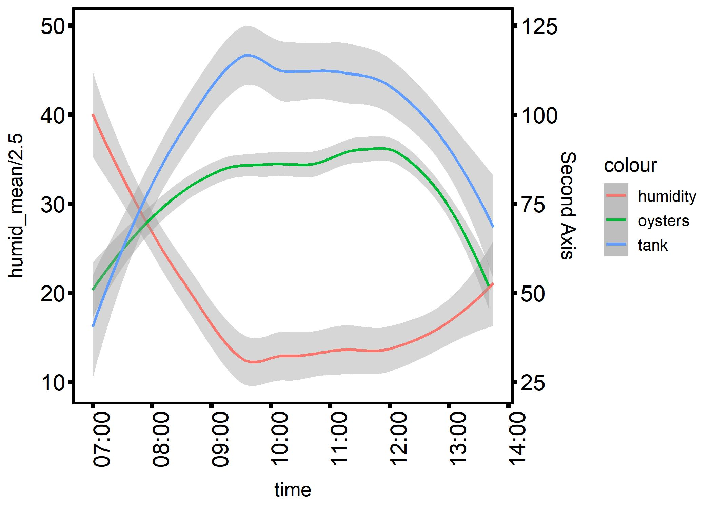
4 hour exposure
Chamber humidity
Chamber temp
44°C target
Internal oyster temp
Temperature (°C)
Relative Humidity (%)
Time (hour)

