Slide 1
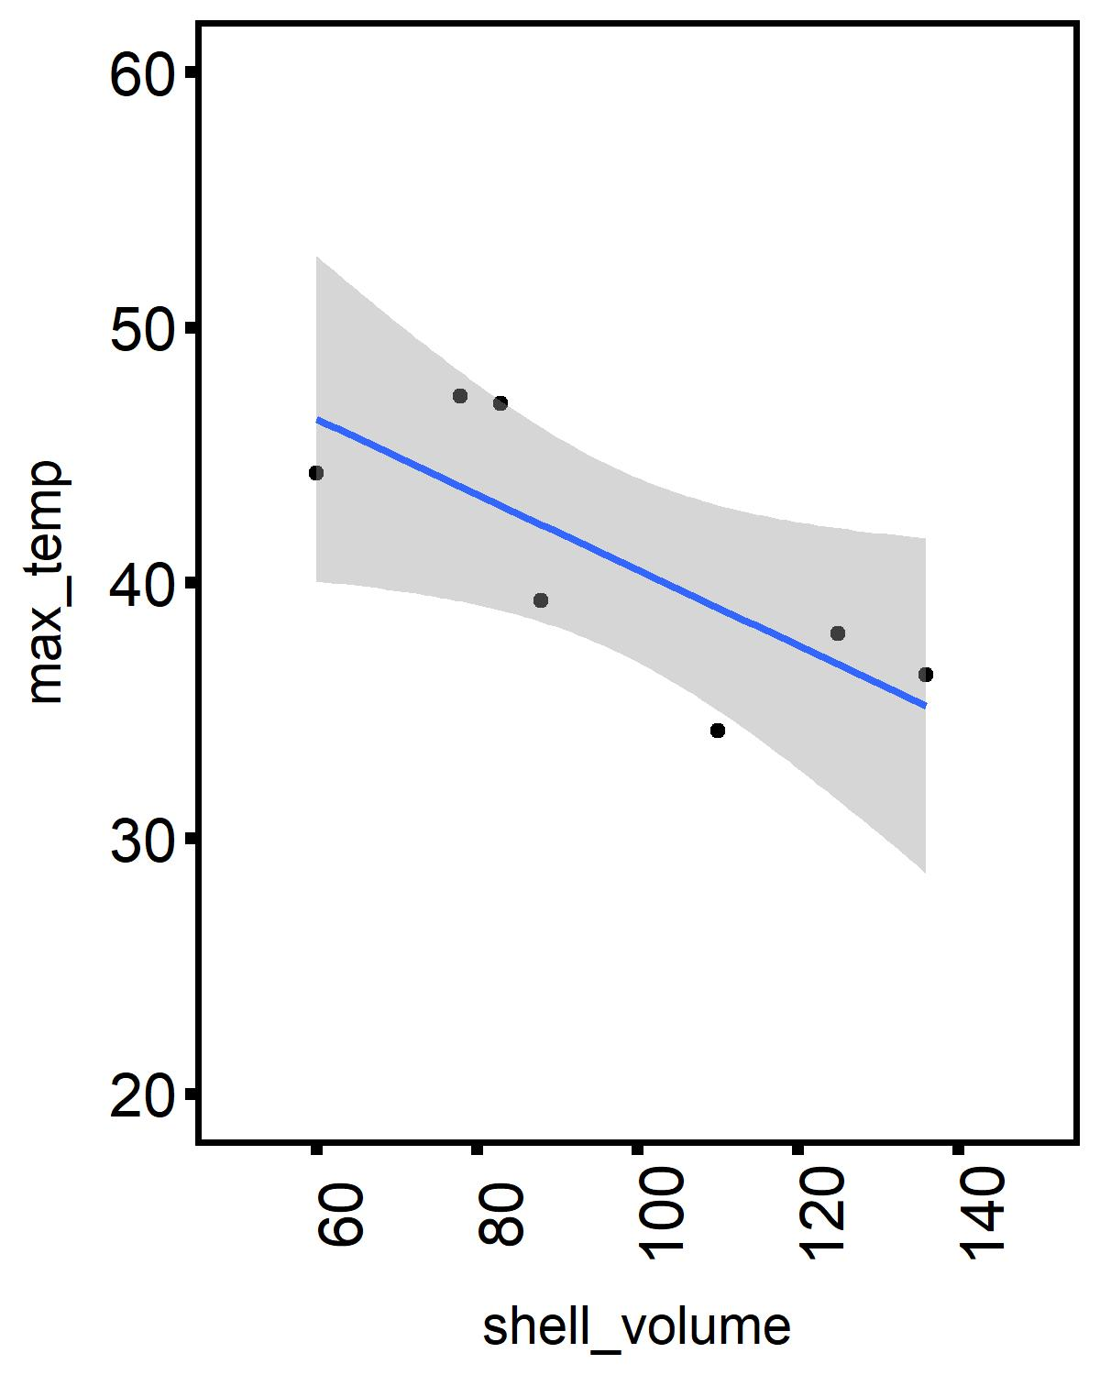
R² = 0.59
maximum internal oyster temperature (°C)
oyster shell volume (cm³)

