Slide 1
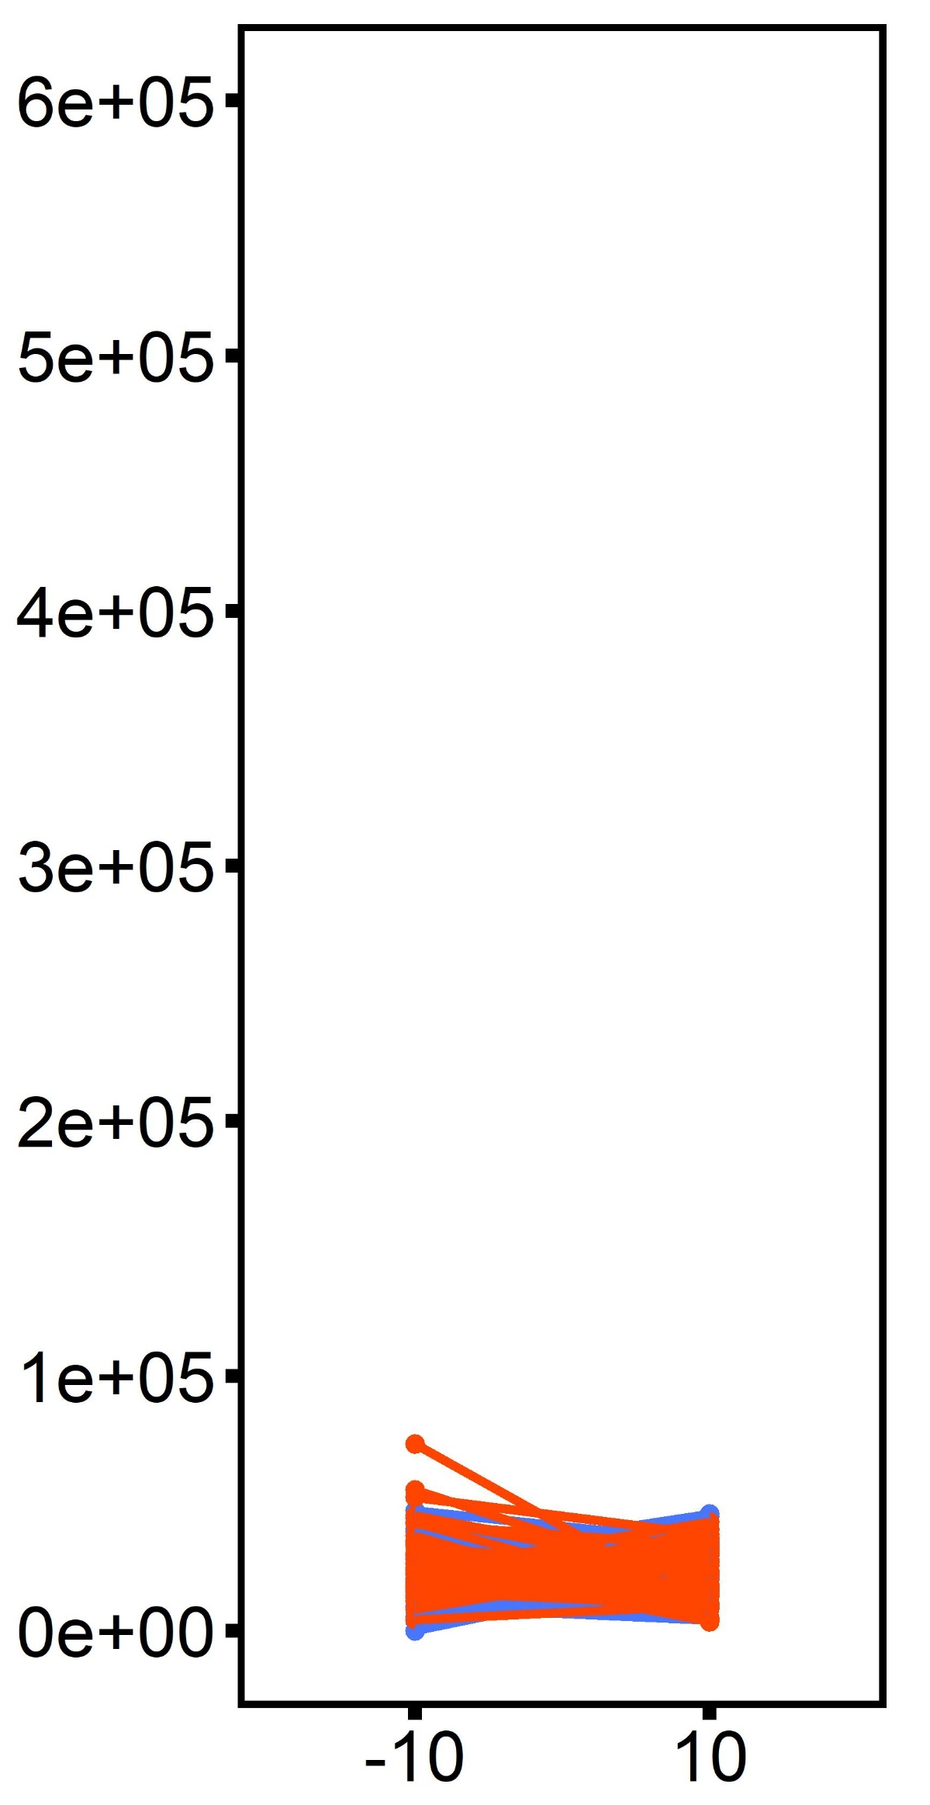
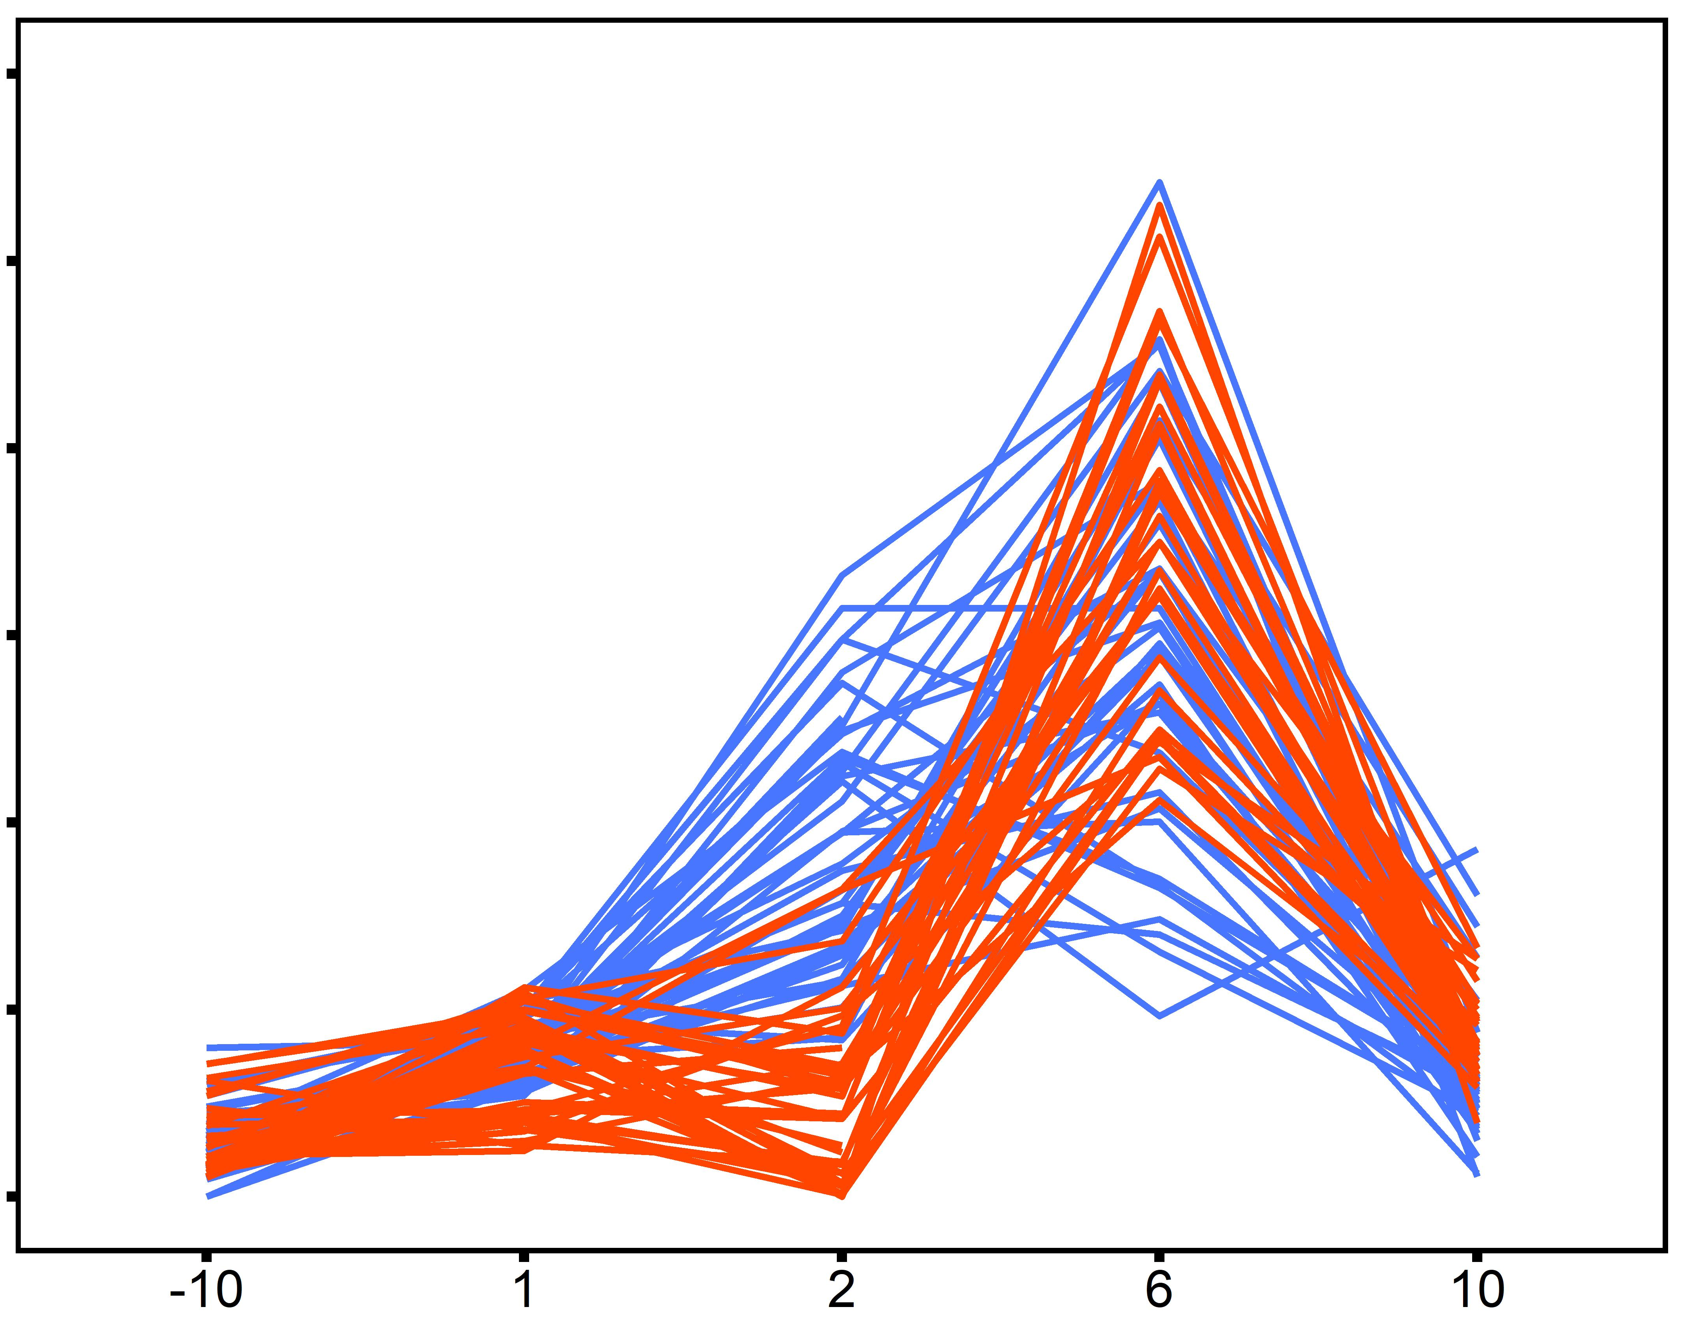
2°C d⁻¹ ramp
Desiccation @ 44°C for 4 hrs
20°C
20°C
30°C
30°C
Control
Heated Oysters
ploidy: p < 0.001
time: p < 0.001
time x ploidy: p < 0.001
Feeding Rate
(cells ml⁻¹ h⁻¹ cm⁻¹)
Timepoint

