Slide 1
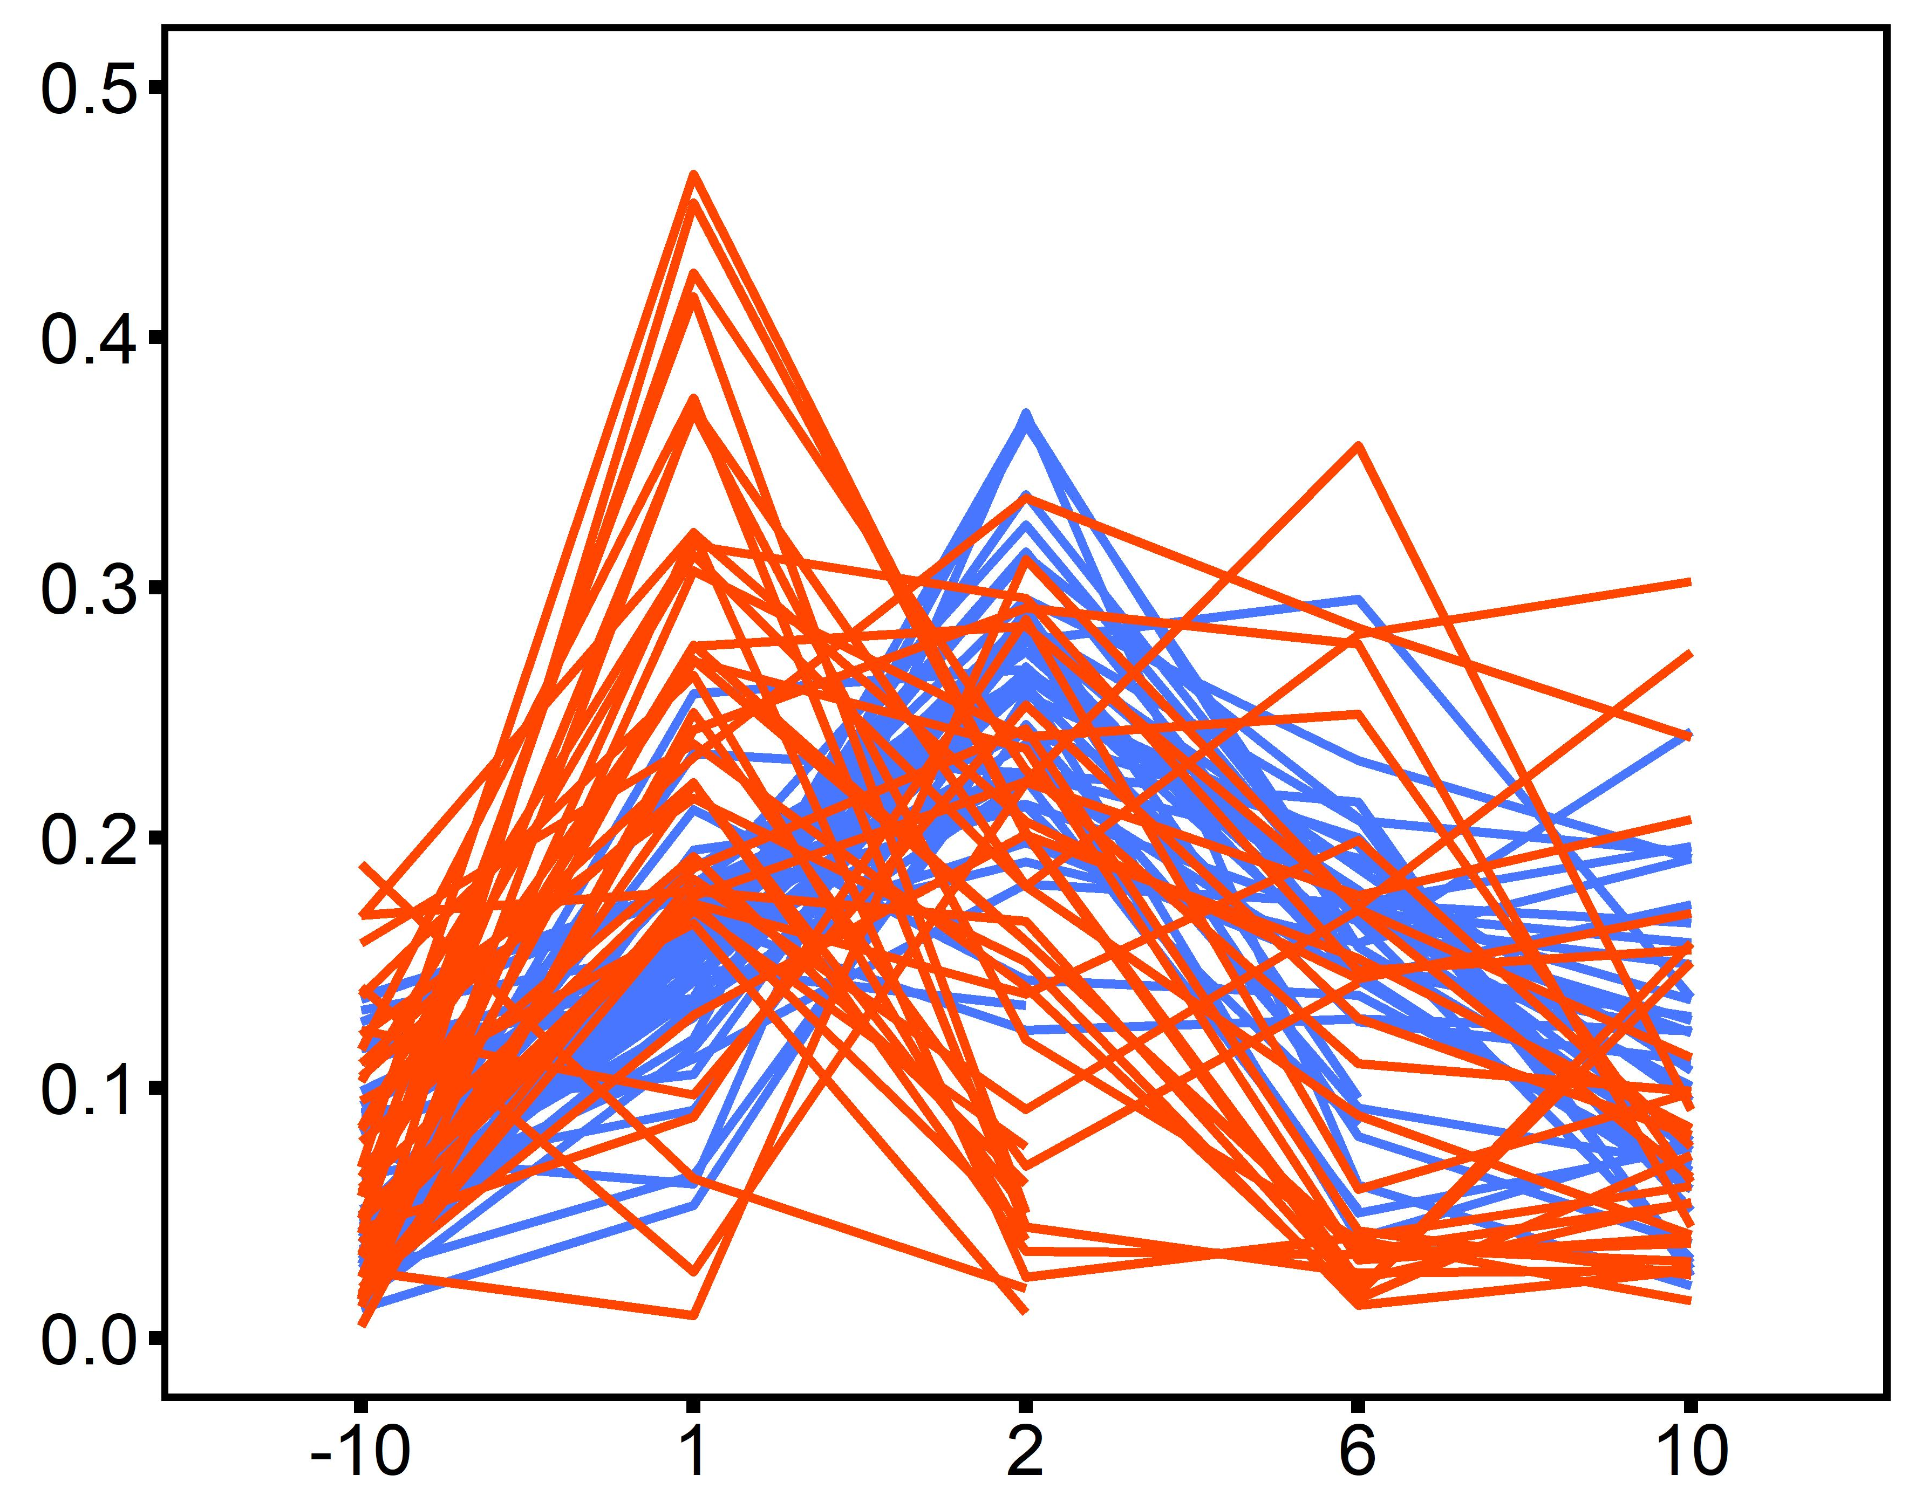
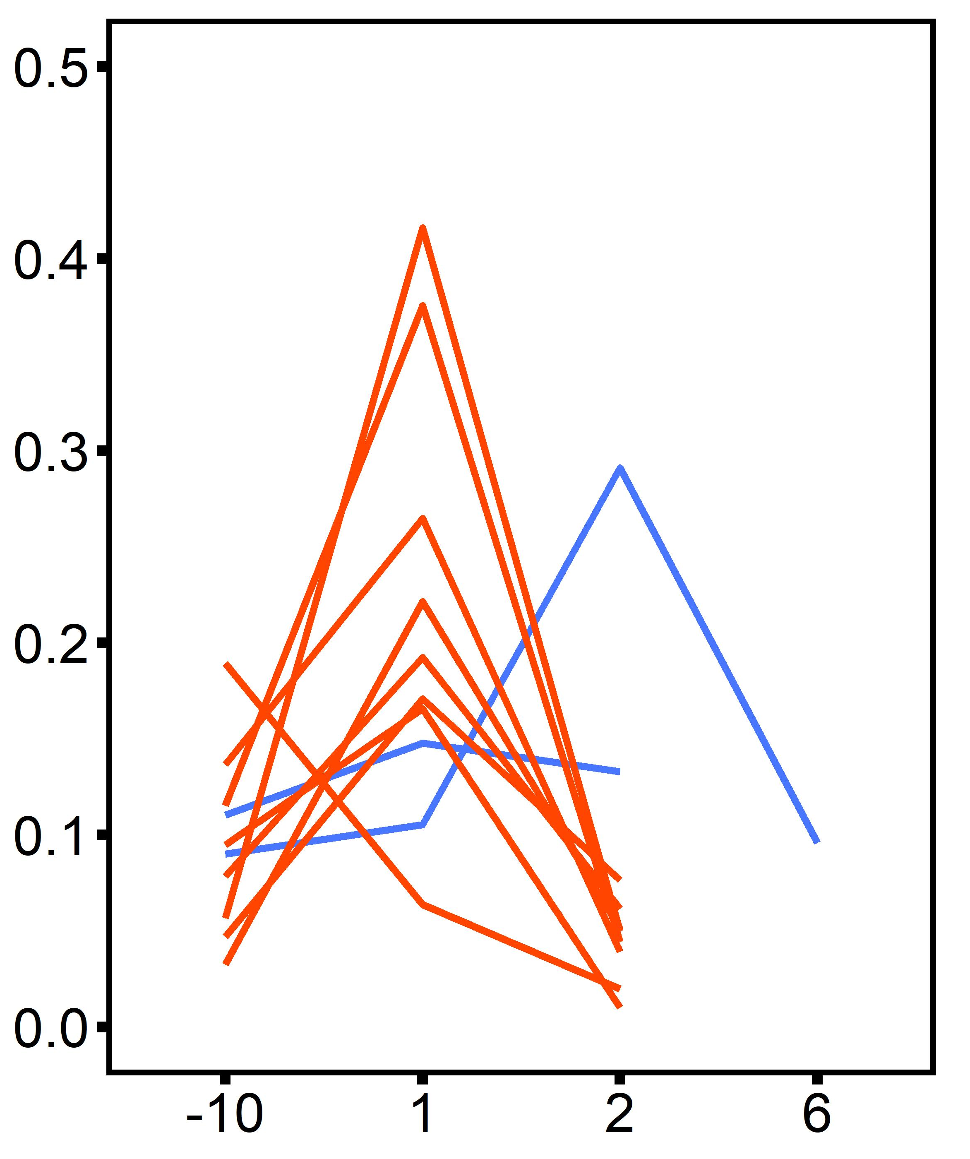
20°C
Control
Heated
ploidy: p = 0.24
time: p < 0.001
time x ploidy: p < 0.001
*
*
Treatment
2°C d⁻¹ ramp
Desiccation @ 45°C for 4 hrs
20°C
30°C
30°C
Heated oysters
ploidy: p = 0.24
time: p < 0.001
time x ploidy: p < 0.001
Oysters that died
SMR (mg O₂ h⁻¹ cm⁻³)
Timepoint

