Slide 1
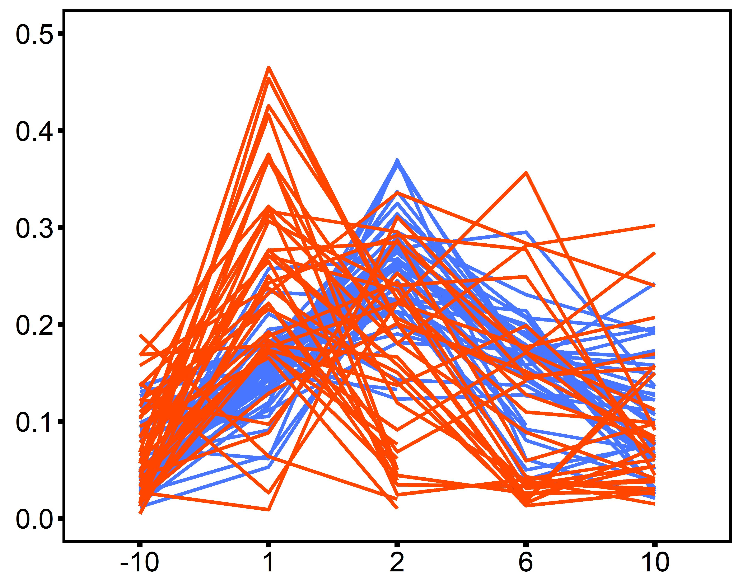
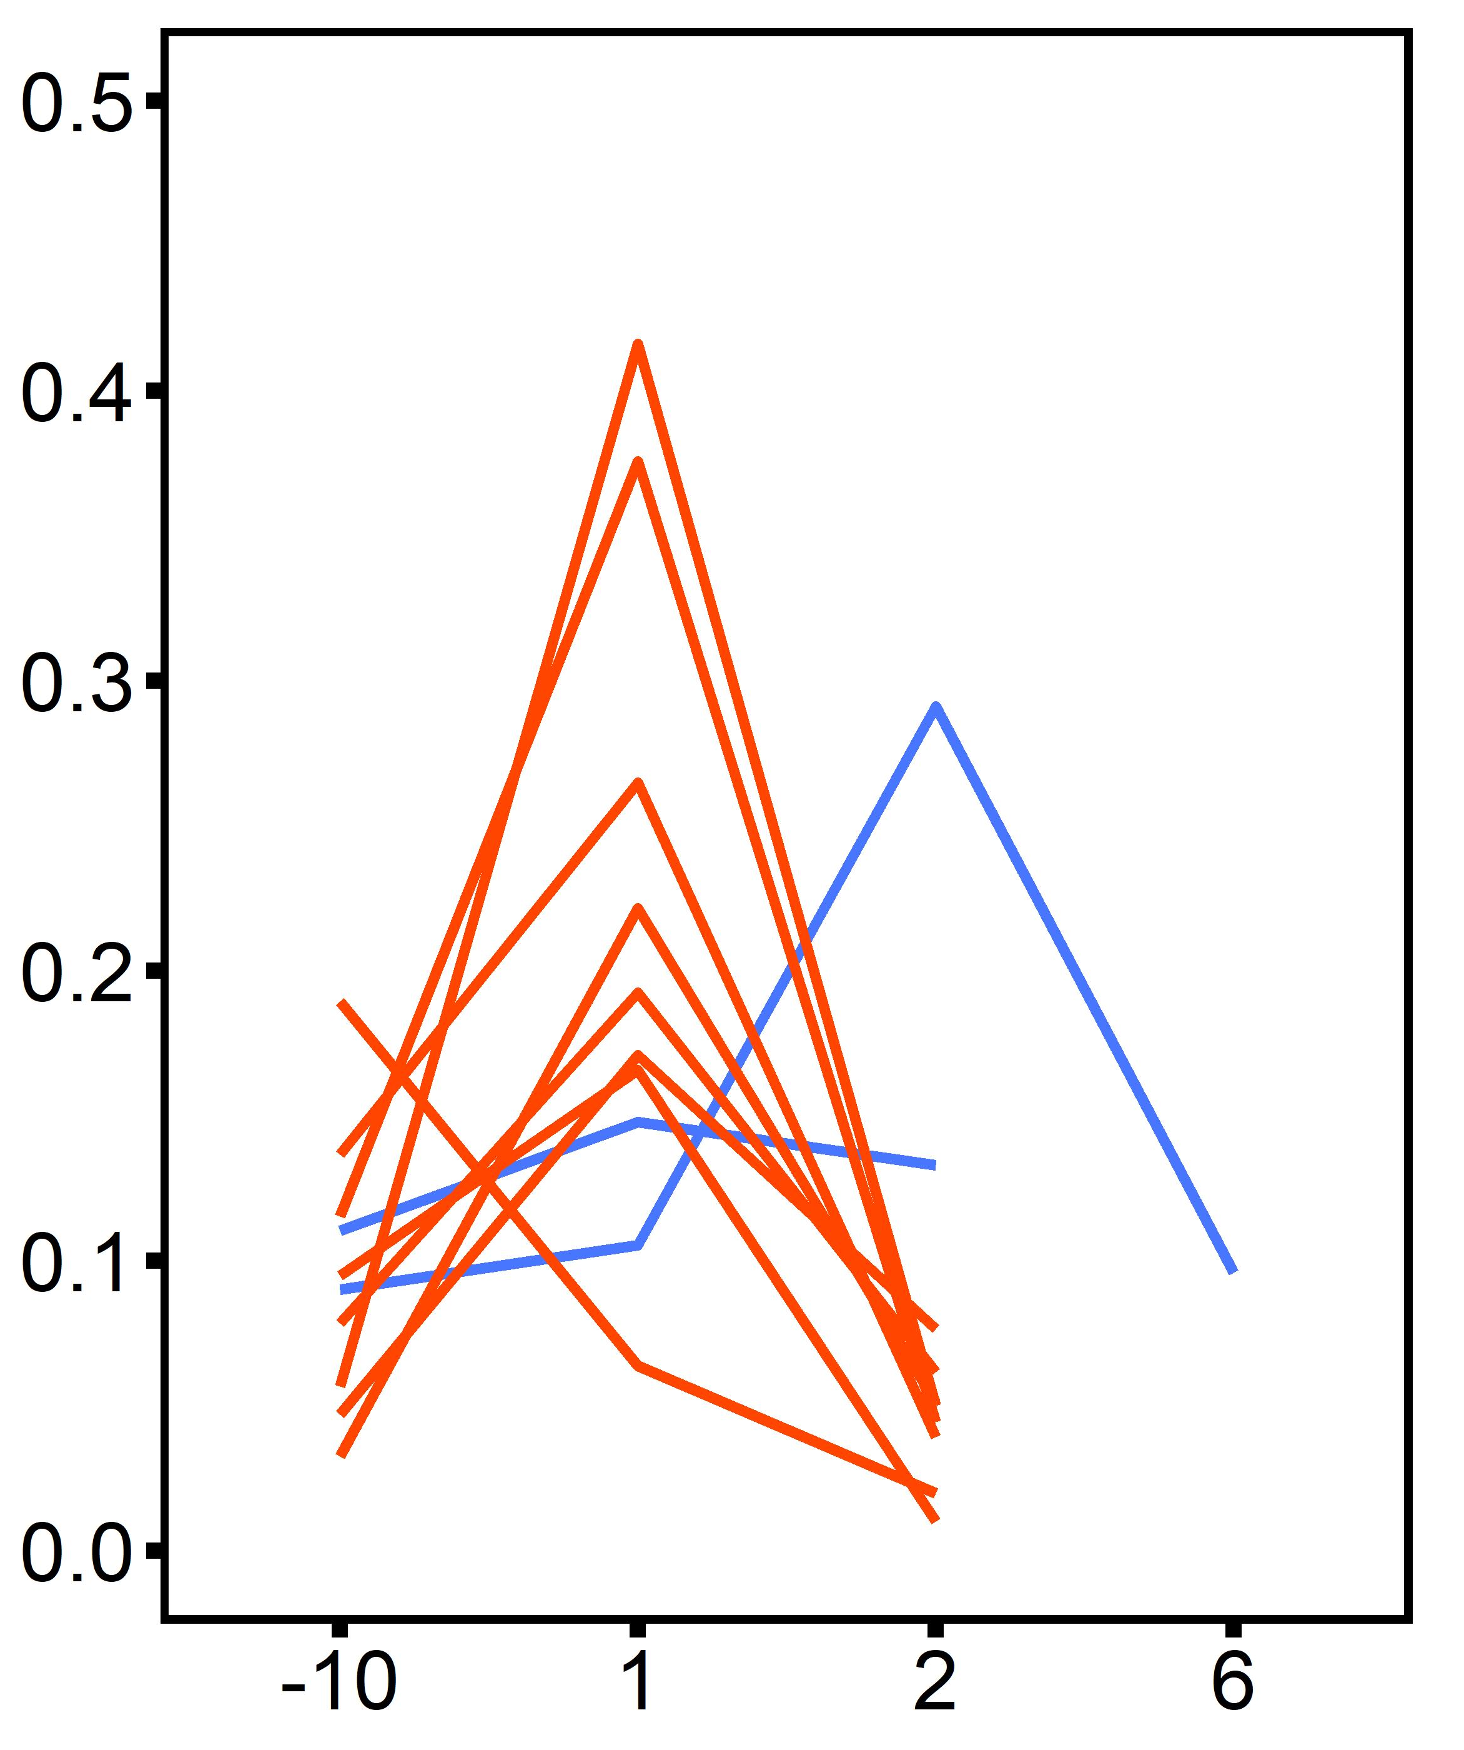
2°C d⁻¹ ramp
Desiccation @ 45°C for 4 hrs
20°C
30°C
30°C
All oysters
Oysters that died
SMR (mg O₂ h⁻¹ cm⁻³)
Timepoint

